Slide 1
Random Quotes Translated

Slide 2
Would you like to be able to practice your foreign language skills with an entertaining and quick webapp? Translating random quotes can do that.

Slide 3
Concept
Description:
A web app to generate random quotes and translate them into other languages
Motivation:
Is a fun way to learn bits of other languages or to satisfy curiosity
User story:
As a user
I want to see quotes in other languages
So that I can enjoy or study them

Slide 4
Process
Technologies used:
HTML, CSS, JavaScript, Jquerry, Tailwind, Microsoft Azure Translator, Random Quotes Generator API
Task breakdown:
Issue generated would be assigned every two days
Work would be split evenly based on what someone thought they could accomplish
Challenges:
The entire project was reworked five days before turn in
APIs proved to be difficult
Successes:
Taking the code from idea one and reworking it quickly

Slide 5
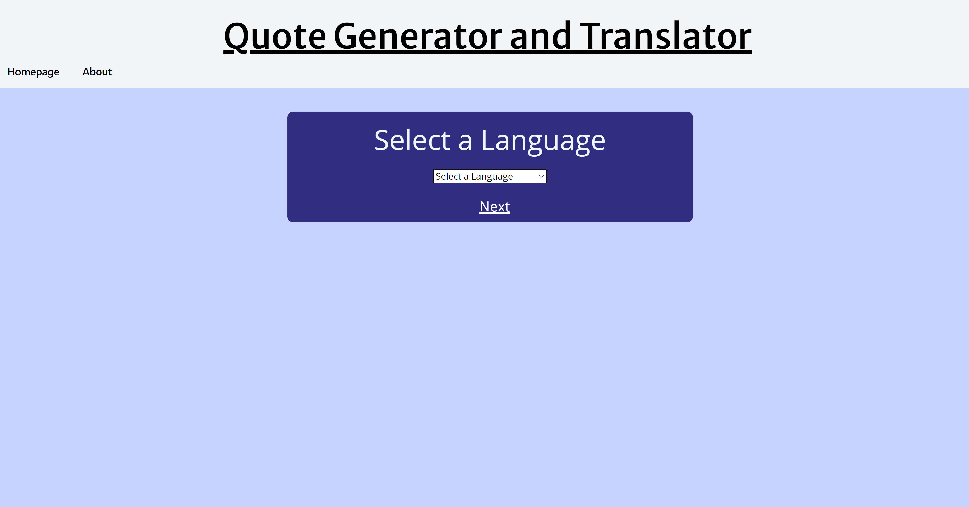

Slide 6
Directions for Future Development
Ability to save multiple quotes for later viewing
Approving a quote before translation
Reading the translation back to you
A larger quote database
Ability to take quotes from other languages besides English

Slide 7
Links
Deployed:
https://jacobjgoldfine.github.io/quote_gen_translator/
GitHub repo:
https://github.com/jacobjgoldfine/quote_gen_translator

