Slide 1

10/20
SPIRIT
WEEK
OCT 20–24
Mon: Pajama Day · Tue: Decades · Wed: Jersey
Day
Thu: Twin Day · Fri: Maroon & Cream
Notes:
Announcement: example

Slide 2

11/8
ACADEMIC TEAM
REGION
TOURNAMENT
Saturday, Nov 8 · Matches start at 9:00 AM
Come cheer on the team in the media center.
Notes:
Announcement: example-academic

Slide 3
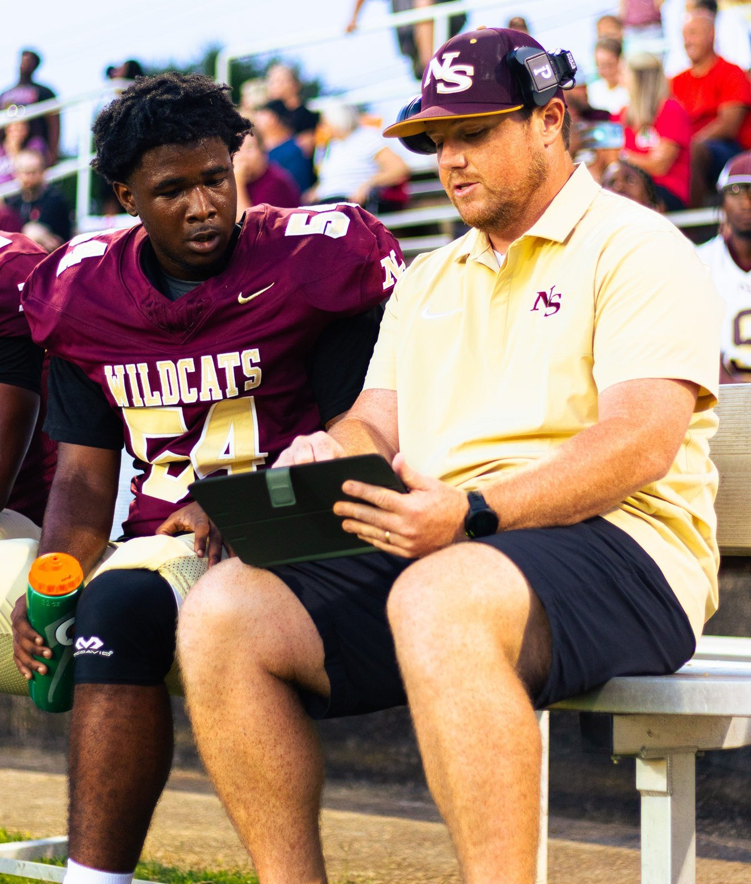

GAME PHOTOS
ARE UP
See the full gallery on the school website.
Notes:
Photo post: example

Slide 4
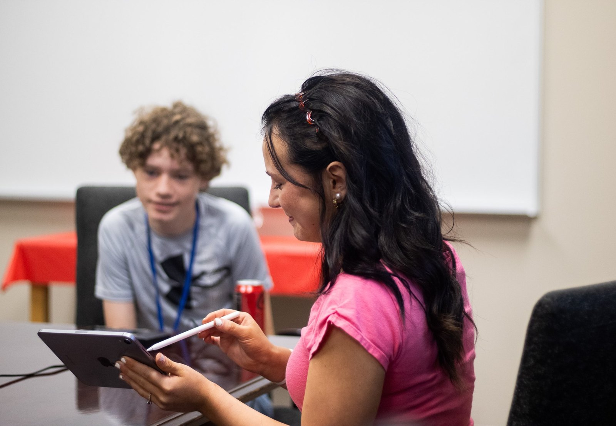

MEET THE
WEEKLY WILDCAT
STAFF
A new issue every Friday.
Notes:
Photo post: example-newspaper

Slide 5
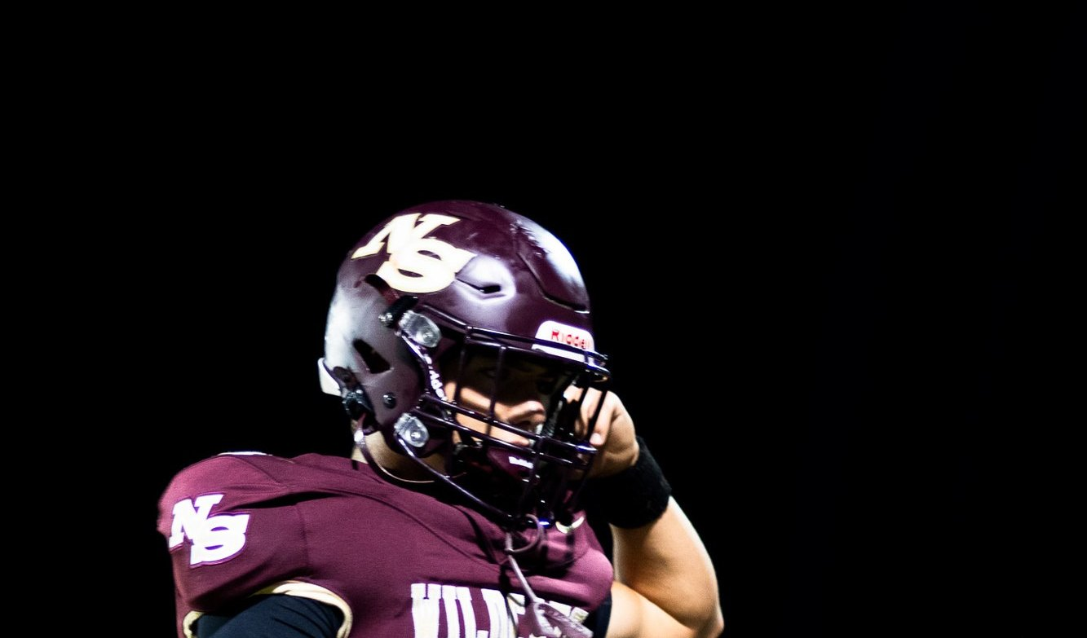
10/24
FRIDAY 7:30 PM
GAME DAY
VS. ABBEVILLE
Wilson Campbell Stadium
Notes:
Game or event: example

Slide 6
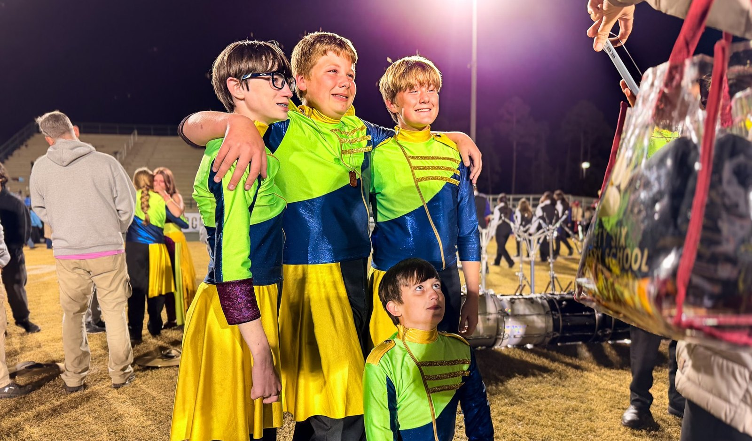

10/25
SATURDAY
COMPETITION
UPPER STATE
CHAMPIONSHIPS
Finals performance after 8:00 PM
Notes:
Game or event: example-band

Slide 7
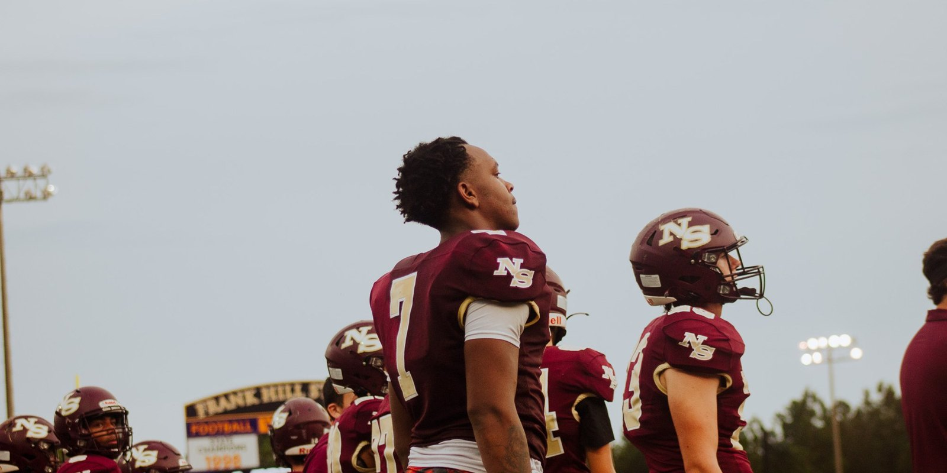
FINAL · WIN
28
14
WILDCATS
Abbeville
Region 1-2A · 6–1 overall
Notes:
Result: example

Slide 8
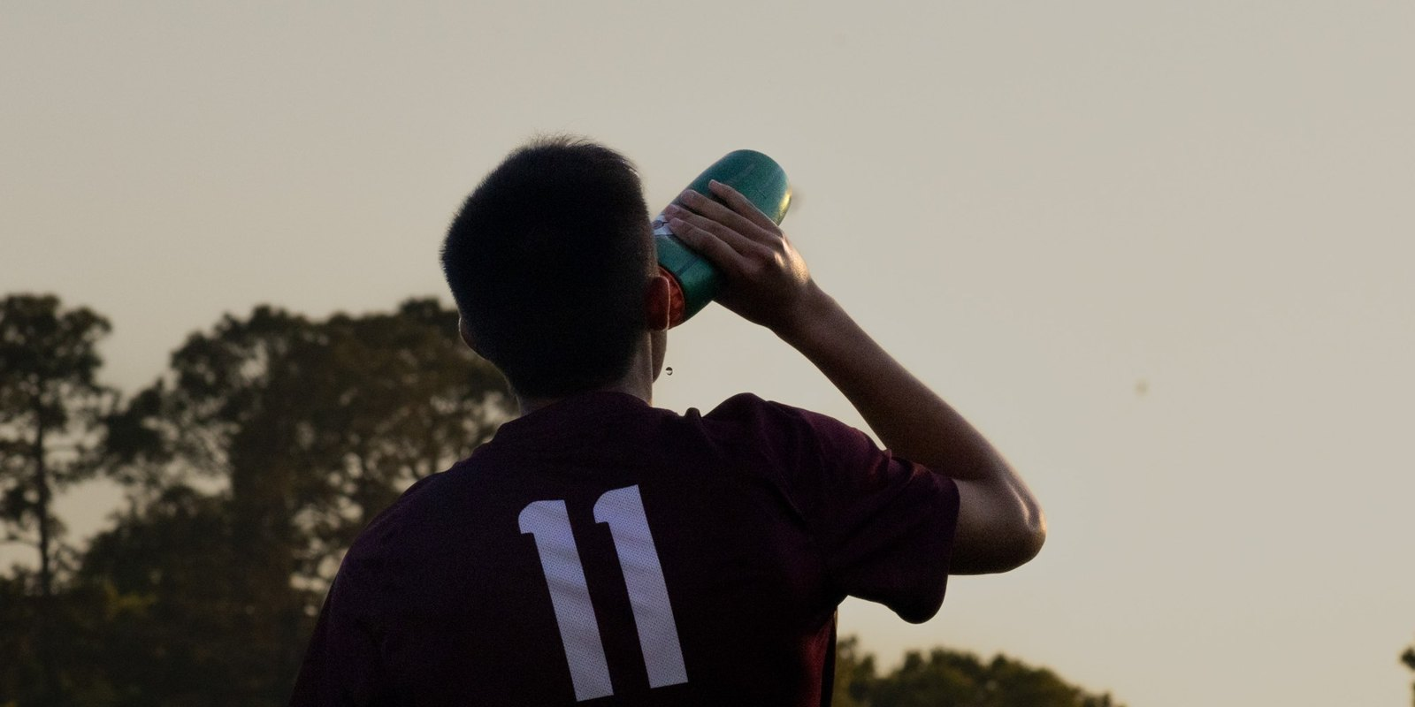

FINAL · WIN
3
1
WILDCATS
Saluda
Region 1-2A
Notes:
Result: example-soccer

Slide 9

FINAL · WIN
112
108
WILDCATS
McCormick
Final, 2OT
Notes:
Result: example-no-photo

Slide 10

2026 SCHEDULE
8/22
vs. Abbeville
7:30
8/29
at Westwood Christian Academy
7:00
9/5
vs. Saluda
7:30
9/12
at McCormick
7:30
9/19
vs. Greenwood Christian School
7:30
9/26
Open date
10/3
vs. Dixie (Homecoming)
7:30
10/10
at Region tournament, site TBA
TBA
Notes:
Schedule: example

