Slide 1
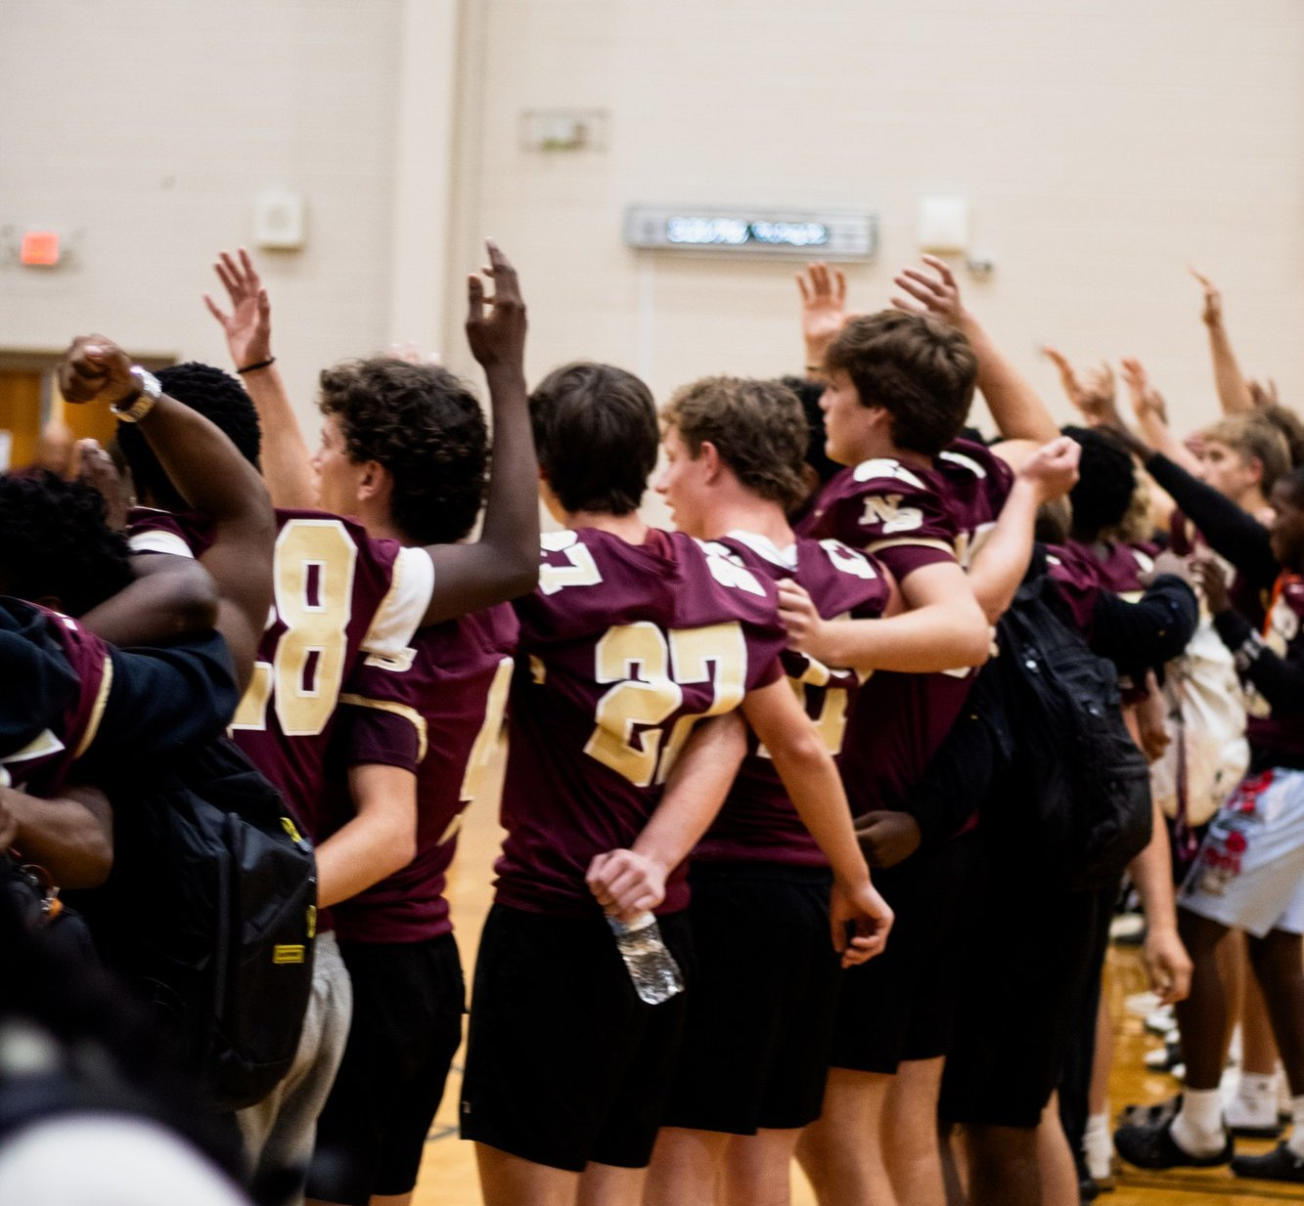

10/20
MONDAY
SPIRIT WEEK
PAJAMA DAY KICKS IT OFF
Full list of themes on the school website.
Notes:
Story: example

Slide 2
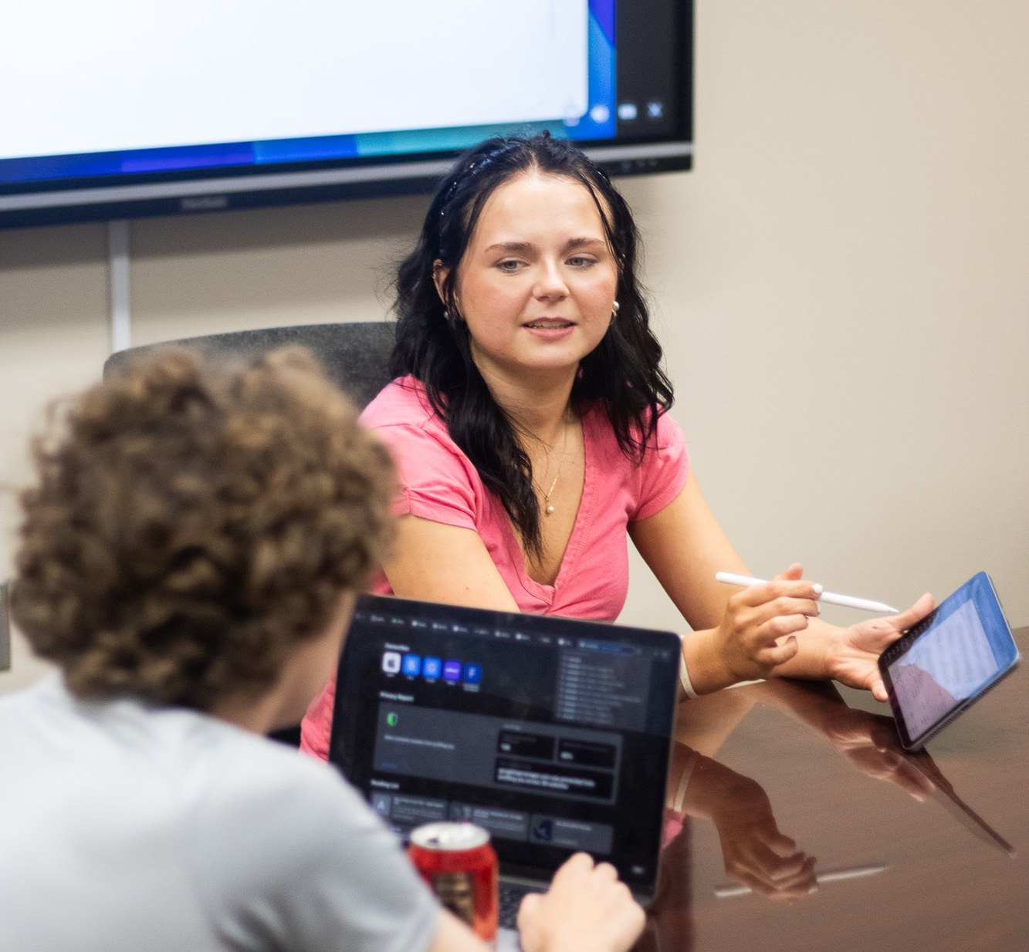

WEEKLY WILDCAT
WRITE FOR US
Staff meetings are Tuesdays after school.
Notes:
Story: example-newspaper

