Slide 1
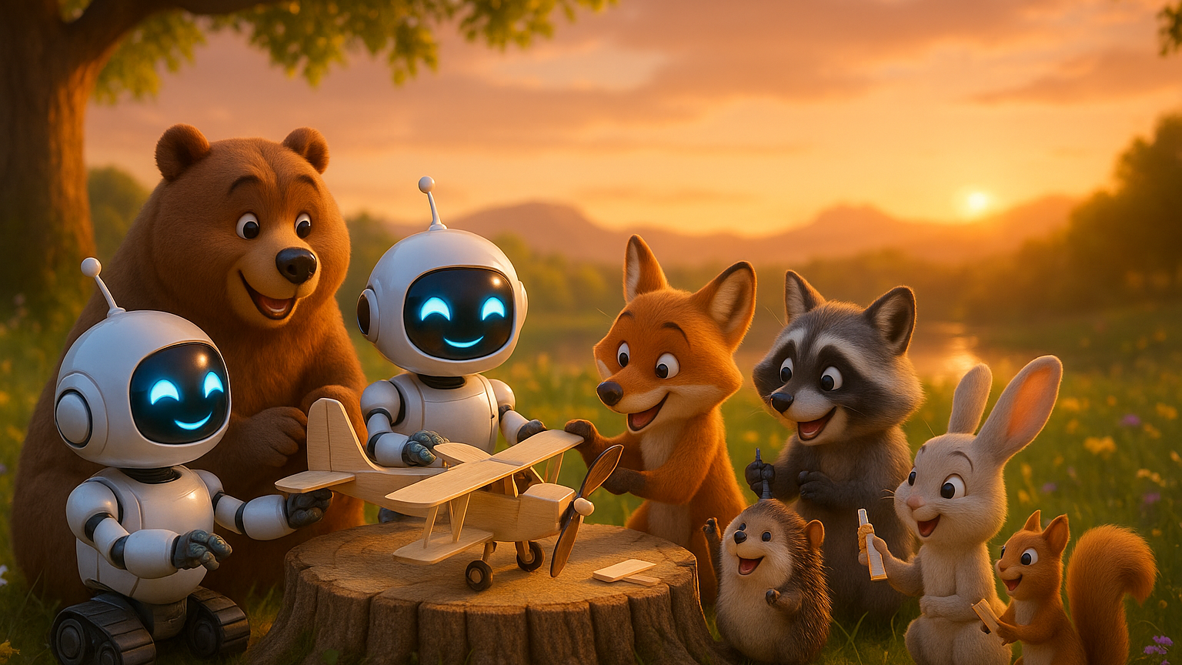
Section 2

Slide 2
Welcome back!

Slide 3
Intro Card
Interactive demo — runs on the web

Slide 4
Review

Slide 5

The most important thing to know about a random variable: its bars.
One bar per value, as tall as its chance. They add up to 1. (Officially: the probability mass function, PMF.)

Slide 6


Review: two random variables
Bernoulli
Binomial
One trial. 1 if it happens, 0 if not.
p is the chance it happens.
Does the penalty kick go in?
The number of successes in n independent trials, each with chance p.
Average: n × p.
Heads in 10 flips: Bin(10, ½).

Slide 7
A probabilistic model is a story with random variables that makes data.
Run it to make fake data. Count to answer questions. Multiply along the story for the chance of one outcome.

Slide 8
Let’s play a game...
Bernoulli, Binomial, or Neither?

Slide 9
Warm-up
Your favorite sports team plays 5 games.
WIN
WIN
LOSS
Bernoulli
One trial: 1 if it happens, 0 if not.
\textcolor{#75cefa}{X} \sim \text{Ber}(p)
Binomial
The number of successes in n independent trials.
\textcolor{#75cefa}{X} \sim \text{Bin}(n, p)
Neither
Any other random variable: not a yes-or-no trial, and not a count of successes.
game 1
game 2
game 3
X: how many wins?
LOSS
WIN
game 4
game 5
Editable Demo
Interactive demo — runs on the web

Slide 10
Warm-up
Weather forecast for tomorrow.
Editable Demo
Interactive demo — runs on the web
Bernoulli
One trial: 1 if it happens, 0 if not.
\textcolor{#75cefa}{X} \sim \text{Ber}(p)
Binomial
The number of successes in n independent trials.
\textcolor{#75cefa}{X} \sim \text{Bin}(n, p)
Neither
Any other random variable: not a yes-or-no trial, and not a count of successes.
X: does it rain?
Editable Demo
Interactive demo — runs on the web

Slide 11
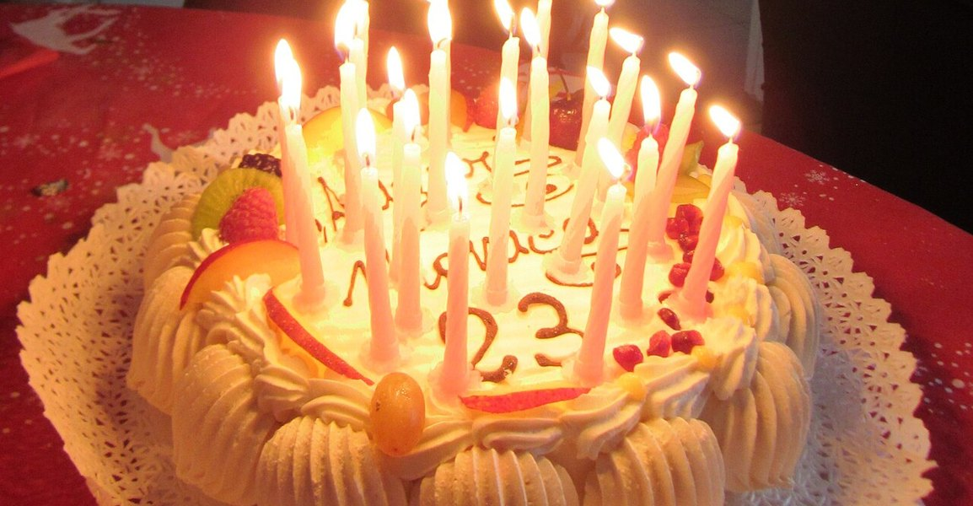
Tricky ones
You have 30 classmates.
Bernoulli
One trial: 1 if it happens, 0 if not.
\textcolor{#75cefa}{X} \sim \text{Ber}(p)
Binomial
The number of successes in n independent trials.
\textcolor{#75cefa}{X} \sim \text{Bin}(n, p)
Neither
Any other random variable: not a yes-or-no trial, and not a count of successes.
X: how many share your birthday?
Editable Demo
Interactive demo — runs on the web
Photo via Wikimedia Commons: Francesca Cesa Bianchi (CC BY-SA 3.0 IT)

Slide 12
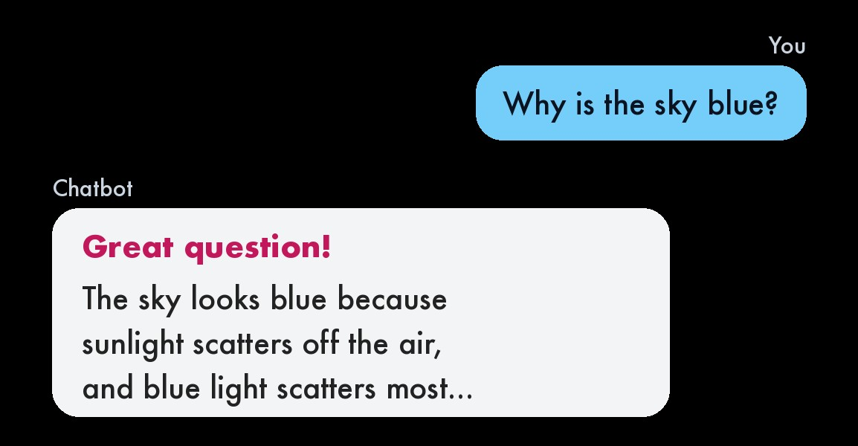
Tricky ones
You ask a chatbot a question.
X: does its reply start with “Great question!”?
Bernoulli
One trial: 1 if it happens, 0 if not.
\textcolor{#75cefa}{X} \sim \text{Ber}(p)
Binomial
The number of successes in n independent trials.
\textcolor{#75cefa}{X} \sim \text{Bin}(n, p)
Neither
Any other random variable: not a yes-or-no trial, and not a count of successes.
Editable Demo
Interactive demo — runs on the web

Slide 13
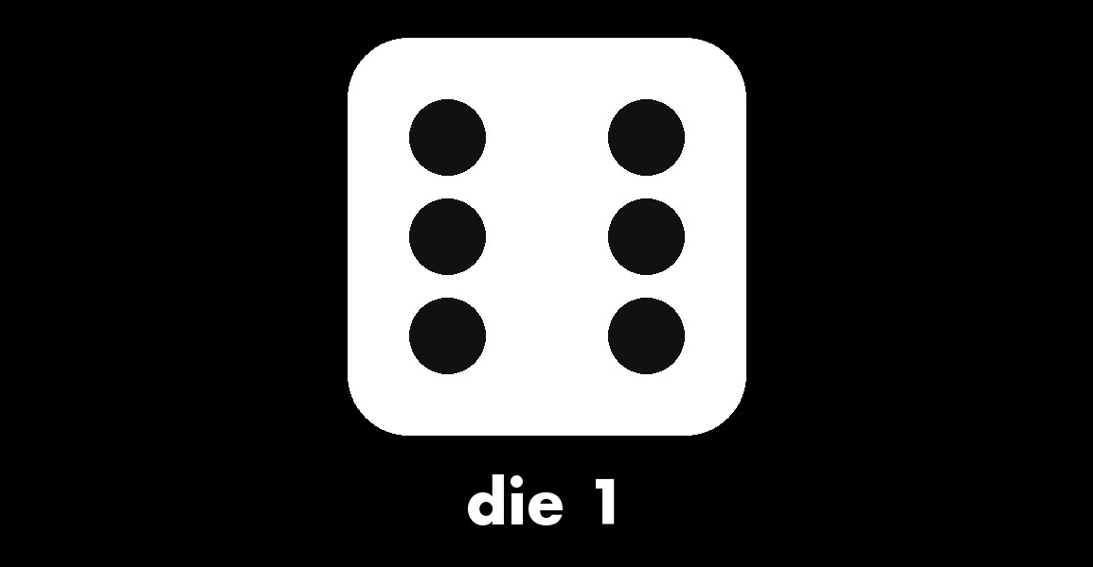
Tricky ones
Roll one die.
Bernoulli
One trial: 1 if it happens, 0 if not.
\textcolor{#75cefa}{X} \sim \text{Ber}(p)
Binomial
The number of successes in n independent trials.
\textcolor{#75cefa}{X} \sim \text{Bin}(n, p)
Neither
Any other random variable: not a yes-or-no trial, and not a count of successes.
X: the number it shows
Editable Demo
Interactive demo — runs on the web
Die drawn for this deck.

Slide 14
End Review

Slide 15
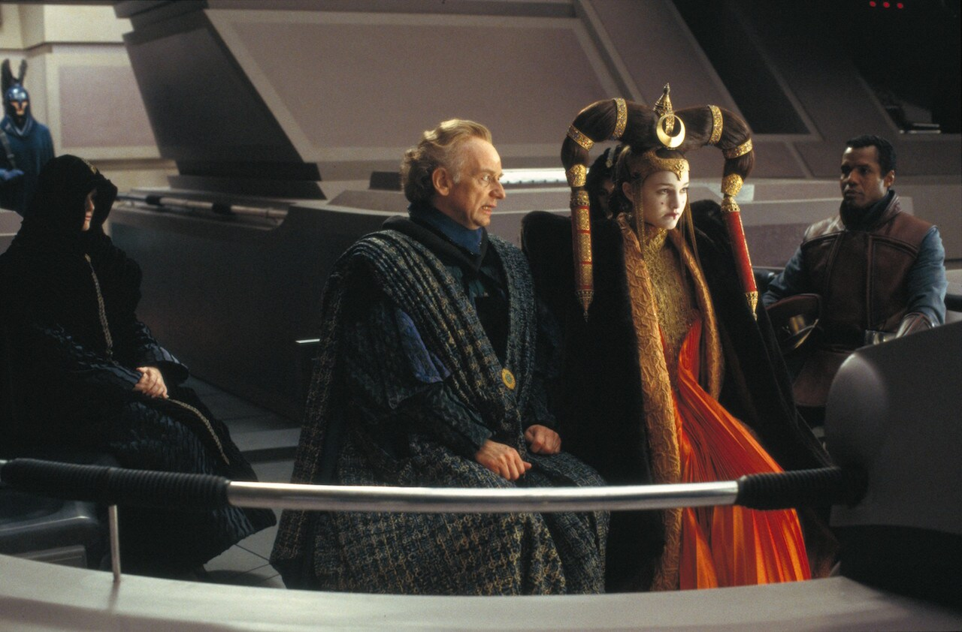
This is Emperor Palpatine

Slide 16
This is Emperor Palpatine
He’s a bad guy in the Star Wars universe.

Slide 17
This is Emperor Palpatine
He’s a bad guy in the Star Wars universe.
How many people hate him?

Slide 18
This is Emperor Palpatine
He’s a bad guy in the Star Wars universe.
How many people hate him?
We don’t know. It is hard to poll.

Slide 19
This is Emperor Palpatine
He’s a bad guy in the Star Wars universe.
How many people hate him?
We don’t know. It is hard to poll.
He kills people who tell pollsters they don’t like him

Slide 20
?
How many people support Palpatine?

Slide 21
?
How many people support Palpatine?
In Star Wars, Palpatine rules the galaxy. Nobody answers that question honestly.

Slide 22
The trick: hide the question in a list
1. Do you like surprises?
2. Do you like the beach more than the mountains?
3. Do you like paper books more than e-books?
4. Would you rather have more time than more money?
5. Do you like holidays at home more than abroad?

Slide 23
The trick: hide the question in a list
1. Do you like surprises?
2. Do you like the beach more than the mountains?
3. Do you like paper books more than e-books?
4. Would you rather have more time than more money?
5. Do you like holidays at home more than abroad?
6. Do you support Palpatine?

Slide 24
The trick: hide the question in a list
1. Do you like surprises?
2. Do you like the beach more than the mountains?
3
3. Do you like paper books more than e-books?
4. Would you rather have more time than more money?
5. Do you like holidays at home more than abroad?
6. Do you support Palpatine?
Say how many are yes. Not which ones.

Slide 25
The trick: hide the question in a list
1. Do you like surprises?
2. Do you like the beach more than the mountains?
3
3. Do you like paper books more than e-books?
4. Would you rather have more time than more money?
5. Do you like holidays at home more than abroad?
6. Do you support Palpatine?
Say how many are yes. Not which ones.
Five harmless questions, each about 50/50. Your answer is just a number.

Slide 26
This trick is real
Vietnam, 2023: researchers hid a question about cheating with ChatGPT in a list like this one.
Nguyen and Goto, “Unmasking academic cheating behavior in the artificial intelligence era”, Education and Information Technologies 29 (2024): 9.6% said yes when asked directly; the list experiment gave 23.7%.

Slide 27
This trick is real
Vietnam, 2023: researchers hid a question about cheating with ChatGPT in a list like this one.
Asked directly, 1 in 10 said yes. The “trick” said about 1 in 4.
Nguyen and Goto, “Unmasking academic cheating behavior in the artificial intelligence era”, Education and Information Technologies 29 (2024): 9.6% said yes when asked directly; the list experiment gave 23.7%.

Slide 28
Warm-up: the five harmless questions
One person answers the five harmless questions. Each is 50/50.
How many of the five do they say yes to?

Slide 29
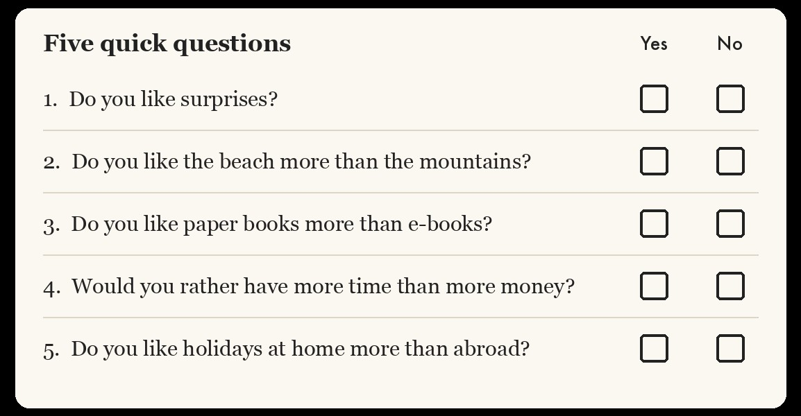
Warm-up: the five harmless questions
Bernoulli
One trial: 1 if it happens, 0 if not.
\textcolor{#75cefa}{X} \sim \text{Ber}(p)
Binomial
The number of successes in n independent trials.
\textcolor{#75cefa}{X} \sim \text{Bin}(n, p)
Neither
Any other random variable: not a yes-or-no trial, and not a count of successes.
X: how many yeses?
Editable Demo
Interactive demo — runs on the web

Slide 30
Warm-up: the five harmless questions
One person answers the five harmless questions. Each is 50/50.
How many of the five do they say yes to?

Slide 31
Warm-up: the five harmless questions
One person answers the five harmless questions. Each is 50/50.
How many of the five do they say yes to?
Let H be the number of yesses to the harmless questions

Slide 32
Warm-up: the five harmless questions
One person answers the five harmless questions. Each is 50/50.
How many of the five do they say yes to?
Let H be the number of yesses to the harmless questions
Binomial Calculator
Interactive demo — runs on the web

Slide 33
Warm-up: the five harmless questions
One person answers the five harmless questions. Each is 50/50.
How many of the five do they say yes to?
Galton Board Demo
Interactive demo — runs on the web
0
1
2
3
4
5
harmless yeses

Slide 34
Warm-up: the five harmless questions
One person answers the five harmless questions. Each is 50/50.
How many of the five do they say yes to?
Galton Board Demo
Interactive demo — runs on the web
0
1
2
3
4
5
harmless yeses

Slide 35
Warm-up: the five harmless questions
One person answers the five harmless questions. Each is 50/50.
How many of the five do they say yes to?
Galton Board Demo
Interactive demo — runs on the web
0
1
2
3
4
5
harmless yeses

Slide 36
Your Turn

Slide 37
Today's task: find the hidden support

Slide 38
Today's task: find the hidden support
1
Tell the story of one answer: what is random, and what is not.

Slide 39
Today's task: find the hidden support
1
Tell the story of one answer: what is random, and what is not.
2
Run the story. Do 1,000 of its answers look like the real ones?

Slide 40
Today's task: find the hidden support
1
Tell the story of one answer: what is random, and what is not.
2
Run the story. Do 1,000 of its answers look like the real ones?
3
Answer the question: how many people really support Palpatine?

Slide 41
How would you model this?
1. Do you like surprises?
2. Do you like the beach more than the mountains?
3
3. Do you like paper books more than e-books?
4. Would you rather have more time than more money?
5. Do you like holidays at home more than abroad?
6. Do you support Palpatine?
Say how many are yes. Not which ones.
Five harmless questions, each about 50/50. Your answer is just a number.

Slide 42
Live Assignment
Interactive demo — runs on the web

Slide 43
Live Assignment
Interactive demo — runs on the web

Slide 44
Live Assignment
Interactive demo — runs on the web

Slide 45
Live Assignment
Interactive demo — runs on the web

Slide 46
Live Assignment
Interactive demo — runs on the web

Slide 47
Live Assignment
Interactive demo — runs on the web

Slide 48
Live Assignment
Interactive demo — runs on the web

Slide 49
Live Assignment
Interactive demo — runs on the web

Slide 50
[if extra time]

Slide 51
Question: Is anyone's secret out?
Solution:

Slide 52
Question: Is anyone's secret out?
Solution:
An answer of 6 means yes to everything, Palpatine too.

Slide 53

Question: Is anyone's secret out?
Solution:
An answer of 6 means yes to everything, Palpatine too.
(½)⁵ means ½ multiplied by itself 5 times: ½ × ½ × ½ × ½ × ½ = 1/32.

Slide 54
Question: Is anyone's secret out?
Solution:
An answer of 6 means yes to everything, Palpatine too.
(½)⁵ means ½ multiplied by itself 5 times: ½ × ½ × ½ × ½ × ½ = 1/32.
About 3 people in 1,000 give themselves away.

Slide 55
Question: Is anyone's secret out?
Solution:
An answer of 6 means yes to everything, Palpatine too.
(½)⁵ means ½ multiplied by itself 5 times: ½ × ½ × ½ × ½ × ½ = 1/32.
About 3 people in 1,000 give themselves away.
How would you protect them?

Slide 56
Question: Is anyone's secret out?
Solution:

Slide 57
Question: Is anyone's secret out?
Solution:
An answer of 0 means no to everything, Palpatine too: the dangerous answer.

Slide 58

Question: Is anyone's secret out?
Solution:
An answer of 0 means no to everything, Palpatine too: the dangerous answer.
(½)⁵ means ½ multiplied by itself 5 times: ½ × ½ × ½ × ½ × ½ = 1/32.

Slide 59
Question: Is anyone's secret out?
Solution:
An answer of 0 means no to everything, Palpatine too: the dangerous answer.
(½)⁵ means ½ multiplied by itself 5 times: ½ × ½ × ½ × ½ × ½ = 1/32.
About 28 people in 1,000 would give themselves away.

Slide 60
Question: Is anyone's secret out?
Solution:
An answer of 0 means no to everything, Palpatine too: the dangerous answer.
(½)⁵ means ½ multiplied by itself 5 times: ½ × ½ × ½ × ½ × ½ = 1/32.
About 28 people in 1,000 would give themselves away.
How would you protect them?

Slide 61
What if the harmless questions are too easy?
Now almost everyone says yes to each harmless question: 9 in 10.
Galton Board Demo
Interactive demo — runs on the web
Where do the five harmless answers land?
0
1
2
3
4
5
harmless yeses

Slide 62
What if the harmless questions are too easy?
Now almost everyone says yes to each harmless question: 9 in 10.
Galton Board Demo
Interactive demo — runs on the web
Where do the five harmless answers land?
0
1
2
3
4
5
harmless yeses

Slide 63
What if the harmless questions are too easy?
Now almost everyone says yes to each harmless question: 9 in 10.
Galton Board Demo
Interactive demo — runs on the web
Where do the five harmless answers land?
Binomial Calculator
Interactive demo — runs on the web
Most people say 4 or 5. Add a supporter's secret yes, and a 6 is common.
0
1
2
3
4
5
harmless yeses

Slide 64
What if the harmless questions are too easy?
Now almost everyone says yes to each harmless question: 9 in 10.
Galton Board Demo
Interactive demo — runs on the web
Where do the five harmless answers land?
Binomial Calculator
Interactive demo — runs on the web
Most people say 4 or 5. Add a supporter's secret yes, and a 6 is common.
About 5 in 100 answers give someone away.
0
1
2
3
4
5
harmless yeses

Slide 65
What if the harmless questions are too easy?
Now almost everyone says yes to each harmless question: 9 in 10.
Galton Board Demo
Interactive demo — runs on the web
Where do the five harmless answers land?
Binomial Calculator
Interactive demo — runs on the web
Most people say 4 or 5. Add a supporter's secret yes, and a 6 is common.
About 5 in 100 answers give someone away.
Pick harmless questions near 50/50.
0
1
2
3
4
5
harmless yeses

Slide 66
[Build the model from scratch]
Warning: This feature is in Beta

Slide 67
Live Assignment
Interactive demo — runs on the web

