Slide 1
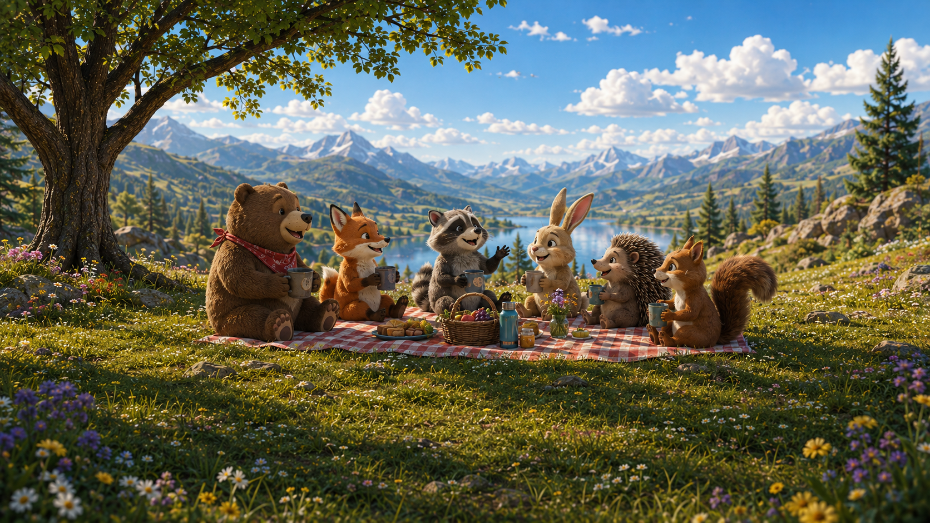
Section 1

Slide 2
Let’s get to know each other!

Slide 3
Intro Card
Interactive demo — runs on the web

Slide 4
Review

Slide 5



Review from Lecture:
not
or
and

Slide 6


not
Many times it is easier to calculate \P(E^c).

Slide 7


Rolling a die:
Event E: Rolling a 4.
Complement of E: NOT rolling a 4.

Slide 8

or

Slide 9
or
Mutually Exclusive?

Slide 10
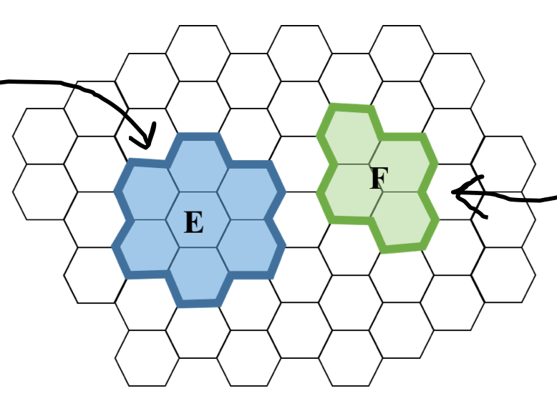
or
Mutually Exclusive?

Slide 11
or
Mutually Exclusive?
yes

Slide 12
or
Mutually Exclusive?
yes

Slide 13

or
Mutually Exclusive?
yes

Slide 14
or
Mutually Exclusive?
yes
no

Slide 15
or
Mutually Exclusive?
yes
no

Slide 16

or
Mutually Exclusive?
yes
no

Slide 17


Rolling a die (mutually exclusive example):
Event E: Rolling a 4.
Event F: Rolling an odd number.
Rolling a die (not mutually exclusive exmaple):
Event E: Rolling a 4.
Event F: Rolling an even number.

Slide 18

and

Slide 19
and
Independent?

Slide 20

and
Independent?

Slide 21
and
Independent?
yes

Slide 22
and
Independent?
yes

Slide 23

and
Independent?
yes

Slide 24
and
Independent?
yes
no

Slide 25
and
Independent?
yes
no

Slide 26
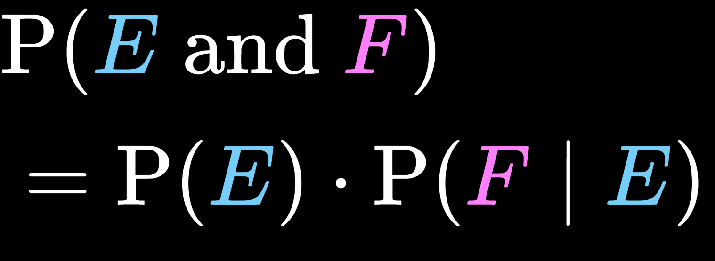
and
Independent?
yes
no

Slide 27



Rolling two dies (independent example):
Event E: Get a 6 for the first roll.
Event F: Get a 6 for the second roll.
Rolling two dies (not independent example):
Event E: Get a 6 for the first roll.
Event F: Two rolls sum up to 2.

Slide 28
End Review

Slide 29
If I give a large language model the exact same prompt twice, should I expect the exact same answer? Is this a feature or a bug?

Slide 30
Consider this Toy Model and the prompt:
A sleepy robot dreams about
LLM Demo
Interactive demo — runs on the web

Slide 31

Question: If prompted twice, what is the probability the model produces two different outputs?
Table: all possible outputs
 | Output | Probability, p_i
1 | electric sheep | 0.44
2 | counting stars | 0.20
3 | sample spaces | 0.14
4 | counting outcomes | 0.13
5 | robot puppies | 0.09

Slide 32
Question: If prompted twice, what is the probability the model produces two different outputs?
Table: all possible outputs
 | Output | Probability, p_i
1 | electric sheep | 0.44
2 | counting stars | 0.20
3 | sample spaces | 0.14
4 | counting outcomes | 0.13
5 | robot puppies | 0.09
p_4

Slide 33
Question: If prompted twice, what is the probability the model produces two different outputs?
Table: all possible outputs
 | Output | Probability, p_i
1 | electric sheep | 0.44
2 | counting stars | 0.20
3 | sample spaces | 0.14
4 | counting outcomes | 0.13
5 | robot puppies | 0.09
p_4

Slide 34
Question: If prompted twice, what is the probability the model produces two different outputs?
Solution:

Slide 35
Question: If prompted twice, what is the probability the model produces two different outputs?
Solution:
Let E be the event that both calls produce the same output

Slide 36
Question: If prompted twice, what is the probability the model produces two different outputs?
Solution:
Let E be the event that both calls produce the same output
Let B_i be the event that both calls produce output i.

Slide 37

Question: If prompted twice, what is the probability the model produces two different outputs?
Solution:
Let E be the event that both calls produce the same output
Let B_i be the event that both calls produce output i.

Slide 38

Question: If prompted twice, what is the probability the model produces two different outputs?
Solution:
Let E be the event that both calls produce the same output
Let B_i be the event that both calls produce output i.

Slide 39

Question: If prompted twice, what is the probability the model produces two different outputs?
Solution:
Let E be the event that both calls produce the same output
Let B_i be the event that both calls produce output i.

Slide 40
Question: If prompted twice, what is the probability the model produces two different outputs?
Solution:
Let E be the event that both calls produce the same output
Let B_i be the event that both calls produce output i.

Slide 41
Question: If prompted twice, what is the probability the model produces two different outputs?
Solution:
Let E be the event that both calls produce the same output
Let B_i be the event that both calls produce output i.

Slide 42

Question: If prompted twice, what is the probability the model produces two different outputs?
Solution:
Let E be the event that both calls produce the same output
Let B_i be the event that both calls produce output i.

Slide 43

Question: If prompted twice, what is the probability the model produces two different outputs?
Solution:
Let E be the event that both calls produce the same output
Let B_i be the event that both calls produce output i.

Slide 44

Question: If prompted twice, what is the probability the model produces two different outputs?
Solution:
Let E be the event that both calls produce the same output
Let B_i be the event that both calls produce output i.

Slide 45

Question: If prompted twice, what is the probability the model produces two different outputs?
Solution:
Let E be the event that both calls produce the same output
Let B_i be the event that both calls produce output i.

Slide 46

Question: If prompted twice, what is the probability the model produces two different outputs?
Solution:
Let E be the event that both calls produce the same output
Let B_i be the event that both calls produce output i.

