Slide 1
Monitoring design changes
Web UX Research & Design
Winter 2026

Slide 2
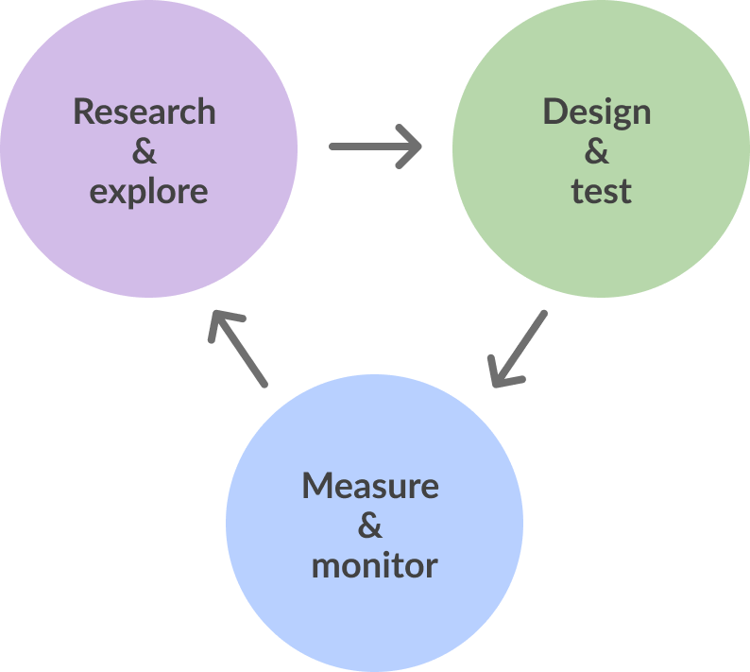
Continuous improvement cycle
We’re focusing on the Measure & monitor phase of the continuous improvement cycle.
This is the final step in the cycle! Today we’ll learn about the importance of monitoring new designs once they go live. Topics today:
What is a monitoring plan
Monitoring for small designs
For medium designs
And for large designs
You can also find resources and template for today in the Appendix

Slide 3
Overview of rollout; monitoring; reacting; reporting
What is a monitoring plan?

Slide 4
Five key aspects: Risk, rollout, monitor, react, report
Rollout
Monitor
React
Report
Impact
Impact: What’s the impact of the change? Risks? Visibility?
Rollout: How you’re going to launch the new changes
Monitor: How you’ll measure performance once live
React: What you’ll do based on the monitor data
Report: Who you’ll tell about the monitoring
Guidance for monitoring & workshop template:
Templates available in the Appendix: small design = one pager with checklist
Medium = 2 page with checklist and reporting examples
Large = 3 pager with checklists, monitoring template, reporting template

Slide 5
How big is this design change? What are the risks?
Impact & risk

Slide 6
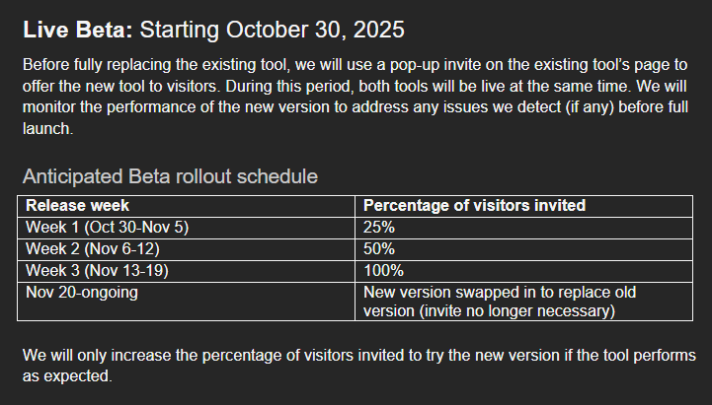
Impact: What will this change for users? What risks are present?
Impact: What we hope to achieve for users
Tweaking words or a few changes on a page usually doesn’t require a full rollout plan – just go live and monitor.
Risks: What might go wrong
Phased launch? Live beta? All live at once? What pages?
From: Visa Tool Rollout & Monitoring Plan
From: Visa Tool Rollout & Monitoring Plan
Notes:
We won’t spend too much time discussing rollout – you are all familiar with launching content!

Slide 7
“Size” of design isn’t the same as impact/risk
Small changes can make major differences
E.g. changing text from “visa” to “permit” could drastically change search results, findability, etc.
Large changes might not change much for users
Lift + shift
From: Visa Tool Rollout & Monitoring Plan
From: Visa Tool Rollout & Monitoring Plan
Notes:
We won’t spend too much time discussing rollout – you are all familiar with launching content!

Slide 8
Impact/Risks determine the rest of your monitoring plan
Impact/Risk
Low
Medium
High
Go live!
No plan – just check data 2-3 times post-launch
Ad hoc reactions
Verbal reporting, if any
Consider a Live Beta phase
Robust monitoring plan, multiple data sources and frequent checks
Ad hoc reactions
Email reporting
Phased rollout, not all at once
Robust monitoring plan, multiple data sources and frequent checks
Pre-planned reactions to various possible outcomes
Formal regular performance reports
There is no one-size-fits-all approach! Assess the risks and develop a monitoring plan tailored to the situation
Notes:
We won’t spend too much time discussing rollout – you are all familiar with launching content!

Slide 9
How are we going to launch this design?
Rollout

Slide 10
Rollout: How you’re going to launch a new design
Less important for small and medium design work
Tweaking words or a few changes on a page usually doesn’t require a full rollout plan – just go live and monitor.
Critical for large changes, new tools (e.g. Program Finder)
Phased launch? Live beta? All live at once? What pages?
Key message: Consider phased launches for large changes or novel content. Use monitoring data to determine when to move from one phase to the next
From: Visa Tool Rollout & Monitoring Plan
Notes:
We won’t spend too much time discussing rollout – you are all familiar with launching content!

Slide 11
As you design: Explicit rollout plan
✓ Pre-launch
📋 Pre-launch checklist:
All links working and tested?
Content reviewed and approved?
Monitoring plan documented?
Calendar reminders set?
How will you launch this new large design?
You can “ramp up” the launch in a variety of ways, e.g.:
Promotional Features
Most Requested
Indexing/Deindexing
Promotion via Social Media team
Recommended: Gradual increase in visibility, e.g.:
Phase 1: Link to new content from just 1 page
Phase 2: Link from 5 pages
Phase 3: Full cross-linkage and indexing
Important: Be explicit about when you’ll move from one phase to the next using data.
E.g. “We’ll move to Phase 2 after 4 weeks of no issues detected in our monitoring”

Slide 12
Pre-launch: Check everything
Go live then start to monitor
Set yourself some calendar reminders to monitor at key intervals:
3 days post-launch; 2 weeks; 1 month
Each interval, look at data sources you selected and look for evidence of issues
🚀 Go live
Launch day checklist:
Design is live — start the clock!
Notify stakeholders
Check data sources within first 24h
Document baseline metrics
Interpret your data sources to figure out what’s happening.
Unsure how? Check out Rapid Research

Slide 13
Launch according to rollout plan
Go live then start to monitor
Set yourself some calendar reminders to monitor at key intervals:
3 days post-launch; 2 weeks; 1 month
Each interval, look at data sources you selected and look for evidence of issues
visual
Interpret your data sources to figure out what’s happening.
Unsure how? Check out Rapid Research

Slide 14
What data will we check? How frequently?
Monitoring

Slide 15
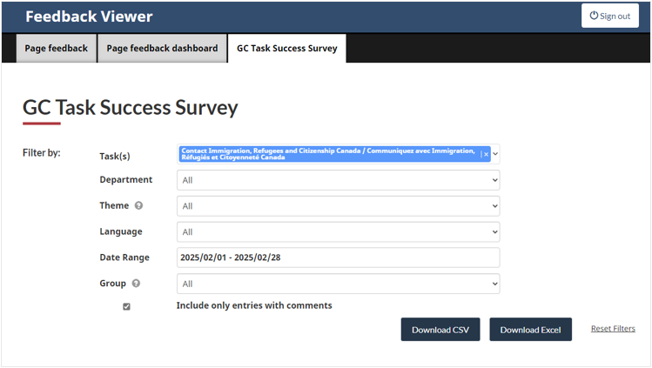
As you design: Determine KPIs and data sources
What does success look like, and how will you measure it?
Small design changes often hard to measure impact
Instead, look for stability, e.g.
Decrease or stable CSC call volumes for this LoB
Decrease or stable PFT “no” clicks
Increase or stable analytics for Apply Now button
Identify 2-3 data sources that you’ll monitor
Sometimes just checking the PFT or TSS will be all you need!

Slide 16
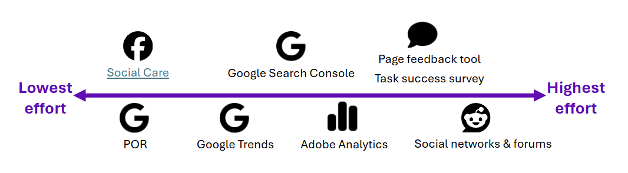
Monitor: How you’ll measure performance once live
Pick your KPIs – what does success look like?
Improved client satisfaction? Increased self-serve?
Choose data sources – how will you measure success?
Can use existing data sources, and/or new ones (e.g. custom survey)
Interpret data – do you need to React?
Does data suggest an issue? E.g. broken links, unclear text, poor IA, findability issues
No issues? Keep monitoring until end of monitoring plan
Interpret your data sources to figure out what’s happening.
Unsure how? Check out Rapid Research

Slide 17
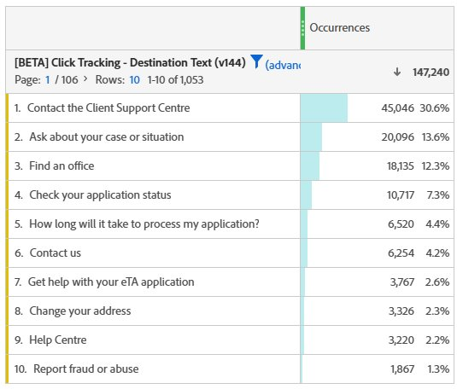
Launch & monitor
Go live then start to monitor
Set yourself calendar reminders to monitor in intervals
Recommended: 3 days post-launch; 2 weeks; 1 month
Each interval, look at data sources you selected and look for evidence of issues
After the last interval, you’re done!
Interpret your data sources to figure out what’s happening.
Unsure how? Check out Rapid Research
Analytics can help indicate if the new design is working or not

Slide 18
Monitoring data suggests a problem – what do we do?
React

Slide 19
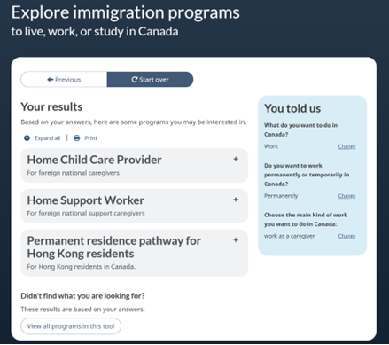
React: What you’ll do based on the monitor data
For small/medium designs: ad hoc data-based reaction
KPIs improving/stable? Do nothing
Things getting worse? Tweak or rollback changes
Large designs: Explicit reaction plans for different outcomes
What will you do if the design:
Has usability issues? Negative client feedback? Problems with AI search tools?
If no issues, at what point do you transition to next phase of launch?
From: Program Finder Phase 2 summary report
Monitoring revealed that our results page was too long – we reacted by merging individual program streams into 1 result instead of separate results for each stream
Notes:
We won’t spend too much time discussing rollout – you are all familiar with launching content!

Slide 20
React: Detecting an issue & assessing risk
Step 1: Notice something is off
KPI trending in wrong direction (e.g. PFT “no” clicks rising)
Spike in negative user comments or CSC call volume
Unexpected drop in page traffic or task completion
Step 2: Assess the severity
Is it a blip, or a sustained trend? Look at 2+ data sources before acting
High risk design? Escalate quickly. Low risk? Monitor for one more interval first
📊 Tip: Cross-check
Don’t react to a single data point. Confirm the issue in at least two sources before making changes.
Activity: Identify KPIs

Slide 21
React: Tweak or rollback
Tweak: Make targeted fixes
Fix broken links, adjust confusing headings, clarify CTAs
After tweaking, reset your monitoring clock and observe again
Rollback: Undo the change entirely
Used when the issue is severe and a quick fix isn’t possible
For large designs: your pre-planned if/then reactions guide this decision
⚠ When to rollback
If a tweak won’t solve the root problem, a full rollback protects users while you rethink the design.
Activity: Identify KPIs

Slide 22
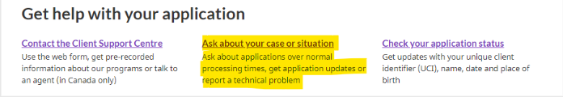

Tweak if needed & verbal report
Data suggests an issue? Tweak your design, e.g.:
Fix a link; reduce reading level; frontload headings; etc.
No issues? Leave it be and keep monitoring
Report whatever happens verbally
“Hey Sheila, we had feedback in the PFT that there was a broken link, so I fixed it”
After last monitoring interval, you’re done!

Slide 23
After tweaks, reset the monitoring clock
Why resetting the clock matters
Your tweak is itself a change to the design — it needs its own monitoring period
Restart your monitoring intervals from day 1 after any significant change
When are you done monitoring?
Once all monitoring intervals pass with no issues detected
For large designs: once all rollout phases are complete and stable
🔁 Reset = Restart
Every change restarts the clock. Keep monitoring until you’ve completed a full interval cycle with no new issues.
Activity: Identify KPIs

Slide 24
Who are we keeping in the loop, and how?
Report

Slide 25
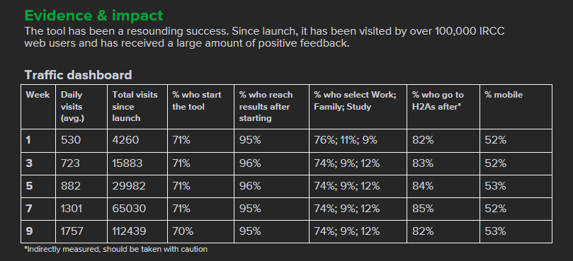
Report: Who you’ll tell about the monitoring
Small/medium designs don’t need much reporting
Small: verbal reporting
Medium: email reporting
Large designs benefit from regular reporting
Biweekly reporting of monitoring data and any reactions
End-of-phase report to summarize findings and next steps
From: Program Finder Phase 1 summary report
Monitoring revealed that our results page was too long – we reacted by merging individual program streams into 1 result instead of separate results for each stream
Notes:
We won’t spend too much time discussing rollout – you are all familiar with launching content!

Slide 26
Different needs for different designs
 | Small designs (minor edits, tweaks, additions) | Medium designs (plain lang rewrites, lift + shift to subway, etc.) | Large changes, big new content or tool
Rollout | N/A – Go live | N/A – Go live | Phased launch, gradual increase in visibility
Monitor | Ad hoc monitoring in the days/weeks post launch. 2-3 data sources Frequency: 1 day post launch, 3, 7, 14. | Regular monitoring for days and weeks post launch. 3-4 data sources & explicit monitoring plan Frequency: 1 day post launch; 3, 5, 7, 14, 28 | Regular monitoring for days and weeks post launch. As many data sources as possible & explicit monitoring plan. Data used as gate for moving to next phase of rollout. Frequency: Daily for first week post-launch, then weekly until end of rollout plan.
React | Ad hoc based on monitoring data | Ad hoc based on monitoring data and based on what the new design changed | Explicit If/Then plans to address wide range of possible issues
Report | No formal reports; verbal reporting enough | Email reports post-launch | Weekly/Biweekly reports, summary reports after each phase

Slide 27
As you design: Determine KPIs and data sources
What does success look like, and how will you measure it?
Larger changes
Instead, look for stability, e.g.
Decrease or stable CSC call volumes for this LoB
Decrease or stable PFT “no” clicks
Increase or stable analytics for Apply Now button
🎯 Tip
KPI examples for larger designs:
Task completion rate (TSS)
Apply Now / CTA click rate
CSC call volume for the LoB
Activity: Identify KPIs

Slide 28
As you design: Tailored data sources
What does success look like, and how will you measure it?
Small design changes often hard to measure impact
Instead, look for stability, e.g.
Decrease or stable CSC call volumes for this LoB
Decrease or stable PFT “no” clicks
Increase or stable analytics for Apply Now button
📋 Match
Match data sources to the type of change:
Content change? Use PFT + Analytics
Navigation change? Use TSS + back-button data
New tool? Add a custom survey
Activity: Identify KPIs

Slide 29
As you design: Monitoring plan
What does success look like, and how will you measure it?
Small design changes often hard to measure impact
Instead, look for stability, e.g.
Decrease or stable CSC call volumes for this LoB
Decrease or stable PFT “no” clicks
Increase or stable analytics for Apply Now button
📝 Plan template
Your monitoring plan should specify:
Which KPIs to track
Which data sources to check
At what intervals to check them
What a “pass” looks like
Activity: Identify KPIs

Slide 30
Launch & monitor
Go live then start to monitor
Set yourself some calendar reminders to monitor at key intervals:
3 days post-launch; 2 weeks; 1 month
Each interval, look at data sources you selected and look for evidence of issues
📅 Check-in schedule
Recommended monitoring intervals (medium designs):
Day 1 post-launch
Day 3, Day 7
Day 14 (2 weeks)
Day 28 (1 month)
Interpret your data sources to figure out what’s happening.
Unsure how? Check out Rapid Research

Slide 31
Tweak if needed
Go live then start to monitor
Set yourself some calendar reminders to monitor at key intervals:
3 days post-launch; 2 weeks; 1 month
Each interval, look at data sources you selected and look for evidence of issues
🔧 Common tweaks
Common tweaks after launch:
Fix broken or outdated links
Clarify ambiguous headings
Adjust reading level of body text
Frontload key info in paragraphs
Interpret your data sources to figure out what’s happening.
Unsure how? Check out Rapid Research

Slide 32
Email reporting & end of monitoring
Go live then start to monitor
Set yourself calendar reminders to monitor at key intervals:
Recommended: Each day for first week post-launch; 2 weeks; 4 weeks; 6 weeks; 8 weeks
Each interval, look at data sources you selected and look for evidence of issues
📧 Report template
Email report should include:
Summary of monitoring data
Any issues found
Reactions taken
Next monitoring milestone
Interpret your data sources to figure out what’s happening.
Unsure how? Check out Rapid Research

Slide 33
As you design: Tailored data sources & monitoring plan
As before:
Leverage as many data sources as possible for large designs, e.g.:
Page Feedback Tool
Analytics Dashboard
Environmental Scan
Survey embedded in new content
Feedback from Social Care
🔎 Data checklist
Data sources for large designs:
Adobe Analytics dashboard
Page Feedback Tool (PFT)
Task Success Survey (TSS)
Environmental scan (forums, social)
Custom survey embedded in content

Slide 34
As you design: Plan how you’ll React
What does success look like, and how will you measure it?
Small design changes often hard to measure impact
Instead, look for stability, e.g.
Decrease or stable CSC call volumes for this LoB
Decrease or stable PFT “no” clicks
Increase or stable analytics for Apply Now button
⚡ React plan
Sample if/then reaction plan:
If PFT “no” clicks spike >20% → investigate comments
If TSS score drops → consider rollback
If no issues after 4 weeks → advance to next phase
Activity: Identify KPIs

Slide 35
Monitoring
Go live then start to monitor
Set yourself some calendar reminders to monitor at key intervals:
3 days post-launch; 2 weeks; 1 month
Each interval, look at data sources you selected and look for evidence of issues
📊 Dashboard
Monitoring dashboard should track:
Traffic to new content
Task completion and drop-off
PFT yes/no ratios
Return visit rate (if applicable)
Interpret your data sources to figure out what’s happening.
Unsure how? Check out Rapid Research

Slide 36
Reporting & end of monitoring
Go live then start to monitor
Set yourself some calendar reminders to monitor at key intervals:
3 days post-launch; 2 weeks; 1 month
Each interval, look at data sources you selected and look for evidence of issues
✅ Wrap-up
End-of-monitoring checklist:
All intervals completed with no new issues?
Final report drafted and shared?
Design team debriefed?
Lessons learned documented?
Interpret your data sources to figure out what’s happening.
Unsure how? Check out Rapid Research

Slide 37
Conclusion
Key takeaways
Every design change — big or small — deserves some level of monitoring
Impact and risk determine how robust your monitoring plan needs to be
Use data to react, not guesswork — and reset the clock when you make changes
Templates and examples are in the Appendix to help you get started

Slide 38
Quick reference: Data sources by effort level
Low effort (check these first)
Adobe Analytics: page traffic, button clicks, drop-off rates
Page Feedback Tool (PFT): yes/no ratings and open comments from users
Google Trends: search demand for key terms
Medium effort
Task Success Survey (TSS): task completion rates and ease ratings
Social Care: feedback themes from social media and email support
Higher effort (for large designs)
Environmental scan: Reddit, forums, Facebook groups
Custom surveys: SUPR-Q, embedded surveys for usability scores
💡 Start simple: Adobe Analytics + PFT are enough for most small and medium designs.
Notes:
If I had extremely limited time, I would prioritize:
Adobe Analytics (quant)
Reddit (qual)
The bigger the request, the bigger the research effort. Just changing a page? Quickly check analytics. Revamping a subway? Supplement analytics with forums and/or TSS.

Slide 39
More resources + links
So
Program Finder Phase 2 summary report.docx
Example monitoring plans:
- Program Finder Rollout & Monitoring
- Visa Tool Rollout & Monitoring
- Contact IRCC Rollout & Monitoring
Feel free to use these as examples & inspiration!
Notes:
If I had extremely limited time, I would prioritize:
Adobe Analytics (quant)
Reddit (qual)
The bigger the request, the bigger the research effort. Just changing a page? Quickly check analytics. Revamping a subway? Supplement analytics with forums and/or TSS.

Slide 40
Thank you!
Questions?
Notes:
Reach out to WURD if you want to work together on any UX projects

Slide 41
Examples of monitoring

Slide 42
Example of large design rollout & monitoring
Phase 1
Analytics dashboard to ensure metrics are relatively stable. Key metrics of interest:
Clicks on all doormats
Clicks on Most requested band
Clicks on social media icons
Clicks on Help with common topics
Slow roll-out of social media icons:
As discussed with Social care, the social media icons will only be shown to 10% of visitors at the start of Phase 1 (using Adobe Target)
Social care team will assess if volumes of Facebook messages have significantly increased
If yes, we’ll end the Target activity and remove the icons from the topic page
If no, we’ll increase visibility to 25%, 50% and then 75% of visitors and check in with Social care at each increment
If volumes are deemed manageable by Social Care team at 75%, we’ll end the Target activity and add the icons to the topic page in AEM
Phase 2
Slow roll-out:
We’ll run an Adobe Target activity that splits traffic to Contact IRCC topic page, only diverting 25% to the revamped page in Phase 2
We’ll incrementally increase traffic to 50% and 75%
We’ll check-in with call centre & web form teams 1 week and 2 weeks after each increment to ensure volumes are still manageable
If call volumes are not manageable, we will roll back the Adobe Target activity and brainstorm other ideas for the revamp
Analytics dashboard to ensure metrics are relatively stable. Key metrics in immediate term:
Clicks to web form
Clicks to open expand-collapse with phone number
Clicks on phone link from mobile devices (compared against baseline rate)
Clicks on self-serve section
Key metrics of interest in long term:
Task Success Survey scores (i.e. task completion and ease for Contact IRCC task)
Contact IRCC - Research, designs, monitoring plan.docx

Slide 43
Example of large design rollout & monitoring
Live Beta – URLs for Program Finder Feature
URL EN | URL FR | Web Advisor
Studying and working in Canada as an international student - Canada.ca | Étudier et travailler au Canada à titre d’étudiant étranger - Canada.ca | Ariana Emond
Work in Canada - Canada.ca | Travailler au Canada - Canada.ca | John Wong + Liza Hamilton
Sponsor your family members to immigrate to Canada - Canada.ca | Parrainer les membres de votre famille pour qu’ils immigrent au Canada - Canada.ca | Danna El-Arab
Irregular border crossings and asylum in Canada - Canada.ca | Passages irréguliers à la frontière et demande d’asile au Canada - Canada.ca | Tracy Dransfield
Study in Canada as an international student - Canada.ca | Étudier au Canada à titre d’étudiant étranger - Canada.ca | Ariana Emond
Contact Immigration, Refugees and Citizenship Canada - Canada.ca | Contactez Immigration, Réfugiés et Citoyenneté Canada - Canada.ca | Aloisa Santos
Extend your work permit - Canada.ca | Prolonger votre permis de travail - Canada.ca | John Wong & Liza Hamilton
Get a work permit - Canada.ca | Obtenir un permis de travail - Canada.ca | John Wong & Liza Hamilton
Parent and grandparent super visa - Canada.ca | Super visa pour parents et grands-parents - Canada.ca | Sean Mueller
Live Beta
We will link a user experience survey on the Results page of the tool
We will construct and monitor an Adobe Analytics dashboard
Total tool traffic, average completion and drop-off rates
Which branches of the tool’s decision tree are clicked most
Which program results get shown to users most frequently (user sees list of results)
Which program result expand-collapses are opened (user looked at specific program)
We will implement the Page Feedback Tool on every screen
We will conduct a broader environmental scan to capture feedback about the program finder outside of Canada.ca data sources:
Social media sites (Facebook, X, immigration forums) for any discussion of the program finder since launch
IRCC Comms Social Media Team and Social Care team to enquire about any program finder feedback
The tool will only be moved to our full launch plan once we have four weeks of performance data without any new usability issues detected
Program Finder Rollout & Monitoring

Slide 44
Program Finder monitoring
Explore immigration programs tool

Slide 45
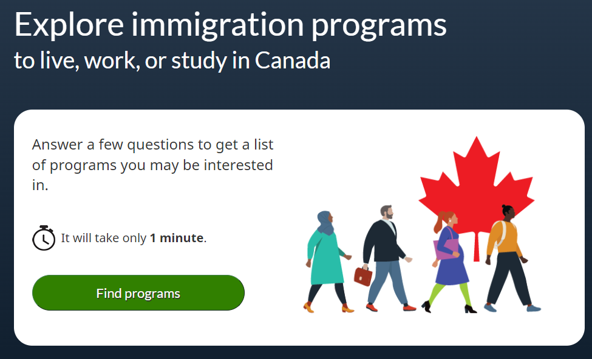

Program finder

Slide 46
Data sources for monitoring
Environmental scan
Reddit, Canadavisa.com, Twitter, Facebook
Page feedback tool comments
Optimal Workshop survey (SUPR-Q score & comments)
Adobe Analytics dashboard
Participation + completion rates, top selections, top results expanded, if users clicked to go to H2As, previous button clicks, 'Change answer' link clicks
Notes:
Daily during phased roll-out

Slide 47
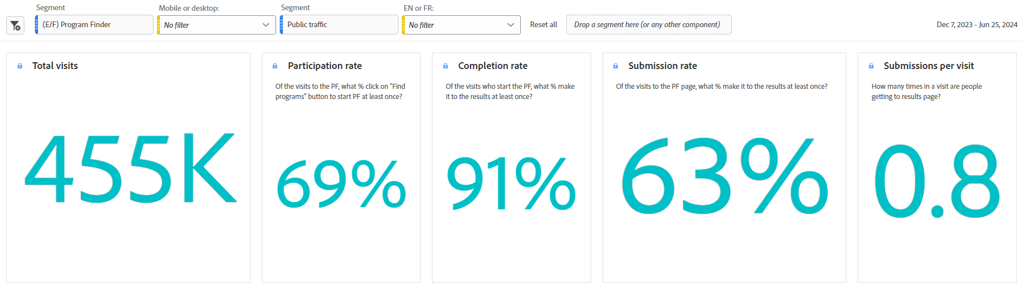
Adobe Analytics dashboard
Notes:
Key rates: participation, completion rate
Indicators of confusion: previous btn clicks, change answer
Dashboard set up before going live using test link
Important to add definitions to metrics
Ability to segment by device type and language if needed

Slide 48
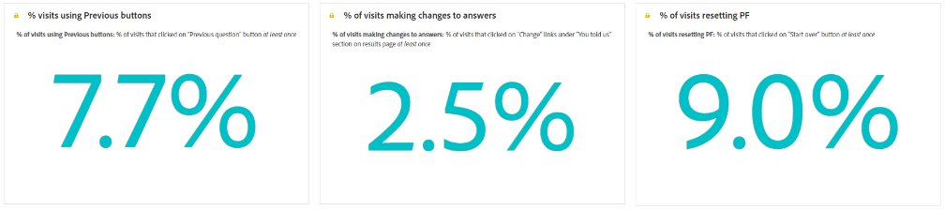
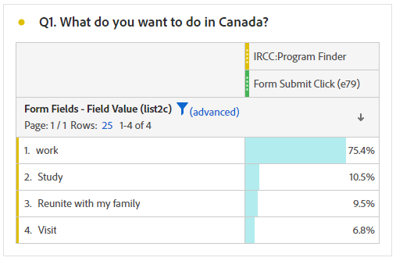
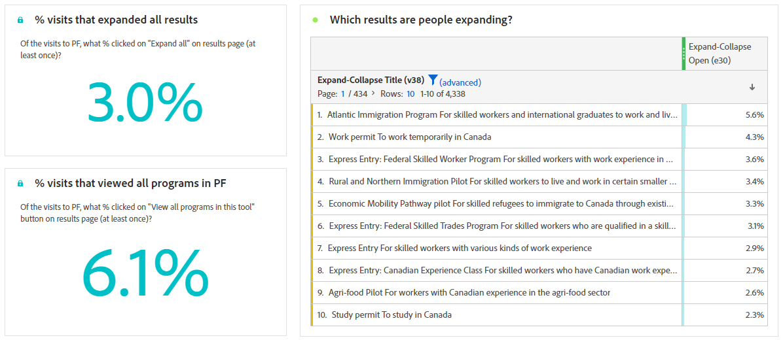
Adobe Analytics dashboard
Notes:
Most popular selections & results

Slide 49
Client feedback: Page feedback tool & SUPR-Q survey
...I used the tool just now and was given links to ALL of the economic immigration programs. It's way too much/overwhelming for someone who knows nothing about IRCC's immigration programs. Please improve the tool by adding more questions/filters before suggesting which programs to apply to.
When I went through this tool for PR opportunities, the final page provided a long list of PR programs. It would be nice to narrow the search further through a filter system.
If [I] get short information, it would be great.
The tool presents too many options that aren't really viable for people. I think you should add more questions, so the results are more tailored...
Notes:
Most popular selections & results

Slide 50
Changes made to Program Finder
Continued phased roll-out based on positive feedback
Removed Special measures link from landing page
Analytics data showed most visitors weren't continuing to a special measure
Tweaks to Work branch + results list
Feedback showed users were overwhelmed with amount of results
Iterated multiple versions of questions under Work branch
Merged individual streams (e.g. EE, PNP, Home child care...) into one result for entire program
Notes:
Special measures link would first send users to home page and then they'd have to click on an alert from alert band, so most were just getting lost on home page
Work branch: We iterated multiple versions of the work branch to strike a balance between number of questions asked and number of results per branch

Slide 51
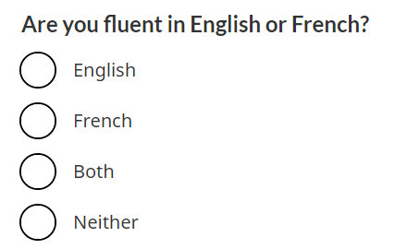
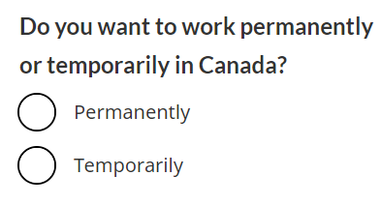
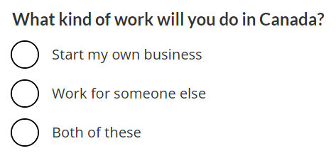
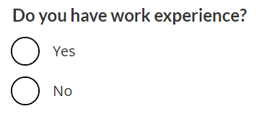
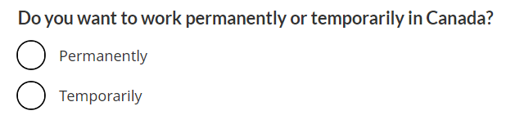
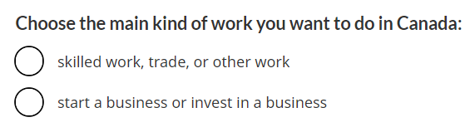
Streamlining questions in Work branch
'Work permanently' branch: Before
'Work permanently' branch: After
Notes:
Continued phased roll-out based on positive feedback
Special measures link would first send users to home page and then they'd have to click on an alert from alert band, so most were just getting lost on home page
Work branch: We iterated multiple versions of the work branch to strike a balance between number of questions asked and number of results per branch

Slide 52
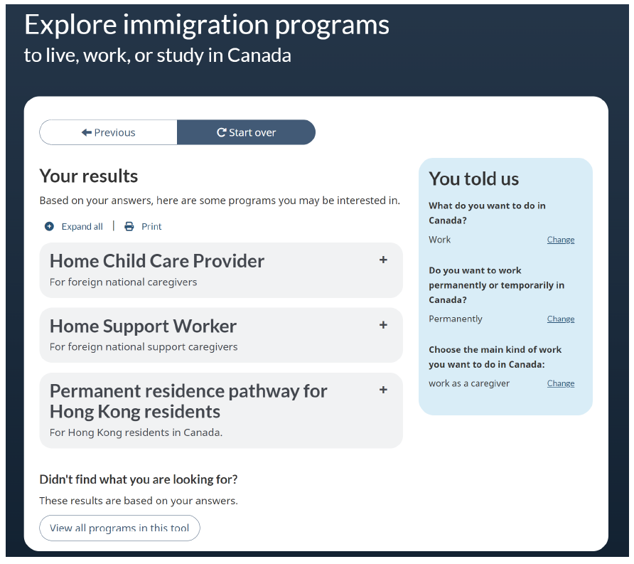
Merging results
Merged individual streams (e.g. EE, PNP, Home child care...) into one result for entire program, as feedback showed users were overwhelmed with amount of results

Slide 53
Account Chooser
Wizard to help users find the right IRCC account

Slide 54
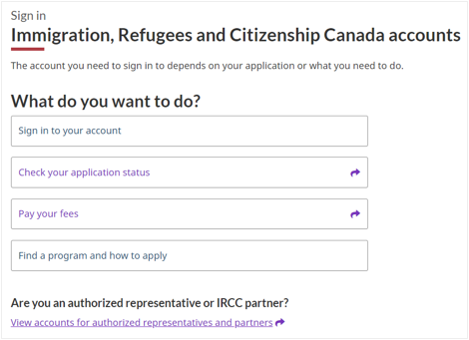
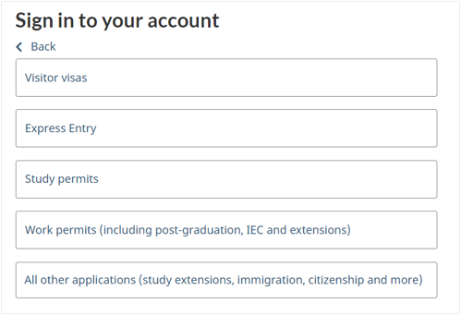
Account chooser
Notes:
Daily during phased roll-out
Add some icons to make it pretty

Slide 55
Data sources for monitoring
Environmental scan
Reddit, Canadavisa.com, Twitter, Facebook
Page feedback tool comments
Adobe Analytics dashboard
Participation + completion rates, top selections, most popular accounts/destinations, back button clicks, inside/outside Canada
Notes:
Daily during phased roll-out
Add some icons to make it pretty

Slide 56
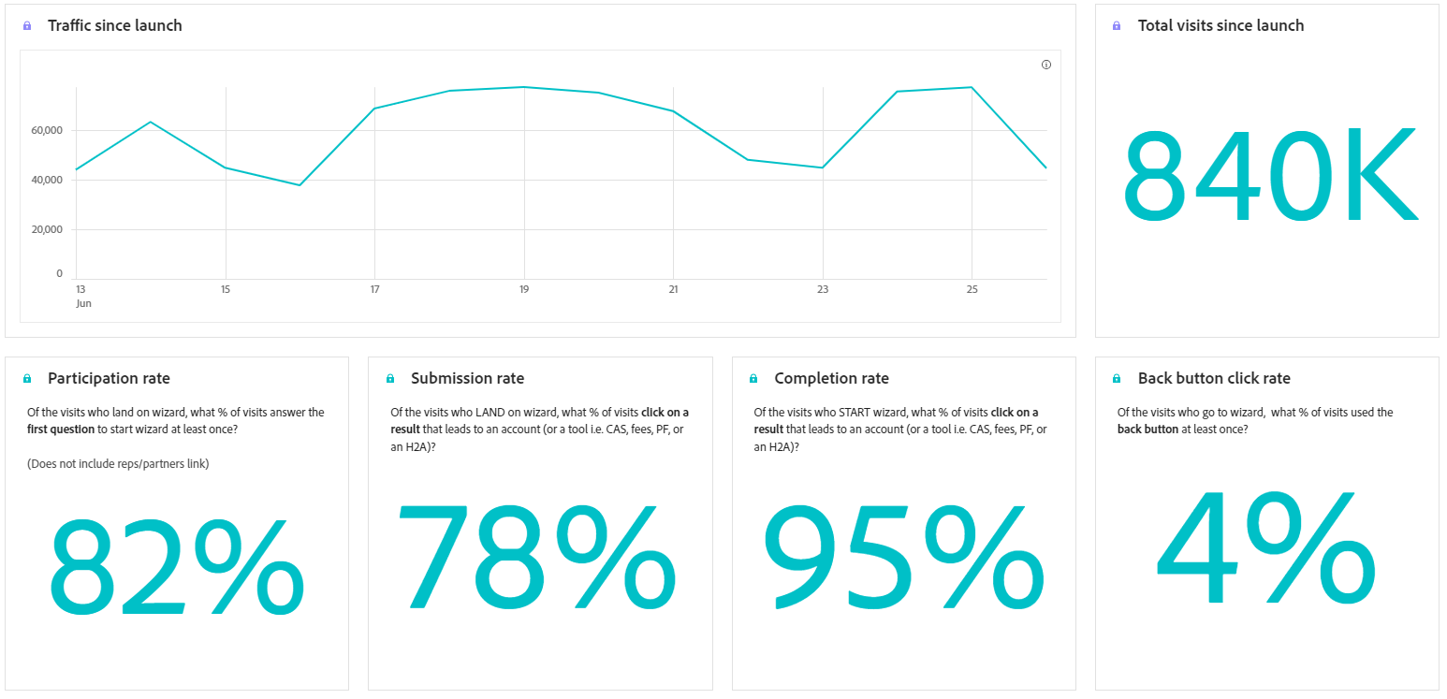
Adobe Analytics dashboard

Slide 57
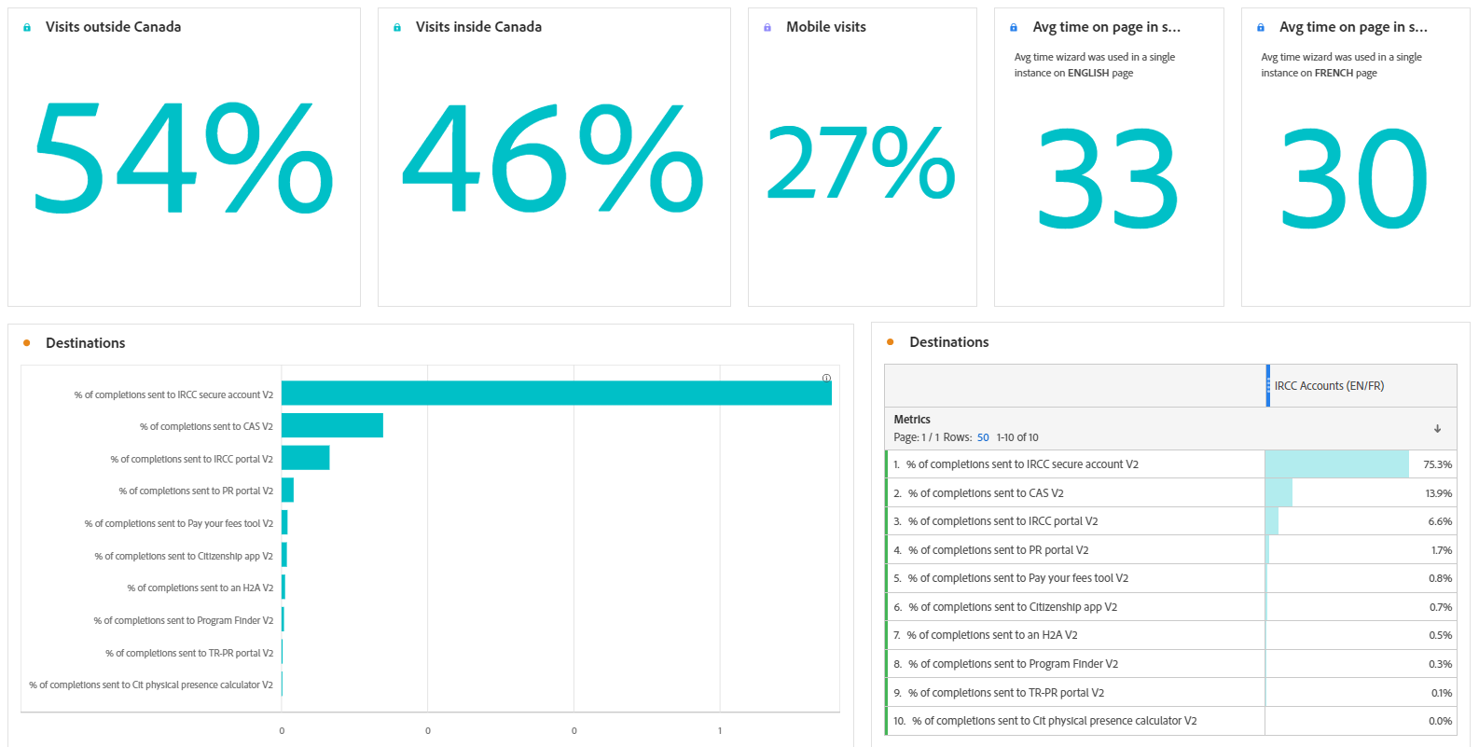
Adobe Analytics dashboard
Notes:
Most popular selections & results

Slide 58
Client feedback: Page feedback tool
Sign in to my IRCC account
How to create a GCKey account
...This new categorized view is taking me to the login page anyways and just adds extra steps for me to login.
Just add a sign in tab for God's sake
Sign in to GCKey
IRCC just complicated the process of signing in with GCKey... please do not waste other people's time with these useless steps.
Search for create an account
Notes:
Themes: GCKey, sign in/log in, create an account/register, extra steps/too many clicks

Slide 59
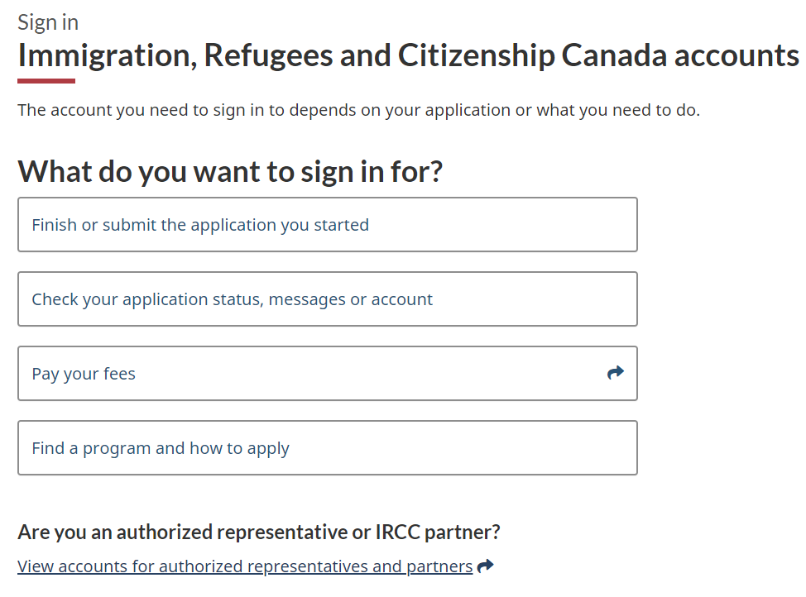
Version 2: Sign-in language
Added keyword 'sign in', combined 'Finish' & 'Check' branches
Version 1
Version 2
Notes:
V2 used 'sign-in' language that users are desperately looking for
Sign in to your account was added as a main branch (to replace Check/Finish)

Slide 60
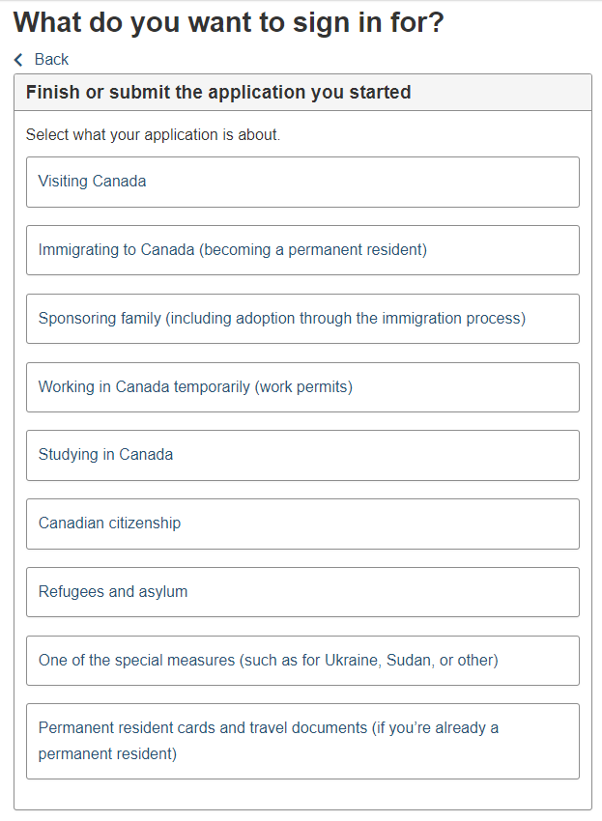
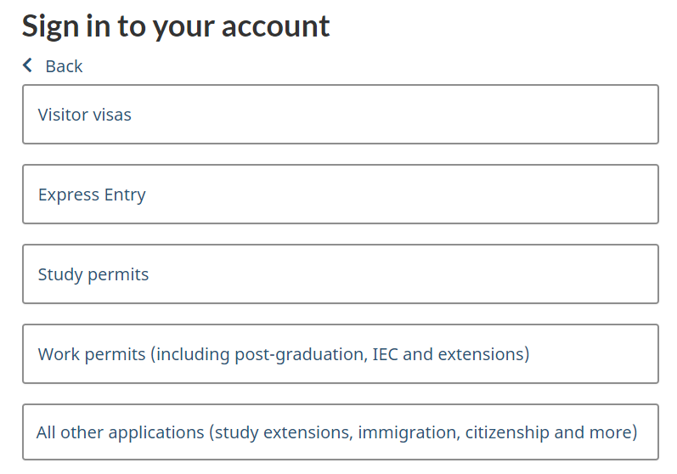
Version 2: Most popular programs
Moved most popular programs to the forefront for quick access with fewer clicks
Version 2
Version 1
Notes:
V2 had most popular programs at the forefront, fewer clicks needed
Marianne to do: maybe grab stats on what % of clicks were going to visitor visa, EE, etc.

Slide 61
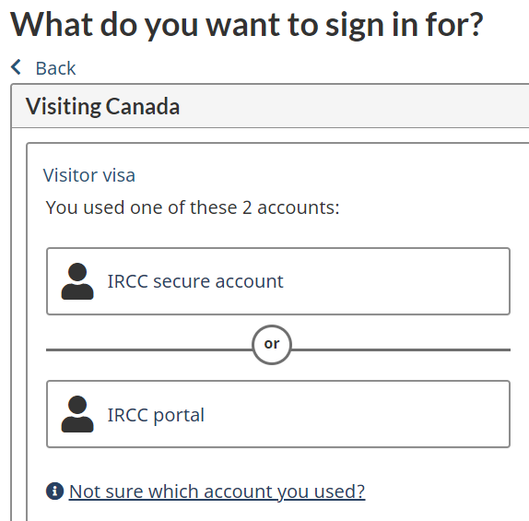
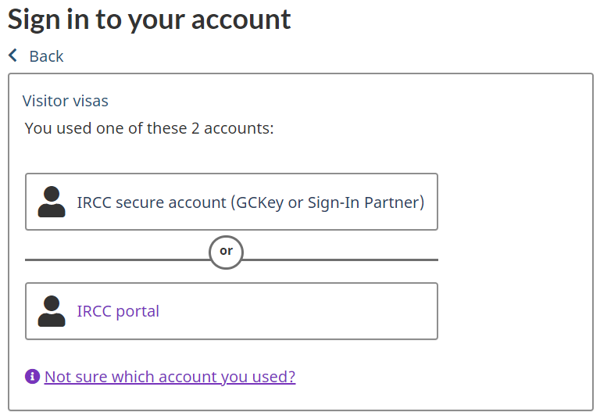
Version 2: GCKey association with Secure account
Added mention of GCKey so users will more easily recognize Secure account
Version 1
Version 2
Notes:
GCKey or Sign-In Partner' was added after Secure account since many users think GCKey is the account

Slide 62
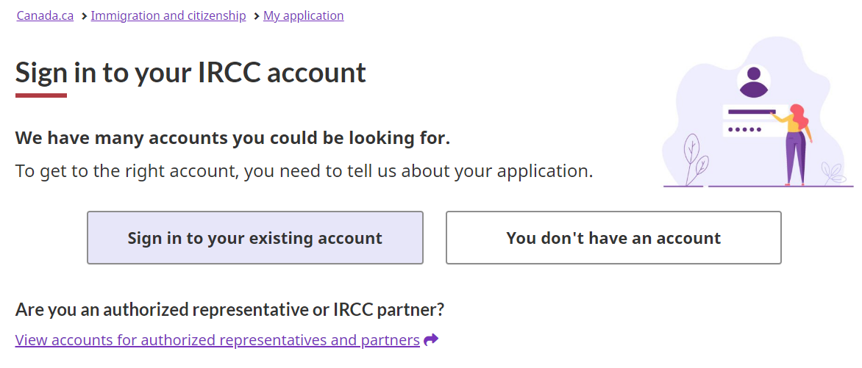
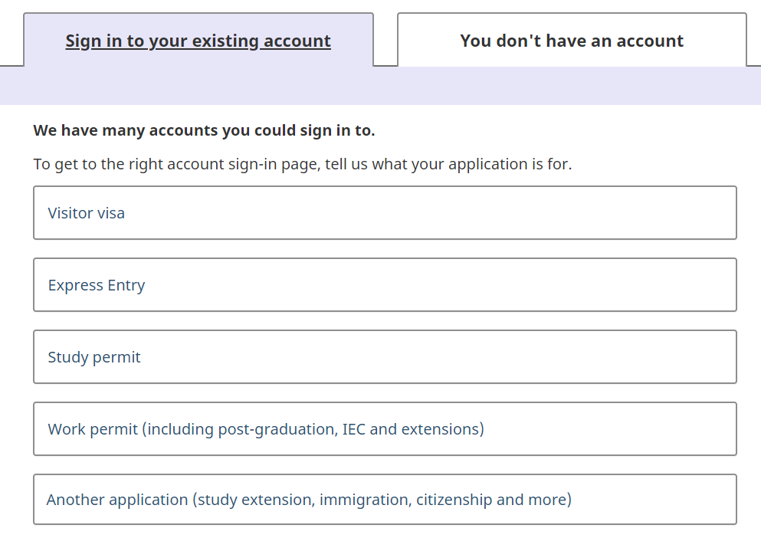
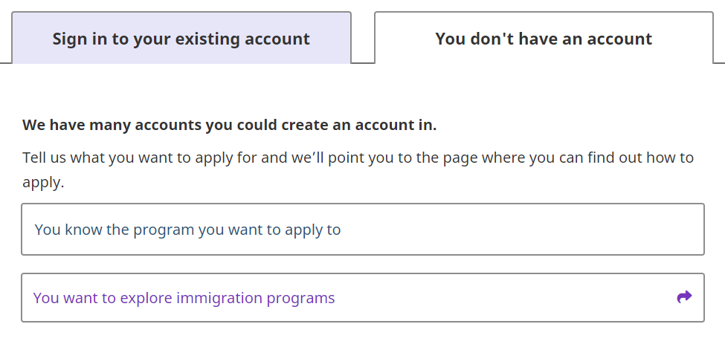
Version 3: Create an account
Notes:
Lots users looking to create an account in comments so two buttons were added on landing page before jumping into wizard
Matches the expectations of a typical sign-in page users would see elsewhere more closely

Slide 63
SLIDE GRAVEYARD

Slide 64





We have plenty of data that’s readily available
Page feedback tool
Social Care
Google Search Console
Task success survey
Lowest effort
Highest effort
POR
Google Trends
Adobe Analytics
Social networks & forums

Slide 65
Why users couldn’t complete tasks and what information they couldn’t find
Task success survey (TSS) & Page feedback tool (PFT)

