Slide 1
CMPT 450
Graham Cooper
Adrian Cate

Slide 2
The Purpose of the Application
The purpose of the application is to design a visual idiom that allows users to:
Explore the U.S. Dividend Champions dataset
Compare different companies
Make informed decisions on potential investments

Slide 3
Features
EPS % payout - Calculates the annual dividend as a percentage of trailing twelve months Earnings Per Share.
TTM EPS – the earnings per share for the most recently reported trailing twelve months.
PEG Ratio - the price/earnings ratio divided by 5-year estimates growth rate.
TTM ROE - the trailing twelve months' rate of return on shareholder equity.
TY% Growth - the percentage change of this year's earnings estimate compared with last year's EPS.

Slide 4
Features
NY% Growth - the percentage change of next year's earnings estimate compared with this year's estimate.
DGR - (or Dividend Growth Rate) is the compound annual growth rate of the dividend for the periods shown.
No. Yrs - the number of consecutive years of higher dividends.
Debt/Equity - the proportion of capitalization provided by debt in relation to shareholder equity
Estimated dividends to be paid in 2019

Slide 5
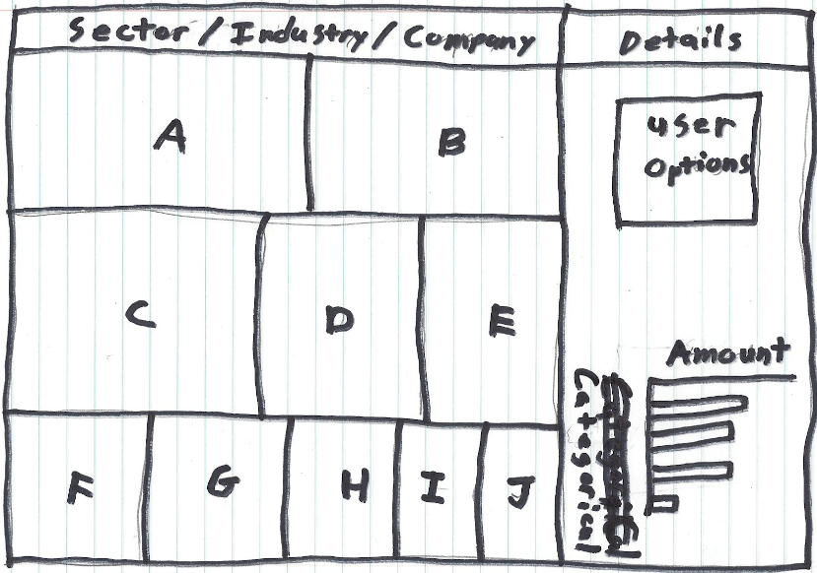
Low-Fidelity Prototype

Slide 6
Design Justifications
What – The data being shown in the views are the statistics that will inform novice user on the best dividends, with regard to sector, industry, and company.
Why – The task is being performed to find the companies that pay out the best dividends and have the highest potential to be possible future investments
How – The visualization idiom is constructed by allowing the user to filter by sector then industry then company. This allows the user to select specific sections in the economy that are of interest to them.

Slide 7
Rules of Thumb
Eye Beat Memory – using our eyes to switch between different views that are visible simultaneously has lower cognitive load than consulting our memory to compare a current view with what was seen before.
Memory and Attention - Conscious search for items is an operation that grows more difficult with the number of items there are to be checked.
Overview First, Zoom and Filter, Details on Demand
Responsiveness is Required – how much time it takes for the system to respond to the user actions.
Getting it Right in Black and White
Function First, Form Next – focus is on function of the application first, then beauty next.

