Slide 1
Machine Learning for Analysis and Prediction of Customer Data
CMPT 496
Graham Cooper

Slide 2
The Goal of the Project
To analyze a dataset of bike sales and discover what features of customers best explains whether they bought a bike or not.
Use machine learning approaches to discover what features are important.
Machine learning algorithms: Decision Trees, Neural Networks, Naïve Bayes, Support Vector Machines, and Random Forest.

Slide 3
Issues with too many features
May not increase predictive power
Irrelevant and redundant features
Increase computational resources needed to train the data
The learner learned irrelevant information

Slide 4
Goal of Feature Selection
Minimum subset of features that can predict the labels
This will result in
Reduction in computational resources
Reduce redundant features
Reduce useless features
Increase learning efficiency
Increase in predictive accuracy of the labels.

Slide 5
The dataset
The dataset that was obtained was from edX.org from a course they offered “Principles of Machine Learning” by Microsoft.
The data set contains information on whether or not the customer purchased an item from there.

Slide 6
Pre-processing
The dataset contained 24 features
The number of features were reduced to 13
After removing duplicates the data was reduced to 16,404 items.
Feature engineering was done to transform the data into more usable forms .
With 12 features the total number of subsets were 4095.

Slide 7
Cross validation
Cross validation was used to rank the accuracy
Cross validation was used on:
Decision Trees
Support Vector Machines
Naïve Bayes
Cross validation was not used on:
Random Forest
Neural Networks

Slide 8
Nested Cross Validation
The top 10 subset of features with the highest accuracy were chosen and the top 4 subset of features of each size where chosen.
This resulted in a total of 55 subsets for each learning algorithm that cross validation was performed on.
Nested cross validation was used to optimize these 55 subsets of features.

Slide 9
Nested Cross Validation
Naïve Bayes has no tuning parameters as it is Gaussian, so nested cross validation was not needed
Random forest used the features selected with Decision Trees to tune on.
Neural Networks used the union of all the features selected by Decision Trees, Naïve Bayes, and Support Vector Machines to optimize on for a total of 114 items

Slide 10
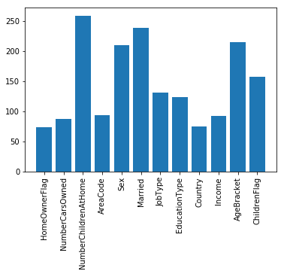
Results
Feature Count

Slide 11
Results
Three categories of features:
Category 1 – Above 76%
NumberChildrenAtHome: 94.5%
Married: 87.2%
AgeBracket: 78.5%
Sex: 76.6%
Category 2 – Between 45% and 58%
ChildrenFlag: 57.3%
JobType: 47.8%
EducationType: 45.3%
Category 3 - Below 35%
AreaCode: 34.3%
Etc …

Slide 12
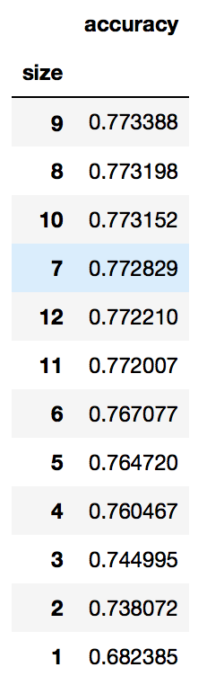
Results
average
Size seven features provide the best gain and sacrifices very little in terms of accuracy
This reflects the seven features found in category one and two

Slide 13
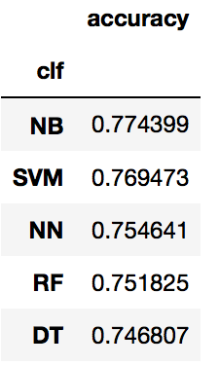
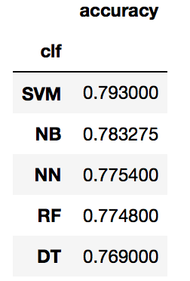
Results
Average
Maximum

Slide 14
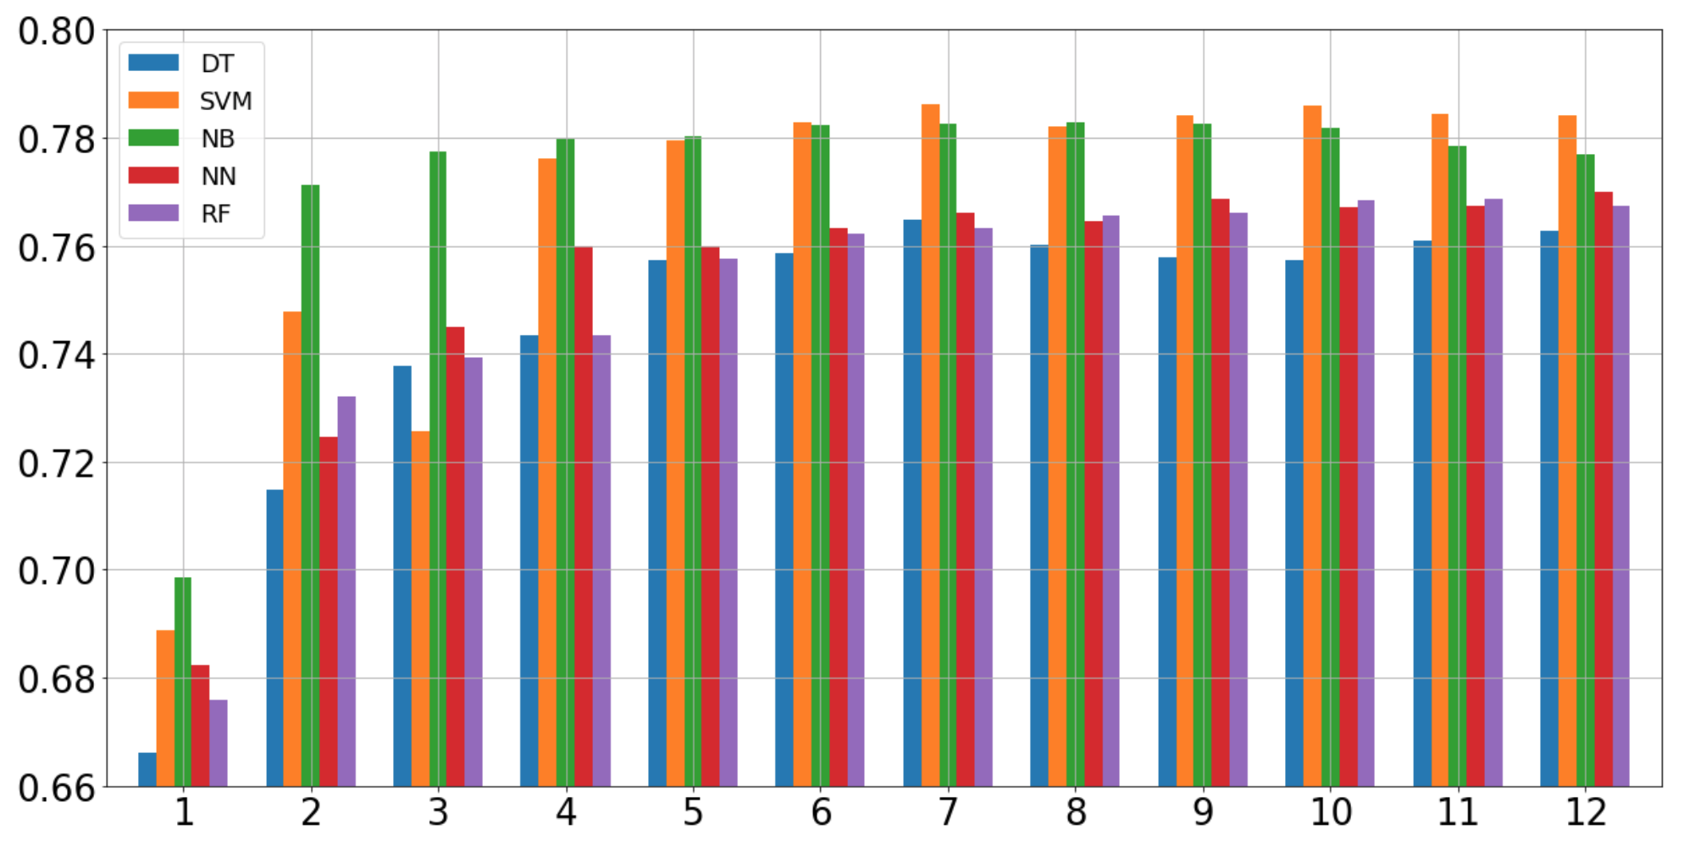
Results
Average Accuracy per Size

Slide 15
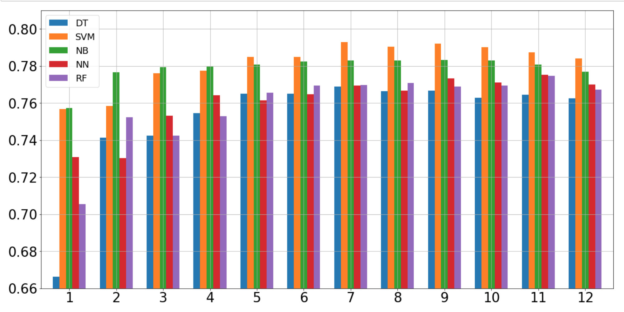
Results
Maximum Accuracy per Size

Slide 16
Thanks for listening
Questions and Comments?

