Slide 1
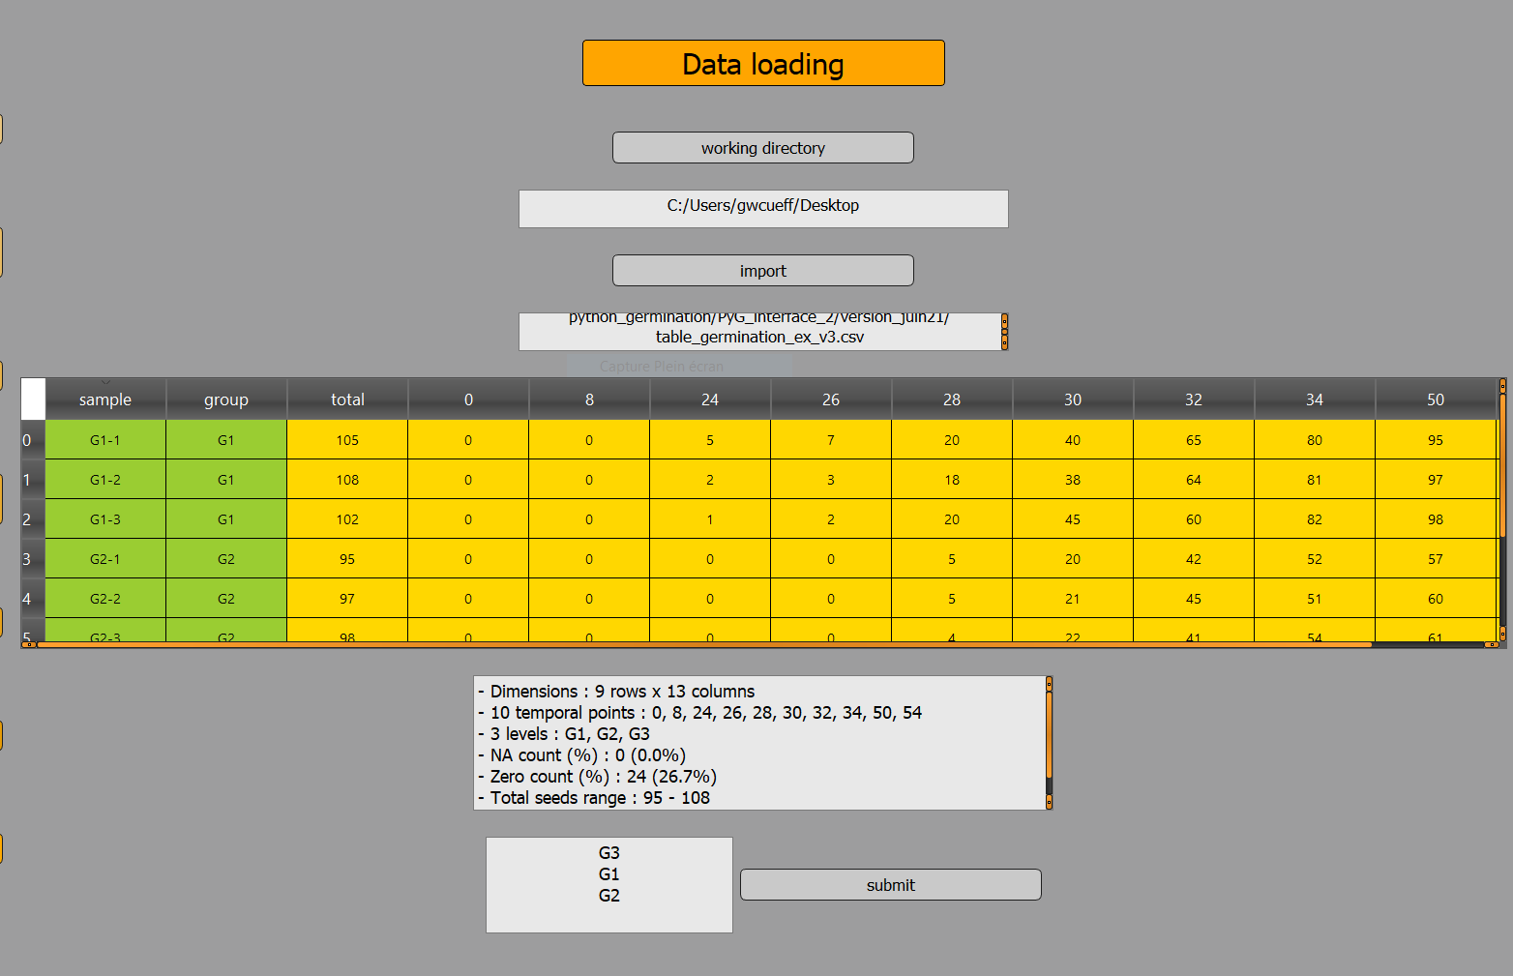
Choose a working directory
Working directrory path
Dataset display
Choose a dataset
File path
QC data
Group levels order
Group order validation

Slide 2
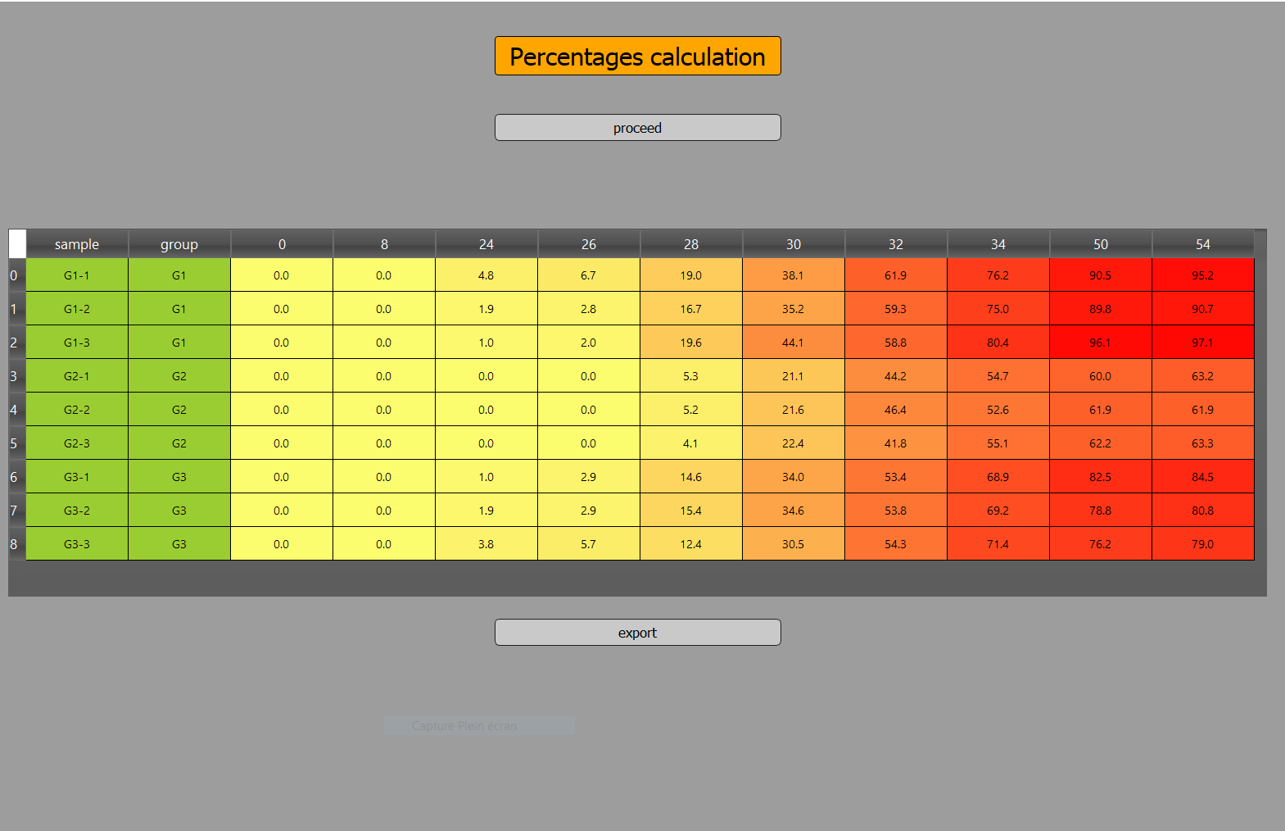
Percentages table display
in a heatmap style
Launch percentages calculation
Save the percentages table

Slide 3
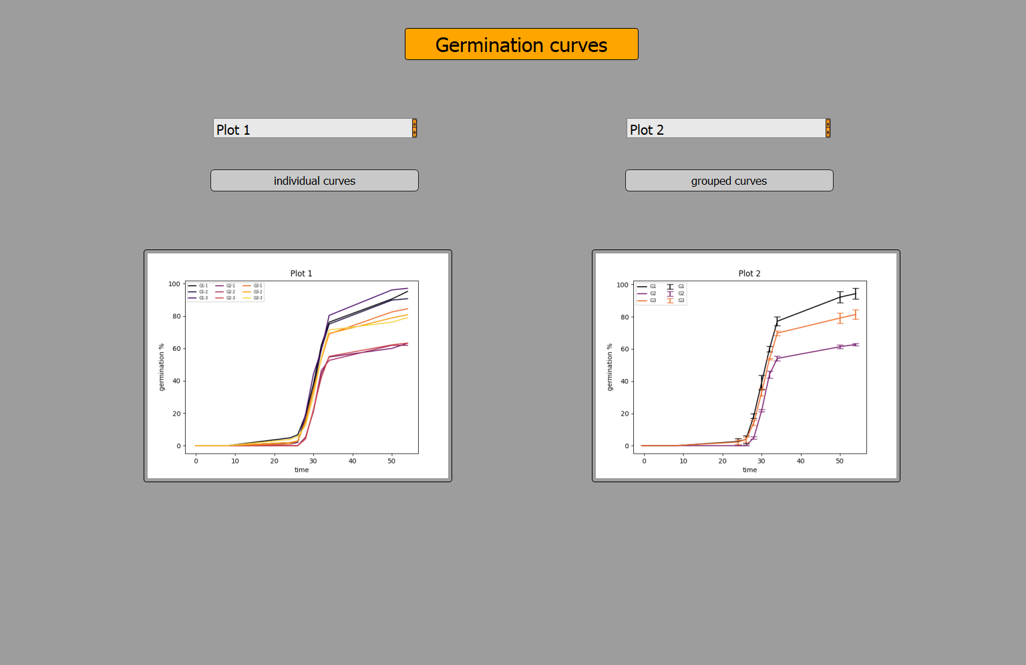
Individual curves plot main title
Grouped curves plot main title
Independent display of
individual curves
Independent display of
grouped curves
Thumbnails

Slide 4
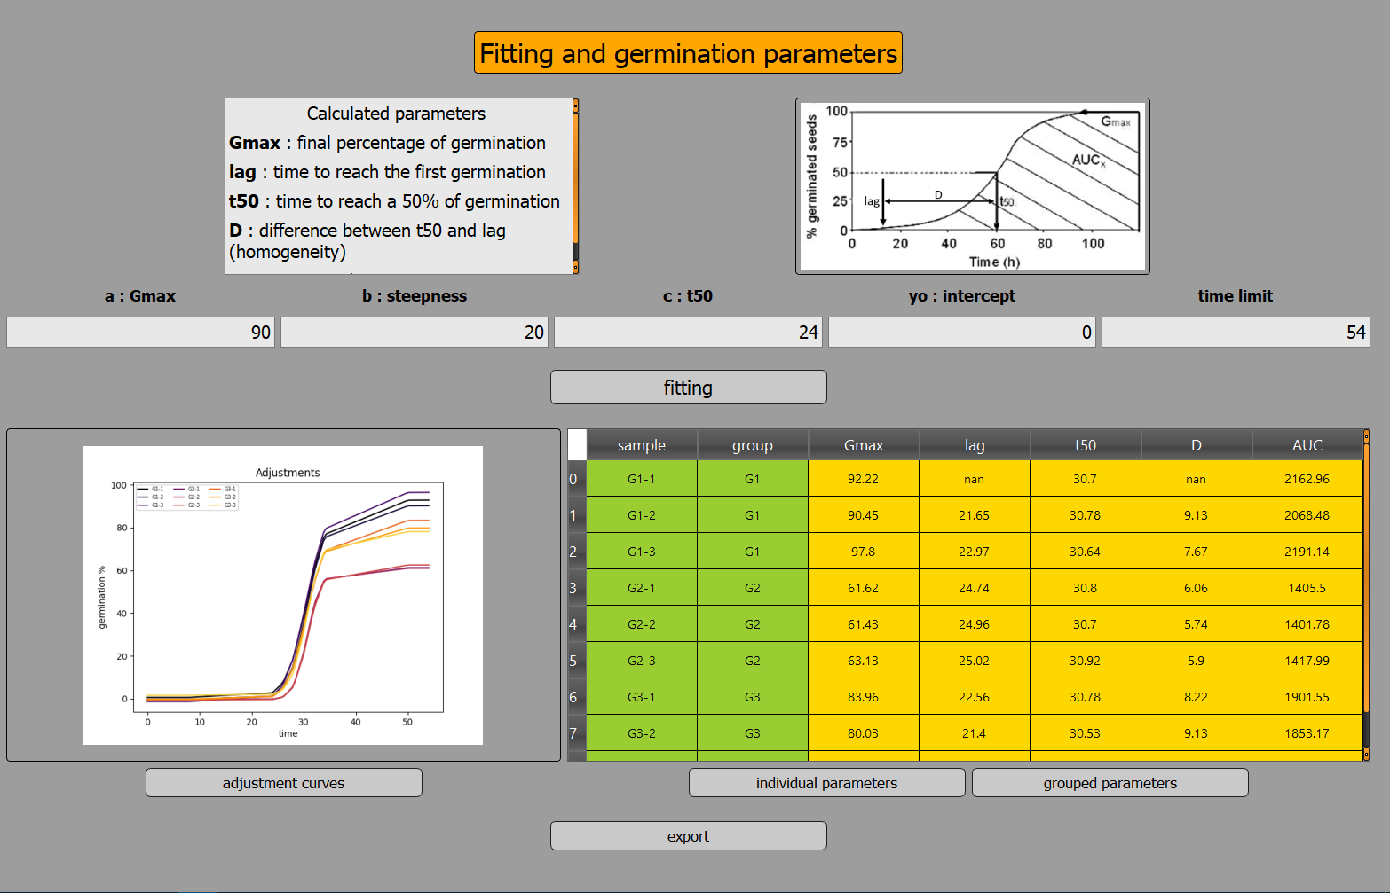
Initial values
for fitting
Display of adjustment curves
Proceed with fitting
Save the
displayed table
Independent display
Display parameters tables

Slide 5
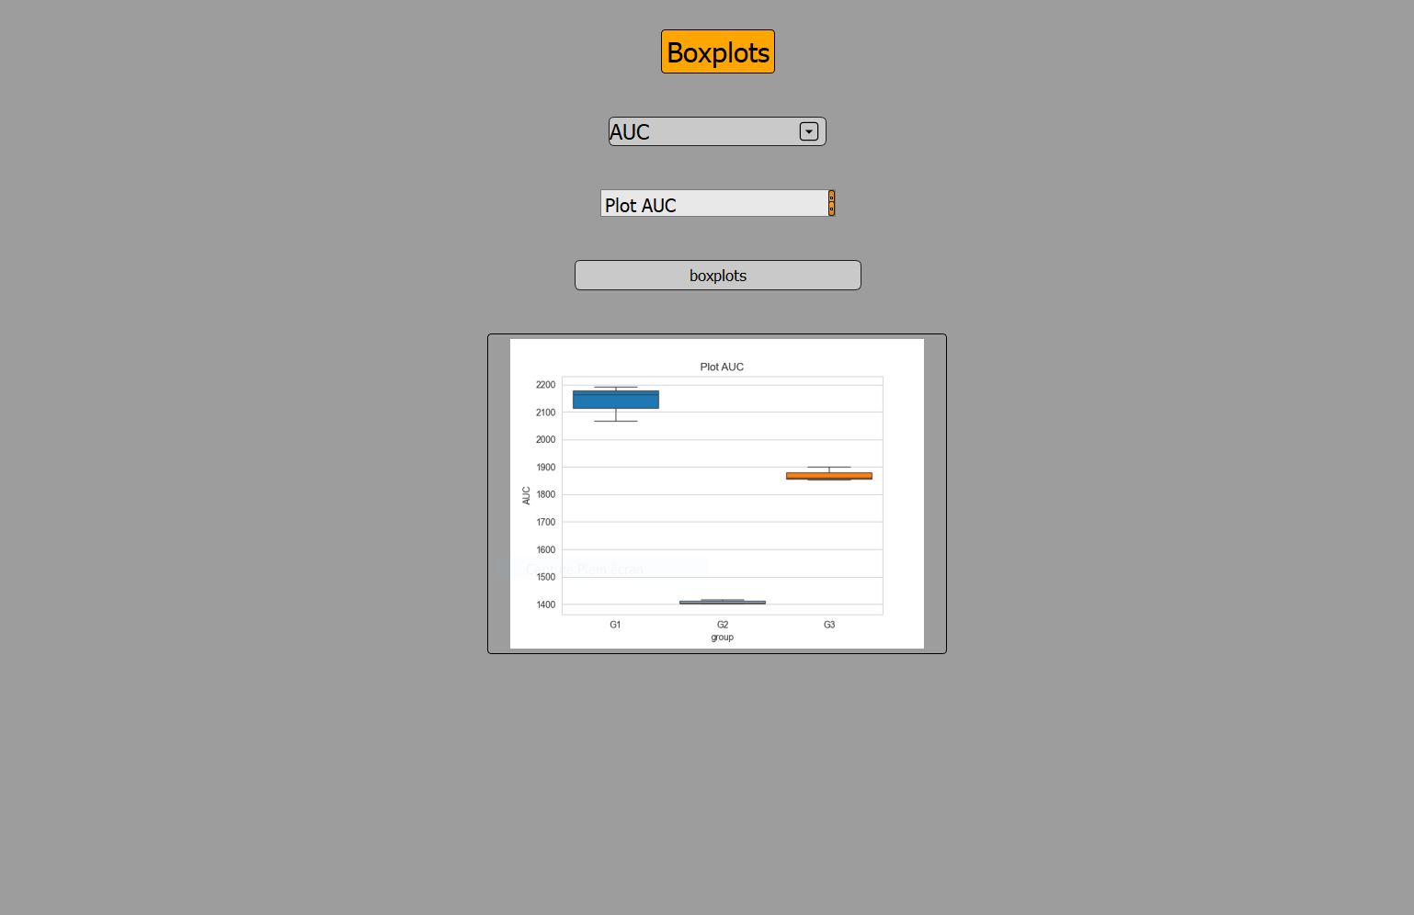
Choose a germination
parameter
Boxplot main title
Independent display
of boxplot
Thumbnail

Slide 6
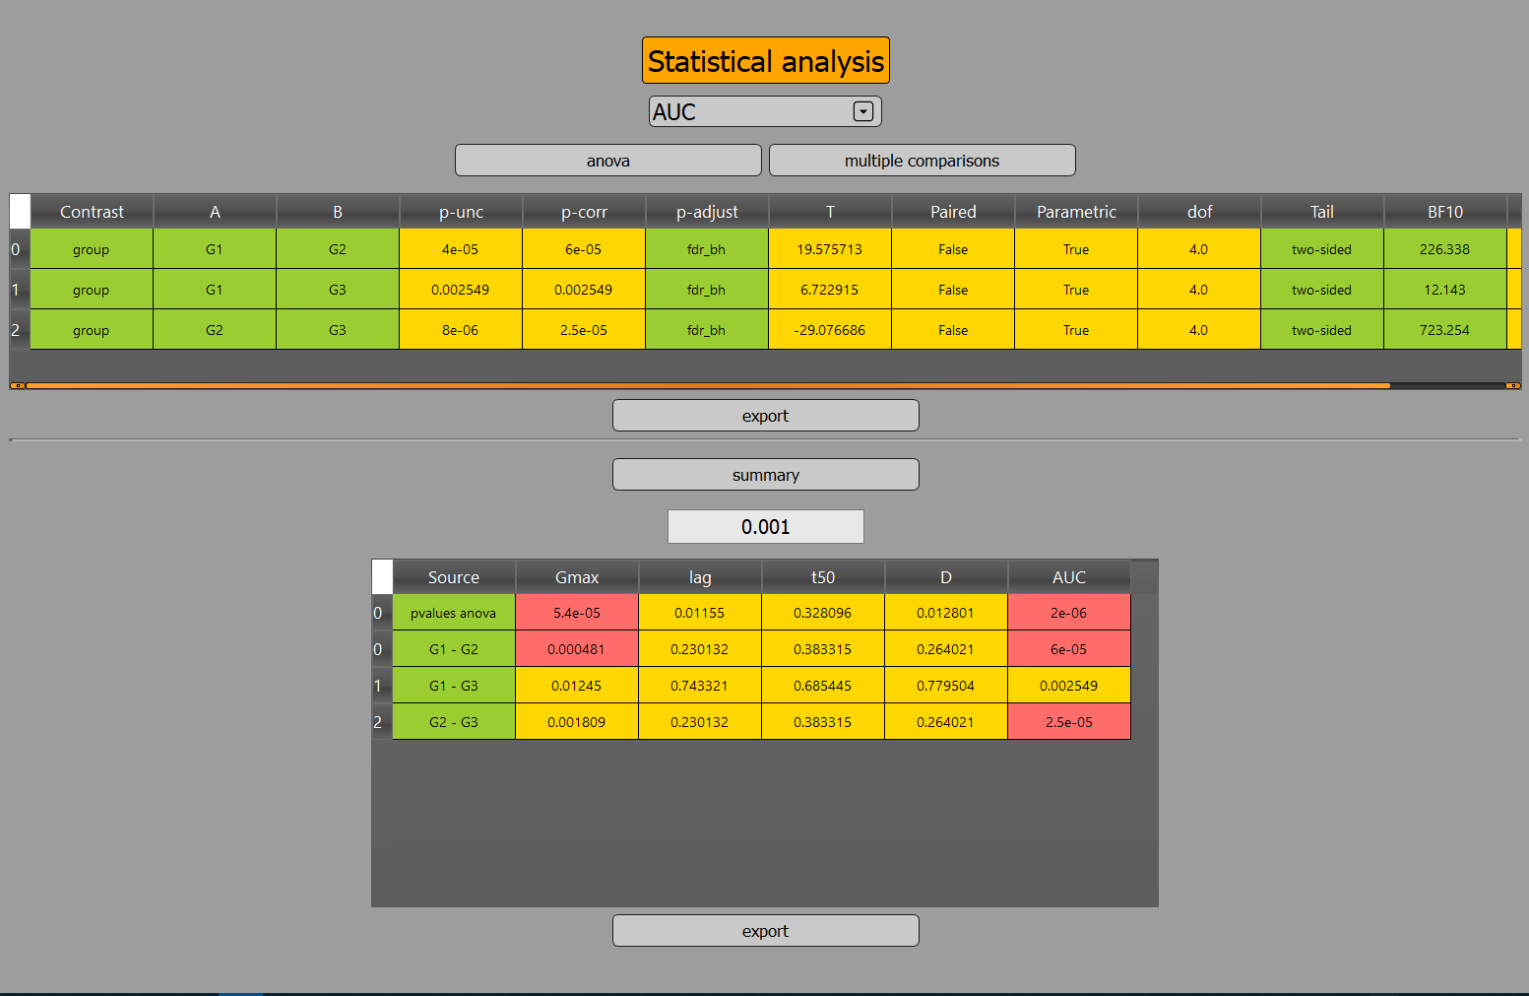
Choose a germination
parameter
Proceed with
multiple comparisons
Proceed with anova
Save the displayed table
Display a summary of
the whole p-values
Choose a threshold to highlight p-values
Anova
Multiple
comparisons
Save the displayed table

Slide 7
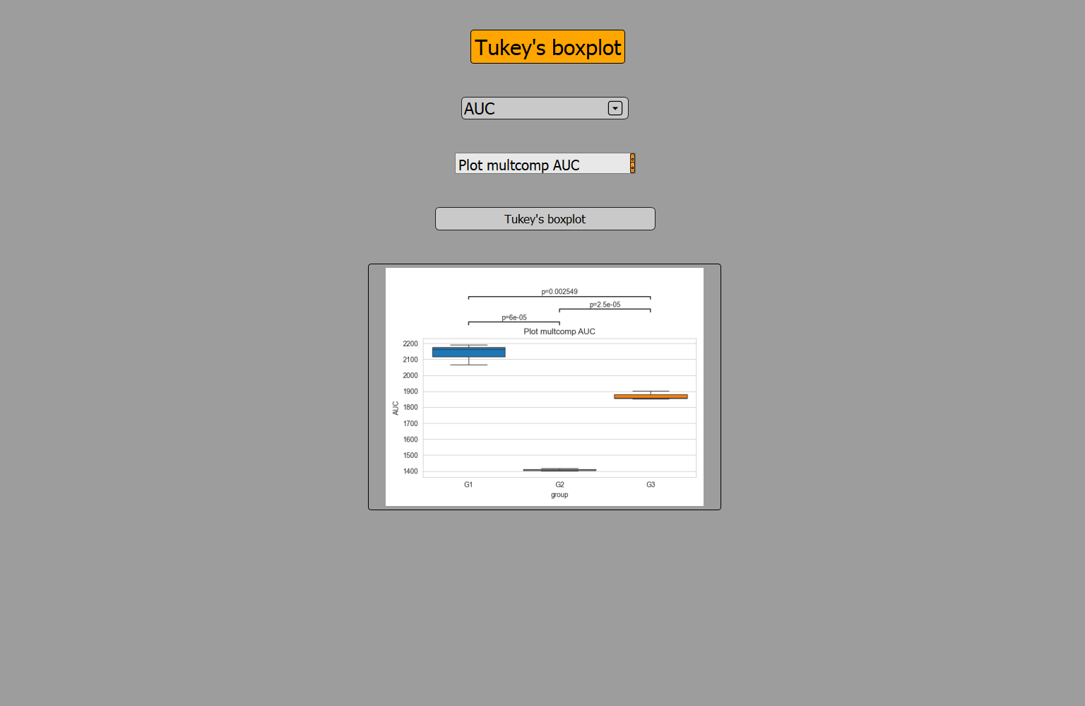
Choose a germination parameter
Boxplot main title
Independent display
of Tukey’s boxplot
Thumbnail

