Slide 1
Building High Throughput
Molecular Simulation
Tools
Mark Monroe¹, Sergio Maffioletti²
¹ Kim Baldridge’s group, Organic Chemistry Institute
² Grid Computing Competence Center
University of Zurich, Switzerland

Slide 2
Table of content
GC3pie:
  Ideas and motivations
  Simple model
What can be done:
  GAMESS.UZH
  Htpie
Added value
Next steps

Slide 3
Overall Reasoning
Goal
Ease integration of computational infrastructure into analysis tools. Hide the creation, management, and execution of large numbers of jobs under higher level abstractions
Why?
Transition state searching, genetic algorithms and many others demand a large computing infrastructure. The management of *all* computing requests generated does not scale for a single user that would have to keep track of hundreds or thousands of jobs

Slide 4
GC3pie: Motivations
Need access to computing resources when building/integrating QM and MD analysis tools
Need to integrate the access to computational resources within the analysis pipelines
Computational chemistry tools are too often presented with cumbersome interfaces:
  Too low level: difficult to use
  Too abstract: not flexible
Most of pipelines are developed/integrated using either home grown or external ‘all-in-a-box’ tools

Slide 5
GC3pie: ideas
Provide abstraction for developing an integrating computational chemistry applications/tools
Provide simple API to access computational resources
Application-centric programming model easy to adapt and extend

Slide 6
GC3Pie
Single point of interaction for available computing resources
Programmable interface
Composed by:
  gc3libs (basic APIs for accessing and controlling computational resources)
  gc3uitls (command line interfaces implementing different functionalities all relaying on gc3libs)
  htpie (Mark to detail)

Slide 7
GC3pie: Architecture
gc3utils
gc3libs API
Control
CONTROL
Application
Job
Resource
gc3libs
ARC
SGE
ACCESS
Computational Resources

Slide 8
GC3pie: simple examples
g* commands:
  gsub
  gstat
  gkill
  gget
  gtail

Slide 9

GAMESS.UZH: Online GAMESS-DB
Allows to import external data sources
Convert imported data into GAMESS format
Provide simple Web interface
Allows authorized annotation of data
Allows to run GAMESS analysis
http://ocikbgtw.uzh.ch/gamess.uzh/
Entirely written using gc3utils
Leverage gc3libs for computational part
Access National Computing
Infrastructure: SMSCG
Import
GAMESS.UZH
Web Interface
Annotation
Analyze
gc3libs
Computing

Slide 10
GAMESS.UZH: Online GAMESS-DB
Import
Data Import convert library
Web Interface
Web content and GUI
Persistency
FS, DBMS
Data Annotation
Annotation
Applications library
Analysis
module
Analyze
gc3libs
Computing

Slide 11
GAMESS.UZH
Show how it works…
Grundb.py

Slide 12

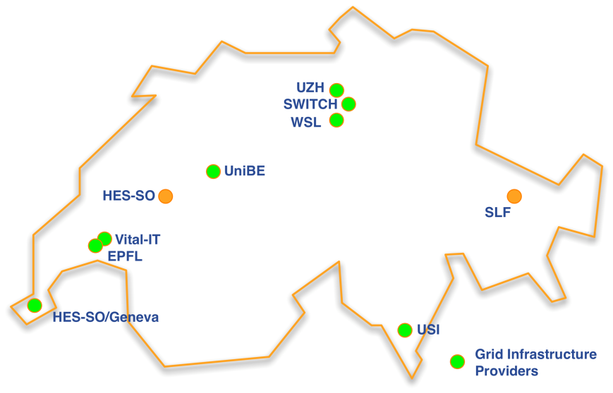
SMSCG - Swiss Multi-Science Computing Grid
An AAA/SWITCH Project
Provide computing resources to solve scientific computational problems
    http://www.smscg.ch
    SMSCG enables GAMESS on various sites
    Initial testing and validation phase completed
    Entering production support
Funded by AAA/SWITCH program ( 2008 – 2012 )
Working group of SwiNG - Swiss National Grid Initiative
Aggregate cores available for GAMESS: 5698

Slide 13
HTPie
Asynchronous batch job execution
Manage large numbers of arbitrarily related tasks
Relies on GC3pie for accessing computational infrastructure

Slide 14
Semi-Numeric Hessian
Forward difference algorithm
  Take initial geometry and perturb each x, y, z position
  3N perturbed geometries and 1 initial geometry
  Calculate gradient for 3N+1 geometries
  Use the resulting gradients to calculate the Hessian

Slide 15
Semi-Numeric Hessian Computation
Initial Geometry
Single Computation
Atoms = 50
Total Jobs 1 = (50*3+1 Steps)
Wall time = 151 * Single Step Time
Perturbed Geometry 1
Perturbed Geometry 2
Perturbed Geometry 3N
Initial Geometry
Parallel Computation
Atoms = 50
Total Jobs 151 = (50*3+1), 1 Step per Job
Wall time = Max(Jobs Wall time)
Perturbed Geometry 1
Perturbed Geometry 2
Perturbed Geometry 3N

Slide 16














Technical Overview
Cluster
User
GC3pie
Database
Task Scheduler
Web Server

Slide 17


Document Databases
http://www.mongodb.org/
http://couchdb.apache.org/
If you mated a key-value store with a relational database, you might get a document database
Stores dictionaries
  Unordered set of key-value pairs
  In JSON/BSON format (JavaScript Object Notation)
Great for Semi-Structured data
  No tables to define
  No database ‘schema’ to adhere to

Slide 18
Pymongo code example
>>> import pymongo
>>> from pymongo import Connection
>>> import datetime
>>>
>>> connection = Connection()
>>> connection = Connection('localhost', 27017)
>>> db = connection['test-database']
>>> collection = db['test-collection']
>>>
>>> post = {"author": "Mark",
... "text": "My first mongo doc!",
... "tags": ["mongodb", "python", "pymongo"],
... "date": datetime.datetime.utcnow()}
>>>
>>> collection.insert(post)
ObjectId(‘…’)

Slide 19
Execute
# cd ~/gc3pie/htpie
# gsingle -f examples/water_UHF_gradient.inp
Successfully create GSingle 4c98563249e41b5f5f000000
# ghessian –f examples/water_UHF_gradient.inp
Successfully create GHessian 4c98570349e41b6005000000

Slide 20
Tasks
Tasks are our unit of work
Tasks can contain other tasks
Tasks of different types do different things
  Calculate a Semi-Numeric Hessian
  Run a single batch job and parse the results
  Etc.
Tasks are store in MongoDB
Every task type has its own state machine
To add new functionality the user must add a new task type
  Create a data model class
  Create the state machine for that task type

Slide 21

State machines
Workflow driven by external events
Allows the separation of data, execution context, and process logic
If Superman
arrives
State B
True
State A
State Complete
Repeat
If Wonder Woman
arrives
State C
True
Notes:
A model composed of a finite number of states and transitions between those states, similar to a flow graph in which one can inspect the way logic runs when certain conditions are met.
A state-machine workflow is an event driven workflow. That is, the state machine workflow relies on external events to drive the workflow to completion. We define the legal states of the workflow, and the legal transitions between those states. The workflow is always in one of the states, and has to wait for an event to arrive before transitioning to a new state. Generally, the important decisions happen outside of the workflow. The state machine defines a structure to follow, but control belongs to the outside world.
A sequential workflow is a predictable workflow. The execution path might branch, or loop, or wait for an outside event to occur, but in the end, the sequential workflow will use the activities, conditions, and rules we've provided to march inevitably forward. The workflow is in control of the process.
(http://odetocode.com/articles/460.aspx)

Slide 22
GSingle State Machine
Interacts with GC3pie; submits, retrieves, and checks jobs submitted to the grid.
Works on GSingle Tasks
READY
True
WAITING
Repeat
If Job Done
RETRIEVING
True
POST PROCESS
COMPLETE

Slide 23
Execute
# gcontrol -i 4c98563249e41b5f5f000000

Slide 24
Task Scheduler
Process that periodically wakes up
Checks the database for tasks to run
Runs those Tasks
  Selects which state machine the task is assigned to
  Executes the current state of the task once

Slide 25
GC3pie/HTPie
Communication Diagram
User
Database
Task
Scheduler
GC3Pie
Create Task
Runnable Tasks?
Task Info?
Tasks
GAMESSApp
Task Info
Job
Create Task
Runnable Tasks?
Key
Tasks
GAMESSApp
Request
Job
Response
Job Done?
Task Info?
Task Result
Job Result
Task Info

Slide 26
Semi-Numeric Hessian Data Model
List
Starting molecular geometry
Perturbed Geometry 1
Perturbed Geometry 2
Perturbed Geometry 3N
Normal Mode Run
Key
GSingle
Task

Slide 27
Semi-Numeric Hessian
Algorithm
  First task generates molecular orbital initial guess used in subsequent tasks
  Generate 3N parallel tasks
  Create semi-numeric Hessian
  Run task to calculate normal modes from Hessian
Arrow Of Time
Generate Orbital Estimate
Generate 3N Tasks
Perturbed Geometry 1
Create Hessian
Normal Mode Run
Perturbed Geometry 2
Key
Perturbed Geometry 3N
GSingle
Task
HTPie Process

Slide 28
Execute
mmonroe@ocikbs11:~/gc3pie/htpie$ gcontrol -i 4c98570349e41b6005000000 -l

Slide 29
Hessian Test Data Model
List
Dictionary
filename | GSingle | GHessian
Key
Dictionary
filename | gsingle | ghessian
GSingle
Task
GHessian Task
Name of file to process
GAMESS Reference Job
GHessian
Name of file to process
GAMESS Reference Job
GHessian
List
List
Starting molecular geometry
Perturbed Geometry 1
Perturbed Geometry 2
Perturbed Geometry N
Normal Mode Run
Starting molecular geometry
Perturbed Geometry 1
Perturbed Geometry 2
Perturbed Geometry N
Normal Mode Run

Slide 30
Execute
mmonroe@ocikbs11:~/gc3pie/htpie$ gcontrol -i 4c973cc949e41b0806000000

Slide 31
Conclusion
Allows the tracking and management of large numbers of batch jobs
Nested tasks allows users to use preexisting functionality
Small code base
  GC3pie 5100 lines of code
  HTPie 4000 lines of code
GC3pie and HTPie are separate modules and could be used independently of each other
Code repository, http://code.google.com/p/gc3pie/
Lesser GPL License

Slide 32
Acknowledgments
Grid Computing Competence Center - GC3:
  Sergio Maffioletti
  Riccardo Murri
  Mike Packard
  http://www.gc3.uzh.ch
Kim Baldridge’s group (Organic Chemistry Institute):
  Mark Monroe
  Roberto Peverati
  http://www.oci.uzh.ch/group.pages/baldridge/index.php

