Slide 1
Parallelizing Incremental Batch Gradient Descent with Hogwild!
Final Presentation for High-Performance Computing (CSCI-GA 2945) - Spring 2022
Professor Peherstorfer
PRESENTED BY GUILHERME ALBERTINI, MAYUKH GHOSH, TOM REN
05/09/2022

Slide 2
The problem with parallelizing SGD
Initially thought to be an inherently serial algorithm: each thread must wait for another to update before moving on to the next iteration of the steepest descent computation
Parallelizing: each thread locks the current estimate of the solution before updating the parameter, and unlocks once the update is done
Overhead from numerous lock allocations and scheduling supersedes the actual times spent on updates — this is where the Hogwild! algorithm shines: by removing all thread locks from parallel SGD code, the asynchronous parallelization has shown to be mathematically efficient
Now apply this algorithm to batch gradient descent

Slide 3
Methodology and Challenges
Serialized Batch SGD implemented using C++ using native libraries and the utilities (for timing) provided by instructor; data generating distribution (polynomial regressors) produced by Python scripts found in Jupyter notebook
Code from previous work already done on Python and C/C++ has been language of choice for speed/this course
Used batch sizes of 8, 16, 32, 64, 128 and matrix size of N (instances) by 10 (predictors), where N was either 10k, 50k, or 100k
Identified several logic errors in regards to matrix indexing after using valgrind on script and observing leakages and memory overwrite warnings; initially forgot to free after malloc
Parallel Implementation was also done in C++ using CUDA.
The mini-batches were computed over different cores in the GPU. The number of cores used were the size of the training dataset divided by the batch size.
While each thread/core has to compute their own prediction and gradients, the weights are shared among all the cores. This means that any thread is free to update the weights even at the risk of race conditions.

Slide 4
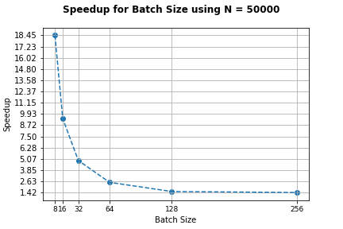
Speedup, fixed Number of Instances
Speedup was measured by dividing the time of execution of the serial version by that of the parallelized version produced by CUDA. Here we show both the speedup for a fixed size design matrix over different batch sizes for both serial and parallel implementations.

Slide 5
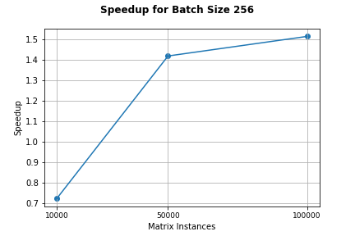
Speedup, fixed Batch Size
Fixing batch size to 256, changes N. The speedup increases as N increases but doesn’t scale well.
All the threads fits in a single block. A block in CUDA always executes on a single SM.

Slide 6
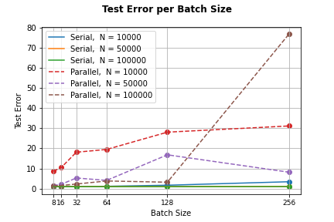
Test Error Over Batches
Here we plot the test error (measured by the mean squared loss) over the batch sizes considered for our different matrix configurations.

Slide 7
Summary
For a fixed matrix size, speedup decreases exponentially with increasing batch size. We believe this to be the case because the larger batch size causes the number of threads generated to decrease. Since we fix the number of threads per block to be 500, fewer threads results in fewer blocks run a SM.
Based on the first graph, the speedup grows as the number of matrix instrances increases, but it doesn’t scale well. The reason for that is the large batch size causes the number of threads to be small, therefore, all the threads can fit in one block to be run in one SM, making other SMs idle.
The test error was the greatest for the largest matrix in the parallel regime, probably due to the lock-free scheme where the different threads are free to access and overwrite the same weights all at once. This leads to a lot of race conditions. Therefore, the weights are not the most optimal as compared to the serial version.
Notes:
In conclusion, our implementation of parallel Hogwild version SGD has about 20 times speedup and the test error is almost the same as the serial version with a good choice of batch size. For future work, using CUDA streams can help hide the data transfer latency to gain further speedup.

