Slide 1
HUMAN RESOURCES ANALYTICS
Why The Best And Most Experienced Employees Leaving Prematurely?

Slide 2
What the dataset includes?
Employee satisfaction level
Last evaluation
Number of projects
Average monthly hours
Time spent at the company
Whether they have had a work accident
Whether they have had a promotion in the last 5 years
Department
Salary
Whether the employee has left

Slide 3
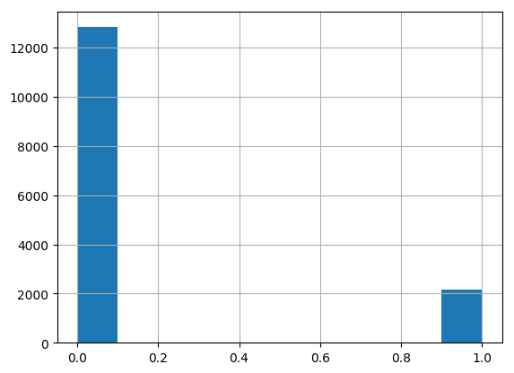
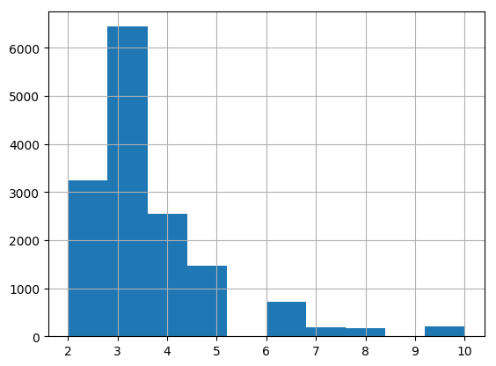
HISTOGRAMS
Work Accident
Time Spent At The Company

Slide 4
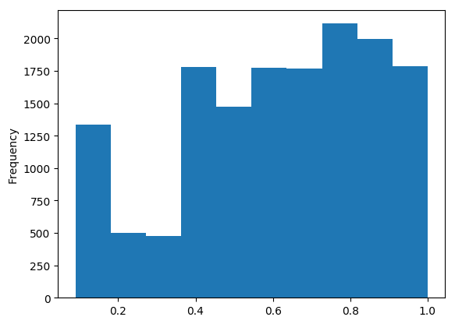
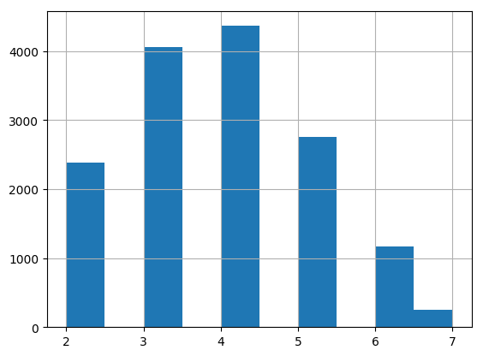
HISTOGRAMS (cont’d)
Satisfaction Level
Number of Projects

Slide 5
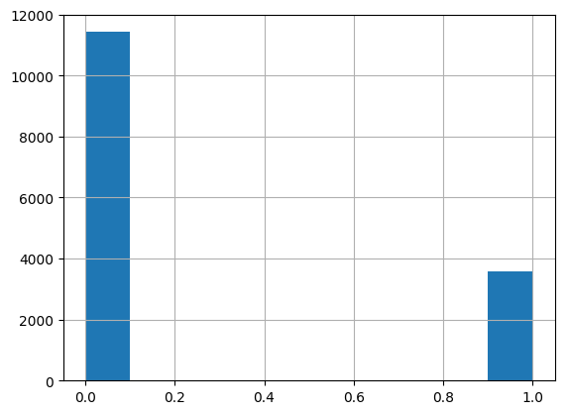
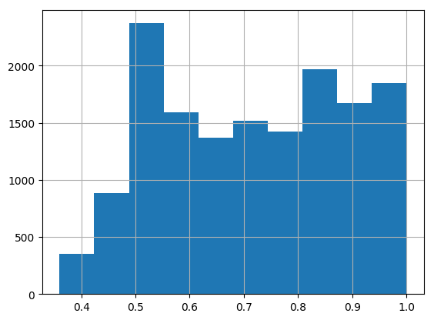
HISTOGRAMS (cont’d)
Left
Last Evaluation

Slide 6
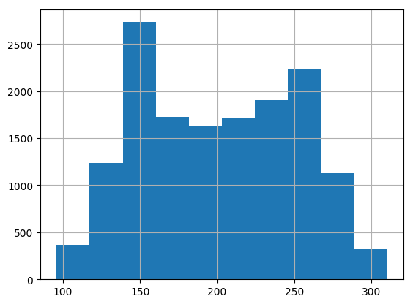
HISTOGRAMS (cont’d)
Average Montly Hours

Slide 7
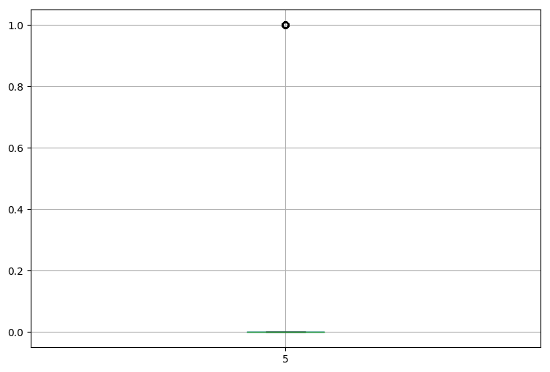
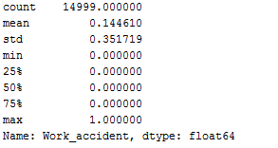
BOXPLOTS
Work Accident

Slide 8
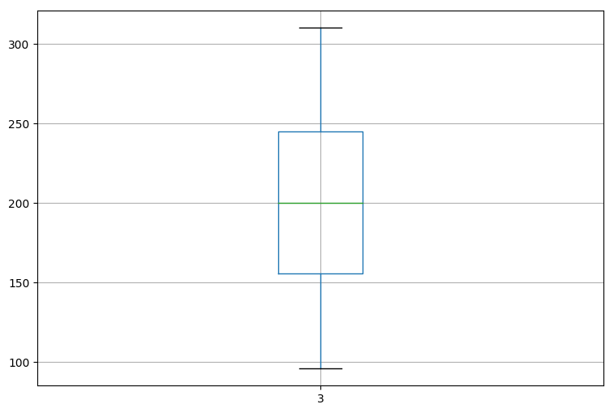
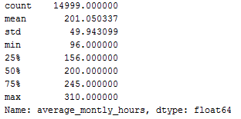
BOXPLOTS (cont’d)
Average Montly Hours

Slide 9

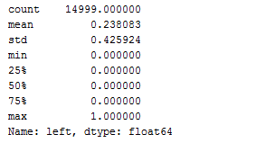
BOXPLOTS (cont’d)
Left

Slide 10
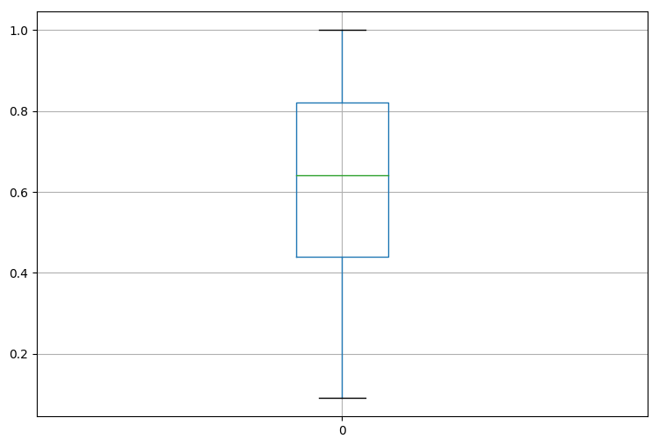
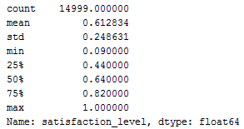
BOXPLOTS (cont’d)
Satisfaction Level

Slide 11
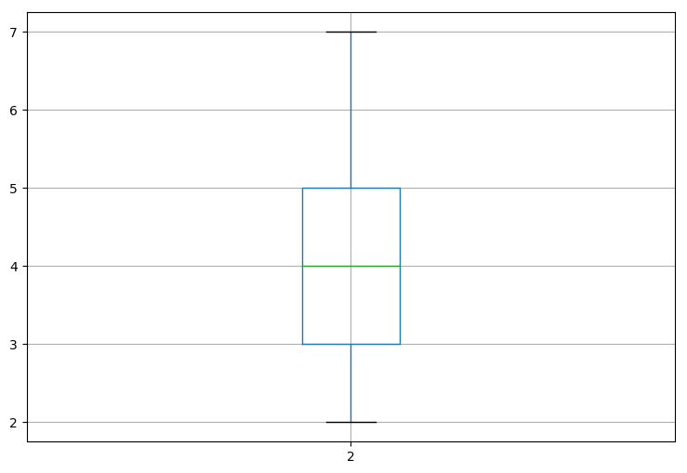
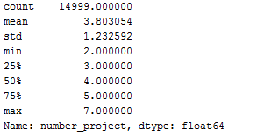
BOXPLOTS (cont’d)
Number of Projects

Slide 12
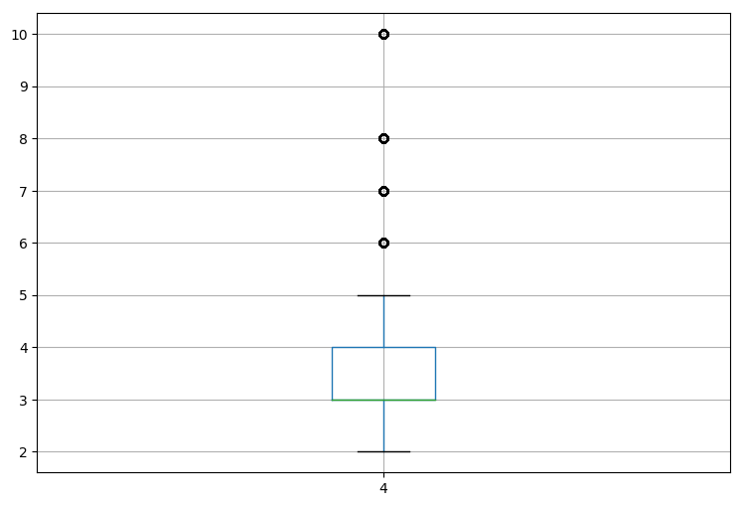
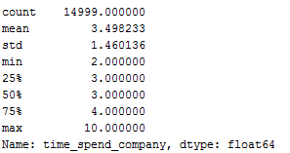
BOXPLOTS (cont’d)
Time Spent At The Company

Slide 13
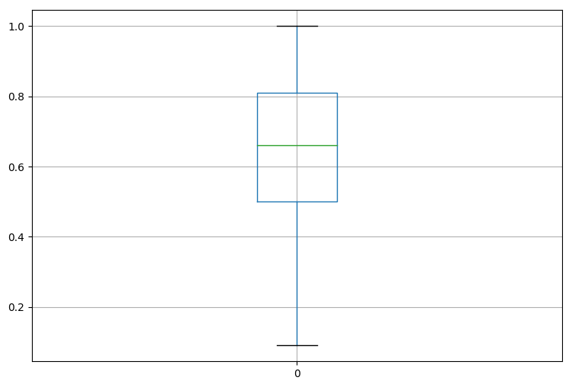

Specific Boxplots According To Salary
Satisfaction Level – High Salary
Satisfaction Level – Low Salary

Slide 14
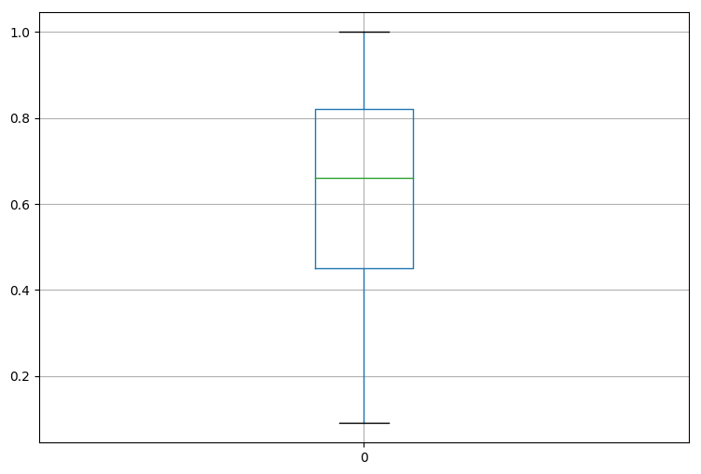
Satisfaction Level - Medium Salary

Slide 15
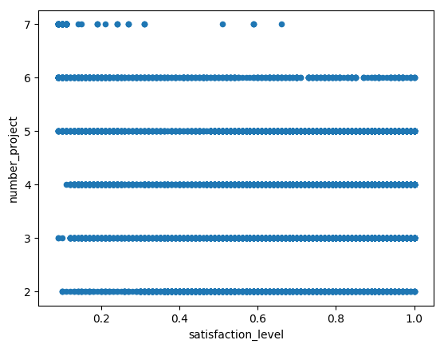
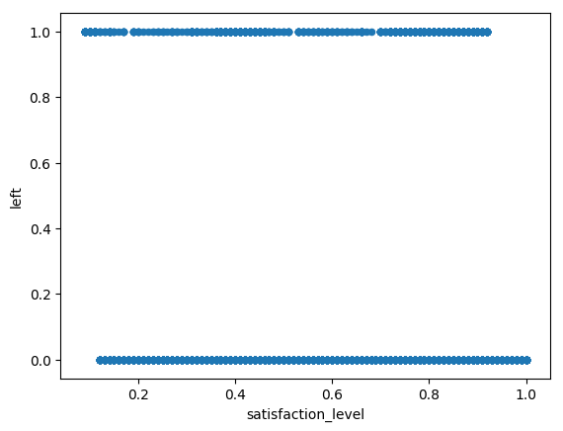
SCATTER PLOTS
Satisfaction – Number Of Project
Satisfaction – Left

Slide 16
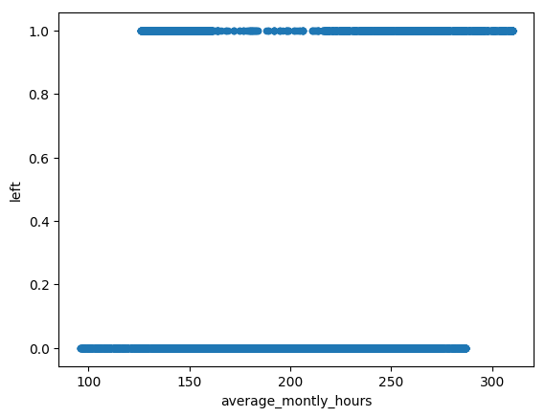
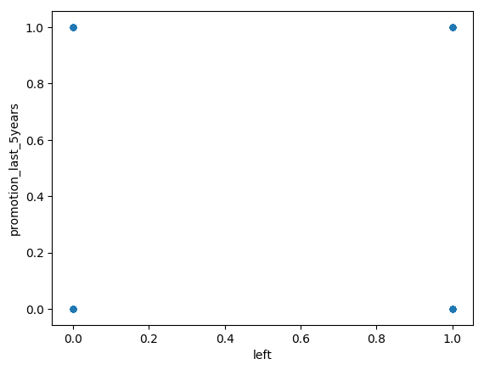
SCATTER PLOTS (cont’d)
Average Monthly Hours – Left
Left – Promotion Last Five Years

Slide 17
THANK YOU FOR LISTENING

