Slide 1

DevOps and the Division of Labor
From human machines to creative agents

Slide 2
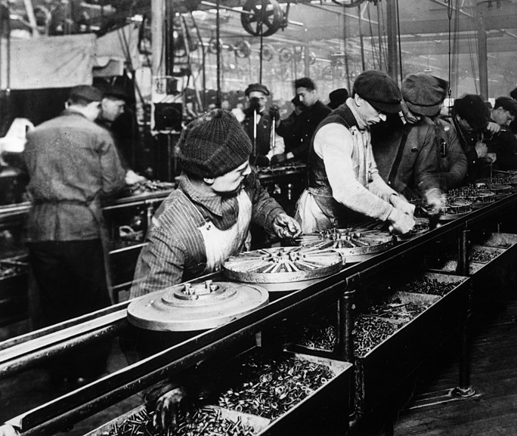
Assembly-Line Labor
The workers were human machines, given mechanical jobs beyond the capabilities of the then-current technology.

Slide 3
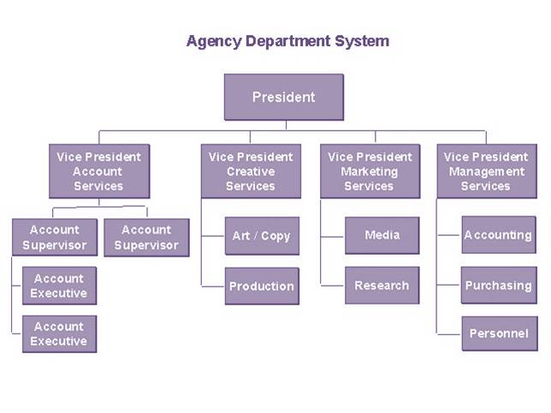
All Thinking Should Occur at the Top
The managers and factory engineers were supposed to think… the workers to do as they were instructed.

Slide 4
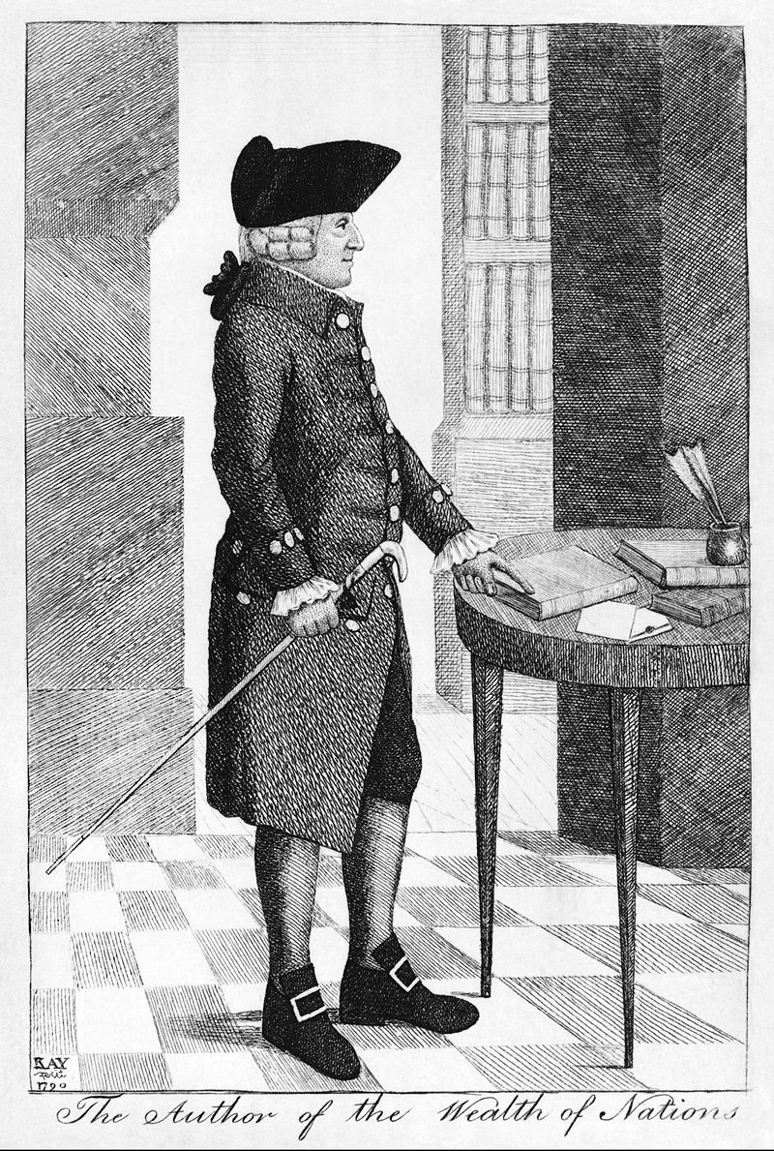
Adam Smith
“In the progress of the division of labour, the employment of... the great body of people, comes to be confined to a few very simple operations... But the understandings of the greater part of men are necessarily formed by their ordinary employments. The man whose whole life is spent in performing a few simple operations, of which the effects are perhaps always the same... has no occasion to exert his understanding or to exercise his invention... He naturally loses, therefore, the habit of such exertion, and generally becomes as stupid and ignorant as it is possible to become for a human creature to become.”

Slide 5
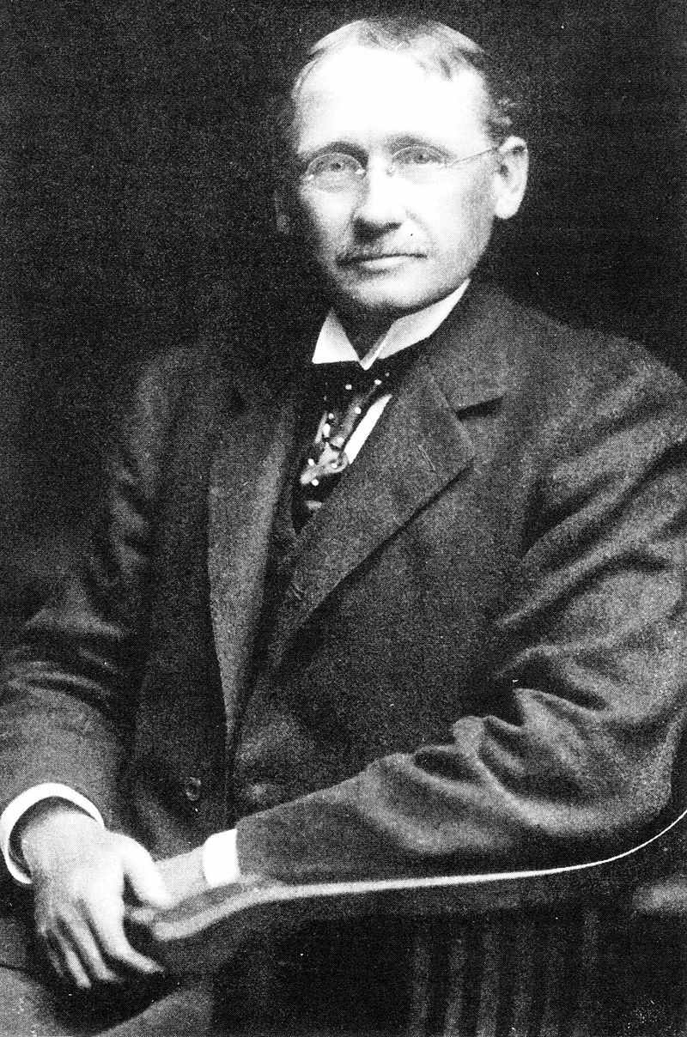
Taylorism
“He posited that time and motion studies combined with rational analysis and synthesis could uncover one best method for performing any particular task…” -- Wikipedia

Slide 6
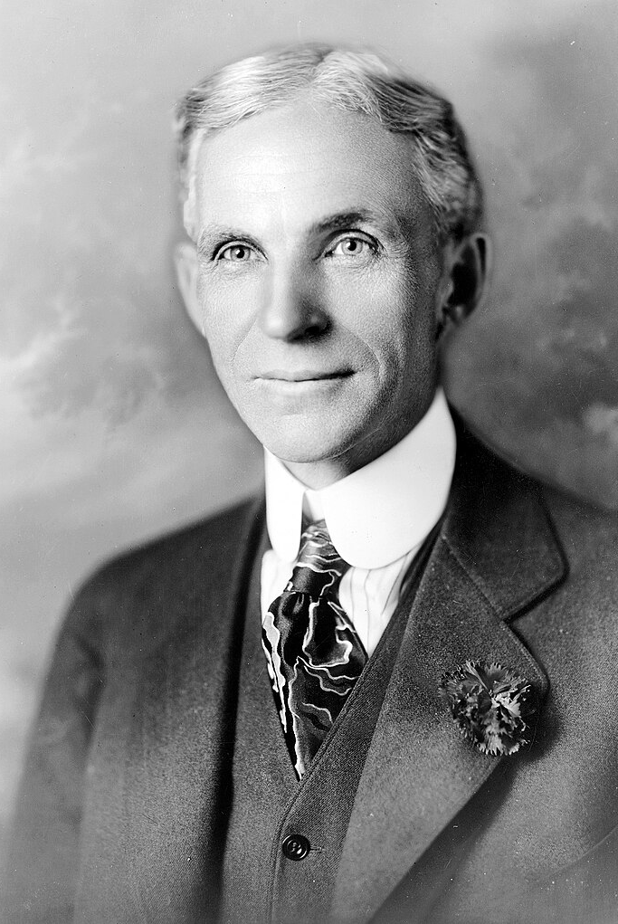
Henry Ford
Cars are available in “Any color the customer wants, as long as it’s black.”

Slide 7
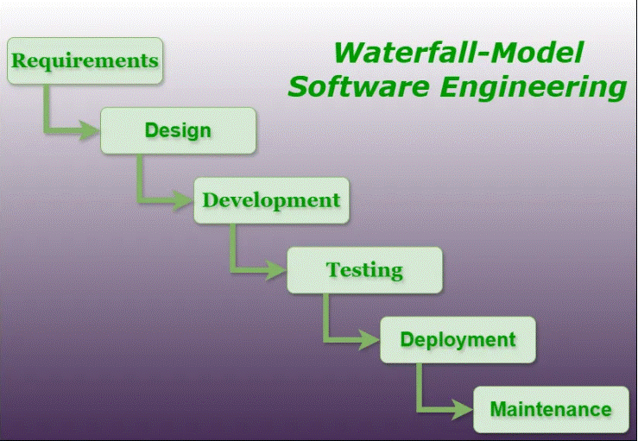
The Factory Model Applied to Software
Intelligence is concentrated in the first two steps.
“Coders” are the equivalent of factory workers.
The method assumes the product that is needed is known at the start.

Slide 8
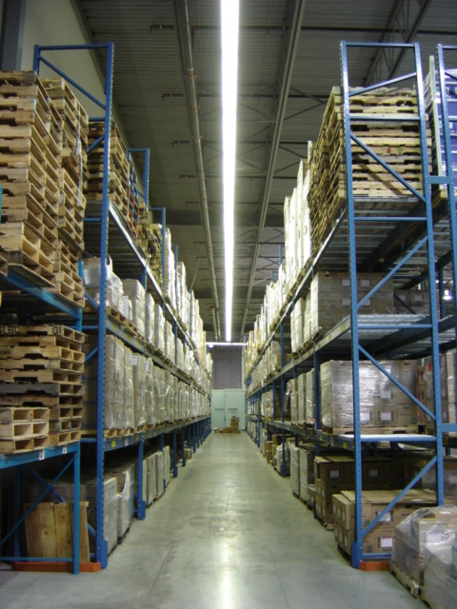
Building New Software Is Like Building a New Warehouse
We know (almost) exactly what we need.
All “blueprints” can be drawn up in advance.
Surprises are very unlikely. (Earthquake? Revoked zoning permission?)
The basic technology is stable.
Of course, all is different if one is building a cutting-edge warehouse!

Slide 9
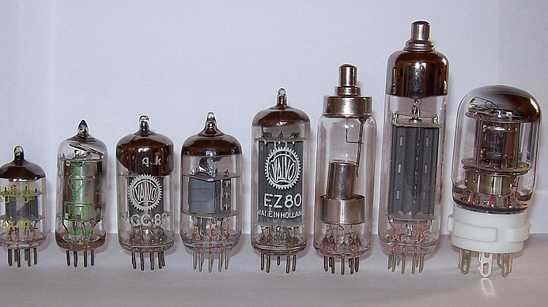
The Result
Who was the biggest consumer of vacuum tubes in the world by the 1990s?
Who needed so many they were buying them from Soviet bloc countries?
And why?

Slide 10
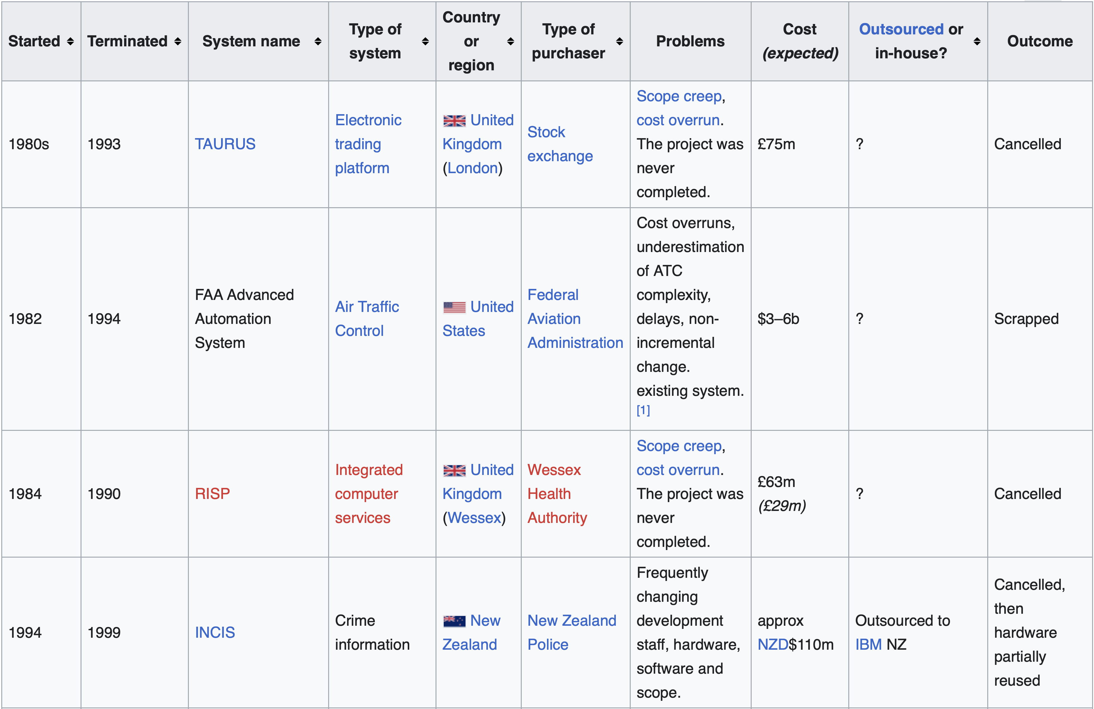
The Result: But Is There a Better Way?

Slide 11
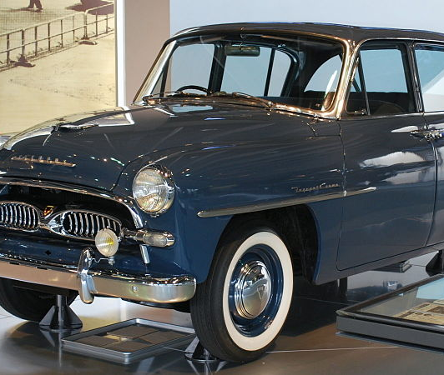
Toyota
“Toyota’s real innovation is its ability to harness the intellect of ‘ordinary’ employees” – Mary and Tom Poppendieck

Slide 12
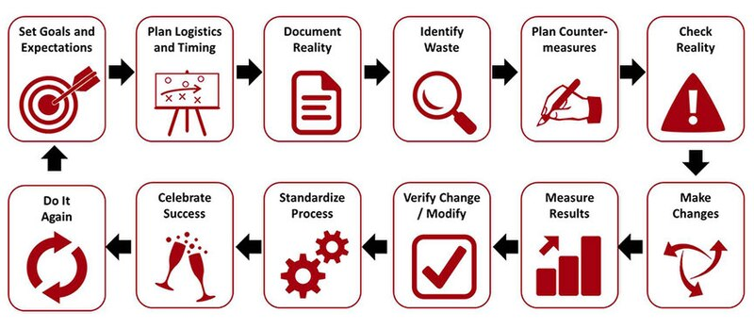
The Toyota Way
The right process will produce the right results
Create continuous process flow to bring problems to the surface.
Use the "pull" system to avoid overproduction.
Level out the workload (heijunka). (Work like the tortoise, not the hare.)
Build a culture of stopping to fix problems, to get quality right from the start. (Jidoka)
Standardized tasks are the foundation for continuous improvement and employee empowerment.
Use visual control so no problems are hidden.
Use only reliable, thoroughly tested technology that serves your people and processes.

Slide 13
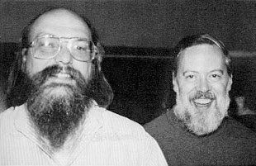
UNIX
Write small components
Deliver minimal versions of software fast
Wait for feedback before adding more features
Make components flexibly connected to allow rapid experimentation

Slide 14
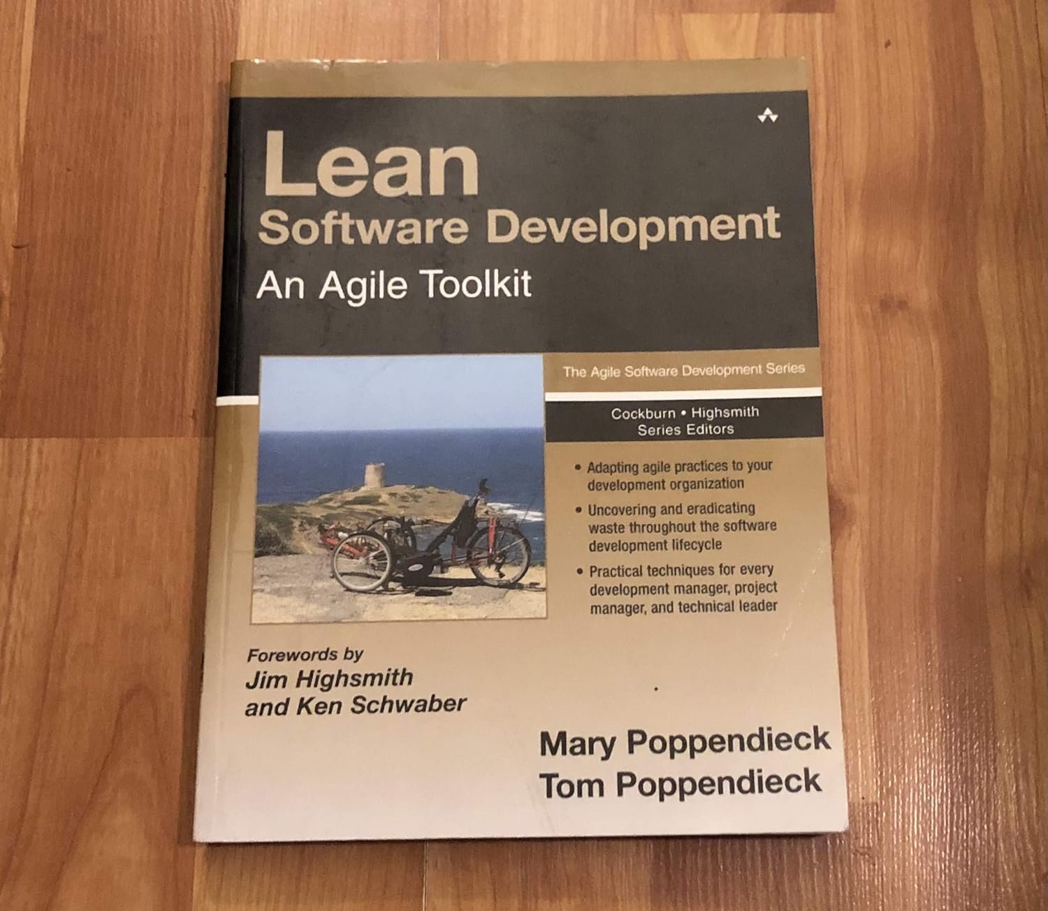
Lean Software Development
Lean development can be summarized by seven principles, very close in concept to lean manufacturing principles:
Eliminate waste
Amplify learning
Decide as late as possible
Deliver as fast as possible
Empower the team
Build integrity in
Optimize the whole
(Source: Wikipedia)

Slide 15
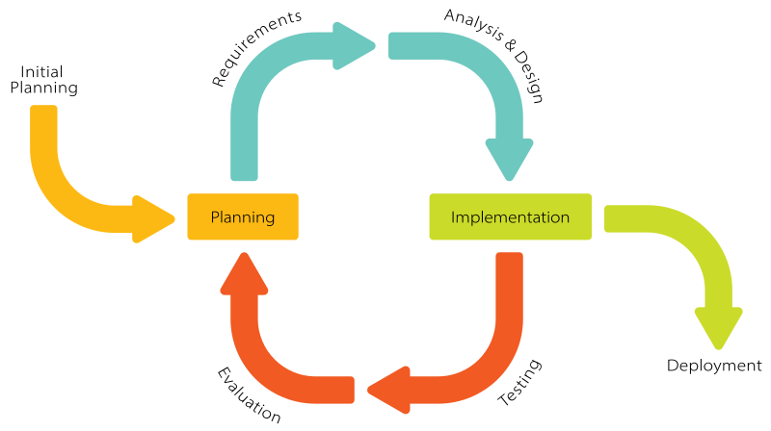
Agile
Individuals and interactions over processes and tools
Working software over comprehensive documentation
Customer collaboration over contract negotiation
Responding to change over following a plan

Slide 16
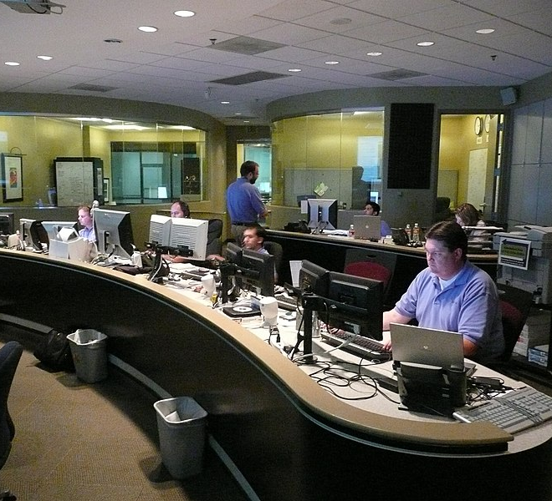
What About Operations?
The prevailing view (circa 2000):
Releases are painful
Software should remain stable as long as possible
An annual release cycle is about as much as can be endured!

Slide 17
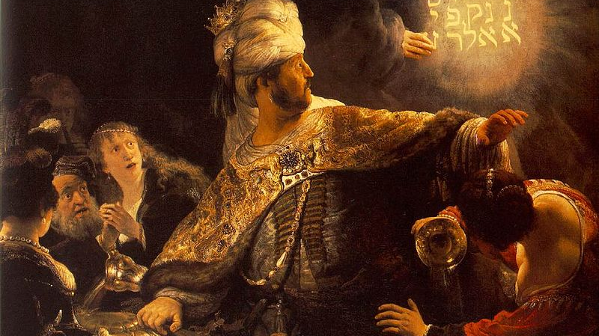
But… What If Operations Could Become Agile?

Slide 18
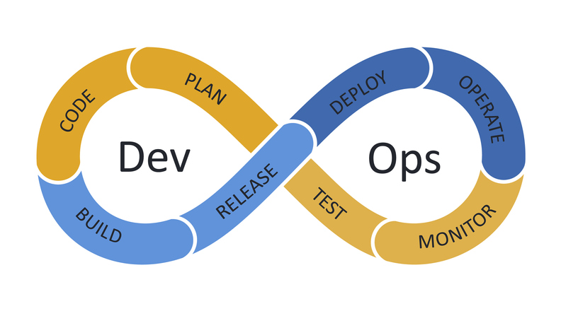
Bringing Development and Operations Together in an Agile Environment
Incremental development
Continuous testing
Continuous integration
Continuous delivery
Infrastructure as code
Monitoring

Slide 19

Here Comes Everybody!
“Successful lean initiatives must be based first and foremost on a deep respect for every person in the company, especially the ‘ordinary’ people who make the product or pound out the code.” – Mary and Tom Poppendieck

