Slide 1
Probabilities
Dr. Eugene Callahan

Slide 2
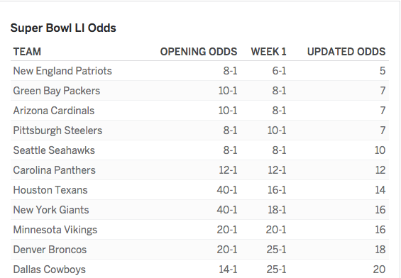
Introduction
What does all this mean?!

Slide 3
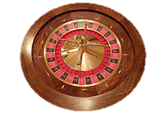
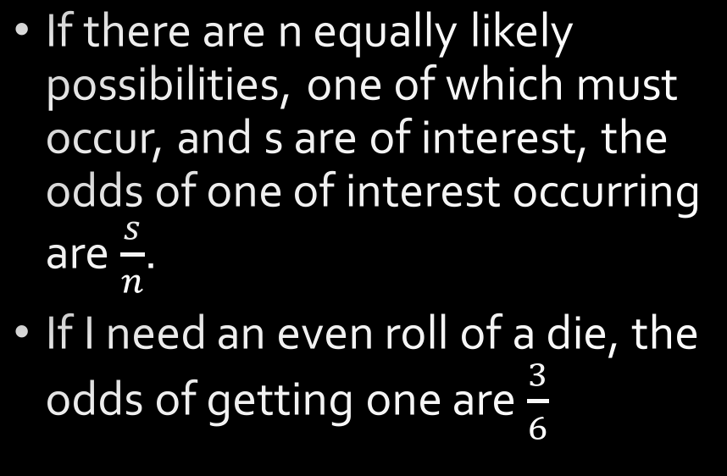
Classical View
If there are n equally likely possibilities, one of which must occur, and s are of interest, the odds of one of interest occurring are $\frac{s}{n}$.
If I need an even roll of a die, the odds of getting one are $\frac{3}{6}$

Slide 4
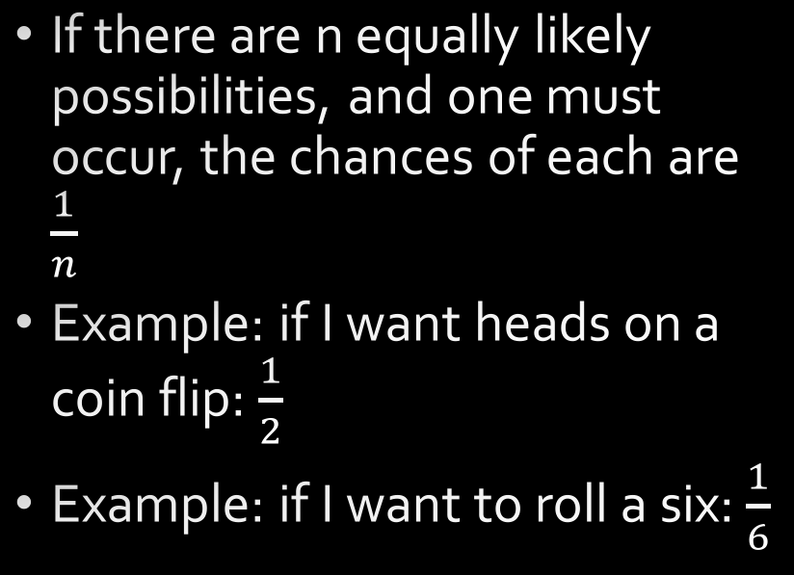
Classical View
If there are n equally likely possibilities, and one must occur, the chances of each are $\frac{1}{n}$
Example: if I want heads on a coin flip: $\frac{1}{2}$
Example: if I want to roll a six: $\frac{1}{6}$

Slide 5
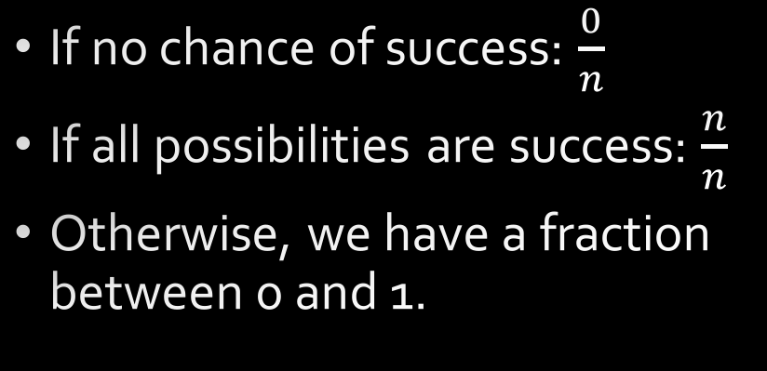
Classical View
If no chance of success: $\frac{0}{n}$
If all possibilities are success: $\frac{n}{n}$
Otherwise, we have a fraction between 0 and 1.

Slide 6
Classical View

Slide 7
Probabilities and Odds

Slide 8
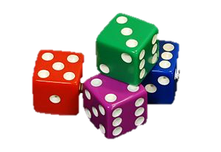
Probabilities: Let’s Play Yahtzee!
How many combinations of two dice are there?
How many are there if order doesn’t matter?
What are the odds of rolling two sixes?
What are the odds of rolling a six and a two?

Slide 9
Frequency Interpretation
The probability of an event occurring is interpreted as the proportion of the time that similar events will occur in the long run.

Slide 10
Frequency Interpretation
Law of large numbers.
“If the number of times a situation is repeated becomes larger and larger, the proportion of successes Will 10 to come closer and closer to the actual probability of success.”
WARNING: Only true for normally distributed populations!
Adding largest human to population versus adding richest human.

Slide 11
Sources
By Source (WP:NFCC#4), Fair use, https://en.wikipedia.org/w/index.php?curid=50963016

Slide 12
Subjective Interpretation

Slide 13
Axiomatic View

