Slide 1
Week 3: Coding Day
“Teamworking and Collaborative Learning”

Slide 2

Instruction
Student must complete the Week 3 Coding Day Challenges on USART and I2C for exam revision and the AMR project development.
Develop STM32F446 code to acquire real-time data from the RPLidar C1 and MPU6500 using interrupts, DMA, and relevant peripheral register configuration.
Use PulseView to analyse the sensor signals and protocols, and convert captured data into meaningful physical values.
The minimum required analysis is the revision for final closed-book examination reviewion, namely RPLidar C1 SCAN mode and MPU6500 gyroscope transactions.
Additional extension work should include RPLidar C1 Express mode and the MPU6500 accelerometer are required for the AMR project development.
Submit an analysis report and demonstrate the working system to the TA. The Coding Day mark will be awarded individually through questioning based on the report, the protocol analysis, and the live demonstration.
Submit report using this QR code

Slide 3
Task 1: STM32F446 Real-Time Sensor Interfacing
Develop an integrated STM32F446 code to acquire data from:
RPLidar C1 using USART
MPU6500 using I2C
Your implementation must use a real-time interrupt and DMA approach, not simple polling. This includes configuring the relevant peripheral registers as appropriate, such as:
USART configuration registers for baud rate and communication setup
I2C configuration registers for master communication
DMA stream/channel configuration
interrupt enable and NVIC configuration
Your code should demonstrate that the microcontroller can continuously receive or transfer sensor data reliably in real time.

Slide 4
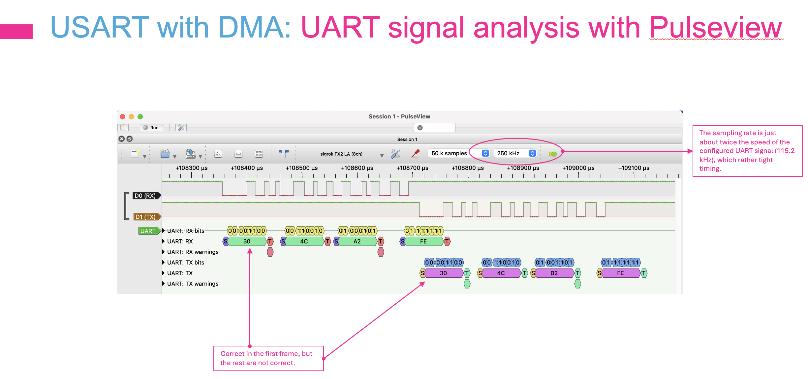
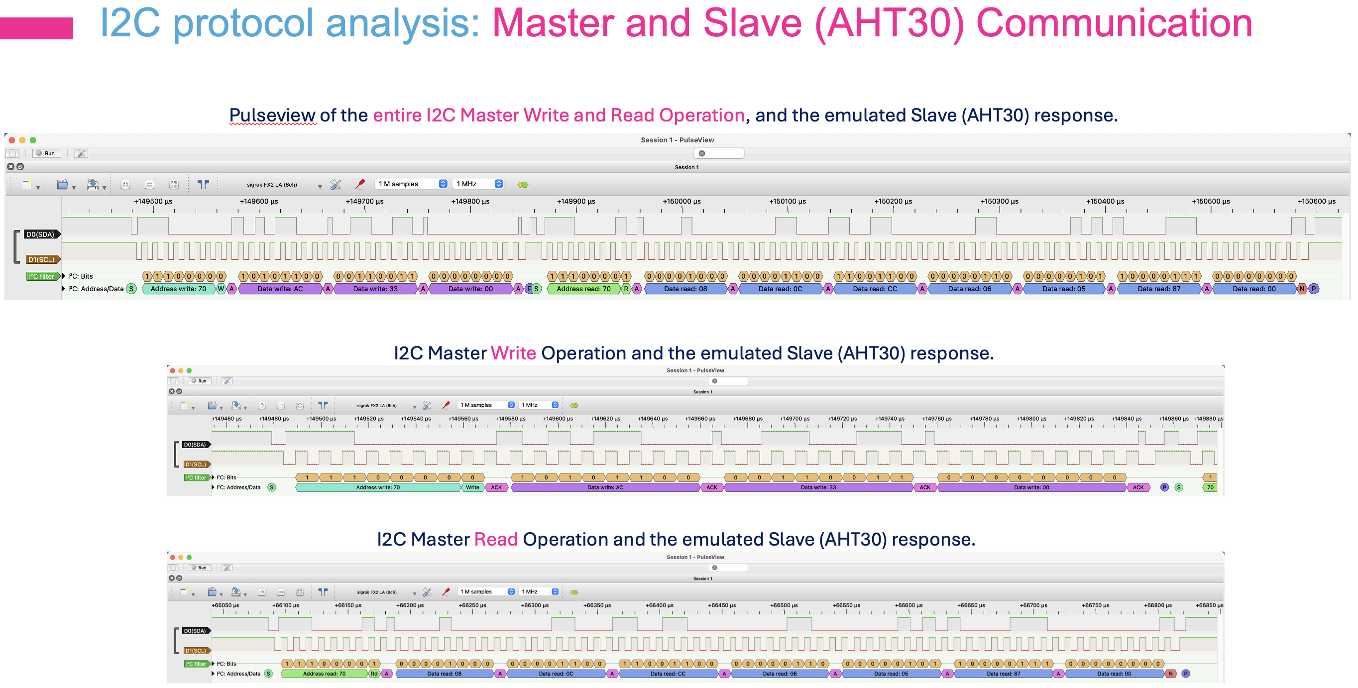
Task 2: Protocol Analysis Using PulseView
Using PulseView logic analyser to capture and analyse the signalling and protocol communication of both RPLidar C1 and MPU6500 sensors.
Your analysis must include the minimum required parts listed in the following sub-sections of RPLidar C1 and MPU6500, which are based directly on the knowledge required for final closed-book examination, together with additional extension analyses towards the project development.
Pulseview Signaling and Protocol Analyses

Slide 5
Task 2.1: RPLidar C1 Analysis
Capture and analyse the UART communication between the STM32F446 and the RPLidar C1.
Minimum required analysis
Configure the USART communication settings used for the sensor
Identify the response descriptor in SCAN mode
Identify the start of each measurement sample
Explain how the start bits work in the SCAN-mode packet format
Decode at least one measurement sample
Determine and explain:
whether the sample is valid
the quality value
the angle in degrees
the distance in mm
Additional extension analysis
Express mode packet structure and behaviour;
How Express mode differs from normal SCAN mode
How the captured bytes would be interpreted in Express mode

Slide 6
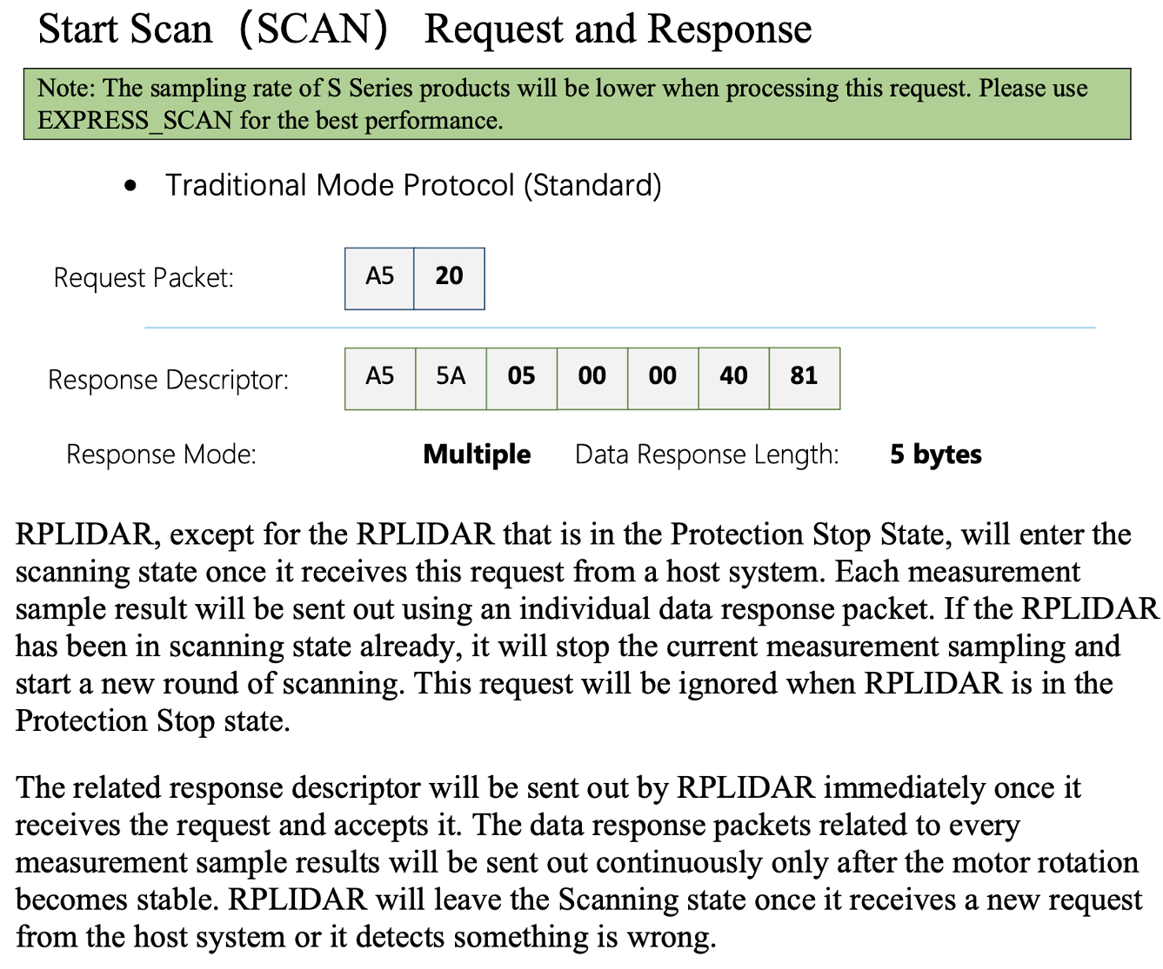
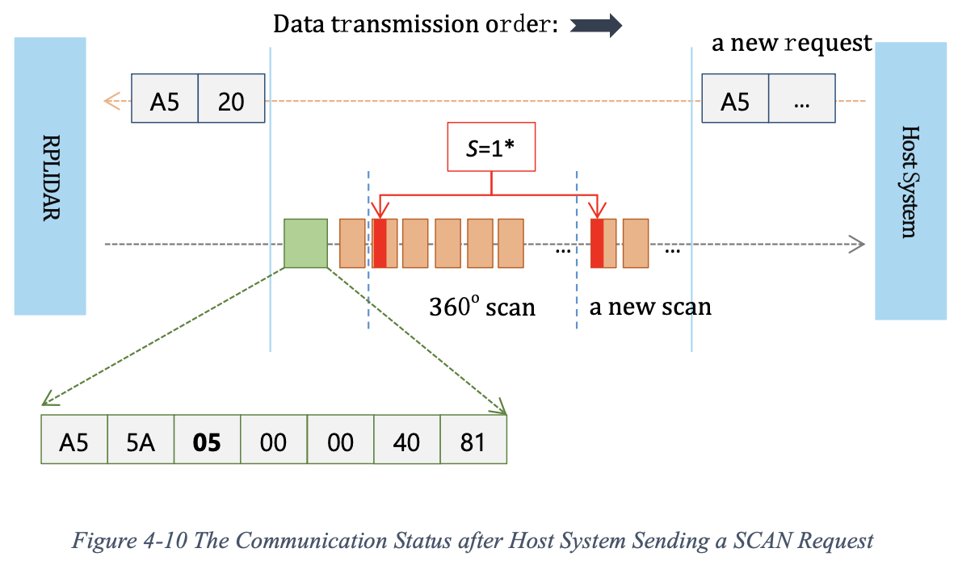
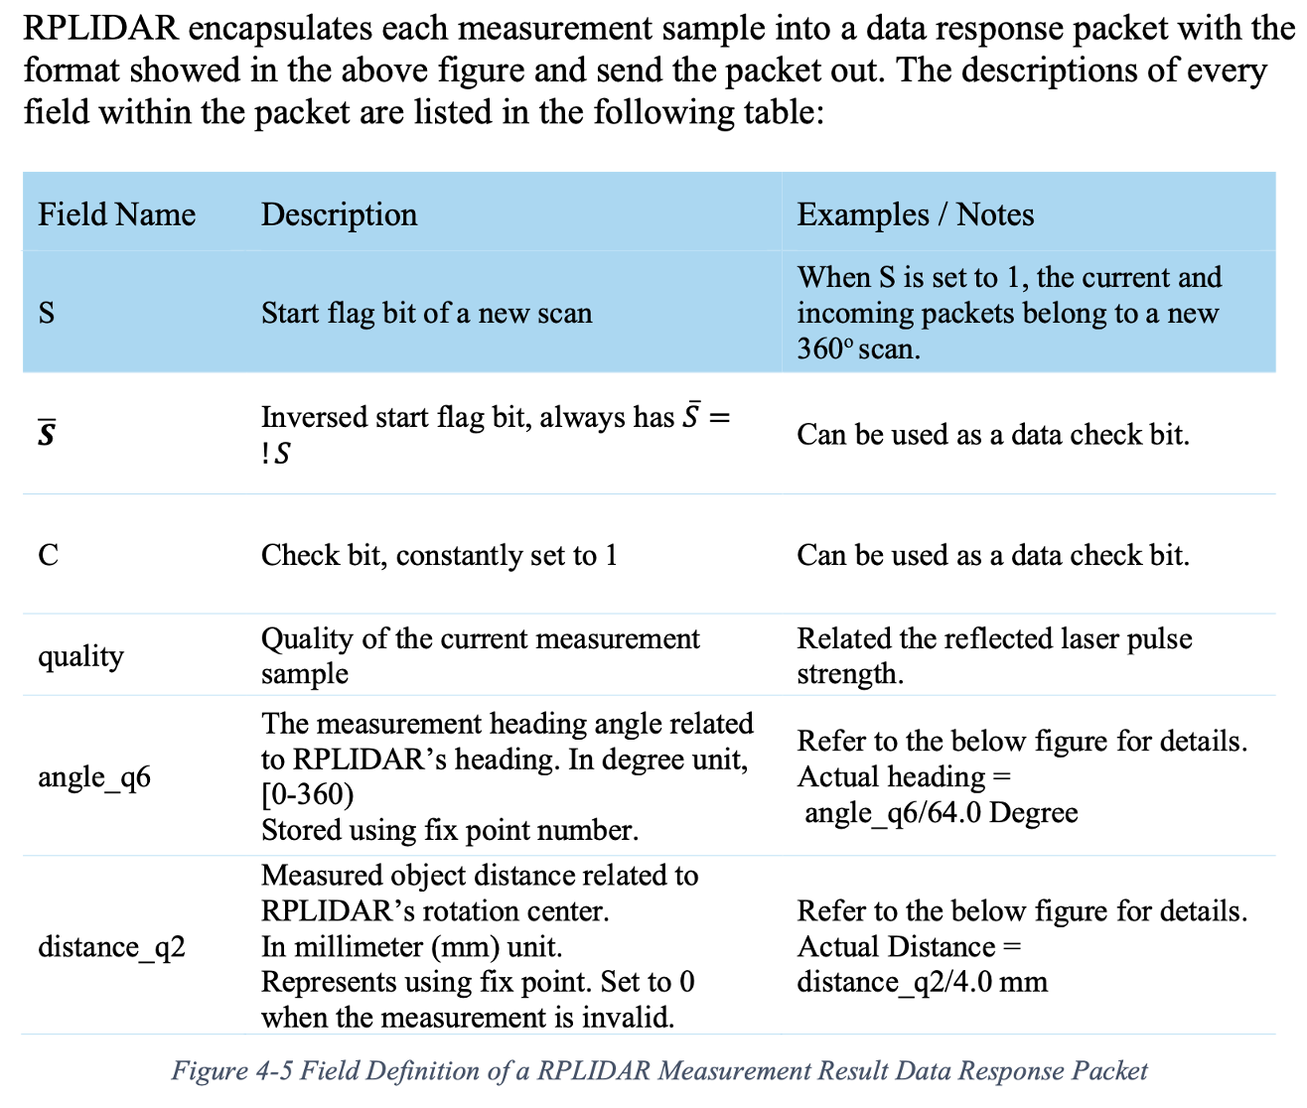
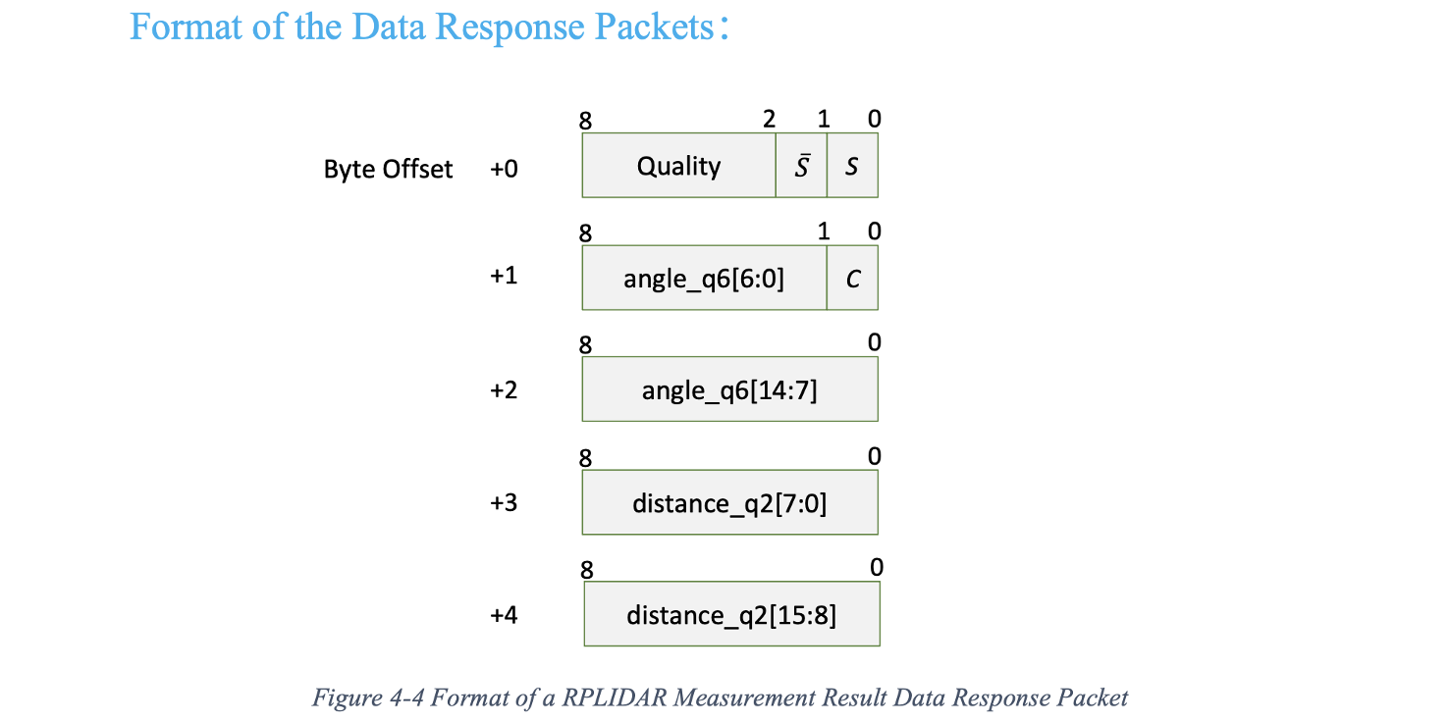
Task 2.1: RPLidar C1 Analysis

Slide 7
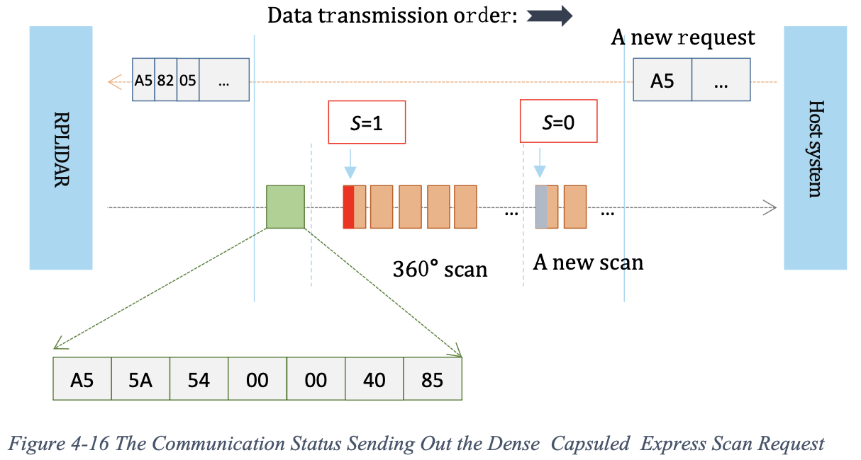
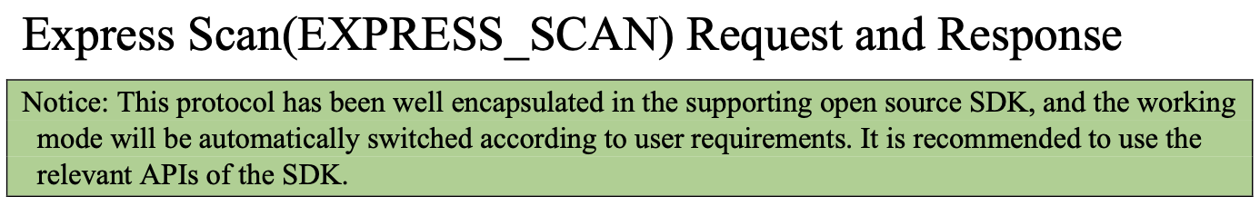
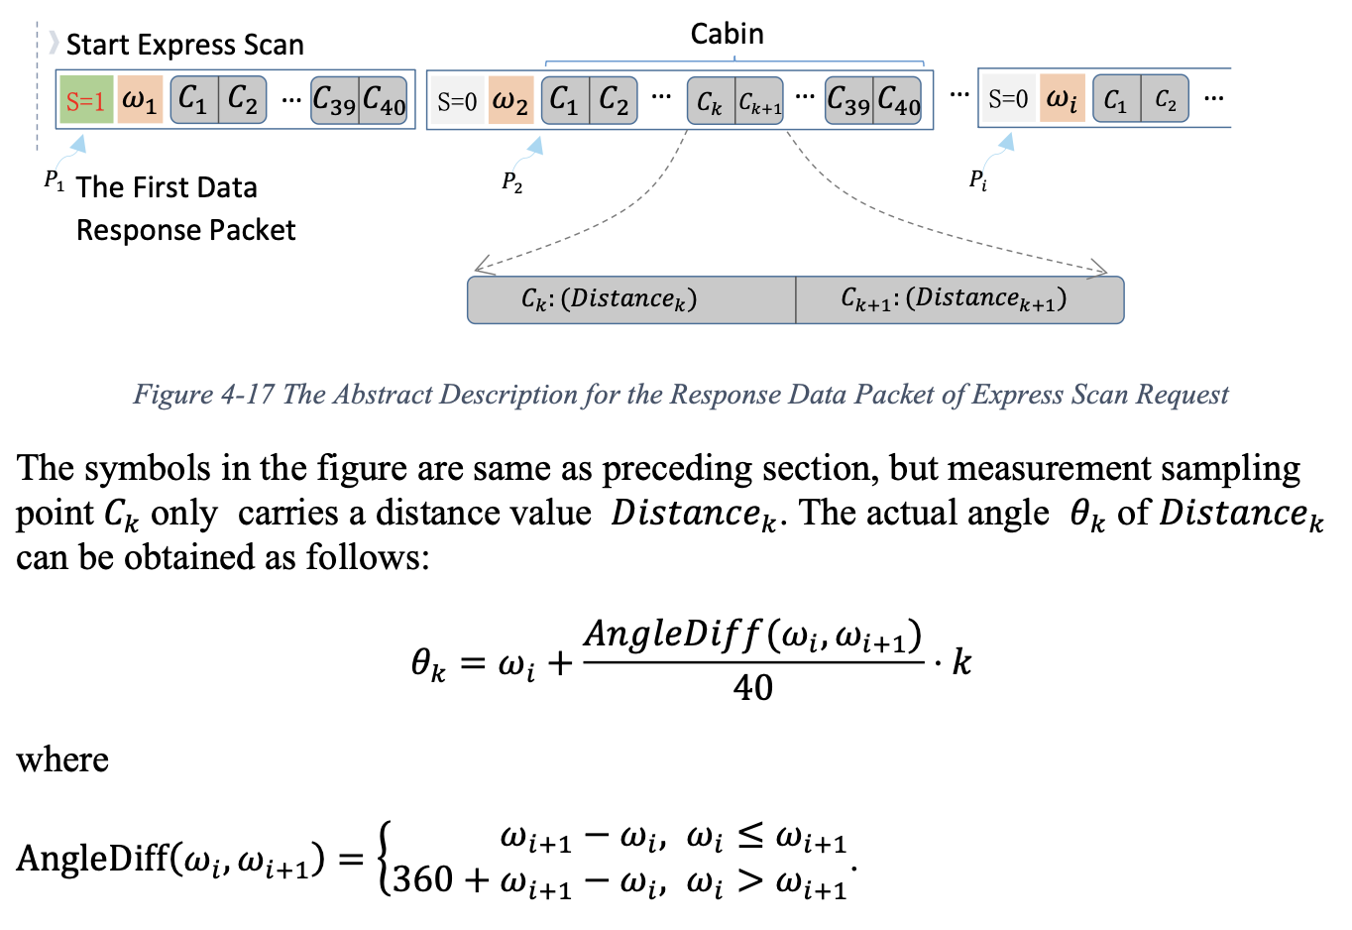
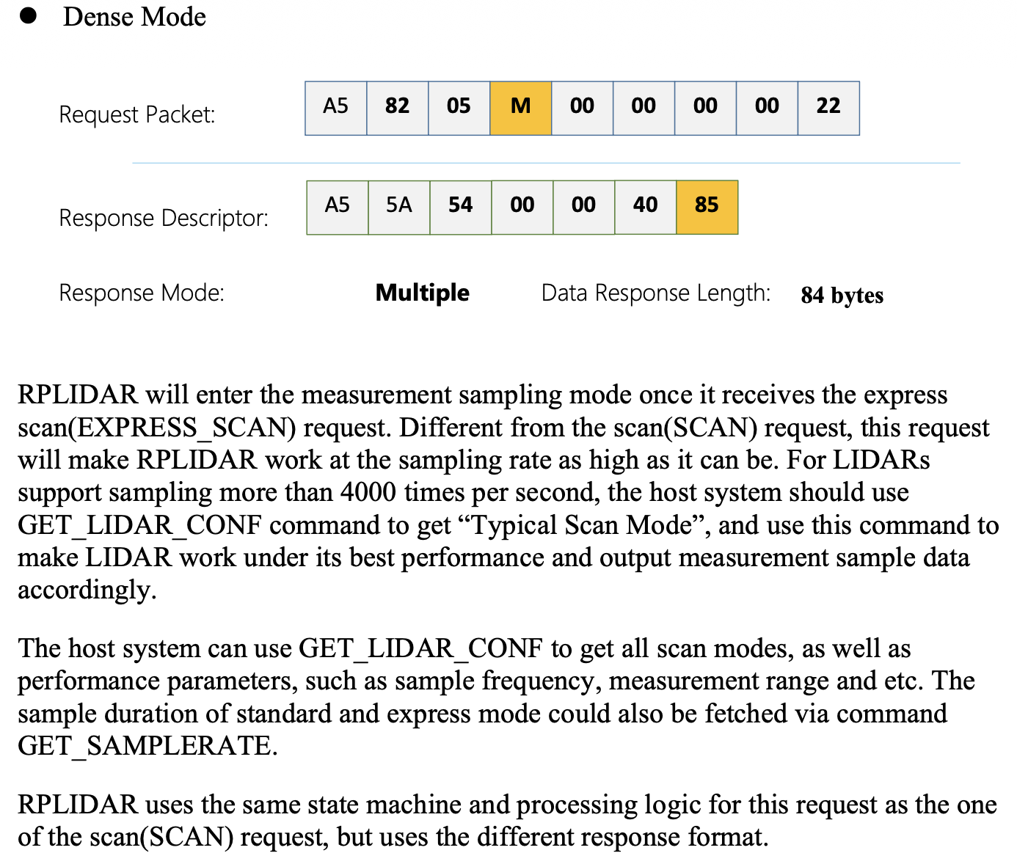
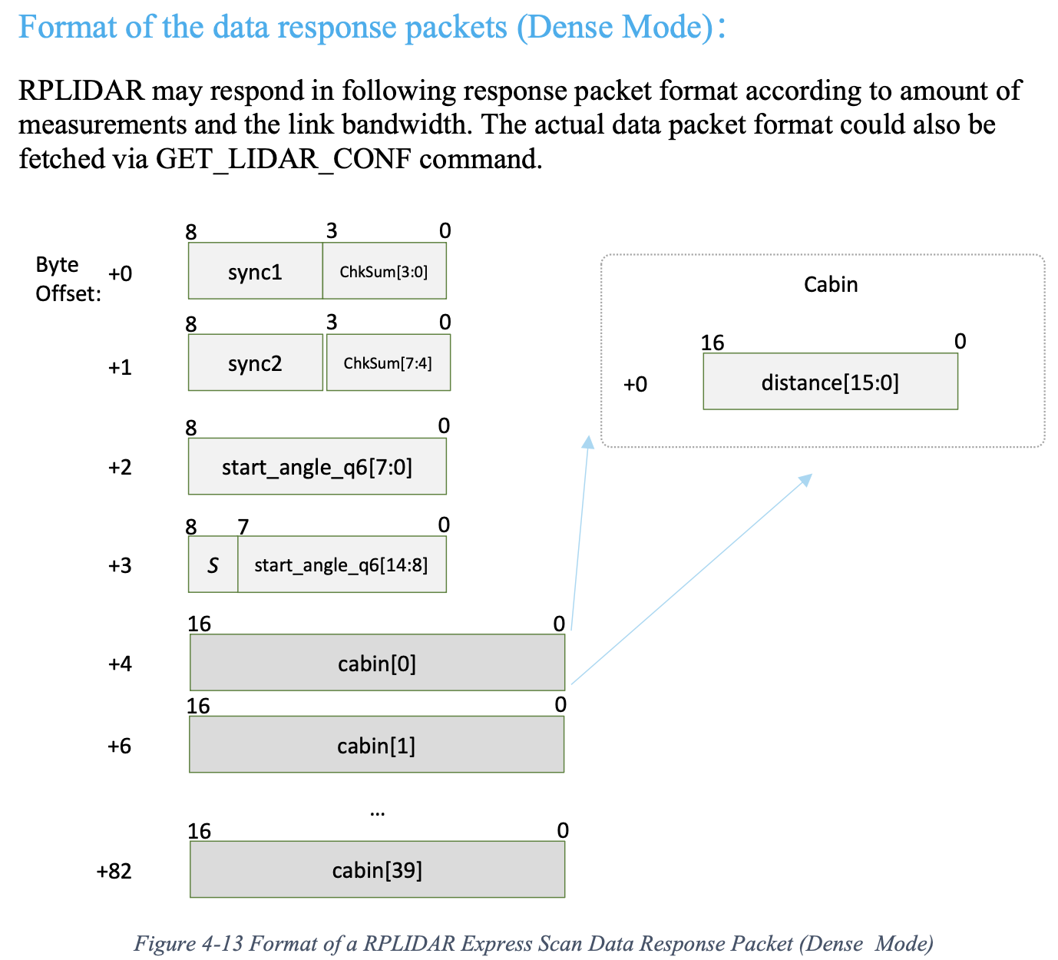
Task 2.1: RPLidar C1 Analysis

Slide 8
Task 2.2: MPU6500 Analysis
Capture and analyse the I2C communication between the STM32F446 and the MPU6500.
Minimum required analysis
Identify the device address and the meaning of the read/write address bytes
Identify the register address used in the transaction
Explain the I2C transaction sequence, including:
START, address + write, register selection, repeated START, address + read, returned data bytes, ACK/NACK and STOP
Reconstruct the returned gyroscope values from the captured bytes
Convert the raw gyroscope readings into:
16-bit hexadecimal values
signed decimal values
physical values in appropriate units
Additional extension analysis
the accelerometer registers and read sequence
reconstruction of raw accelerometer output data
conversion of accelerometer readings into meaningful physical values

Slide 9
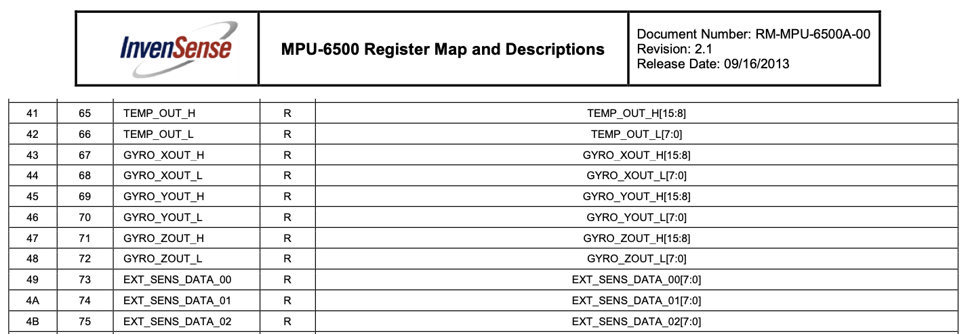
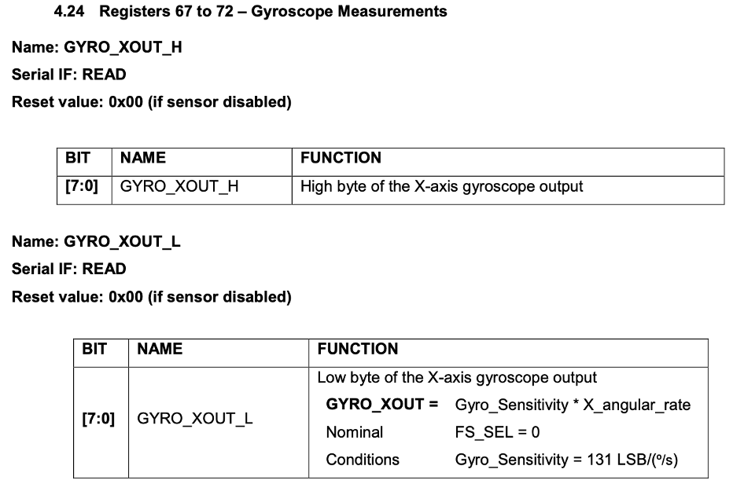
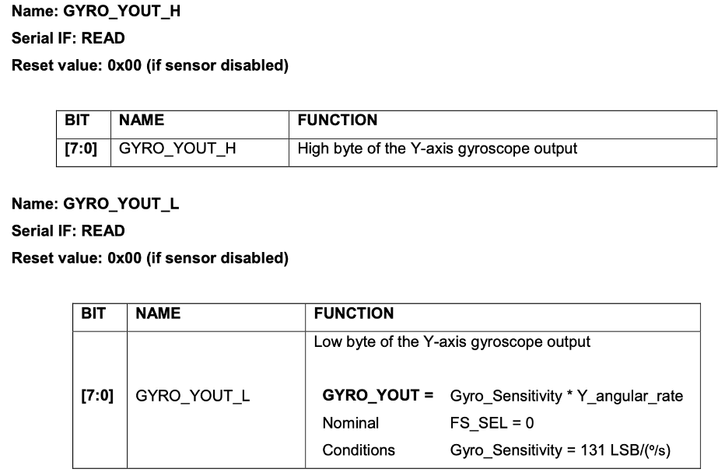
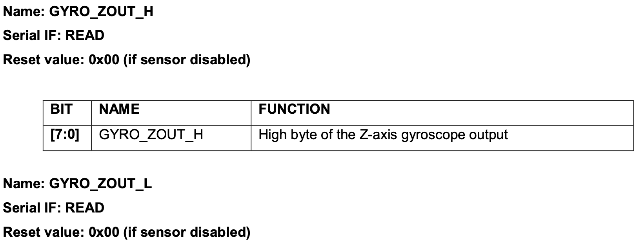
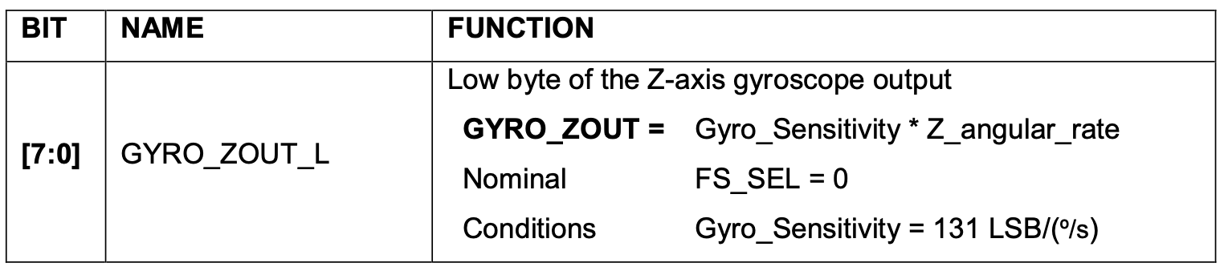
Task 2.2: MPU6500 Analysis

Slide 10
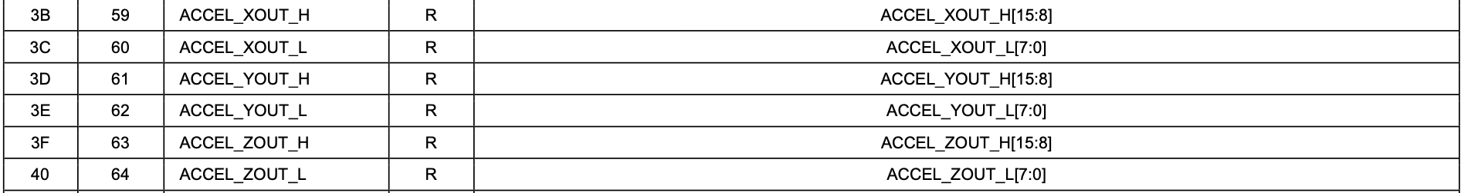
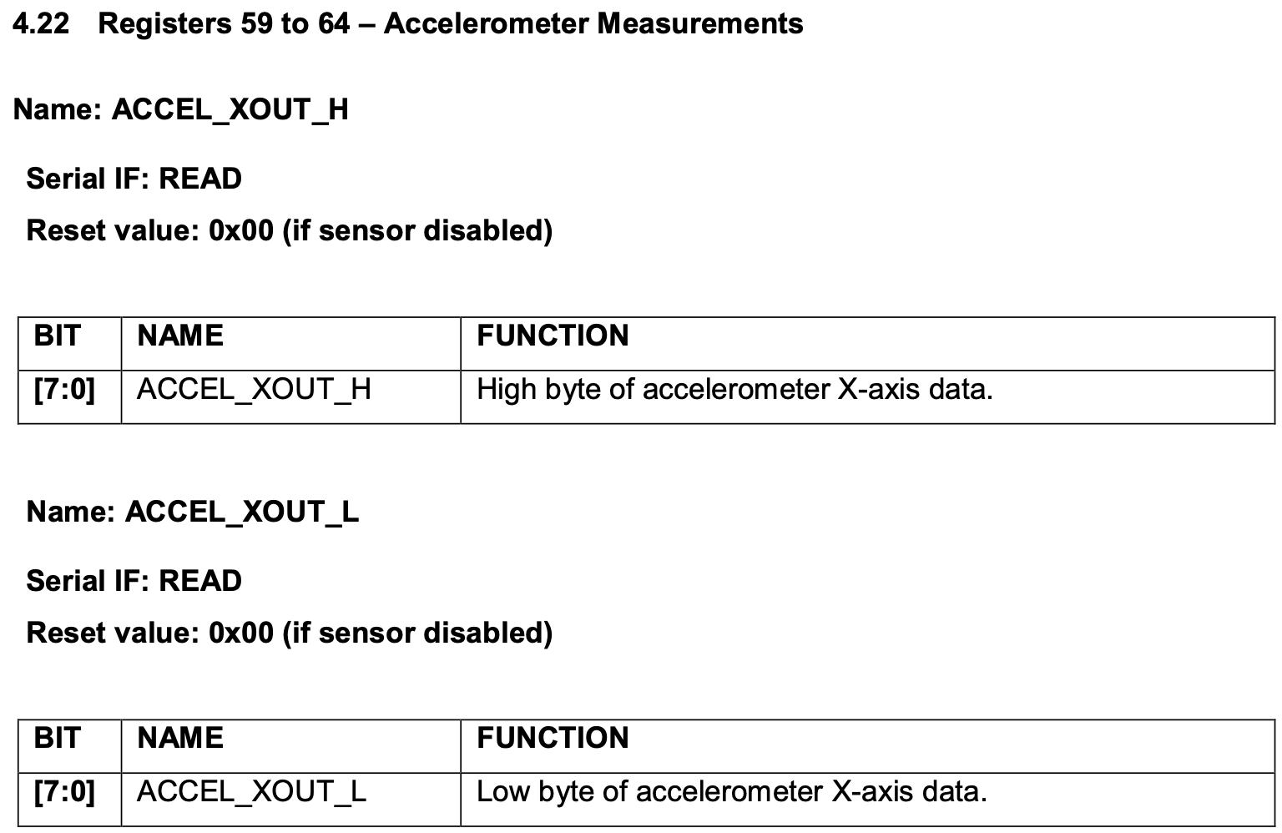
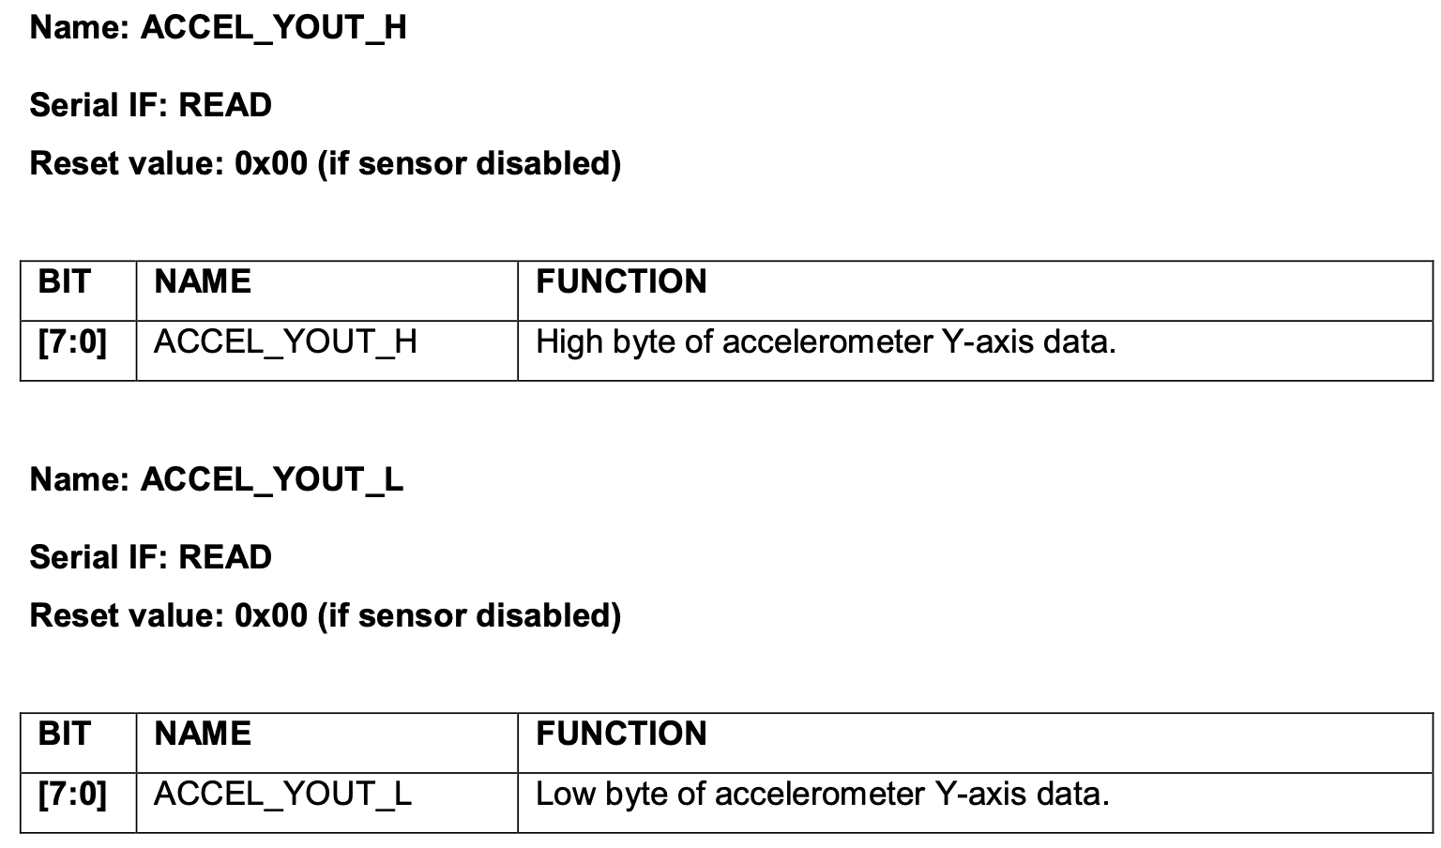
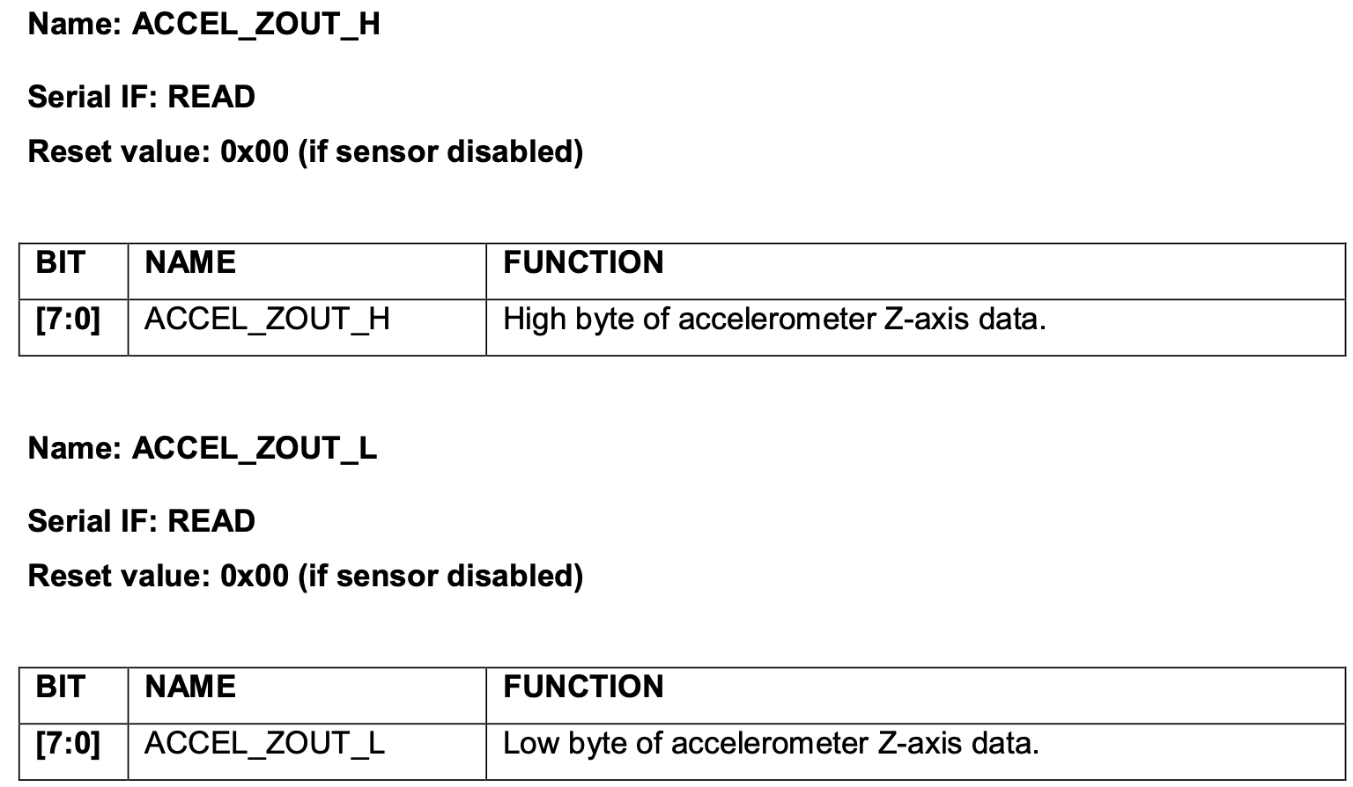
Task 2.2: MPU6500 Analysis

Slide 11
Task 3: Analysis Report
Prepare a short analysis report that clearly documents:
Your peripheral configuration approach
How interrupts and DMA are used
PulseView captures of UART and I2C transactions
Protocol interpretation for each sensor
Example calculations showing how raw bytes are converted into meaningful values
Brief explanation of any implementation issues, debugging steps, or limitations
The report should be technical, concise, and structured clearly enough that each member can explain it confidently.

Slide 12
End of Week3

