Slide 1
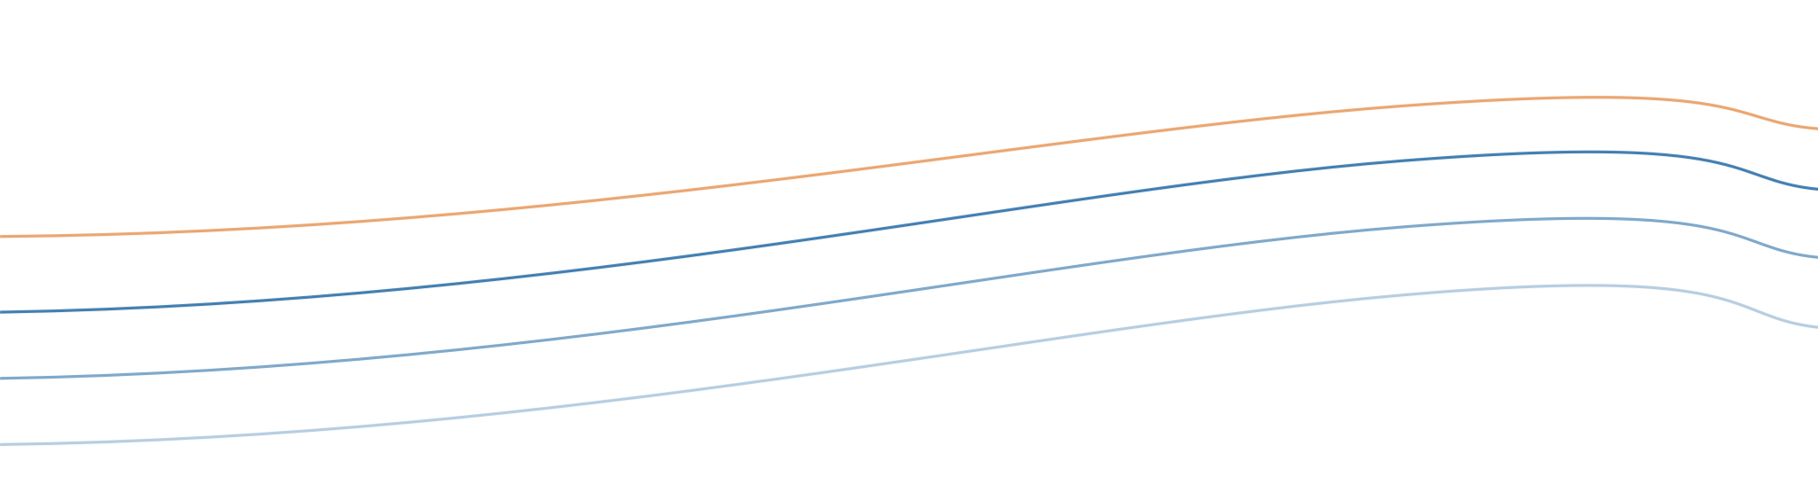


Observation products
LOCMARCA 2026 · COURSE 1
In situ vs satellite, and what a gridded dataset really tells you
LOCMARCA 2026
Notes:
Welcome. This first course is about the data you will handle all week: observations of the ocean and the atmosphere. The goal is not to make you instrument specialists, but to give you the reflexes to read any dataset critically: what was measured, where, when, how, and what was filled in afterwards. The lines in the background are isotherms rising towards the Costa Rica Dome: we will meet them again in TP1b.

Slide 2
What you should take away
GOALS
1
2
3
Choose
Understand
Question
Pick the right product for a question: variable, depth, period, resolution.
Know how the numbers were made: measured, interpolated, or averaged.
Spot the limits of a dataset before they turn into wrong conclusions.
Not a catalogue: a way of reading any dataset you will meet this week.
LOCMARCA 2026 · Course 1 — Observation products
2
Notes:
Three verbs. Choose: by Thursday (TP4) you will pick your own data for a region; you need to know what exists. Understand: a map of SST can be a direct measurement, an interpolation of many sensors, or a 30-year average; these are different objects. Question: most mistakes in data analysis come from using a product outside what it can say, not from coding errors.

Slide 3
Six questions, one hour
ROADMAP
1
2
3
In situ vs satellite
Ocean, atmosphere, BGC
2D vs 3D
Who measures what, and how
The variables and their products
The surface and the water column
4
5
6
Coverage
Climatology vs interannual
Gridded data
How often, how fine, how long: advantages and limits
The typical year and the real ones
What interpolation adds, and what it hides
LOCMARCA 2026 · Course 1 — Observation products
3
Notes:
The six items of the programme. Parts 1 to 4 are about the instruments and their sampling; part 5 is about the time axis of a product; part 6 is about what happens between the raw measurements and the neat map you download. About 10 minutes per part. Encourage questions at any time.

Slide 4
Every dataset is a compromise between what is measured, where, when, and how precisely.
PART 1 · IN SITU VS SATELLITE
No product does everything. Knowing which compromise it made is most of the skill.
Notes:
Key message of the whole course. A ship measures very precisely, down to the bottom, but at one place and one time. A satellite sees the whole surface every day, but only the surface, and indirectly. Every dataset sits somewhere in this space of compromises; the rest of the course is about locating it.

Slide 5
In situ: measured where the instrument is
PART 1 · IN SITU VS SATELLITE
Ships
CTD casts and water samples: full depth, physics and biogeochemistry, but rare and expensive
Strengths
Direct and accurate
Below the surface, down to the bottom
Long records at fixed points
The reference used to calibrate satellites
Moorings
e.g. the TAO/TRITON array in the tropical Pacific: one point, measured continuously for years
Argo floats
About 4,000 floats worldwide, a temperature and salinity profile every 10 days, 0–2,000 m
Limits
Sparse and irregular in space
Gaps in time
Costly: few in coastal and developing regions
And also
Surface drifters, gliders, tide gauges, coastal and weather stations
LOCMARCA 2026 · Course 1 — Observation products
5
Notes:
In situ means the sensor is in the water (or the air) where the value is measured. CTD = Conductivity, Temperature, Depth: the basic profiling instrument lowered from a ship. Moorings give long, continuous series at one point; the TAO/TRITON array along the equatorial Pacific was built to monitor El Niño. Argo revolutionised oceanography after 2000: autonomous floats that dive to 2,000 m, drift, and surface every 10 days to send a profile by satellite. Ask the participants which in situ data they already use in their own work (coastal stations, fish surveys, plankton nets...).

Slide 6
Satellites: the whole surface, from above
PART 1 · IN SITU VS SATELLITE
What | Sensor | The catch
Sea surface temperature | Infrared and microwave radiometers | Infrared is blocked by clouds; microwave sees through them but is coarse (tens of km)
Sea level anomaly | Altimeters | Measured along tracks only; gridded maps smooth out small eddies
Chlorophyll | Ocean colour radiometers | Clouds; sees only the first metres of the water
Surface wind | Scatterometers | Less reliable close to the coast
Sea surface salinity | SMOS, SMAP | Coarse (≈ 40–50 km) and noisy near land
Global, repeated, consistent — but only the surface, measured indirectly, and always calibrated against in situ data.
LOCMARCA 2026 · Course 1 — Observation products
6
Notes:
A satellite never measures temperature or chlorophyll directly: it measures radiation (infrared, microwave, visible light, radar echoes) and an algorithm converts it into a geophysical variable. That is why satellites need in situ data for calibration and validation. Each sensor has its weak point; for this region, clouds are the big one for infrared SST and ocean colour, especially in the rainy season. Altimetry: the satellite measures the height of the sea surface along its ground track; maps of sea level anomaly are built by interpolating between tracks.

Slide 7
Side by side
PART 1 · IN SITU VS SATELLITE
 | In situ | Satellite
Depth | From the surface to the bottom | Surface only (skin to a few metres)
Coverage | Sparse points, irregular | Global, every 1 to 10 days
Accuracy | High: a direct measurement | Indirect: needs an algorithm and calibration
Gaps | Wherever nobody went | Clouds, coasts, between tracks
Records | Ships since the late 1800s; Argo since 2000 | SST from 1981, altimetry 1993, ocean colour 1997
LOCMARCA 2026 · Course 1 — Observation products
7
Notes:
The two families are complementary, almost mirror images: what one does well, the other does badly. Note the length of the records: satellites give at most about 40 years, which matters for climate studies (a climatology is usually computed over 30 years). The dates are the start of the continuous modern records: AVHRR infrared SST from 1981, the TOPEX/Poseidon altimetry era from late 1992 (gridded products start in 1993), SeaWiFS ocean colour from September 1997.

Slide 8

Neither is enough alone: we combine them
PART 1 · IN SITU VS SATELLITE
In situ
Accurate, deep, but sparse
Combine
Gridded products
Interpolation (objective analysis) or data assimilation in a model
Gap-free maps (L4), climatologies, reanalyses
Satellite
Dense, global, but surface only
This week: OSTIA SST (L4) and WOA climatology (TP1b) · ARMOR3D 3D observations, GLORYS12 ocean reanalysis and Wind L4 (TP2a, TP2b) · GlobColour chlorophyll and the PISCES model (TP2c) · CROCO regional model (TP3)
LOCMARCA 2026 · Course 1 — Observation products
8
Notes:
Most of the data you will download this week are not raw observations but products that combine many sources. Two ways of combining: statistical interpolation (objective analysis, optimal interpolation), which fills the gaps between observations, as in OSTIA or WOA; and data assimilation, where a numerical model is corrected by the observations, which gives reanalyses such as ERA5 for the atmosphere or the Copernicus ocean reanalysis. We come back to models in Course 2 tomorrow. Key idea: a gridded product always contains information that was not measured at that point.

Slide 9
Three domains, three sets of variables
PART 2 · OCEAN, ATMOSPHERE, BGC
Domain | Key variables | Observed by | Used this week
Ocean physics | Temperature, salinity, sea level, currents | Argo, CTD, moorings, altimetry, SST radiometers | OSTIA SST, WOA, ARMOR3D, GLORYS12 reanalysis
Atmosphere | Wind, air temperature, pressure, rain, radiation | Weather stations, radiosondes, scatterometers | Wind L4: ERA5 corrected by scatterometers
Biogeochemistry | Chlorophyll, oxygen, nutrients, pH | Ocean colour, bottle samples, BGC-Argo floats | GlobColour chlorophyll, PISCES model (TP2c)
Biogeochemistry is the least observed: few in situ samples, and satellites only see surface chlorophyll.
LOCMARCA 2026 · Course 1 — Observation products
9
Notes:
The same logic applies to all three domains, but the observing systems are very unequal. The atmosphere is the best observed (weather services, radiosondes, satellites), then ocean physics (Argo has made a huge difference since 2000), and biogeochemistry lags far behind: oxygen, nutrients and pH still rely mostly on ship samples, plus a growing number of BGC-Argo floats. For many participants, BGC is the most interesting domain: be honest that this is where models and climatologies have to fill most of the gaps.

Slide 10

One process, three domains: the Papagayo jet
PART 2 · OCEAN, ATMOSPHERE, BGC
ATMOSPHERE
OCEAN
BIOGEOCHEMISTRY
November to March, the trade winds funnel through a gap in the mountains and blow as a strong jet over the Gulf of Papagayo.
The wind mixes and pushes surface water offshore; cold water rises. SST falls to ≈ 24 °C in February 2023.
Nutrients reach the sunlit layer: phytoplankton blooms and surface chlorophyll rises.
Seen by: OSTIA SST (TP1a, TP1b, TP2a)
Seen by: ocean colour (TP2c)
Seen by: scatterometers, ERA5 (TP2a)
Understanding a process often needs products from all three domains: that is the spirit of the TP4 mini-project.
LOCMARCA 2026 · Course 1 — Observation products
10
Notes:
A local example that connects the three domains. In boreal winter, high pressure over the Gulf of Mexico and the Caribbean drives strong northeasterly winds through the low gap of the Lake Nicaragua region; the jet comes out over the Gulf of Papagayo. On the ocean side, wind mixing and offshore transport bring cold, nutrient-rich water to the surface: in the OSTIA file used in TP1a and TP1b, SST at 87°W, 10°N drops to about 24 °C around 20 February 2023, against 30 °C in May. On the biology side, this fertilises a phytoplankton bloom visible in ocean colour images. Ask: which products would you need to study this event?

Slide 11
2D or 3D: is there a depth axis?
PART 3 · 2D VS 3D
2D
3D
The surface
The water column
(time, latitude, longitude)
(time, depth, latitude, longitude)
Satellite SST, sea level, chlorophyll, 10 m wind
Argo and CTD profiles, WOA, ocean reanalyses, model outputs
TP1b: analysed_sst(time, latitude, longitude)
TP1b: temperature(T, Z, Y, X)
3D is much heavier: one month of daily 3D ocean data (≈ 165 MB) outweighs a whole year of daily SST (≈ 42 MB) on the same region. Select before you download (TP2a).
LOCMARCA 2026 · Course 1 — Observation products
11
Notes:
A simple question to ask of any dataset: does it have a depth (or pressure, or altitude) axis? This is exactly what you will read in the netCDF header in Course 0a. Note that the names of the dimensions change from file to file: the WOA file of TP1b calls them T, Z, Y, X instead of time, depth, latitude, longitude. The file sizes are those of the files prepared for this workshop around Costa Rica (sst_costarica_2023.nc and 3Docean_costarica_daily_2023_01.nc). In TP2a, with 20 people downloading at the same time, a small region and a short period are essential.

Slide 12
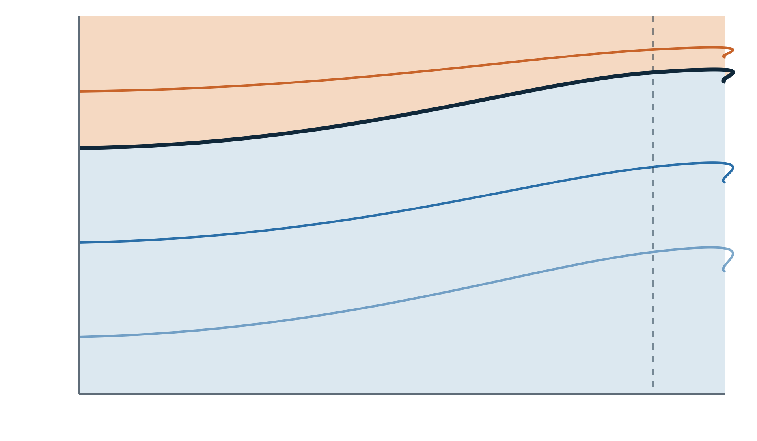
Why depth matters: the Costa Rica Dome
PART 3 · 2D VS 3D
0 m
The thermocline rises from ≈ 70 m to ≈ 30 m near 90°W, 9°N.
25 °C
A satellite only sees the surface signature: cooler SST, more chlorophyll.
20 °C
To see the structure you need 3D data: Argo, CTD, WOA, a reanalysis or a model.
100 m
15 °C
Schematic. You will draw the real section from WOA in TP1b.
Costa Rica Dome
200 m
120°W
90°W
LOCMARCA 2026 · Course 1 — Observation products
12
Notes:
The Costa Rica Dome is an open-ocean upwelling area off the Pacific coast of Central America, centred near 9°N, 90°W, where the thermocline comes very close to the surface. It is important for biology: high productivity, and a known feeding area for blue whales. The drawing is schematic, built from the numbers you will find in TP1b: in the WOA annual mean along 9.5°N, the 20 °C isotherm (a common marker of the thermocline) rises from about 70 m at 120°W to about 30–35 m east of 90°W. Satellite SST shows a cool patch, but cannot tell you whether it comes from a shallow thermocline, from mixing or from heat loss to the atmosphere: for that you need the vertical structure.

Slide 13
How fine, how often, how deep, how long
PART 4 · COVERAGE IN SPACE AND TIME
Platform | Spatial sampling | Time sampling | Depth | Since
Argo floats | ≈ one float per 3° × 3° | A profile every 10 days | 0–2,000 m | 2000
Moorings | A few fixed points | Minutes to hours | Surface to 500 m | 1980s
Ship surveys | Sparse lines | Occasional campaigns | To the bottom | Late 1800s
Infrared SST | ≈ 1 km | Daily, if no clouds | Surface | 1981
Altimetry | Along tracks; maps ≈ 1/8°–1/4° | ≈ 10 days per track | Surface | 1993
Ocean colour | ≈ 1–4 km | Daily, if no clouds | First metres | 1997
ERA5 reanalysis | ≈ 31 km | Hourly | Atmosphere | 1940
Orders of magnitude to compare platforms: check each product's documentation for exact values.
LOCMARCA 2026 · Course 1 — Observation products
13
Notes:
Four axes to locate any dataset: spatial sampling, time sampling, vertical extent, and length of the record. No platform is good on all four. Argo: about 4,000 floats for the global ocean is roughly one per 3° × 3° box, which is fine for large-scale climate but blind to coastal processes. Moorings: excellent in time, but a handful of points. Satellites: fine and frequent at the surface, but clouds and coasts create gaps. ERA5 is not an observation but a reanalysis: a model constrained by observations, hourly from 1940 to today, which is why it is so widely used. Ask the participants: for your own research question, which axis matters most?

Slide 14
The typical year and the real ones
PART 5 · CLIMATOLOGY VS INTERANNUAL
Climatology
The average of many years (often 30) for each month or season: the typical year. Examples: WOA (TP1b), GLORYS12 1993–2023 (TP2b).
Interannual variability
How one year differs from another. In the eastern tropical Pacific the main driver is El Niño / La Niña (ENSO).
anomaly = observation − climatology
Removes the seasonal cycle, keeps what is unusual.
LOCMARCA 2026 · Course 1 — Observation products
14
Notes:
Three words participants will meet constantly. A climatology is a statistical "typical year": for each calendar month (or season), the average over many years, conventionally 30 (for example 1991–2020). It contains the seasonal cycle but no particular year. Interannual variability is the year-to-year departure from that typical year; here the dominant signal is ENSO: during El Niño the eastern tropical Pacific is warmer than usual, during La Niña colder. The anomaly is the tool that separates the two: subtract the climatology for the same calendar month from the observation. In TP1a (advanced track) the students compute a simple anomaly relative to the annual mean of 2023: explain that a true anomaly uses a multi-year climatology.

Slide 15
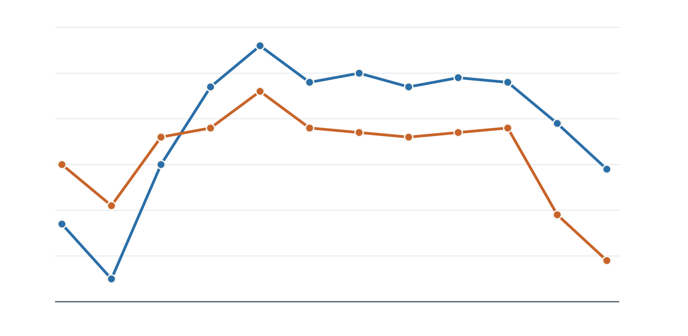
Same seasonal cycle, different years
PART 5 · CLIMATOLOGY VS INTERANNUAL
Monthly mean SST (°C)
2023
2024
OSTIA SST at 87°W, 10°N (Gulf of Papagayo)
31
Both years: cold Jan–Mar, warm May–Oct. That shape is the seasonal cycle.
Jan–Feb 2024: +1.3 to +1.6 °C (end of El Niño 2023–24). Nov–Dec 2024: −2 °C.
29
2023
That offset is interannual variability. Two years are not a climatology: you need ~30.
27
2024
25
J
M
M
J
S
N
LOCMARCA 2026 · Course 1 — Observation products
15
Notes:
Real data: monthly means of the OSTIA files sst_costarica_2023.nc and sst_costarica_2024.nc at the grid point nearest 87°W, 10°N. Values in °C, 2023: 26.7, 25.5, 28.0, 29.7, 30.6, 29.8, 30.0, 29.7, 29.9, 29.8, 28.9, 27.9. 2024: 28.0, 27.1, 28.6, 28.8, 29.6, 28.8, 28.7, 28.6, 28.7, 28.8, 26.9, 25.9. Both years share the seasonal cycle driven by the Papagayo winds. The differences between the years are interannual variability: early 2024 is warmer, at the end of the 2023–24 El Niño; from May 2024 the region is cooler, and November–December 2024 are about 2 °C colder than in 2023, as the Pacific moved towards La Niña-like conditions. Insist: with two years we can describe differences, not a climatology.

Slide 16

Know what kind of time axis you have
PART 5 · CLIMATOLOGY VS INTERANNUAL
Product | Time axis | Good for
WOA 2009 | 4 seasons, long-term mean | The typical state; a reference for anomalies
OSTIA SST 2023 | Daily, one year | Events and one specific year
GLORYS12 reanalysis | Monthly, 1993 to today | Your own climatology and anomalies (TP2b)
Climatological model run | A "typical" year, repeated | Processes, not a given date (Course 2)
Pitfall: comparing a model climatology with one El Niño year mixes two things, model error and interannual variability.
LOCMARCA 2026 · Course 1 — Observation products
16
Notes:
Before using a product, look at its time axis in the netCDF file (Course 0a): how many time steps, what interval, what period? In TP1b the WOA file has only 4 time steps (seasons): it is a climatology. The OSTIA file has 365 daily steps for 2023: it is one real year. This matters a lot for TP4: if you compare a model run that represents a typical year with observations of one particular year, a difference can come from the model or simply from the fact that the observed year was unusual. Compare like with like: climatology with climatology, or the same dates.

Slide 17
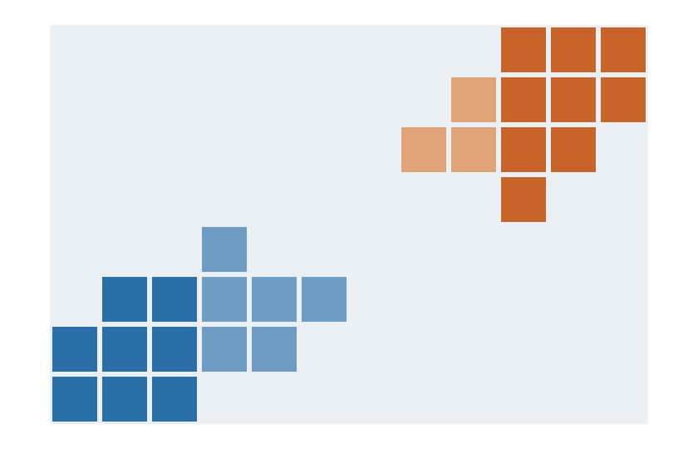
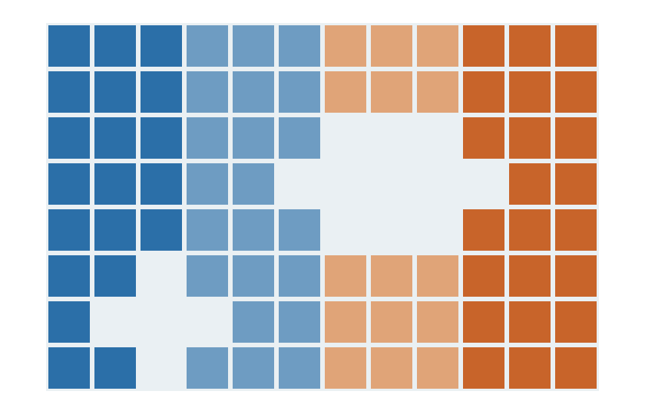


From swath to map: processing levels
PART 6 · GRIDDED DATA
L2 · swath
L3 · gridded
L4 · gap-free
Measurements along the satellite's path, at the instrument's resolution. Holes under clouds.
L2 data put on a regular grid and averaged over a day or more. Gaps remain.
Gaps filled by interpolation, often merging several sensors. Complete and smooth. OSTIA is L4.
LOCMARCA 2026 · Course 1 — Observation products
17
Notes:
Satellite products are labelled by processing level. L0 and L1 are raw signals and calibrated radiances: you will never use them. L2 is the geophysical variable (SST, chlorophyll) along the swath, at the native resolution, with gaps. L3 puts L2 data on a regular grid, often averaging over a day, 8 days or a month: gaps remain. L4 fills the gaps by interpolation, usually merging several sensors and sometimes in situ data: this is what most users download, and what OSTIA is. The same idea applies to in situ data: scattered profiles are turned into gridded fields by objective analysis, as in WOA or the Copernicus in situ products. The more processed, the easier to use, and the further from the actual measurements.

Slide 18

What interpolation gives, and what it hides
PART 6 · GRIDDED DATA
It gives you
It costs you
A value at every grid point
Maps that are easy to plot, average and compare
No gaps to manage in your code
Smoothing: small, short features fade away
Filled values are estimates, not measurements
Where data are scarce, the map falls back on its first guess, often a climatology
Artefacts near coasts and islands
Look for the error or quality field shipped with the product (OSTIA: analysis_error) and read its documentation.
LOCMARCA 2026 · Course 1 — Observation products
18
Notes:
Interpolation is not cheating: it is a statistical estimate, usually optimal interpolation, which weights nearby observations according to their distance and their error, and starts from a first guess (yesterday's analysis, or a climatology). But it has consequences. Features smaller or shorter than the correlation scales of the method are smoothed out: a small coastal upwelling or a two-day event can disappear. Where observations are scarce, the result stays close to the first guess, which can make a region look more "normal" than it really was. Coasts are difficult for all satellite sensors. Good products provide an error estimate: OSTIA has an analysis_error variable, which is large where few observations went in. Our files for TP1b contain only analysed_sst, to keep them small.

Slide 19
A 0.05° grid is not a 5 km resolution.
PART 6 · GRIDDED DATA
The grid spacing is the producer's choice. The effective resolution depends on how many observations went in: under persistent clouds, a "fine" L4 map is mostly interpolation.
Notes:
One sentence to remember. OSTIA is distributed on a 0.05° grid (about 5.5 km), but its effective resolution is coarser, and varies in space and time: high where many infrared observations are available, much coarser under persistent clouds where only microwave data (tens of km) and the first guess remain. Same for models (Course 2): the grid spacing is not the size of the smallest feature the model can really represent, which is several grid cells. Practical consequence: do not interpret features of a few grid cells as real without checking.

Slide 20
Five questions to ask any dataset
TAKE-AWAY
1
What exactly is measured? Variable, units, depth. OSTIA gives a foundation SST, not the skin.
2
Where and when are the real observations? And where is it interpolated?
3
What is the effective resolution? Not just the grid spacing.
4
A climatology or a real period? Which years, which time step?
5
How uncertain is it? Error fields, quality flags, documentation.
LOCMARCA 2026 · Course 1 — Observation products
20
Notes:
If participants remember one slide, it should be this one: a checklist they can apply to every file this week, and in their own research. Question 1, example: satellites measure the skin temperature (the top micrometres), which can differ from the temperature a few metres below, especially on calm sunny days; OSTIA is a foundation SST, free of the daily warming, which is what the attribute standard_name = sea_surface_foundation_temperature says in the file. Most answers to these questions are in the netCDF attributes (Course 0a) and in the product documentation. In TP4, ask each pair to answer these five questions for the datasets they choose.

Slide 21
This week, you will use all of this
NEXT
Course 0a
TP1a, TP1b
TP2a
TP2b, TP2c
TP3, TP4
Anatomy of a netCDF file: where the answers to the five questions are written
xarray basics, then OSTIA SST and the WOA climatology on Kabre: maps, series, sections
Download your own data from Copernicus: SST L4, 3D temperature, reanalyses
Climatology vs interannual variability, then biogeochemistry (chlorophyll, nitrate, oxygen)
NEMO and CROCO model outputs, then compare observations, reanalyses and models on a region of your choice
Questions?
LOCMARCA 2026 · Course 1 — Observation products
21
Notes:
Close by connecting the course to the rest of the week. As seen in Course 0a on Monday, the netCDF header is where you find the variable names, units, dimensions and time axis that answer most of the five questions. TP1b uses two of the products seen today: OSTIA (an L4 satellite product, one real year) and WOA (an in situ climatology, 3D). TP2a shows how to download products yourself. TP2b uses ocean colour and a biogeochemical model (the least observed domain); TP2c builds a climatology and finds El Niño in 31 years of SST (part 5 of this course). Course 2 then introduces numerical models, the third source of gridded data, and TP4 brings everything together.

