Slide 1
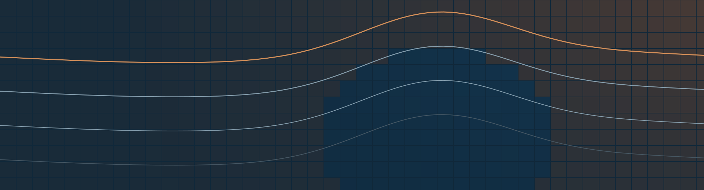


LOCMARCA 2026 · COURSE 2
Numerical models
Ocean, atmosphere, climate: what a model computes, and what it can tell you
LOCMARCA 2026
Notes:
Welcome back. Yesterday (Course 1, TP1, TP2) we worked with observations, and with one reanalysis. Today we open the other big family of data: the outputs of numerical models. The goal is not to turn you into modellers. It is to give you enough understanding of how a model works to use its outputs correctly: know what is in the file, what the numbers mean, and where they should not be trusted. This afternoon (TP3a) and tomorrow morning (TP3b) you will open two of them: a global model, NEMO, and a regional model, CROCO.

Slide 2
What you should take away
GOALS
1
2
3
Understand
Use
Question
What a model computes, and the four ideas behind any model: resolution, time step, processes, grid.
Pick the right kind of model output for a question: process study, reanalysis, forecast or projection.
Know the limits of a model, and always check it against observations before you trust it.
Not a modelling course: a way of reading model outputs like the ones you will open in TP3a and TP3b.
Notes:
Three verbs again, as in Course 1. Understand: a model is not a black box, it is the laws of physics computed on a grid; with four ideas (resolution, time step, processes, grid) you can read any model description. Use: pick the right type of model output for a question (a reanalysis to describe the past, a regional model for the coast, a climate projection for 2050...). Question: every model has biases; you will always compare a model with observations before trusting it, which is exactly the TP4 mini-project.

Slide 3
Five parts
ROADMAP
1
2
3
4
5
What is a model?
Key ideas
What for?
Global vs regional
Climate models
Equations on a grid, a run step by step, a long history
Scales, resolution, time step, processes, grids
Four uses, process studies, choosing a model
Nesting, scenarios, and the limits of models
Coupled Earth system models, CMIP6, ESGF
Today: Course 2. Tomorrow: TP3a (NEMO, global) and TP3b (CROCO, regional), then the TP4 mini-project.
Notes:
The five items of the programme. Part 1: what a model is. Part 2: the key ideas you need to read a model description, with a link to each TP. Part 3: why people run models. Part 4: global vs regional, scenarios, and the limits. Part 5: climate models and where to download their outputs (CMIP6, ESGF). About 10 minutes per part.

Slide 4
A model solves the laws of physics on a grid, one time step after another.
PART 1 · WHAT IS A NUMERICAL MODEL?
It does not measure anything: it computes what the equations predict, from what we give it.
Notes:
Key message of the course. A numerical model takes the laws of physics (Newton's law for the currents, conservation of heat, salt and mass), writes them on a grid of cells, and advances them in time with a small time step. Everything else in this course follows from this sentence: the grid gives the resolution, the time step gives the cost, and what is smaller than the grid must be parameterised.

Slide 5
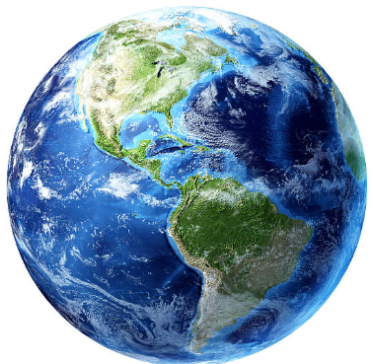
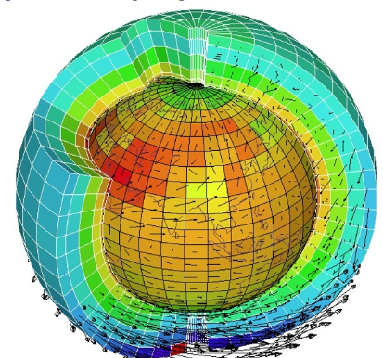
What is ocean modelling?
PART 1 · WHAT IS A NUMERICAL MODEL?
The ocean counterpart
of the better-known weather (atmospheric) models.
A computer code
that computes the state of the ocean at a later time, from its state at an initial time and all the forces acting on it.
Numerical approximations
The real ocean
Its model: the ocean cut into grid cells
of the equations of physics: for most ocean general circulation models (OGCMs), the primitive equations.
Notes:
Left, the real ocean; right, its model: the same ocean cut into grid cells, in the horizontal and in the vertical. Ocean modelling is the ocean counterpart of the better-known weather models. It is the effort to build, use and improve computer codes that compute the state of the ocean at a later time, from its state at an initial time and all the forces acting on it (wind, heat, fresh water, tides). These codes are numerical approximations of the equations of physics. For most ocean general circulation models (OGCMs), NEMO and CROCO included, these equations are the primitive equations (next slide).

Slide 6
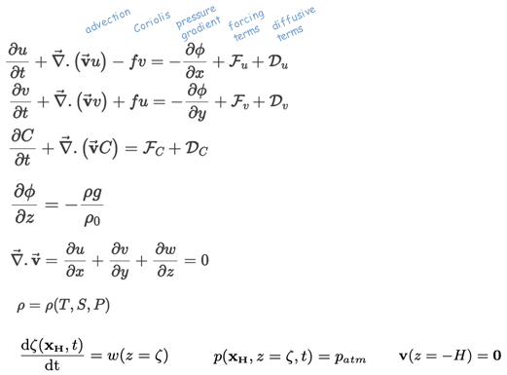
The primitive equations, in plain words
PART 1 · WHAT IS A NUMERICAL MODEL?
Momentum: currents change by advection, Coriolis, pressure gradients, forcing and friction
Tracers (T, S): carried by the currents and mixed
Hydrostatic balance: pressure = weight of the water above
Continuity: water is neither created nor destroyed
Equation of state: density from temperature, salinity, pressure
Boundary conditions: at the surface and at the sea floor
F, D: forcing and the parameterised effect of the small scales (Part 2).
Notes:
For information: you will not solve these equations, but it helps to know what is inside the model. They are the Navier-Stokes equations simplified for the large scales of the ocean: hydrostatic (the vertical acceleration is neglected), Boussinesq (density changes are neglected except in the weight of the water), written here on z-levels. Line by line: the horizontal currents change because of advection (the current carries itself), the Coriolis force of the Earth's rotation, pressure gradients, forcing and friction. Tracers such as temperature and salinity are carried by the currents and mixed. The pressure is the weight of the water above. Water is neither created nor destroyed. Density depends on temperature, salinity and pressure. And conditions at the surface and the sea floor close the system. The F and D terms contain the forcing and the parameterised effect of everything smaller than the grid: we come back to them in Part 2.

Slide 7
How a model run works
PART 1 · WHAT IS A NUMERICAL MODEL?
Model source code
the discretised equations
Inputs · pre-processing
compilation
Outputs
Grid and bathymetry
Initial condition
Boundary conditions
Forcing: atmosphere, waves, rivers
Parameters
Ready to run
4D state variables (x, y, z, time) and optional diagnostics, in netCDF files
execution
Post-processing
Comparison with observations, calibration, validation
You are here this week: TP3, TP4
Notes:
The life of a model run. The source code implements the discretised equations; it is compiled into an executable. Before running, the pre-processing prepares the inputs: the grid, the bathymetry, the initial condition, the boundary conditions for a regional model, the forcing (atmosphere, waves, rivers) and the parameters. The execution produces the outputs: the 4D state variables (x, y, z, time) and optional diagnostics, in netCDF files. Then the post-processing: comparison with in situ and satellite data, calibration, validation, which often sends the modeller back to the inputs. This week you are in the post-processing box: TP3 and TP4.

Slide 8
One method, three families of models
PART 1 · WHAT IS A NUMERICAL MODEL?
Atmosphere
Ocean
Climate
TIME SCALE
TIME SCALE
TIME SCALE
Changes in hours; memory of about two weeks
Changes in days to centuries; stores heat and carbon
Ocean + atmosphere + sea ice + land, coupled
USED FOR
USED FOR
USED FOR
Weather forecasts, atmospheric reanalyses (ERA5, the winds of TP2a)
Currents, upwelling, El Niño, the Costa Rica Dome, ocean reanalyses (GLORYS12)
Past and future climate over decades to centuries, scenarios
WRF, ECMWF IFS, ARPEGE
NEMO (TP3a), CROCO (TP3b), MOM, HYCOM
IPSL-CM6A-LR, CNRM-CM6, CESM2
Notes:
Same method, three families. Atmospheric models are the oldest (weather forecasting since the 1950s); the atmosphere changes in hours and has a memory of about two weeks, which is why weather forecasts stop at about 10 days. Ocean models: the ocean is slower, with a memory of months to centuries, so ocean models need long runs. Climate models couple both, plus sea ice, land and often biogeochemistry, and are run for centuries. The names in grey are examples: NEMO and CROCO are the two you will open; ERA5 (TP2a wind) comes from the ECMWF IFS model; IPSL-CM6A-LR is a climate model whose ocean component is NEMO.

Slide 9
A long history
PART 1 · WHAT IS A NUMERICAL MODEL?
1963
1967
1980s
1994–2000
2016
Kirk Bryan, GFDL
Bryan & Cox; Holland
MOM, POM, OPA, HYCOM…
SCRUM, then ROMS
CROCO
First numerical ocean circulation models
The first 3D ocean model (GFDL); Scripps
Many ocean models are born
Terrain-following (sigma) models
Coastal and Regional Ocean COmmunity model
NEMO · TP3a
CROCO · TP3b
Born from the French model OPA; z-levels; global and basin scales, also inside climate models.
The last of the sigma family: POM → SCRUM → ROMS → CROCO; regional and coastal scales.
Notes:
To cite only a few milestones. Ocean modelling started in the 1960s at GFDL (Princeton) with Kirk Bryan, and at Scripps with William Holland; Bryan and Cox built the first three-dimensional ocean circulation model. Since the 1980s many models have been developed: MOM, POM, OPA (which became NEMO), HYCOM... CROCO belongs to a family of models with terrain-following (sigma) vertical levels: POM, then SCRUM in 1994, ROMS around 2000, and CROCO since 2016. NEMO, used in TP3a, comes from the French OPA model. These codes are open source and maintained by international communities.

Slide 10
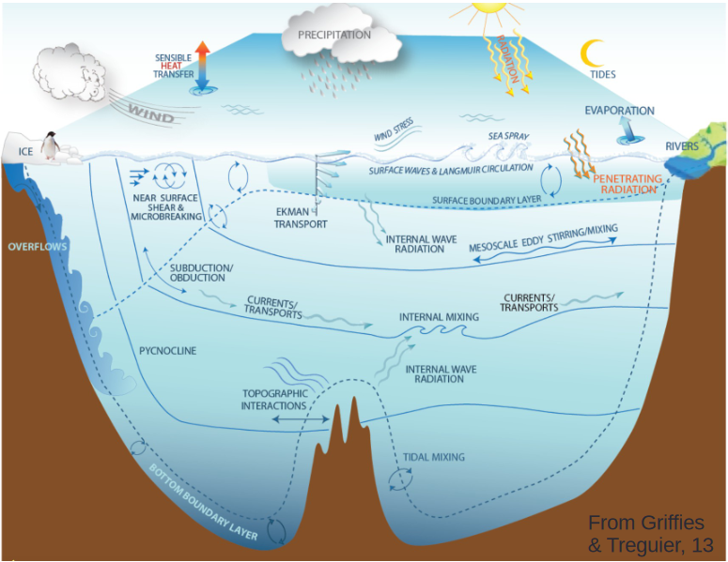
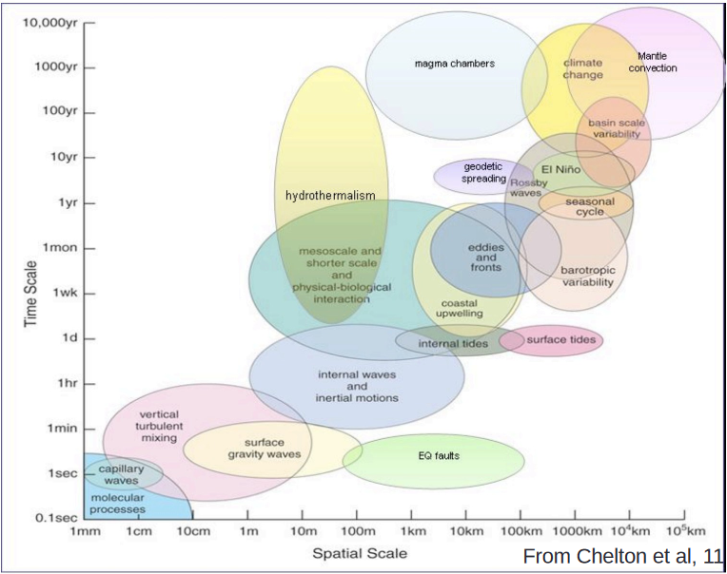
A zoo of processes and scales
PART 2 · KEY IDEAS
Scales of ocean models
Left: Griffies & Treguier (2013). Right: Chelton et al. (2011).
Notes:
Left: the processes at work in the ocean, from the air-sea fluxes and the mixed layer down to the overflows and the mixing over rough topography (Griffies and Treguier, 2013). Right: the same processes placed by their space scale (horizontal axis) and their time scale (vertical axis), from molecular processes (millimetres, seconds) to the climate change and the large-scale circulation (thousands of kilometres, centuries) (Chelton et al., 2011). No model can cover all of them. The circle shows the scales addressed by ocean general circulation models such as NEMO and CROCO: from fronts and eddies (kilometres, days) to the basin (thousands of kilometres, years). Everything to the lower left of the circle must be parameterised.

Slide 11
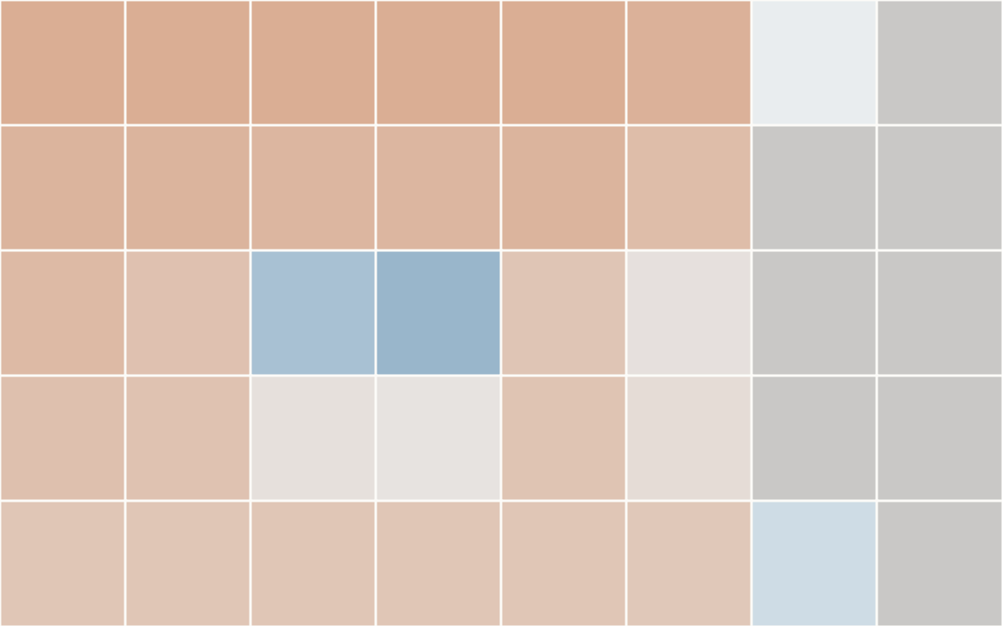

Resolution: one value per grid cell
PART 2 · KEY IDEAS
5–10
grid cells are needed to represent a feature
1° grid (≈ 110 km) · NEMO, TP3a
≈ 5 km grid · CROCO, TP3b
Idealised field: a cold eddy offshore and a cold strip along the coast (land in grey).
Notes:
Same idealised ocean, seen at two resolutions: a cold eddy offshore and a narrow strip of cold upwelled water along the coast (think of the Papagayo coast). At 1 degree (about 110 km, the NEMO run of TP3a), the eddy is a single cold-ish cell and the coastal strip has disappeared: it is smaller than one cell. At about 5 km (the CROCO run of TP3b), both appear. Rule of thumb: a model needs 5 to 10 grid cells to represent a feature correctly, so its effective resolution is 5 to 10 times its grid spacing. Same lesson as in Course 1 for gridded observations. This is an idealised picture, not model output.

Slide 12

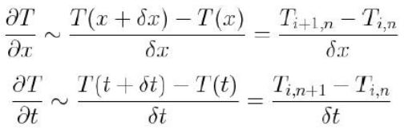

From an equation to a computation
PART 2 · KEY IDEAS
1
A simple equation
Temperature T carried by a current u0 along x
2
Derivatives become differences
between neighbouring grid points (δx) and time steps (δt)
3
A rule the computer repeats
the new T at point i, from the old T at i and i + 1
Notes:
The simplest example: a temperature anomaly carried by a constant current u0 along x (1D advection). A computer cannot handle derivatives, so they are replaced by differences between neighbouring grid points (distance δx) and between successive time steps (δt): these are finite differences. The result is a rule the computer can repeat: the new temperature at point i is the old one, corrected by what the current brings from the neighbour. NEMO and CROCO do exactly this, with better schemes, for all the primitive equations, millions of grid points and millions of time steps. The size of δx is the resolution; the size of δt is the time step: the next two slides.

Slide 13
Time integration: step by step
PART 2 · KEY IDEAS
t
t + Δt
t + 2Δt
…
t + nΔt
state → compute the tendencies from the equations → new state
≈ 1 h
minutes
× 8
time step of a 1° global ocean model
time step of a ≈ 5 km regional model
cost when the grid spacing is divided by 2
Notes:
The model knows the state of the ocean at time t. From the equations it computes how fast each variable is changing (the tendencies), and moves forward by one time step: t + Δt. Then again, millions of times. The time step cannot be chosen freely: a signal (a wave, a current) must not cross more than one cell during one step (this is the CFL condition). Smaller cells therefore mean a smaller time step. Consequence: dividing the grid spacing by 2 multiplies the cost by about 8 (2 in x, 2 in y, 2 in time), and more with more vertical levels. This is why global models are coarse and why we use regional models for the coast.

Slide 14
Processes: resolved or parameterised
PART 2 · KEY IDEAS
Resolved
Parameterised
Larger than a few grid cells: computed by the equations
Smaller or faster than the grid: replaced by a formula
Large-scale currents and gyres
Upwelling driven by the wind
El Niño, Kelvin and Rossby waves
Eddies and fronts, but only if the grid is fine enough (≈ 5 km yes, 1° no)
Vertical mixing and turbulence (depth of the mixed layer)
Convection
Eddies in a 1° model
In the atmosphere: clouds, rain, radiation
Parameterisations are the main reason why two models of the same ocean give different answers.
Notes:
A process is resolved when the grid and the time step are fine enough for the equations to compute it directly. Everything smaller or faster than the grid must be parameterised: replaced by a simple formula that estimates its average effect on the resolved scales, with coefficients tuned by the modellers. Examples: vertical mixing in the ocean (it sets the depth of the mixed layer, the thermocline), turbulence, convection, and in the atmosphere clouds and rain. Mesoscale eddies (50 to 200 km) are resolved at 5 km, but must be parameterised at 1 degree. Parameterisations are the main source of differences between models, and of their biases.

Slide 15
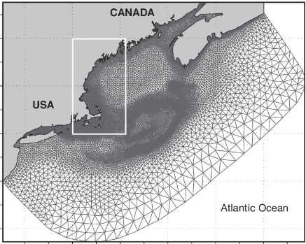
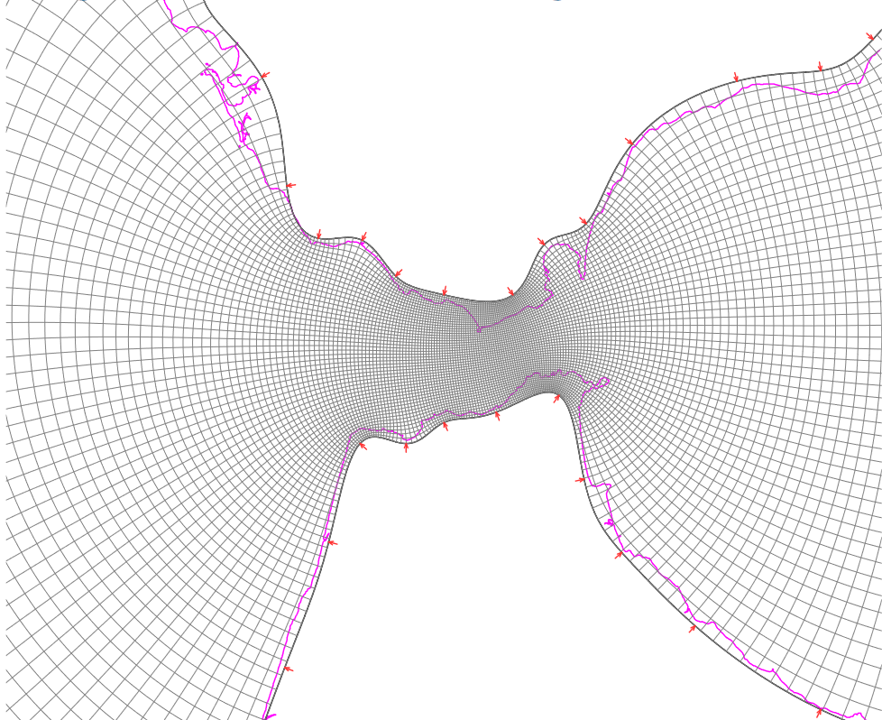
Grid types: a diversity of horizontal grids
PART 2 · KEY IDEAS
Logically rectangular
Unstructured: triangles
Curvilinear, fitted to a coast
curvilinear; finite differences or volumes; open ocean, large scales (NEMO, CROCO)
finite volumes or elements; coasts and estuaries
a grid following a strait (Izogrid, Shchepetkin)
Notes:
Three families of horizontal grids. Logically rectangular grids, possibly curvilinear (the grid lines bend but every cell still has four neighbours): solved with finite differences or finite volumes, favoured for the open ocean and the large scales; NEMO and CROCO use them. Unstructured grids made of triangles: solved with finite volumes or finite elements, favoured for coasts and estuaries because the triangles can follow the coastline and become very small where needed. In between, curvilinear grids can be fitted to a coastline, here a strait (Izogrid, by Shchepetkin). For you as users: a curvilinear grid means 2D longitude and latitude arrays; an unstructured grid needs special tools to plot.

Slide 16
Grid types: where the variables live
PART 2 · KEY IDEAS
v
What it means for your files
u, v and T do not share the same coordinates
CROCO: temp on (eta_rho, xi_rho), u on (eta_rho, xi_u), v on (eta_v, xi_rho)
u
u
T, S, η
Interpolate before you combine
Bring u and v to the T points before plotting arrows on a temperature map (TP3b)
v
The grid may be curvilinear
2D longitude and latitude arrays instead of 1D axes, as in CROCO and near the poles in NEMO
One cell of an Arakawa C-grid
Notes:
Most ocean models use an Arakawa C-grid: temperature, salinity and sea level are computed at the centre of each cell (the T or rho point), the eastward velocity u on the east and west faces, and the northward velocity v on the north and south faces. This is numerically efficient, and it has a direct consequence for you: u and v do not have the same coordinates as temperature. In CROCO files, u lives on (eta_rho, xi_u) and v on (eta_v, xi_rho), so the arrays have one point less in one direction. In NEMO, T, U and V points are often written in different files (grid_T, grid_U, grid_V). To plot currents with temperature, you first interpolate u and v to the T points; the helper functions of TP3b do it for you. The horizontal grid itself can be a regular lon/lat grid (as most observation products), or curvilinear: 2D longitude and latitude arrays, as in the global NEMO grid near the poles or in a rotated regional CROCO grid.

Slide 17
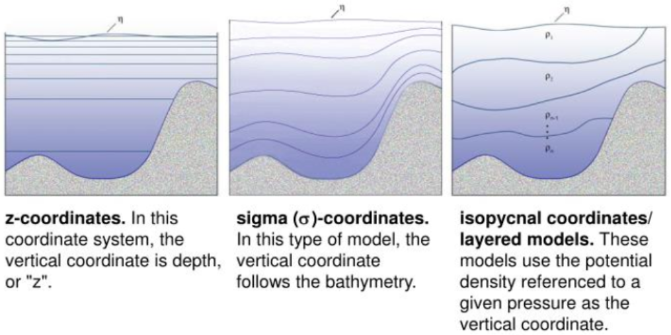
Grid types: the vertical levels
PART 2 · KEY IDEAS
z-levels · NEMO, TP3a
Sigma levels · CROCO, TP3b
Isopycnal · e.g. HYCOM
Fixed depths: easy to read; the sea floor is a staircase.
They follow the sea floor. A level is not a depth: interpolate.
They follow density: good for the ocean interior.
Notes:
The choice of the vertical coordinate is one of the main differences between models. z-levels (NEMO, TP3a): each level is at a fixed depth, the same everywhere. Easy to use: the temperature at 100 m is simply one level of the array; but the sea floor becomes a staircase. Sigma levels (CROCO, TP3b): the same number of levels between the surface and the bottom, so they follow the sea floor: good on the shelf and the slope; but a level is not a depth any more: to get the temperature at 100 m you must compute the depth of each level and interpolate, a central exercise of TP3b. Isopycnal or layered models (HYCOM, partly): the levels follow surfaces of equal density, well suited to the ocean interior. Each with its own advantages and limitations.

Slide 18




Four uses, four kinds of output
PART 3 · WHAT MODELS ARE USED FOR
Process studies
Reanalyses
Forecasts
Projections
Understand how the ocean works, with experiments nature does not allow
Model + observations (data assimilation): the best description of the past
Start from today's state and run a few days ahead
Decades to centuries ahead, under a scenario of future emissions
e.g. the regional runs of TP3b
e.g. GLORYS12 (TP2), ERA5
e.g. weather, Copernicus Marine forecasts
e.g. CMIP6 (Part 5)
Advantages: cheap compared with ships, a complete 4D view (x, y, z, time), hypotheses can be tested. Limits: approximate equations and numerics, parameterisations (Part 4).
Notes:
Four uses of the same tool. Process studies: understand how the ocean works by running experiments that nature does not allow (next slide). Reanalyses: a model constantly corrected by observations (data assimilation), the best description of the past state of the ocean: GLORYS12, used in TP2. Forecasts: start from today's state and run a few days ahead: weather forecasts, or the Copernicus Marine ocean forecasts. Projections: run the climate system for decades under an assumption about future emissions (a scenario). Before using any model output, ask which of the four it is: a free model run is not a description of what really happened on a given day.

Slide 19
Process studies: virtual experiments
PART 3 · WHAT MODELS ARE USED FOR
Control run
Sensitivity run
Difference
The model with all its forcings, first checked against observations
vs
The same run with one thing changed: e.g. no wind jets through the Central American gaps
=
Experiment − control = the effect of that one process
Other experiments
Switch the tides or a river on and off
Change the resolution: what does a 5 km grid add to a 1° grid? (TP3b vs TP3a)
Change a parameterisation and compare with observations
Notes:
In a lab you change one thing and see what happens. With the real ocean you cannot. With a model you can: run a reference simulation (the control run), then the same run with one thing changed (the sensitivity experiment). The difference between the two isolates the effect of that one process. Example to discuss with the group: what if the wind jets that blow through the gaps of the Central American mountains (Papagayo, Tehuantepec, Panama) were removed? Does the winter cooling off the Gulf of Papagayo disappear? Does the Costa Rica Dome change? This is the kind of question regional models such as CROCO are built for. It only makes sense if the control run is first validated against observations.

Slide 20
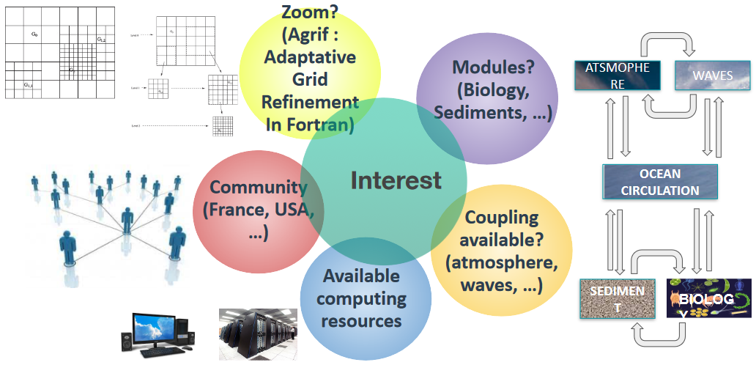
In practice: which ocean model?
PART 3 · WHAT MODELS ARE USED FOR
Questions to ask
Which scales and region?
A community around you?
Computing resources: laptop or HPC (Kabre)?
Modules: biology, sediments?
Coupling: atmosphere, waves?
Zooms (AGRIF in CROCO)?
As a user: the model is often already chosen. Read its documentation.
Notes:
There is no best model: the choice depends on the question and on practical constraints. The scales and region of interest first (global or coastal, z or sigma levels). Then: is there a community of users and developers around you (France, USA...)? What computing resources do you have, a laptop or a supercomputer like Kabre? Which modules are available: biogeochemistry, sediments? Can it be coupled with an atmosphere or a wave model? Does it allow zooms (in CROCO, the AGRIF library for adaptive grid refinement)? For most of you, the model will already be chosen by the data provider: what matters is to read its documentation and know what it resolves.

Slide 21
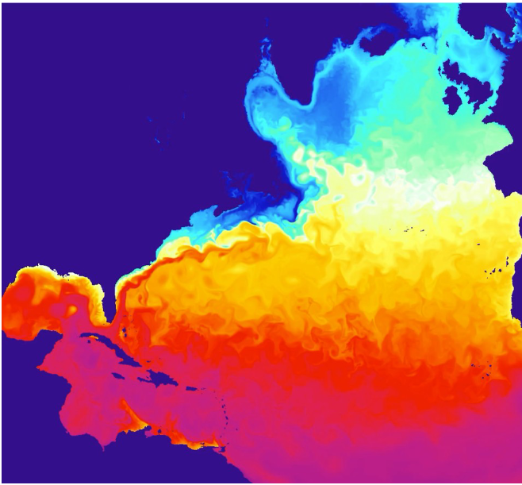
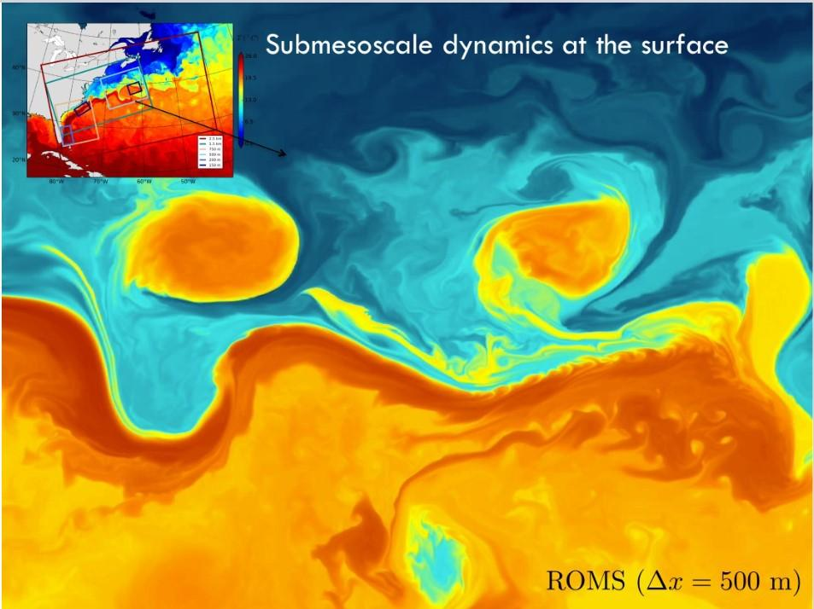
A taste of what ocean models can do
PART 3 · WHAT MODELS ARE USED FOR
Coupled North Atlantic: ocean 6 km, atmosphere 18 km
Submesoscale eddies: ROMS, Δx = 500 m
Courtesy J. Gula, LOPS, Brest
Notes:
Two examples from Jonathan Gula (LOPS, Brest). Left: a coupled simulation of the North Atlantic, ocean model at 6 km and atmosphere model at 18 km: the Gulf Stream and its eddies are visible in the surface temperature. Right: the same kind of model at 500 m resolution (ROMS): submesoscale eddies and filaments at the surface, a few kilometres wide, which no satellite product at 0.05 degree can fully resolve. Link with TP3: a 1 degree model (NEMO) shows none of these structures, a 5 km model (CROCO) starts to show the eddies.

Slide 22
Global vs regional: nesting
PART 4 · GLOBAL VS REGIONAL
Model | Global | Regional
Example this week | NEMO, 1° (TP3a) | CROCO, ≈ 5 km (TP3b)
Domain | Whole ocean | One region
Boundaries | None | From a larger model
Good for | Basins, El Niño, climate | Coasts, upwelling, eddies
Cost per km² | Low | High
Global model
1°, whole ocean, no lateral boundary
Regional model
≈ 5 km, one region
Open boundaries: temperature, salinity, currents and sea level from the global model
Notes:
A global model has no lateral boundary: the whole ocean is computed, at a coarse resolution because of the cost. A regional model computes only one region, at a fine resolution, but it needs to be told what comes in and out at its open boundaries: those values come from a larger model, global model or reanalysis. This is called nesting or downscaling. Consequence: a regional model cannot be better than its boundaries for what comes from outside (for example El Niño, which is born in the whole Pacific). The table is the recap that the students will fill in at the end of TP3a and TP3b.

Slide 23
Scenarios: a projection is not a forecast
PART 4 · SCENARIOS
SSP1-2.6
SSP2-4.5
SSP3-7.0
SSP5-8.5
Low emissions
Intermediate
High
Very high
+1.8 °C
+2.7 °C
+3.6 °C
+4.4 °C
Global surface warming, 2081–2100 vs 1850–1900, best estimate (IPCC AR6, WG1).
Projection: “if the world follows this path, the climate of 2070 will look like this, on average.” Not “it will rain in Heredia on 3 March 2070.”
Notes:
Future climate depends on what humans will emit, which no model can predict. So climate models are run under scenarios: assumptions about future emissions, land use and society. In CMIP6 they are called SSPs (Shared Socioeconomic Pathways). The name reads SSPx-y: x is the socio-economic storyline, y the radiative forcing reached in 2100 in watts per square metre. The numbers are the IPCC AR6 best estimates of global surface warming for 2081–2100 relative to 1850–1900. A projection does not say what the weather will be on a given day in 2070: it gives the statistics of the climate (means, extremes, trends) if the world follows that path. Before the scenarios, the historical run (1850–2014) is driven by the observed forcings and can be compared with observations.

Slide 24
Six limits to keep in mind
PART 4 · LIMITS
1
Resolution
2
Parameterisations
3
Forcing and boundaries
Nothing smaller than a few grid cells: coasts, bays, narrow upwelling
Simplified, tuned formulas for what the grid cannot resolve
Errors in the wind or at the open boundaries go into the ocean
4
Initial state and drift
5
Systematic biases
6
A free run is not the real weather
A model needs time to adjust (spin-up) and can slowly drift
e.g. many climate models are too warm in tropical upwelling regions
Its eddies are not on the real day: compare statistics, not snapshots
Notes:
Go through the six cards. Resolution: nothing smaller than a few cells (Gulf of Nicoya at 1 degree?). Parameterisations: tuned formulas, the main source of differences between models. Forcing and boundaries: errors in the wind or at the boundaries go straight into the ocean. Initial state and drift: a model needs years to centuries to adjust (spin-up) and can drift away from reality. Systematic biases: for example many climate models are too warm in the eastern tropical Pacific and in coastal upwelling regions, exactly our region. A free run is not the real weather: an ocean model forced by real winds follows the large-scale variability, but its eddies are not at the real place on the real day, and the year 2030 of a climate model is not the real 2030. Compare statistics (means, seasonal cycles, variability), not single snapshots.

Slide 25
A model output is not an observation. Compare it with data before you trust it.
PART 4 · LIMITS
“All models are wrong, but some are useful.” (G. Box) · TP3b and TP4: models vs observations
Notes:
“All models are wrong, but some are useful” (George Box, a statistician). The useful ones are those whose errors you know. This is why every serious use of a model output starts with a comparison with observations: is the mean right, the seasonal cycle, the variability? You will do exactly that at the end of TP3b (CROCO vs NEMO vs OSTIA satellite SST) and in the TP4 mini-project.

Slide 26
Climate models couple the Earth system
PART 5 · CLIMATE MODELS
Atmosphere
Ocean
Exchanged through the coupler
LMDZ
NEMO (≈ 1°)
Heat
Fresh water: rain, evaporation, rivers, ice melt
Momentum: the wind stress
Carbon (CO₂)
Coupler
(OASIS)
Link with this week: NEMO (TP3a) and PISCES (TP2c) are the same models, inside a climate model.
Sea ice
Land
LIM3
Biogeochemistry
ORCHIDEE
PISCES
IPSL-CM6A-LR, one of the CMIP6 climate models
Notes:
A climate model, or Earth system model, couples several models that exchange heat, water, momentum and carbon through a coupler. Example: IPSL-CM6A-LR, the French model of the Institut Pierre-Simon Laplace used in CMIP6. Its atmosphere is LMDZ, its ocean is NEMO on the eORCA1 grid at about 1 degree, its sea ice is LIM3, its land surface is ORCHIDEE, its ocean biogeochemistry is PISCES, and the components talk through the OASIS coupler. Note the link with this week: the NEMO and PISCES of TP3a and TP2c are the same models, here inside a climate model. Resolution of climate models: typically 100 km for the atmosphere and the ocean, because they must run for centuries and many scenarios.

Slide 27
Climate model outputs: CMIP6 on ESGF
PART 5 · CLIMATE MODELS
tos
Omon
IPSL-CM6A-LR
ssp245
r1i1p1f1
gn
201501-210012
.nc
variable
table
model
experiment
member
grid
period
sea surface temperature
ocean, monthly
source_id
scenario SSP2-4.5
one run of the ensemble
native model grid
Jan 2015 – Dec 2100
CMIP6
ESGF
About 50 modelling groups, one common protocol: same experiments, same variable names. The basis of the IPCC reports, free to download.
The federation of data nodes that distributes CMIP6, e.g. the IPSL node:
esgf-node.ipsl.upmc.fr/projects/esgf-ipsl/
Notes:
CMIP6, the Coupled Model Intercomparison Project, phase 6, is a coordinated set of experiments run by about 50 modelling groups worldwide with the same protocol: the same historical forcings, the same scenarios, the same variable names and units. Its outputs are the basis of the IPCC reports, and they are free. They are distributed by ESGF, the Earth System Grid Federation, a network of data nodes; the IPSL node in Paris is one of them (esgf-node.ipsl.upmc.fr). You search with facets, and every file name follows the same pattern, so you can read a file name before opening it. Decode the example together: sea surface temperature (tos), ocean monthly table (Omon), model IPSL-CM6A-LR, scenario SSP2-4.5, member r1i1p1f1 (realisation, initialisation, physics, forcing), native grid (gn: here the curvilinear NEMO grid, with 2D lon and lat as in CROCO), period January 2015 to December 2100. Other useful variables: thetao (3D temperature), so (salinity), zos (sea level), tas (air temperature). The Copernicus Climate Data Store also provides a subset of CMIP6.

Slide 28
One run is not enough: ensembles
PART 5 · CLIMATE MODELS
Internal variability
Model uncertainty
Your practice
The climate is chaotic: the same model, started from slightly different states, gives different El Niño years.
Different models make different choices (resolution, parameterisations) and give different answers.
Look at the ensemble mean and its spread, never at one run. Check the historical runs against observations first.
Several members: r1, r2, r3…
Several models: the CMIP6 spread
Mean ± spread, validated
Notes:
Two reasons why climate scientists never trust a single run. Internal variability: the climate system is chaotic; the same model started from slightly different initial states gives different El Niño years, different decades. These runs are the members of an ensemble (r1, r2, r3... in the file name). Model uncertainty: different models make different choices (resolution, parameterisations) and give different answers; the spread across CMIP6 models measures it. Practical rule for your own work: use several members and several models, look at the mean and at the spread, and compare the historical runs with observations to choose or weight the models for your region.

Slide 29
Five questions to ask any model output
TAKE-AWAY
1
Which model, at which resolution? Grid spacing, number of levels: what is too small to be seen?
2
Which kind of run? Free run, reanalysis, forecast or projection under which scenario?
3
Resolved or parameterised? Is the process I study computed, or replaced by a formula?
4
Which grid? Where are T, u and v? z-levels or sigma levels? 1D or 2D coordinates?
5
Compared with observations? What are its known biases in my region? One run or an ensemble?
Notes:
The five questions, mirroring the five questions of Course 1 for observations. Keep them for TP3, TP4 and your own work. 1: which model, at which resolution (horizontal and vertical)? 2: which kind of run: a free run, a reanalysis, a forecast, a projection? 3: what is resolved and what is parameterised at this resolution? 4: on which grid: where are the variables (T, u, v points), which vertical levels? 5: has it been compared with observations, and what are its known biases in my region?

Slide 30
This week, you will use all of this
NEXT
TP3a · today
TP3b · tomorrow
TP4 · mini-project
NEMO, global, 1°: z-levels, longitudes 0–360, a section across the Costa Rica Dome
CROCO, regional, ≈ 5 km: sigma levels, the C-grid, CROCO vs NEMO vs OSTIA
Your own model–data comparison, on a region of your choice
Questions?
Notes:
Where each idea of the course comes back. TP3a this afternoon: a global model, NEMO at 1 degree: longitudes from 0 to 360, a model calendar, z-levels, a section across the Costa Rica Dome. TP3b tomorrow morning: a regional model, CROCO at about 5 km: sigma levels, the C-grid, and a comparison with NEMO and with OSTIA satellite SST. TP4 tomorrow afternoon and Friday: your own model–data comparison on a region of your choice. Questions?

