Slide 1
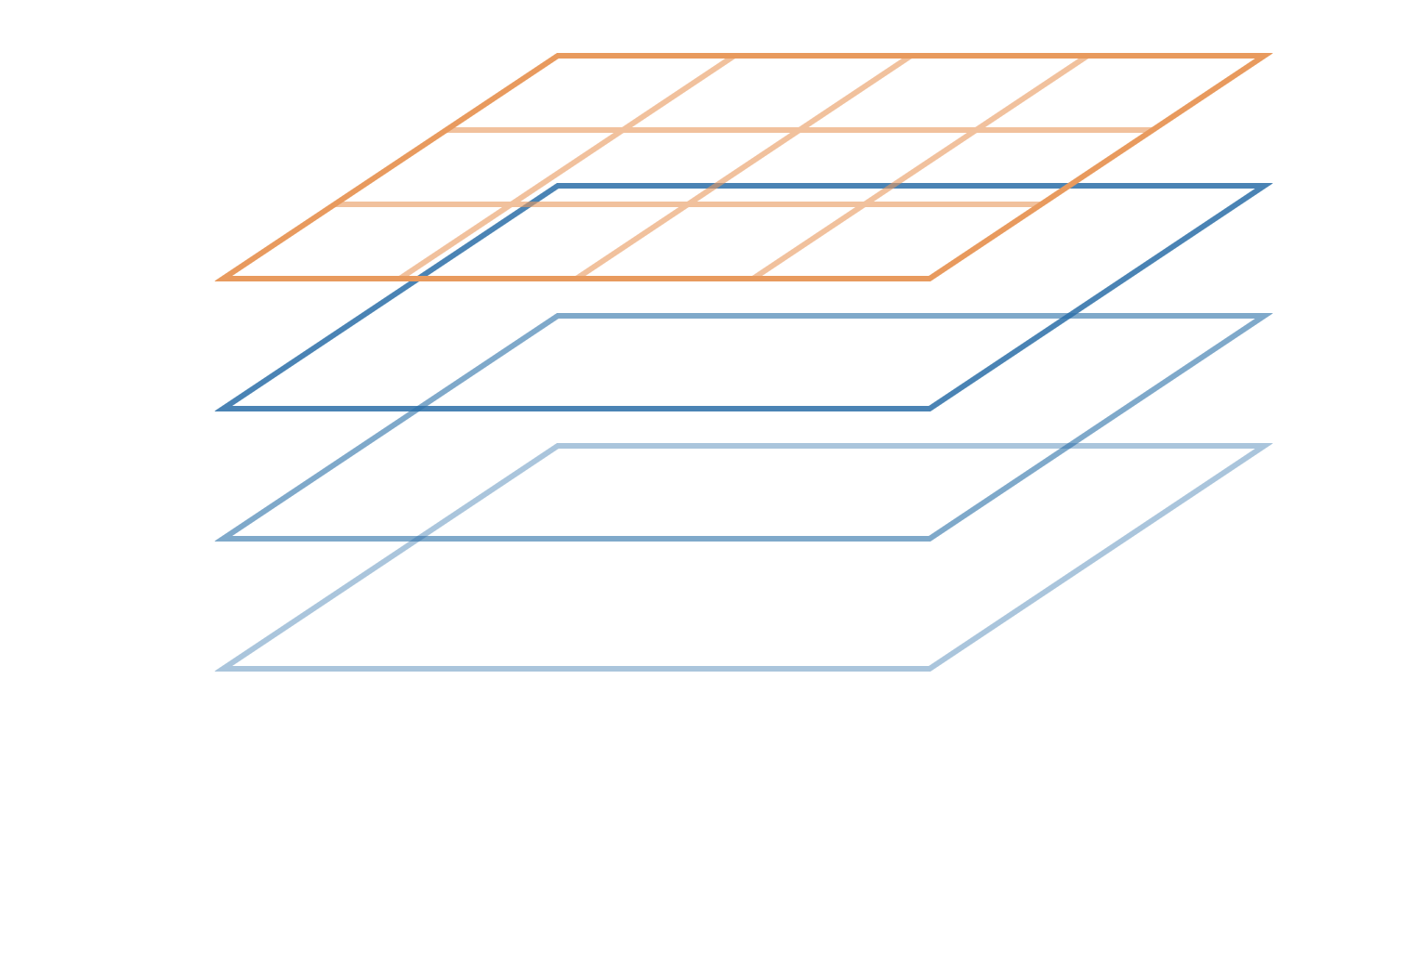
Anatomy of a netCDF file
LOCMARCA 2026 · COURSE 0a
What is inside the files you will open all week, and how to read them
UNA, Heredia, Costa Rica · Tuesday 17 November 2026
Notes:
This course is about the container the data arrive in: almost every ocean, atmosphere and climate dataset you will download this week, observations or model outputs, is a netCDF file. The goal: be able to open any netCDF file, read its header, and find in it the answers to the five questions of Course 1 (tomorrow). Most examples come from the two files of TP1a and TP1b, already on Kabre: the OSTIA SST file and the WOA climatology. Two come from the files of the next days: the GLORYS12 reanalysis (TP2a, TP3) and the CROCO model (TP3).

Slide 2




Why not a spreadsheet?
INTRODUCTION
Self-describing
Many dimensions
Binary, compact
A standard
Data and their description (units, origin, grid) travel in the same file
Natural for fields that depend on time, depth, latitude and longitude
Fast to read, and you can read only the part you need
Read by Python, R, Matlab, CDO, NCO, ncview… on any computer
22 million
lines: what one year of daily SST on our small Costa Rica grid would need as a CSV table (365 days × 200 × 300 points).
LOCMARCA 2026 · Course 0a — Anatomy of a netCDF file
2
Notes:
netCDF (network Common Data Form) was developed by Unidata, in the United States, from the late 1980s, and has become the standard format for ocean, atmosphere and climate data: satellite products, reanalyses, climate model outputs (CMIP), the Copernicus Marine catalogue. Four reasons. Self-describing: the file carries its own documentation. Multidimensional: a 4D temperature field is stored as such, not flattened. Binary: compact and fast, and tools can read a sub-region without loading everything. Standard: one format, many tools. The 22 million figure is simply 365 × 200 × 300, the size of the sst_costarica_2023.nc variable used in TP1a and TP1b.

Slide 3
A netCDF file is a labelled box: a header that describes the content, and the data themselves.
THE ONE IDEA
You can read the label without opening the box: ncdump -h reads only the header, instantly, even for a file of several GB.
Notes:
Keep this image in mind. The header is small (a few kilobytes) and lists everything: the axes, the variables, their units, where the data come from. The data part is big. Most of the work of a data analyst starts by reading the header carefully: it answers most of the questions before any computation. In Python, xr.open_dataset does the same thing: it reads the header immediately and the data only when needed (TP1a).

Slide 4
Four building blocks
BUILDING BLOCKS
1 · Dimensions
2 · Coordinate variables
The named axes and their sizes
The values along each axis
time = 365 ;
latitude = 4.025, …, 13.975 ;
3 · Data variables
4 · Attributes
The physical fields, defined on the dimensions
Metadata attached to a variable or to the whole file
analysed_sst(time, latitude, longitude)
analysed_sst:units = "kelvin" ;
Everything else is a combination of these four. In xarray: ds.sizes, ds.coords, ds.data_vars, .attrs.
LOCMARCA 2026 · Course 0a — Anatomy of a netCDF file
4
Notes:
The whole netCDF data model fits in four notions. Dimensions are just names and sizes. Coordinate variables are ordinary variables that carry the same name as a dimension and give its values: that is how a file knows that index 0 of latitude means 4.025°N. Data variables are the fields we care about, each defined on a list of dimensions. Attributes are name = value pairs attached to a variable (units, long name, missing value) or to the file itself (title, institution, history). The examples are taken from sst_costarica_2023.nc. Point out the link with the xarray commands they used in TP1a.

Slide 5
Reading a real header: ncdump -h
BUILDING BLOCKS
netcdf sst_costarica_2023 {
dimensions:
time = 365 ;
latitude = 200 ;
longitude = 300 ;
variables:
short analysed_sst(time, latitude, longitude) ;
analysed_sst:long_name = "analysed sea surface…" ;
analysed_sst:units = "kelvin" ;
analysed_sst:scale_factor = 0.01 ;
analysed_sst:add_offset = 273.15 ;
analysed_sst:_FillValue = -32768s ;
float latitude(latitude) ;
float longitude(longitude) ;
int time(time) ;
time:units = "seconds since 1981-01-01" ;
Dimensions: names and sizes
Data variable: type, name, dimensions
Coordinate variables: same name as their dimension
Attributes: variable:name = value
The header of sst_costarica_2023.nc (TP1b), shortened.
LOCMARCA 2026 · Course 0a — Anatomy of a netCDF file
5
Notes:
This is what ncdump -h prints for the OSTIA file of TP1b, with some lines removed (the full header has many more attributes). Read it from top to bottom with the participants: first the dimensions, then each variable with its type (short, float, int), its name, and the dimensions it depends on in parentheses, followed by its attributes, written variable:attribute = value. Coordinate variables are easy to spot: latitude(latitude) is a variable named like its dimension. Ask: how many values does analysed_sst contain? What are its units? Why is it stored as "short"? We answer the last question in a few slides.

Slide 6
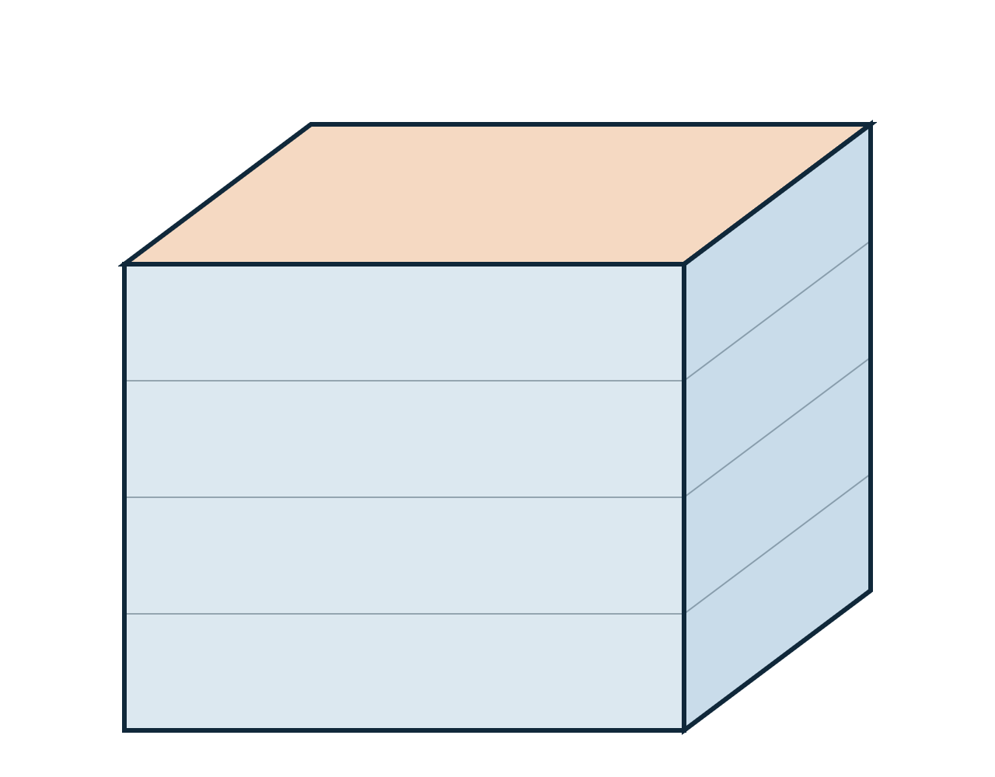
Dimensions give the shape of the data
BUILDING BLOCKS
latitude = 200
Size: 365 × 200 × 300 = 21.9 million values. Stored as 2-byte integers, that is ≈ 44 MB: the size of the file.
Order matters: analysed_sst(time, latitude, longitude). Each time step is one map.
time
Names are free: WOA calls its dimensions X, Y, Z, T (360 × 180 × 33 × 4). Always read them first.
365
longitude = 300
LOCMARCA 2026 · Course 0a — Anatomy of a netCDF file
6
Notes:
A dimension is only a name and a size, but it tells you the shape of every variable. Multiply the sizes and you get the number of values; multiply by the size of the type (short = 2 bytes, float = 4, double = 8) and you get the order of magnitude of the file: here 21.9 million × 2 bytes ≈ 44 MB, which matches the 42 MB of sst_costarica_2023.nc on disk. Useful before a download: a 3D daily field on a large region quickly reaches tens of GB. The order of the dimensions is the order of the indices: the first is time, so each time step is a full map. Names are a convention, not a rule: WOA uses X, Y, Z, T. Some files also have an UNLIMITED (record) dimension, usually time, which can be extended by appending new steps; ncdump marks it as UNLIMITED.

Slide 7
Coordinates turn an index into a place
BUILDING BLOCKS
latitude | [0] | [1] | [2] | … | [199]
value (°N) | 4.025 | 4.075 | 4.125 | … | 13.975
Index or value
Spacing
Direction
isel(latitude=0) takes position 0; sel(latitude=4.025) takes the value. Same point.
0.05° between two values: the grid spacing (≈ 5.5 km), not the effective resolution (Course 1, tomorrow).
Here south to north. Some files store north to south: check before any slice.
LOCMARCA 2026 · Course 0a — Anatomy of a netCDF file
7
Notes:
A coordinate variable is a 1D variable with the same name as its dimension. It gives the geographic (or physical) value of each index: index 0 of latitude is 4.025°N, index 199 is 13.975°N. The values are the centres of the grid cells, every 0.05°. This is exactly the difference between isel (by position) and sel (by value) in TP1a. Three things to check on any new file: the spacing (is it regular? what resolution?), the range (does it cover my region? are longitudes from −180 to 180 or from 0 to 360?), and the direction (increasing or decreasing): with a decreasing latitude, a slice(8, 12) silently returns an empty selection.

Slide 8
One file, several variables
BUILDING BLOCKS
dimensions: depth = 31 ; latitude = 121 ; longitude = 181 ; time = 31 ;
short thetao(time, depth, latitude, longitude) ; // sea_water_potential_temperature
short so(time, depth, latitude, longitude) ; // sea_water_salinity
short uo(time, depth, latitude, longitude) ; // eastward_sea_water_velocity
short vo(time, depth, latitude, longitude) ; // northward_sea_water_velocity
One month of the GLORYS12 reanalysis (TP2a, TP3): 4 variables share the same 4 dimensions.
Type | Bytes | Typical use
short | 2 | Packed data (next slides)
int | 4 | Counts, time
float | 4 | Most fields, coordinates
double | 8 | High precision, time
Short names (thetao, so…) change from producer to producer: the attributes tell you what they are.
LOCMARCA 2026 · Course 0a — Anatomy of a netCDF file
8
Notes:
The header of 3Docean_costarica_daily_2023_01.nc, one month of the GLORYS12 global ocean reanalysis (Copernicus Marine) around Costa Rica, daily, prepared for the workshop and used in TP3. In TP2a the participants download the monthly version of the same product themselves. Four 4D variables share the same dimensions: potential temperature, salinity and the two velocity components. The names thetao, so, uo, vo are the Copernicus (and CMIP) conventions; another producer may call them temp, salt, u, v: never guess from the name, read the standard_name and units attributes (shown here as comments). The type tells you how each value is stored; short means a packed variable: real values are reconstructed with scale_factor and add_offset, the topic of the next slides.

Slide 9
The attributes you must read
ATTRIBUTES
Attribute | In the OSTIA file | Why it matters
units | kelvin | 300 K is 27 °C: convert before plotting
long_name | analysed sea surface temperature | Human-readable description
standard_name | sea_surface_foundation_temperature | Exact meaning, from the CF list
_FillValue | -32768 | Marks missing points (land)
scale_factor, add_offset | 0.01, 273.15 | Unpack stored integers into real values
valid_min, valid_max | -300, 4500 (packed) | Values outside are not physical
LOCMARCA 2026 · Course 0a — Anatomy of a netCDF file
9
Notes:
Variable attributes are where the meaning is. Units first: SST in kelvin is a classic trap (a colorbar up to 300). long_name is for humans; standard_name is a controlled term from the CF conventions list: it tells you, for instance, that OSTIA is a foundation temperature, not a skin temperature (Course 1). _FillValue marks missing values: here land points. scale_factor and add_offset are used to pack the data as integers. valid_min and valid_max are expressed in packed units: -300 and 4500 correspond to −3 + 273.15 and 45 + 273.15 K, so −3 °C to 45 °C. In xarray, these are in da.attrs (or da.encoding for the packing attributes, once decoded).

Slide 10
Packing: integers that hide real numbers
ATTRIBUTES
value = stored × scale_factor + add_offset
2811 × 0.01 + 273.15 = 301.26 K = 28.11 °C
Why
Good news
Trap
2 bytes instead of 4 or 8: the file is 2 to 4 times smaller, at 0.01 K precision.
xarray, CDO and ncview unpack automatically: you see 301.26.
ncdump -v prints the raw integers: 2811, not 301.26.
LOCMARCA 2026 · Course 0a — Anatomy of a netCDF file
10
Notes:
A real example from sst_costarica_2023.nc: the first day, latitude index 100, longitude index 150, the stored integer is 2811. With scale_factor = 0.01 and add_offset = 273.15, the real value is 301.26 K, that is 28.11 °C; this is exactly what xarray returns. Packing saves space: a short takes 2 bytes, against 4 for a float and 8 for a double, at the cost of a fixed precision (here 0.01 K, more than enough for satellite SST). Most tools apply the formula for you. But a raw dump (ncdump -v analysed_sst) prints the stored integers, and so does any low-level reading that disables unpacking: if you see SST values in the thousands, that is packing, not a bug in the data. Note also that NCO operators can repack data: ncpdq -U unpacks a file.

Slide 11
Missing values: one number means "nothing"
ATTRIBUTES
File | Attribute | Value | Where
OSTIA SST | _FillValue | -32768 | Land
WOA 2009 | missing_value | -99.9999 | Land and below the sea floor
When the tool knows
When it does not
The value becomes NaN (Not a Number): blank on maps, skipped by means.
-99.99 °C enters your average. Always check the min and max of a new variable.
LOCMARCA 2026 · Course 0a — Anatomy of a netCDF file
11
Notes:
netCDF has no "empty" cell: every grid point holds a number, and missing points are flagged with a special value declared in an attribute. Two conventions coexist: _FillValue (the netCDF standard) and missing_value (older, but still common, as in the WOA file of TP1b). xarray understands both and turns them into NaN, which is why land appears white on the maps of TP1a. A tool or a script that ignores the attribute will treat -99.9999 as a real temperature, and a mean over a box including land becomes absurd. A simple habit, part of the cross-checking of TP1b: print the min and max of any new variable; a value of -32768 or -99.99 is an immediate warning sign.

Slide 12
Time is stored as a number
ATTRIBUTES
date = reference date + value × unit
File | time:units | Example
OSTIA SST | seconds since 1981-01-01 | 1325376000 → 2023-01-01
GLORYS12 reanalysis | hours since 1950-01-01 | Another reference, another unit
WOA 2009 | months (no reference) | 1.5, 4.5, 7.5, 10.5: mid-season, not dates
CROCO model (TP3) | seconds (no reference date) | Start of the model run: you add it (TP3)
Also read calendar: climate models often use 365-day years (no 29 February) or 360-day years (Course 2).
LOCMARCA 2026 · Course 0a — Anatomy of a netCDF file
12
Notes:
Dates are never stored as text: the time variable holds numbers, and its units attribute says how to read them, in the form "unit since reference date". The first value of the OSTIA file is 1325376000 seconds since 1 January 1981, which is exactly 1 January 2023 (15,340 days × 86,400 s). The GLORYS12 reanalysis file uses hours since 1950: every producer chooses its own. The CROCO model outputs of TP3 store seconds since the start of the model run, and that date is not written in the file: TP3 adds it by hand (CROCO_TIME_ORIGIN in croco_helpers.py), a good example of a header that does not answer every question. xarray decodes these automatically into real dates, which is why you can write sel(time="2023-02") in TP1a. The WOA file is an exception: its units are just "months", with no reference date, so xarray leaves the values as numbers (1.5 to 10.5, the middle of each season): this is not CF-compliant, and a reminder that a climatology has no real date. The calendar attribute matters with climate models, which often use a 365-day "noleap" or a 360-day calendar: comparing them with observations day by day needs care.

Slide 13
Global attributes: the file's identity card
GLOBAL METADATA
Attribute | In the OSTIA file
title | Global SST & Sea Ice Analysis, L4 OSTIA, 0.05 deg daily
institution | UKMO (the UK Met Office)
source | AMSR2, GOES, SEVIRI, SLSTR, AVHRR, VIIRS… (the satellites merged)
Conventions | CF-1.4, ACDD-1.3
history | Created from sst.nc; obs_anal.nc; seaice.nc
acknowledgment | How to cite the data in your report or paper
history grows: NCO and CDO append each command you run (TP1b). Your own processing leaves a trace.
LOCMARCA 2026 · Course 0a — Anatomy of a netCDF file
13
Notes:
Global attributes, listed at the end of ncdump -h, describe the file as a whole: what it is (title), who made it (institution), from what (source: here the long list of satellite sensors merged into the L4 analysis, see Course 1), which conventions it follows, and its processing history. The acknowledgment attribute tells you how to cite the product: please use it in your Friday slides and in any publication. The history attribute is very useful for reproducibility: NCO and CDO append the command line they ran, with the date. After TP1b, run ncdump -h on one of your output files and look at its history.

Slide 14
CF conventions: a shared vocabulary
GLOBAL METADATA
The Climate and Forecast (CF) conventions say how to write units, axes, time and variable names, so that tools understand a file without help.
What the tool looks for | OSTIA (CF-1.4) | WOA 2009 (no CF declared)
standard_name | On every variable | None
axis (X, Y, T) | On every coordinate | None: only the names X, Y, Z, T
Time units | seconds since 1981-01-01 | months: no reference, not decoded
Missing values | _FillValue | missing_value
A CF file "just works" in xarray, CDO, ncview. With WOA, you must tell the tools which dimension is which (TP1b).
LOCMARCA 2026 · Course 0a — Anatomy of a netCDF file
14
Notes:
netCDF is only a container; CF is the agreement on how to fill it. CF defines the standard_name table (thousands of controlled names such as sea_water_potential_temperature), the way to write units (udunits), how to mark axes (axis, positive = down for depth), how to write time, and how to flag missing data. Tools rely on these attributes, not on the variable names, to recognise latitude, longitude, depth and time. The OSTIA and Copernicus files declare CF in their Conventions attribute and carry standard_name and axis on everything. The WOA 2009 file of TP1b is an older, minimal file: no Conventions attribute, no standard_name, no axis, and a time unit with no reference date. It still works, but the analyst has to do the interpretation: that is why TP1b insists on the X, Y, Z, T names and on averaging over T.

Slide 15
Metadata can be wrong
GLOBAL METADATA
Three real attributes of sst_costarica_2023.nc, a 2023 file covering 92°W–77°W:
time_coverage_start = "19811001T000000Z"
The data start on 1 January 2023
easternmost_longitude = 180.00002
The grid stops at 77°W
analysed_sst:coordinates = "lon lat"
The variables are latitude and longitude
Cutting a sub-region copied the attributes of the global product. Trust the coordinates and the data; check the attributes.
LOCMARCA 2026 · Course 0a — Anatomy of a netCDF file
15
Notes:
A real and very common situation. The OSTIA file of TP1b was extracted from the global reprocessed product with the Copernicus Marine toolbox. The subsetting kept the original global attributes, which describe the global product (and one of its original daily files), not our extract: time_coverage_start says October 1981, easternmost_longitude says 180°, and the coordinates attribute names variables "lon lat" that do not exist in this file. None of this breaks the analysis, but anyone who reads only the attributes gets it wrong. The rule: the coordinate variables and the data are the truth; attributes are a description that may be outdated. Check the time and coordinate ranges yourself (TP1a section 1, TP1b section 1).

Slide 16
Six ways to look inside
TOOLS
Tool | Command | What you get
ncdump | ncdump -h file.nc | The header only, instantly
ncdump | ncdump -v time file.nc | Header plus the values of one variable (raw, packed)
NCO | ncks -m file.nc | The metadata
CDO | cdo sinfo file.nc | A summary: grid, levels, time steps
ncview | ncview file.nc | Interactive quick-look maps (needs a graphical display)
Python | xr.open_dataset("file.nc") | Decoded: real dates, NaN, unpacked values
Same file, different views. In a Jupyter cell, prefix shell commands with ! : !ncdump -h {SST_FILE}
LOCMARCA 2026 · Course 0a — Anatomy of a netCDF file
16
Notes:
All these tools are available on Kabre with the psf2026 module. ncdump comes with the netCDF library itself: -h for the header, -v var to print one variable (beware: raw packed values). NCO and CDO are the two command-line toolboxes of TP1b: ncks -m prints the metadata, cdo sinfo gives a compact summary of grids, levels and time steps. ncview opens quick interactive maps but needs a graphical display, which a Jupyter notebook does not provide (use the OnDemand desktop, or a local copy). In Python, xarray decodes everything for you: dates, missing values, packing. In a notebook, shell commands are run with an exclamation mark, and Python variables are inserted with braces: !ncdump -h {SST_FILE}, exactly as in TP1b.

Slide 17
The five questions, answered by the header
PREVIEW OF COURSE 1
Question | Where to look
1 · What exactly is measured? | standard_name, long_name, units
2 · Where and when? | Range of the coordinate variables; time:units and the time values
3 · Which resolution? | Spacing of the coordinates (here 0.05°): the grid, not the effective resolution
4 · Climatology or real period? | Number and meaning of the time steps: 4 seasons (WOA) or 365 days (OSTIA)
5 · How uncertain? | Error or quality variables (e.g. analysis_error), references, documentation
The header answers the first four in two minutes. The fifth often needs the product documentation.
LOCMARCA 2026 · Course 0a — Anatomy of a netCDF file
17
Notes:
This slide ties the two courses together. The five questions of Course 1 are not abstract: most of the answers are written in the netCDF header, and reading it takes a couple of minutes. What is measured: standard_name and units. Where and when: the coordinate variables and the time axis (decoded). Resolution: the spacing of the coordinates, keeping in mind that it is the grid spacing, not the effective resolution. Climatology or real period: look at the number of time steps and their units. Uncertainty is the weak point: some products ship an error variable, but often you have to read the documentation (Copernicus product user manuals, quality information documents).

Slide 18
Your turn: TP1a, then TP1b
NEXT
1
2
3
Open
Find
Check
TP1a, section 1: the OSTIA file with xarray, the four blocks
TP1b, B.1 and B.2: the same header with ncdump -h and cdo sinfo
Units, time range, latitude order: before any map or average
Questions?
LOCMARCA 2026 · Course 0a — Anatomy of a netCDF file
18
Notes:
Hand over to the hands-on sessions. Section 1 of TP1a ("Open a netCDF file and look inside") is a direct application of this course: open sst_costarica_2023.nc with xarray, find the four blocks, the units and the time range. TP1b starts with a 2-minute warm-up on the same file (including the order of the latitudes), shows a less tidy file in section A.3 (WOA, with X, Y, Z, T dimensions), and reads the headers from the command line in B.1 and B.2 (ncdump -h, cdo sinfo). Encourage participants to run ncdump -h on every new file they meet this week, including the ones they download in TP2 and the model outputs of TP3, and to look at the history attribute of their own output files after using NCO or CDO.

