Slide 1
Instructions for using this template
Delete this slide before sharing
Purpose
Provide simplified template for external customer-facing Business Case deliverable
Audience and delivery mechanism
External customers
1 on 1 customer engagements
How you should use the template
Update slides with Customer/engagement specific data. Guidance is given in the red boxes in the top right corner of each slide (to be removed once updates are completed)
Amend/add/delete any slide to suit your needs. You are the owner of the presentation and the template is intended to facilitate achieving desired outcome
Share a PDF version of this PPT with your customer
Additional resources
Benchmarking data: “The Business Value of Migration to Amazon Web Services” February 2022, The Hackett Group
https://pages.awscloud.com/rs/112-TZM-766/images/hackett-group-the-business-value-of-migration-to-aws-012022.pdf

Slide 2
Quantifying the Value of AWS
Customer XYZ
Team or presenters name
Date

Slide 3
Customer XYZ’s IT Environment in Scope
Illustrative
Update / adjust to reflect DC, IT environment, workloads and/or applications in scope
Clearly state any exclusions
Compute
Provisioned Storage
Servers/VMs
Server Statistics
SAN Storage: xxxx GB
NAS Storage: xxxx GB
Local Storage: xx GB
Backup: xxxxxx GB
Server Type | Avg. vCPUs | Avg. RAM
Physical | 20 | 40
Virtual | 4 | 12
Operating System
Environments
Databases
3 x MySQL databases
8 x MS SQL databases (Standard Edition)
Source: TBC

Slide 4
Customer XYZ’s Current Server Utilization
Illustrative
Update /adjust with uptime and utilization data collected by automated discovery tool
Current Server Utilization (%)
Statistics
XX% of servers had an uptime < x%
XX% of server had an avg. RAM utilization < y%
XX% of servers had an avg. CPU utilization < z%
Comments
In Use – Est. time the servers delivered business value by being on and having their CPU utilization above 5%.
Idle – Est. time the servers were on but did not deliver business value by having their CPU utilization below 5%.
Unclassified – Est. time servers were on but had no metrics available to determine if they were idle or in use.
Zombie – Servers that were expected to deliver business value, but did not.
Expected Idle – Percentage of servers expected to not be in use but deliver business value in different ways.
Source: TBC

Slide 5
Customer XYZ’s Costs if Remaining On Premise (OP)
Expected OP Infrastructure costs (k USD, p.a.)
Comments
Estimated IT spend is at the level of $3.0 m (annualized):
Facilities: $ 0.5m
Power and cooling: $ 0.2m
Server hardware, OS and hypervisor licensing and rack infrastructure: $1.33m
Storage: $0.44m
Network: $0.15m
Database licenses: $ 0.1m
Others (Monitoring, Security, etc.): $0.10m
IT Labor not included in this TCO
Illustrative
Update / adjust to reflect annual costs of staying on premise. This typically includes one HW refresh cycle.
Delete if Customer’s on-premises costs are not available
Source: TBC

Slide 6

Customer XYZ’s Costs if Remaining On Premise (OP)
Illustrative
Adjust / add / delete pillars as needed.
The pillars should reflect the multi-year view of the cost and benefit categories calculated on the previous slides.
k USD

Slide 7
AWS Services Used for AWS Steady State Cost Estimation
On Premise
AWS
Servers
Servers
Virtual
80
Retire E.g. no activity, not required
5
Bare Metal
40
EC2 Shared Tenancy (OS Licenses included)
On Demand
3 Year No Upfront Reserved Instances (NURI)
70
0
70
Peak CPU Utilisation
30%
Peak RAM Utilisation
60%
EC2 Dedicated Hosts (DH)
(OS & SQL Server Bring your own license)
45
OS breakdown
Win 45% Linux 40%
Others 15%
Storage (TBs)
Storage (TBs)
Provisioned
400
EBS General Purpose SSD
Throughput Optimised HDD
180 180
0
Used
180
Illustrative
Update / adjust to reflect IT environment in scope and the AWS services chosen
Source: TBC

Slide 8
Customer XYZ Annual AWS Operating Costs Lift & shift scenario with initial optimizations
Illustrative
Update / adjust to reflect estimates of steady state annual AWS costs and underlying assumptions
Steady State Annual Costs (k USD) |  |  | Key assumptions
Compute | 1,150 |  | Mapped 115 servers as per assumed mix of sizes (Initial # of servers: 120; servers not required to be migrated due to no activity, etc.:10%) Server OS licenses costs: included Uptime (continuous): Assumed 100% (24/7) Pricing options (servers): 3-Year NURI
Storage | 210 |  | Storage volume: 180000GB (200GB per server) - 100% General Purpose SSD (EBS gp2)
Network | 40 |  | Assumed monthly data transfer out: 50TB via public internet
Other services | 57 |  | Monitoring, Networking and Security services (e.g. System Manager, CloudWatch, AWS Config, KMS). Assumed 5% of compute spend
Total Infra Costs (list price) | 1,457
AWS Support | 96 |  | 1) AWS Business Support
Total Costs incl. AWS Support (list price) | 1,553
Note: Presented figures include volume discounts, but not other ‘one-off’ financial incentives (e.g. MAP credits).

Slide 9
Assumptions
List all assumptions taken in the Business Case Calculation

Slide 10

Customer XYZ Comparative Operating Cost Summary
Illustrative
Update / adjust with AWS and on-premises cost estimates shown on previous slide.
Delete second bar (and create a stacked bar chart for AWS costs) if Customer’s on-premises costs are not available.
Costs comparison (steady state, k USD, p.a.)
Comments
AWS annual costs are estimated at the level of $1.55m, ~23% lower than current spend on-premises
-48%
Source: TBC

Slide 11
Cost of Migration/Transformation
Illustrative
Cost drivers not limited to those listed below. Add / adjust as needed.
Add a second column / table if migration costs vary among scenarios.
One-off Costs (k USD) |  |  | Key assumptions
Landing Zone | 150 |  | Scope of work:
Staff Training | 25 |  | 10 employees attending 1 course at USD 2500 each
Internal Efforts | 20 |  | 3 employees investing 1 month in migration
Partner Efforts | 60 |  | 1) Server migration strategy: xx retained, xx relocated, xx retained, xx rehosted, xx repurchased, xx replatformed, xx refactored
Total cost of migration | 1,257

Slide 12
Migration Plan
Add one or more high-level migration plans detailing migration waves.

Slide 13

Customer XYZ Can Profit from AWS Investment Program ABC
AWS Spend Prior and Post AWS
Investment in the First Two Years
Comments
Components of the AWS Investment Program ABC are:
Platform credits amounting to xx% of incremental AWS spend
xxx
Prerequisites:
k USD p.a.
Illustrative
Briefly outline the AWS investment program from which the customers can benefit and calculate the financial implications. Include the prerequisites for this program especially when it is not clear whether the customer will qualify.

Slide 14

Benefits of the Cloud Go Beyond Infrastructure Cost Savings Cloud Value Framework
Illustrative
Alternatively, outcomes of the Benchmarking Study could be overwritten with customer references: https://aws.amazon.com/solutions/case-studies/
CO2
Cost savings
Staff productivity
Operational resilience
Business agility
Sustainability
What is it?
Infrastructure cost savings/ avoidance from moving to the cloud
What is it?
Efficiency improvement by function on a task-by-task basis
What is it?
Benefit of improving SLAs and reducing unplanned outage
What is it?
Deploying new features/ applications faster and reducing errors
What is it?
Running infrastructure more efficiently and reducing carbon footprint
Top value driver
Total Cost of Ownership (TCO)
Top value driver
Servers per Admin
Top Value Driver
Downtime
Top Value Driver
Time-to-market
Top Value Driver
Carbon Footprint
Cost impact
Value impact
Source: Source: “The Business Value of Migration to Amazon Web Services” February 2022, The Hackett Group
Link: https://pages.awscloud.com/rs/112-TZM-766/images/hackett-group-the-business-value-of-migration-to-aws-012022.pdf
Source: Hackett Group 2021. The percentage values on this page represents the improvement in these respective KPIs since migration.
14

Slide 15

AWS CVF Benefits for Customer
Customer
LOGO
Provide Customer with modern, stable and cost-optimized solutions to keep advancing in growing their business.
AWS CVF
CO2
Cost savings
Staff productivity
Operational resilience
Business agility
Sustainability
46%
Reduction in infrastructure Total Cost of Ownership (TCO)
19.8%
VMs Managed per Admin
46%
Annual Unplanned Downtime
31%
Time to Market for New Features
89%
Total Carbon Reduction Estimate
Benefits
79%
Return on Investment
76%
TBs Managed per Admin
40%
Monthly Security Incidents
53%
Time to Data insight
72% 
Benefit from server utilization

Slide 16
Cash Flow
Aquí pegar el flujo que proviene del Template de Excel

Slide 17
5 Year Financial Summary
Illustrative
Adjust / add / delete pillars as needed.
The pillars should reflect the multi-year view of the cost and benefit categories calculated on the previous slides.
k USD

Slide 18
Customer XYZ Could Save USD 92 p.a. Due to an Increase in Staff Productivity Post AWS Migration
Prior AWS Migration
Number of admins: 2
Hours worked p.a.: 3520 (40/week x 44 weeks)
Annual salary of each: USD 70 k
Hourly salary: USD 70k / 1760 = USD 40
Cost p.a.: 2 x USD 70k = USD 140k
Post AWS Migration
Working hours p.a.: 3520 hours x (1-66%) = 1197
Hourly slary: USD 40
Cost p.a.: 1197 * USD 40 = 48 k
66% reduction
Potential p.a. savings: USD 140 – USD 48 = USD 92k

Slide 19
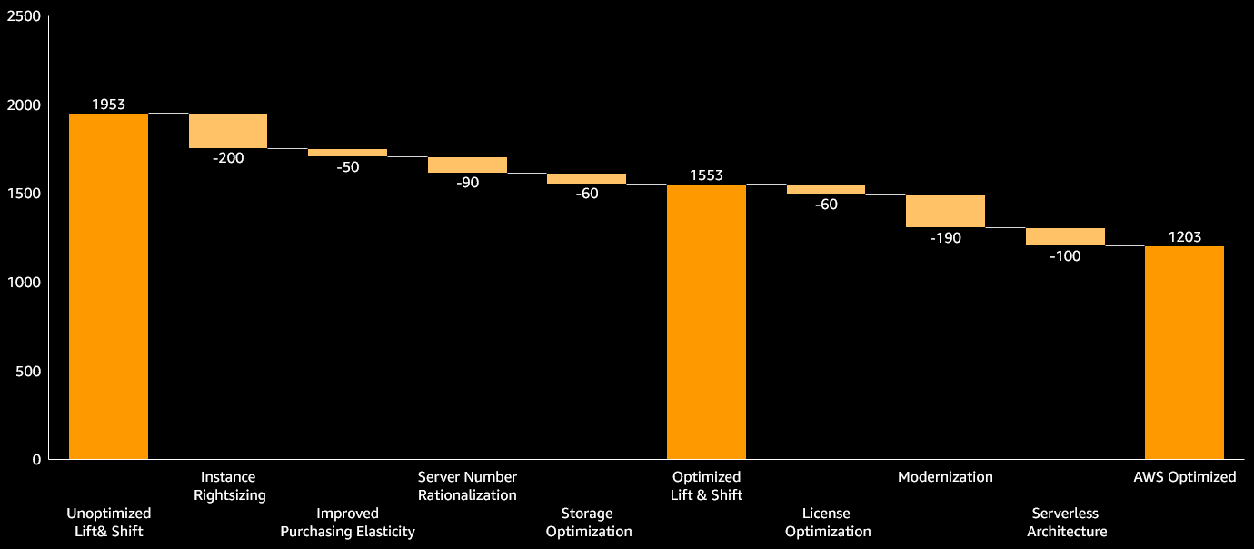
Further Optimization and Modernization Can Lower TCO
Illustrative
Adjust pillars/optimization measures as needed.
The cost of the “Optimized Lift & Shift” scenario in this waterfall diagram should equate the AWS costs shown on the previous slides.
The cost of the “AWS Optimized” scenario should equate the AWS costs shown on the next slide.
Economic case improves through optimization
…and architecting for cloud
k USD p.a.
Source: TBC

Slide 20
Customer XYZ Can Reduce Costs Further via Optimization and Modernization Measures
Illustrative
Update / adjust with estimates of annual AWS costs post optimization and modernization and on-premises costs.
If Customer’s on-premises costs are not available a stacked bar chart could be used to depict the AWS annual cost breakdown
Costs comparison (steady state, k USD, p.a.)
Comments
By migrating from MS SQL databases on EC2 to Amazon Aurora USD 60 k can be saved p.a
-60%
Source: TBC

Slide 21
5 Year Financial Summary
Illustrative
Adjust / add / delete rows as needed.
Add comments if underlying assumptions/calculations are not detailed elsewhere
USD thousands |  | Year 1 | Year 2 | Year 3 | Year 4 | Year 5 | Total
Stay On Premises |  | 5000 | 3000 | 3000 | 3000 | 3000 | 15000
AWS Steady State Costs |  | 1000 | 1203 | 1203 | 1203 | 1203 | 5812
Migration Costs |  | 1257 |  |  |  |  | 1257
Parallel Run Costs |  | 1500 |  |  |  |  | 1500
Staff Productivity Benefits |  |  | -92 | -92 | -92 | -92 | -368
Operational Resilience Benefits |  |  |  |  |  |  | 0
Business Agility Benefits |  |  |  |  |  |  | 0
AWS Investments |  | -250 | -50 |  |  |  | -300
Migrate to AWS |  | 3507 | 1061 | 1111 | 1111 | 1111 | 7901
Comments
Gradual ramp down of on-premises costs over 8 months

Slide 22
Next steps
Illustrative
Update accordingly
Open points and next steps
TBC
TBC
TBC
Key actions
# | Area | Action | Owner | Deadline
1
2

Slide 23
Backup

Slide 24
Illustrative
Illustrative over simplified example based on the outcomes of the benchmarking studies shown on the prior slide and assuming the customer has 2 admin taking care of the current infrastructure. Alternative approaches are detailed in the on demand video of the “theory section”.
Repeat these “non-TCO” calculations for an Increase in Operational Resilience and Business Agility

