Slide 1
3
2
5
POST
Maintenance org
Task
GET - status
Publish
SubstanceDefinition
(GSID)
SubstanceDefinition
(Draft – no GSID)
GET - status
1
4
GET
6

Slide 2
Task
MedicinalProductDefinition
POST
Maintenance org
GET - status
Publish
AdministrableProductDefinition
(PhPID)
AdministrableProductDefinition
(Draft – no PhPID)
GET - status
Ingredient
GET

Slide 3
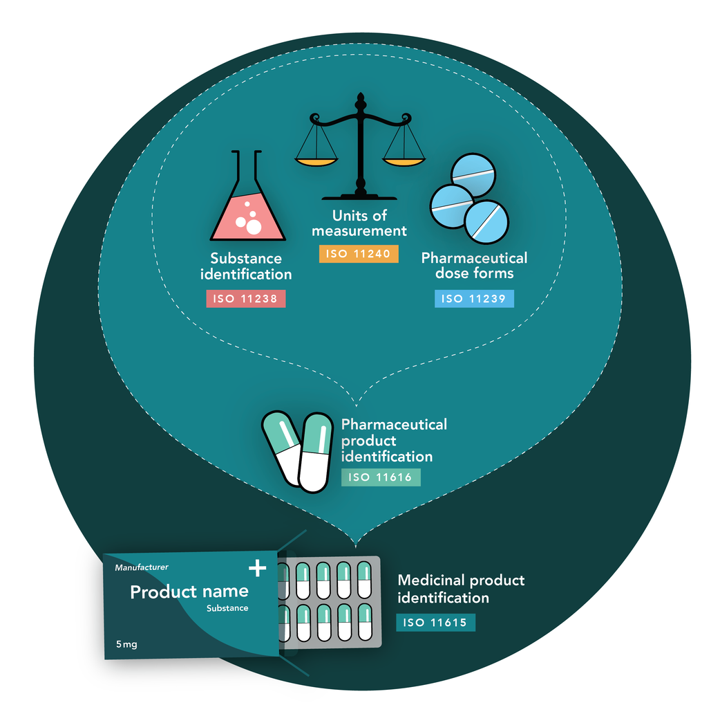
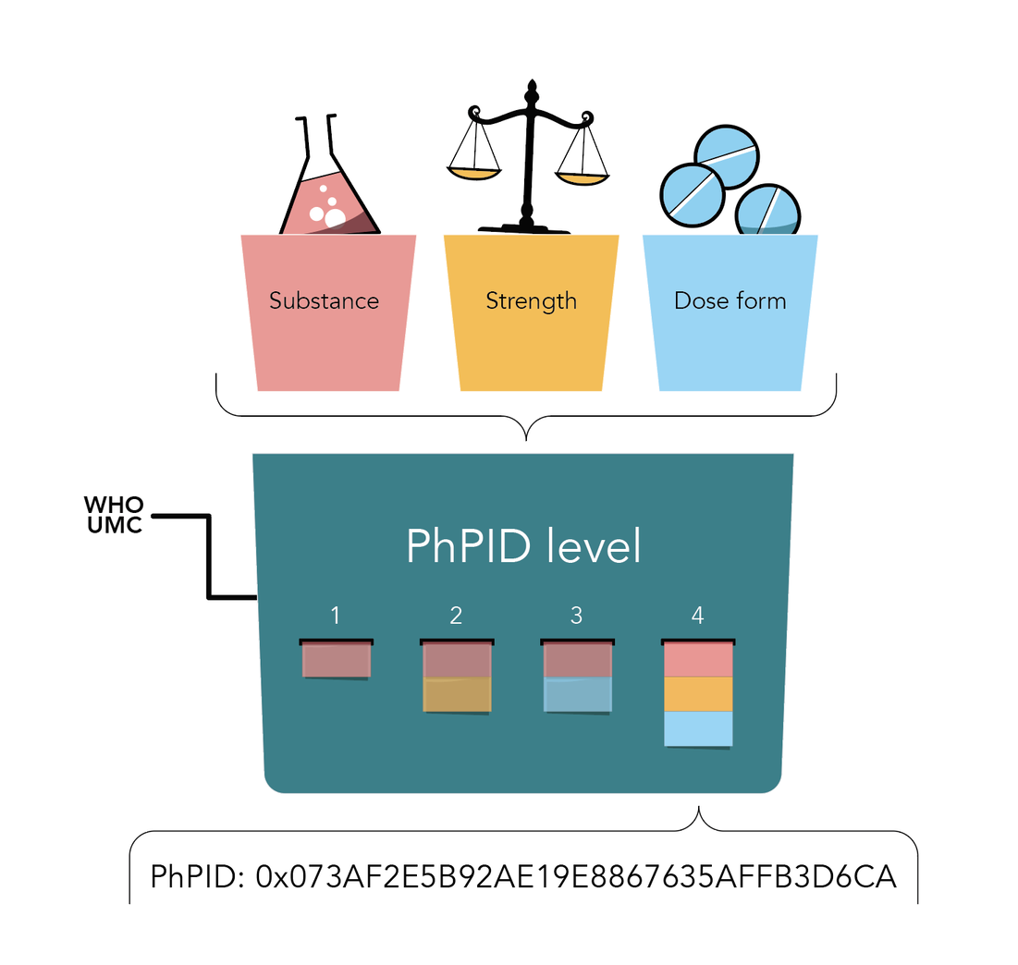
Global PhPID and Substance ID (GSID)

