Slide 1
Giacomo Cappon
Hello, Flutter!

Slide 2
Outline
Flutter
Creating a new project
App dissection
Expanding our first app
Homework & Resources
Project overview

Slide 3

Flutter
What is Flutter?
Simply a declarative framework for Dart
Why this choice?
State-of-the-art and Google-maintained
Single codebase for iOS and Android (and Mac, Windows, Web)
Relatively easy to learn
Lots of examples
Fastly growing job market
Today we will create and study our first Flutter app

Slide 4

Before starting…
What you’ll see in these labs about Flutter capabilities
Actual things that you will probably use
Flutter possibilities

Slide 5
Outline
Flutter
Creating a new project
App dissection
Expanding our first app
Homework & Resources
Project overview

Slide 6
Hello, Flutter!
In this lesson, we will run and analyse our first Flutter app
First, setup VS Code to work with Flutter (this should have already been done)
Start VS Code.
Invoke View > Command Palette….
Type “install”, and select Extensions: Install Extensions.
Type “flutter” in the extensions search field, select Flutter in the list, and click Install. This also installs the required Dart plugin.
Then, create the app
Invoke View > Command Palette.
Type “flutter”, and select the Flutter: New Project.
Select Application
Select the parent directory that will contain the app
Enter a project name, such as ”my_first_app”, and press Enter.
Wait for project creation to complete and the main.dart file to appear.

Slide 7
Hello, Flutter!
Replace all the code of main.dart with
import 'package:flutter/material.dart'; void main() {
runApp(const MyApp());
}//main class MyApp extends StatelessWidget {
const MyApp({Key? key}) : super(key: key);
@override
Widget build(BuildContext context) {
return MaterialApp(
title: 'Welcome to Flutter’,
home: Scaffold(
appBar: AppBar(title: const Text('Welcome to Flutter'),),
body: const Center(child: Text('Hello World'),),),
);
}//build
}//MyApp

Slide 8
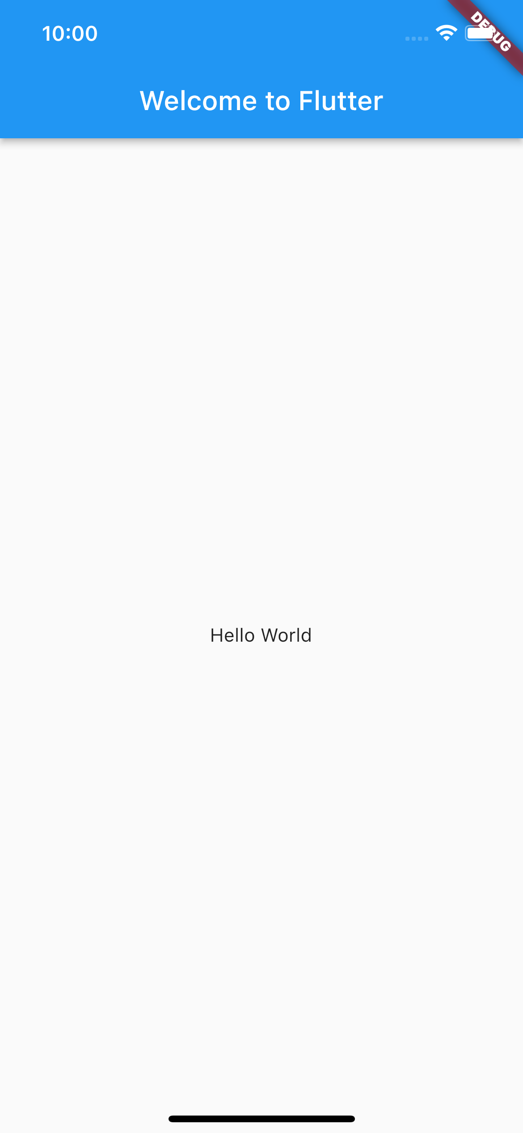
Hello, Flutter!
Finally, run the app!
Locate the VS Code status bar (the blue bar at the bottom of the window):
Select a mobile device from the Device Selector area
Invoke Run > Start Debugging or press F5
Wait for the app to launch — progress is printed in the Debug Console view.
After the app build completes, you’ll see the starter app on your device.

Slide 9
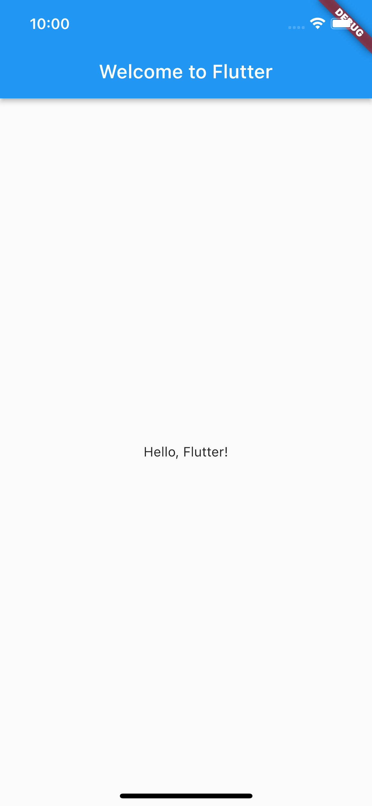
A great feature: Hot reload
Dart offers a fast development cycle with Stateful Hot Reload, the ability to reload the code of a live running app without restarting or losing app state. Make a change to app source, tell your IDE or command-line tool that you want to hot reload, and see the change in your simulator, emulator, or device.
Try that!
Open lib/main.dart.
Change the string
‘Hello World’
with
‘Hello, Flutter!’
Save your changes: invoke Save All, or click Hot Reload
You’ll see the updated string in the running app almost immediately.

Slide 10
Outline
Flutter
Creating a new project
App dissection
Expanding our first app
Homework & Resources
Project overview

Slide 11
Let’s dissect the app
Let’s understand what we have done.

Slide 12
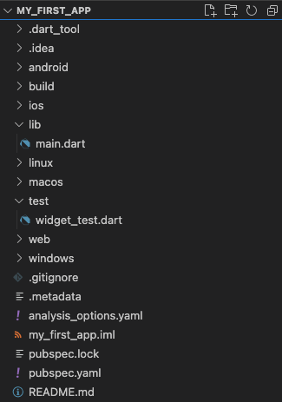
Let’s dissect the app – Project folder
First, what’s inside the project folder?
Important things
lib folder: it contains the app source code
main.dart file: the entry point for the compiler
pubspec.yaml file: it specifies high level app features as well as listing which third party libraries our app needs and uses
README.md file: a markdown file describing the app
(Less) Important things
android/ios/linux/macos/windows/web folders: where native specific code can be defined if needed
test folder: where to put code for running automatic testers
(Even less) Important things
All other folders and files are very use case specific and probably you will never use those in this course. If you are curious…
Notes:
Note the .gitignore file.

Slide 13
Let’s dissect the app – main.dart
Let’s understand the main.dart file.
import 'package:flutter/material.dart'; void main() {
runApp(const MyApp());
}//main class MyApp extends StatelessWidget {
const MyApp({Key? key}) : super(key: key);
@override
Widget build(BuildContext context) {
return MaterialApp(
title: 'Welcome to Flutter’,
home: Scaffold(
appBar: AppBar(title: const Text('Welcome to Flutter'),),
body: const Center(child: Text('Hello World'),),),
);
}//build
}//MyApp
To run an app using the Flutter framework we can use the runApp method which takes a Widget object as an input.
What’s a Widget?

Slide 14
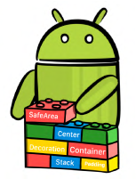

Everything is a Widget
In Flutter, almost everything is (inherits from) a Widget!
A Widget is a building block for your user interface (UI). Using widgets is like combining Legos.
More technically, a Widget is a sort of blueprint for displaying your app state.
Widgets can be thought as a function of UI. Given a state, the build() method (that every custom Widget must override and implement) constructs the widget UI:

Slide 15
Let’s dissect the app – main.dart
In bold the Widgets of our app
import 'package:flutter/material.dart'; void main() {
runApp(const MyApp());
}//main class MyApp extends StatelessWidget {
const MyApp({Key? key}) : super(key: key);
@override
Widget build(BuildContext context) {
return MaterialApp(
title: 'Welcome to Flutter’,
home: Scaffold(
appBar: AppBar(title: const Text('Welcome to Flutter'),),
body: const Center(child: Text('Hello World'),),),
);
}//build
}//MyApp
Key method for building the Widget that must be implemented
But how Widgets are combined together?

Slide 16
The Widget Tree
Widgets are combined together using a tree structure
import 'package:flutter/material.dart'; void main() {
runApp(const MyApp());
}//main class MyApp extends StatelessWidget {
const MyApp({Key? key}) : super(key: key);
@override
Widget build(BuildContext context) {
return MaterialApp(
title: 'Welcome to Flutter’,
home: Scaffold(
appBar: AppBar(title: const Text('Welcome to Flutter'),),
body: const Center(child: Text('Hello World'),),),
);
}//build
}//MyApp
main
MyApp
MaterialApp
Scaffold
AppBar
Center
Text
Text

Slide 17
State and widgets
In bold the Widgets of our app
import 'package:flutter/material.dart'; void main() {
runApp(const MyApp());
}//main class MyApp extends StatelessWidget {
const MyApp({Key? key}) : super(key: key);
@override
Widget build(BuildContext context) {
return MaterialApp(
title: 'Welcome to Flutter’,
home: Scaffold(
appBar: AppBar(title: const Text('Welcome to Flutter'),),
body: const Center(child: Text('Hello World'),),),
);
}//build
}//MyApp
MyApp is not just a Widget, it is a StatelessWidget

Slide 18
Stateless vs. Stateful widgets
StatelessWidgets are Widgets that always build the same way given a particular configuration and ambient state. So, they never re-build while they are displayed to the user (their lifetime).
StatefulWidgets for widgets that can build differently several times over their lifetime.
You can think about StatelessWidget as a sort of constant and StatefulWidget as a variable.

Slide 19
Let’s dissect the app – pubspec.yaml
pubspec.yaml contains high-level instructions for the development environment and information on the app
name: my_first_app
description: A new Flutter project.
publish_to: 'none’
version: 1.0.0+1
environment:
sdk: ">=2.19.4 <3.0.0"
dependencies:
flutter:
sdk: flutter cupertino_icons: ^1.0.2
dev_dependencies:
flutter_test:
sdk: flutter
flutter_lints: ^2.0.0
flutter: uses-material-design: true
my_first_app information (name, description, version, …)
Flutter sdk version to be used
App dependencies: what the app needs in order to work: other packages? Other libraries? Put them here.
App dependencies while developing the app
Information for the Flutter environment such as where to find assets.
Full example in lab_04-hello_flutter/my_first_app/

Slide 20
Outline
Flutter
Creating a new project
App dissection
Expanding our first app
Homework & Resources
Project overview

Slide 21
My first app with steroids
Let’s play with my_first_app and let’s expand it
We will learn how to:
Install an external package and add it as a dependency
Use the external package inside our app
StatefulWidgets 101
How to modify the UI

Slide 22
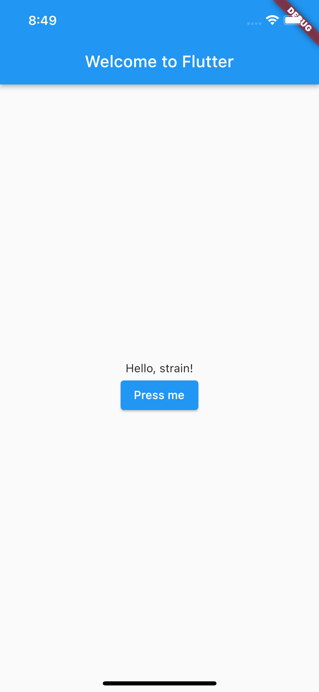
My first app with steroids
Aim: The result will be a very simple app that, each time a button is tapped, a new random ”Hello” message is shown to the user.

Slide 23
My first app with steroids
Roadmap
Understand what to use to generate a random word
Generate a random word and check that everything is working
Display the word in the “Hello” message
Modify the UI to generate a new message each time a button is tapped

Slide 24
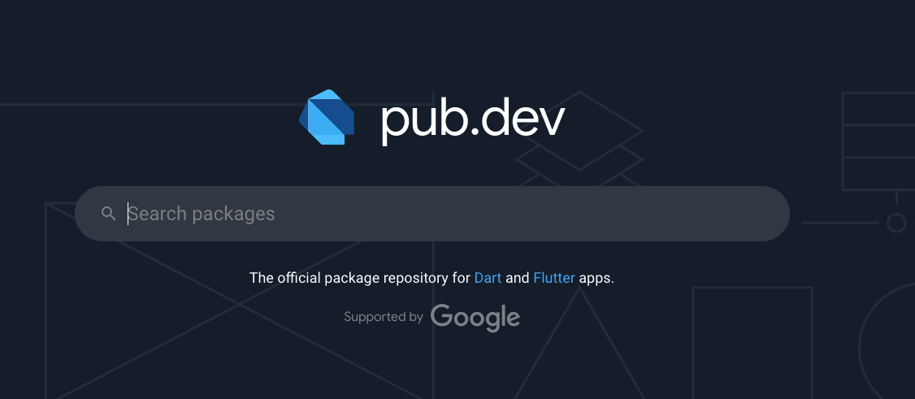
Solving point 1
We do not want to code a random English word generator!
On the Internet we can find a lot of already made code and ready-to-use packages that can fit your needs
A place that we will visit often during this course is pub.dev:

Slide 25
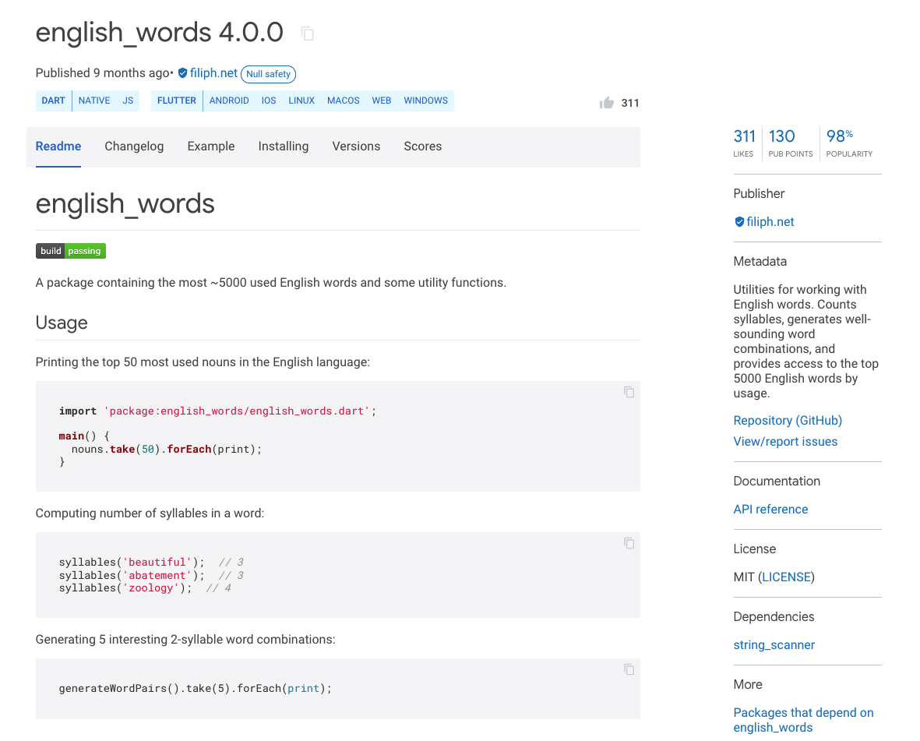
This is the package I was looking for
After some research, it seems like the english_words package can solve our needs
It can generate words and words pairs!
How to use it? Docs!
Code is available too!

Slide 26
Including english_words in the app
Installing the english_words package in our app is very easy.
By definition, it is a dependency right?
So, let’s add it under the dependency list of our app into pubspec.yaml
After adding it, save pubspec.yaml and you will see VSCode running flutter pub get for you.
Done!
...
dependencies:
flutter:
sdk: flutter
cupertino_icons: ^1.0.2
english_words: ^4.0.0
...

Slide 27

My first app with steroids
Roadmap
Understand what to use to generate a random word
Generate a random word and check that everything is working
Display the word in the “Hello” message
Modify the UI to generate a new message each time a button is tapped

Slide 28
Generating a random word
Let’s add some line of code to main.dart to generate a word using the english_words package
Modify the build method by adding
final word = WordPair.random().first;
before the return statement and run the app.
Nothing it’s happening. How to see if we are generating a random word?
We can use the logger and the debug console!

Slide 29
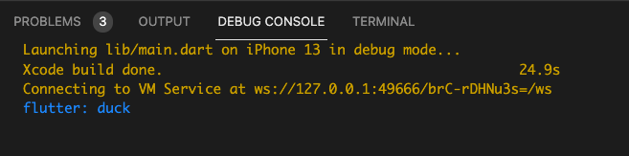
Logging things
Simply try to print the word value as a normal Dart program:
final word = WordPair.random().first;
print(word);
If you run the application now you will see something like this in the Debug Console of VS Code:

Slide 30

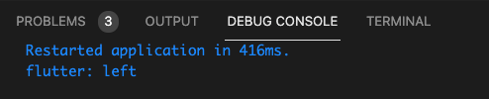
Logging things
Every time you reload/restart the app
…you will see a different word
Restart button
Reload button

Slide 31
My first app with steroids
Roadmap
Understand what to use to generate a random word
Generate a random word and check that everything is working
Display the word in the “Hello” message
Modify the UI to generate a new message each time a button is tapped

Slide 32
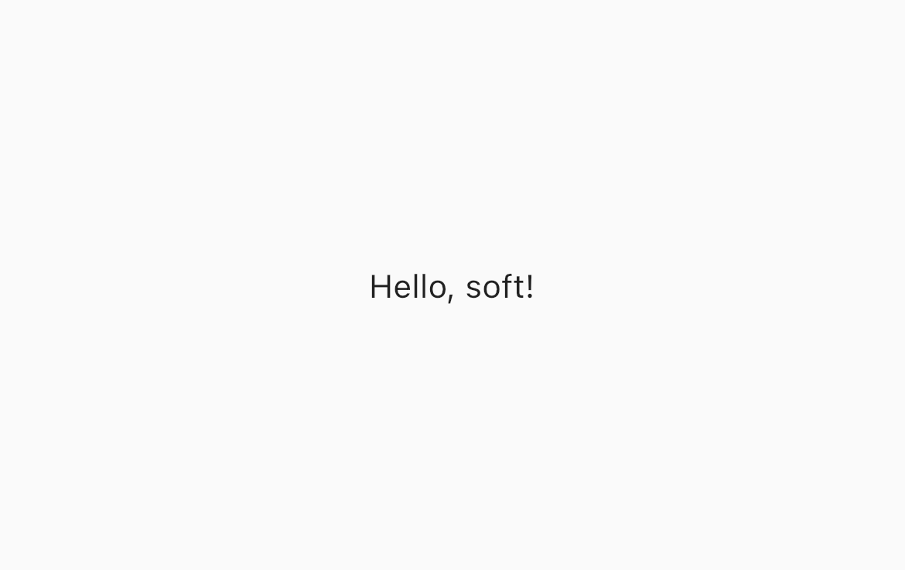
Change the Hello message
You should be able to solve this point by yourself now
Simply, using string interpolation, change
‘Hello, Flutter!’ to ’Hello, $word!’
and save to reload the app and see the changes.

Slide 33
My first app with steroids
Roadmap
Understand what to use to generate a random word
Generate a random word and check that everything is working
Display the word in the “Hello” message
Modify the UI to generate a new message each time a button is tapped

Slide 34
Changing the UI
Let’s start by simply changing the UI
We need to obtain something like
Problems:
How to add a button
How to put it there

Slide 35
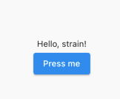
The Column Widget
We can use the Column widget.
It has a list of children (not like Text or Center or Scaffold)
Children are lined up to a column from top to the bottom
Column( children: [ Child#1, Child#2, ], );
Column
Child#1
Child#2

Slide 36
Implement the new UI
Change the build method of MyApp to
Widget build(BuildContext context) {
final word = WordPair.random().first;
print(word);
return MaterialApp(
title: 'Welcome to Flutter’,
home: Scaffold(
appBar: AppBar(title: const Text('Welcome to Flutter'),),
body: Center(
child: Column(
mainAxisAlignment: MainAxisAlignment.center,
children: [
Text('Hello, $word!’),
ElevatedButton(onPressed: (){}, child: const Text('Press me')),
],
),),),
);
}//build

Slide 37

Different UI, different tree
How the widget tree changed?
...
...
Scaffold
Scaffold
AppBar
Center
AppBar
Center
Text
Column
Text
Text
MainAxisAlignment
ElevatedButton
Text
Text

Slide 38
Changing the UI
(New) Problem: How to change the message when we press the button?
In other words: how to change the app state without reloading or restarting everything
We need a StatefulWidget

Slide 39
StatefulWidget
As we mentioned before, stateful widgets maintain state that might change during the lifetime of the widget.
Implementing a stateful widget requires at least two classes:
A StatefulWidget class that creates an instance of the Widget itself
A State class: a class that manages the state of the StatefulWidget

Slide 40
The boilerplate code of a StatefulWidget
class RandomHello extends StatefulWidget{
const RandomHello({Key? key}) : super(key: key);
@override
_RandomHelloState createState() => _RandomHelloState();
}//RandomHello
class _RandomHelloState extends State<RandomHello>{
@override
Widget build(BuildContext buildContext){
//return some widget
}//build
}//_RandomHelloState

Slide 41
Refactoring the UI - RandomHello
Let’s copy some code into the build method new Widget
... class _RandomHelloState extends State<RandomHello>{
@override
Widget build(BuildContext buildContext){
final word = WordPair.random().first;
return Column(
mainAxisAlignment: MainAxisAlignment.center,
children: [
Text('Hello, $word!’),
ElevatedButton(onPressed: (){}, child: const Text('Press me')),
],
);
}//build
}//_RandomHelloState

Slide 42
Refactoring the UI - MyApp
Now let’s refactor the MyApp code
class MyApp extends StatelessWidget {
const MyApp({Key? key}) : super(key: key);
@override
Widget build(BuildContext context) {
return MaterialApp(
title: 'Welcome to Flutter’,
home: Scaffold(
appBar: AppBar(title: const Text('Welcome to Flutter'),),
body: const Center(child: RandomHello(),),
),
);
}//build
}//MyApp

Slide 43
Same UI, different tree
The UI should look like the same as before, but we have a new widget tree
...
...
Scaffold
Scaffold
AppBar
Center
AppBar
Center
Text
Column
Text
RandomHello
MainAxisAlignment
ElevatedButton
Text
Column
Text
MainAxisAlignment
ElevatedButton
Text
Text

Slide 44
void initState(){}
Let’s do some changes to RandomHello to make it more stateful
class _RandomHelloState extends State<RandomHello>{
String? _word;
@override
void initState() {
_word = WordPair.random().first;
super.initState();
}//initState
...
_word will represent the state of the Widget
initState is a special method that is called the first time the Widget is created. It is used (as its name suggest) to initialize the state of the Widget itself.

Slide 45
setState((){})
We are ready to implement the function to provide to onPressed
...
@override
Widget build(BuildContext buildContext){
return Column(
mainAxisAlignment: MainAxisAlignment.center,
children: [
Text('Hello, $_word!’),
ElevatedButton(onPressed: _changeRandomWord, child: const Text('Press me')),
],);
}//build
void _changeRandomWord(){
setState(() {
_word = WordPair.random().first;
});
}//_changeRandomWord
...
setState is a special method that requires a callback function as input. setState notifies the Flutter framework that the state might be changed causing to delete and rebuild the widget itself.

Slide 46
My first app with steroids
Roadmap
Understand what to use to generate a random word
Generate a random word and check that everything is working
Display the word in the “Hello” message
Modify the UI to generate a new message each time a button is tapped
Full example in lab_04-hello_flutter/my_first_app_with_steroids/

Slide 47
Outline
Flutter
Creating a new project
App dissection
Expanding our first app
Homework & Resources
Project overview

Slide 48
Homework
Play with our first example
Get familiar with the structure of a Flutter project and how to install new packages using pubspec.yaml
Get familiar with the concept of Widget
To know what to do to create a StatelessWidget and a StatefulWidget
Understanding the Flutter flow

Slide 49
Resources
Introduction to Widgets
https://docs.flutter.dev/development/ui/widgets-intro
Write your first Flutter app, part 1 codelab
https://docs.flutter.dev/get-started/codelab
DevTools
https://docs.flutter.dev/development/tools/devtools/overview

Slide 50
Outline
Flutter
Creating a new project
App dissection
Expanding our first app
Homework & Resources
Project overview

Slide 51




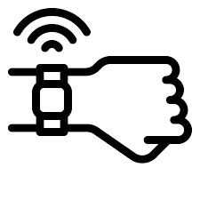
Project structure
The project consists of building an app for iOS or Android that collects user data from a wearable device through Web APIs, stores them, visualizes them, and does some tricks with them.
Core functionalities:
User authentication and management
Data collection
Data persistence
Data visualization and presentation
Additional fuctionalities → It’s up to you! Some basic examples:
Run some analysis on data and provide suggestions to the user
Implement some literature algorithm
…

Slide 52

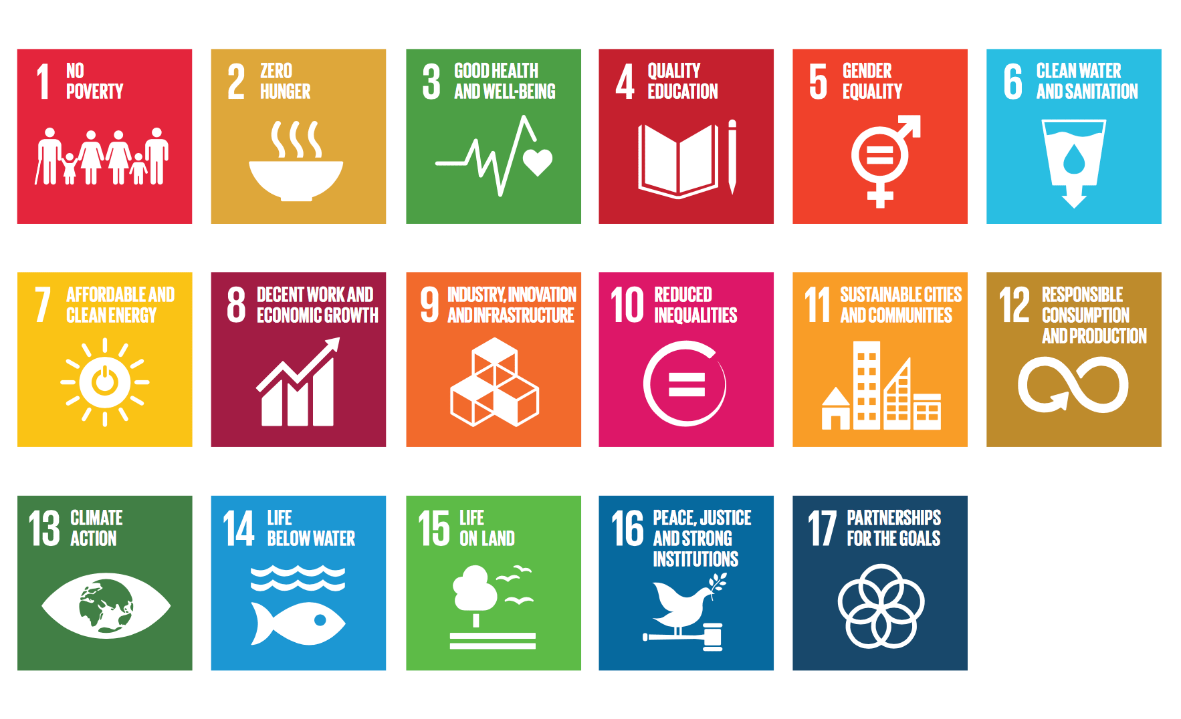
A target for you app
Your app must represent a solution for the current SDGs (Sustainable Development Goals) targets
SDG are 17 topics representing the current big challenges humanity must face and solve

Slide 53
A target for you app
These are the target you can choose from (see the moodle page for more details):
SDG 2: Target 2.2 (By 2030, end all forms of malnutrition, including achieving, by 2025, the internationally agreed targets on stunting and wasting in children under 5 years of age, and address the nutritional needs of adolescent girls, pregnant and lactating women and older persons)
SDG 2: Target 2.3 (By 2030, double the agricultural productivity and incomes of small-scale food producers, in particular women, indigenous peoples, family farmers, pastoralists and fishers, including through secure and equal access to land, other productive resources and inputs, knowledge, financial services, markets and opportunities for value addition and non-farm employment).
SDG 3: Target 3.4 (By 2030, reduce by one third premature mortality from non-communicable diseases through prevention and treatment and promote mental health and well-being).
SDG 3: Target 3.5 (Strengthen the prevention and treatment of substance abuse, including narcotic drug abuse and harmful use of alcohol).
SDG 4: Target 4.7 (By 2030, ensure that all learners acquire the knowledge and skills needed to promote sustainable development, including, among others, through education for sustainable development and sustainable lifestyles, human rights, gender equality, promotion of a culture of peace and non-violence, global citizenship and appreciation of cultural diversity and of culture’s contribution to sustainable development).
SDG 8: Target 8.9 (By 2030, devise and implement policies to promote sustainable tourism that creates jobs and promotes local culture and products).

Slide 54
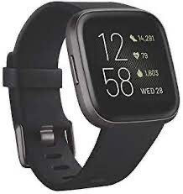
Data source
Data that you will use are collected by me using a Fitbit Versa 2
Data are available starting from 09/02 and will be collected up to 30/11 and include the following data “types”:
Calories
Distance
Exercise sessions
Heart rate
Resting heart rate (Estimated)
Sleep
Steps
Your project must use at least 1 type of data

Slide 55





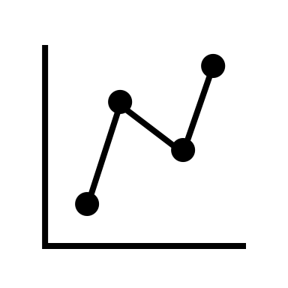
How to get data - The IMPACT backend
HTTPS requests/responses
Get token (JWT) using credentials
(If credentials are ok) Receive token
Ask for specific data using token
(If request is ok) Receive data (JSON format)
https://impact.dei.unipd.it/bwthw/
Your app
You will be provided with credentials (different for each group) and learn how to get data in the next lessons (lesson 9 and 10)

Slide 56
Focus on data – Calories
Calories: a list with 1 data point exactly every minute
Fields meaning:
time: timestamp (hh:mm:ss format) of the calory entry
value: the calories spent during the last 1 minute (rest + active)
[
{
"time": "00:00:00",
"value": "1.29"
},
{
"time": "00:01:00",
"value": "1.29"
},
{
"time": "00:02:00",
"value": "1.29"
},
{
"time": "00:03:00",
"value": "1.55"
},
{
"time": "00:04:00",
"value": "1.29"
},
{
"time": "00:05:00",
"value": "1.29"
},
{
"time": "00:06:00",
"value": "1.29"
},
...
]

Slide 57
Focus on data – Distance
Distance: a list with 1 data point every minute or more depending on user’s movement
Fields meaning:
time: timestamp (hh:mm:ss format) of the distance entry
value: the distance travelled between the last timestamp and now (in cm)
[
{
"time": "00:03:00",
"value": "0"
},
{
"time": "00:50:00",
"value": "0"
},
{
"time": "01:28:00",
"value": "0"
},
{
"time": "01:32:00",
"value": "1440"
},
{
"time": "01:33:00",
"value": "3110"
},
{
"time": "01:34:00",
"value": "0"
},
{
"time": "01:53:00",
"value": "0"
},
{
"time": "03:09:00",
"value": "0"
},
...
]

Slide 58
Focus on data – Steps
Steps: a list with 1 data point every minute or more depending on user’s movement
Fields meaning:
time: timestamp (hh:mm:ss format) of the step entry
value: the number of steps done between the last timestamp and now
Note: there can be days without data
[
{
"time": "00:07:00",
"value": "0"
},
{
"time": "00:10:00",
"value": "0"
},
{
"time": "01:57:00",
"value": "0"
},
{
"time": "02:29:00",
"value": "0"
},
{
"time": "02:40:00",
"value": "0"
},
{
"time": "02:57:00",
"value": "11"
},
{
"time": "02:58:00",
"value": "18"
},
{
"time": "02:59:00",
"value": "0"
}, ...
]

Slide 59
Focus on data – Heart rate
Heart rate: a list with 1 data point every 5 seconds.
Fields meaning:
time: timestamp (hh:mm:ss format) of the heart rate entry
value: the heart rate at the current time (in bpm)
confidence: a number from 0 to 3 defining how much the reading is reliable (this problably depends on user movement, etc. You can ignore it)
Note: there can be missing values
[
{
"time": "03:10:19",
"value": 58,
"confidence": 1
},
{
"time": "03:10:24",
"value": 54,
"confidence": 3
},
{
"time": "03:10:29",
"value": 52,
"confidence": 3
},
{
"time": "03:10:44",
"value": 52,
"confidence": 3
},
{
"time": "03:10:54",
"value": 53,
"confidence": 3
},
{
"time": "03:11:09",
"value": 54,
"confidence": 3
},
{
"time": "03:11:19",
"value": 53,
"confidence": 3
}, ...
]

Slide 60
Focus on data – Resting heart rate
Resting heart rate: an entry per day.
Fields meaning:
time: timestamp (hh:mm:ss format) of the resting heart rate entry (always 00:00:00)
value: the estimated resting heart rate at the current time (in bpm)
error: the estimate error (in %) (Can be ignored)
Note: there can be days without data
{
"time": "00:00:00",
"value": 51.35,
"error": 17.86
}

Slide 61
Focus on data – Exercise
[
{
"activityName": "Corsa",
"averageHeartRate": 143,
"calories": 727,
"distance": 8.474117,
"distanceUnit": "Kilometer",
"duration": 3.548E+6,
"activeDuration": 3.214E+6,
"steps": 8604,
"logType": "tracker",
"heartRateZones": [
{
"name": "Fuori zona",
"min": 30,
"max": 110,
"minutes": 3,
"caloriesOut": 30.146219999999971
},
{
"name": "Grassi bruciati",
"min": 110,
"max": 137,
"minutes": 8,
"caloriesOut": 97.13782
},
{
"name": "Attivita aerobica",
"min": 137,
"max": 170,
"minutes": 48,
"caloriesOut": 659.73843
},
{
"name": "Picco",
"min": 170,
"max": 220,
"minutes": 0,
"caloriesOut": 0
}
],
"speed": 9.4981754822650917,
"vo2Max": {
"vo2Max": 48.77853
},
"elevationGain": 28.042,
"time": "11:22:43"
},
Exercise: a list with 1 entry for each recorded exercise session
Fields meaning:
activityName: the type of entry (“Corsa”: Run, “Bici”: bike, “Camminata”: Walk)
averageHeartRate: the average heart rate during the session
calories: the active calories spent during the session
distance: the distance covered during the session
distanceUnit: the unit of the “distance” field
duration: the total duration of the session (in ms)
activeDuration: the total active duration of the session (in ms)
steps: the total number of steps done during the session (if “Corsa” or ”Camminata”)
logType: how this record was logged (“tracker” or “auto_detected”)
heartRateZones: a list that summarizes the number of minutes and calories spent in specific heart rate ranges (from min to max)
speed: the average speed (in km/h)
vo2max: the estimated running VO2Max (only for “Corsa” activities)
elevationGain: the elevation gained during the session
time: the starting time of the session (format hh:mm:ss)
Note: different activity types can have (slightly) different fields
Note: there can be days without data
{
"activityName": "Bici",
"averageHeartRate": 150,
"calories": 3893,
"distance": 140.143695,
"distanceUnit": "Kilometer",
"duration": 2.0901E+7,
"activeDuration": 1.756E+7,
"logType": "tracker",
"heartRateZones": [
{
"name": "Fuori zona",
"min": 30,
"max": 110,
"minutes": 28,
"caloriesOut": 214.83527999999842
},
{
"name": "Grassi bruciati",
"min": 110,
"max": 136,
"minutes": 64,
"caloriesOut": 664.55027999999993
},
{
"name": "Attivita aerobica",
"min": 136,
"max": 170,
"minutes": 232,
"caloriesOut": 3167.1500100000012
},
{
"name": "Picco",
"min": 170,
"max": 220,
"minutes": 24,
"caloriesOut": 377.76059999999995
}
],
"speed": 28.734978587699313,
"elevationGain": 663.55,
"time": "11:03:54"
},...
]

Slide 62
Focus on data – Sleep
Sleep: a list with 1 entry for each sleep session
Fields meaning:
dateOfSleep: day associated to the sleep entry (MM-DD format)
startTime: the starting timestamp of the sleep (MM-DD hh:mm:ss format)
endTime: the ending timestamp of the sleep (MM-DD hh:mm:ss format)
duration: the duration of the sleep session (in ms)
minutesToFallAsleep: the number of minutes spent to fall asleep
minutesAsleep: the number of minutes asleep during the sleep entry
minutesAwake: the number of minutes awake during the sleep entry
minutesAfterWakeup: the number of minutes the user spent in bed after waking up
efficiency: the estimated sleep efficiency (from 0 to 100)
logType: how the entry was logged (always “auto_detected”)
mainSleep: a boolean indicating if the entry corresponds to the main sleep session
levels: a summary of the sleeping stages (deep/wake/light/rem/restless) during the sleep session
data: the stage profile of the sleep session. Each entry contains the starting timestamp, the level, and how much it lasted.
Note: there can be days without data
[
{
"dateOfSleep": "02-14",
"startTime": "02-13 22:44:00",
"endTime": "02-14 06:36:30",
"duration": 2.832E+7,
"minutesToFallAsleep": 0,
"minutesAsleep": 429,
"minutesAwake": 43,
"minutesAfterWakeup": 3,
"timeInBed": 472,
"efficiency": 96,
"logType": "auto_detected", ”mainSleep": true,
"levels": {
"summary": {
"deep": {
"count": 5,
"minutes": 106,
"thirtyDayAvgMinutes": 86
},
"wake": {
"count": 34,
"minutes": 43,
"thirtyDayAvgMinutes": 46
},
"light": {
"count": 28,
"minutes": 235,
"thirtyDayAvgMinutes": 281
},
"rem": {
"count": 11,
"minutes": 88,
"thirtyDayAvgMinutes": 101
}
},
"data": [
{
"dateTime": "02-13 22:44:00",
"level": "wake",
"seconds": 30
},
{
"dateTime": "02-13 22:44:30",
"level": "light",
"seconds": 150
},
{
"dateTime": "02-13 22:47:00",
"level": "deep",
"seconds": 1860
}, ... },
...
]

