Slide 1
Giacomo Cappon
State Management

Slide 2
Outline
State management concepts
Provider
Case study
Other Provider classes
Exercise
Homework
Resources

Slide 3
State
State stands for everything that is necessary to define how the app and its screen behave and look at some point in time:
Assets
Variables
Fonts
…
Conceptually can be divided in:
Ephemeral state: sometimes called local state, what can be striclty contained in a Widget
App state: sometimes called shared state, things that you want to share across many parts of the app

Slide 4
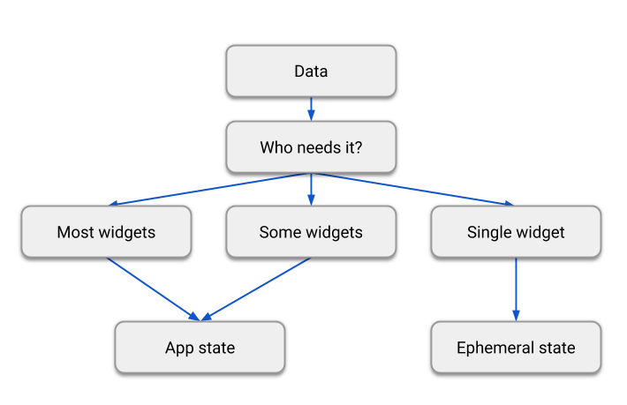
State
There is no universal rule to chose if a variable is part of the ephemeral state or the app state. A diagram that can help:

Slide 5
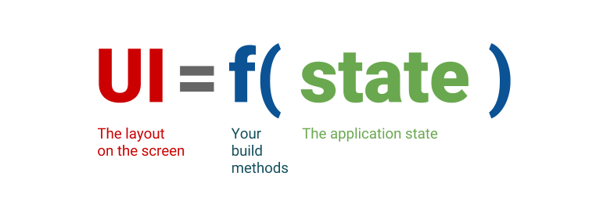
Remember: Flutter is declarative
Flutter is a declarative framework
State is changed? Build methods are called and the UI is refreshed.

Slide 6
So far…
So far, we had a grasp on state management:
Stateful widgets: their state can change through time
Stateless widgets: their state cannot change though time
We need to understand how to change state when something occurs (e.g., a button is pressed, data change,…) and reflect those changes to the UI (rebuilding it).
In lesson 4, we used setState():

Slide 7
So far…
In lesson 4, we used setState():
...
@override
Widget build(BuildContext buildContext){
return Column(
mainAxisAlignment: MainAxisAlignment.center,
children: [
Text('Hello, $_word!’),
ElevatedButton(onPressed: _changeWord, child: const Text('Press me')),
],);
}//build
void _changeRandomWord(){
setState(() {
_word = WordPair.random().first;
});
}//_changeRandomWord
...

Slide 8


The limitation
Why we cannot fully depend on this approach?
In a typical widget tree, when two children of a parent are not in the same class as of the parent, rendering one child from another becomes impossible until and unless you involve the parent for the same.
You either have to call a setState() from parent which in turn renders both children or pass a call-back function from one child to another child via the Parent.
In other words, app state is very messy to handle
Parent
Rendering Child
Renderer Child

Slide 9
So, how to manage state?
There is no such a thing as a “universal way to manage state”
Actually, there are a lot of possible approaches:
Provider
Riverpod
Redux
BLoC
…
Every approach has its PROs and CONs. So?
Here, we will discuss Provider, the recommended approach by the Flutter community.

Slide 10
Outline
State management concepts
Provider
Case study
Other Provider classes
Exercise
Homework
Resources

Slide 11

Provider core idea
Provider wants to provide!
The core idea is to provide the entity (one or more classes) in charge of maintaining the state down through the widget tree
Each child will be able to access to the entity and react to state changes.
State manager entity
Inject it to
Child widget tree

Slide 12
Provider classes
Provider implement a set of classes, here’s the most important:
ChangeNotifier
ChangeNotifierProvider
Consumer
FutureProvider/StreamProvider
MultiProvider
ProxyProvider

Slide 13
Provider classes
Provider implement a set of classes, here’s the most important:
ChangeNotifier
ChangeNotifierProvider
Consumer
FutureProvider/StreamProvider
MultiProvider
ProxyProvider

Slide 14



Provider classes: ChangeNotifier
ChangeNotifier is a class that can notify listeners of any changes in the state.
You usually extend the ChangeNotifier for models so you can send notifications when your model changes.
When something in the model changes, you call notifyListeners() and whoever is listening can use the newly changed model.
A class that extends ChangeNotifier
notifyListeners() is called
A class that listens to the other class
Do something!

Slide 15
Provider classes: ChangeNotifierProvider
ChangeNotifierProvider is a class that wraps a class that implements ChangeNotifier and provide it to its descendants.
Now the widget tree can access to it (and use it!)
Synthax: ChangeNotifierProvider( create: (context) => ClassImplementingChangeNotifier(), child: <widget_tree>, );
ClassImplementingChangeNotifier
ChangeNotifierProvider
Inject an instance to
Child widget tree

Slide 16
Provider classes: Consumer
Consumer is a widget that listens for changes in a class that implements ChangeNotifier, then rebuilds the widget tree below itself when it finds any.
Whenever notifyListeners() is called, the Consumer’s builder function is called. Synthax: return Consumer<ClassImplementingChangeNotifier>( builder: (context, cart, child) { return Text("Total price: ${cart.totalPrice}"); }, );
ClassImplementingChangeNotifier
ChangeNotifierProvider
Inject an instance to
Child widget tree
notifyListeners() is called
Consumer
Call builder method

Slide 17
Wrapping up: Provider (core) flow
ClassImplementingChangeNotifier
ChangeNotifierProvider
Inject an instance to
Child widget tree
notifyListeners() is called
Consumer
Call builder method

Slide 18
Outline
State management concepts
Provider
Case study
Other Provider classes
Exercise
Homework
Resources

Slide 19
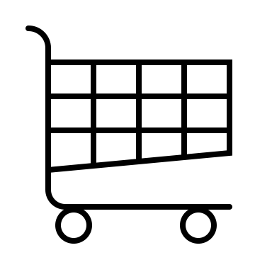
Case of study
We will build a (too) simple e-commerce app. Users can choose, in the HomePage, products from a catalog and add them to the cart. In a different screen, CartPage, the number of items in the cart is visualized.
HomePage
CartPage
Contains
Visualizes/Clears
Catalog
Cart
User chooses a product

Slide 20
Case of study – UI widget tree
MaterialApp
HomePage
ListView
CartPage
To visualize the number of items in the Cart
To visualize the Catalog
ListTile
Text
How to manage the catalog and the cart? With two class (model).
No problems with the Catalog (Ephemeral state)…
On the other hand, Cart must be shared (App state) Where to put it?
Catalog
Cart

Slide 21
Lift the state up
The idea is “Lift the state up”
MaterialApp
Cart
Cart is injected through the tree.
Catalog
HomePage
Catalog is just a variable of HomePage.
ListView
CartPage
ListTile
Text

Slide 22
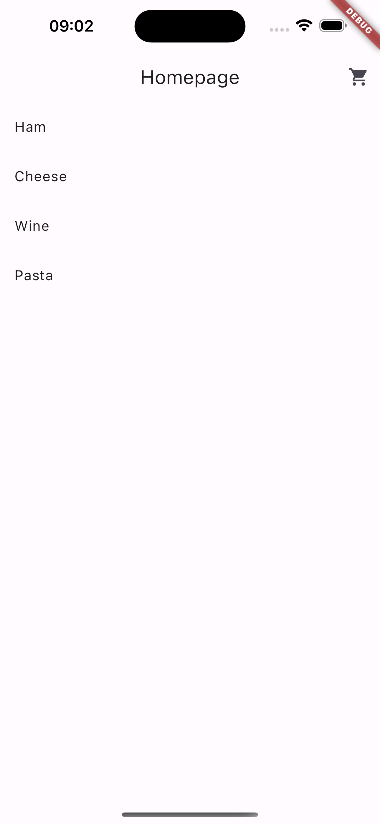
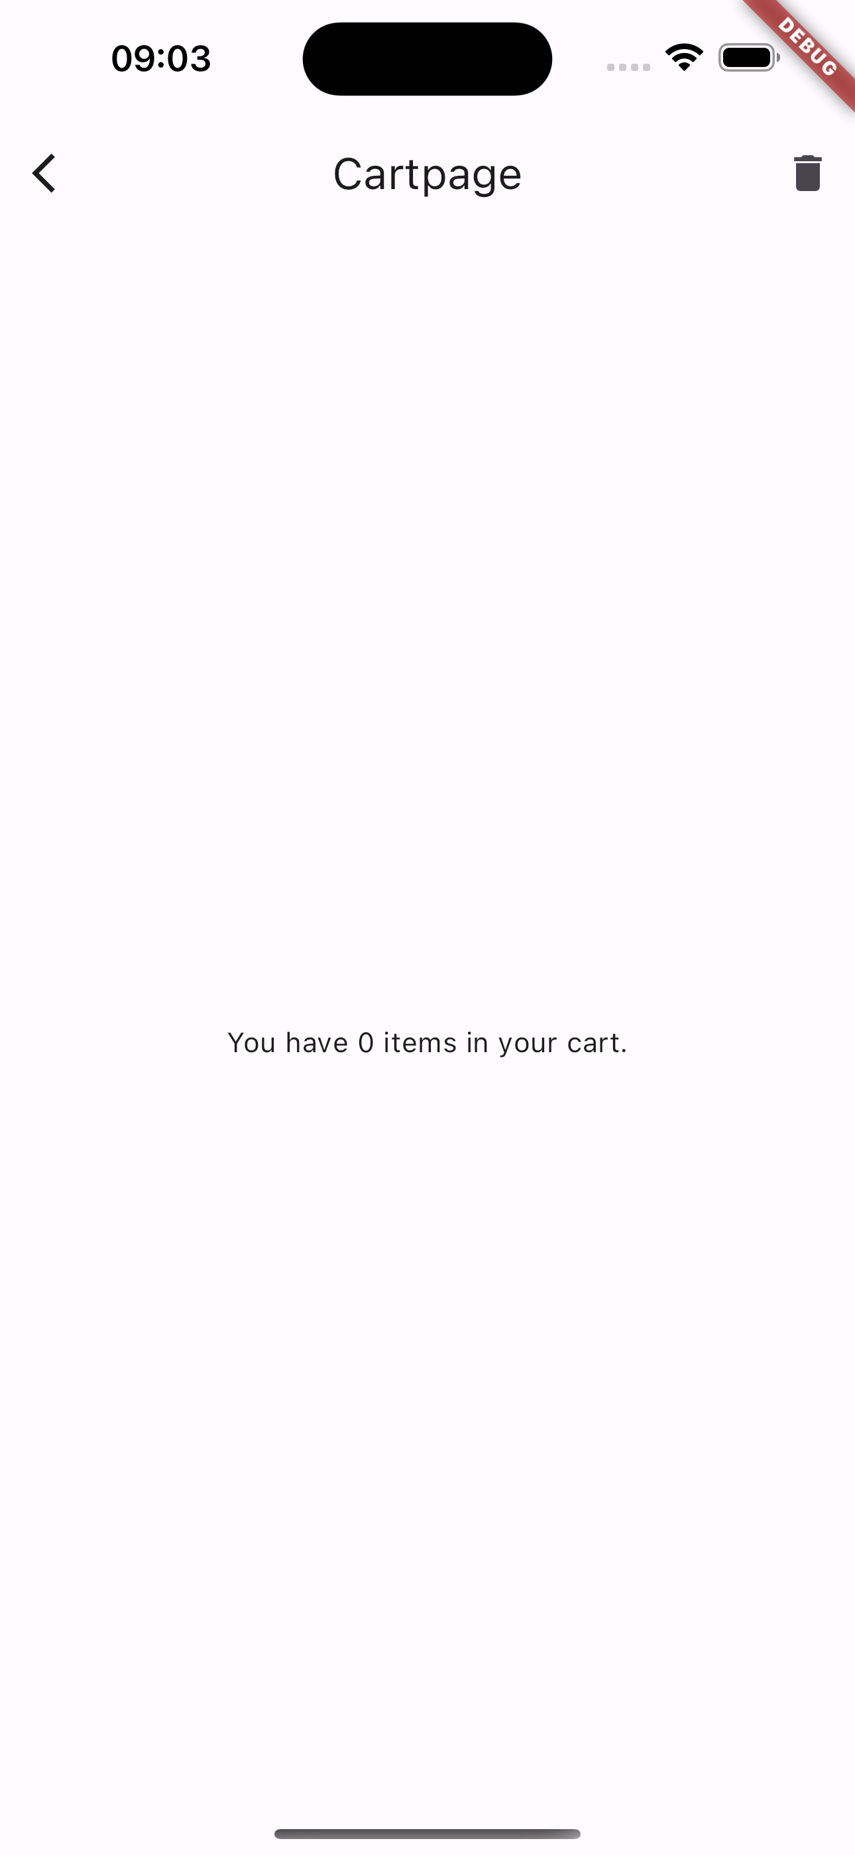
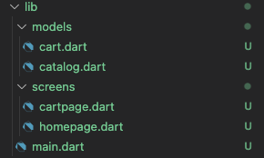
Case of study - Live
Let’s create a new project “shopper” that implements the case of study and shows how to use Provider.
Full example in lab_07-state_management/shopper/

Slide 23
Outline
State management concepts
Provider
Case study
Other Provider classes
Exercise
Homework
Resources

Slide 24
Provider classes
Provider implement a set of classes, here’s the most important:
ChangeNotifier
ChangeNotifierProvider
Consumer
FutureProvider/StreamProvider
MultiProvider
ProxyProvider

Slide 25
Provider classes: FutureProvider/StreamProvider
FutureProvider and StreamProvider are the same thing as ChangeNotifier but they work with Futures and Streams instead of ChangeNotifier.
Synthax example:
FutureProvider(
initialData: null,
create: (context) => <get_a_future>,
child: <widget>,
);
StreamProvider(
initialData: null,
create: (context) => <get_a_stream>,
child: <widget>,
);
initialData is used as value while the Future is loading.
create specifies the Future object.

Slide 26
Provider classes: MultiProvider
What if you need to inject more than one provider through the widget tree? Use MultiProvider.
Synthax example:
MultiProvider(
providers: [
ChangeNotifierProvider(...),
FutureProvider(...),
],
child: <widget_tree>,
);
List of providers.

Slide 27
Provider classes: ProxyProvider
What if you have two models that you want to provide, but one of the models depends on the other one? In that case you can use a ProxyProvider.
A ProxyProvider takes the value from one provider and lets it be injected into another provider.
Synthax example:
MultiProvider(
providers: [
ChangeNotifierProvider<MyModel>(
create: (context) => MyModel(),
),
ProxyProvider<MyModel, AnotherModel>(
update: (context, myModel, anotherModel) => AnotherModel(myModel),
),
],

Slide 28
Provider classes – Much more
Of course, the Provider package can do much more
ListenableProvider
ValueListenableProvider
ChangeNotifierProxyProvider
Selector
...
To learn more, take a look at this useful article:
Making sense of all those Flutter Providers
https://medium.com/flutter-community/making-sense-all-of-those-flutter-providers-e842e18f45dd

Slide 29
Outline
State management concepts
Provider
Case study
Other Provider classes
Exercise
Homework
Resources

Slide 30
Exercise
Exercise 07.01
Create a new project ‘meal_manager’, an app that stores the meal intakes of a user in terms of carbohydrate content and meal timing.
The app needs to implement the following functionalities:
When a user opens (or restarts) the app, an empty list is showed;
By tapping a button, the user navigates to another page where he can add a new meal (CHO content and timing). Once he/she is done, the user taps a button and navigates back to the home page. The home page must show the updated meal list with the new meal just created;
The user can select a meal from the list. If he/she does that, he/she navigates to another page where he/she can edit or delete the meal entry from the list.

Slide 31
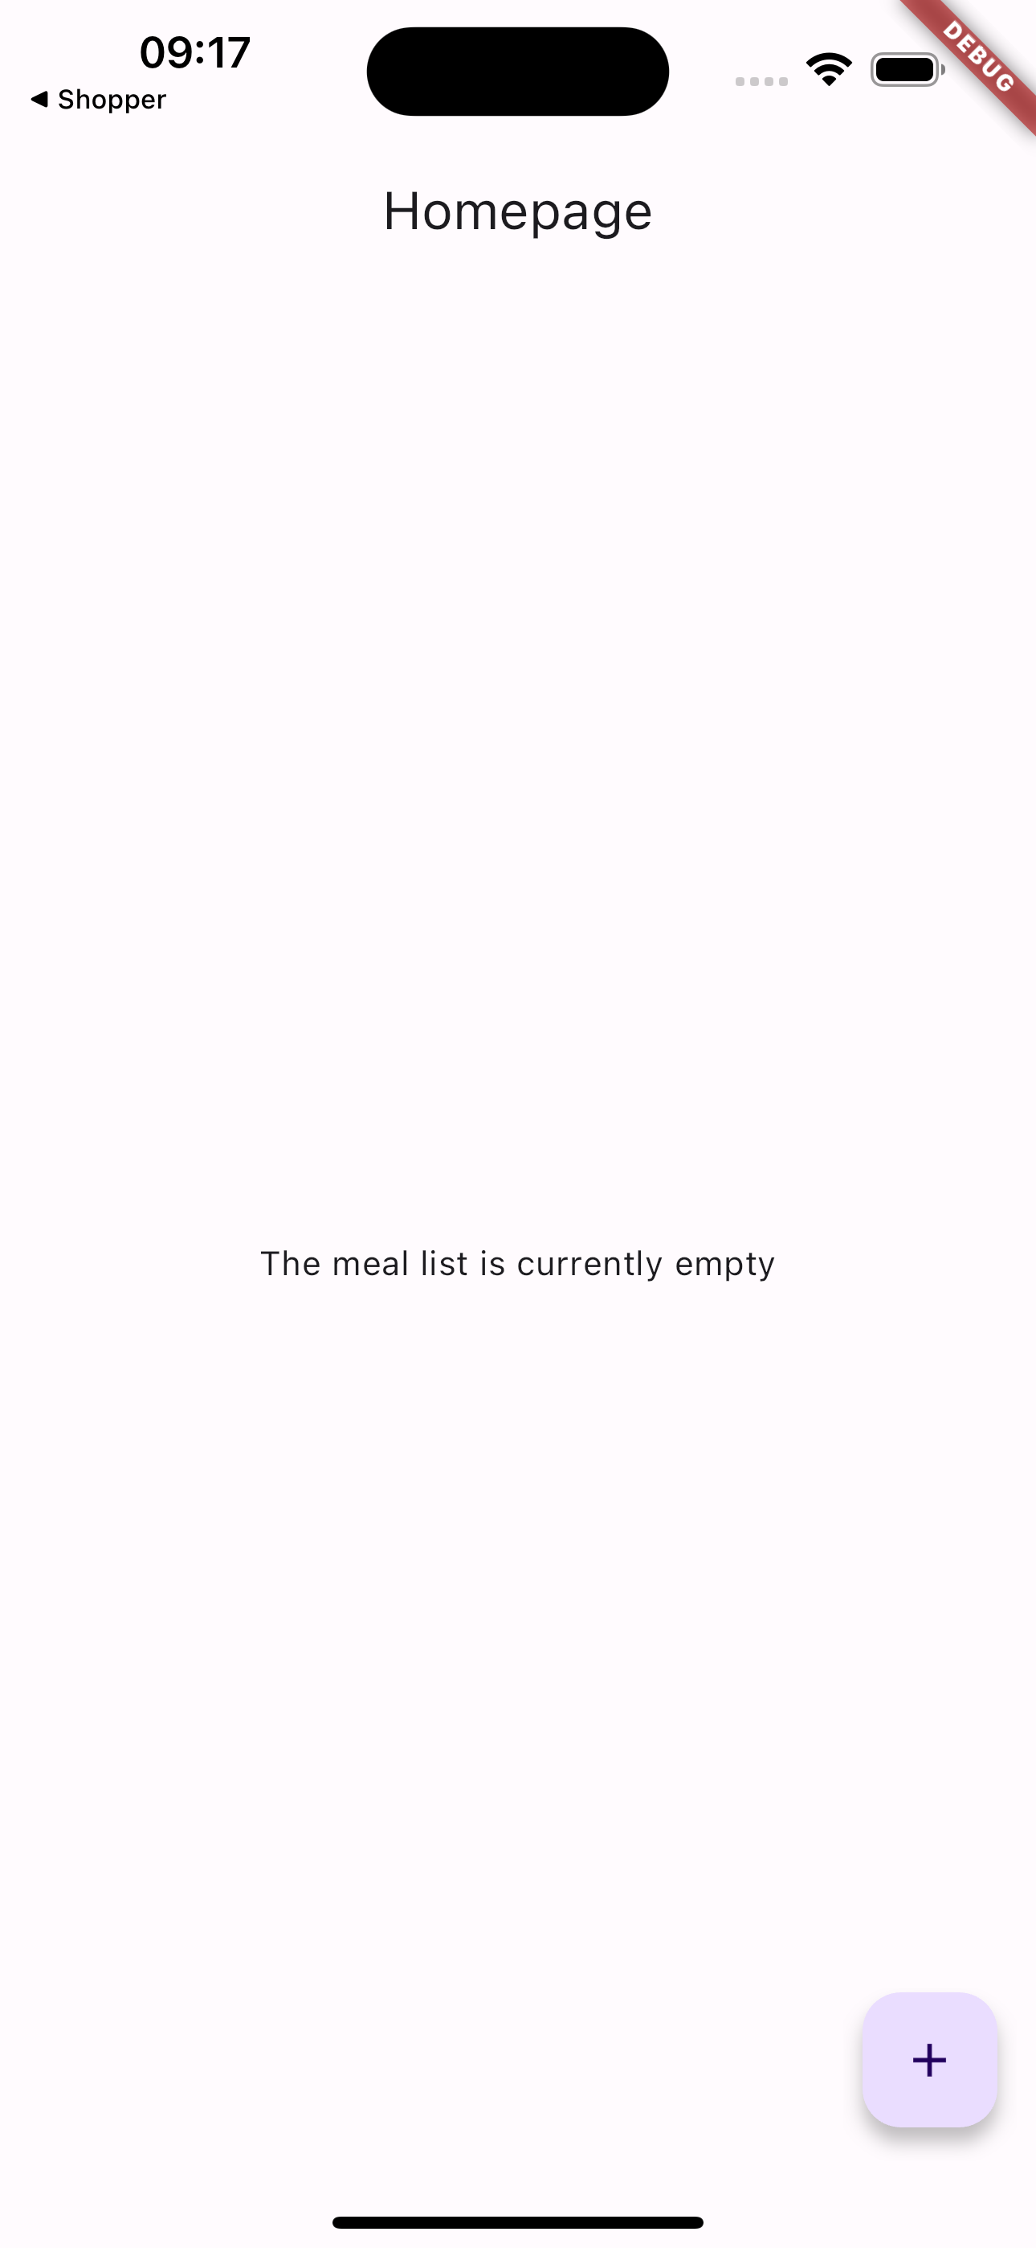
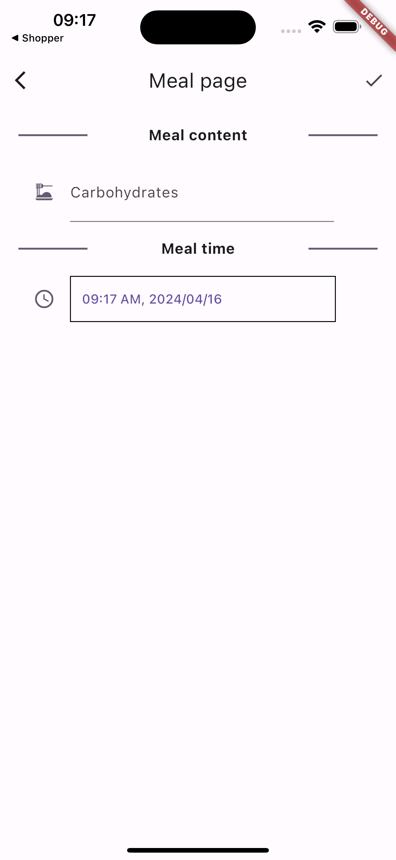
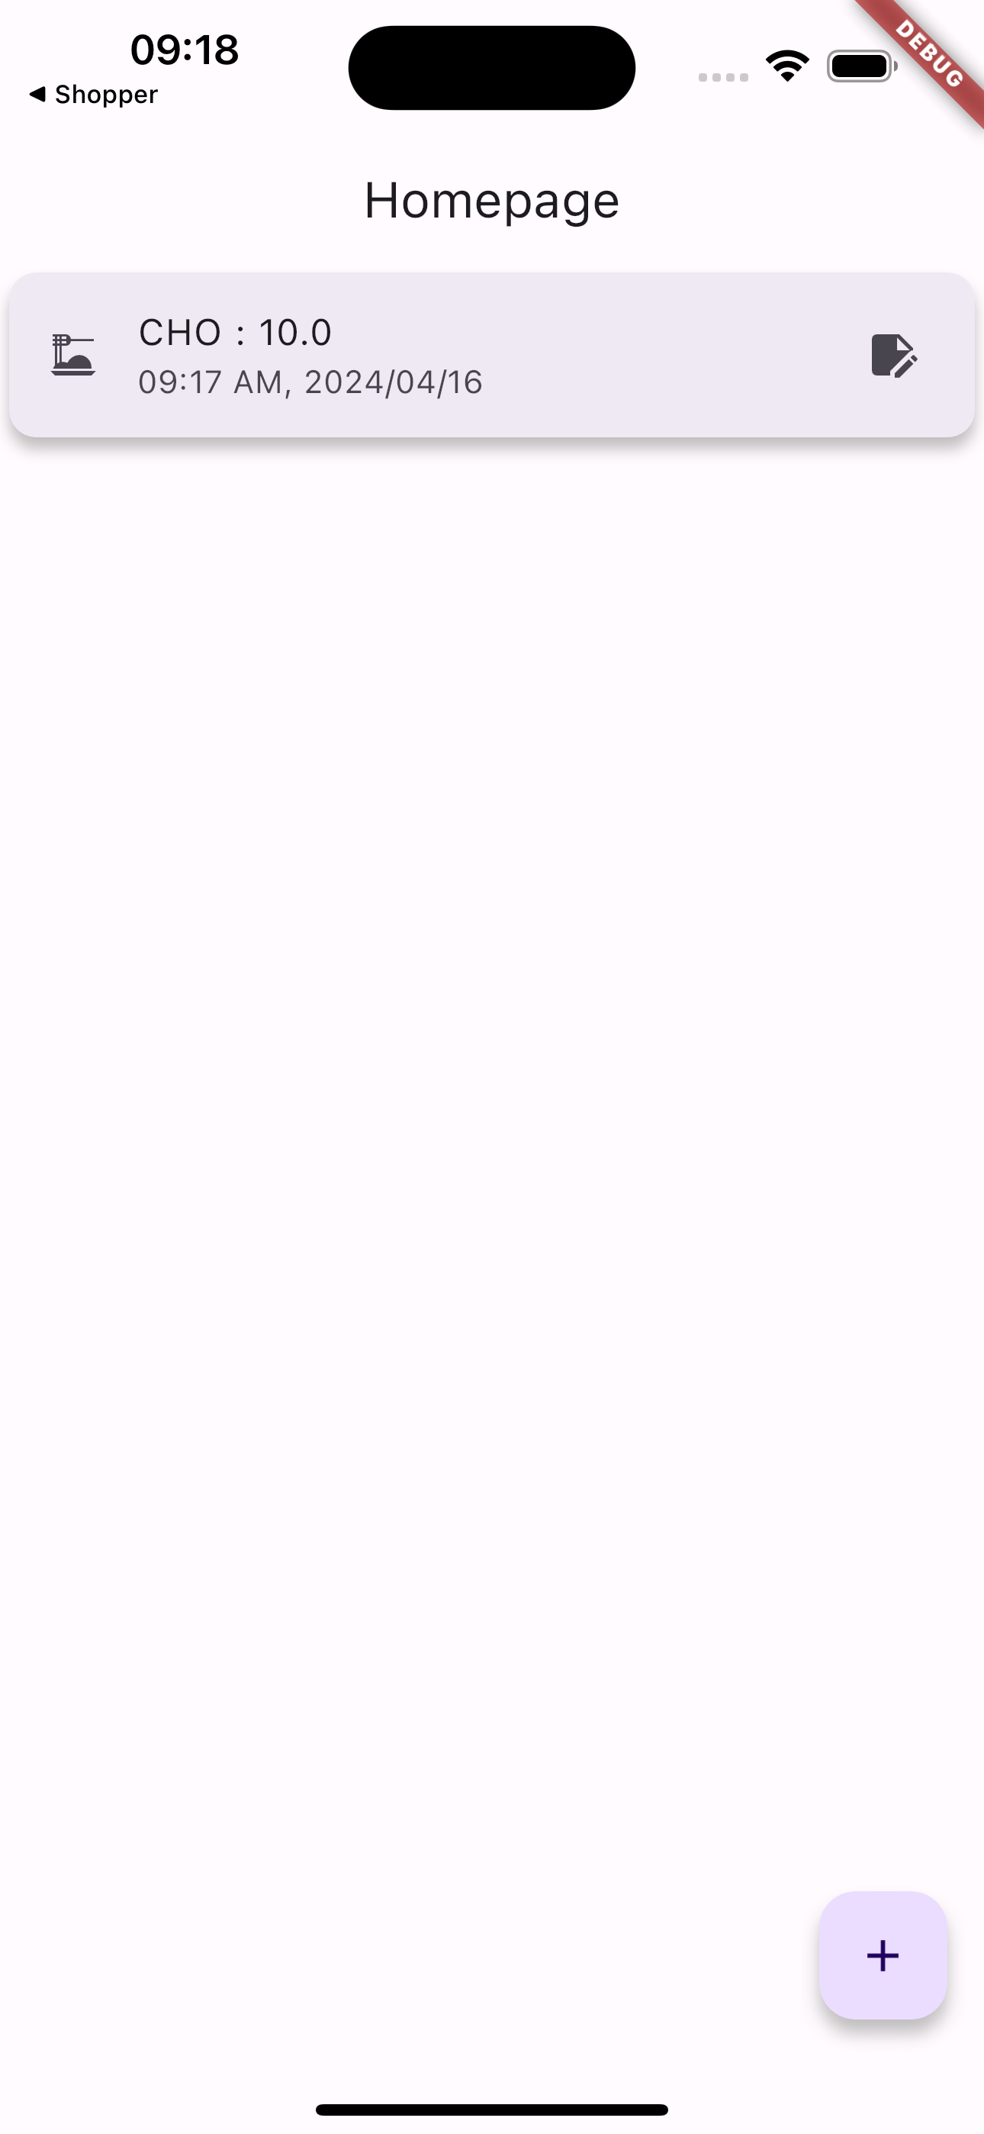
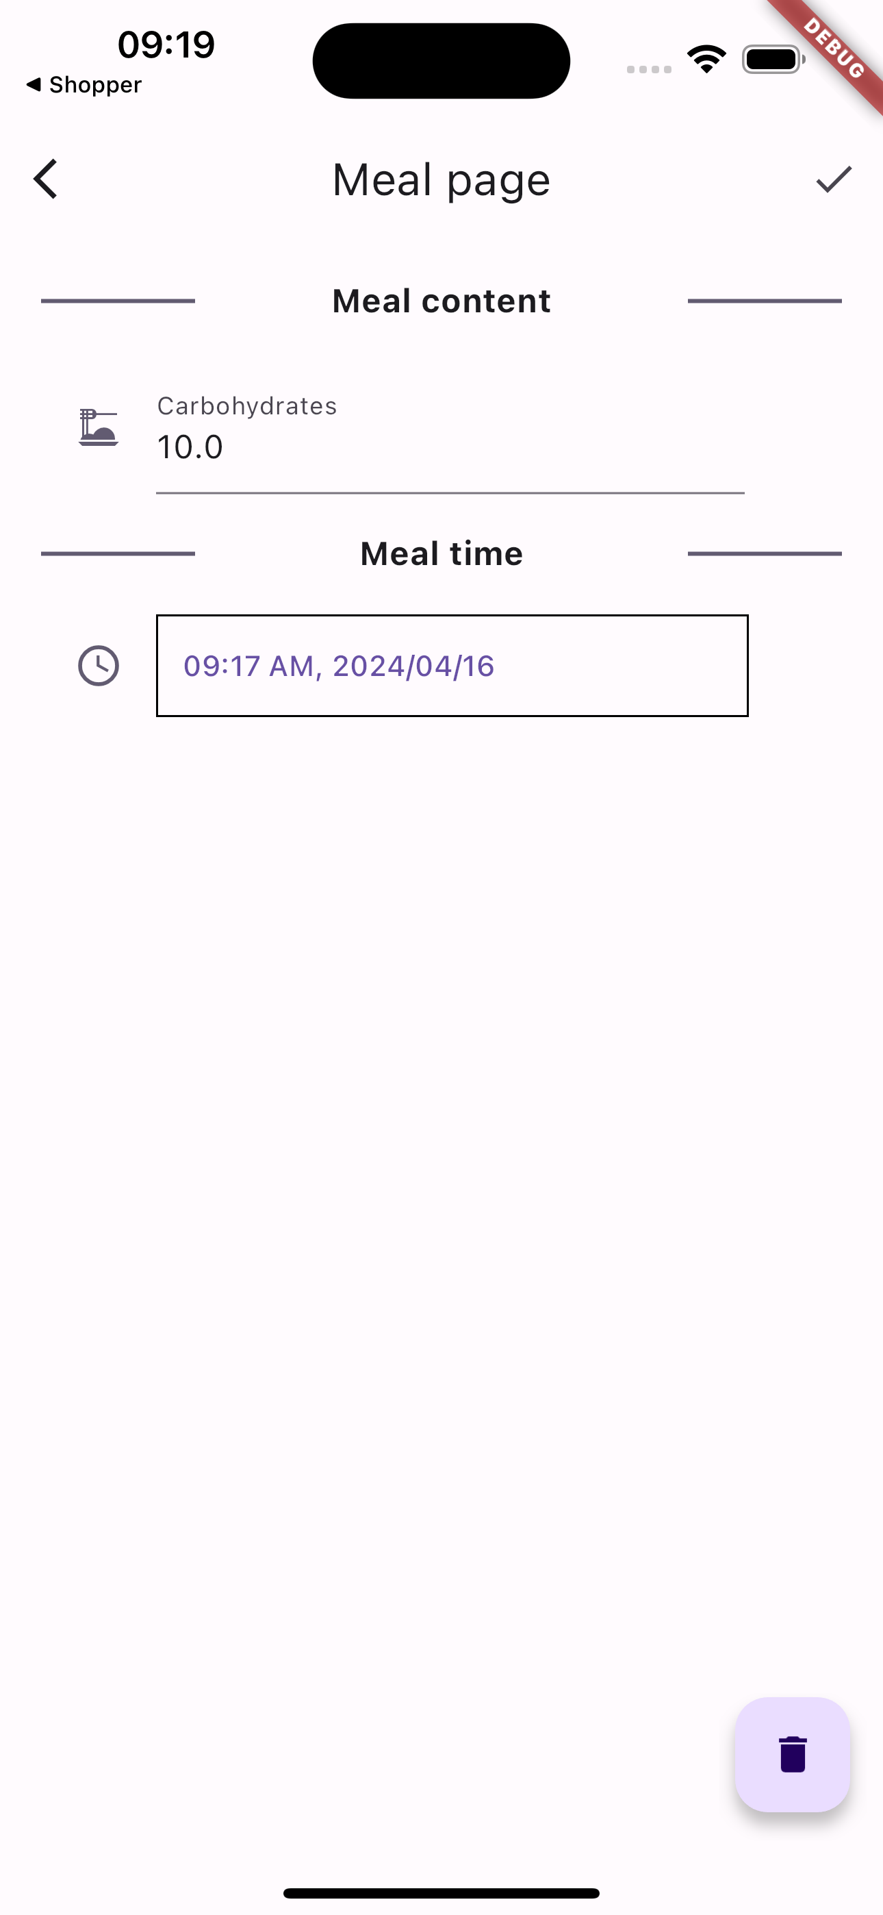
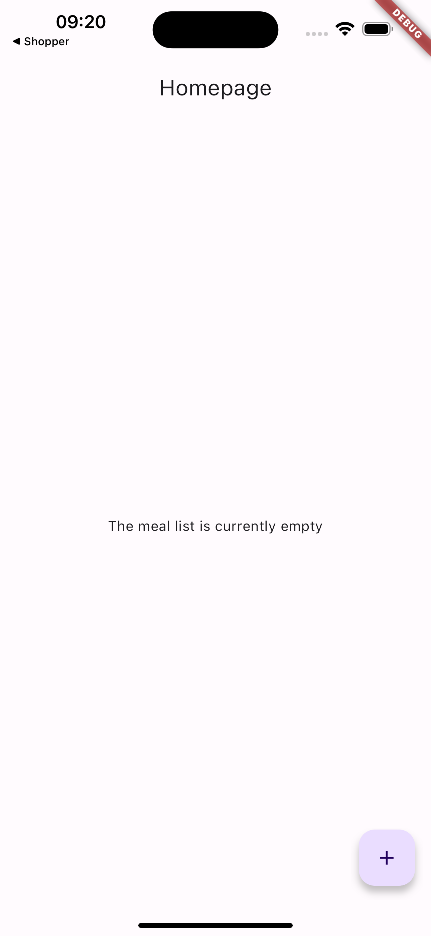
Exercise: here’s a possible idea
Homepage is initially empty
When the button is tapped the user navigates to another page where he/she can add a new meal
When the user finishes, the new meal is added to the list
When the meal is tapped, the user navigates to a new screen where he/she can edit or delete it
If the meal is edited/deleted the list is updated.

Slide 32
Outline
Recap
State management concepts
Provider
Case study
Other Provider classes
Exercise
Homework
Resources

Slide 33
Homework
Get familiar with Provider
Take a look to other approaches, e.g., Riverpod or BLoC. Maybe there is something that fits better your way of thinking!
Take a look at my solution. You will find some useful code.

Slide 34
Outline
State management concepts
Provider
Case study
Other Provider classes
Exercise
Homework
Resources

Slide 35
Resources
State management
https://docs.flutter.dev/development/data-and-backend/state-mgmt/intro
Making sense of all those Flutter Providers
https://medium.com/flutter-community/making-sense-all-of-those-flutter-providers-e842e18f45dd
List of state management approaches
https://docs.flutter.dev/development/data-and-backend/state-mgmt/options

