Slide 1
Wearable sensors – Part 1

Slide 2
Agenda
Definition of sensors and wearable devices
Different types of sensors used in wearable devices based on the sensing technique:
Mechanical sensors
Electrical sensors
Optical sensors
Chemical sensors
Sensor characteristics
Systematic characteristics
Statistical characteristics
Dynamic characteristics
Embedded processing unit
Signal processing
Communication systems
Part 1
Part 2

Slide 3
Agenda
Definition of sensors and wearable devices
Different types of sensors used in wearable devices based on the sensing technique:
Mechanical sensors
Electrical sensors
Optical sensors
Chemical sensors
Sensor characteristics
Systematic characteristics
Statistical characteristics
Dynamic characteristics
Embedded processing unit
Signal processing
Communication systems
Part 1
Part 2

Slide 4

Wearable devices

Slide 5
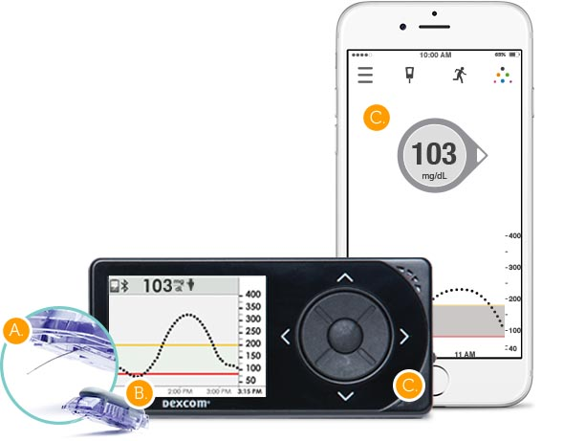
Wearable devices
A wearable device is a device that can be used for sensing physiological parameters or signals which generally include two components:
A sensor that measures the physical quantity of interest (measurand)
An embedded processing unit that does some initial processing of the measurements and either stores them in a memory or sends them to another device
Sensor
Receiver device / Gateway device (for IoT devices)
Embedded processing unit

Slide 6
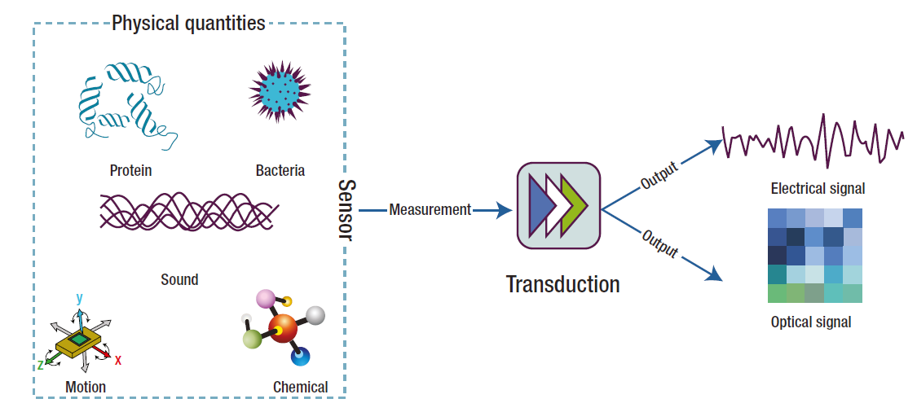
Definitions of sensor
“A sensor generally refers to a device that converts a physical measure into a signal that is read by an observer or by an instrument” (Chen et al., 2012)
Measurand

Slide 7
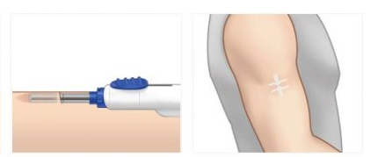
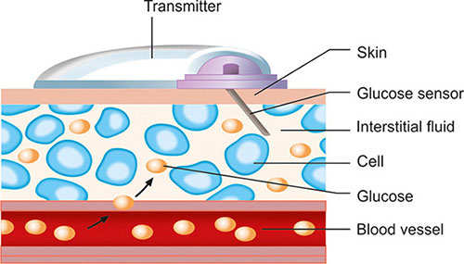
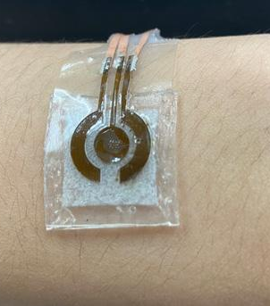
Classification of sensors based on their interaction with the measurand
Contact sensor: sensors requiring physical contact with the measurand.
Their deployment obviously perturbs the state of the subject to some degree.
Comfort and biocompatibility are important considerations
Response time determined by the speed at which the measurand is transported to the measurement site.
Poor contact can result in signal noise and the introduction of signal artifacts.
Invasive: sensors inserted into human body
Minimally-invasive: patch-type devices on the skin that monitor interstitial fluids
Non-invasive: sensors that simply have contact with the skin without effect

Slide 8
Classification of sensors based on their interaction with the measurand
Non-contact sensors: do not require direct contact with the measurand.
Minimum perturbation of the subject
Generally used in ambient sensing applications
Example: infrared thermometer
Sample based sensors: require an invasive collection of a sample of the person to be monitored by a human or automated sampling system.
The collected samples are analyzed using sensors or laboratory-based analytical instrumentation
Common approach in healthcare (e.g. monitoring cholesterol)

Slide 9
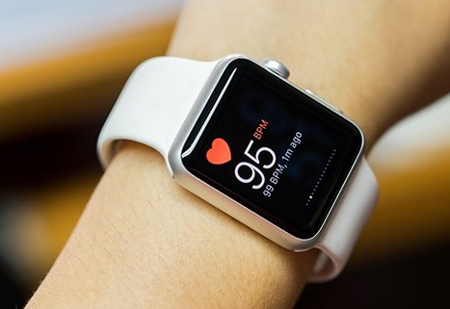
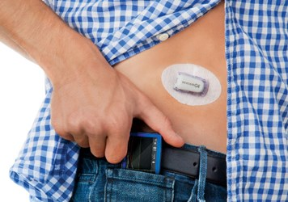
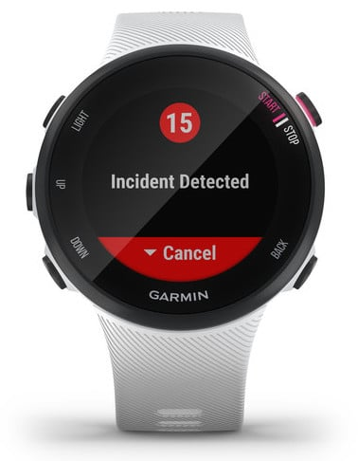
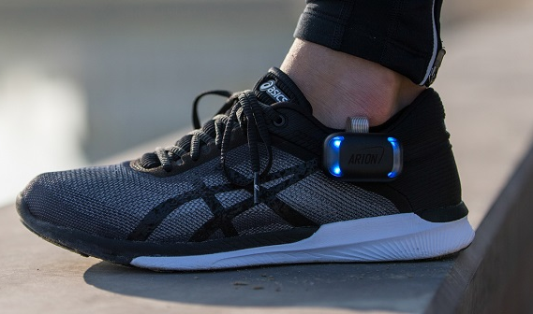
Wearable devices
Wearable devices are equipped by sensors (generally non-invasive or minimally-invasive contact sensors) that can be worn by an individual
Important requirement: a comfortable form factor

Slide 10
Classification of sensors based on their sensing technique
Mechanical sensors
Electrical sensors
Optical sensors
Chemical sensors

Slide 11
Mechanical sensors
Mechanical sensors detect some form of mechanical deformation of a material, in response to the measurand (input), and translate it to an electrical, optical, magnetic or thermal signal (output).
Electromechanical sensors:
Types of electromechanical sensing techniques:
Piezoresistive sensors
Capacitive sensors
Iontronic sensors
Piezoelectric sensors
Measurand
Mechanical deformation
Electrical signal

Slide 12
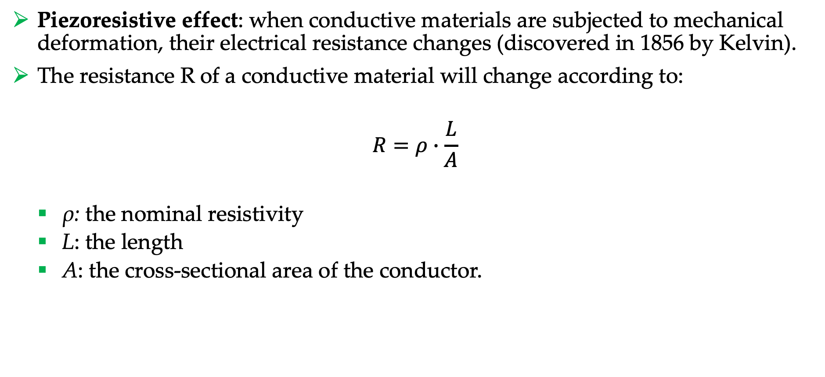
Electromechanical sensors - Piezoresistive sensors
Piezoresistive effect: when conductive materials are subjected to mechanical deformation, their electrical resistance changes (discovered in 1856 by Kelvin).
The resistance R of a conductive material will change according to:
$$R=ρ∙\frac{L}{A}$$
ρ: the nominal resistivity
L: the length
A: the cross-sectional area of the conductor.

Slide 13
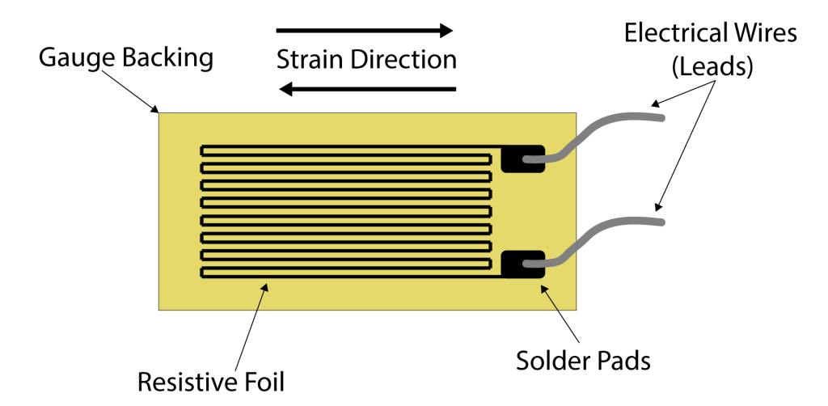

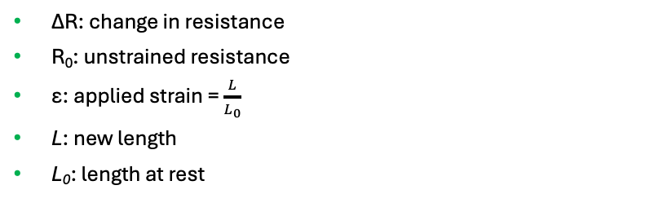
Electromechanical sensors - Piezoresistive sensors
Strain gauges: contact sensors that exploit the piezoresistive effect to measure mechanically-induced deformation.
They can be put on the human body to detect and quantify motion, such as the bending of a finger or knee, or to measure pression.
The sensor sensitivity is characterized by the Gauge Factor:
$$GF=\frac{\frac{∆R}{R_{0}}}{ε}$$
ΔR: change in resistance
R₀: unstrained resistance
ε: applied strain = $\frac{L}{L_{0}}$
L: new length
L₀: length at rest

Slide 14
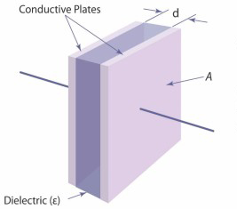

Electromechanical sensors - Capacitive sensors
Capacitive sensors: they measure variations of capacitance of a material in response to mechanical stimuli.
Parallel-plate configuration (most common):
Changes in A or d due to mechanical stimuli → changes of C detected by the sensor.
Capacitive sensors are used to detect pressure and strain.
They are also commonly used in touchscreen.
Capacitor:
C = capacitance (farads, F)
ε = permittivity of the dielectric (F/m)
A = area of overlap between the plates (m2)
d = distance between the plates (m)
$$C=ε∙\frac{A}{d}$$

Slide 15
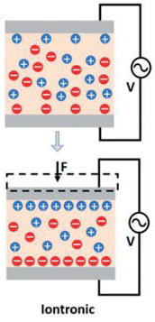
Special capacitive sensors – Iontronic sensors
A capacitive sensor that uses ionic liquid or gel (electrolyte) as dielectric.
The electrons on the electrode and the counter ions from electrolyte attract to each other at a nanoscopic distance, leading to an ultrahigh unit-area capacitance.
Capacitance at least 1000 times larger than traditional parallel plate capacitive sensors.
This excellent property is suitable for wearable electromechanical sensors: iontronic sensor are less sensitive to environmental or body capacitive noises.

Slide 16
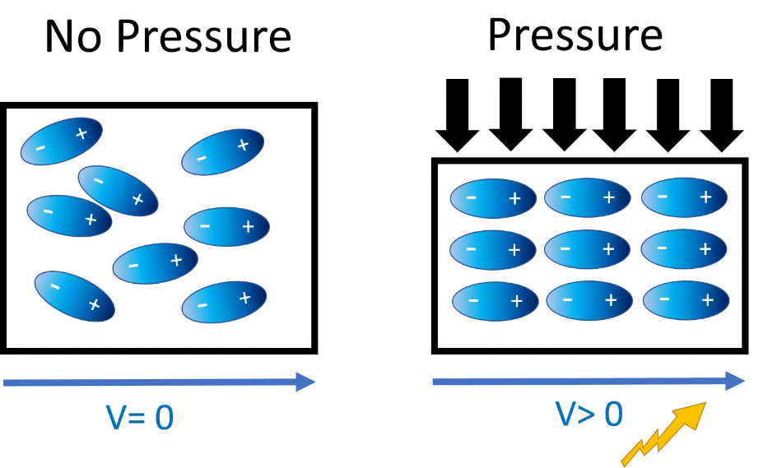
Electromechanical sensors - Piezoelectric sensors
Piezoelectric effect: when a mechanical stress (e.g., pressure or strain) is applied to a piezo-electric material, there is a change in electrical polarization inside the material (e.g., re-orientation of molecular dipole moments). This results in a change in surface charge (voltage) at the surface of the piezoelectric material.
Applications: skin-mounted sensors for tactile sensation, finger bending motion detection, measuring arterial pulse pressure waveform, detecting body movements, etc.

Slide 17
MEMS
Micro Electro-Mechanical Systems (MEMS): miniaturized chip including mechanical and electrical structures, e.g., micro-electromechanical sensors
Dimension: from several millimeters to less than 1 micrometer
Two MEMS widely used in wearables as inertial sensors for motion sensing:
Accelerometer
Gyroscope

Slide 18
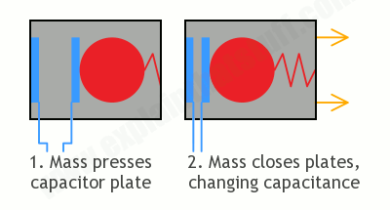
MEMS – Accelerometer
Accelerometer: it measures proper acceleration, i.e., the rate of change of velocity of an object in its own instantaneous rest frame.
The accelerometer measures how much a mass is pressed on an elastic element by an external force.
Capacitive accelerometer
Conceptually, an accelerometer is a box with a damped mass on a spring.
When there is acceleration, the mass moves compared to the resting position.
A movement sensor (e.g., piezoelectric or capacitive) detects the movement of the mass which is proportional to the acceleration.

Slide 19
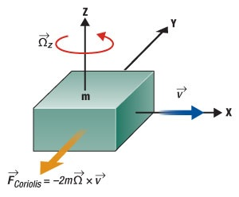
MEMS – Gyroscope
Gyroscope: it measures the angular rate of rotation around one or more axes.
Most of MEMS gyroscopes exploit the Coriolis effect: when a mass m is moving in linear direction with velocity v (x axis) and undergoes angular rotation with velocity Ω (around the z axis), the mass experiences an apparent force F in a direction perpendicular to z and x (y axis).
Coriolis effect

Slide 20
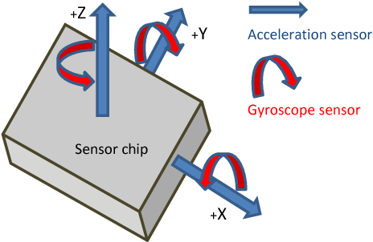
MEMS - Inertial Measurement Unit (IMU)
An individual inertial sensor (accelerometer or gyroscope) can only sense a measurement along or about a single axis.
Inertial Measurement Unit: an electronic device that measures and reports a body's specific acceleration and angular rate using a combination of accelerometers and gyroscopes.
3-axis IMU: three inertial sensors mounted together into an orthogonal cluster known as a triad.
3-axis accelerometer measures acceleration along 3 orthogonal axes
3-axis gyroscope measures angular velocity around 3 orthogonal axes
6-axis IMU: 3-axis accelerometer and a 3-axis gyroscope
Sometimes IMU also includes magnetometers, i.e., sensors that measure the strength and direction of a magnetic field, used to determine the orientation of the body with respect to the magnetic north.
9-axis IMU: inertial system consisting of a 3-axis accelerometer, a 3-axis gyroscope, and a 3-axis magnetometer

Slide 21
Classification of sensors based on their sensing technique
Mechanical sensors
Electrical sensors
Optical sensors
Chemical sensors

Slide 22
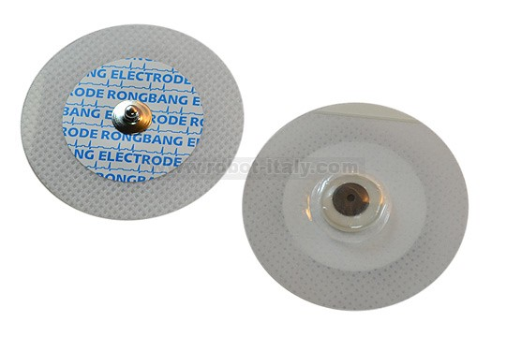
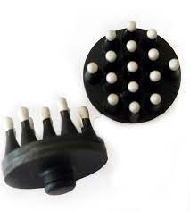
Electrical sensors
Electrical sensors: on-skin electrodes that measure a change in electrical resistance or the electrical charge of the skin.
Good electrical contact with skin is required.
Wet electrodes: solid conductive pad interfaced to the skin via an electrolyte gel that minimizes the impedance of skin by hydrating it and forming a conformal electrical contact with its textured surface.
Dry electrodes: direct contact with the skin, less robust to movement artifacts.
Skin electrodes allow to collect high-fidelity measurements of a broad range of physiologically relevant biopotentials:
electrocardiogram (ECG)
electroencephalogram (EEG)
electromyogram (EMG)
electrooculogram (EOG)
electroretinogram (ERG)
galvanic skin response (GSR), also known as skin impedance or electrodermal activity (EDA)

Slide 23
Classification of sensors based on their sensing technique
Mechanical sensors
Electrical sensors
Optical sensors
Chemical sensors

Slide 24
Optical sensors
Electro-optical sensors detect light and convert it to an electrical signal
Photoconductive devices convert a change of incident light into a change of resistance.
Photovoltaics (solar cells) convert an amount of incident light into an output voltage.
Photodiodes and phototransistor convert an amount of incident light into an output current.
Operating principle of wearable optical sensors: a light source introduces light into the body and based on how much the light is absorbed or reflected, measurements related to the body tissue are derived.
The wavelength of light sources can range from UV to deep infrared, depending on needed penetration depth and the absorption peak for the relevant sensing application.
Commonly used for monitoring of heart rate and blood oxygenation.

Slide 25
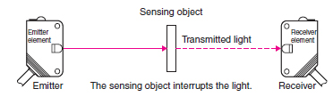
Types of optical sensors (1/3)
Through-beam sensors: two separate components, a light source and a light detector mounted opposite to each other. The light source emits a light beam in the direction of the detector. The object of the measurement is interposed between the light source and the detector and based on its light absorption the measurements are derived.

Slide 26
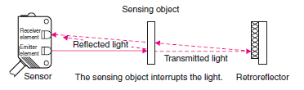
Types of optical sensors (2/3)
Retroreflector sensors: Two separate components, a sensor including the emitter and the detector, and a retroreflector mounted on opposite to each other. The light beam emitted by the sensor passes across the sensing object, reaches the retroreflector which reflects it back to the sensor.

Slide 27
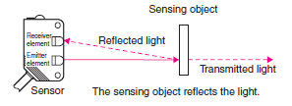
Types of optical sensors (3/3)
Diffuse-reflective sensors: A single component integrating the light emitter and the light detector. The light source emits a light beam through the sensing object, which partially reflect light back to the detector.

Slide 28
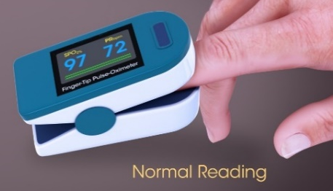
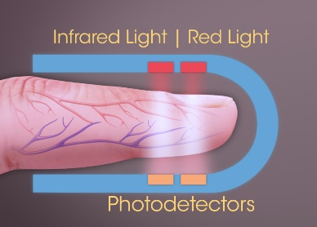
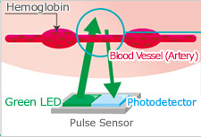
Through-beam vs. diffuse-reflective
Portable pulseoximeter
(through-beam)
Through-beam sensors:
Advantage: the detected light interacts through a sufficiently long optical path with the target tissue → strong signal attenuation for measurement extraction.
Disadvantage: it can be applied easily only to some anatomical regions, e.g., finger or ear lobe; not straightforward to miniaturize.
Wearable HR monitor
(diffuse-reflective)
Diffuse-reflective sensors :
Advantage: they can be used in nearly any region of the body; simple to miniaturize and to make wireless.
Disadvantage: they are susceptible to motion artifacts; slight changes in the relative position of the optical components create noise → Filtering algorithms and systematic compensating approaches that exploit accelerometers as motion sensors are used to mitigate motion artifacts.

Slide 29
Optical HR sensor: Photoplethysmography
Optical HR sensors integrated in commercial wearable devices (e.g., smartwatches) are diffuse-reflective sensors that use the photoplethysmography technique.
Photoplethysmography (PPG) utilizes a light source and a photodetector to measure the properties of blood circulation.
The light source emits light to a tissue and the photodetector measures the intensity of reflected light from the tissue.
The hemoglobin contained in red blood cells absorbs light.

Slide 30
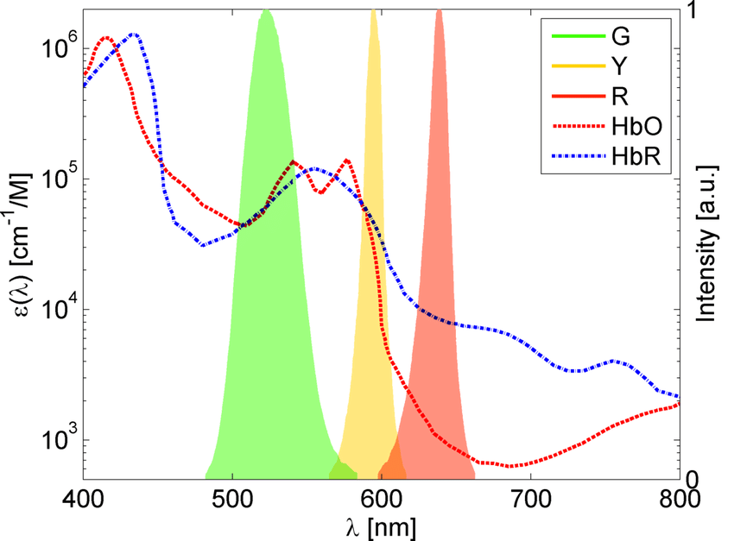
Optical HR sensor: Photoplethysmography
The intensity of absorbed light depends on the light wavelength and the oxygenation of hemoglobin.
At red wavelength: deoxygenated hemoglobin (HbR) absorbs more light that oxygenated hemoglobin (HbO) → red and infra-red lights are used in pulseoxymeters that exploit the difference in light absorption of oxygenated and deoxygenated hemoglobin to measure peripheral oxygen saturation.
Most common optical HR sensors use a green light emitting diode (LED) as light source.
At the wavelength of green light: the intensity of light absorbed by oxygenated and deoxygenated hemoglobin is roughly the same.

Slide 31
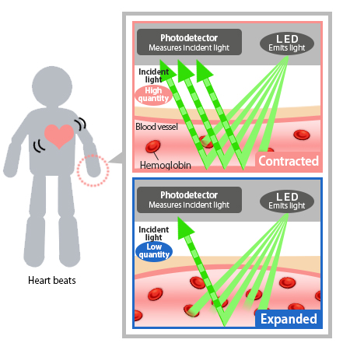
The PPG signal
The intensity of reflected light directly depends on the amount of hemoglobin present in blood vessels, which can be linked to blood volume.
Large blood volume → more absorbed light → small reflected light
The PPG signal, measured by the photodetector, represents light absorption.
Variations in the intensity of light absorbed (or reflected) correspond to variations in blood volume.

Slide 32
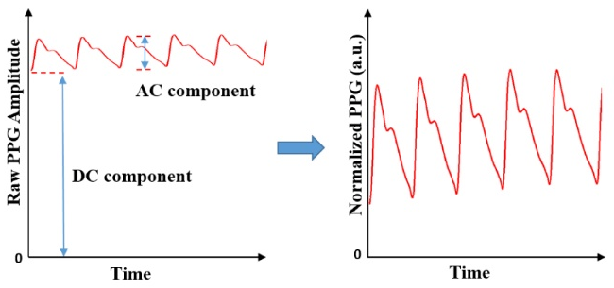
The PPG signal
The PPG signal has two components:
a pulsatile (‘AC’) waveform attributed to changes in the blood volume synchronous with heart beat.
a slowly varying (‘DC’) baseline with various lower frequency components attributed to respiration, sympathetic nervous system activity and thermoregulation.
The AC can be extracted with suitable electronic filtering and amplification.
HR is determined by calculating the frequency of PPG systolic peaks in AC.
Systolic peak

Slide 33
Classification of sensors based on their sensing technique
Mechanical sensors
Electrical sensors
Optical sensors
Chemical sensors

Slide 34
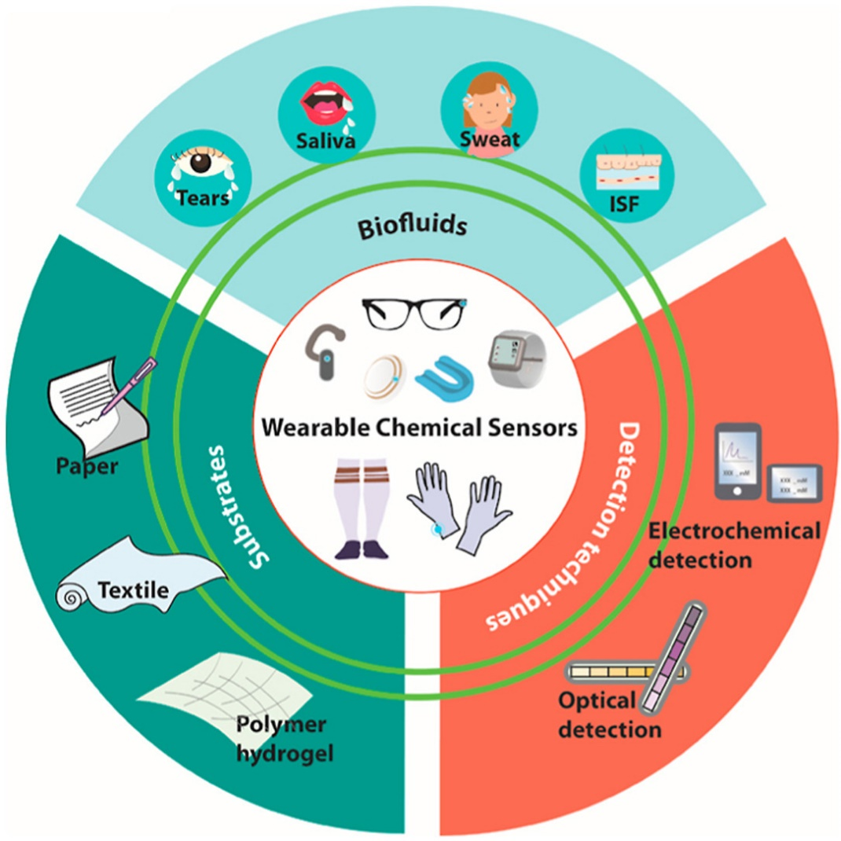
Chemical sensors
They quantify chemical markers, or analytes, in biological fluids and convert this information in an optical (optochemical sensor) or electrical signal (electrochemical sensor).
Require direct chemical interaction with the biomarker (contact sensors).
Wearable chemical sensors use non-invasive or minimally-invasive techniques to measure analytes in alternative biofluids instead of invasive blood sampling.
Biofluids secreted by the body (saliva, sweat, tears)
Interstitial fluid reached through minimally-invasive sensors or by reverse iontophoresis
When a new wearable chemical sensor is designed, the relationship between analyte concentration in the chosen biofluid and that in the traditional samples (e.g., blood) must be confirmed.

Slide 35
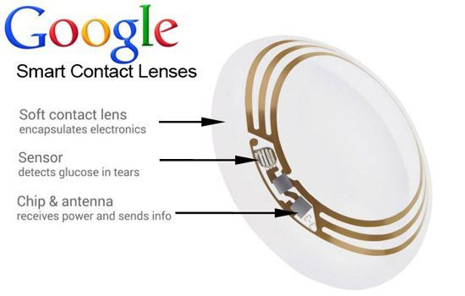
Biofluids: Tears
Tears contain a variety of biomarkers: electrolytes (e.g., Na⁺, K⁺, and Cl⁻), metabolites (e.g., glucose, lactate, and ascorbate), and proteins (e.g., lysozyme, lactoferrin, lipocalin, and albumin).
Tear biomarkers have been used for the diagnosis of both ocular diseases and common diseases (e.g., diabetes)
Pros: Tear biomarkers directly diffuse from blood → close correlation between the biomarker concentration in tears and blood.
Cons: small sample volume, rapid evaporation during sample collection, eye irritation, and a lack of tear fluids of users who face with a dry eye syndrome.
Typical form factor: smart contact lens.

Slide 36
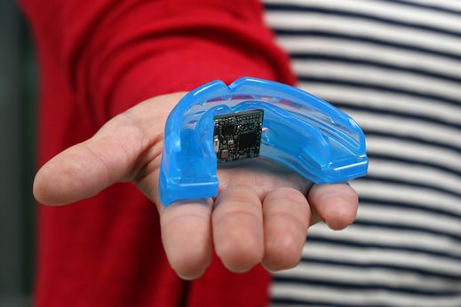
Biofluids: Saliva
Saliva contains small metabolites (e.g., glucose, uric acid, and creatinine), proteins (e.g., lactate dehydrogenase (LDH), a-amylase, and albumin), and hormones (e.g., cortisol, testosterone, and progesterone)
Saliva biomarkers can be used for diagnosing oral diseases, diabetes, cancer, kidney disease and cardio-vascular disease.
Pros: Large volume of saliva; easy, low-cost, non-invasive sample collection.
Cons: the concentration of salivary biomarkers is usually lower than blood and other non-invasive biofluids; food particles, bacteria, and other contaminants limit the performance of saliva diagnostics.
Typical form factor: mouthguard with embedded sensor.

Slide 37
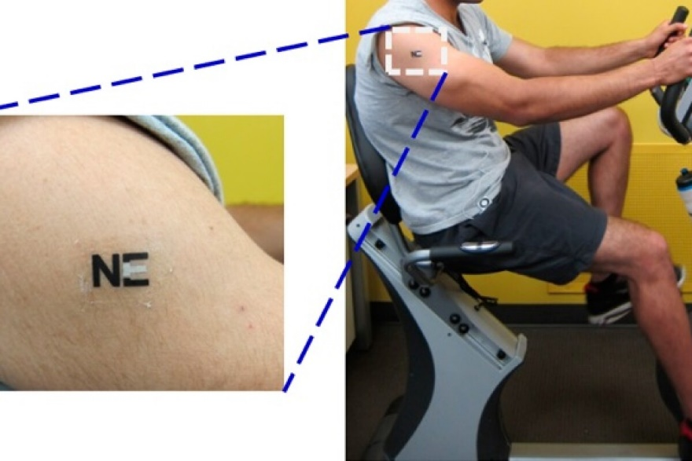
Biofluids: Sweat
Sweat contains electrolytes (e.g., Na⁺, Cl⁻, K⁺, and Ca2⁺), metabolites (e.g., lactate, creatinine, glucose, and uric acid), small molecules (e.g., amino acid and cortisol), and proteins (e.g., interleukin, tumor necrosis factor, and neuropeptide)
Pros: Sweat biomarkers contain abundant health information (e.g., hydration status, physical stress, and bone mineral loss).
Cons: variation of sweat secretion (which depends on the weather, heat, physical activity, stress, and chemical stimulus); sample evaporation; skin surface contamination.
Typical form factor: skin tattoo biosensors.
Wearable lactate sensor

Slide 38
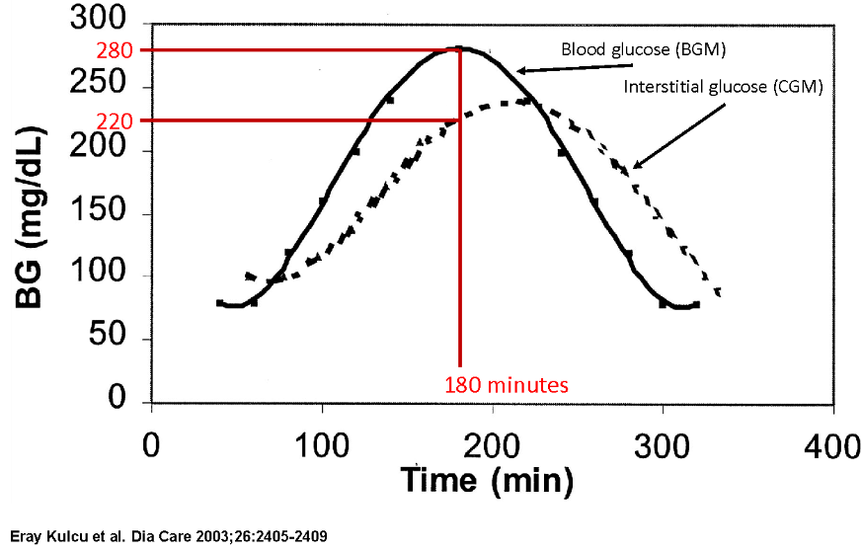
Biofluids: Interstitial fluid
Interstitial fluid (ISF): extracellular fluid surrounding all cells in the body. ISF contains electrolytes (e.g., Na⁺, Mg²⁺, K⁺, and Ca²⁺), metabolites (e.g., glucose, ethanol, and cortisol), and proteins that diffuse from the capillary endothelium.
Pros: Most of ISF analyte concentrations are similar to blood concentrations → reliable correlation between blood and ISF biomarkers.
Example: in steady-state conditions glucose concentration in ISF is equal to that in blood. During dynamics, concentration of glucose in ISF is delayed and attenuated compared to that in the blood because of the time needed by glucose to diffuse from plasma to ISF.
Cons: ISF analysis requires either minimally-invasive needle electrodes or additional method, such as reverse iontophoresis, to bring the ISF to the skin surface for non-invasive monitoring.
Typical form factor: needle electrodes or reverse iontophoresis electrodes.

Slide 39
Detection techniques
The signal from biomarkers can be detected, either directly (e.g., Na⁺ and K⁺ in sweat by ion-selective host), or indirectly from other species generated from the reaction between biomarker and recognition element (e.g., glucose measurement via H₂O₂ generated from the glucose oxidase-catalysed reaction)
Two most popular detection techniques:
Optochemical detection
Electrochemical detection

Slide 40
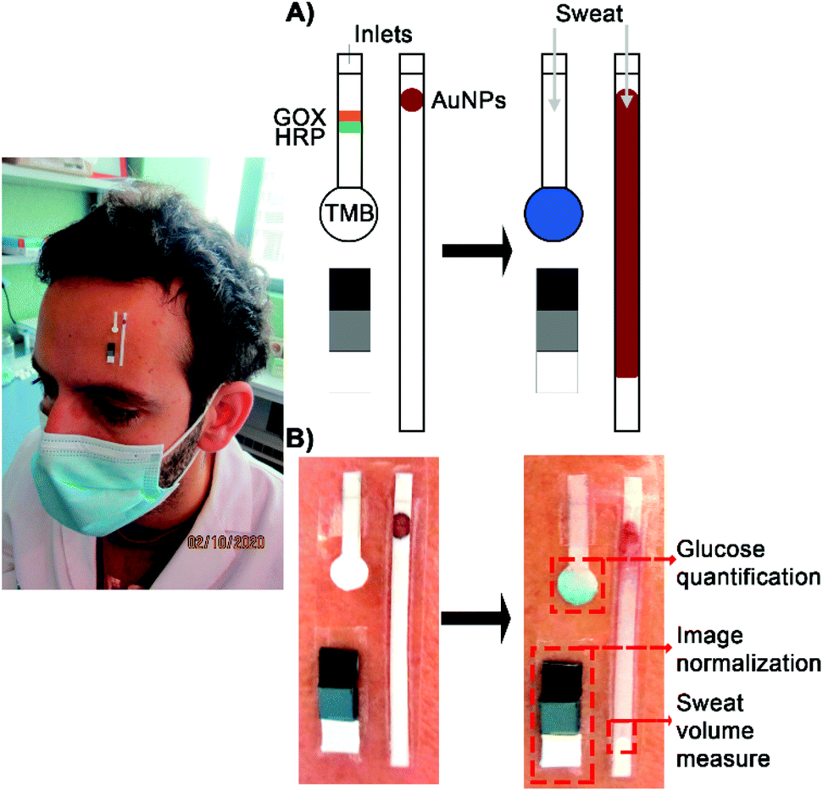
Optochemical sensors
They exploit materials whose optical properties are related to the analyte of interest.
Colorimetric biosensors: The sensor uses an immobilized chemical material. When an analyte comes into contact with the sensor, a chemical reaction occurs between the analyte and sensor chemical material which produces a measurable color change.
Generally based on the naked-eye measurement.
Pros: it does not require any external energy source, which allows simpler instrumentation.
Cons: our eyes cannot differentiate small changes of color.
A smartphone camera can be used to differentiate colors with high sensitivity. A smartphone captures the color change photo and quantifies the intensity of light in RGB scales, which is then correlated to the analyte concentration.
Vaquer et al., Analyst, 2021

