Slide 1
Giacomo Cappon
Understanding UI

Slide 2
Outline
Recap
Some fundamental Flutter Widgets
Layout in Flutter
App#1: layout_basics
App#2: scaffolding
ListView
Exercise
Homework
Resources

Slide 3

Recap
Lesson 1
Lesson 5
Lesson 8
Lesson 10
Collaborate and version code
Create a layout
Make simple API calls
Implement user authentication
Lesson 2/3
Lesson 6
Lesson 9
Lesson 11
Get familiar with Dart
Navigate between screens
Fetch wearable data
Persist user data
Lesson 4
Lesson 7
Lesson 12
Understand Flutter’s principles
Manage the app state
Advanced stuff
Milestone #1
Milestone #2
Milestone #3
Do something with your fantasy

Slide 4
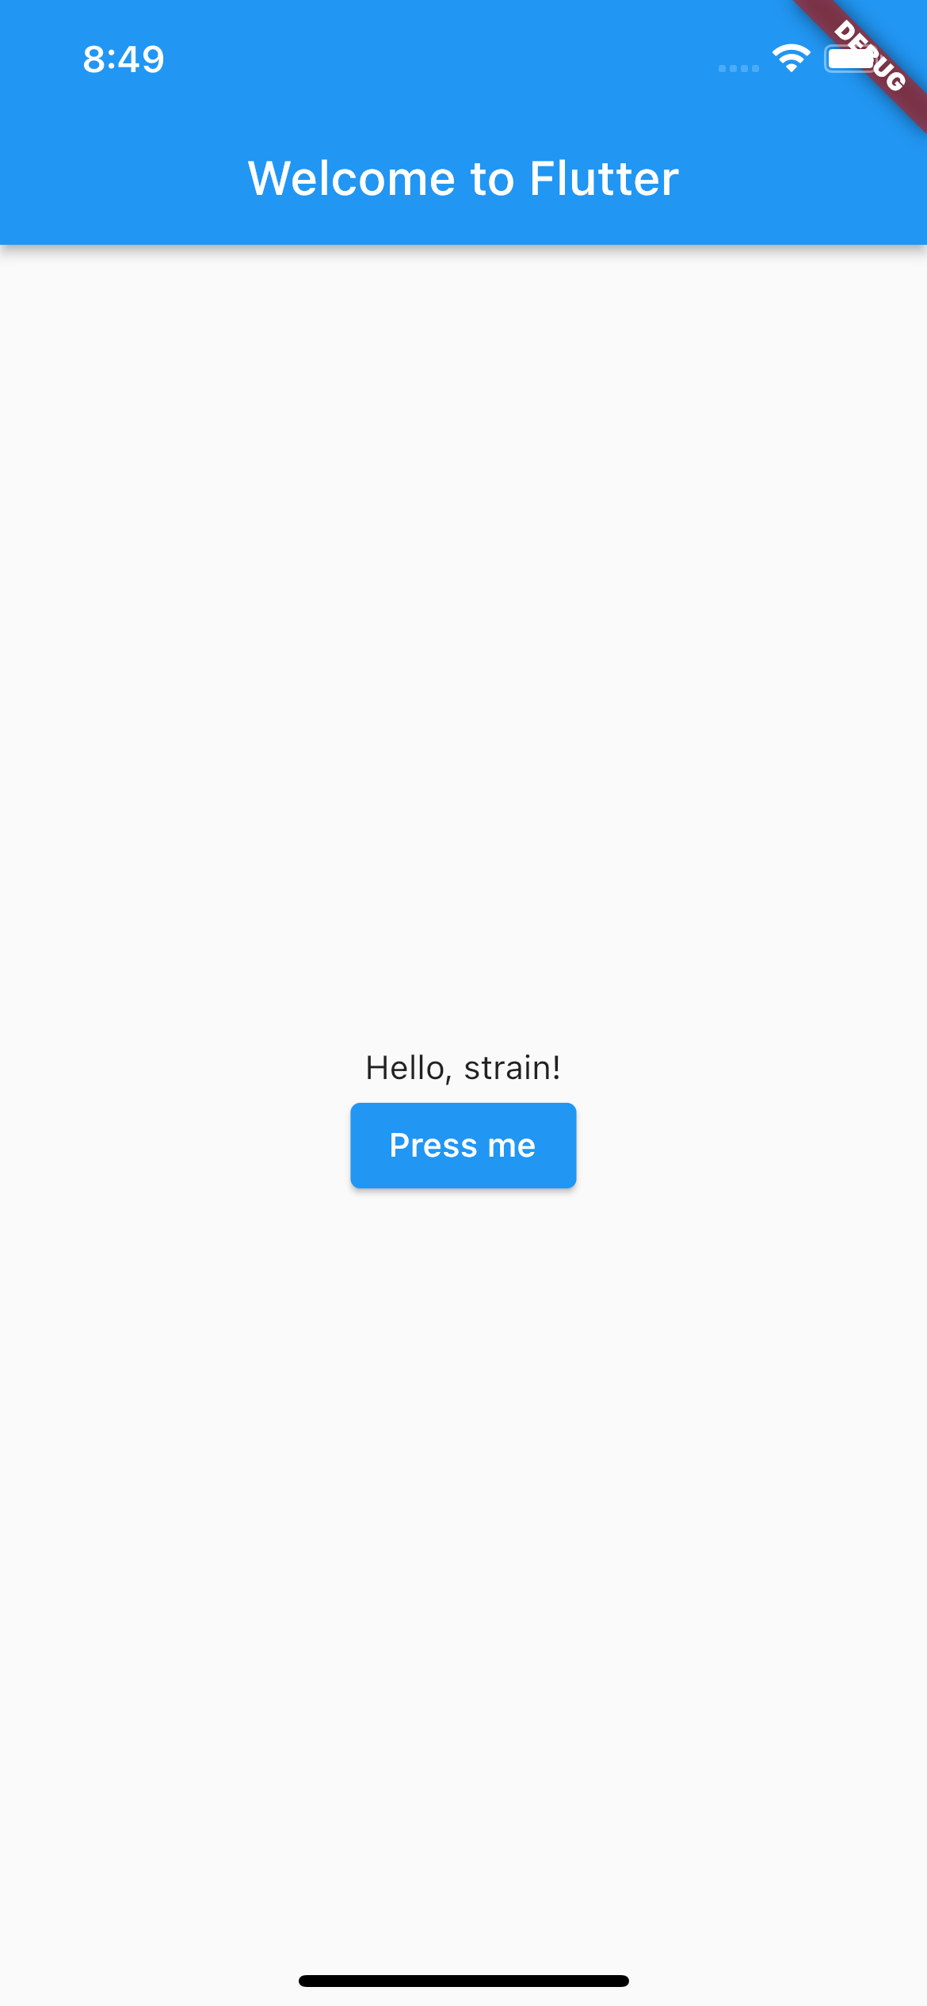
Recap: Widget tree
UIs are represented in Flutter hierarchically through a Widget tree
...
Scaffold
AppBar
Center
Text
Column
MainAxisAlignment
ElevatedButton
Text
Text

Slide 5
Outline
Recap
Some fundamental Flutter Widgets
Layout in Flutter
App#1: layout_basics
App#2: scaffolding
ListView
Exercise
Homework
Resources

Slide 6
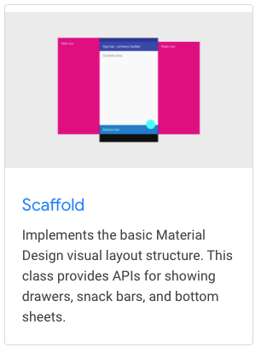
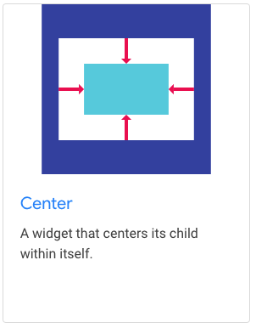
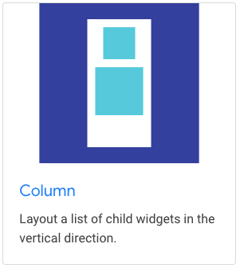
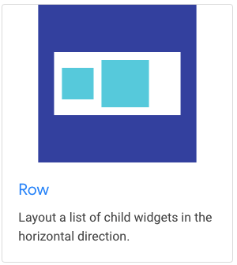
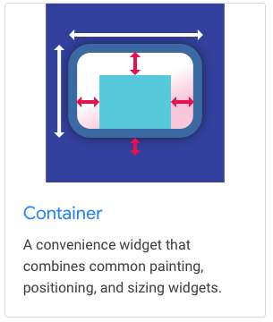
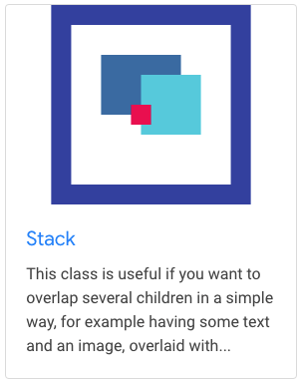
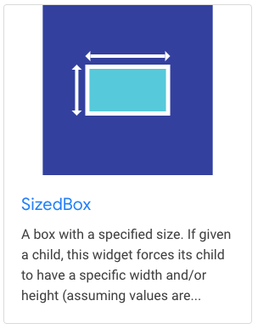
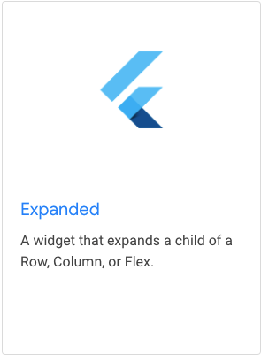
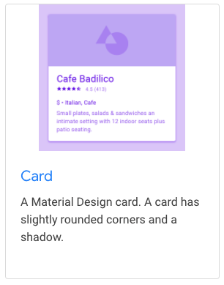
Fundamental Widget for UI
Of course, there are many others…

Slide 7
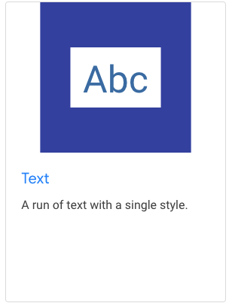
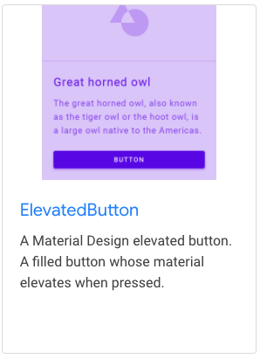
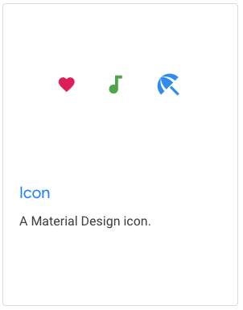
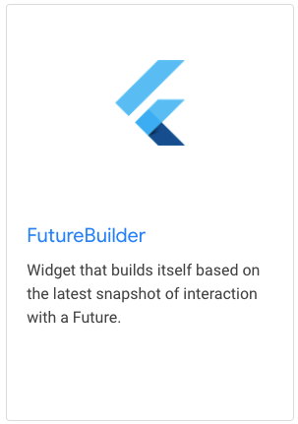
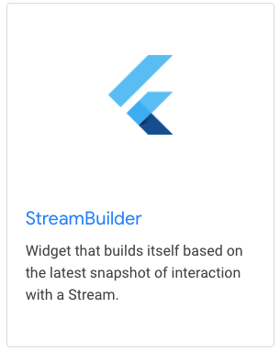
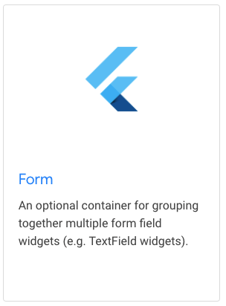
Fundamental Widget for UI
Of course, there are many others…

Slide 8
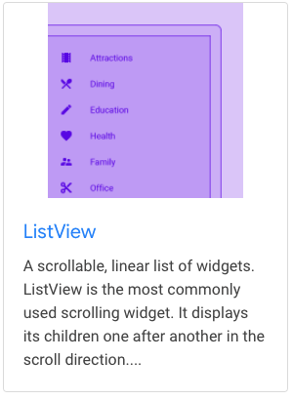
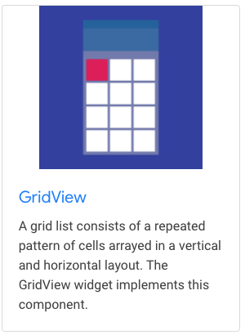
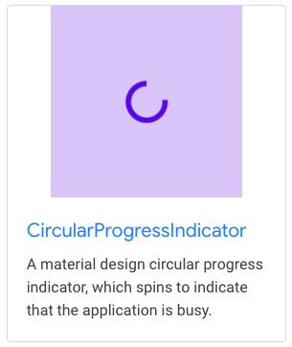
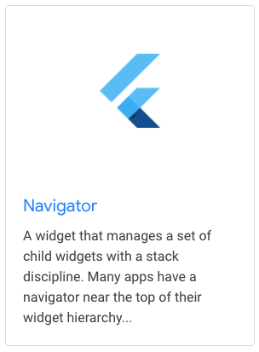
Fundamental Widget for UI
Of course, there are many others…
Extensively discussed in the next lesson

Slide 9
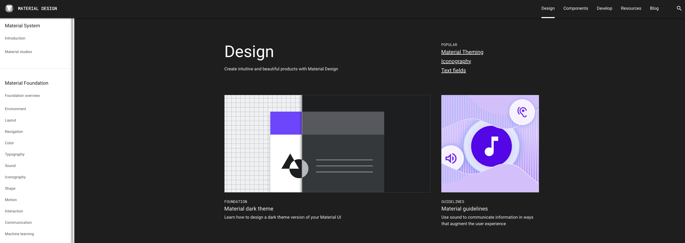
Designing your UI - Material
Many approaches can be followed
Material is an adaptable system of guidelines, components, and tools to support best practices of UI design
Flutter includes many widgets from Material

Slide 10
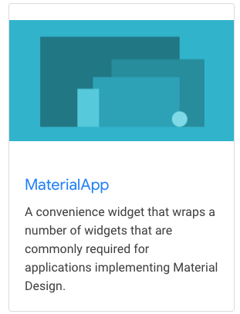
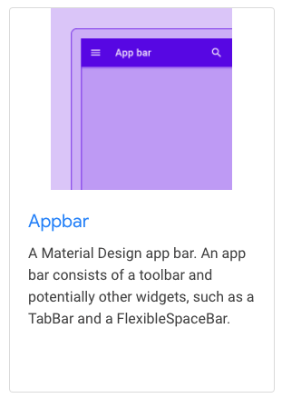
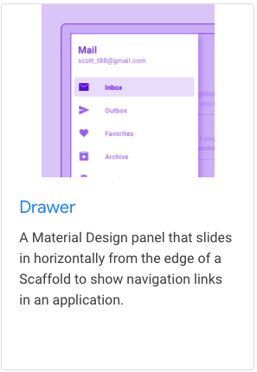
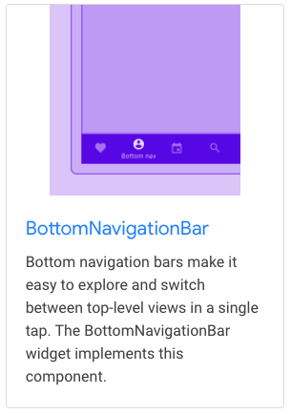
Material UI Widget – App Structure and Navigation
Of course, there are many others…

Slide 11
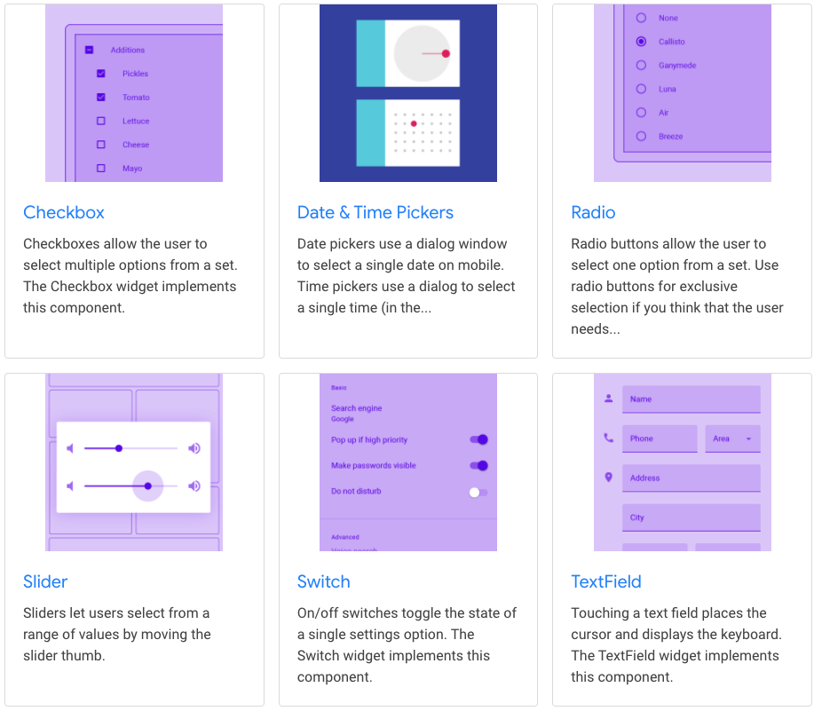
Material UI Widget – Buttons
Of course, there are many others…

Slide 12
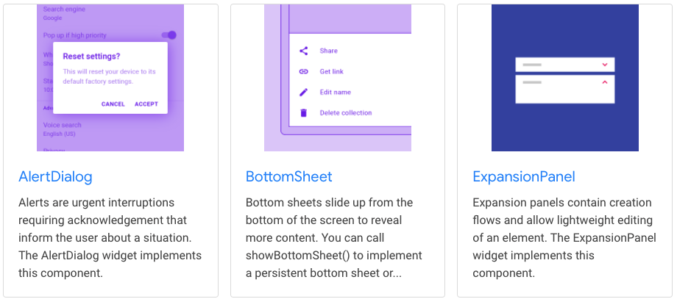
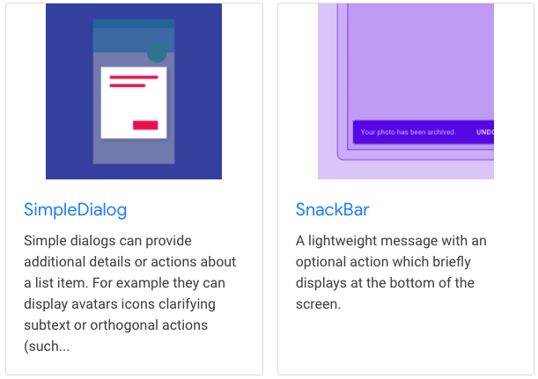
Material UI Widget – Dialogs, alerts, and panels
Of course, there are many others…

Slide 13
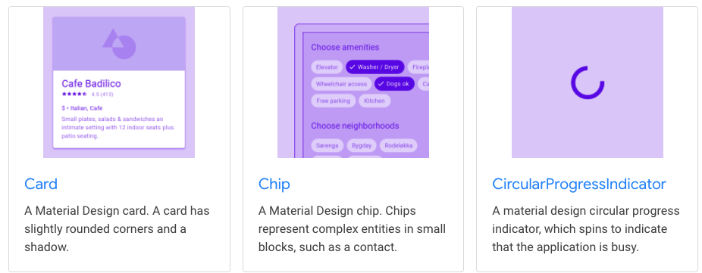
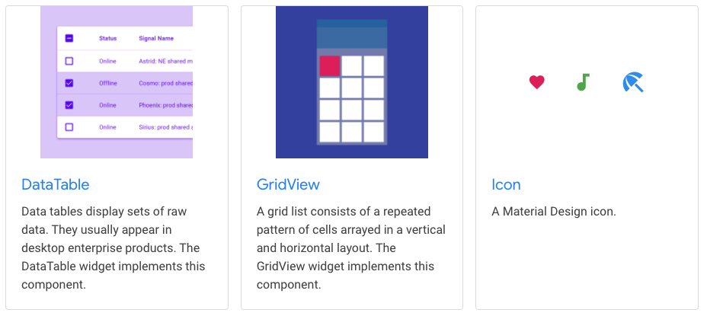
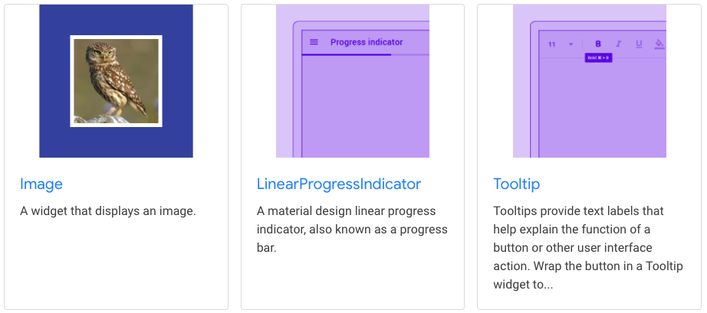
Material UI Widget – Information displays
Of course, there are many others…

Slide 14
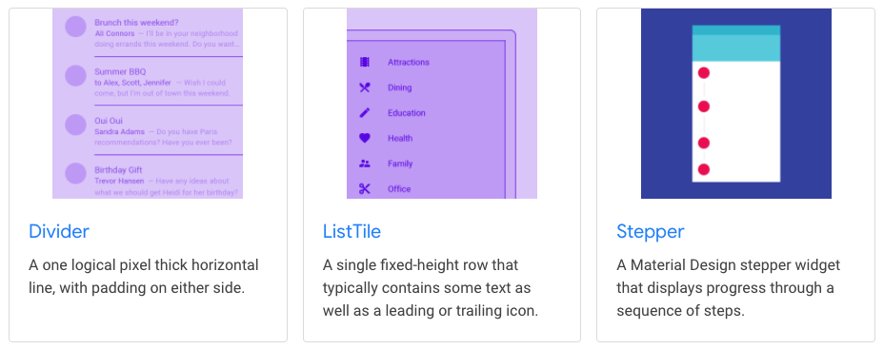
Material UI Widget – Layout
Of course, there are many others…

Slide 15
Outline
Recap
Some fundamental Flutter Widgets
Layout in Flutter
App#1: layout_basics
App#2: scaffolding
ListView
Exercise
Homework
Resources

Slide 16
Layouts in Flutter
Layouts are organized in a Widget tree
But how a widget is sized and positioned somewhere?
To answer this question, we need to fully understand this rule:
Constraints go down. Sizes go up. Parent sets position.
The set of 4 doubles: minimum and maximum height, minimum and maximum width.
The set of 2 doubles: height and width.
The set of 2 doubles: x and y.

Slide 17
Layouts in Flutter
Constraints go down. Sizes go up. Parent sets position.
A widget gets its constraints from its parent and tells its children what are the constraints (i.e., “constraints go down”).
A widget then asks its children the sizes they want to be (i.e., “sizes go up”).
A widget positions its children (i.e., “parent sets position”).
Parent
POS.
CONSTRAINTS
SIZES
Widget
POS.
Children

Slide 18
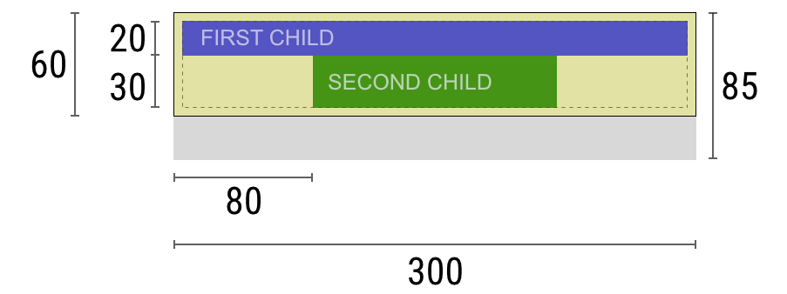
Negotiating constraints, sizes, and position
Widget: “Hey parent, what are my constraints?”
Parent: “You must be from 80 to 300 pixels wide, and 30 to 85 tall.”
Widget: “Since I want to have 5 pixels of padding, then my children can have at most 290 pixels of width and 75 pixels of height.”
Widget: “Hey first child, You must be from 0 to 290 pixels wide, and 0 to 75 tall.”
First child: “OK, then I wish to be 290 pixels wide, and 20 pixels tall.”
Widget: “Since I want to put my second child below the first one, this leaves only 55 pixels of height for my second child.”
Widget: “Hey second child, You must be from 0 to 290 wide, and 0 to 55 tall.”
Second child: “OK, I wish to be 140 pixels wide, and 30 pixels tall.”
Widget: “Very well. My first child has position x: 5 and y: 5, and my second child has x: 80 and y: 25.”
Widget: “Hey parent, I’ve decided that my size is going to be 300 pixels wide, and 60 pixels tall.”
Parent
POS.
CONSTRAINTS
SIZES
Widget
POS.
Children

Slide 19
Limitations
A widget can decide its own size only within the constraints given to it by its parent: a widget can’t have any size it wants.
A widget can’t know and doesn’t decide its own position in the screen.
It’s impossible to precisely define the size and position of any widget without taking into consideration the tree as a whole.
If a child wants a different size from its parent and the parent doesn’t have enough information to align it, then the child’s size might be ignored. Be specific when defining alignment.
Parent
POS.
CONSTRAINTS
SIZES
Widget
POS.
Children

Slide 20
Outline
Recap
Some fundamental Flutter Widgets
Layout in Flutter
App#1: layout_basics
App#2: scaffolding
ListView
Exercise
Homework
Resources

Slide 21
Dive into examples
In the “Understanding constraints” article by Marcelo Glasberg https://docs.flutter.dev/development/ui/layout/constraints (you will also find the link in the Resources section of this presentation) there are a lot (29) of examples explaining how all of this works.
Let’s report the most interesting ones.

Slide 22
App #1: layout_basics
Create a new project named ‘layout_basics’
Replace all the code of main.dart with
import 'package:flutter/material.dart';
void main() {
runApp(const MyApp());
}//main
class MyApp extends StatelessWidget {
const MyApp({Key? key}) : super(key: key);
@override
Widget build(BuildContext context) {
return MaterialApp(
home:
//TODO: implement something here
);
}//build
}//MyApp

Slide 23

Example 1
Widget _example1() => Container(color: Colors.red);
The screen is the parent of the Container, and it forces the Container to be exactly the same size as the screen.
So the Container fills the screen and paints it red.

Slide 24
Example 2
Widget _example2() => Container(width: 100, height: 100, color: red);
The red Container wants to be 100 × 100, but it can’t, because the screen forces it to be exactly the same size as the screen.
The Container fills the screen.

Slide 25
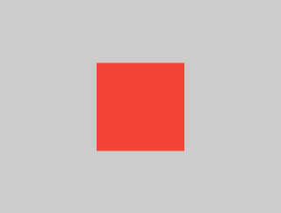
Example 3
Widget _example3() => Center(
child: Container(width: 100, height: 100, color: red),
);
The screen forces the Center to be exactly the same size as the screen, so the Center fills the screen.
The Center tells the Container that it can be any size it wants, but not bigger than the screen. Now the Container can be 100 × 100.

Slide 26
Example 6
Widget _example6() => Center(
child: Container(color: red),
)
The screen forces the Center to be exactly the same size as the screen, so the Center fills the screen.
The Center tells the Container that it can be any size it wants, but not bigger than the screen. Since the Container has no child and no fixed size, it decides it wants to be as big as possible, so it fills the whole screen.

Slide 27
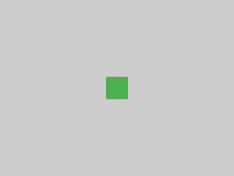
Example 7
Widget _example7() => Center(
child: Container(
color: red,
child: Container(color: green, width: 30, height: 30),
),
);
The screen forces the Center to be exactly the same size as the screen, so the Center fills the screen.
The Center tells the red Container that it can be any size it wants, but not bigger than the screen. Since the red Container has no size but has a child, it decides it wants to be the same size as its child.
The red Container tells its child that it can be any size it wants, but not bigger than the screen.
The child is a green Container that wants to be 30 × 30. Given that the red Container sizes itself to the size of its child, it is also 30 × 30. The red color isn’t visible because the green Container entirely covers the red Container.

Slide 28
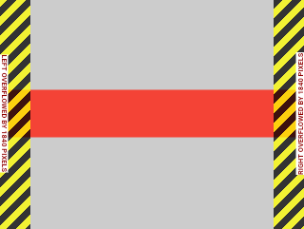
Example 14
Widget _example14() => UnconstrainedBox(
child: Container(color: red, width: 4000, height: 50),
);
The screen forces the UnconstrainedBox to be exactly the same size as the screen, and UnconstrainedBox lets its child Container be any size it wants.
Unfortunately, in this case the Container is 4000 pixels wide and is too big to fit in the UnconstrainedBox, so the UnconstrainedBox displays the much dreaded “overflow warning”.

Slide 29
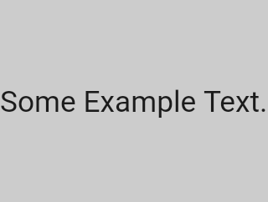
Example 18
Widget _example18() => const FittedBox(
child: Text('Some Example Text.'),
);
The screen forces the FittedBox to be exactly the same size as the screen. The Text has some natural width (also called its intrinsic width) that depends on the amount of text, its font size, and so on.
The FittedBox lets the Text be any size it wants, but after the Text tells its size to the FittedBox, the FittedBox scales the Text until it fills all of the available width.

Slide 30
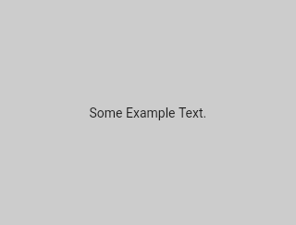
Example 19
Widget _example19() => const Center(
child: FittedBox(
child: Text('Some Example Text.'),
),
);
But what happens if you put the FittedBox inside of a Center widget? The Center lets the FittedBox be any size it wants, up to the screen size.
The FittedBox then sizes itself to the Text, and lets the Text be any size it wants. Since both FittedBox and the Text have the same size, no scaling happens.
Full example in lab_05-understanding_ui/layout_basics/

Slide 31
Outline
Recap
Some fundamental Flutter Widgets
Layout in Flutter
App#1: layout_basics
App#2: scaffolding
ListView
Exercise
Homework
Resources

Slide 32
App #2: scaffolding
Create a new project named ‘scaffolding’
Replace all the code of main.dart with
import 'package:flutter/material.dart';
void main() {
runApp(const MyApp());
}//main
class MyApp extends StatelessWidget {
const MyApp({Key? key}) : super(key: key);
@override
Widget build(BuildContext context) {
return MaterialApp(
home:
//TODO: implement something here
);
}//build
}//MyApp

Slide 33
Focus on the Scaffold
Let’s focus into the Scaffold Widget
It provides a framework which implements the basic material design visual layout structure
Detailed info: https://api.flutter.dev/flutter/material/Scaffold-class.html
//Constructor of Scaffold
const Scaffold({ Key key, this.appBar, this.body, this.floatingActionButton, this.floatingActionButtonLocation, this.floatingActionButtonAnimator, this.persistentFooterButtons, this.drawer, this.endDrawer, this.bottomNavigationBar, this.bottomSheet, this.backgroundColor, this.resizeToAvoidBottomPadding = true, this.primary = true, })

Slide 34
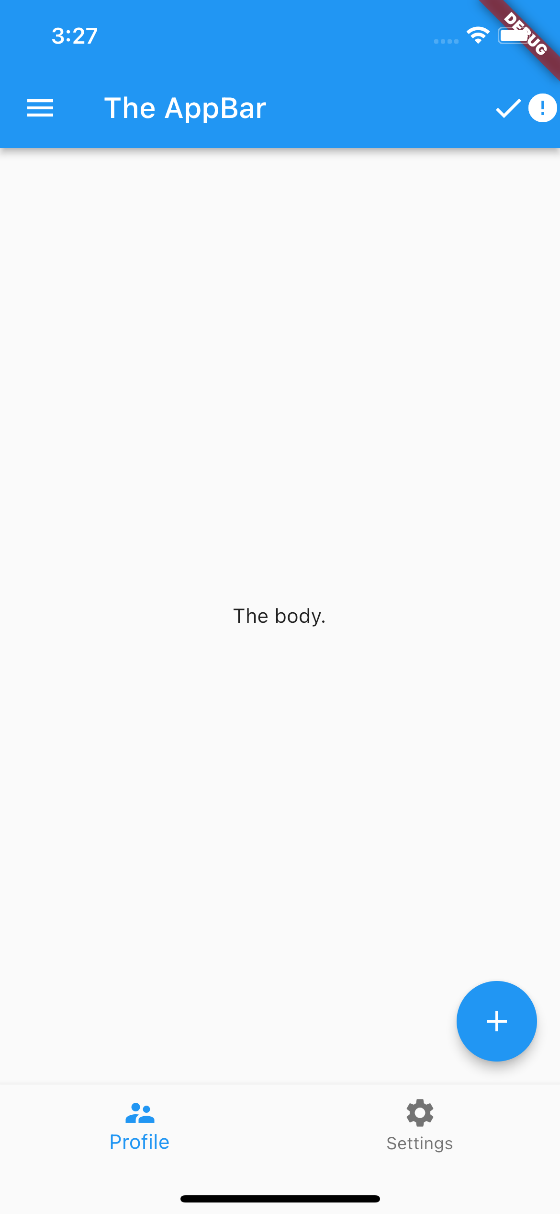
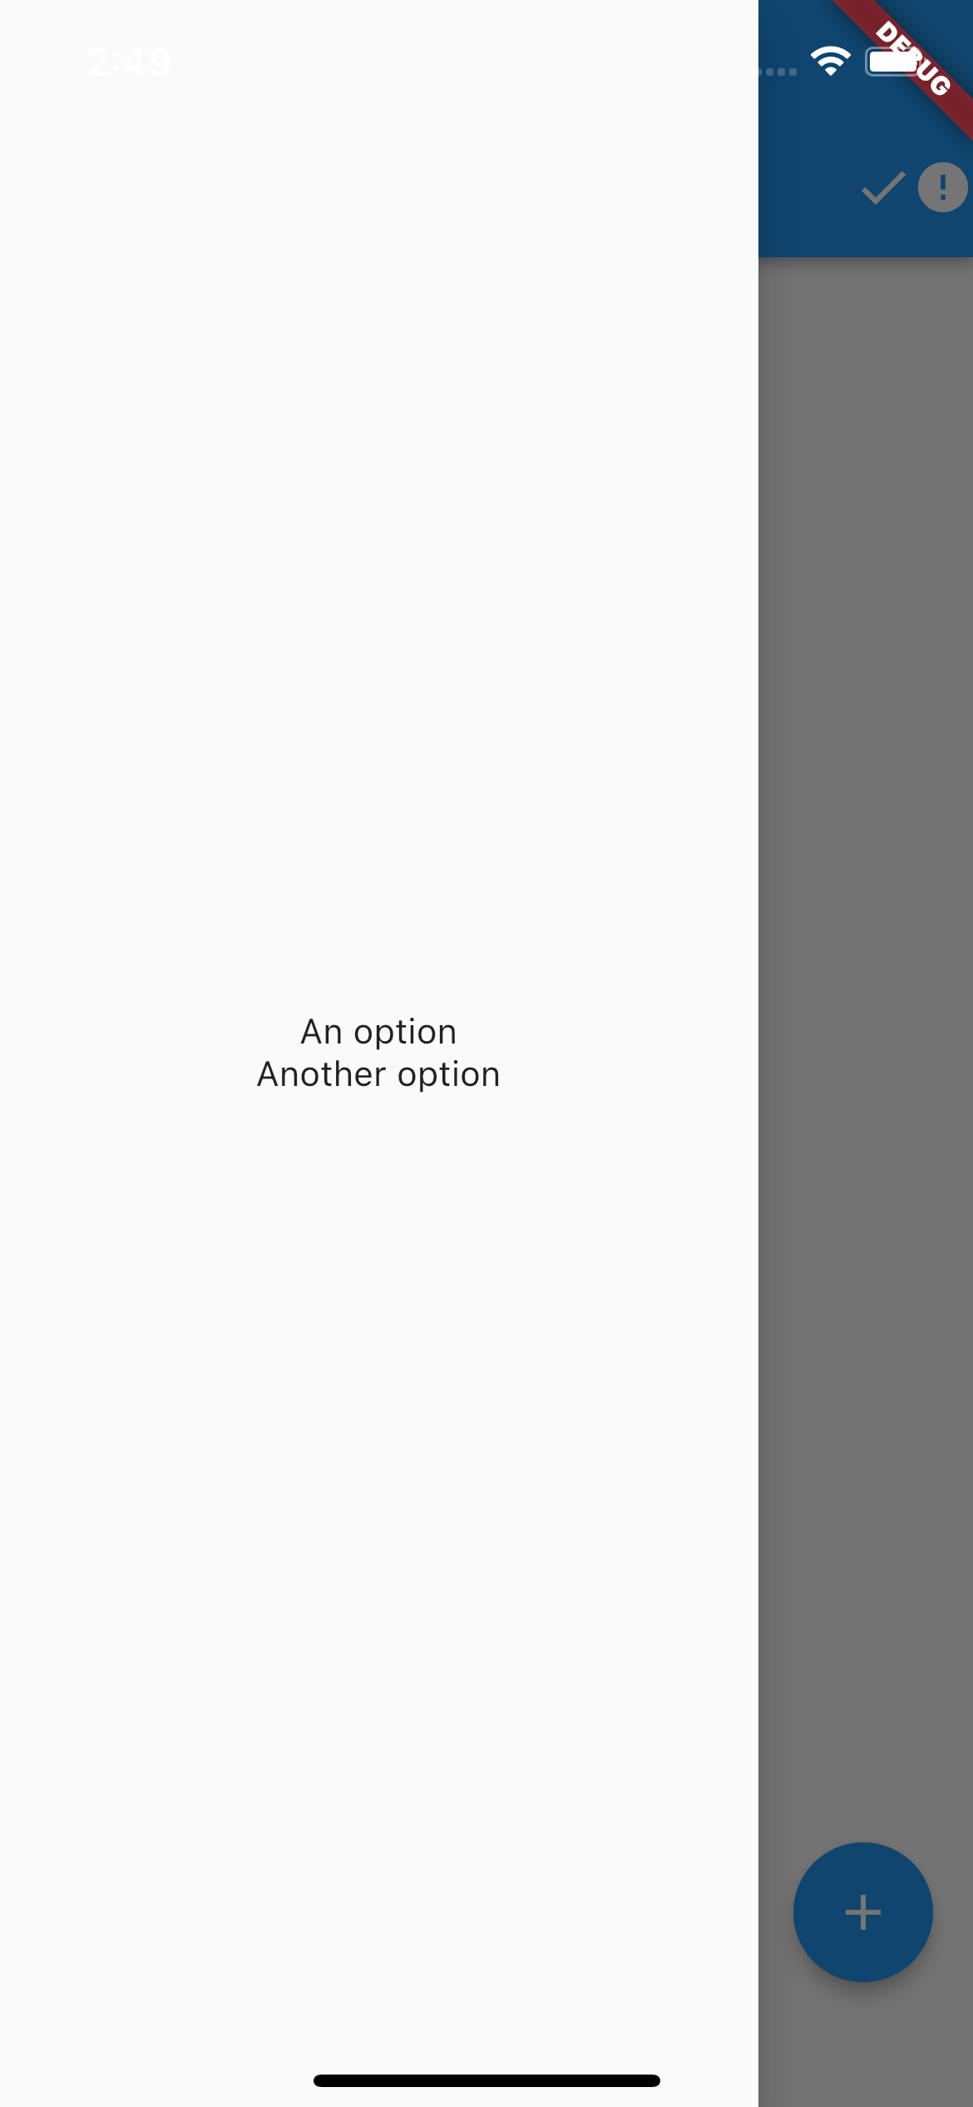
Focus on the Scaffold
//Constructor of Scaffold
const Scaffold({ Key key, this.appBar, this.body, this.floatingActionButton, this.floatingActionButtonLocation, this.floatingActionButtonAnimator, this.persistentFooterButtons, this.drawer, this.endDrawer, this.bottomNavigationBar, this.bottomSheet, this.backgroundColor, this.resizeToAvoidBottomPadding = true, this.primary = true, })

Slide 35
Focus on the Scaffold
//Constructor of Scaffold
const Scaffold({ Key key, this.appBar, this.body, this.floatingActionButton, this.floatingActionButtonLocation, this.floatingActionButtonAnimator, this.persistentFooterButtons, this.drawer, this.endDrawer, this.bottomNavigationBar, this.bottomSheet, this.backgroundColor, this.resizeToAvoidBottomPadding = true, this.primary = true, })

Slide 36
Focus on the Scaffold
...
home: Scaffold(
appBar: AppBar(
actions: const [
Icon(Icons.done,),
Icon(Icons.error),
],
title: const Text('The AppBar’),
),
...

Slide 37
Focus on the Scaffold
//Constructor of Scaffold
const Scaffold({ Key key, this.appBar, this.body, this.floatingActionButton, this.floatingActionButtonLocation, this.floatingActionButtonAnimator, this.persistentFooterButtons, this.drawer, this.endDrawer, this.bottomNavigationBar, this.bottomSheet, this.backgroundColor, this.resizeToAvoidBottomPadding = true, this.primary = true, })

Slide 38
Focus on the Scaffold
...
home: Scaffold(
...
drawer: Drawer(
child: Column(
mainAxisAlignment: MainAxisAlignment.center,
children: const [
Text('An option’),
Text('Another option'),
],
),
),
...

Slide 39
Focus on the Scaffold
//Constructor of Scaffold
const Scaffold({ Key key, this.appBar, this.body, this.floatingActionButton, this.floatingActionButtonLocation, this.floatingActionButtonAnimator, this.persistentFooterButtons, this.drawer, this.endDrawer, this.bottomNavigationBar, this.bottomSheet, this.backgroundColor, this.resizeToAvoidBottomPadding = true, this.primary = true, })

Slide 40
Focus on the Scaffold
...
home: Scaffold(
...
body: const Center(
child: Text('The body.'),
),
...

Slide 41
Focus on the Scaffold
//Constructor of Scaffold
const Scaffold({ Key key, this.appBar, this.body, this.floatingActionButton, this.floatingActionButtonLocation, this.floatingActionButtonAnimator, this.persistentFooterButtons, this.drawer, this.endDrawer, this.bottomNavigationBar, this.bottomSheet, this.backgroundColor, this.resizeToAvoidBottomPadding = true, this.primary = true, })

Slide 42
Focus on the Scaffold
...
home: Scaffold(
...
floatingActionButton:
FloatingActionButton(
child: const Icon(Icons.add),
onPressed: () {},
),
...

Slide 43
Focus on the Scaffold
//Constructor of Scaffold
const Scaffold({ Key key, this.appBar, this.body, this.floatingActionButton, this.floatingActionButtonLocation, this.floatingActionButtonAnimator, this.persistentFooterButtons, this.drawer, this.endDrawer, this.bottomNavigationBar, this.bottomSheet, this.backgroundColor, this.resizeToAvoidBottomPadding = true, this.primary = true, })

Slide 44
Focus on the Scaffold
...
home: Scaffold(
...
bottomNavigationBar:
BottomNavigationBar(
items: const [
BottomNavigationBarItem(
icon: Icon(Icons.supervisor_account),
label: 'Profile',
),
BottomNavigationBarItem(
icon: Icon(Icons.settings),
label: 'Settings',
)
],
),
),
Full example in lab_05-understanding_ui/scaffolding/

Slide 45
Outline
Recap
Some fundamental Flutter Widgets
Layout in Flutter
App#1: layout_basics
App#2: scaffolding
ListView
Exercise
Homework
Resources

Slide 46
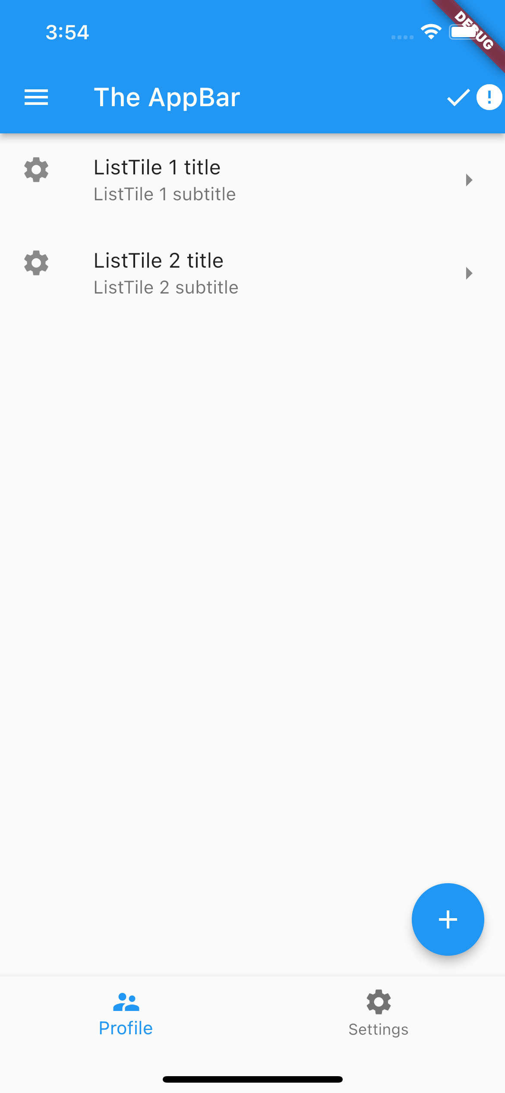
ListView
Let’s replace the body with something cooler: ListView
ListView is the most commonly used scrolling widget. It displays its children one after another in the scroll direction. In the cross axis, the children are required to fill the ListView.
Detailed info: https://api.flutter.dev/flutter/widgets/ListView-class.html

Slide 47

ListView
...
home: Scaffold(
...
body: ListView(
children: [
ListTile(
leading: Icon(Icons.settings),
title: Text('ListTile 1 title’),
subtitle: Text('ListTile 1 subtitle’),
trailing: Icon(Icons.arrow_right),
),
ListTile(
leading: Icon(Icons.settings),
title: Text('ListTile 2 title’),
subtitle: Text('ListTile 2 subtitle'),
trailing: Icon(Icons.arrow_right),
),
],
),
...
Full example in lab_05-understanding_ui/scaffolding/

Slide 48
Outline
Recap
Some fundamental Flutter Widgets
Layout in Flutter
App#1: layout_basics
App#2: scaffolding
ListView
Exercise
Homework
Resources

Slide 49
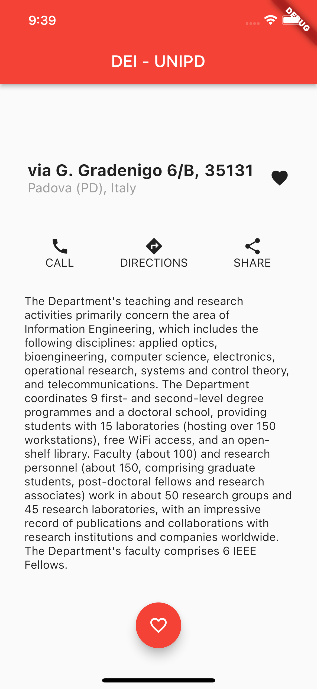
Exercise
Exercise 05.01 (easy)
Create a new project ‘reproduce_layout’
Reproduce, as close as possible, the layout on the right.
Hint: I used the following widgets: ThemeData, AppBar, Text, Container, Icon, SizedBox, Column, Row, and some others…

Slide 50
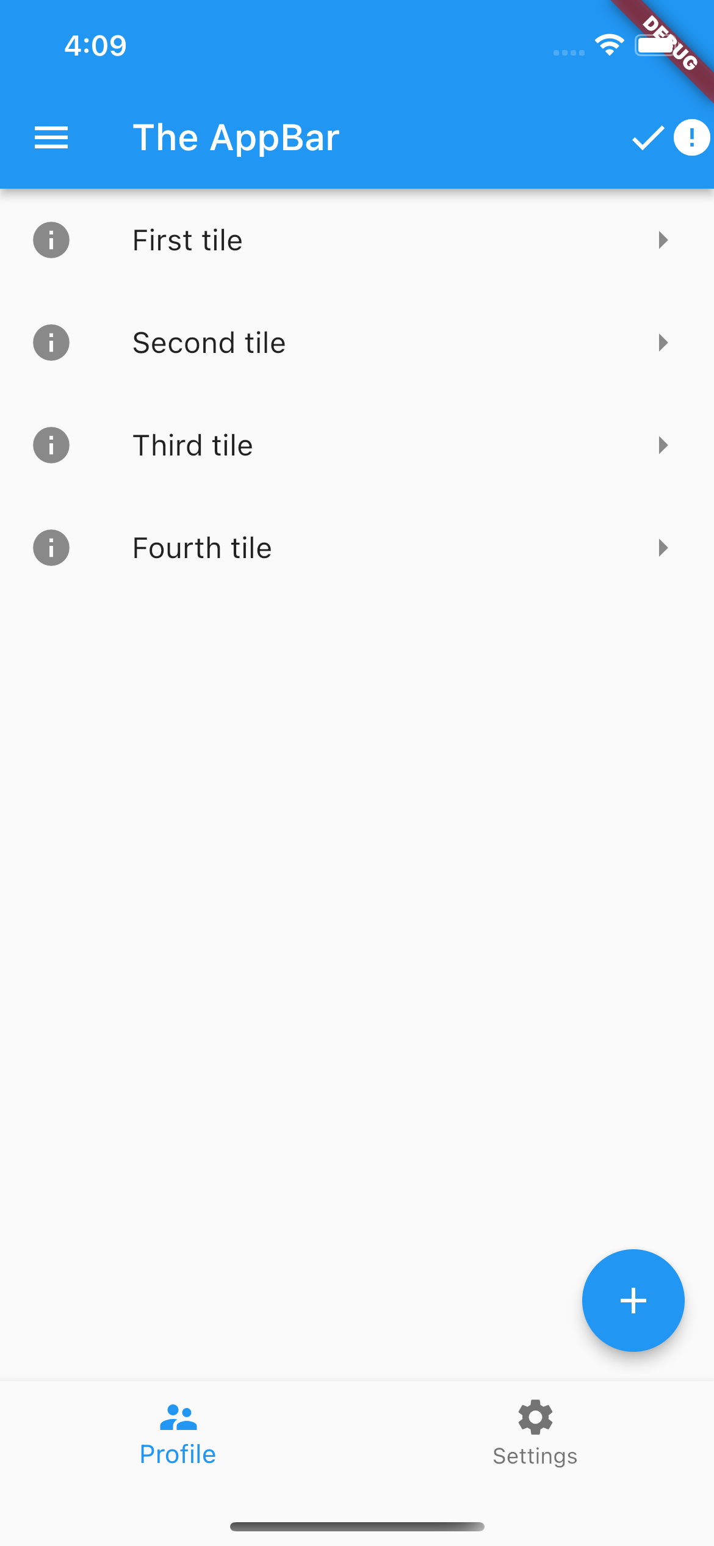
Exercise
Exercise 05.02 (easy)
Create a new project ‘exercise_listview’
Copy the code of main.dart of ‘scaffolding’ into the main.dart of ‘exercise_view’
Modify the ListView so that the app looks like the app on the right (hint: I used Icons.info)

Slide 51
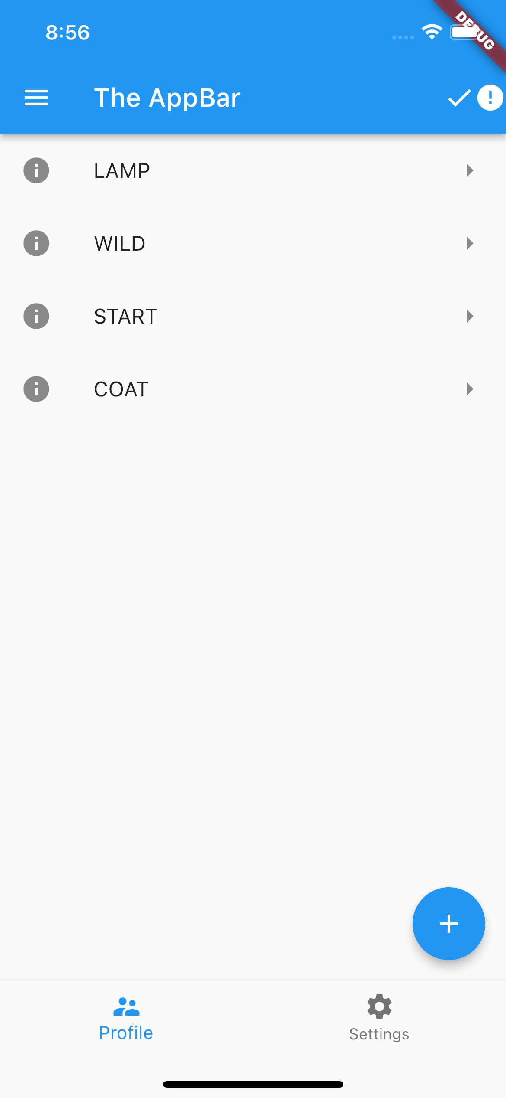
Exercise
Exercise 05.03 (easy)
Install the english_words package into the ‘exercise_listview’ app
Starting from the code of exercise 05.02, modify each ListTile in order to have as a title a random word in uppercase generated using the english_words package just installed

Slide 52
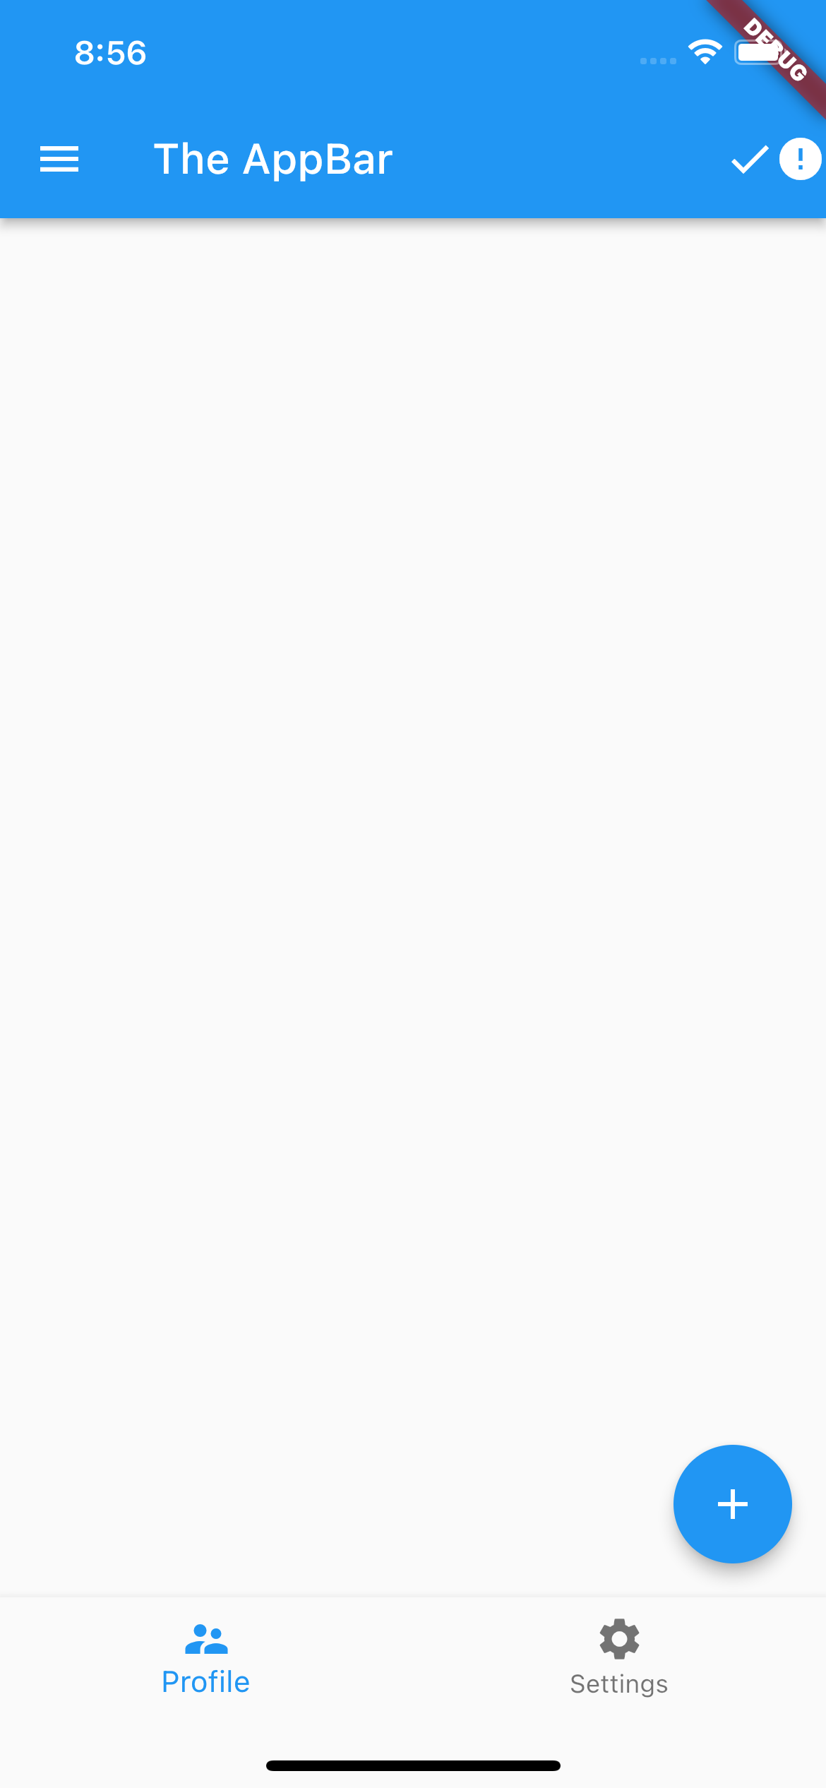
Exercise
Exercise 05.04 (medium)
Starting from the code of exercise 05.03, refactor MyApp so that it becomes a StatefulWidget
Add to the state of MyApp the current list of ListTiles to be displayed in the ListView
Replace the harcoded list of ListTiles with the “state” list just implemented
Note that when the app is reloaded or restarted, the ListView will look empty.

Slide 53
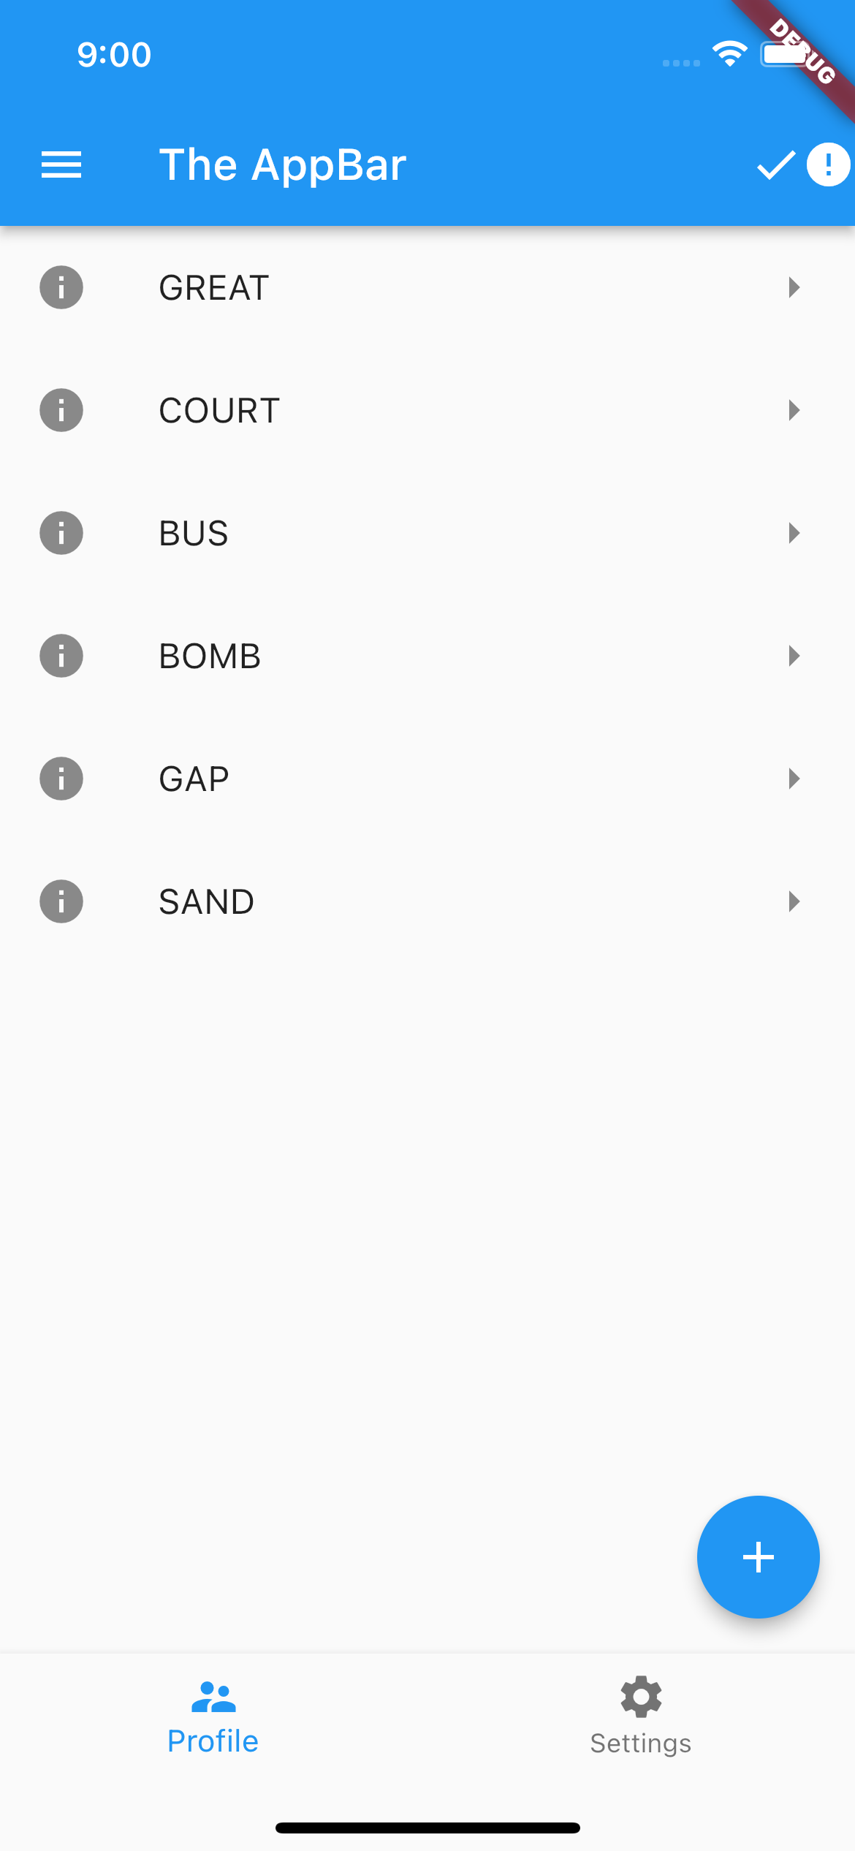
Exercise
Exercise 05.05 (medium-hard)
Modify the code of exercise 05.04 so that when the user pushes the FloatingActionButton on the bottom right, a new ListTile is added to the ListView and displayed to the user.
Hint: ListView has not just 1 but 4 constructurs! ListView.builder could be of help. Look at the docs.

Slide 54
Outline
Recap
Some fundamental Flutter Widgets
Layout in Flutter
App#1: layout_basics
App#2: scaffolding
ListView
Exercise
Homework
Resources

Slide 55
Homework
Get familiar with UI constraints
Get fluent in writing simple UIs

Slide 56
Outline
Recap
Some fundamental Flutter Widgets
Layout in Flutter
App#1: layout_basics
App#2: scaffolding
ListView
Exercise
Homework
Resources

Slide 57
Resources
Material Widgets for UI
https://docs.flutter.dev/development/ui/widgets/material
(Some) Widget for UI Catalog
https://docs.flutter.dev/development/ui/widgets
Flutter Widget list
https://docs.flutter.dev/reference/widgets
Understanding constraints
https://docs.flutter.dev/development/ui/layout/constraints
Layouts in Flutter
https://docs.flutter.dev/development/ui/layout

