Slide 1
Giacomo Cappon
Navigation

Slide 2
Outline
Recap
Navigator
Navigate to a new screen and back
Named routes
Passing argument to a named routes
Returning an argument from a named route
Exercise
Homework
Resources

Slide 3

Recap
Lesson 1
Lesson 5
Lesson 8
Lesson 10
Collaborate and version code
Create a layout
Make simple API calls
Implement user authentication
Lesson 2/3
Lesson 6
Lesson 9
Lesson 11
Get familiar with Dart
Navigate between screens
Fetch wearable data
Persist user data
Lesson 4
Lesson 7
Lesson 12
Understand Flutter’s principles
Manage the app state
Advanced stuff
Milestone #1
Milestone #2
Milestone #3
Do something with your fantasy

Slide 4
Outline
Recap
Navigator
Navigate to a new screen and back
Named routes
Passing argument to a named routes
Returning an argument from a named route
Exercise
Homework
Resources

Slide 5
Navigator
In general, apps are made of multiple screens (called routes)
How to navigate through routes?
How to pass things to routes and get values back from them?
Navigator is a special class that allows to manage all of this

Slide 6
Outline
Recap
Navigator
Navigate to a new screen and back
Named routes
Passing argument to a named routes
Returning an argument from a named route
Exercise
Homework
Resources

Slide 7
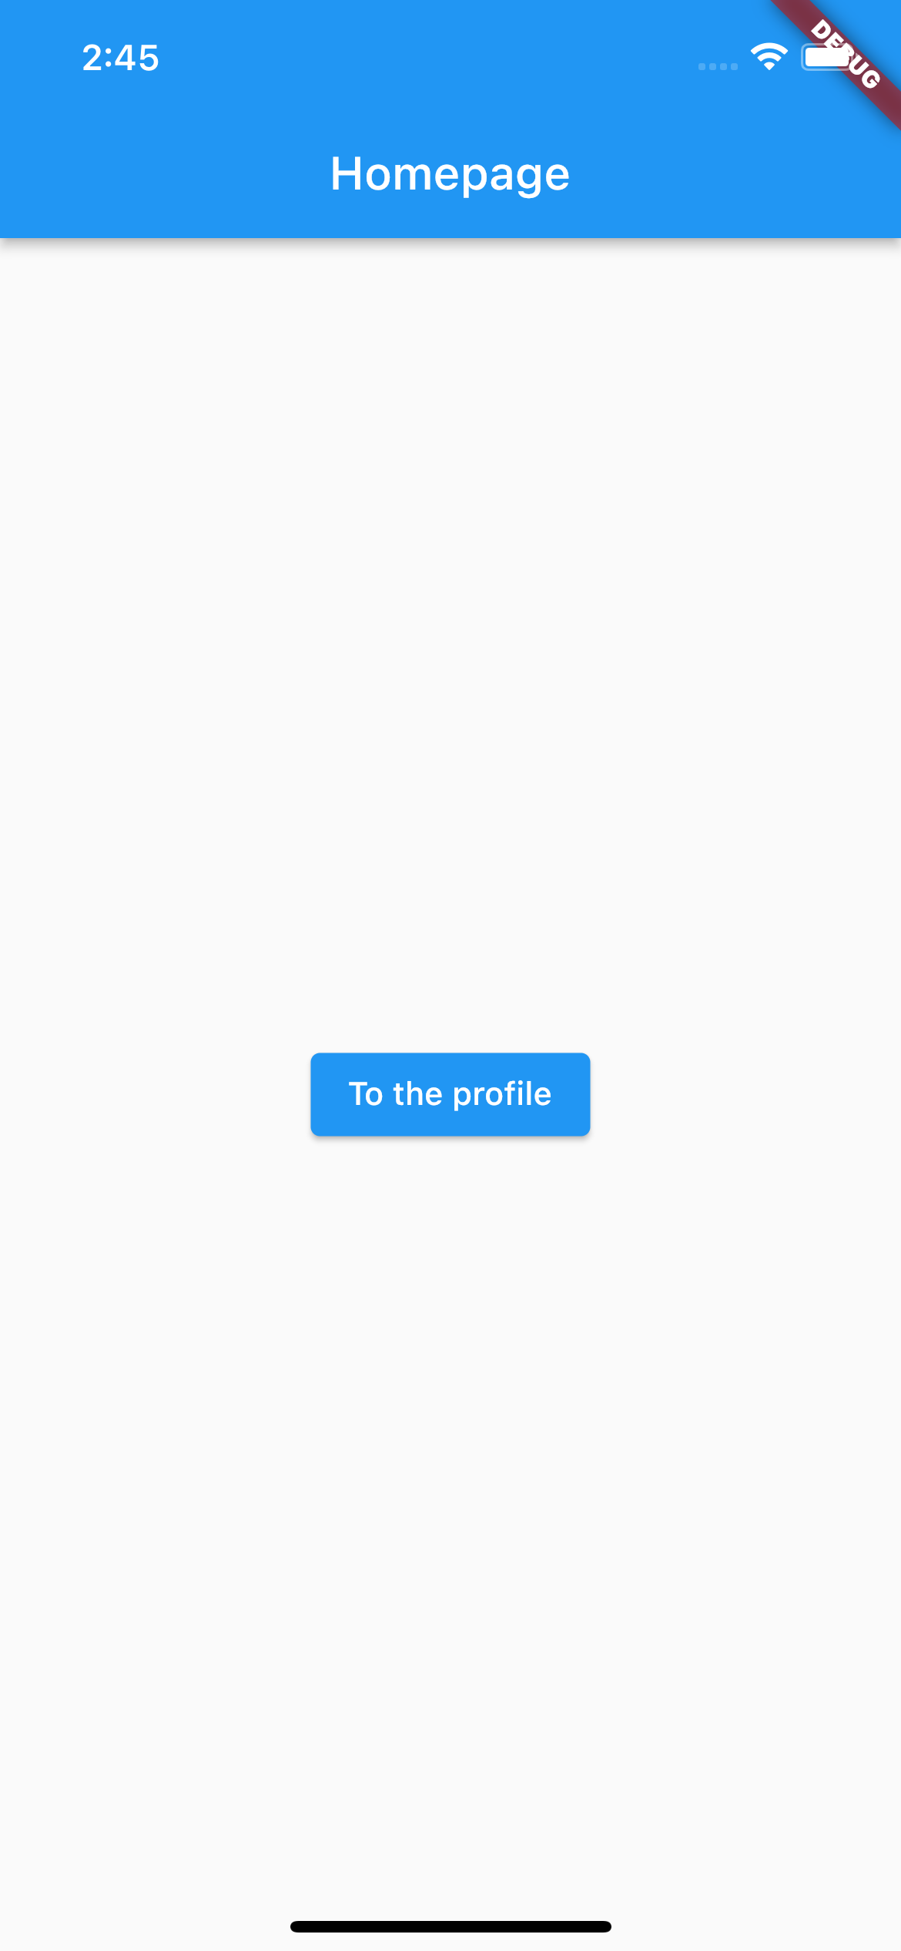
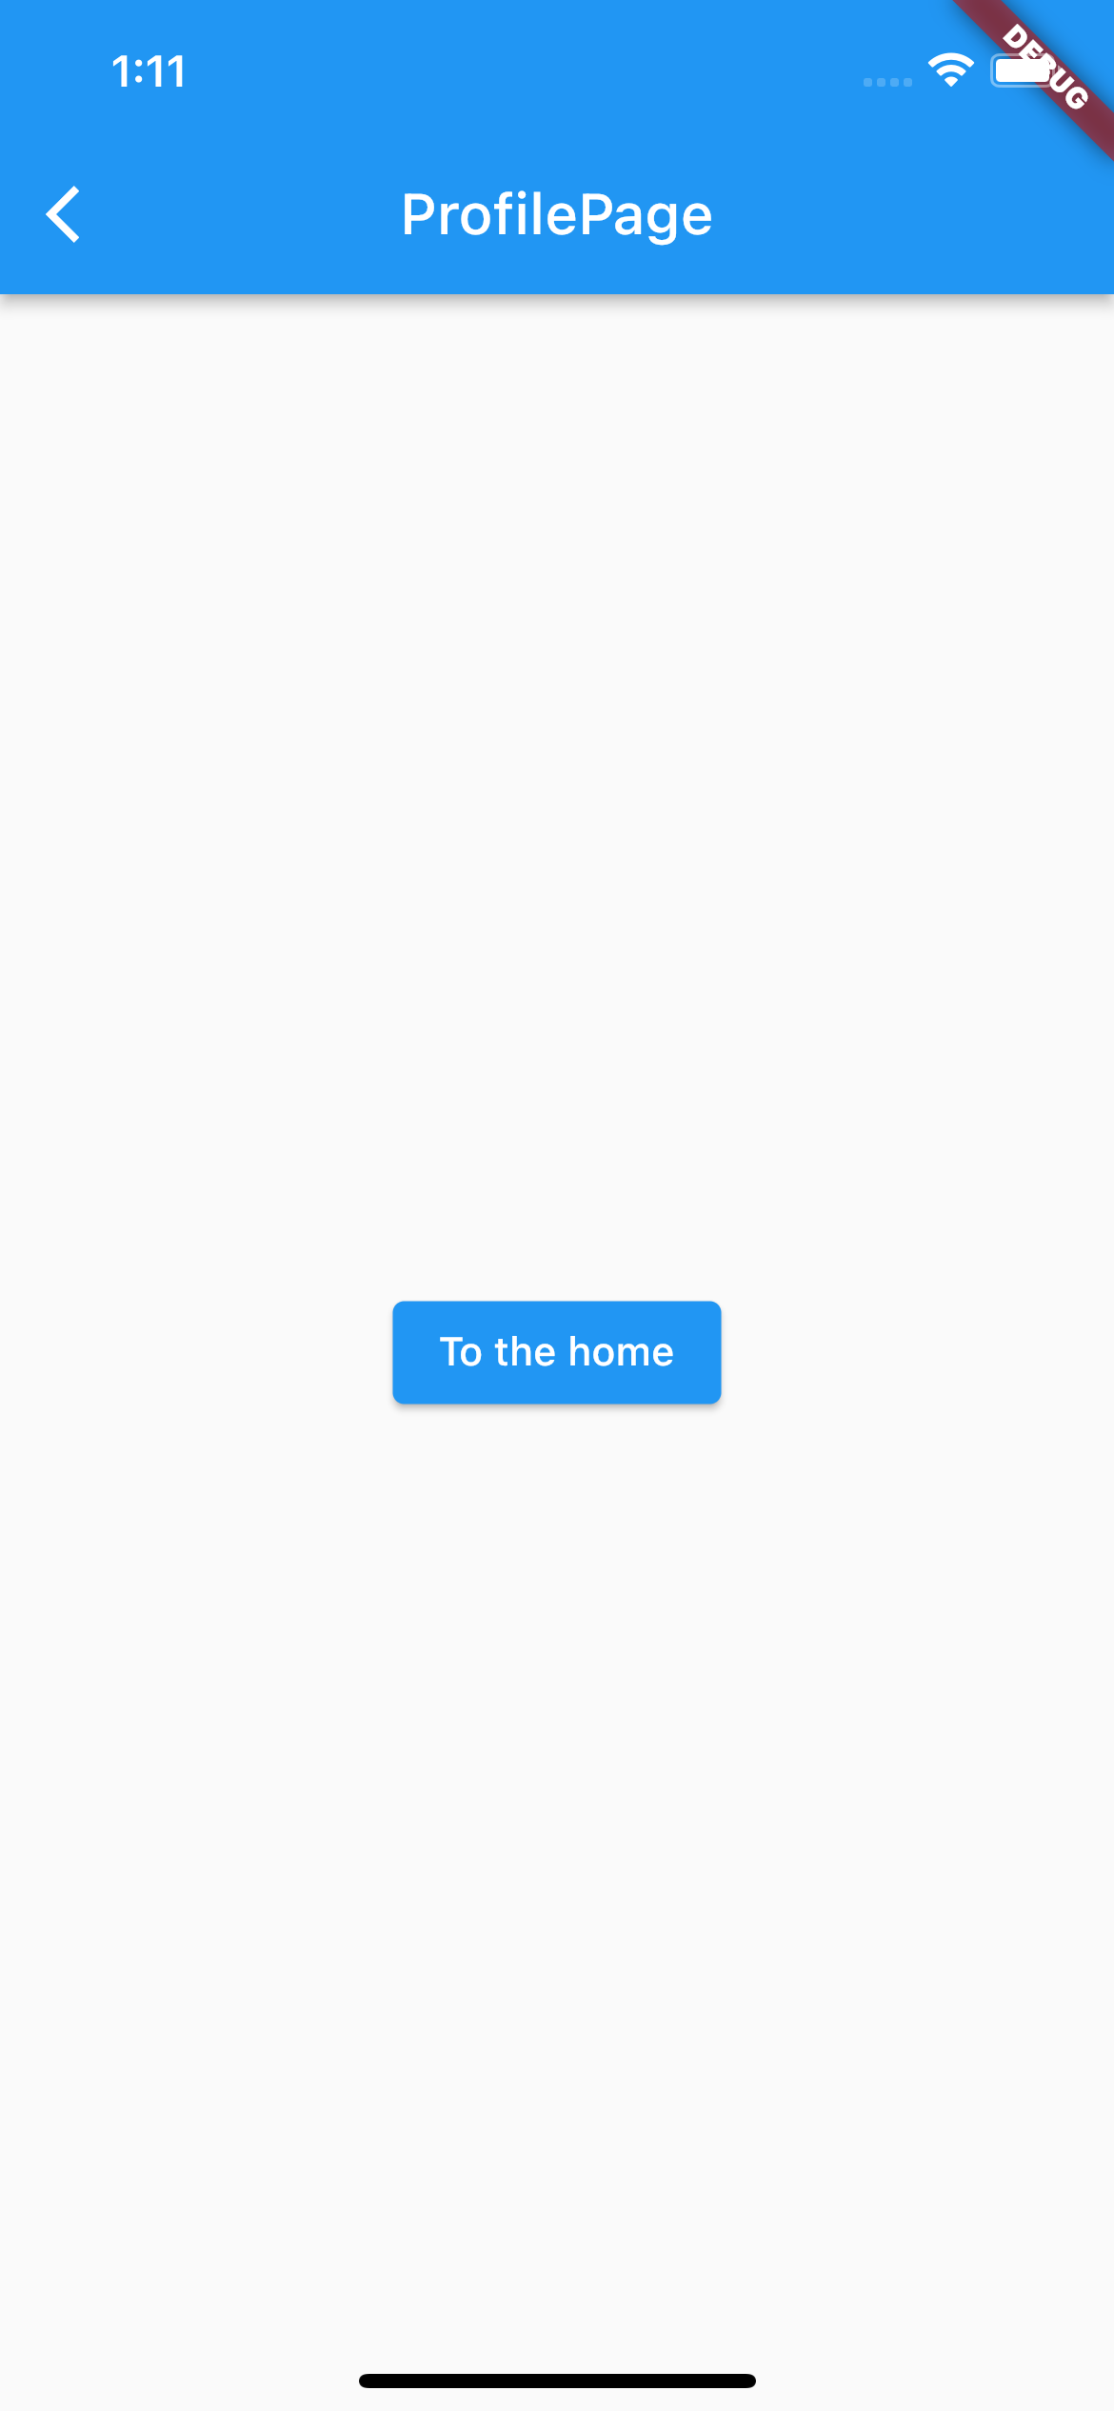
Navigator basics
First let’s see how to move between two routes
We will start from creating a simple two-routes app where the first route will act as homepage and the second will represent the route that will ideally contain the info on the user profile.
When the user taps the button on the homepage it will be directed to the profile page and viceversa

Slide 8
Navigator rationale
Navigator is in charge of managing the navigation through the app
To do so, Navigator uses a stack-like structure. The user sees the “top” of the stack
When you go to a new route, you are ”pushing” it into the stack
When you go back, you are “popping” the route out of the Navigator
Navigation stack
Navigation stack
Navigation stack
ProfilePage
HomePage
HomePage
HomePage
Go to ProfilePage
Go to HomePage
HomePage
ProfilePage
HomePage

Slide 9
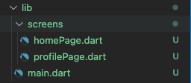
Navigator basics - Preparation
Create a new project called ‘there_and_back_again’
Create the lib/screens/ folder
Create two files in the lib/screens/ folder just created and rename them as ’homePage.dart’ and ‘profilePage.dart’
The project lib folder should look like this:

Slide 10
Navigator basics – homePage.dart boilerplate
import 'package:flutter/material.dart';
class HomePage extends StatelessWidget {
const HomePage({Key? key}) : super(key: key);
static const routename = 'Homepage';
@override
Widget build(BuildContext context) {
return Scaffold(
appBar: AppBar(
title: Text(HomePage.routename),
),
...
...
body: Center(
child: ElevatedButton(
child: Text('To the profile'),
onPressed: () {
//TODO: implement the navigation
},
),
),
);
} //build
} //HomePage

Slide 11
Navigator basics – profilePage.dart boilerplate
import 'package:flutter/material.dart';
class ProfilePage extends StatelessWidget {
const ProfilePage({Key? key}) : super(key: key);
static const routename = 'ProfilePage';
@override
Widget build(BuildContext context) {
return Scaffold(
appBar: AppBar(
title: Text(HomePage.routename),
),
...
...
body: Center(
child: ElevatedButton(
child: Text('To the home'),
onPressed: () {
//TODO: implement the navigation
},
),
),
);
} //build
} //ProfilePage

Slide 12
Navigator basics – main.dart boilerplate
import 'package:flutter/material.dart';
import 'package:there_and_back_again/screens/homepage.dart';
void main() {
runApp(const MyApp());
} //main
class MyApp extends StatelessWidget {
const MyApp({Key? key}) : super(key: key);
@override
Widget build(BuildContext context) {
return MaterialApp(
home: HomePage(),
);
} //build
}//MyApp

Slide 13
Navigator basics – push and pop
To go to the ProfilePage route, simply invoke Navigator.push():
...
onPressed: () {
Navigator.push(context, MaterialPageRoute(builder: (context) => const ProfilePage()));
},
...
Current BuildContext
The new MaterialPageRoute to be pushed into the stack
To pop the ProfilePage route, simply invoke Navigator.pop():
...
onPressed: () {
Navigator.pop();
},
...
Navigation stack
Navigation stack
Navigation stack
ProfilePage
HomePage
Navigator.push()
HomePage
Navigator.pop()
HomePage

Slide 14
Navigator basics – push and pop
Note that you could have used Navigator.push() to go back to the HomePage but this would have been result:
Very messy situation. The stack will grow indefinetely
Navigation stack
Navigation stack
Navigation stack
HomePage
Navigator.push()
Navigator.push()
ProfilePage
ProfilePage
HomePage
HomePage
HomePage

Slide 15
Outline
Recap
Navigator
Navigate to a new screen and back
Named routes
Passing argument to a named routes
Returning an argument from a named route
Exercise
Homework
Resources

Slide 16
Another approach: Named routes
An alternative approach to Navigator.push() is Navigator.pushNamed()
This solution consists of associating names to each route and use the names for navigation
My personal opinion: this is a cleaner approach that leads to better, more readable code
Let’s see how to go for this approach

Slide 17
Named navigation – Preparation
If you want to implement this approach, you need to specify, from the beginning, the name of each route.
This is done via the initialRoute and routes named parameters of MaterialApp:
MaterialApp(
initialRoute: '/’,
routes: {
'/' : (context) => HomePage(),
'/profile/': (context) => ProfilePage(),
},
);
This specifies the app entry point
This maps names to the corresponding routes within the app

Slide 18
Named navigation – pushNamed
To go to the ProfilePage route, now you can invoke Navigator.pushNamed():
...
onPressed: () {
Navigator.pushNamed(context,’/profile/’);
},
...
Current BuildContext
The name of the route to be pushed into the stack
To pop the ProfilePage route, you can still use Navigator.pop():
...
onPressed: () {
Navigator.pop();
},
...
Navigation stack
Navigation stack
Navigation stack
ProfilePage
HomePage
Navigator.pushNamed()
HomePage
Navigator.pop()
HomePage

Slide 19
Outline
Recap
Navigator
Navigate to a new screen and back
Named routes
Passing argument to a named routes
Returning an argument from a named route
Exercise
Homework
Resources

Slide 20
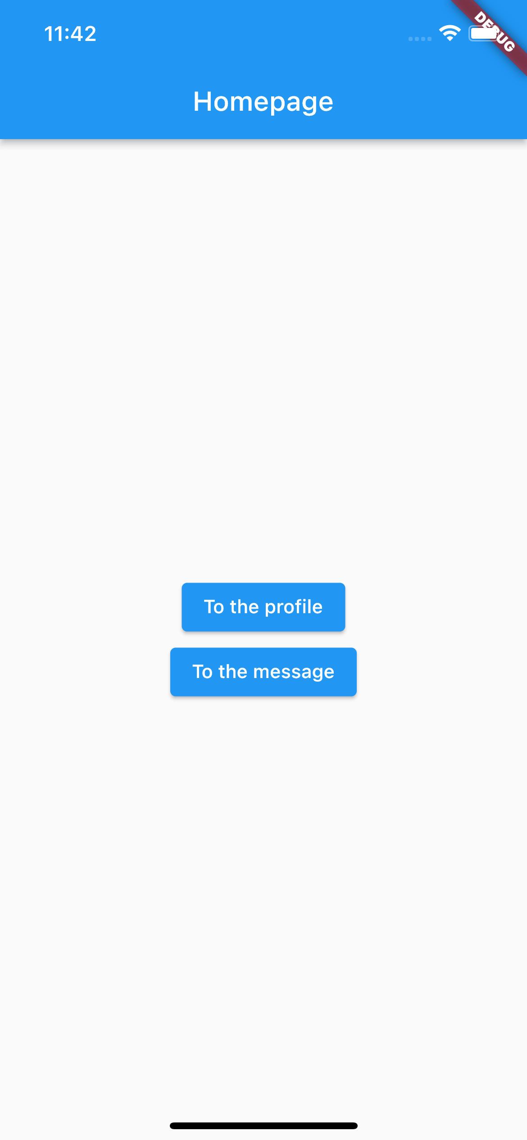
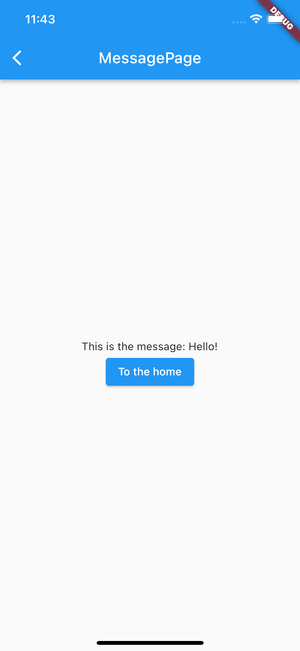
Navigator – Passing an argument
It is (of course) possible to pass arguments to the new route that can be used for several purposes.
To demonstrate how, let’s expand the app with another route MessagePage that will get an argument from the HomePage and will show it in the center of the screen.

Slide 21
Passing arguments – messagePage.dart boilerplate
import 'package:flutter/material.dart';
class MessagePage extends StatelessWidget {
const MessagePage({Key? key}) : super(key: key);
static const routename = 'MessagePage';
@override
Widget build(BuildContext context) {
//TODO: get the message from HomePage
return Scaffold(
appBar: AppBar(
title: Text(MessagePage.routename),
),
...
...
body: Center(
child: Column(
mainAxisAlignment: MainAxisAlignment.center,
children: [
Text(’’), //TODO: put the message inside the Text here
ElevatedButton(
child: Text('To the home'),
onPressed: () {
Navigator.pop(context);
},
),
],
),
),
);
} //build
} // MessagePage

Slide 22
Passing arguments – Add the new route and UI
New route? Let’s add it to the list:
MaterialApp(
initialRoute: '/’,
routes: {
'/' : (context) => HomePage(),
'/profile/': (context) => ProfilePage(),
‘/message/': (context) => MessagePage(),
},
);
To do: add a button in the HomePage to navigate to MessagePage

Slide 23
Passing arguments
To pass an argument to the MessagePage route, now you can invoke Navigator.pushNamed() as:
...
onPressed: () {
Navigator.pushNamed(context,’/message/’, arguments: ‘Hello!’);
},
...
Current BuildContext
The arguments to be passed
The name of the route to be pushed into the stack
Note that you can pass ANYTHING as argument, not just a String.

Slide 24
Retrieving arguments
To retrieve the argument from the MessagePage route side you can use a ModalRoute as:
...
final message = ModalRoute.of(context)!.settings.arguments! as String;
...
To figure out what this is, you can imagine that as a utility that stands between the prevoius route (here HomePage) and the current one (here MessagePage). For details see: https://api.flutter.dev/flutter/widgets/ModalRoute-class.html
Arguments is an Object? But you know this is a String, so parse it explicitely!
We put the ! here to force the non-null type.
Then we display the retrieved argument by simply:
...
Text('This is the message: $message’),
...

Slide 25
Outline
Recap
Navigator
Navigate to a new screen and back
Named routes
Passing argument to a named routes
Returning an argument from a named route
Exercise
Homework
Resources

Slide 26
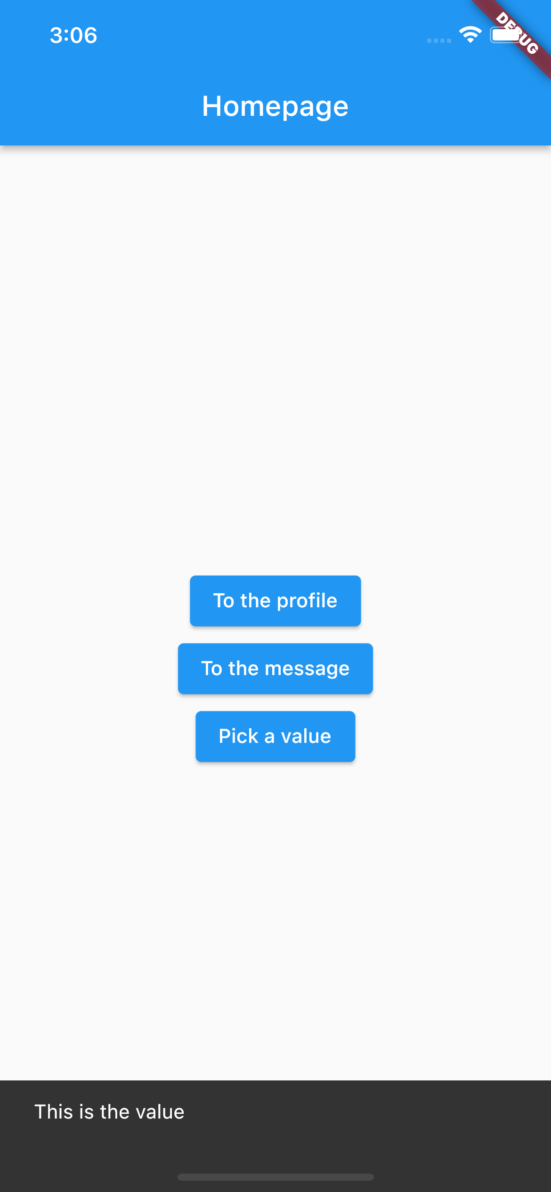
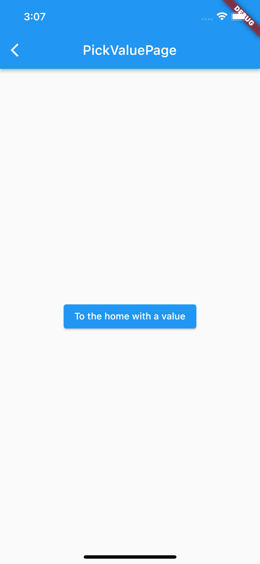
Navigator – Returning data
It is (of course) also possible to return data from a route.
To demonstrate how, let’s expand the app with another route PickValuePage that will provide a value to the HomePage which will be in charge of showing it via a ScaffoldMessenger.

Slide 27
Returning data – pickValuePage.dart boilerplate
import 'package:flutter/material.dart';
class PickValuePage extends StatelessWidget {
const PickValuePage({Key? key}) : super(key: key);
static const routename = ‘PickValuePage';
@override
Widget build(BuildContext context) {
return Scaffold(
appBar: AppBar(
title: Text(PickValuePage.routename),
),
...
...
body: Center(
child: ElevatedButton(
child: Text('To the home'),
onPressed: () {
//TODO: implement the navigation + return the data
},
),
),
);
} //build
} //PickValuePage

Slide 28
Returning data – Add the new route
New route? Let’s add it to the list:
MaterialApp(
initialRoute: '/’,
routes: {
'/' : (context) => HomePage(),
'/profile/': (context) => ProfilePage(),
‘/message/': (context) => MessagePage(),
‘/pickValue/': (context) => PickValuePage(),
},
);

Slide 29
Returning arguments
To return an argument to the HomePage route, you can invoke Navigator.pop() as:
...
onPressed: () {
Navigator.pop(context, 'This is the value');
},
...
The value that will return to the HomePage once PickValuePage is popped out from the stack
Note that you can return ANYTHING, not just a String.

Slide 30
Returning arguments
To get the result, the HomePage must be patient and await for it::
Await means async stuff. The onPressed function become asynchronous as well so…
...
onPressed: () async {
final result = await Navigator.pushNamed(context, '/pickValue/');
ScaffoldMessenger.of(context)
..removeCurrentSnackBar()
..showSnackBar(SnackBar(content: Text('$result')));
},
...
Full example in lab_06-navigation/there_and_back_again/

Slide 31
Outline
Recap
Navigator
Navigate to a new screen and back
Named routes
Passing argument to a named routes
Returning an argument from a named route
Exercise
Homework
Resources

Slide 32
Exercise
Exercise 06.01 (easy)
Create a new project ‘reproduce_structure’
Reproduce the app navigation structure on the right using the named routing approach.
LoginPage
HomePage
ProfilePage
CalendarPage
EditProfilePage
EditEventPage

Slide 33
Exercise
Exercise 06.02 (medium)
Create a new project ‘login_flow’
Reproduce the app navigation structure on the right using the named routing approach.
The login page consists of a form with two textboxes (one for the username and the other for the password) and a button. Hint: you can use the widgets
When the user types “bug@expert.com” in the username textbox and “5TrNgP5Wd” in the password textbox, and taps the button, the user is redirected to the Homepage. If the credentials are wrong, a ScaffoldMessenger is showed for 2 seconds saying “Wrong credentials”.
The HomePage must show the provided username.
LoginPage
HomePage

Slide 34
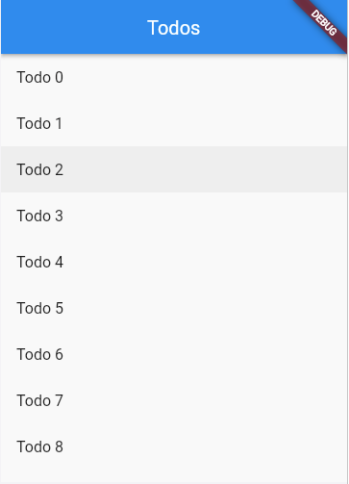
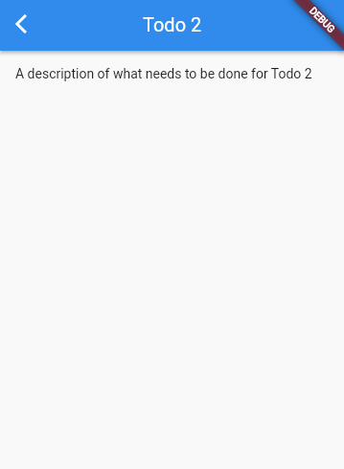
Exercise
Exercise 06.03 (medium)
Follow the cookbook https://docs.flutter.dev/cookbook/navigation/passing-data by the Flutter team to learn how to pass data to a route directly to its constructor.
(solution available from the Flutter team in the cookbook)

Slide 35
Outline
Recap
Navigator
Navigate to a new screen and back
Named routes
Passing argument to a named routes
Returning an argument from a named route
Exercise
Homework
Resources

Slide 36
Homework
Get familiar with Navigator

Slide 37
Outline
Recap
Navigator
Navigate to a new screen and back
Named routes
Passing argument to a named routes
Returning an argument from a named route
Exercise
Homework
Resources

Slide 38
Resources
Navigation Recipes
https://docs.flutter.dev/cookbook/navigation

