Slide 1
Giacomo Cappon
Linking State Management With Networking

Slide 2
Outline
Recap
Linking state management with networking
Exercise

Slide 3

Recap: Provider (core) flow
ClassImplementingChangeNotifier
Lesson 7
ChangeNotifierProvider
Inject an instance to
Child widget tree
notifyListeners() is called
Consumer
Flutter calls builder method

Slide 4

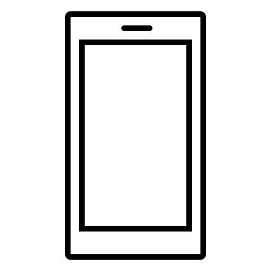

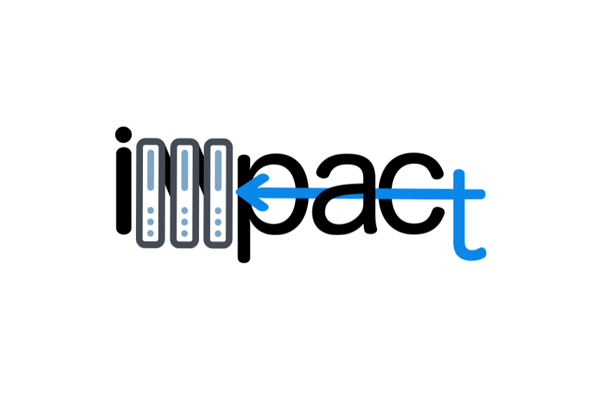


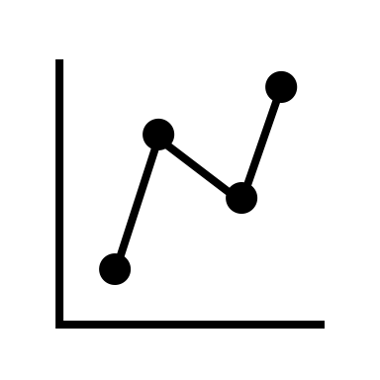
Recap: Communicating with IMPACT
HTTPS requests/responses
Lesson 9
Get token (JWT) using credentials
(If credentials are ok) Receive token
Ask for specific data using token
(If request is ok) Receive data (JSON format)
https://impact.dei.unipd.it/bwthw/
Your app
Lesson 10

Slide 5
Recap: The networking flow
Use credentials to ask for a JWT token pair
Lesson 8
Receive JWT token pair
Store token pair for making calls
Access token expired?
YES
NO
YES
Refresh token expired?
Make a call to get data using access token
NO
Get a new token pair using the refresh token and store it

Slide 6
Outline
Recap
Linking state management with networking
Exercise

Slide 7
Linking state management with networking: simplified schema
WHAT
WHERE
HOW
“Event” that asks to fetch data
Many options, e.g., using a button, automatically done if something happen…
Everywhere in your application
Create request and get the response
In a class dedicated to communicate with IMPACT
<See lesson 9 and 10>
“Manage” response
In the provider (the class that is extending ChangeNotifier)
<See lesson 9 and 10>
Trigger the builders
In the provider (the class that is extending ChangeNotifier)
Calling notifyListeners()
Rebuild the UI
Everywhere in your application (where needed)
Using Consumer

Slide 8
Linking state management with networking: detailed schema
ClassImplementingChangeNotifier
Store token pair for making calls
Receive JWT token pair
ChangeNotifierProvider
Use credentials to ask for a JWT token pair
“Event” that asks to fetch data
Inject an instance to
notifyListeners() if needed
YES
YES
Child widget tree
Refresh token expired?
Access token expired?
NO
Consumer
Get a new token pair using the refresh token and store it
NO
Make a call to get data using access token
Flutter calls builder method
”Manage” response

Slide 9
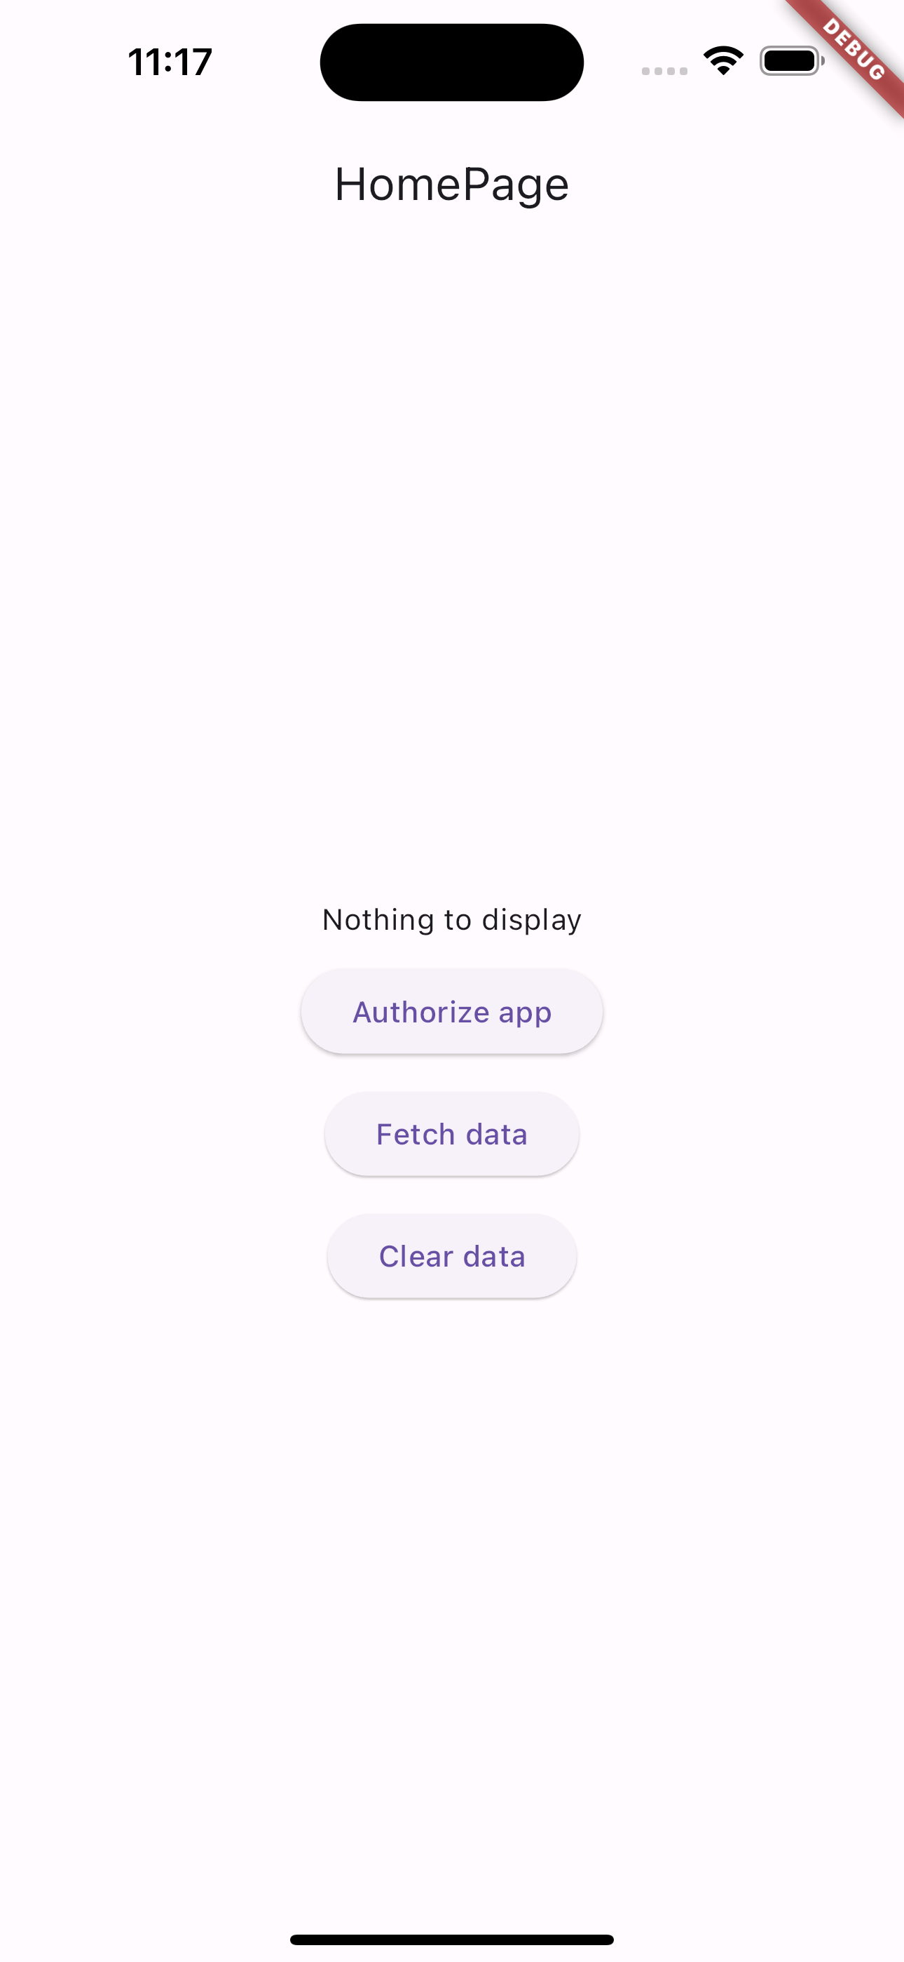
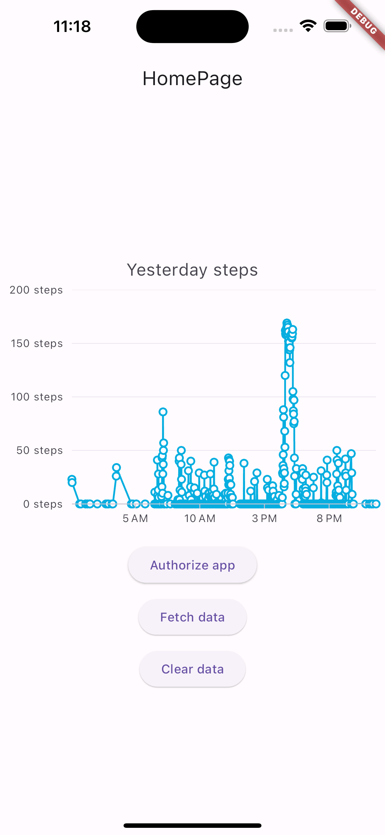
Case of study - Live
Let’s implement a simple application that, after tapping a button, generates a plot showing yesterday’s steps.
Full example in lab_11-linking_state_management_with_networking/visualize_step/

Slide 10
Outline
Recap
Linking state management with networking
Exercise

Slide 11
Exercise
Get familiar with the example

Slide 12
Outline
Recap
Linking state management with networking
Exercise

