Slide 1
Regulation on data protection

Slide 2

Privacy
Privacy: the right to a private life, to be autonomous, in control of information about yourself, to be let alone.
Almost every country in the world recognises privacy in some way.
Privacy recognised as a universal human right.
Universal Declaration of Human Rights (Article 12)
European Convention of Human Rights (Article 8)
European Charter of Fundamental Rights (Article 7).

Slide 3
Data protection
The European Charter of Fundamental Rights (Article 8) contains an explicit right to the protection of personal data.
Data protection → ensure the fair processing (collection, use, storage) of personal data by public and private sectors.
Personal data: any information related to an identified or identifiable natural (living) person
Identifiable natural person: one who can be identified, directly or indirectly, by an identifier such as a name, an identification number, location data, etc.
Examples of personal data:
Names, dates of birth, photographs, email addresses and telephone numbers
IP addresses and communication content related to or provided by end-users of communications services

Slide 4

General Data Protection Regulation (GDPR)
New regulation for data protection adopted by the EU in 2016.
GDPR is the most comprehensive and progressive data protection regulation worldwide.
Each EU member state adopted a national regulation on data protection that is compliant with the GDPR.
Italian law: DECRETO LEGISLATIVO 10 agosto 2018, n. 101. Disposizioni per l'adeguamento della normativa nazionale alle disposizioni del regolamento (UE) 2016/679 del Parlamento europeo e del Consiglio, del 27 aprile 2016, relativo alla protezione delle persone fisiche con riguardo al trattamento dei dati personali, nonchè alla libera circolazione di tali dati e che abroga la direttiva 95/46/CE (regolamento generale sulla protezione dei dati).
The GDPR also applies to entities not established in the EU who offer goods and services to individuals in the EU or monitor their behaviour.

Slide 5
GDPR
The GDPR substituted the 1995 Data Protection Directive, adopted when there was no massive use of the Internet.
Over the last 25 years, technology has transformed our lives in ways nobody could have imagined so a review of the rules was needed.
The GDPR reinforces a wide range of existing rights and establishes new ones
Example: the right to erasure (right to be forgotten) → You can request at any time that an organisation delete all your personal data

Slide 6
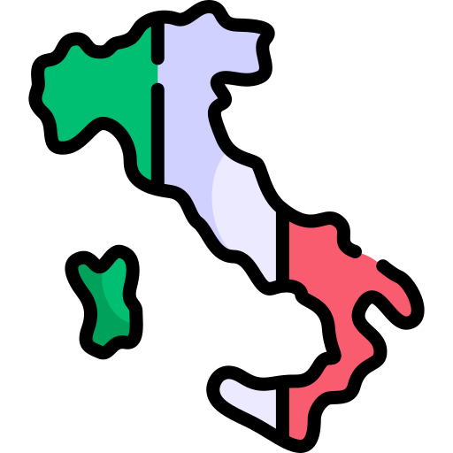
Living and dead individuals
The GDPR only applies to the personal data related to an identifiable living individual.
Information relating to a dead person is not subject to the GDPR.
Single member states are allowed to define their own rules for the protection of dead people.
Italy has extended the application of the GDPR to dead people with the regulation Decreto Legislativo 101/2018.

Slide 7

The ”actors”
Data subject: the person whose personal data are collected, held or processed.
Data controller: the natural or legal person, public authority, agency or other body which, alone or jointly with others, determines the purposes and means of the processing of personal data.
It is the official responsible for data protection.
The actual processing may be delegated to another party, called the data processor.
Data processor: a natural or legal person, public authority, agency or other body which processes personal data on behalf of the controller.
The processor only acts "on behalf of the controller" subject to his instructions.
The processor may have recourse to a subcontractor who processes the data on his behalf.
Recipient: a natural or legal person, public authority, agency or another body, to which the personal data are disclosed.
Data protection officer (DPO): expert in data protection regulation and practices. Guarantees that the GDPR directives are followed and acts as a point of contact with the Data Protection Authorities.

Slide 8

Data Protection Authorities
National Data Protection Authorities (DPAs) or Regulators have been established to be the guardians of data protection.
The Italian one is: Garante per la protezione dei dati personali (http://www.garanteprivacy.it/)
DPAs have the power to investigate, detect and punish violations of data protection rights and obligations.
In the EU, DPAs must be independent of any political, governmental or other influence.
European Data Protection Supervisor (EDPS): independent supervisory authority responsible for ensuring that EU institutions and bodies comply with data protection law when processing personal data.

Slide 9

Restrictions to the application of GDPR
In the EU, privacy and data protection are not absolute rights and can be limited under certain conditions according to the EU Charter of Fundamental Rights.
Need to balance the rights to privacy against other EU values, human rights (e.g., right to freedom of expression), public and private interests (e.g., right to freedom of press), and national security.
GDPR not applicable if data are used for the purposes of prevention, investigation, detection or prosecution of criminal offences.
DPAs ensure the balance between privacy and other interests.

Slide 10
Pseudonymised and anonymised data
Pseudonymisation: a technique that replaces or removes information that identifies an individual.
GDPR definition: “…the processing of personal data in such a manner that the personal data can no longer be attributed to a specific data subject without the use of additional information, provided that such additional information is kept separately and is subject to technical and organisational measures to ensure that the personal data are not attributed to an identified or identifiable natural person.”
Example of pseudonymisation: replacing names and other identifying attributes with a unique identifier.
The data controller can still match the unique identifier to the individual having access to relevant additional information.
Technical measures must be used to ensure that this additional information is held separately and no one apart the authorized people can retrieve it.
Pseudonymisation help protecting the privacy of subjects’ identity.
Remember: Pseudonymised data are still personal data → subject to GDPR.

Slide 11
Pseudonymised and anonymised data
Anonymisation: a technique that eliminates all the information that identifies an individual.
“…The principles of data protection should therefore not apply to anonymous information, namely information which does not relate to an identified or identifiable natural person or to personal data rendered anonymous in such a manner that the data subject is not or no longer identifiable. This Regulation does not therefore concern the processing of such anonymous information, including for statistical or research purposes.”
If at any point we realise that some information allows to re-identify individuals, data should be considered as pseudonymised.
Remember: The GDPR does not apply to personal data that has been anonymised.

Slide 12


GDPR: seven main principles
Lawfulness, fairness and transparency: Personal data shall be processed lawfully, fairly and in a transparent manner in relation to the data subject.
Identify valid grounds under GDPR (known as a ‘lawful basis’) for collecting and using personal data.
Purpose limitation: Personal data shall be collected for specified, explicit and legitimate purposes and not further processed in a manner that is incompatible with those purposes.
Purposes for processing must be clear from the start
Further processing for archiving purposes in the public interest, scientific or historical research purposes or statistical purposes are not considered to be incompatible with the initial purposes

Slide 13

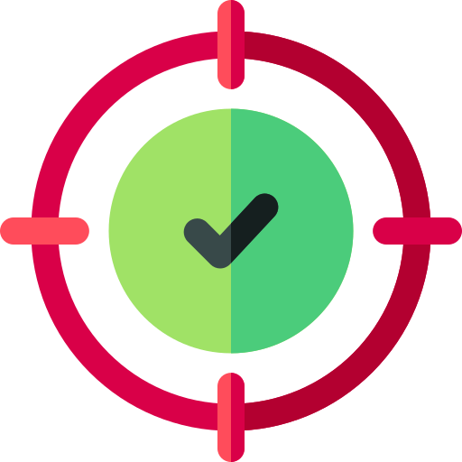

GDPR: seven main principles
Data minimisation: Personal data shall be adequate, relevant and limited to what is necessary in relation to the purposes for which they are processed.
Accuracy: personal data must be accurate and, where necessary, kept up to date.
Personal data that are inaccurate must be erased or rectified without delay.
Storage limitation: personal data shall be stored in a form which permits identification of data subjects for no longer than is necessary for the purposes for which they are processed.
Personal data may be stored for longer periods only if they are processed for archiving purposes in the public interest, scientific/historical research purposes or statistical purposes.

Slide 14

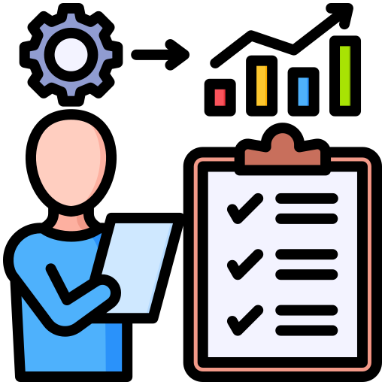
GDPR: seven main principles
Integrity and confidentiality: appropriate security of the personal data must be ensured using appropriate technical security measures.
Protection against unauthorised or unlawful processing and against accidental loss, destruction or damage.
Accountability: The controller shall be responsible for, and be able to demonstrate compliance with the principles of the GDPR.

Slide 15

Data subjects rights under GDPR
The right to be informed
Right to be informed about the collection and use of their personal data.
The right of access
Right to access and receive a copy of their personal data, and other supplementary information, including the purpose and period of processing.
The right to rectification
Right to have inaccurate personal data rectified or completed.
The right to erasure (‘right to be forgotten’)
Right to have personal data erased.
The right to object
Right to object to the processing of personal data in certain circumstances.

Slide 16
Data subjects rights under GDPR
The right to restrict processing
Right to request the restriction or suppression of their personal data. When processing is restricted, the controller can store the data, but not use it.
The right to data portability
Right to move, copy or transfer personal data easily to another controller.
Rights not to be subject to automated decision making and profiling.
Right not to be subject to a decision based solely on automated processing, including profiling, which significantly affects him or her.
Profiling: use of personal data to evaluate or predict certain personal aspects relating to a person, e.g., performance at work, economic situation, health, personal preferences, interests, position…

Slide 17

Data protection by design and by default
Data protection by design:
The controller shall implement appropriate technical and organisational measures, e.g., pseudonymisation, which are designed to implement data-protection principles, in an effective manner.
Data protection by default:
The controller shall implement appropriate technical and organisa­tional measures for ensuring that, by default, only personal data which are necessary for each specific purpose of the processing are processed.
Notes:
Privacy by Design: Si tratta di un approccio proattivo alla protezione della privacy che si concentra sull'integrazione della privacy fin dalla fase di progettazione di sistemi, applicazioni o servizi. L'idea è di considerare la privacy come un fattore chiave sin dall'inizio del processo di sviluppo anziché come un'aggiunta successiva o un'opzione aggiuntiva. Ciò significa che vengono prese in considerazione le implicazioni sulla privacy in ogni aspetto del design, dall'architettura del sistema alla gestione dei dati e alle interfacce utente. L'obiettivo è quello di garantire che i dati personali siano trattati in modo sicuro e trasparente fin dall'inizio, riducendo così il rischio di violazioni della privacy in seguito.
Privacy by Default: Questo concetto si concentra sulla configurazione predefinita dei sistemi e dei servizi per massimizzare la protezione della privacy degli utenti. In pratica, significa che le impostazioni predefinite dovrebbero essere progettate per garantire il massimo livello di privacy possibile, senza richiedere agli utenti di apportare modifiche o regolazioni aggiuntive per proteggere le proprie informazioni personali. Ad esempio, un'applicazione potrebbe essere progettata in modo tale che le impostazioni predefinite limitino la raccolta e l'uso dei dati personali solo al minimo necessario per il funzionamento dell'applicazione stessa, con opzioni per gli utenti di concedere consensi espliciti per finalità aggiuntive.

Slide 18
Security measures
Techniques for the pseudonymisation and encryption of personal data
Techniques to ensure confidentiality, integrity, availabil­ity and resilience of processing systems and services
Techniques to restore the availability and access to personal data in a timely manner in the event of a physical or technical incident
Techniques for regularly testing, assessing and evaluating the effec­tiveness of security measures

Slide 19

Lawful basis for data processing under GDPR
The processing of personal data is lawful if at least one of the following applies:
Consent: the data subject has given clear consent for processing his or her personal data for a specific purpose.
Contract: the processing is necessary for a contract you have with the individual.
Legal obligation: the processing is necessary to comply with a legal obligation to which the controller is subject.
Vital interests: the processing is necessary to protect someone’s life.
Public task: the processing is necessary for performing a task in the public interest.
Legitimate interests: the processing is necessary for your legitimate interests or the legitimate interests of a third party, unless there is a good reason to protect the individual’s personal data which overrides those legitimate interests.
Data controllers and processors are required to provide information about the lawful basis for processing usually through a privacy notice.

Slide 20
Consent
Lawful basis based on consent → the controller shall be able to demonstrate that the data subject has consented to processing of his or her personal data.
Consent: any freely given, specific, informed and unambiguous indication of the data subject's wishes by which he/she agrees to the processing of his/her personal data.
The request for consent must be clear and presented using plain language.
The data subject has the right to withdraw his or her consent at any time.
Withdrawing the consent should be as easy as giving the consent.

Slide 21

Information to be provided before personal data collection
The identity and the contact details of the controller
The contact details of the data protection officer (if applicable)
The categories of personal data concerned
The purposes of the processing and the legal basis for the processing
The recipients of the personal data, if any
If applicable, intention to transfer personal data to a third country or international organisation and the existence/absence of an adequacy decision by the European Commission.
The period for which the personal data will be stored, or the criteria used to determine that period.

Slide 22
Information to be provided before personal data collection
The existence of the right to request:
access to the personal data
rectification of the personal data
erasure of personal data
restriction of processing of personal data
The right to withdraw consent at any time
The right to raise a complaint with a supervisory authority
If the provision of personal data is a contractual requirement, the possible consequences of failure to provide such data
The existence of automated decision-making, including profiling, and information about the logic involved and the consequences of such profiling

Slide 23
Example: Informed consent form for participating in a research trial
Planning a research trial in which you collect some personal data.
Each participant must provide an explicit consent by which they agree with you processing their data for the purpose of the research.
Information sheet: document to share the information of the research trial.
Consent form: form by which the subject provides the consent and agree to participate in the study.

Slide 24
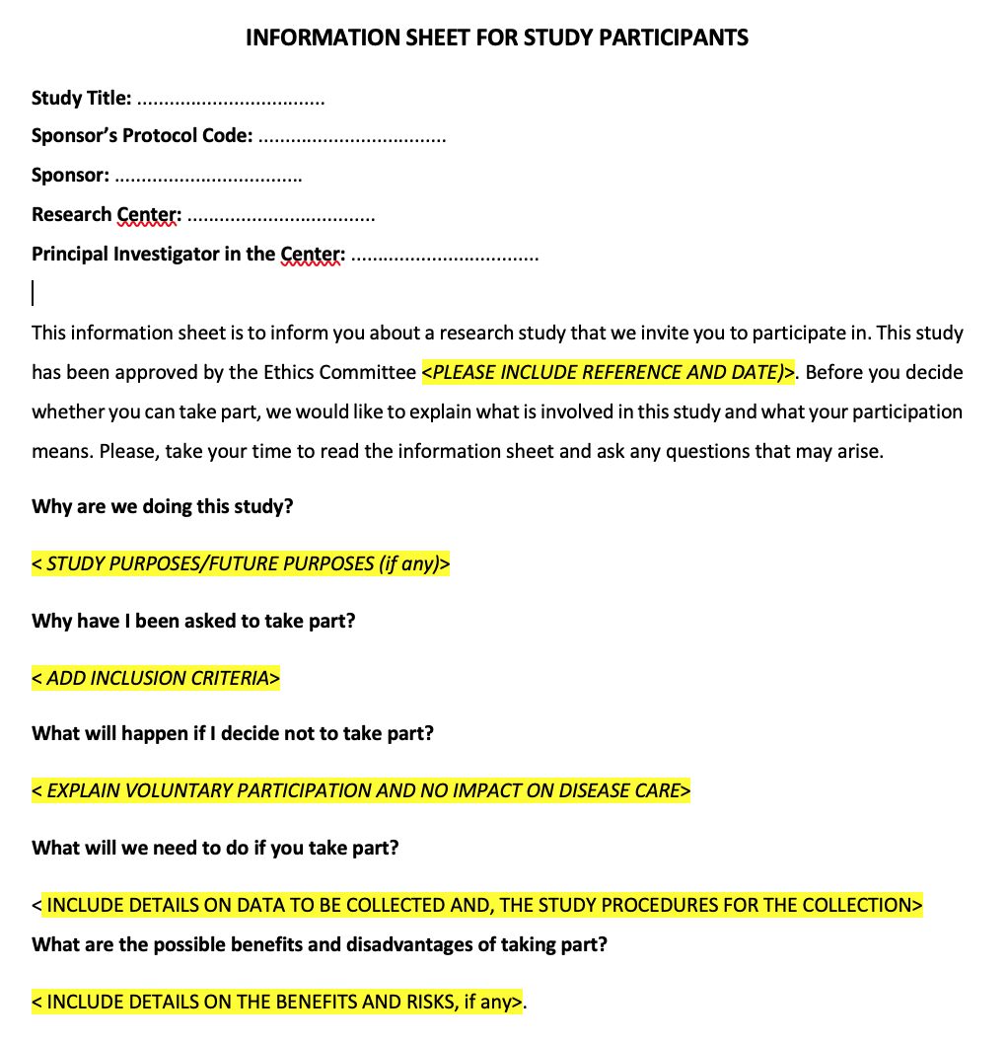
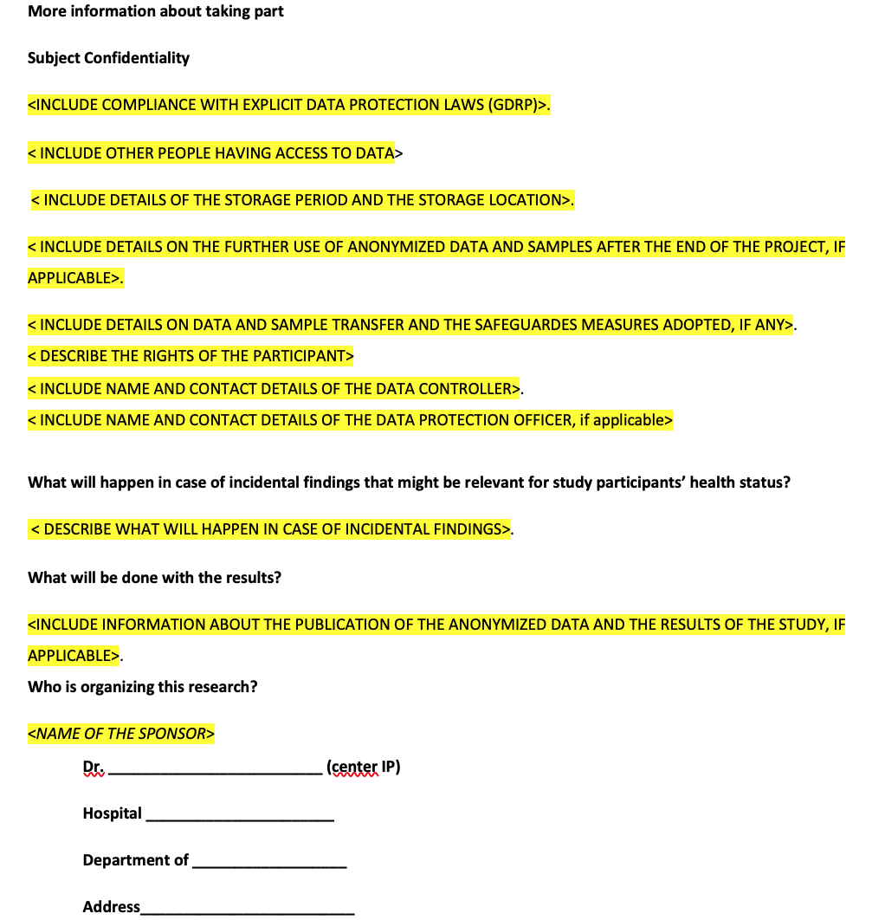
Example of an information sheet template

Slide 25
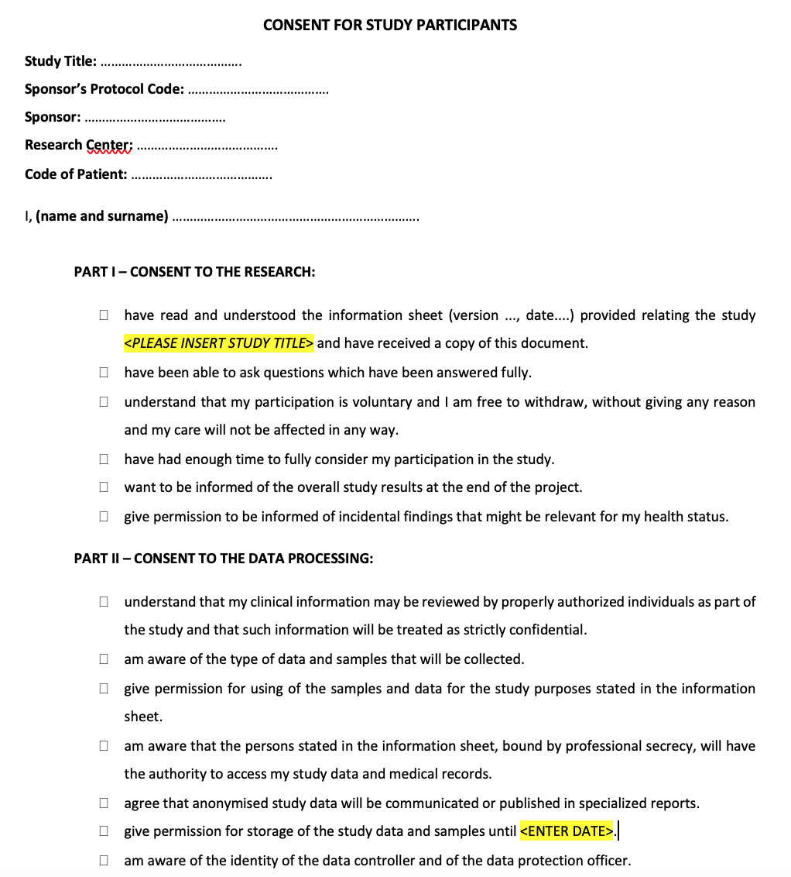
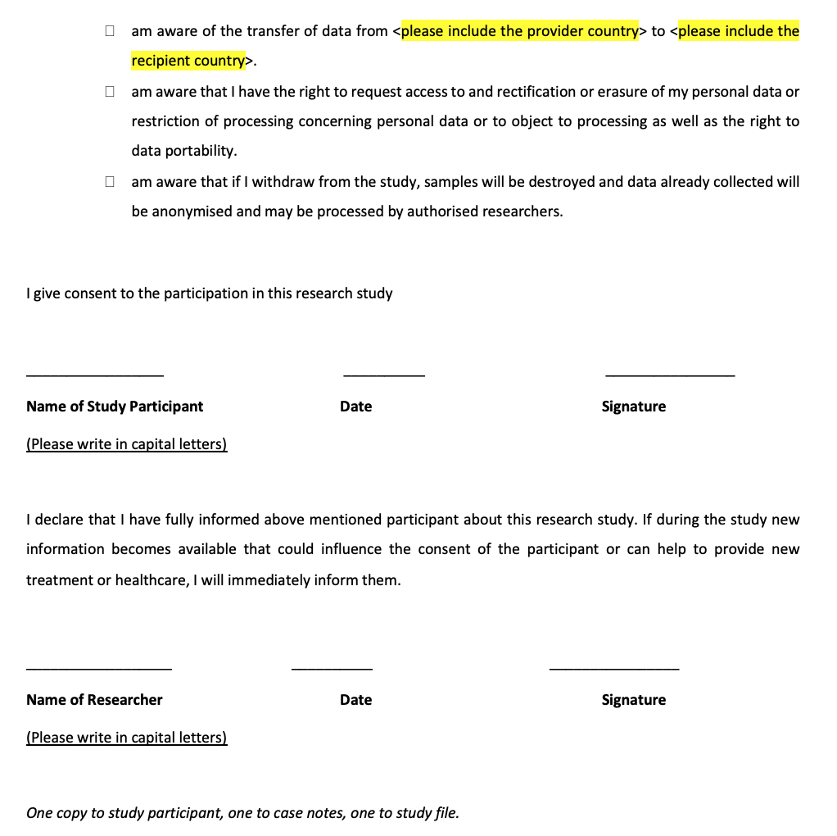
Example of a consent form template

Slide 26

Websites using cookies and GDPR
HTTP cookies: small blocks of data created by a Web server while a user is browsing a website, needed for some crucial functions of browsers (e.g., to track the session state).
Cookies can store enough data to potentially identify the user without his/her consent.
Used by advertisers to track users’ online activity so that they can target them with highly specific advertisements.
They can be considered personal data subject to GDPR!
Compliance with the GDPR imposes that Web servers using cookies must:
receive users’ consent before using any cookies except those that are strictly necessary;
provide accurate and specific information about the data each cookie tracks and its purpose in plain language before consent is received;
document and store user consent;
allow users to access the service even if they refuse the use of certain cookies;
allow easy withdrawal of consent.

Slide 27
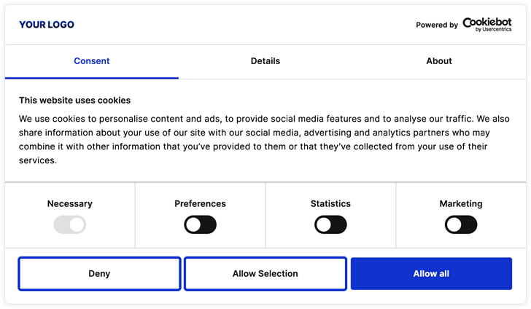
Example of an informed consent form for the use of cookies

Slide 28
Special categories of personal data (Art 9)
Personal data revealing:
racial or ethnic origin
political opinions
religious or philosophical beliefs
trade union membership
data concerning physical or mental health
data concerning sexual life or sexual orientation
genetic data or biometric data (physical, physiological or behavioural characteristics which allow or confirm the unique identification of a person
The processing of these kind of data shall be prohibited.

Slide 29
Conditions for use of special categories of personal data
Exceptions in which special personal data can be processed exist:
the data subject gives explicit consent to the processing of those personal data;
processing is necessary for carrying out the obli­gations and exercising specific rights of the controller or of the data subject;
processing is necessary to protect the vital interests of the data subject or of another person and the data subject is physically or legally incapable of giving consent;
processing is done within an organization for legitimate purposes, solely for members of the organization, and data are not disclosed outside the organization without the consent of the data subject;
the personal data are manifestly made public by the data subject;
…

Slide 30
Conditions for use of special categories of personal data
…
processing is necessary for the establishment, exercise or defence of legal claims;
processing is necessary for reasons of public interest;
processing is necessary for the purposes of preventive or occupa­tional medicine, for the assessment of the working capacity of the employee, medical diagnosis, the provision of health or social care or treatment or the management of health or social care systems;
processing is necessary for reasons of public health, such as protecting against serious cross-border threats to health;
processing is necessary for archiving purposes in the public interest, scientific or historical research purposes or statistical purpose.

Slide 31

Records of processing activities
Each controller shall maintain a record of processing activities under its responsibility (including name of the controller; purpose of processing; security measures adopted;…)
Each processor shall maintain a record of processing activities carried out on behalf of the controller (including name the processor and of the controller; purpose of processing; security measures adopted;…)

Slide 32
Secondary use of the personal data
Secondary use of the personal data: the controller intends to further process the personal data for a purpose other than that for which the personal data were collected
Prior to that further processing, the controller shall provide the data subject with information on that other purpose and any relevant further information.

