Slide 1
Giacomo Cappon
Fitbitter

Slide 2
Outline
Recap
The network flow
Health data from the Web
Fitbit Web API
Fitbitter
Homework
Resources

Slide 3

Recap
Lesson 1
Lesson 5
Lesson 8
Lesson 10
Collaborate and version code
Create a layout
Make simple API calls
Implement user authentication
Lesson 2/3
Lesson 6
Lesson 9
Lesson 11
Get familiar with Dart
Navigate between screens
Fetch wearable data
Persist user data
Lesson 4
Lesson 7
Lesson 12
Understand Flutter’s principles
Manage the app state
Advanced stuff
Milestone #1
Milestone #2
Milestone #3
Do something with your fantasy

Slide 4
Outline
Recap
The network flow
Health data from the Web
Fitbit Web API
Fitbitter
Homework
Resources

Slide 5
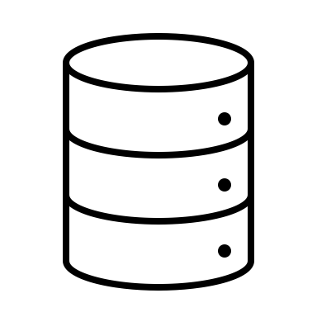

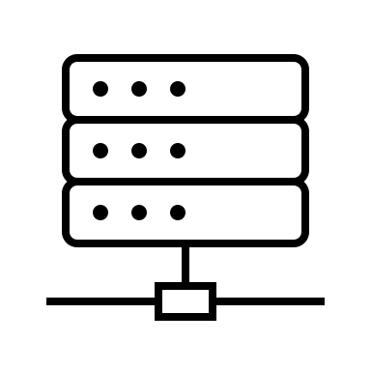



The network flow
Front-End
Back-End
DB
RESTful API
Messaging service
Server
Heavy computing service

Slide 6

What do we want
Front-End
Back-End
RESTful API
Server
Health data DB

Slide 7

What do we want
Front-End
Back-End
RESTful API
Server
Health data DB

Slide 8
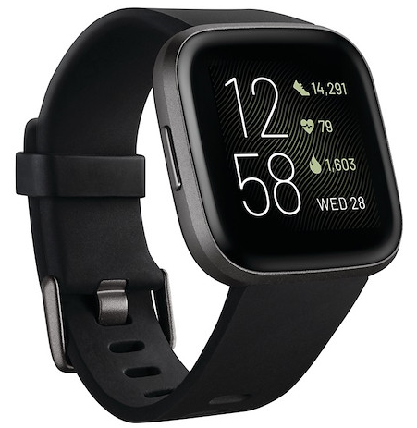
The idea
In this course, we will leverage data generated by a Fitbit smartwatch, i.e., a Fitbit Versa 2
Data will be collected by me using my Fitbit
These data include:
Activity data
Heart data
Calories data
Sleep data
Device data
User data

Slide 9
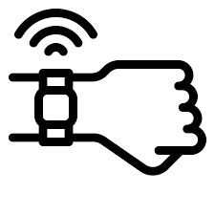

Fitbit data flow
Front-End
Back-End
Fitbit Public Web API
Fitbit Private API
Health data DB
Fitbit Server

Slide 10
Fitbit data flow
Front-End
Back-End
Fitbit Public Web API
Fitbit Private API
Health data DB
Fitbit Server

Slide 11
How to use them? Three steps
Front-End
Fitbit Server
Authorize your app via OAuth2 protocol using my Fitbit credentials
Store the authorization credentials
Use those credentials to make requests

Slide 12
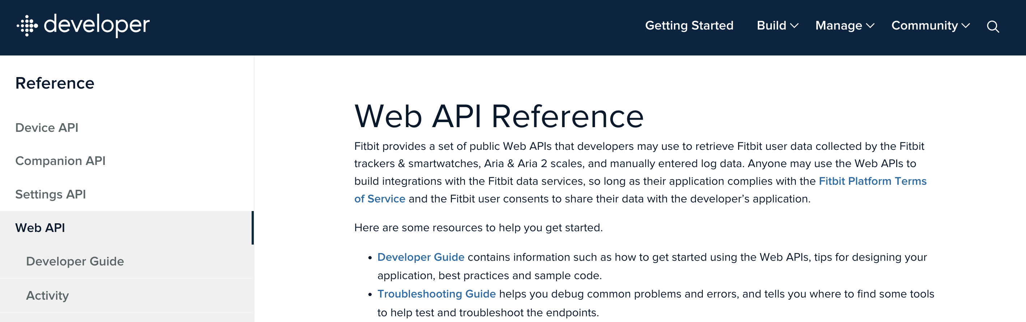
How to use them? Docs
https://dev.fitbit.com/build/reference/web-api/

Slide 13
Outline
Recap
The network flow
Health data from the Web
Fitbit Web API
Fitbitter
Homework
Resources

Slide 14

How to use them? Fitbitter
To make your life easier, I developed a dedicated package: Fitbitter
It exposes simple client-side APIs to make those “three steps” easy.
Pub.dev https://pub.dev/packages/fitbitter
Repository: https://github.com/gcappon/fitbitter
Docs & Guides: https://gcappon.github.io/fitbitter/

Slide 15
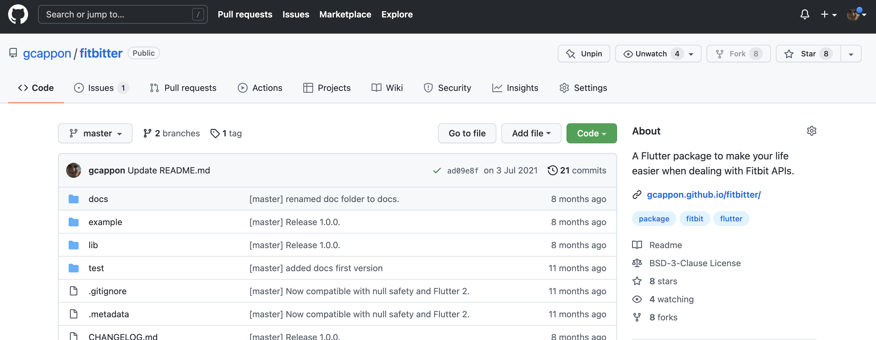
How to use them? Fitbitter

Slide 16
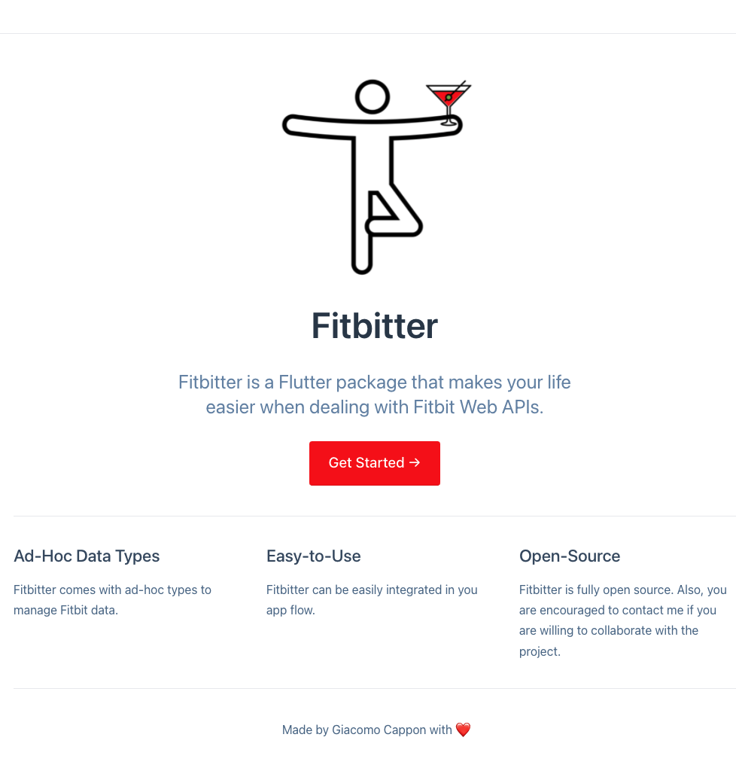
How to use them? Fitbitter
In the “Get Started” page of the docs you will find all the necessary info to start working with fitbitter and access to my Fitbit-generated data: https://gcappon.github.io/fitbitter/getstarted
In this lesson, I won’t guide you with a case study.
Try to follow the guide I prepared for you to fetch yesterday’s step count. This will teach you how to reuse others’ (documented) code, i.e., 99% of the scenarios you will face in the real world.
Full example in lab_09-fitbitter/fitbitter_test/

Slide 17
Don’t want to use my data for your project?
I provide you with the possibility of fetching my data to have some health-related stuff to work on during the project preparation.
What if you do not want to use my data? For the sake of freedom, you have other choices:
If you have your own Fitbit, feel free to use fitbitter to connect to your device
If you have another smartwatch (Garmin, Apple Watch,…) that sync data to Apple Health or Google Fit you can try to use the health package https://pub.dev/packages/health

Slide 18
Outline
Recap
The network flow
Health data from the Web
Fitbit Web API
Fitbitter
Homework
Resources

Slide 19
Homework
Get familiar with the fitbitter package capabilities
Read the docs of the Fitbit Web API
https://dev.fitbit.com/build/reference/web-api/
Take a look the health package
https://pub.dev/packages/health

Slide 20
Outline
Recap
The network flow
Health data from the Web
Fitbit Web API
Fitbitter
Exercise
Homework
Resources

Slide 21
Resources
Fitbit Web API
https://dev.fitbit.com/build/reference/web-api/
Fitbitter package
https://pub.dev/packages/fitbitter
Health package
https://pub.dev/packages/health

