Slide 1
Authorization

Slide 2


Authorization
Authentication: the process of proving that the user is who he/she declares to be.
Authorization: the act of granting a user permission to do something.
Necessary when some resources/tasks are limited to users with special permission (access control).
It specifies what data a user is allowed to access and what the user can do with that data.
Access request
Unauthorized user
Access denied
Server
Protected endpoint
Access request
Authorized user
Access granted

Slide 3
Basic access authentication
Authorization using account credentials
Each user of the website/web application has an account with a user ID and a password (credentials).
The user logs into the website/web application providing its credentials.
The server verifies credentials and allows the user to access the resources it is authorized to access.
HTTP request header to provide credentials:
Authorization: Basic <credentials>
where <credentials> includes user ID and password.
Often authorization is performed after the server request it.

Slide 4
Basic access authentication
Unauthorized request
GET /home HTTP/1.1
Client
Server
DB of credentials
The server responds authorization is needed:
HTTP/1.1 401 Unauthorized
WWW-Authenticate: Basic realm=’’protection space’’
Ask user
Authorized request
GET /home HTTP/1.1
Authorization: Basic <credentials>
Access control program
DB of protected resources
Server’s response to authorized request
HTTP/1.1 200 OK
HTTP/1.1 403 Forbidden
or
How can we protect the transmission of credentials?

Slide 5
Digest access authentication
Its uses an hash function to protect credentials.
Client
Server
Unauthorized request
DB of credentials
DB of protected resources
Authorization is needed
+ random nonce (large number, N)
credentials, N
Access control program
credentials, N
h(·)
h(·)
h’(credentials, N)
h(credentials, N)
h(credentials, N)
Digest comparison
Server’s response to authorized request
Alternative solution: encrypted communication with the HTTPS protocol.

Slide 6
The problem of delegated authorization
A third-party app wants to access some resources of another service provider, whose access is restricted by authorization.
The authorization must be delegated to the third-party app.
Today delegated authorization is very common:
Your Strava app may synchronize your Fitbit data
→ Fitbit authorization is delegated to Strava
You may share your preferred song in Spotify on your Facebook profile
→ Facebook authorization is delegated to Spotify
How can a third-party app perform delegated authorization?

Slide 7
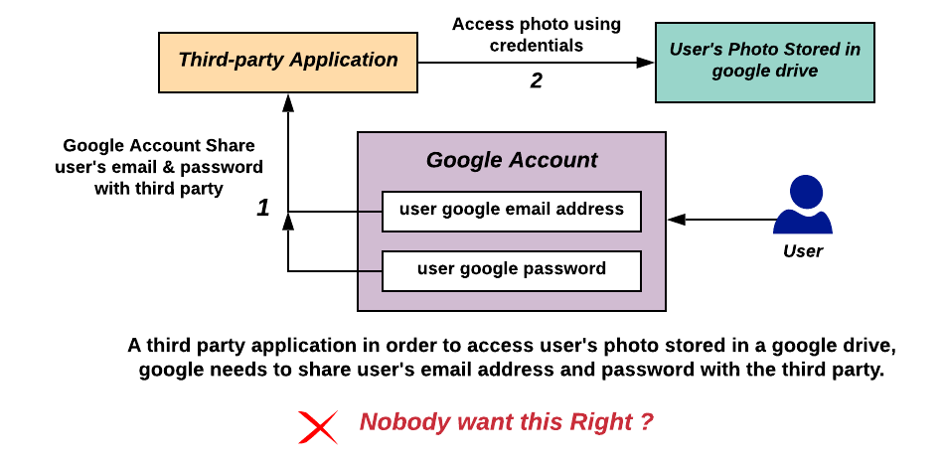
The incorrect solution: sharing login credentials

Slide 8

OAuth protocol
OAuth (Open Authorization): a protocol for delegated authorization that does not require to share credentials with the third-party app.
2007: First version (OAuth 1.0)
2012: Second version (OAuth 2.0)
Main co-author is Blaine Cook, one of the developers of Twitter.
Today OAuth is commonly used by companies such as Twitter, Amazon, Google, Facebook and Microsoft to permit the users to share information about their accounts with third-party applications or websites.
Why do we study OAuth?
If you develop an app that integrates data from third-party servers that require authorization, you may need to use OAuth to request resources.

Slide 9
OAuth roles
Resource owner: The user who authorizes a third-party application to access their data.
The application’s access to the user’s data is limited to the scope of the authorization granted (e.g., read or write access).
Client: The third-party application that wants to access the user’s account.
The client must be authorized by the user.
The authorization must be validated by an API of the authorization server.
Resource server: The server hosting the protected user data.
Authorization server: It verifies the identity of the user and issues access tokens to the third-party application.

Slide 10
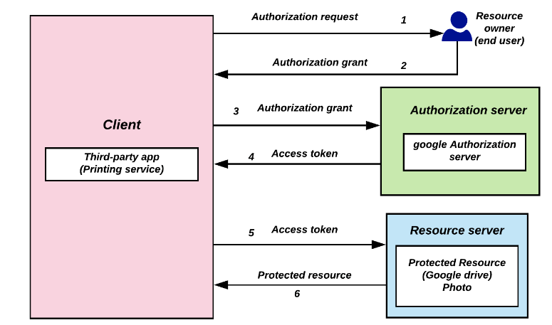
OAuth abstract model
Example: a printing service app wants to access Google drive photos

Slide 11
Application registration
The third-party app (e.g. the printing app) must be registered with the service provider (e.g. Google).
The third-party app’s developer must complete a registration form (usually in the developer page of the service’s website) providing details about the app.
Redirect URI (or Callback URL): where the service will redirect the user after they authorize (or deny) the third-party app → the part of the third-party app that handles authorization codes and access tokens.
Once the third-party app is registered, the service issues client credentials:
Client ID: a public string used by the service to identify the client.
Client secret: a private password used to authenticate the identity of the client when the app requests to access a user’s data

Slide 12

Example of delegated authentication with OAuth
Example: The app yelp.com wants to get access to a user’s Google account profile contacts.
Client
Authorization server
yelp.com
accounts.google.com
Authorization request
Authentication of the resource owner
Connect with Google
Email:
Resource owner
Client ID: abc123
Redirect URI: yelp.com/callback
Scope: profile contacts
Password:
contacts.google.com
Authorization code, client ID, client secret
Request consent from the resource owner
Access token
Contacts
Access token
yelp.com/callback
accounts.google.com
Loading
Allow Yelp to access your profile and contacts?
Back to the redirect URI with the authorization code
No
Yes

Slide 13
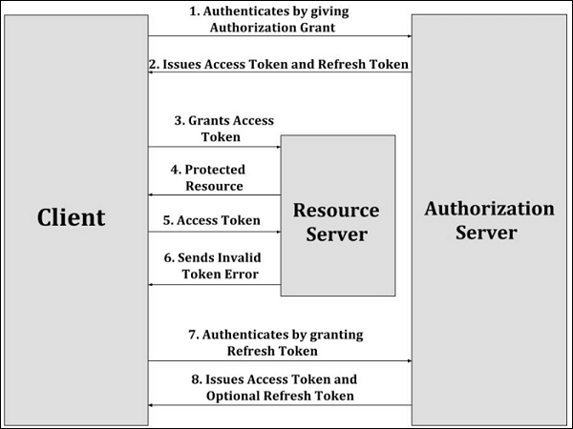
Refresh token
Access token have an expiration time.
A refresh token can be used by the client to request a new access token to the authorization server without the need to repeat the entire authorization process.

Slide 14
JSON Web token
JSON Web Token (JWT): an Internet standard that defines a compact way for securely transmitting a token between parties as a JSON object. The token can be verified and trusted because it is digitally signed (e.g., using RSA with SHA-256).
A JWT token consists of three parts separated by dots, a header, a payload, a signature, encoded in Base64Url (a type of encoding to represent binary data).
xxxxx.yyyyy.zzzzz
Header: the type of the token and the signing algorithm
{ "alg": “RS256", "typ": "JWT" }

Slide 15
JSON Web token
{
"iss": "https://accounts.google.com",
"sub": "you@gmail.com",
"name": “John Smith"
"aud": "s6BhdRkqt3",
"exp": 1311281970,
"iat": 1311280970,
"auth_time": 1311280969
}
xxxxx.yyyyy.zzzzz
Payload: it contains claims, i.e., some statements.
Standard payload claim fields
iss | Issuer | Identifies principal that issued the JWT.
sub | Subject | Identifies the subject of the JWT.
aud | Audience | Identifies the recipients that the JWT is intended for. If the principal processing the claim does not identify itself with a value in the aud claim when this claim is present, then the JWT must be rejected.
exp | Expiration Time | Identifies the expiration time on and after which the JWT must not be accepted for processing.
nbf | Not Before | Identifies the time on which the JWT will start to be accepted for processing.
iat | Issued at | Identifies the time at which the JWT was issued.

Slide 16
JSON Web token
xxxxx.yyyyy.zzzzz
The signature is calculated by these steps:
header and payload encoded using Base64url
concatenation of the encoded header and payload with a separating character
Encryption of the obtained string through the cryptographic algorithm specified in the header.
RS256(base64UrlEncode(header) + "." + base64UrlEncode(payload), signature_key)
Signature: it contains a signature of the header and payload

Slide 17
Example of a JWT token
Header
eyJhbGciOiJSUzI1NiIsImtpZCI6IkRNa3Itd0JqRU1EYnhOY25xaVJISVhu
YUxubWI3UUpfWF9rWmJyaEtBMGMifQ
.
eyJzdWIiOiIwMHU5bzFuaWtqdk9CZzVabzBoNyIsInZlciI6MSwiaXNzIjoi
aHR0cHM6Ly9kZXYtMzQxNjA3Lm9rdGFwcmV2aWV3LmNvbS9vYXV0aDIvYXVz
OW84d3ZraG9ja3c5VEwwaDciLCJhdWQiOiJsWFNlbkx4eFBpOGtRVmpKRTVz
NCIsImlhdCI6MTUwOTA0OTg5OCwiZXhwIjoxNTA5MDUzNDk4LCJqdGkiOiJJ
RC5oa2RXSXNBSXZTbnBGYVFHTVRYUGNVSmhhMkgwS2c5Ykl3ZEVvVm1ZZHN3
IiwiYW1yIjpbImtiYSIsIm1mYSIsInB3ZCJdLCJpZHAiOiIwMG85bzFuaWpr
aWpLeGNpbjBoNyIsIm5vbmNlIjoidWpwMmFzeHlqN2UiLCJhdXRoX3RpbWUi
OjE1MDkwNDk3MTl9
.
dv4Ek8B4BDee1PcQT_4zm7kxDEY1sRIGbLoNtlodZcSzHzXU5GkKyl6sAVmdXOIPUlAIrJAhNfQWQ-
_XZLBVPjETiZE8CgNg5uqNmeXMUnYnQmvN5oWlXUZ8Gcub-GAbJ8-
NQuyBmyec1j3gmGzX3wemke8NkuI6SX2L4Wj1PyvkknBtbjfiF9ud1-
ERKbobaFbnjDFOFTzvL6g34SpMmZWy6uc_Hs--n4IC-ex-
_Ps3FcMwRggCW_-7o2FpH6rJTOGPZYrOx44n3ZwAu2dGm6axtPIsqU8b6sw7DaHpogD_hxsXgMIOzOBMbYsQEiczoGn71ZFz_1O7FiW4dH6g
Payload
Signature

Slide 18







How authorization works in the IMPACT backend
HTTPS requests/responses
Authorization
Get token (JWT) using credentials
(If credentials are ok) Receive JWT token
Ask for specific data using token
(If request is ok) Receive data (JSON format)
https://impact.dei.unipd.it/bwthw/
Your app
Receiving data

Slide 19




The IMPACT user types and permissions
Patient
Generates and manages its data
Clinician
Enrolls patients, reviews data of patients in its clinical center, edits clinical study settings
Researcher
Accesses all data in read-only mode
Superuser/Study Administrator/Data Administrator
They have God-like powers

Slide 20
The researcher role
Each group will have access to the data using the researcher role
Each researcher in IMPACT is characterized by a username and an access expiration date.
The access expiration date defines the date until a specific researcher is allowed to access data stored in the IMPACT database. Two examples:
{
"username": ”<YOUR_USERNAME>",
"access_expiration_date": “<YOUR_ACCESS_EXPIRATION_DATE>”
}
{
"username": "nmRTlOv7W8",
"access_expiration_date": "2024-09-30"
}
{
"username": "nmRTlOv7W8",
"access_expiration_date": null
}

Slide 21
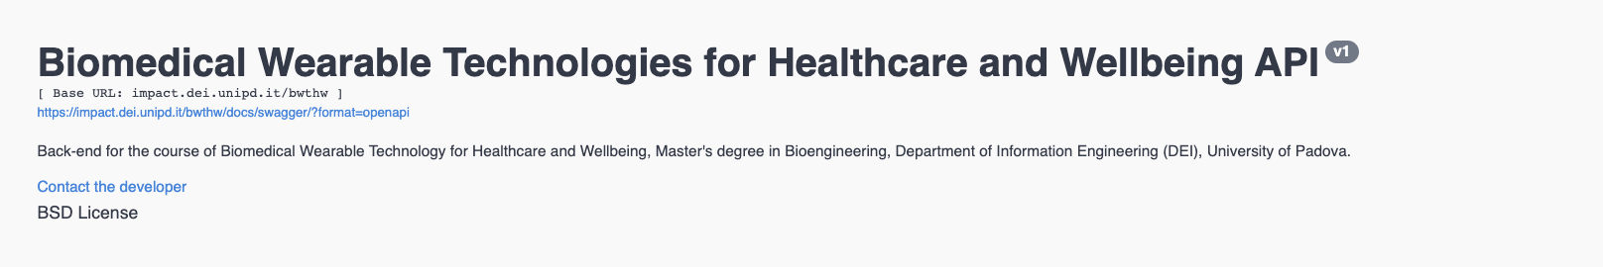
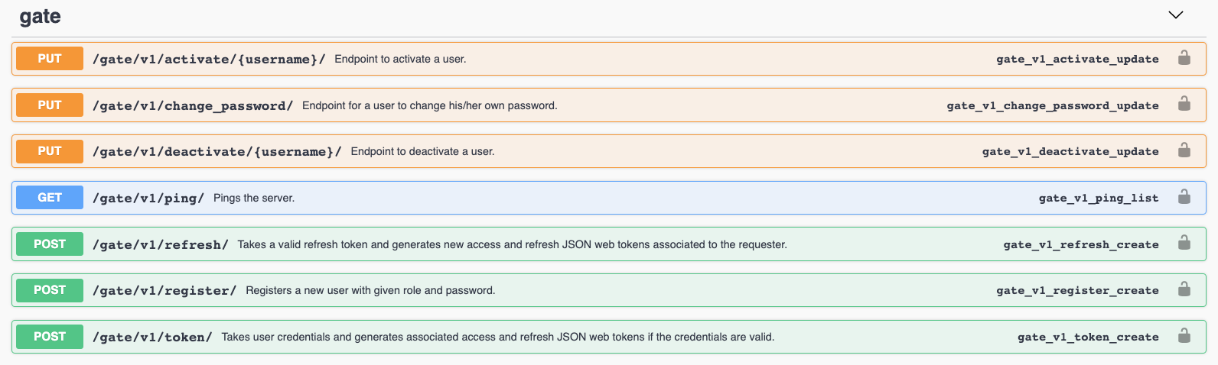
Get the authorization: The IMPACT gate

Slide 22
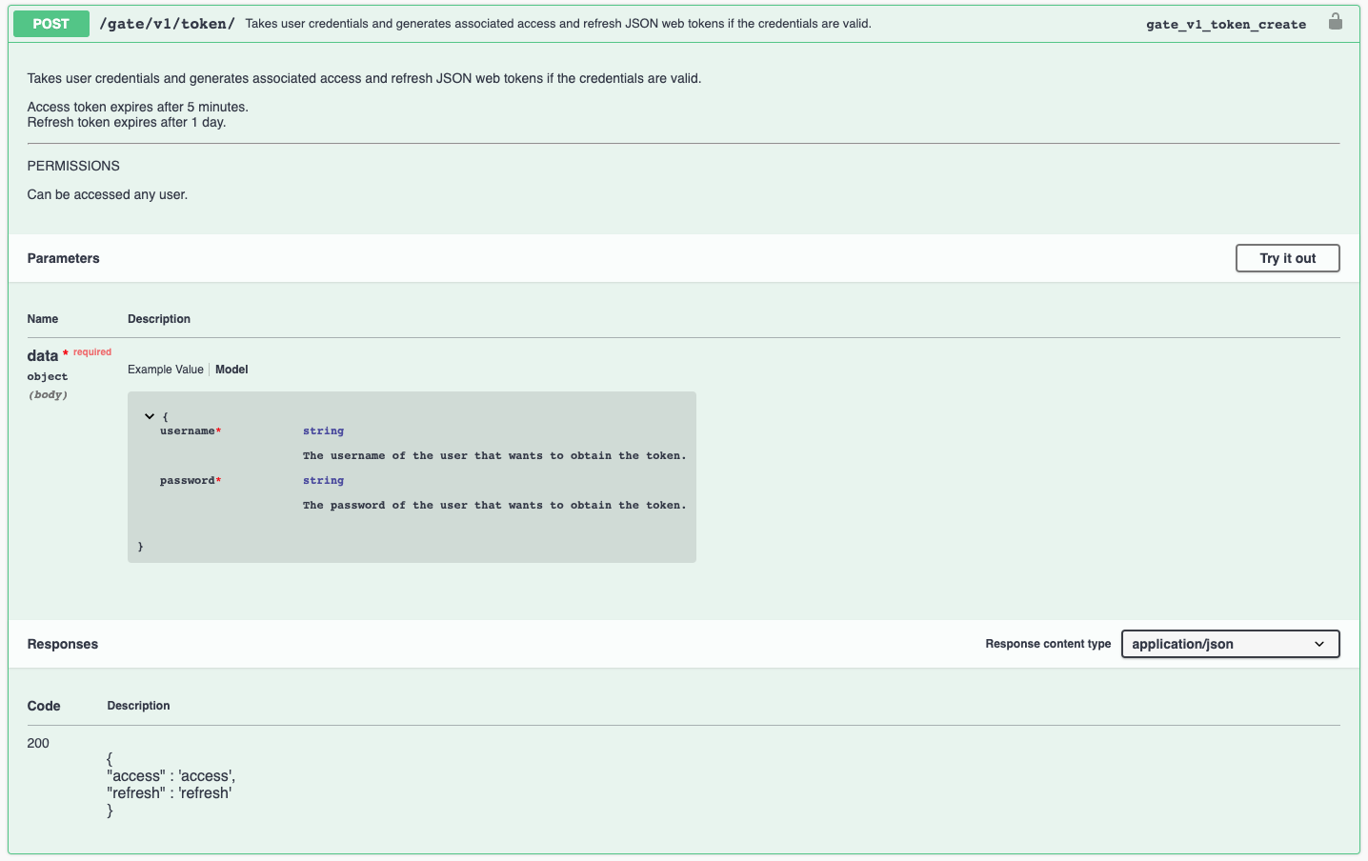
The IMPACT gate: token
This endpoint allows to get the JWT token using your credentials
It needs 2 parameter provided in the request body
If successful (200) it will return a JSON containing the access and the refresh token pair

Slide 23
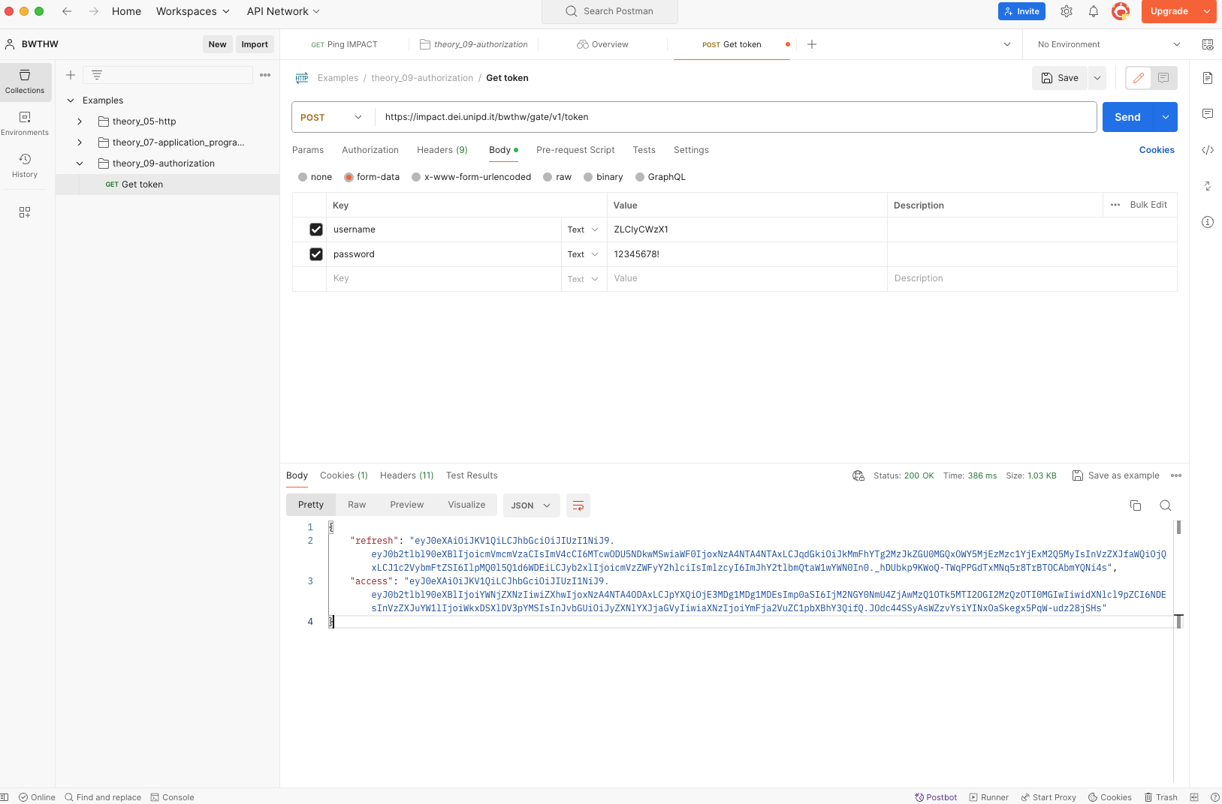
Get the token using POSTMAN
{
"username": "ZLCIyCWzX1",
”access_expiration_date": 2024-06-30
}

Slide 24
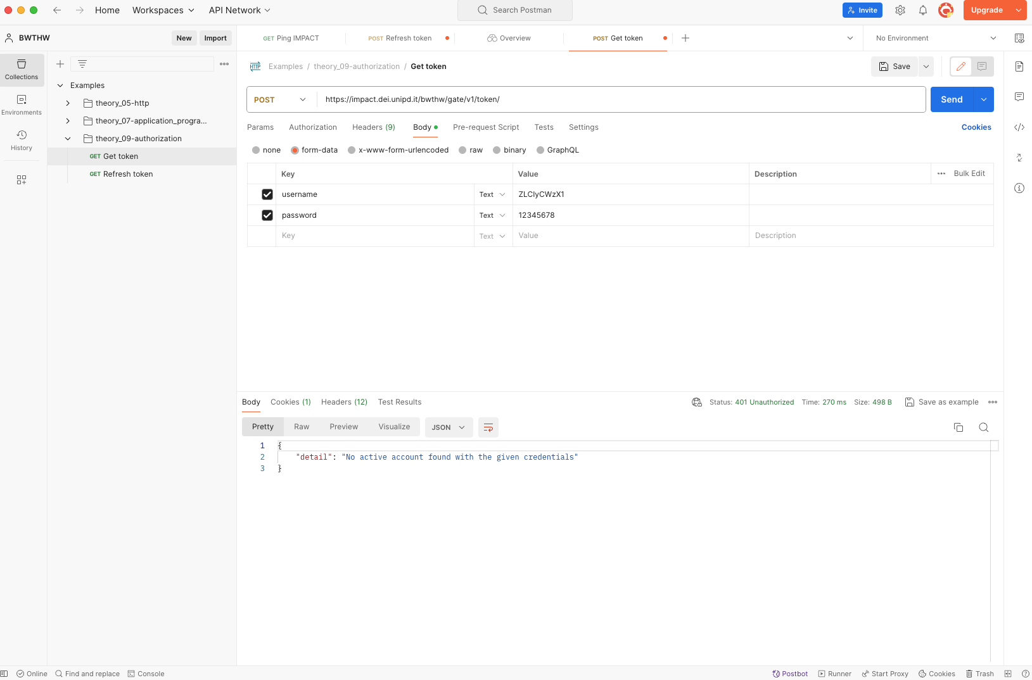
(Wrongly) Get the token using POSTMAN

Slide 25
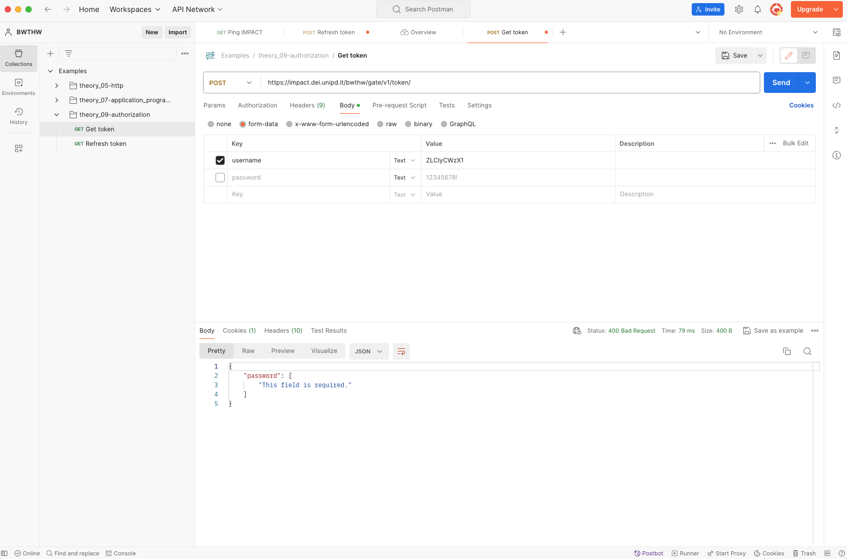
(Wrongly) Get the token using POSTMAN

Slide 26
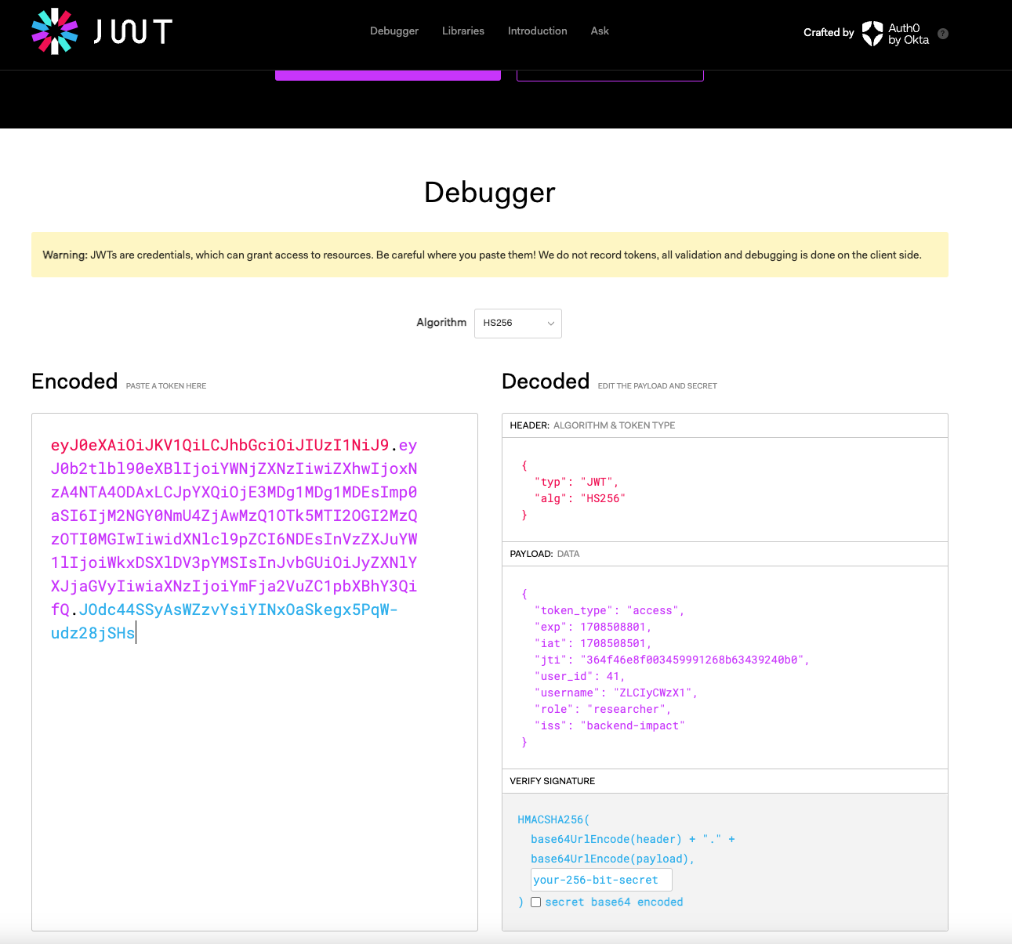
Inspect the access token
We can inspect the content of the JWT token using an handful online tool:
https://jwt.io

Slide 27
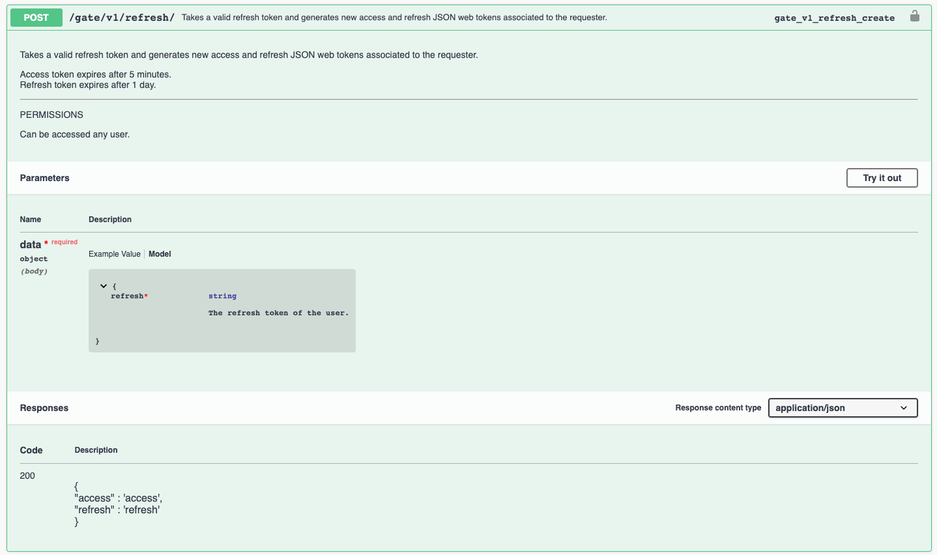
The IMPACT gate: refresh

Slide 28
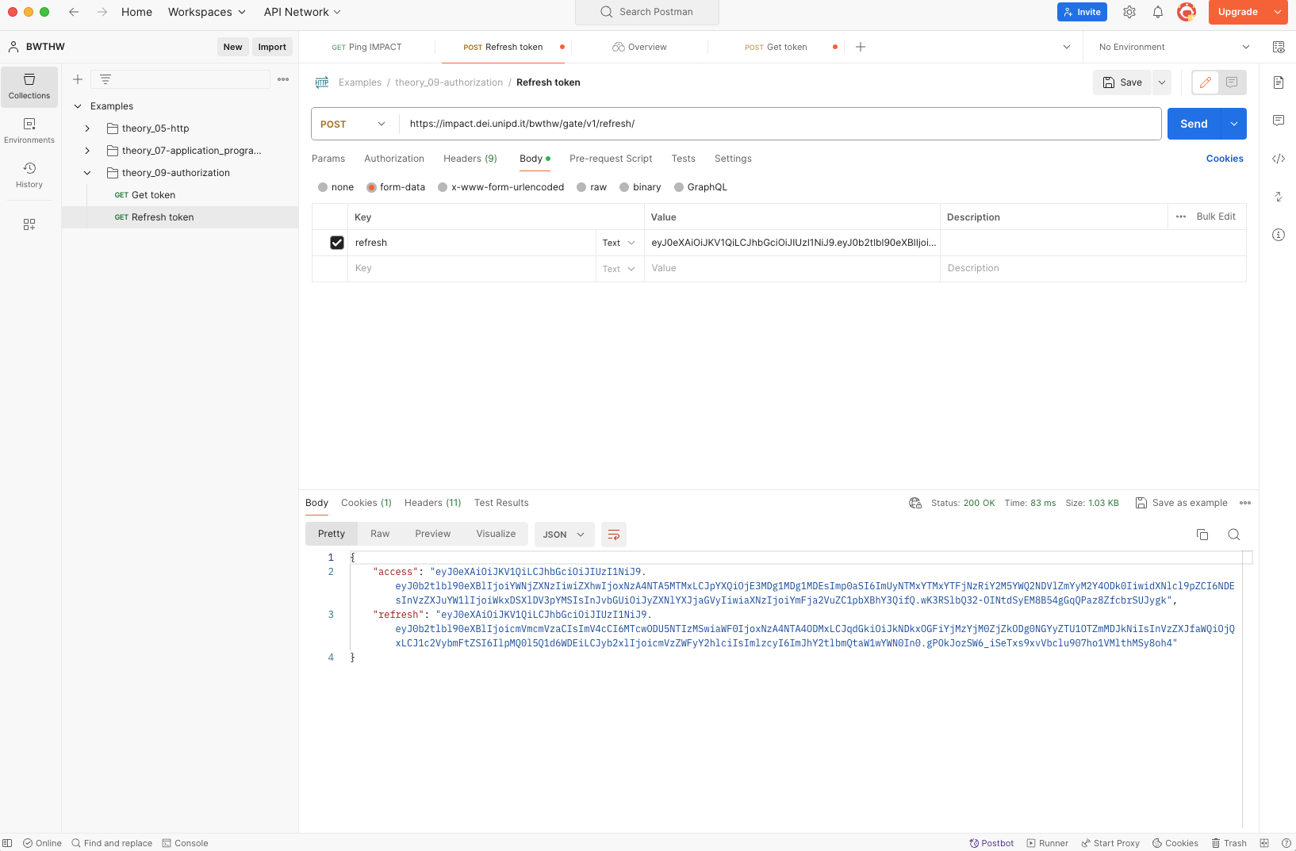
Refresh the token using POSTMAN

Slide 29
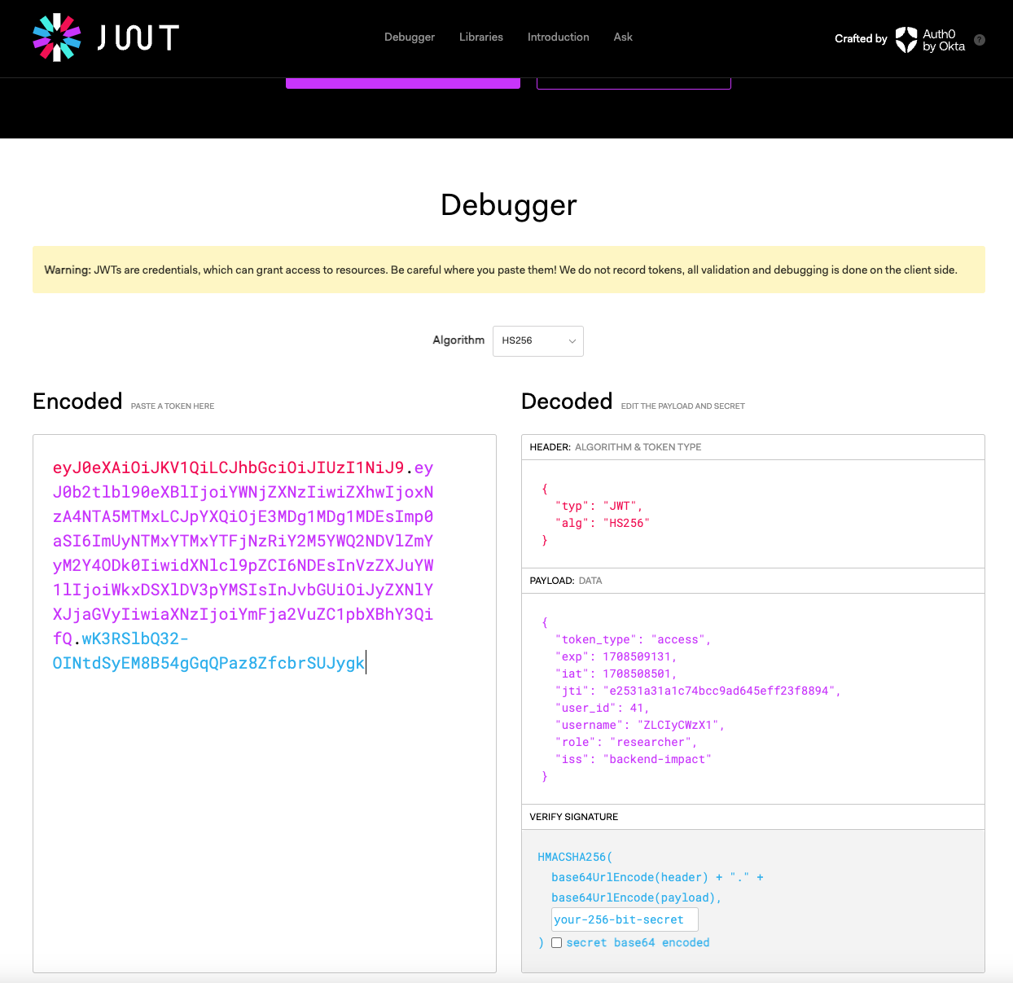
Inspect the new access token

Slide 30
References
Tanenbaum, Wetherall – Computer Networks – Fifth Edition
Chapter 8 – Network security
jwt.io: https://jwt.io

