Slide 1
UX and UI in Flutter

Slide 2
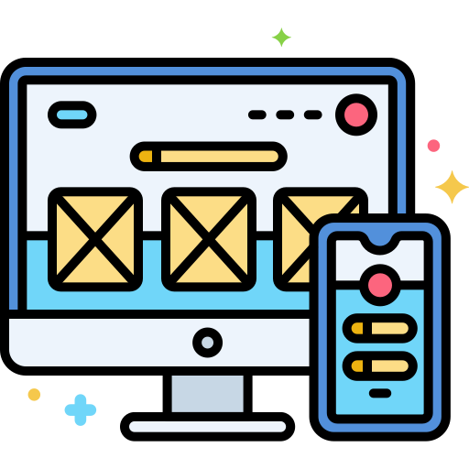
User eXperience (UX)
UX (User eXperience) is the total experience a person has while interacting with a product.
It includes perception, emotional response, efficiency, clarity, friction, trust.
UX is not just screens. UX is the entire journey.
When UX is ok? You should ask yourself:
Does the product solve a real problem?
Is the user goal clear?
Is the path to that goal obvious?
Does the system behave predictably?
Is error handling supportive?

Slide 3
User Interface (UI)
UI (User Interface) is the visual and interactive layer.
It includes typography, color, layout, spacing, components, animations,…
What is the difference between UX and UI?
UI communicates structure. UX defines structure.

Slide 4

Fundamental UX Principles
UX grounds on five principles:
Visual Hierarchy
Consistency
Feedback
Cognitive Load
Accessibility
These apply whether you build a website, mobile app, medical device, or car dashboard.

Slide 5
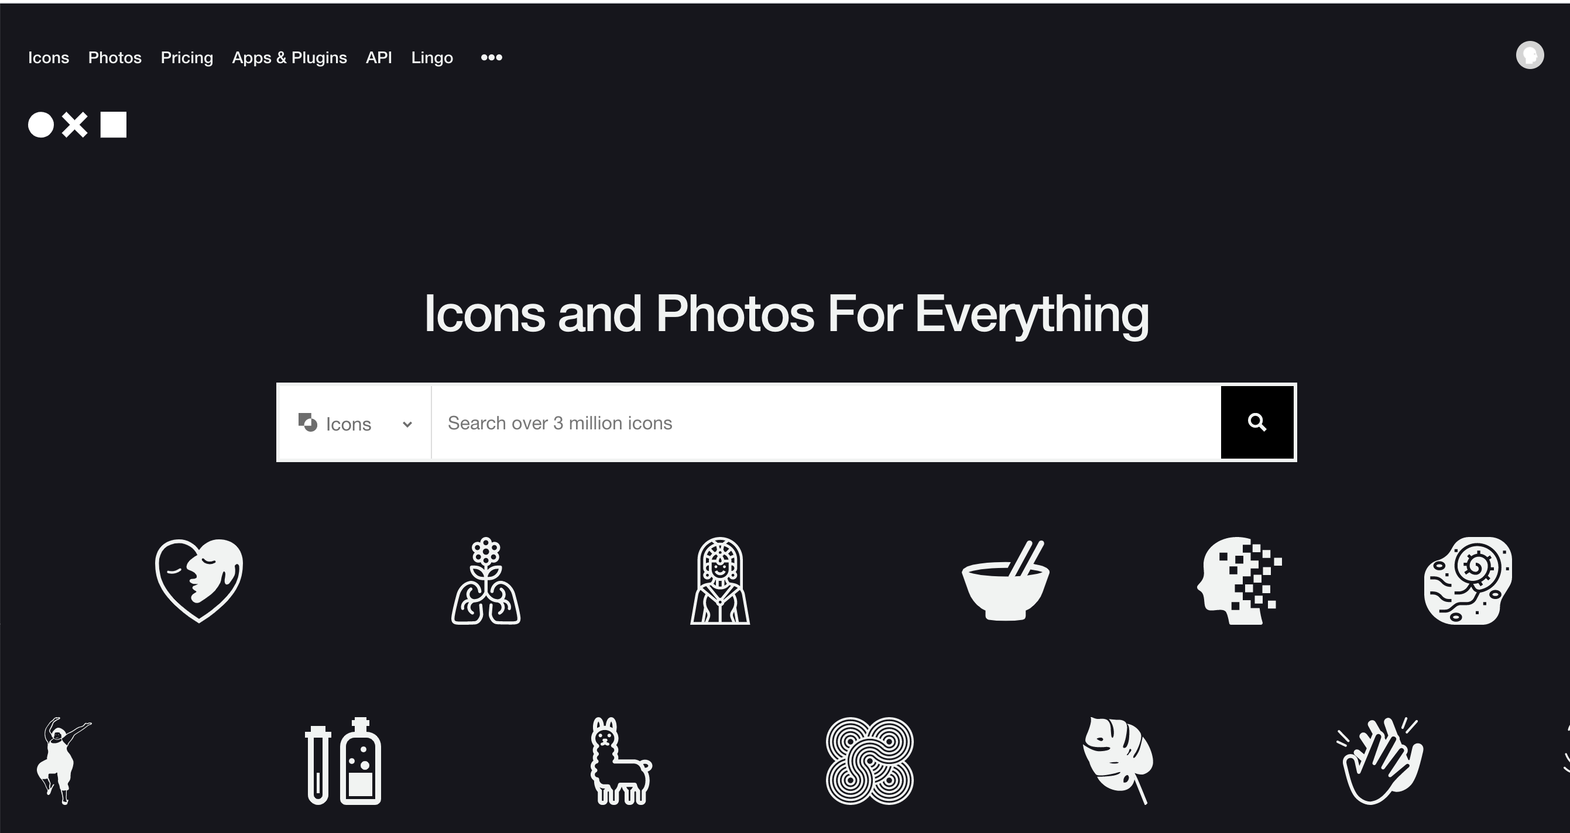
Visual Hierarchy
Users scan. They do not read linearly.
Hierarchy answers:
What matters most?
What is actionable?
What is secondary?
Tools in our hands:
Setting the size of each component
Setting the contrast
Defining spacing
Setup and alignment policy
Grouping stuff together
If everything is bold, nothing is bold.

Slide 6
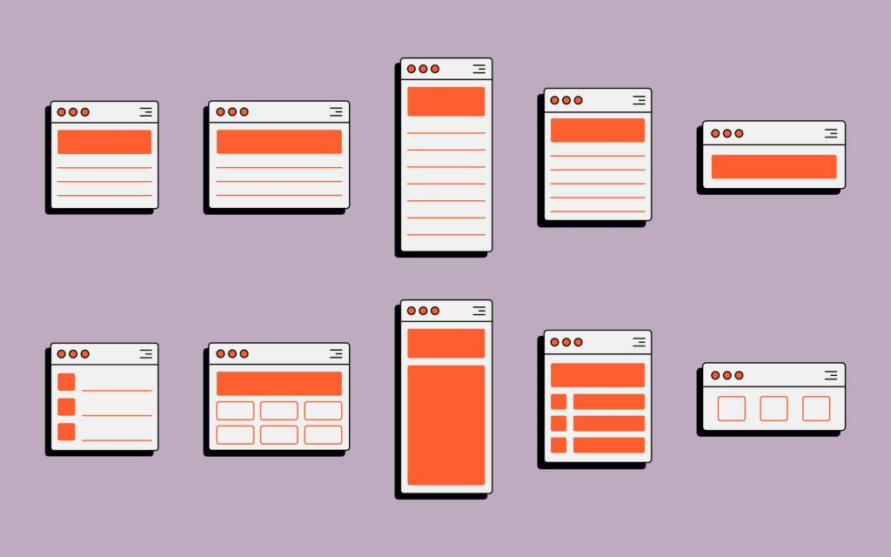
Consistency
Humans recognize patterns.
If
Buttons look different each time
Navigation changes unpredictably
Terminology varies
then, the cognitive load increases.
Consistency builds confidence.

Slide 7
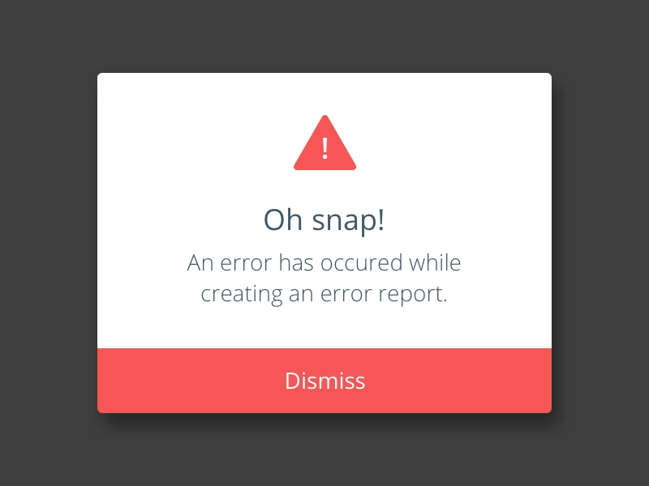
Feedback
Every action must produce feedback.
Examples:
Button press animation
Loading indicator
Error message
Success confirmation
No feedback = anxiety. Did it worked?

Slide 8
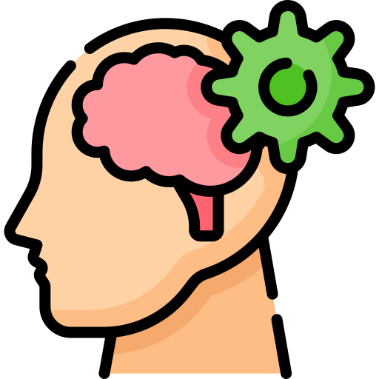
Cognitive Load
Cognitive load = Mental effort and stress
Cognitive load increases when:
Too many options exist
Too much information is visible
Terminology is complex
Interaction patterns vary
Goal: reduce thinking.

Slide 9
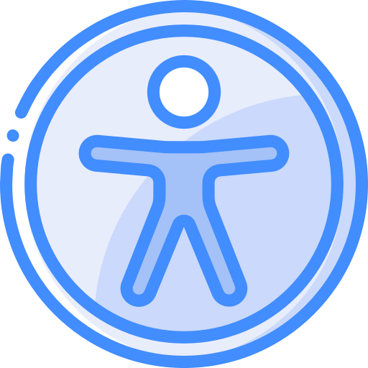
Accessibility
Accessibility means:
Readable contrast
Scalable text
Clear semantics
Usable with assistive technologies
Accessibility is not a feature. It is a quality standard.

Slide 10

Design Systems
A design system is a comprehensive, centralized repository of reusable components, standards, documentation, and design principles used to create consistent digital products at scale.
It prevents:
Random design decisions
Visual inconsistency
Scaling problems
Examples of design systems:
Apple Human Interface Guidelines
Microsoft Fluent
Material Design

Slide 11
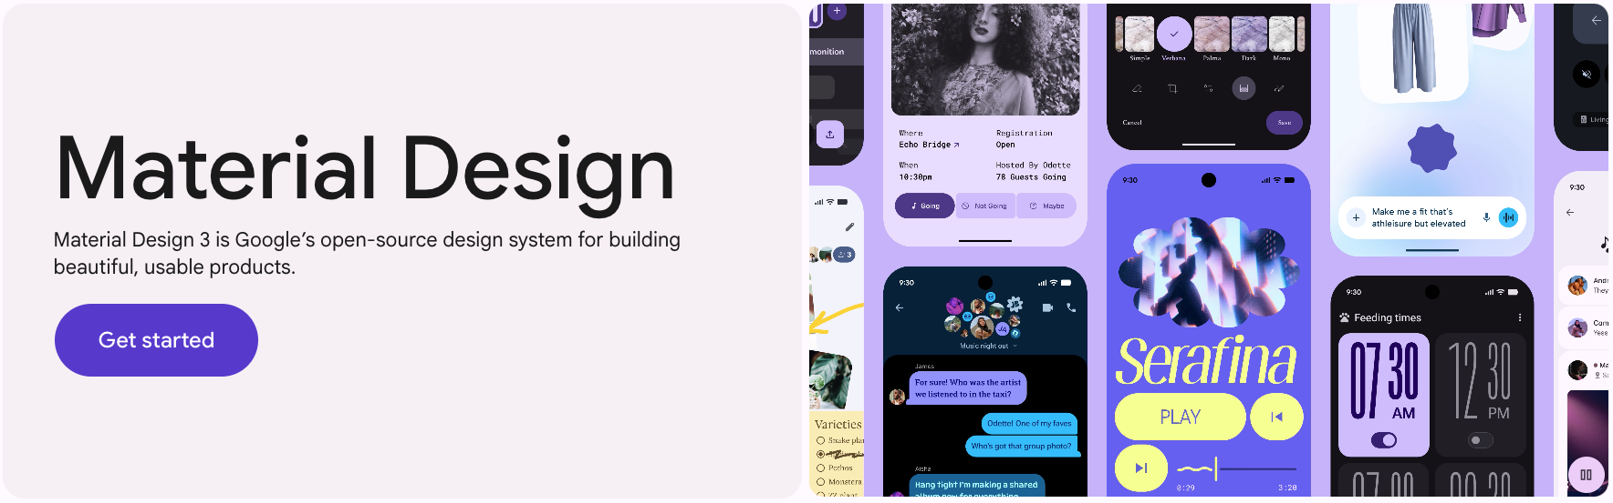
Material Design

Slide 12
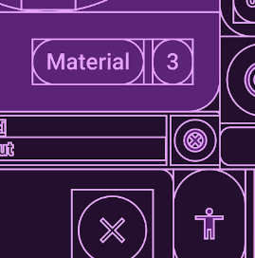
Material Design
Material Design is not “Google style.”
It is a UX framework encoded into UI rules.
Core ideas:
Structure through surfaces: organizing UI into background, surfaces, and elevated components to create visual grouping.
Meaningful motions: explaining what changed, where content came from, and what happened.
Clear hierarchy: defining scales, button hierarchy, component roles.
Color system: using a primary, secondary, surface, error, contrasts
This ensures accessible combinations.

Slide 13
Material Components as UX Decision
Material components are structured by importance.
Let’s make some examples
All examples and best practices can be found at: https://m3.material.io/

Slide 14
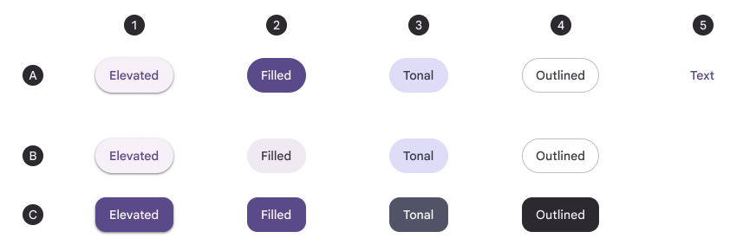
Material Components as UX Decision
Buttons:
Primary action → Elevated, Filled, and Tonal button
Secondary → Outlined button
Tertiary → Text button
This encodes UX hierarchy visually.

Slide 15
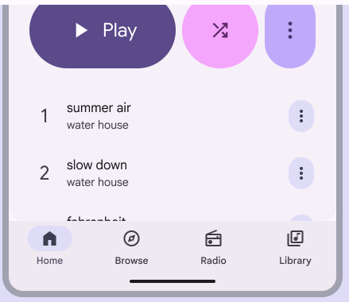
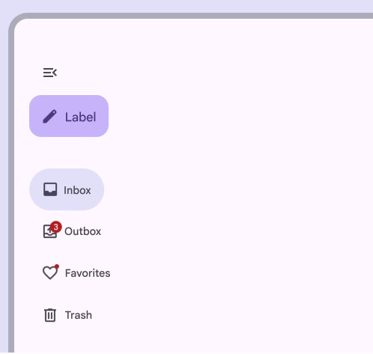
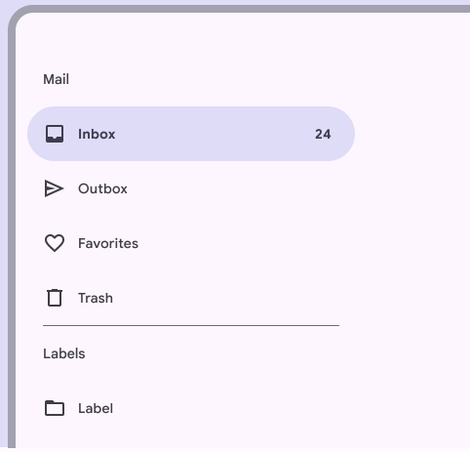
Material Components as UX Decision
Navigation patterns:
Bottom navigation (few top sections)
Navigation rail (larger screens)
Drawer (complex systems)
Material links navigation model to app size.

Slide 16
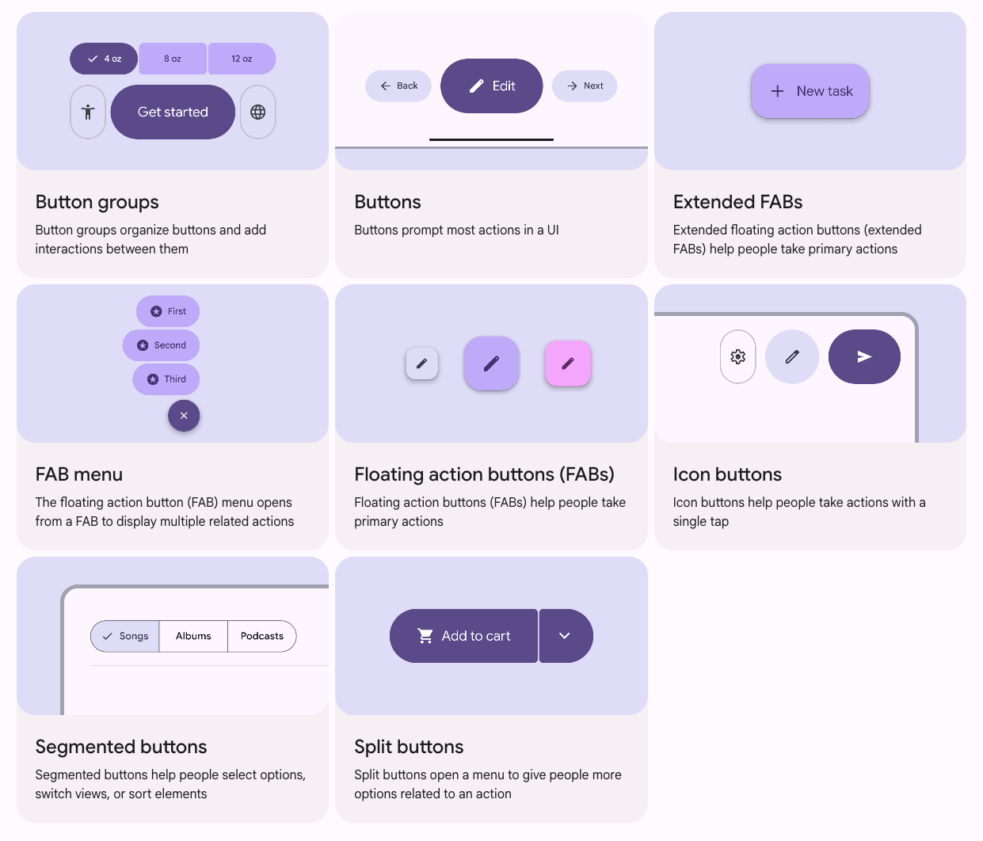
Material Components as UX Decision
Content organization:
Cards for grouping
Lists for scanning
FAB for dominant actions
Each has semantic meaning.

Slide 17
Activating Material in Flutter: Theming
In Flutter, Material is activated providing a ThemeData to your MaterialApp through:
Why this matters:
Color harmony is automatic
Components become consistent
Accessibility improves
You stop hardcoding colors
Advice: Start global. Avoid styling per screen.
MaterialApp(
theme: ThemeData(
useMaterial3: true,
colorScheme: ColorScheme.fromSeed(seedColor: Colors.blue),
),
)
Note: if you do not provide a ThemeData, Material is activated by default but you won’t have global control.

Slide 18


Buttons as UX Communication
Different Buttons for different meanings
Button hierarchy allows to specify primary and secondary actions and put different emphasis.
This allows also to express priorities.
ElevatedButton(
onPressed: () {},
child: Text(”Elevated"),
)
TextButton(
onPressed: () {},
child: Text(”Text"),
)

Slide 19
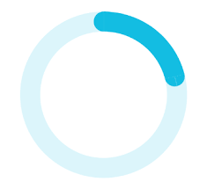
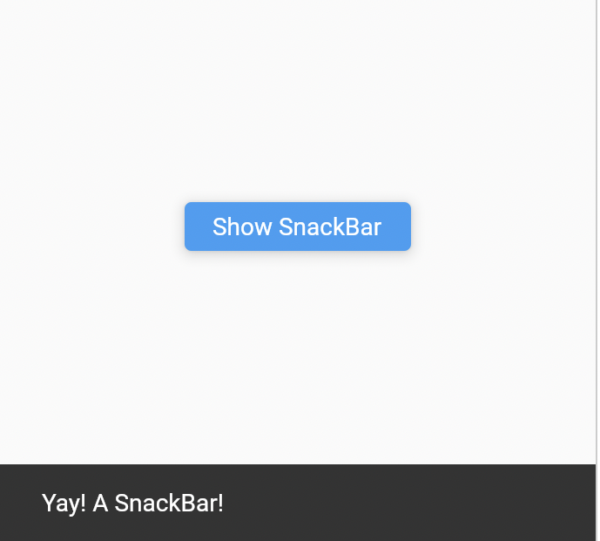
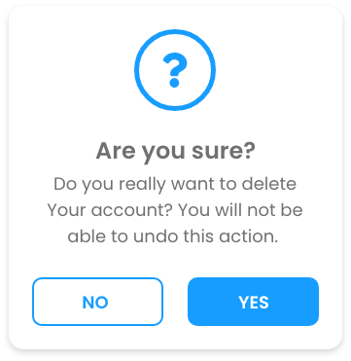
Feedback in Flutter
Use the following to provide specific feedback.
Loading:
Confirmation:
Critical action:
CircularProgressIndicator()
ScaffoldMessenger.of(context).showSnackBar(
SnackBar(content: Text(”Yay! A SnackBar")),
);
showDialog(...)

Slide 20
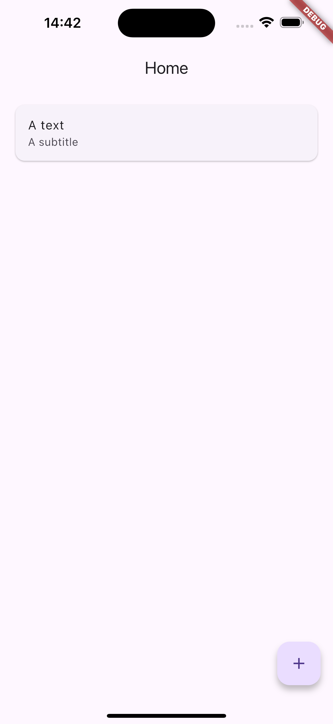
Defining the Structure with Scaffold
Material screens in Flutter use the following to define the basic structure of a screen:
Scaffold
AppBar
NavigationBar
FloatingActionButton
Scaffold(
appBar: AppBar(title: Text("Home")),
body: ListView(
padding: EdgeInsets.all(16),
children: [
Card(
child: ListTile(
title: Text(”A text"),
subtitle: Text(”A subtitle"),
),
),
],
),
floatingActionButton: FloatingActionButton(
onPressed: () {},
child: Icon(Icons.add),
),
);

Slide 21
Focus on the Scaffold
Let’s focus into the Scaffold Widget
Detailed info: https://api.flutter.dev/flutter/material/Scaffold-class.html
//Constructor of Scaffold
const Scaffold({ Key key, this.appBar, this.body, this.floatingActionButton, this.floatingActionButtonLocation, this.floatingActionButtonAnimator, this.persistentFooterButtons, this.drawer, this.endDrawer, this.bottomNavigationBar, this.bottomSheet, this.backgroundColor, this.resizeToAvoidBottomPadding = true, this.primary = true, })

Slide 22
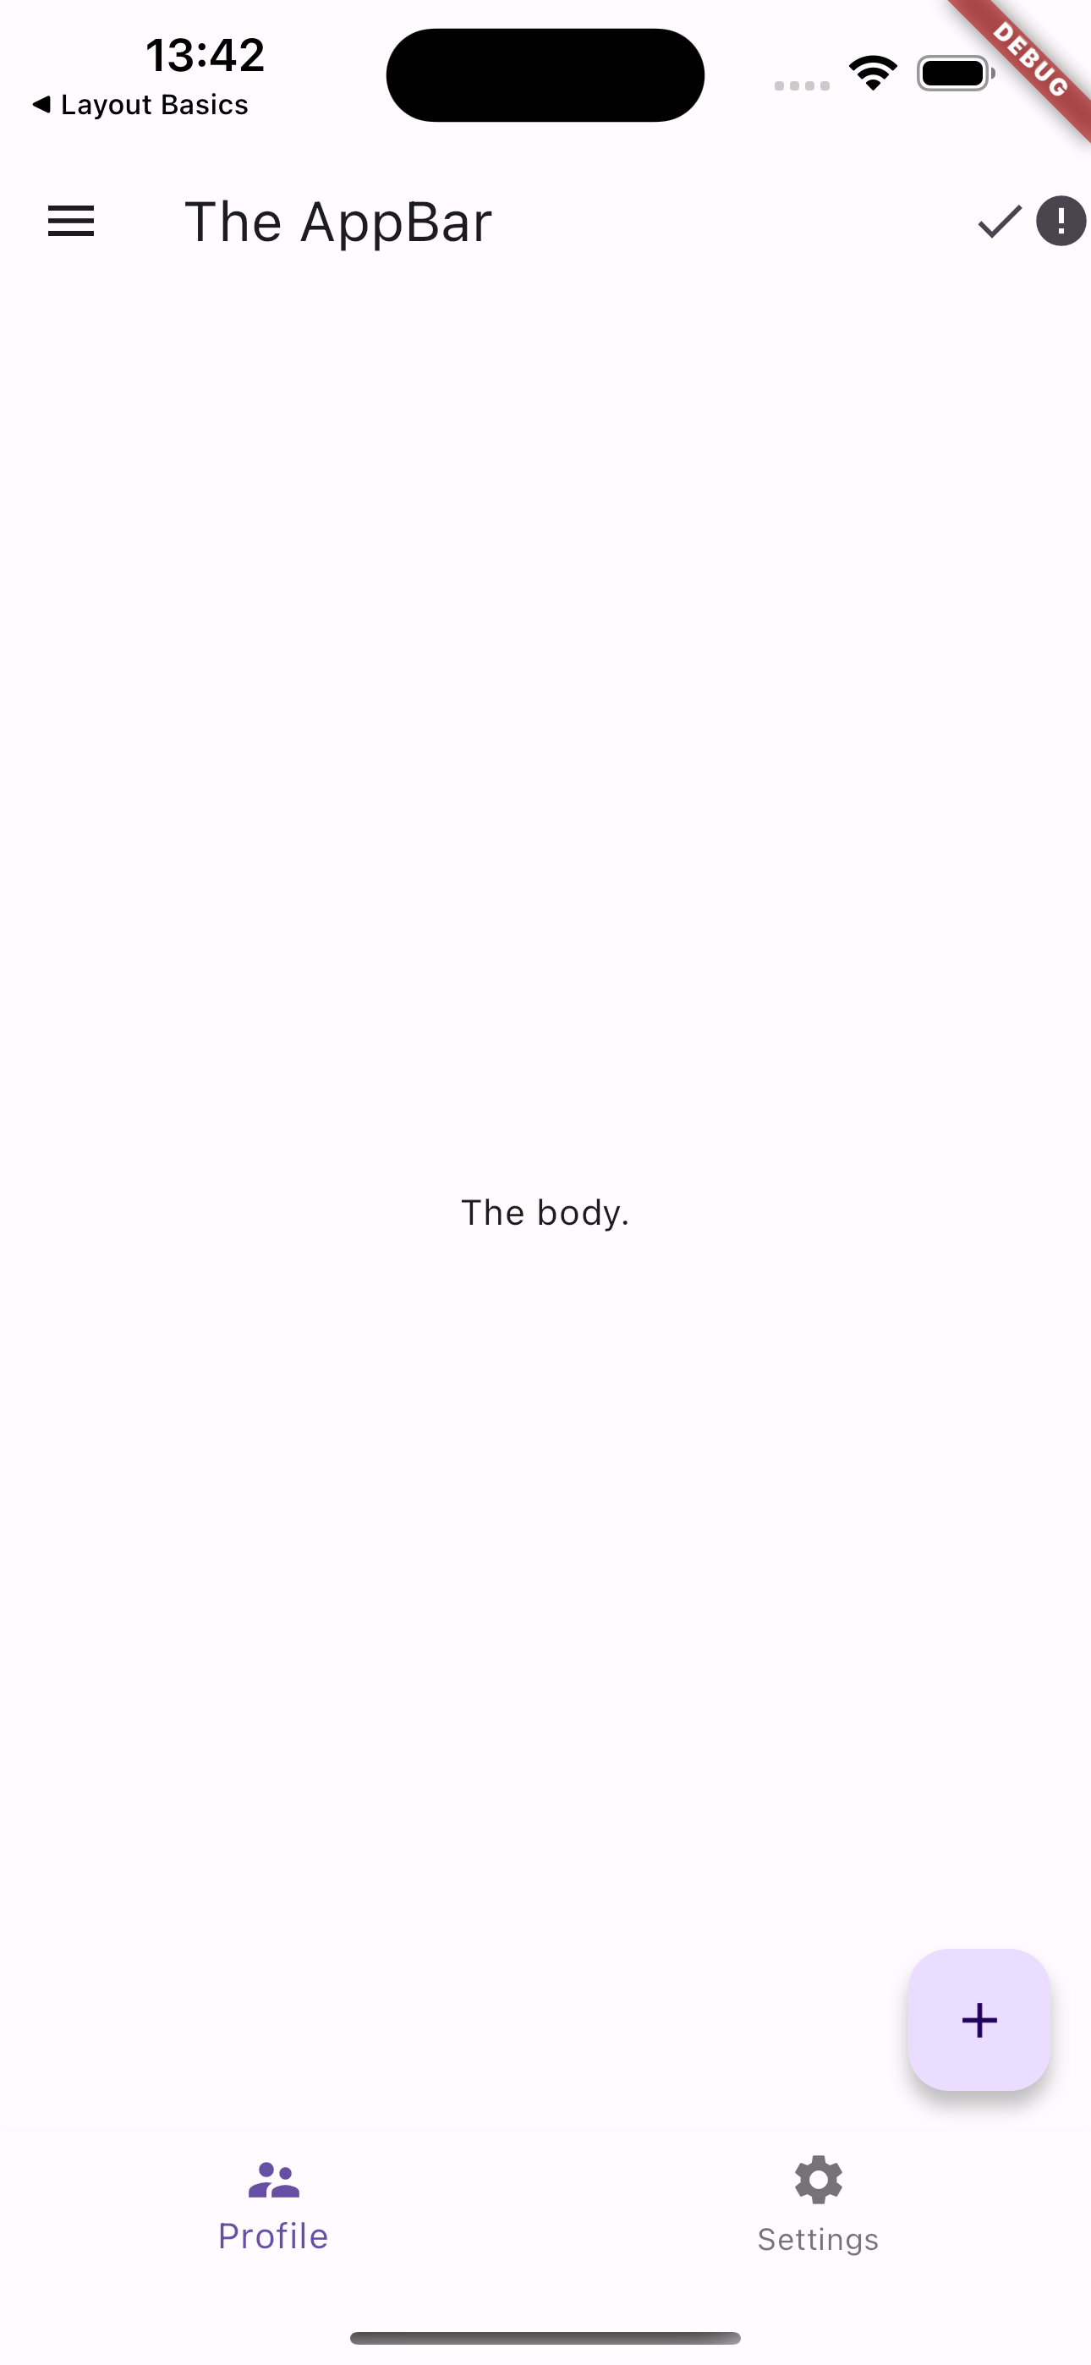
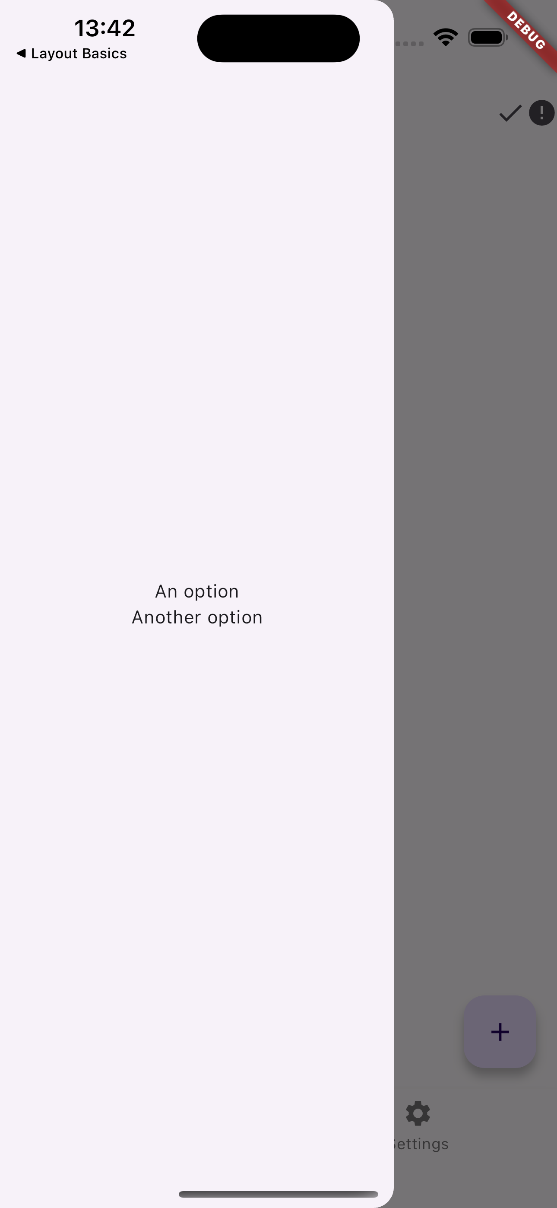
Focus on the Scaffold
//Constructor of Scaffold
const Scaffold({ Key key, this.appBar, this.body, this.floatingActionButton, this.floatingActionButtonLocation, this.floatingActionButtonAnimator, this.persistentFooterButtons, this.drawer, this.endDrawer, this.bottomNavigationBar, this.bottomSheet, this.backgroundColor, this.resizeToAvoidBottomPadding = true, this.primary = true, })

Slide 23
Focus on the Scaffold
//Constructor of Scaffold
const Scaffold({ Key key, this.appBar, this.body, this.floatingActionButton, this.floatingActionButtonLocation, this.floatingActionButtonAnimator, this.persistentFooterButtons, this.drawer, this.endDrawer, this.bottomNavigationBar, this.bottomSheet, this.backgroundColor, this.resizeToAvoidBottomPadding = true, this.primary = true, })

Slide 24
Focus on the Scaffold
...
home: Scaffold(
appBar: AppBar(
actions: [
Icon(Icons.done,),
Icon(Icons.error),
],
title: Text('The AppBar’),
),
...

Slide 25
Focus on the Scaffold
//Constructor of Scaffold
const Scaffold({ Key key, this.appBar, this.body, this.floatingActionButton, this.floatingActionButtonLocation, this.floatingActionButtonAnimator, this.persistentFooterButtons, this.drawer, this.endDrawer, this.bottomNavigationBar, this.bottomSheet, this.backgroundColor, this.resizeToAvoidBottomPadding = true, this.primary = true, })

Slide 26
Focus on the Scaffold
...
home: Scaffold(
...
drawer: Drawer(
child: Column(
mainAxisAlignment: MainAxisAlignment.center,
children: [
Text('An option’),
Text('Another option'),
],
),
),
...

Slide 27
Focus on the Scaffold
//Constructor of Scaffold
const Scaffold({ Key key, this.appBar, this.body, this.floatingActionButton, this.floatingActionButtonLocation, this.floatingActionButtonAnimator, this.persistentFooterButtons, this.drawer, this.endDrawer, this.bottomNavigationBar, this.bottomSheet, this.backgroundColor, this.resizeToAvoidBottomPadding = true, this.primary = true, })

Slide 28
Focus on the Scaffold
...
home: Scaffold(
...
body: Center(
child: Text('The body.'),
),
...

Slide 29
Focus on the Scaffold
//Constructor of Scaffold
const Scaffold({ Key key, this.appBar, this.body, this.floatingActionButton, this.floatingActionButtonLocation, this.floatingActionButtonAnimator, this.persistentFooterButtons, this.drawer, this.endDrawer, this.bottomNavigationBar, this.bottomSheet, this.backgroundColor, this.resizeToAvoidBottomPadding = true, this.primary = true, })

Slide 30
Focus on the Scaffold
...
home: Scaffold(
...
floatingActionButton:
FloatingActionButton(
child: Icon(Icons.add),
onPressed: () {},
),
...

Slide 31
Focus on the Scaffold
//Constructor of Scaffold
const Scaffold({ Key key, this.appBar, this.body, this.floatingActionButton, this.floatingActionButtonLocation, this.floatingActionButtonAnimator, this.persistentFooterButtons, this.drawer, this.endDrawer, this.bottomNavigationBar, this.bottomSheet, this.backgroundColor, this.resizeToAvoidBottomPadding = true, this.primary = true, })

Slide 32
Focus on the Scaffold
...
home: Scaffold(
...
bottomNavigationBar:
BottomNavigationBar(
items: [
BottomNavigationBarItem(
icon: Icon(Icons.supervisor_account),
label: 'Profile',
),
BottomNavigationBarItem(
icon: Icon(Icons.settings),
label: 'Settings',
)
],
),
),
Full example in lesson_07-ux_and_ui_in_flutter/scaffolding/

Slide 33
Grouping Widgets together
Grouping is how we visually communicate relationships.
Humans automatically assume:
Elements close together are related.
Elements inside the same container belong together.
Aligned elements form a logical group.
If we don’t group properly:
Screens feel chaotic
Users don’t know what belongs together
Cognitive load increases
Grouping reduces mental effort.

Slide 34
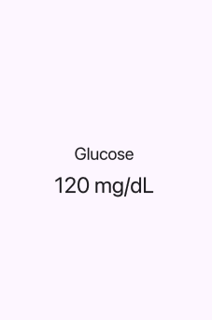
Column: The Vertical Grouping
Use the Column Widget when:
Elements belong together vertically
The user should read top-to-bottom
You are structuring a section
Column(
mainAxisAlignment: MainAxisAlignment.center,
children: [
Text(
"Glucose",
style: Theme.of(context).textTheme.titleLarge,
),
SizedBox(height: 8),
Text(
"120 mg/dL",
style: Theme.of(context).textTheme.headlineMedium,
),
],
)

Slide 35

Row: The Horizontal Grouping
Use the Row Widget when:
Items are at the same hierarchy level
The represent related but parallel information
You want side-by-side structure
Row(
mainAxisAlignment: MainAxisAlignment.center,
children: [
Text(
"Glucose",
style: Theme.of(context).textTheme.titleLarge,
),
SizedBox(height: 8),
Text(
"120 mg/dL",
style: Theme.of(context).textTheme.headlineMedium,
),
],
)

Slide 36
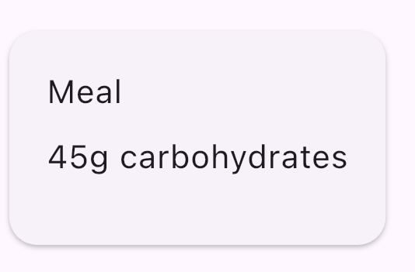
Card: The Unit Grouping
Use the Card Widget to communicate that:
This content is a unit
It belongs together
It can be interacted with as one block
Card(
child: Padding(
padding: EdgeInsets.all(16),
child: Column(
crossAxisAlignment: CrossAxisAlignment.start,
children: [
Text("Meal"),
SizedBox(height: 8),
Text("45g carbohydrates"),
],
),
),
),

Slide 37
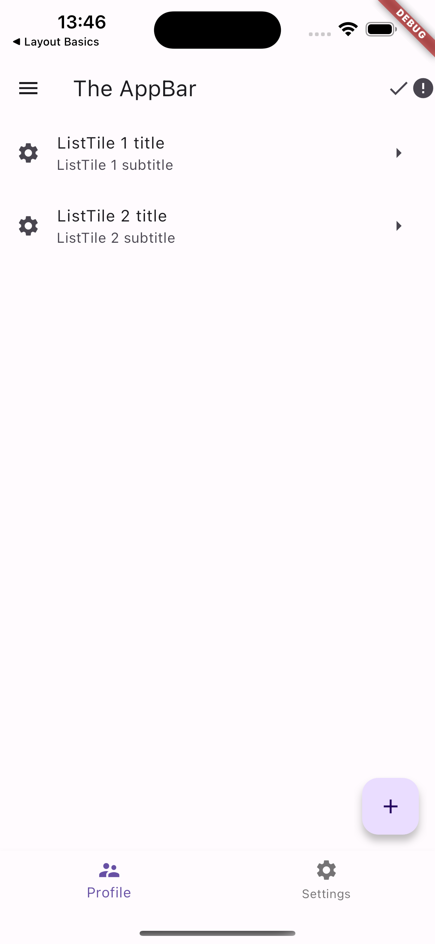
ListView
Use ListView if you want communicate that:
These are similar items
They share the same structure
They can grow dynamically
Conceptually they support scanning and pattern recognition in a UI.
Detailed info: https://api.flutter.dev/flutter/widgets/ListView-class.html

Slide 38

ListView
...
home: Scaffold(
...
body: ListView(
children: [
ListTile(
leading: Icon(Icons.settings),
title: Text('ListTile 1 title’),
subtitle: Text('ListTile 1 subtitle’),
trailing: Icon(Icons.arrow_right),
),
ListTile(
leading: Icon(Icons.settings),
title: Text('ListTile 2 title’),
subtitle: Text('ListTile 2 subtitle'),
trailing: Icon(Icons.arrow_right),
),
],
),
...
Full example in lesson_07-ux_and_ui_in_flutter/list_views/

