Slide 1
Integrating AI Models in Flutter – Part 1

Slide 2


Type 1 Diabetes
T1D is a chronic, autoimmune pathology, in which the pancreas is no longer able to produce insulin, which must then be externally injected
Safety range
+
=
Glucose
time

Slide 3





The burden of T1D management
T1D management is a constant learning process about how daily conditions/routine affect blood glucose (BG) levels.
+
+
Do exercise and check BG level
Have a rescue hypotreatment
BG level
Estimate meal amount and inject insulin
Ready to re-check BG level?
Check BG level
time
Hypoglycemia due to physical exercise
Feel deezy? Re-check BG level

Slide 4
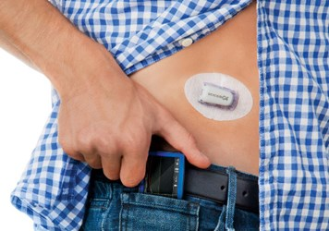
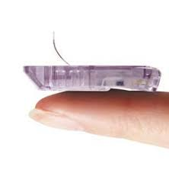

The role of wearable devices in T1D
Continuous Glucose Monitoring (CGM) systems:
Minimally-invasive sensors that measure interstitial glucose every ~ 1/5 minutes
Micro-needle under the skin that leverages glucose-oxidase reaction
Surpasses the traditional fingerprick devices

Slide 5
What does it mean in practice?
Without CGM
With CGM
Glucose
time

Slide 6
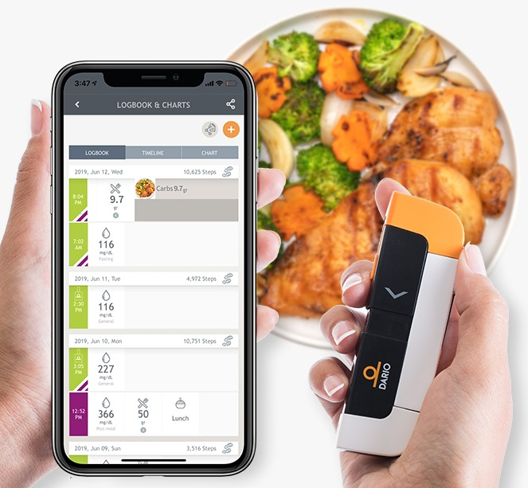

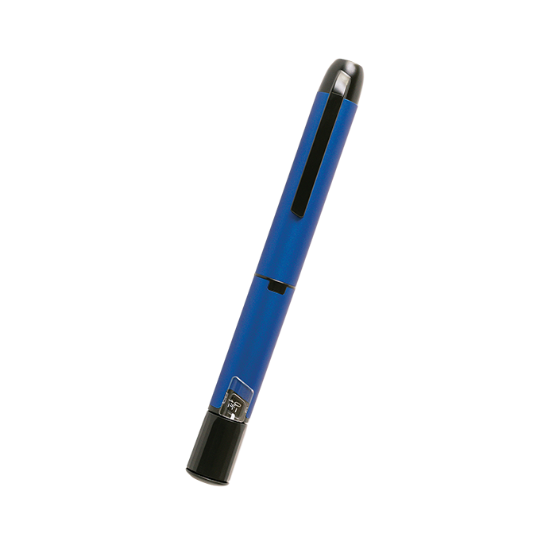
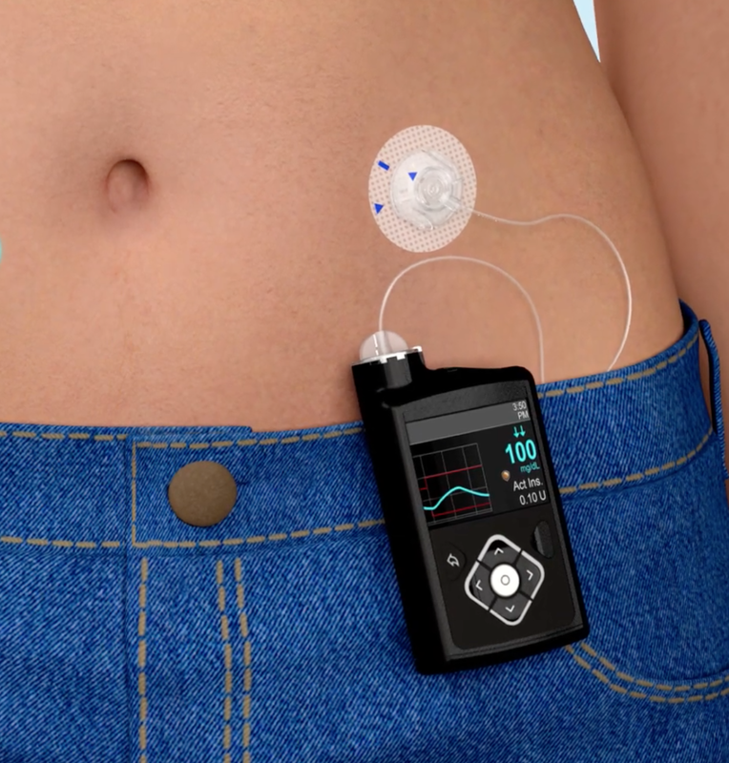
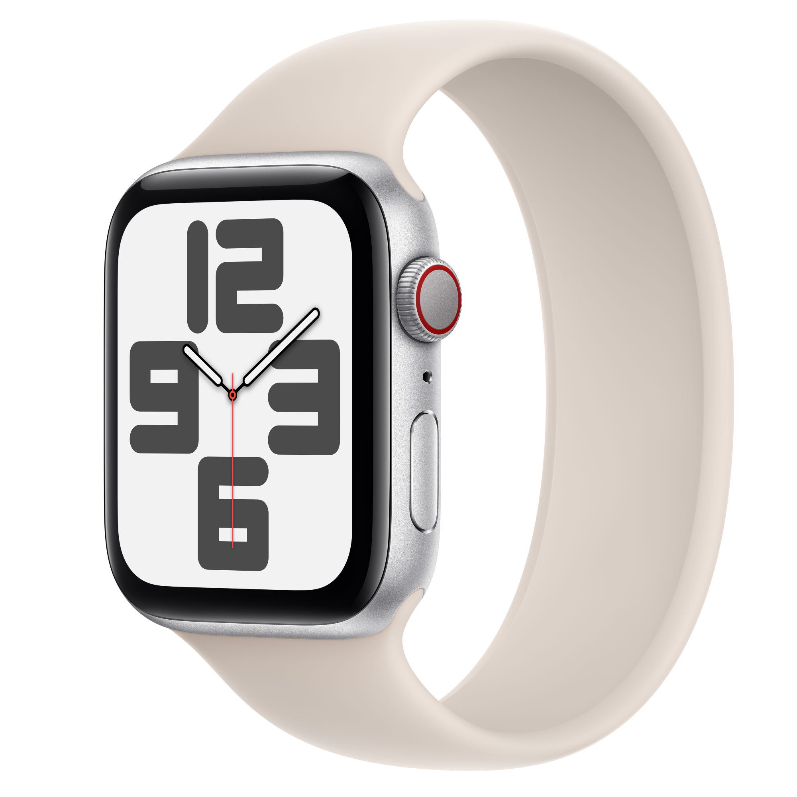
What does it mean in practice?
CGM
Apps for meal intake estimation
AI-based algos
Rich patient-generated dataset
Smart insulin pen Insulin pump
Activity tracker

Slide 7
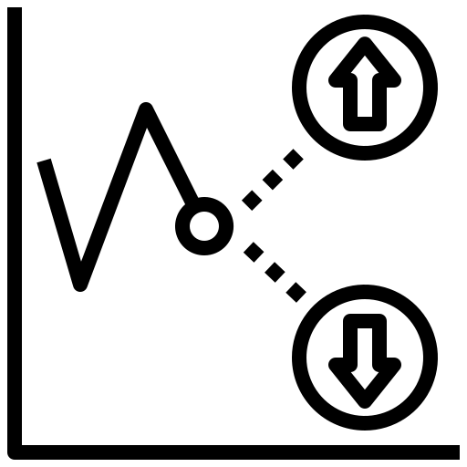
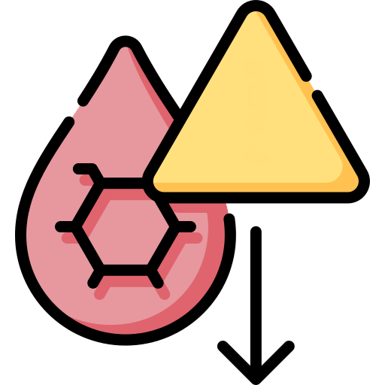



What does it mean?
Diabetes technology research community intensively focused on AI
Accurate predictive algorithms enable preventive actions → avoiding/mitigating onset of critical events
NOW
180
Glucose [mg/dL]
Predictive
algorithm
70
8
9
10
Time

Slide 8

Aim
Part 1
Build a 30-minute glucose prediction model
Part 2
Integrate the model in a Flutter app

Slide 9
Aim
Build a 30-minute glucose prediction model
Predict future CGM values using current CGM and Rate of Change
Train on real-world clinical data (ReplaceBG dataset)
Learn the full Python ML pipeline
Data loading & preprocessing
Feature engineering
Model training, evaluation, and export
Prepare for Flutter integration (Part 2)
Export model as a portable JSON file
Re-implement the prediction formula in Dart

Slide 10

The Dataset – ReplaceBG
We will use data coming from the ReplaceBG clinical trial (https://pmc.ncbi.nlm.nih.gov/articles/PMC5864100/)
Studied whether CGM can replace blood glucose for insulin dosing decisions
Conducted by the T1D Exchange consortium
Available freely thanks to the MetaboNet initiative: https://metabo-net.org/data
Dataset characteristics
~226 Type 1 Diabetes patients
CGM readings sampled every 5 minutes
Columns: date (timestamp), CGM (mg/dL), id (patient)
Available as a Parquet file
Efficient columnar binary format
Loaded with pandas + pyarrow
df = pd.read_parquet('data/ReplaceBG.parquet')

Slide 11
Setting Up
Requirements
Python 3.10+
numpy, pandas, scikit-learn, pyarrow
I provided a requirements file for convenience (pip install -r requirements.txt)
Project structure
predict_glucose/
data/ReplaceBG.parquet # input data
main.py # training script
model/cgm_forecast.json # exported model
requirements.txt

Slide 12

Step 1: Preparing the Data
Load and filter
Keep only CGM, date, id columns
Sort each patient's readings by timestamp
Patient-level train/test split
80% of patients → training set
20% of patients → test set
Avoids data leakage across patients
Build the target vector Y
Shift CGM by 6 samples = 30 minutes ahead
Y[t] = CGM[t + 6]
Drop rows with NaN (edges of the time series)

Slide 13

Step 2: Feature Extraction
Feature 1 – Current CGM value
Most informative single predictor of near-future glucose
Captures the current glucose level
Feature 2 – Rate of Change (ROC)
Glucose velocity over the last 15 minutes (3 samples)
ROC[t] = (CGM[t] - CGM[t-3]) / 15 # mg/dL/min
Captures the glucose trend (rising, stable, falling)
Final feature matrix X
X = [CGM, ROC] → shape: (N_samples, 2)
Simple yet physiologically meaningful
Easy to compute in real-time on a mobile device

Slide 14
Step 3: Model selection and training pipeline
sklearn Pipeline
StandardScaler: zero-mean, unit-variance normalization
LinearRegression: learns weights for CGM and ROC
model = make_pipeline(StandardScaler(), LinearRegression())
Why linear regression?
Simple and interpretable
Prediction formula can be trivially re-implemented in Dart/Flutter
Fast inference: a single dot product
Training
model.fit(X_train, Y_train)
Fits scaler parameters and regression coefficients on training patients

Slide 15
Step 4: Learning the model
Learned prediction formula
Y = 58.40 * (CGM - 159.70)/64.55 + 11.84 * (ROC + 0.001)/0.952 + 159.66
Y = 0.905*CGM + 12.44*ROC + 15.21
ROC coefficient is positive: rising glucose → higher future value

Slide 16

How about performance?
Evaluation on held-out test patients
y_pred = model.predict(X_test)
RMSE – Root Mean Squared Error (mg/dL)
R² – Coefficient of Determination
Interpreting the results
RMSE ~ 20 mg/dL is clinically acceptable for 30-min horizon
R² close to 1.0 indicates strong predictive power
Linear model is surprisingly competitive as a baseline

Slide 17

Exporting the Model
Export as JSON – language-agnostic format
No sklearn dependency needed at inference time
Can be bundled directly in Flutter app assets
JSON structure
feature_names: ["CGM", "ROC"]
mean: [159.70, -0.0008]
scale: [ 64.55, 0.9516]
coef: [ 58.40, 11.84 ]
intercept: 159.66
In Part 2 – Flutter integration
Load JSON from assets at app startup
Implement StandardScaler + dot product in Dart
Run real-time glucose predictions from live CGM stream

