Slide 1
Representational State Transfer (REST)

Slide 2
Representational State Transfer (REST)
Representational state transfer (REST): a software architectural style created to guide the design and development of the World Wide Web.
REST defines a set of constraints for how the architecture of an Internet-scale distributed hypermedia system (e.g., the Web) should behave.
Introduced in 2000 by Roy Fielding (co-founder of the Apache HTTP Server project) in his doctoral dissertation (University of California, Irvine).
The name “Representational State Transfer” evokes an image of how a well-designed Web application behaves:
a Web application forms a virtual state machine
the user progresses through the application by selecting a link or submitting a data-entry
each user action results in a transition to the next state of the application → a representation of that state is transferred to the user.

Slide 3

Architectural style
Architecture:
how system elements are identified and allocated
how they interact to form a system
the amount and granularity of communication needed for interaction
the interface protocols used for communication.
Architectural style: a set of architectural constraints that restricts the roles and features of architectural elements and the allowed relationships among those elements.

Slide 4
REST: goal and constraints
REST is a set of architectural constraints.
REST goal: to minimize latency and network communication, while at the same time maximizing the independence and scalability of components.
This is achieved by placing constraints on the interface between components, rather than on each component implementation.
In total, 6 architectural constraints:
Client-server architecture
Stateless communication
Cache constraint
Uniform interface between components
Layered system
Code-on-demand (optional)

Slide 5
Constraint 1: Client-server architecture
Principle of separation of concerns: a design principle for separating a computer program into distinct sections, in which each section addresses a separate concern (i.e., a different task) → modular system
The client-server (CS) architecture relies on the principle of separation of concern: separation of the user interface concerns (client) from the data storage concerns (server)
Advantages of the client-server architecture
It improves the portability of the user interface across multiple platforms
It improves scalability by simplifying the server components
It allows the client and the server components to evolve independently

Slide 6
Constraint 2: Stateless communication
Communication must be stateless in nature: the server does not store any state about the client session (i.e., the history of requests) on the server-side.
Each request from client to server must be standalone
It must contain all information necessary to understand the request
It cannot take advantage of any stored information on the server.
The session state (i.e., the history of requests) is kept entirely on the client.
If the server needs any information about previous requests to process the current request, then the client must provide this information in the current request.
Advantages:
Improved visibility: no need to look beyond the current request to determine its full nature.
Improved reliability: recovering from partial failures is easier.
Improved scalability: the server does not have to manage resource usage across requests
Tradeoff: it may decrease network performance by increasing the repetitive data sent in a series of requests

Slide 7
Constraint 3: Cache constraint
The data within a response to a request must be implicitly or explicitly labelled as cacheable or noncacheable.
If a response is cacheable, a client cache can reuse that response data for later, equivalent, requests.
Advantage:
Improved efficiency: it partially or completely eliminate some interactions.
Tradeoff:
Decrease reliability, if data within the cache differs significantly from the data that would have been obtained with a new request to the server.

Slide 8
Constraint 4: Uniform interface between components
The information is exchanged in the same way for every client-server interactions, whatever the client and the server are.
There is a common language between servers and clients that allows each part to be substituted or modified without breaking the entire system.
Advantage:
Independent evolvability of the system components: the implementation of interfaces is decoupled from the services they provide.
Tradeoff:
Decreased efficiency for some applications: the information is transferred in a standardized form rather than one which is specific to an application’s needs.

Slide 9
Constraint 5: Layered system style
The architect can inject “layers” of service between the server and the client to efficiently serve the client requests.
The layering must be transparent to the client: each component cannot “see” beyond the immediate layer with which it is interacting → the client does not know if it is talking with final data server or an intermediate server.
Advantage: by restricting knowledge of the system to a single layer, we place a bound on the overall system complexity and promote component independence.
Tradeoff: layers add overhead and latency to the processing of data, reducing user-perceived performance.
Request
Request
Request
Client
Intermediate component 1
Intermediate component 2
Data server
…
Response
Response
Response

Slide 10
Example of layered system: proxy
Proxy: a server that acts as an intermediary between a client and a server. The client directs the request to the proxy server, which evaluates the request and performs the required network transactions.
Possible uses of proxies:
Load balancing: a resource collection is stored in multiple servers, the proxy server receives all the requests to that resources and redirect each request to the competent data server.
Anonymous proxy: a server that forward the client’s requests to the data server without revealing the IP address of the client that originated the request.
Caching: a proxy can be used to cache static contents to improve the network efficiency
Security: a proxy can implement the cryptographic protocols of secure websites
Request
Request
Client
Proxy
Data server
Response
Response

Slide 11
Example of layered system: three-tier application
Three-tier application: a web application that consists of three tiers (or layers) implemented in physically different components
Request
Request
Presentation tier
Application or logic tier
Data tier
Response
Response
User interface
Control of app functionalities and data processing
Data storage

Slide 12
Constraint 6: Code-on-demand (optional)
The client functionalities can be extended by downloading and executing code in the form of applets or scripts.
Advantage:
Clients are simplified by reducing the number of features required to be pre-implemented.
Allowing features to be downloaded after deployment improves system extensibility.
This constraint is not mandatory but optional: the architecture should support this constraint in the general case, but this may be disabled within some contexts.

Slide 13
The definition of the uniform interface
The REST uniform interface (constraint 4) is defined by putting 4 requirements on the interface between components (clients and servers):
Hypermedia as the engine of application state (HATEOAS)
Identification of resources
Manipulation of resources through representations
Self-descriptive messages

Slide 14

Hypermedia as the engine of application state
Web applications are based on distributed hypermedia:
When a client interacts with a Web application, the application servers provide information dynamically through hypermedia.
Hypermedia: any content that contains links to some other form of media (e.g., an image, a movie, a text) → generalization of hypertext for a general media.
When a link is selected, information is moved from the location where it is stored in the server to the location where it will be used in the client → application state transition.
A REST client needs no prior knowledge about how to interact with an application server beyond a generic understanding of hypermedia.

Slide 15

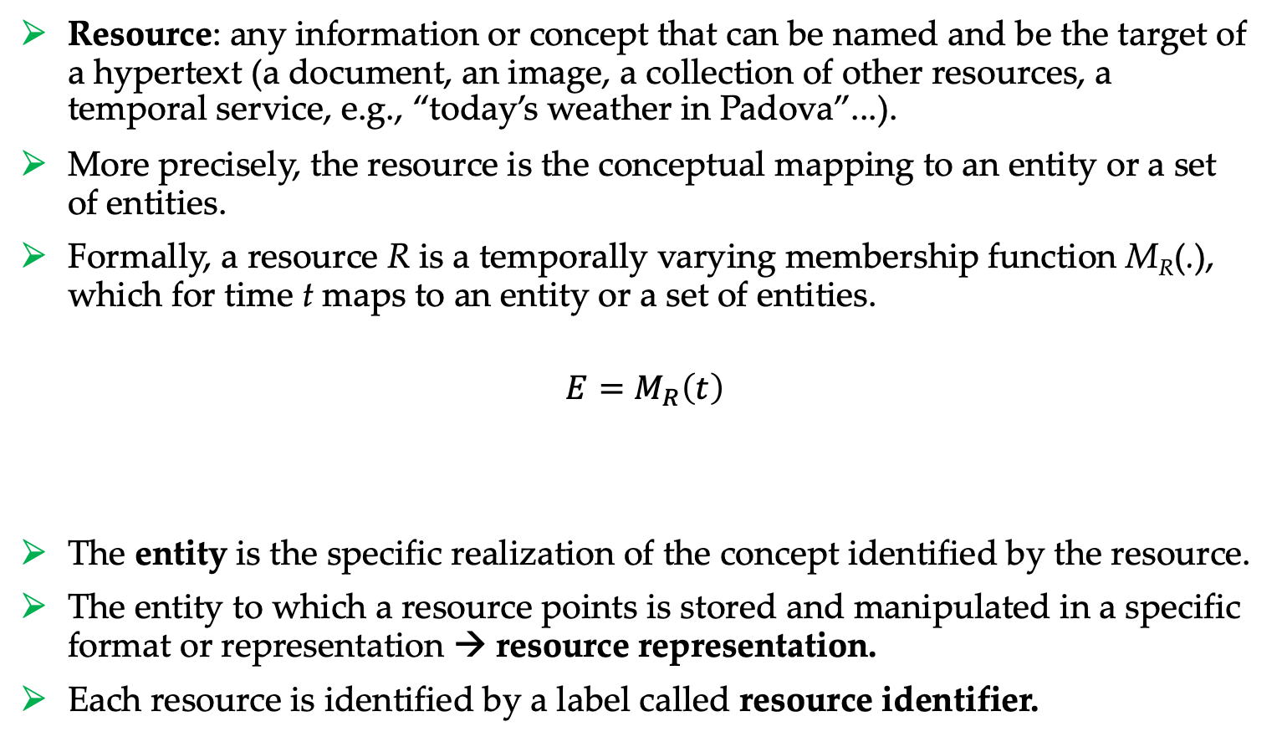
Identification of resources
Resource: any information or concept that can be named and be the target of a hypertext (a document, an image, a collection of other resources, a temporal service, e.g., “today’s weather in Padova”...).
More precisely, the resource is the conceptual mapping to an entity or a set of entities.
Formally, a resource R is a temporally varying membership function M_{R}(.), which for time t maps to an entity or a set of entities.
$E=M_{R}\left(t\right)$
The entity is the specific realization of the concept identified by the resource.
The entity to which a resource points is stored and manipulated in a specific format or representation → resource representation.
Each resource is identified by a label called resource identifier.
Entity
Resource
Time

Slide 16
Resources types
Example:
«the first version of document X»
«the revision 1.0 of document X»
«the revision 1.1 of document X»
…
«the latest version of document X»
A resource can also point to the empty set → this allows to map a concept, i.e., to make references to that concept, before any realization of that concept exists.
Static resources: they always point to the same entity (with a specific representation), in this case a precise document version.
Dynamic resource: the pointed entity can change over time. At some time, the resource «the latest version of document X» will point to the same entity of «the revision 1.1 of document X».

Slide 17
Resources
NEW SLIDE
The abstract definition of resources in REST facilitates content negotiation, which is the process of selecting the most appropriate representation of a resource based on the characteristics of the request.
Let's break down why this is possible

Slide 18
Resources
NEW SLIDE
1. Resource-Centric Design: In REST, the focus is on resources rather than actions. Each resource is uniquely identified, and interactions with resources are typically performed using standard HTTP methods (GET, POST, PUT, DELETE). By abstracting away from specific actions, REST allows for a more flexible and adaptable system.
2. Late Binding of Representations: The abstract definition of resources means that the server can provide different representations of the same resource based on the client's preferences or capabilities. This is known as late binding, as the specific representation is determined at runtime, typically in response to a client request. For example, a client might prefer to receive JSON representations of resources, while another client might prefer XML.

Slide 19
Resources
NEW SLIDE
3. Content Negotiation: Content negotiation is the mechanism by which the server and client agree on the most suitable representation of a resource. This negotiation can be based on various factors, including the client's preferences (as expressed in request headers), the capabilities of the client (such as supported media types), and the characteristics of the resource itself. The server examines these factors and selects the most appropriate representation to include in the response.
4. Flexibility and Interoperability: By allowing content negotiation to take place based on the characteristics of the request, RESTful systems become more flexible and interoperable. Clients and servers can communicate effectively even if they have different preferences or capabilities.
In summary, the abstract definition of resources in REST enables content negotiation by allowing specific representations to be late-bound to resources. This flexibility promotes interoperability and enhances the adaptability of RESTful systems to diverse client requirements.

Slide 20
Resource representations
Resource representation: a view of the current state (or realization) of the resource at the time of the request.
In a client-server interaction, the client asks to the server a resource (by the resource identifier), and the server answers by sending the corresponding resource representation.
Note: The representation sent to the client is not necessarily the same used to store the data in the server.
Resource identifier
Server
Client
Entity
Resource representation
(raw format)

Slide 21
Representations: example
Representation 1: one point for the circle center and one vector for the circle radius in SVG format
Resource: circle
Entity: a circle realization
Representation 2: coordinates of three points of the circumference in a csv file

Slide 22
REST self-descriptive messages
REST request message
Control data
(mandatory)
Resource identifier
(mandatory)
Representation
(optional)
Server
Client
Entity
(raw format)
REST response message
Control data
(mandatory)
Representation
(optional)
Resource metadata (optional)

Slide 23
Resource representations and REST messages
A resource representation includes:
Data (the actual representation)
Metadata (description of the representation) → typically, not displayed to the end user (e.g., data type, creation date, version number, …)
The resource representation is provided to the client within a response message that contains some additional contents:
Resource metadata (optional): additional information about the resource that exists on the server (e.g., alternate text to be displayed in the event an image representation cannot be displayed for some reason).
Control data (mandatory): it deals with the validity of the resource and its representation on the client (e.g., if data is cacheable, the expiry time, a checksum for checking integrity, …).

Slide 24
Summary of REST
An architectural style for distributed hypermedia systems
6 constraints
Client-server architecture
Stateless communication
Cache constraint
Uniform interface
Layered system
Code-on-demand (optional)
The uniform interface is realized through the definition of abstract resources
Each resource is identified by a resource identifier
The realization of a resource is an entity
A resource is manipulated by resource representations that reflect the current realization of the resource
Representations can be sent from server to client (or viceversa) encapsulating them in a self-explained message
A request message must include control data (mandatory), resource identifier (mandatory) and representation’s data and metadata (optional)
A response message must include control data (mandatory), representation’s data and metadata (optional) and resource metadata (optional)
The REST paradigm increases performance, scalability, simplicity, modifiability, visibility, portability, and reliability of the system.

Slide 25
References
Roy T. Fielding and Richard N. Taylor, “Principles and design of the modern Web architecture”, ACM Transactions on Internet Technology, Vol. 2, No. 2, May 2002, Pages 115–150. https://www.ics.uci.edu/~taylor/documents/2002-REST-TOIT.pdf

