Slide 1
Application Programming Interface (API)

Slide 2
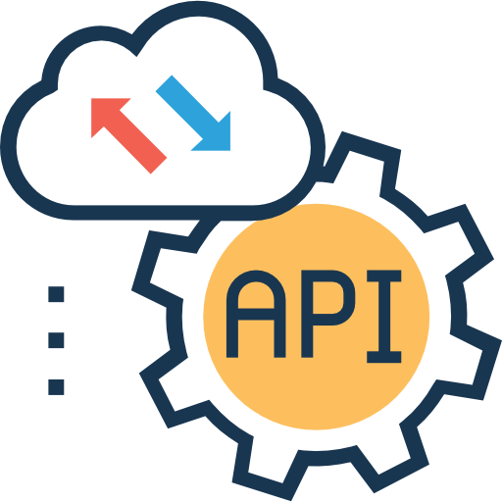
Application programming interface (API)
Two separate applications need an intermediary to talk to each other and to allow one application to access the information or functionality of the other.
Application programming interface (API): a connection or interface between computer programs, which defines how the systems can interact.
The kind of requests that can be made to a system
How to make them
The data formats that should be used
The conventions to follow
In contrast to a user interface, which connects a computer to a person, the API connects pieces of software

Slide 3
Application programming interface (API)
Why do we need API? To allow interoperability, i.e., to allow multiple systems to cooperate.
An API defines how two software systems can interact while hiding the internal details of how each system works. The API exposes only those parts that are needed for the systems to interact and keeps them consistent even if the internal details of the systems later change → Modular programming
The API is often made up of different tools or services that other applications can call.
API specification: a document or standard describing how to build or use the API tools or services.
An API may be custom-built for a particular pair of systems, or it may be a shared standard allowing interoperability among many systems.

Slide 4
Release policy
Based on the release policy, API can be private, partner or public.
Private API
Used only within an organization
For applications that are built for company employees
Common use cases: the integration of company apps or the development of new systems using existing resources
Partner API
Openly promoted but available only for business partners
The target for these API is an application of a business partner of the provider
Common use cases: the integration between the applications of two organizations
Public API
Available to any third-party developers
For applications designed for end customers
They can be open or commercial

Slide 5
Some API types
Library API: the part of a software library that is accessible to programmers (the methods, subroutines or services that can be called by external programs and the specifications of how they can be called)
Language binding: it allows a software written in a certain programming language to use a library written in another language.
Example: Python bindings are API that allows to call C libraries from Python
Operating systems API: the interface between an application and the operating system.
Example: Windows API, which allows Windows programs to interact with the operating system
Database API: They enable an application to communicate with a database management system (example: Drupal 7 Database API).
Web API: API for web-based systems in a client-server architecture

Slide 6
Web API
Web API: an interface for clients and servers that allows them to interact through the Web.
Server-side Web API: the interface of a Web server towards the Web. It consists of one or more publicly exposed endpoints.
Endpoints: the URLs which specify where the resources that can be accessed by clients lie.
Client-side Web API: a software interface that a client uses to send requests to a server-side Web API.
It allows a client web browser or web application to extend its functionality, by exploiting resources (data, programs, more in general services) provided by Web servers.

Slide 7
Request-response Web API
Most of Web APIs are request-response APIs that rely on the HTTP protocol.
HTTP request
Client
Server
Endpoint
HTTP response
Endpoint
Endpoint
Client-side API:
The piece of software that sends requests to the server.
Server-side API:
The piece of software that receives the requests and the endpoints that provide the requested resources.

Slide 8

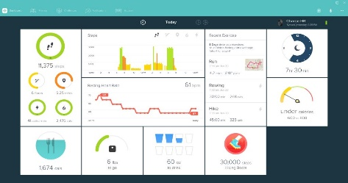

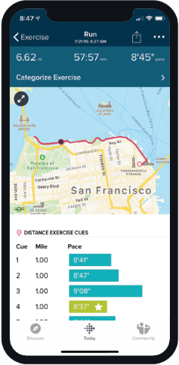
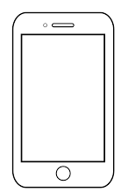
Examples of API in wearable sensors
Web application
Map database
Web API
Proprietary mobile app
Wearable device
Bluetooth API
Sensor company database
Web API
Web API
Web API
Other third-party application

Slide 9
Approaches to design request-response Web API
Web APIs are realized using protocols and/or specifications to define the semantics and syntax of the messages exchanged by client and server.
→ API architectures
Most popular request-response API architectures:
RPC: Remote Procedure Call
SOAP: Simple Object Access Protocol
REST architectural style
In this case the API is called RESTful API.
GraphQL

Slide 10
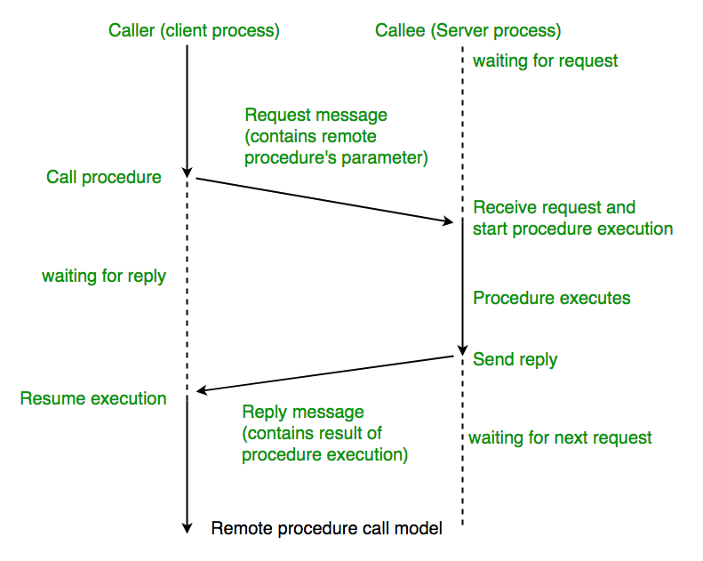
Remote Procedure Call (RPC)
The simpler and oldest web API approach, proposed by Bruce Jay Nelson in 1981.
Remote Procedure Call (RPC) is a request-response protocol by which the client sends a request message to a known remote server to execute a specified procedure with supplied parameters.
RPC extends the conventional local procedure calling so that the called procedure does not need to be in the same address space as the calling procedure. The two processes may be on the same system, or on different systems with a network connecting them.
In RPC the endpoints represent actions

Slide 11
Remote Procedure Call (RPC)
Different RPC protocols:
1997: XML-RPC uses XML to encode its calls and HTTP to send requests and responses
2005: JSON-RPC uses JSON to encode data and HTTP to send requests and responses
2016: Google RPC (gRPC) uses Protocol Buffers to encode data and HTTP/2 to send requests/responses
Pros:
Straightforward and simple interaction: all is done with GET and POST HTTP methods
Easy to add functions: a new function can be defined and associated to a new endpoint
High performance: having the functions in the URL allows to have lightweight payloads
Cons:
Tight coupling to the underlying system: RPC messages are not standardized. Their format depends on the specific application → low reusability of the API
Use cases: to perform extremely high-performance, low-overhead internal messaging within big companies (Google, Facebook, Twitch, etc. ).

Slide 12
Example of RPC
This example illustrates an online shop system that tries to handle a transaction with RPC.
The function paymentService.prcessPayment is implemented in another system.
User must know a lot of things to use the function: i.e., how to create a Card, function parameters, the structure of a Result, etc…
Card card = Card();
card.setCardNumber("1234 5678 1234 5678");
card.setExpiryDate("11/30");
card.setCVC("123");
Result result = await paymentService.processPayment(card, 3.99, Currency.EUR);
if(results.isSuccess()){
fulfilOrder();
}

Slide 13
Simple Object Access Protocol (SOAP)
Released by Microsoft in 1998
Web API protocol with highly standardized messages written in XML
It runs over HTTP or other application layer protocol
<?xml version="1.0"?> <soap:Envelope xmlns:soap="http://www.w3.org/2003/05/soap-envelope/" soap:encodingStyle="http://www.w3.org/2003/05/soap-encoding"> <soap:Header> ... </soap:Header> <soap:Body> ... <soap:Fault> ... </soap:Fault> </soap:Body> </soap:Envelope>
It defines the XML document as a SOAP message
Application-specific information specifying how the recipient should process the message (optional)
The message body
Error messages (optional)

Slide 14
Example of SOAP messages
Example of SOAP request:
Example of SOAP response:
POST /InStock HTTP/1.1 Host: www.example.org Content-Type: application/soap+xml; charset=utf-8 Content-Length: nnn <?xml version="1.0"?> <soap:Envelope xmlns:soap="http://www.w3.org/2003/05/soap-envelope/" soap:encodingStyle="http://www.w3.org/2003/05/soap-encoding">
<soap:Body xmlns:m="http://www.example.org/stock">
<m:GetStockPrice> <m:StockName>IBM</m:StockName> </m:GetStockPrice>
</soap:Body>
</soap:Envelope>
HTTP/1.1 200 OK Content-Type: application/soap+xml; charset=utf-8 Content-Length: nnn <?xml version="1.0"?> <soap:Envelope xmlns:soap="http://www.w3.org/2003/05/soap-envelope/" soap:encodingStyle="http://www.w3.org/2003/05/soap-encoding"> <soap:Body xmlns:m="http://www.example.org/stock"> <m:GetStockPriceResponse> <m:Price>34.5</m:Price> </m:GetStockPriceResponse> </soap:Body> </soap:Envelope>

Slide 15
SOAP: pros and cons
Pros:
Web Services Security (WS-Security): an extention of SOAP that allows to use security mechanisms (e.g., signature of messages, encryption of messages, authentication)
SOAP allows to perform stateful communications, necessary for complex transactions in which multiple parties are involved (e.g., online banking and e-commerce applications)
Cons:
Only XML
Heavy messages
Specialized knowledge of the protocol rules needed

Slide 16
RESTful APIs
With the expansion of modern Web, a more simple, flexible and scalable way of defining API was needed.
RESTful APIs: APIs designed according to the REST principles, proposed in 2000 by Roy Fielding.
REST is resource-based (instead of action-based) and it only uses the HTTP methods (GET, POST, PUT, DELETE) → no specialized knowledge required
No strict protocol, only compliance with the 6 REST constraints
No constraints on the message format → JSON preferred to XML

Slide 17
RESTful APIs: pros and cons
Pros:
Easy, no specialized knowledge required
Multiple formats supported
Great flexibility and scalability
Cache-friendly
Cons:
REST messages have large payloads to transfer metadata necessary to understand the state of the application and to enable complex actions.
Chatty interactions: it generally requires multiple requests to get the needed data. Often unnecessary data are transferred.
Server
Endpoint
Company name, location, year of founding
Client
Company name and founder’s name
Endpoint
Founder’s name, place of birth, education
Results of multiple requests neeed to be processed (combined and filtered) on client side.

Slide 18
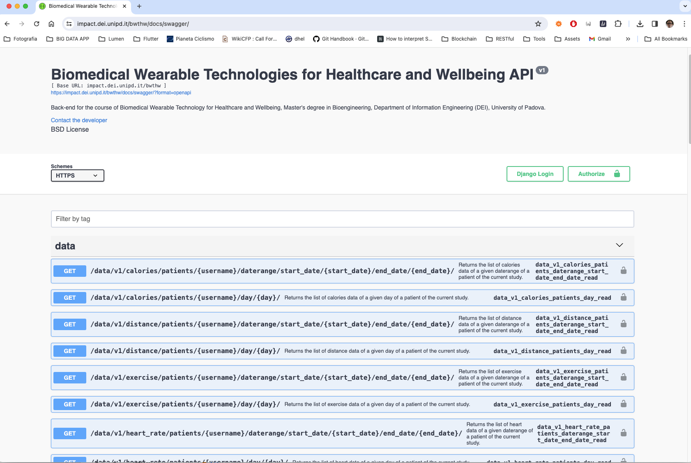
The IMPACT BWTHW RESTful API
This is the API you will use to build your project
It allows to authenticate, ping (to know if the server is alive), and to get data
Full URL: https://impact.dei.unipd.it/bwthw/

Slide 19
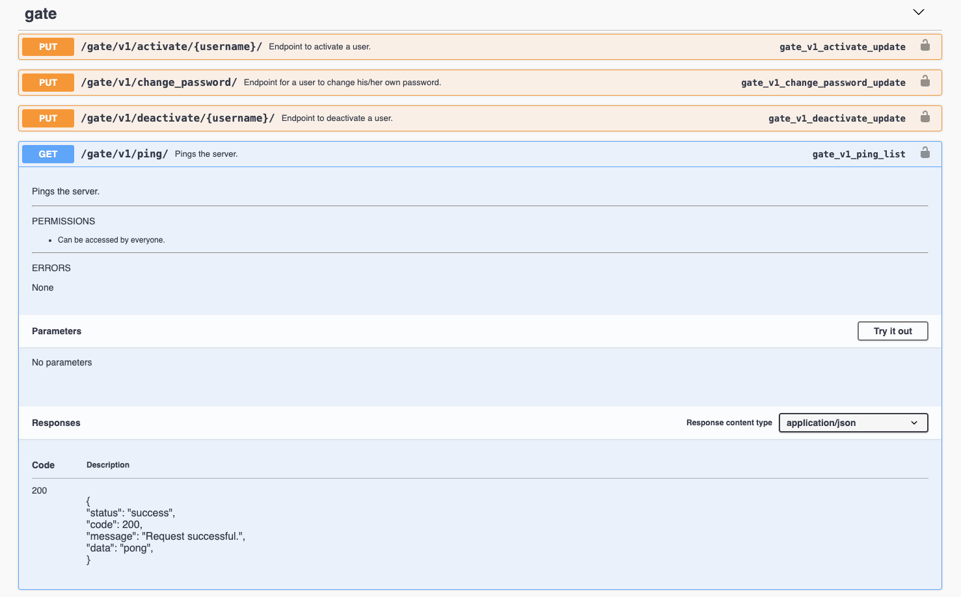
The ping endpoint
Let’s inspect the ping endpoint
Key things we can learn from the docs:
Method: GET
Full URL: https://impact.dei.unipd.it/gate/v1/ping/
It does not require parameters
It does not require to be authenticated
If successful, the response will be a JSON

Slide 20
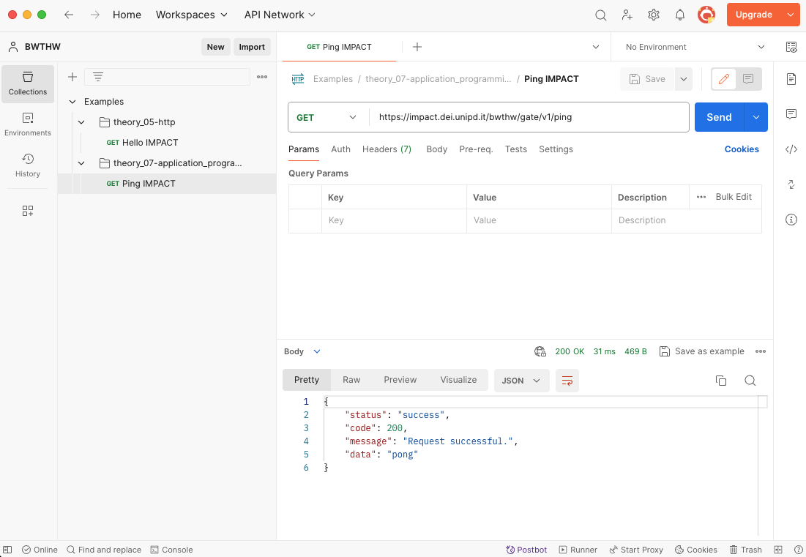
The ping endpoint
POSTMAN can be used to make a request and test it

Slide 21
GraphQL
Released by Facebook in 2015
GraphQL is a syntax to make precise data requests (queries) to servers
Servers provide the clients with a schema that specifies which resources are available, how they are structured and the types of queries that can be done.
Based on the schema, the client can formulate specific queries and send them to the server which will return exactly the data requested by the client’s query (no more, no less).
REST
Multiple endpoints
Servers decide how data are returned
No schema
GraphQL
Single endpoint
Clients decide how data are returned
Schema required

Slide 22
GraphQL: Example
NEW SLIDE
For example, a GraphQL service that tells you who the logged in user is (me) as well as that user’s name might look like this:
Along with functions for each field on each type:
Then, GraphQL queries like:
type Query { me: User }
type User {
id: ID
name: String
}
function Query_me(request) { return request.auth.user }
function User_name(user) { return user.getName() }
{
me {
name
}
}
{
"me": {
"name": "Luke Skywalker"
}
}
Could produce the following JSON result:

Slide 23
Summary of types of request-response Web APIs
 | RPC | SOAP | RESTful | GraphQL
Organized in terms of | Local procedure calling | Enveloped message structure | Compliance with 6 architectural constraints | Schema of server’s resources
Format | Multiple (JSON, XML, Protobuf, …) | XML only | Multiple (JSON, XML, HTML, plain text, …) | JSON
Statefull or stateless | Both | Both | Stateless | Stateless
Learning curve | Easy | Difficult | Easy | Medium
Community | Large | Small | Large | Growing
Use cases | Command and action-oriented APIs, internal high performance and massive micro-services | Payment gateways, identity management, financial applications | Public APIs, simple resource-driven app | Mobile APIs, complex systems

Slide 24
Request-response API architecture
RPC, SOAP, RESTful, GraphQL are all types of request-response Web API
To get the latest information, the client always have to poll the API provider (server).
Has the train arrived?
User
8:00
API provider
No
Train station server
Has the train arrived?
8:05
No
…
8:25
Has the train arrived?
Yes!

Slide 25
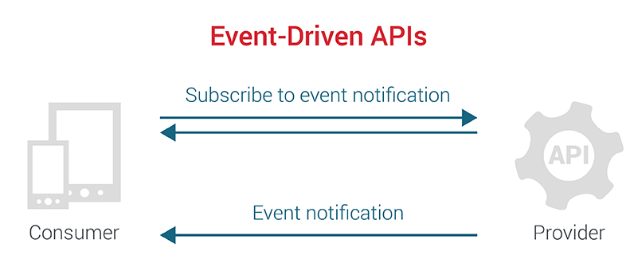
Event-driven API architecture
In event-driven APIs the API provider notifies the client when something interesting happens. Notifications do not need a request from the client.
An event-driven API must offer two capabilities to its clients
A mechanism to allow clients to subscribe to events of their interest.
Delivery of events to subscribed clients in an asynchronous manner.
User
Please notify me when the train arrives.
API provider
8:00
Train station server
8:25
The train arrived.

Slide 26
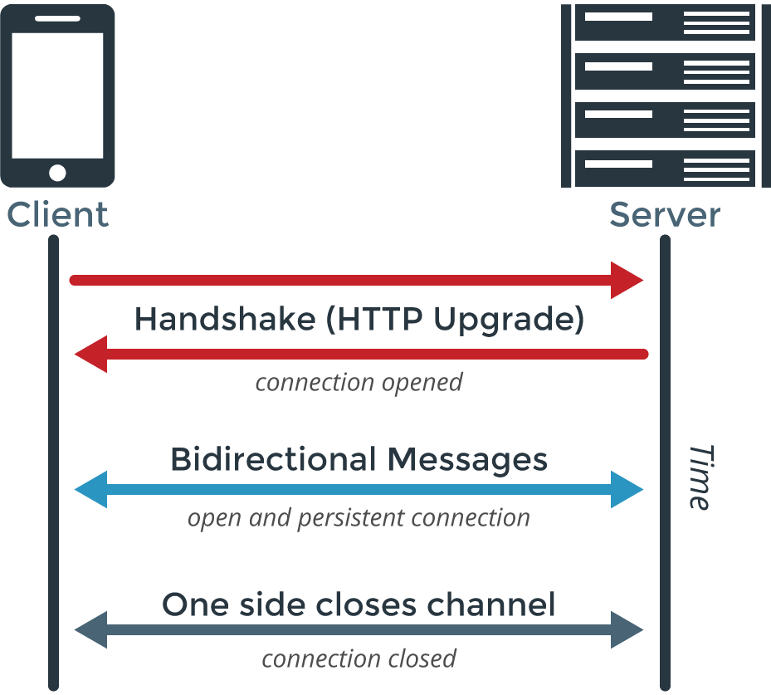
WebSocket
An example of protocol for event-driven APIs
WebSocket allows for constant, bi-directional communication between the server and client, which means both parties can communicate and exchange data as and when needed.
Suitable for realizing Web chats.

