Slide 1
Giacomo Cappon
Requesting data

Slide 2
Outline
Recap
Requesting data from IMPACT
Exercise
Resources

Slide 3







Recap: The IMPACT backend
HTTPS requests/responses
Lesson 9
Get token (JWT) using credentials
(If credentials are ok) Receive token
Ask for specific data using token
(If request is ok) Receive data (JSON format)
https://impact.dei.unipd.it/bwthw/
Your app
Lesson 10

Slide 4
The entire flow in practice
Use credentials to ask for a JWT token pair
Receive JWT token pair
Store token pair for making calls
Access token expired?
YES
NO
YES
Refresh token expired?
Make a call to get data using access token
NO
Get a new token pair using the refresh token and store it

Slide 5
The (required) flow in practice
Use credentials to ask for a JWT token pair
Receive JWT token pair
Store token pair for making calls
Access token expired?
YES
NO
Get a new token pair using the refresh token and store it
Make a call to get data using access token

Slide 6
Outline
Recap
Requesting data from IMPACT
Exercise
Resources

Slide 7
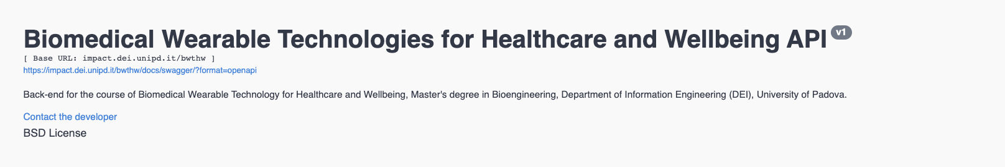
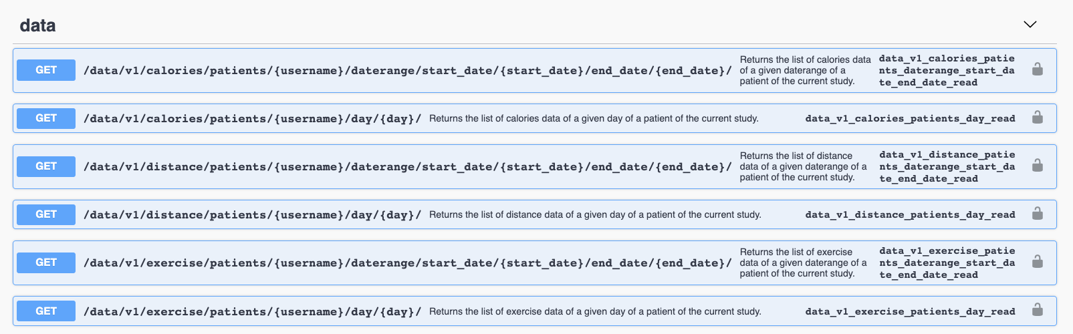
Requesting data: The IMPACT data

Slide 8

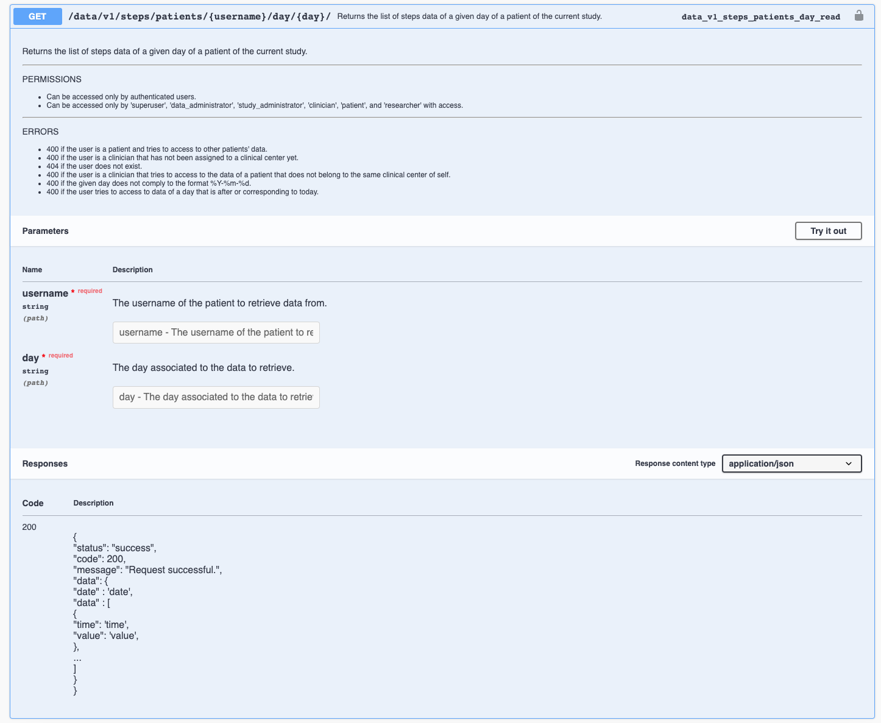
Example: Obtaining step data
For example, let’s obtain the steps data of 2023, May, 4th
{
"username": "Jpefaq6m58",
"birth_year": 1994,
"display_name": "Luca",
"clinical_center": 1,
"to_be_deleted": false
}

Slide 9
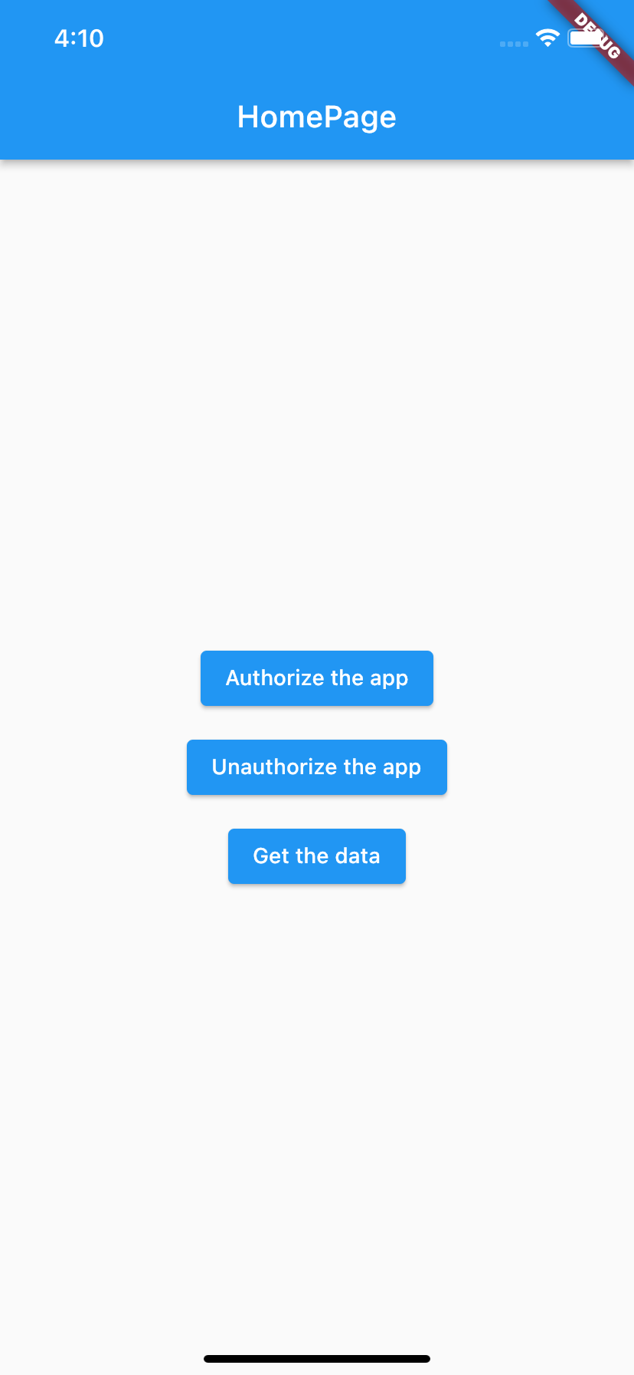
Case of study - Live
Let’s implement the operations required to request the data
Access token expired?
YES
NO
Get a new token pair using the refresh token and store it
Make a call to get data using access token
Full example in lab_10-requesting_data/get_step/

Slide 10
Outline
Recap
Requesting data from IMPACT
Exercise
Resources

Slide 11
Exercise
Get familiar with the example
Try to integrate the request data flow in your project

Slide 12
Outline
Recap
Requesting data from IMPACT
Exercise
Resources

Slide 13
Resources
IMPACT documentation
https://impact.dei.unipd.it/bwthw/docs/swagger/
HTTP Status Codes
https://en.wikipedia.org/wiki/List_of_HTTP_status_codes
Fetch data from the internet. Cookbook by the Flutter community
https://docs.flutter.dev/cookbook/networking/fetch-data
Send data to the internet. Cookbook by the Flutter community
https://docs.flutter.dev/cookbook/networking/send-data

