Slide 1
Giacomo Cappon
Navigation

Slide 2
Outline
Asynchrony
Navigator
Navigate to a new screen and back
Named routes
Passing argument to a route
Returning an argument from a route
Exercise
Homework
Resources

Slide 3
New concept: asynchrony
Let’s learn something (I believe) new.
Dart (and Flutter) is full of asynchronous functions: they return after doing something possibly time consuming without waiting for that something to complete
Common asynchronous operations:
Fetching data over the net
Writing/Reading data from a database
Load and show an image stored within the phone
This is a problem because this
fetchDataFromFacebook(); // <-- asynchronous stuff print(‘Done’);
Can possibly print ‘Done’ before actually finishing fetching data!
We need to learn how to manage asynchronous code in a synchronized fashion!

Slide 4
Key terms
synchronous operation: A synchronous operation blocks other operations from executing until it completes.
synchronous function: A synchronous function only performs synchronous operations.
asynchronous operation: Once initiated, an asynchronous operation allows other operations to execute before it completes.
asynchronous function: An asynchronous function performs at least one asynchronous operation and can also perform synchronous operations.

Slide 5
Future
Dart manages asynchrony using the Future class
A future (lower case “f”) is an instance of the Future class. A future represents the result of an asynchronous operation, and can have two states: uncompleted or completed.
Uncompleted: When you call an asynchronous function, it returns an uncompleted future. That future is waiting for the function’s asynchronous operation to finish or to throw an error.
Completed:
With a value: A future of type Future<T> completes with a value of type T. For example, a future with type Future<String> produces a string value. If a future doesn’t produce a usable value, then the future’s type is Future<void>.
With an error: If the asynchronous operation performed by the function fails for any reason, the future completes with an error.

Slide 6
Future (wrong example)
void fetchUserOrder() {
Future.delayed(const Duration(seconds: 2), () => print('Large Latte'));
}//fetchUserOrder
void main() {
print('Fetching user order...’);
fetchUserOrder();
print('Done');
}//main
The function is doing some asynchronous stuff.
Note: main is an asynchronous function now
Note: ‘Done’ will be print before ‘Large latte’. How to fix this?
Full example in lab_06-navigation/01-introducing_futures.dart

Slide 7
Async and Await
The async and await keywords provide a declarative way to define asynchronous functions and use their results. Remember these two basic guidelines when using async and await:
To define an asynchronous function, add async before the function body and wrap its return type in a Future.
The await keyword is used to wait for the result of an asynchronous function before going on and works only inside asynchronous functions.

Slide 8
Fixing the main function
Let’s then fix the main function:
First, add the async keyword before the function body void main() async {}
Wrap the return type in a Future: Future<void> main() async {}
Now that you have a correctly defined async function, you can use the await keyword to wait for a future to complete:
await fetchUserOrder();

Slide 9
Fixing the fetchUserOrder function
To fix the fetchUserOrder function we can proceed in a similar way
First, add the async keyword before the function body void fetchUserOrder() async {}
Wrap the return type in a Future: Future<void> fetchUserOrder() async {}
Then, await the end of the asynchronous operation: await Future.delayed...

Slide 10
Future (correct example)
Future<void> fetchUserOrder() async {
await Future.delayed(const Duration(seconds: 2), () => print('Large Latte'));
}//fetchUserOrder
Future<void> main() async{
print('Fetching user order...’);
await fetchUserOrder();
print('Done');
}//main
Note: Now ‘Done’ will be print AFTER ‘Large latte’.
Full example in lab_06-navigation/02-async_and_await.dart

Slide 11
Outline
Asynchrony
Navigator
Navigate to a new screen and back
Named routes
Passing argument to a route
Returning an argument from a route
Exercise
Homework
Resources

Slide 12
Navigator
In general, apps are made of multiple screens (called routes)
How to navigate through routes?
How to pass things to routes and get values back from them?
Navigator is a special class that allows to manage all of this

Slide 13
Outline
Asynchrony
Navigator
Navigate to a new screen and back
Named routes
Passing argument to a named routes
Returning an argument from a named route
Exercise
Homework
Resources

Slide 14
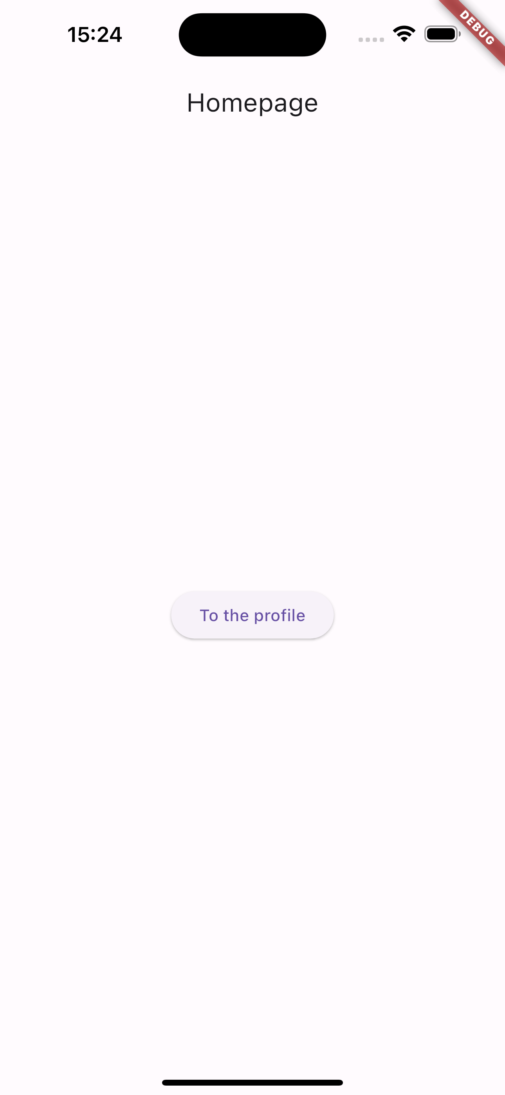
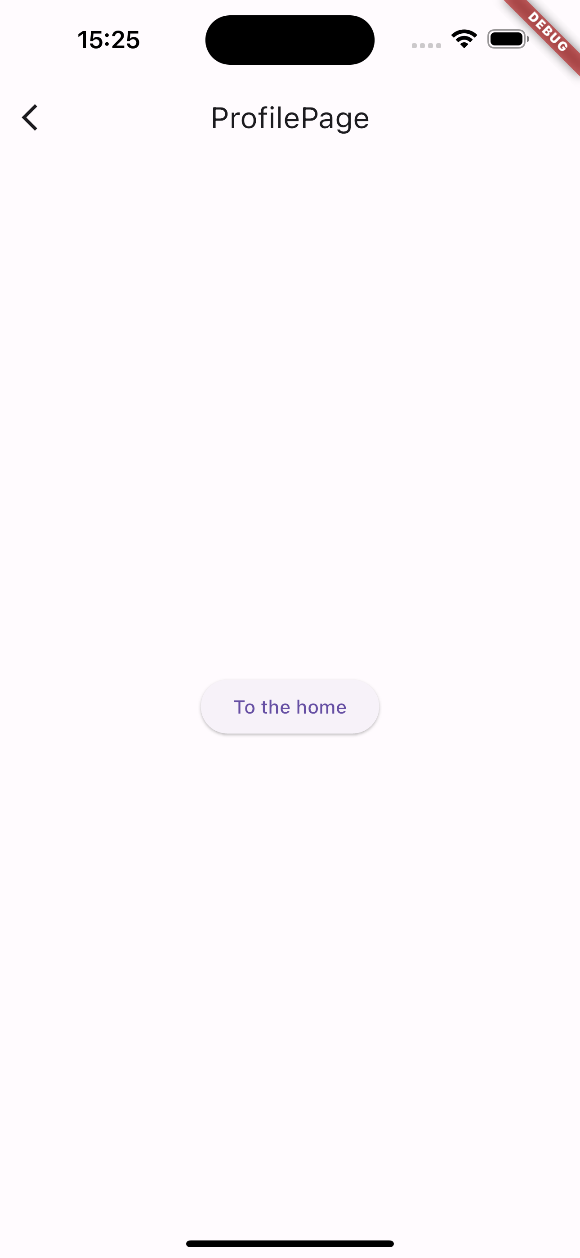
Navigator basics
First let’s see how to move between two routes
We will start from creating a simple two-routes app where the first route will act as homepage and the second will represent the route that will ideally contain the info on the user profile.
When the user taps the button on the homepage it will be directed to the profile page and viceversa

Slide 15
Navigator rationale
Navigator is in charge of managing the navigation through the app
To do so, Navigator uses a stack-like structure. The user sees the “top” of the stack
When you go to a new route, you are ”pushing” it into the stack
When you go back, you are “popping” the route out of the Navigator
Navigation stack
Navigation stack
Navigation stack
ProfilePage
HomePage
HomePage
HomePage
Go to ProfilePage
Go to HomePage
HomePage
ProfilePage
HomePage

Slide 16
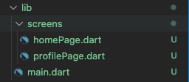
Navigator basics - Preparation
Create a new project called ‘there_and_back_again’
Create the lib/screens/ folder
Create two files in the lib/screens/ folder just created and rename them as ’homePage.dart’ and ‘profilePage.dart’
The project lib folder should look like this:

Slide 17
Navigator basics – homePage.dart boilerplate
import 'package:flutter/material.dart';
class HomePage extends StatelessWidget {
const HomePage({Key? key}) : super(key: key);
static const routename = 'Homepage';
@override
Widget build(BuildContext context) {
return Scaffold(
appBar: AppBar(
title: Text(HomePage.routename),
),
...
...
body: Center(
child: ElevatedButton(
child: Text('To the profile'),
onPressed: () {
//TODO: implement the navigation
},
),
),
);
} //build
} //HomePage

Slide 18
Navigator basics – profilePage.dart boilerplate
import 'package:flutter/material.dart';
class ProfilePage extends StatelessWidget {
const ProfilePage({Key? key}) : super(key: key);
static const routename = 'ProfilePage';
@override
Widget build(BuildContext context) {
return Scaffold(
appBar: AppBar(
title: Text(HomePage.routename),
),
...
...
body: Center(
child: ElevatedButton(
child: Text('To the home'),
onPressed: () {
//TODO: implement the navigation
},
),
),
);
} //build
} //ProfilePage

Slide 19
Navigator basics – main.dart boilerplate
import 'package:flutter/material.dart';
import 'package:there_and_back_again/screens/homepage.dart';
void main() {
runApp(const MyApp());
} //main
class MyApp extends StatelessWidget {
const MyApp({Key? key}) : super(key: key);
@override
Widget build(BuildContext context) {
return MaterialApp(
home: HomePage(),
);
} //build
}//MyApp

Slide 20
Navigator basics – push and pop
To go to the ProfilePage route, simply invoke Navigator.push():
...
onPressed: () {
Navigator.push(context, MaterialPageRoute(builder: (context) => ProfilePage()));
},
...
Current BuildContext
The new MaterialPageRoute to be pushed into the stack
To pop the ProfilePage route, simply invoke Navigator.pop():
...
onPressed: () {
Navigator.pop();
},
...
Navigation stack
Navigation stack
Navigation stack
ProfilePage
HomePage
Navigator.push()
HomePage
Navigator.pop()
HomePage

Slide 21
Navigator basics – push and pop
Note that you could have used Navigator.push() to go back to the HomePage but this would have been result:
Very messy situation. The stack will grow indefinetely
Navigation stack
Navigation stack
Navigation stack
HomePage
Navigator.push()
Navigator.push()
ProfilePage
ProfilePage
HomePage
HomePage
HomePage

Slide 22
Outline
Asynchrony
Navigator
Navigate to a new screen and back
Named routes
Passing argument to a route
Returning an argument from a route
Exercise
Homework
Resources

Slide 23
Another approach: Named routes
BONUS
An alternative approach to Navigator.push() is Navigator.pushNamed()
This solution consists of associating names to each route and use the names for navigation
Let’s see how to convert the previous example using this approach

Slide 24
Named navigation – Preparation
BONUS
If you want to implement this approach, you need to specify, from the beginning, the name of each route.
This is done via the initialRoute and routes named parameters of MaterialApp:
MaterialApp(
initialRoute: '/’,
routes: {
'/' : (context) => HomePage(),
'/profile/': (context) => ProfilePage(),
},
);
This specifies the app entry point
This maps names to the corresponding routes within the app

Slide 25
Named navigation – pushNamed
BONUS
To go to the ProfilePage route, now you can invoke Navigator.pushNamed():
...
onPressed: () {
Navigator.pushNamed(context,’/profile/’);
},
...
Current BuildContext
The name of the route to be pushed into the stack
To pop the ProfilePage route, you can still use Navigator.pop():
...
onPressed: () {
Navigator.pop();
},
...
Navigation stack
Navigation stack
Navigation stack
ProfilePage
HomePage
Navigator.pushNamed()
HomePage
Navigator.pop()
HomePage

Slide 26
Outline
Asynchrony
Navigator
Navigate to a new screen and back
Named routes
Passing argument to a route
Returning an argument from a route
Exercise
Homework
Resources

Slide 27
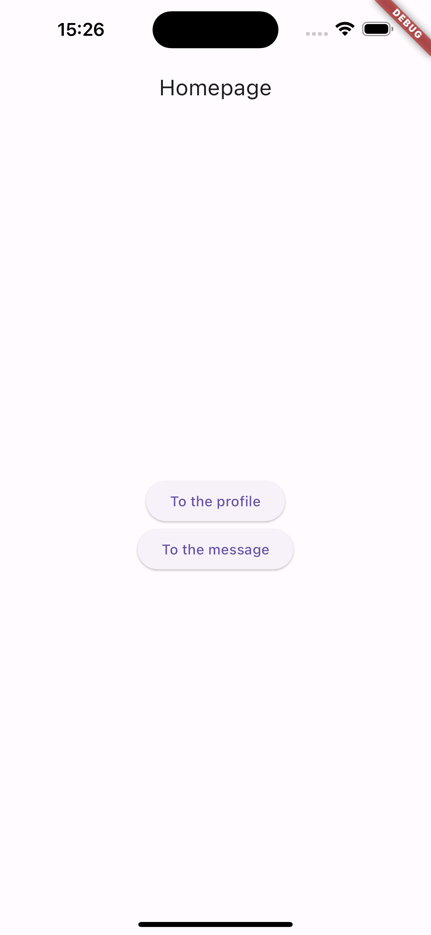

Navigator – Passing an argument
It is (of course) possible to pass arguments to the new route that can be used for several purposes.
To demonstrate how, let’s expand the app with another route MessagePage that will get an argument from the HomePage and will show it in the center of the screen.

Slide 28
Passing arguments – messagePage.dart boilerplate
import 'package:flutter/material.dart';
class MessagePage extends StatelessWidget {
MessagePage({Key? key}) : super(key: key);
static const routename = 'MessagePage';
@override
Widget build(BuildContext context) {
//TODO: get the message from HomePage
return Scaffold(
appBar: AppBar(
title: Text(MessagePage.routename),
),
...
...
body: Center(
child: Column(
mainAxisAlignment: MainAxisAlignment.center,
children: [
Text(’’), //TODO: put the message inside the Text here
ElevatedButton(
child: Text('To the home'),
onPressed: () {
Navigator.pop(context);
},
),
],
),
),
);
} //build
} // MessagePage

Slide 29
Passing arguments
To pass an argument to the MessagePage route, now you can invoke Navigator.pushNamed() as:
...
onPressed: () {
Navigator.push(context, MaterialPageRoute(builder: (context) => MessagePage(message: 'Hello!',)));
},
...
Note: to make this work we need to modify the constructor of MessagePage:
...
MessagePage({Key? key, required this.message}) : super(key: key);
final String message;
...
Then, we can finally show the message:
...
Text(‘This is the message: $message’),
...

Slide 30
Outline
Asynchrony
Navigator
Navigate to a new screen and back
Named routes
Passing argument to a named routes
Returning an argument from a named route
Exercise
Homework
Resources

Slide 31
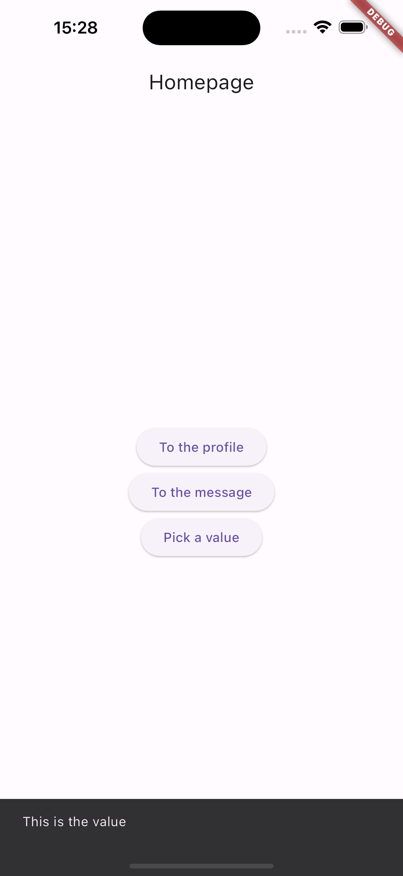

Navigator – Returning data
It is (of course) also possible to return data from a route.
To demonstrate how, let’s expand the app with another route PickValuePage that will provide a value to the HomePage which will be in charge of showing it via a ScaffoldMessenger.

Slide 32
Returning data – pickValuePage.dart boilerplate
import 'package:flutter/material.dart';
class PickValuePage extends StatelessWidget {
PickValuePage({Key? key}) : super(key: key);
static const routename = ‘PickValuePage';
@override
Widget build(BuildContext context) {
return Scaffold(
appBar: AppBar(
title: Text(PickValuePage.routename),
),
...
...
body: Center(
child: ElevatedButton(
child: Text('To the home'),
onPressed: () {
//TODO: implement the navigation + return the data
},
),
),
);
} //build
} //PickValuePage

Slide 33
Returning arguments
To return an argument to the HomePage route, you can invoke Navigator.pop() as:
...
onPressed: () {
Navigator.pop(context, 'This is the value');
},
...
The value that will return to the HomePage once PickValuePage is popped out from the stack
Note that you can return ANYTHING, not just a String.

Slide 34
Returning arguments
To get the result, the HomePage must be patient and await for it::
Await means async stuff. The onPressed function become asynchronous as well so…
...
onPressed: () async {
final result = await Navigator.push(context, MaterialPageRoute(builder: (context) => PickValuePage()));
ScaffoldMessenger.of(context)
..removeCurrentSnackBar()
..showSnackBar(SnackBar(content: Text('$result')));
},
...
Full example in lab_06-navigation/there_and_back_again/

Slide 35
A final note
BONUS
There are other approaches:
You can push “replacements”: Navigator.pushReplacement() / Navigator.pushReplacementNamed()
There is a new Navigator: Navigator 2.0 -> https://blog.codemagic.io/flutter-navigator2/
…
The usual rationale: they all have their pros and cons. Choose the approach you prefer!

Slide 36
Outline
Asynchrony
Navigator
Navigate to a new screen and back
Named routes
Passing argument to a named routes
Returning an argument from a named route
Exercise
Homework
Resources

Slide 37
Exercises
Exercise 06.01
Write an asynchronous function fetchUserRole() that after 3 seconds returns the String ‘admin’. Then, use that function in the main function to print the provided and properly produce the following output:
Fetching user role… The user is an admin.
Exercise 06.02
Use the fetchUserRole() function developed in 06.01 to create a new function isAdminUser() that checks if the string provided by fetchUserRole() is ‘admin’ and returns the respective boolean. Use the new function in the main to produce the following output:
Checking if user is an admin… Ok, access granted! (if the user is an admin) Access denied! (if the user is not an admin)

Slide 38
Exercise
Exercise 06.03 (easy)
Create a new project ‘reproduce_structure’
Reproduce the app navigation structure on the right.
LoginPage
HomePage
ProfilePage
CalendarPage
EditProfilePage
EditEventPage

Slide 39
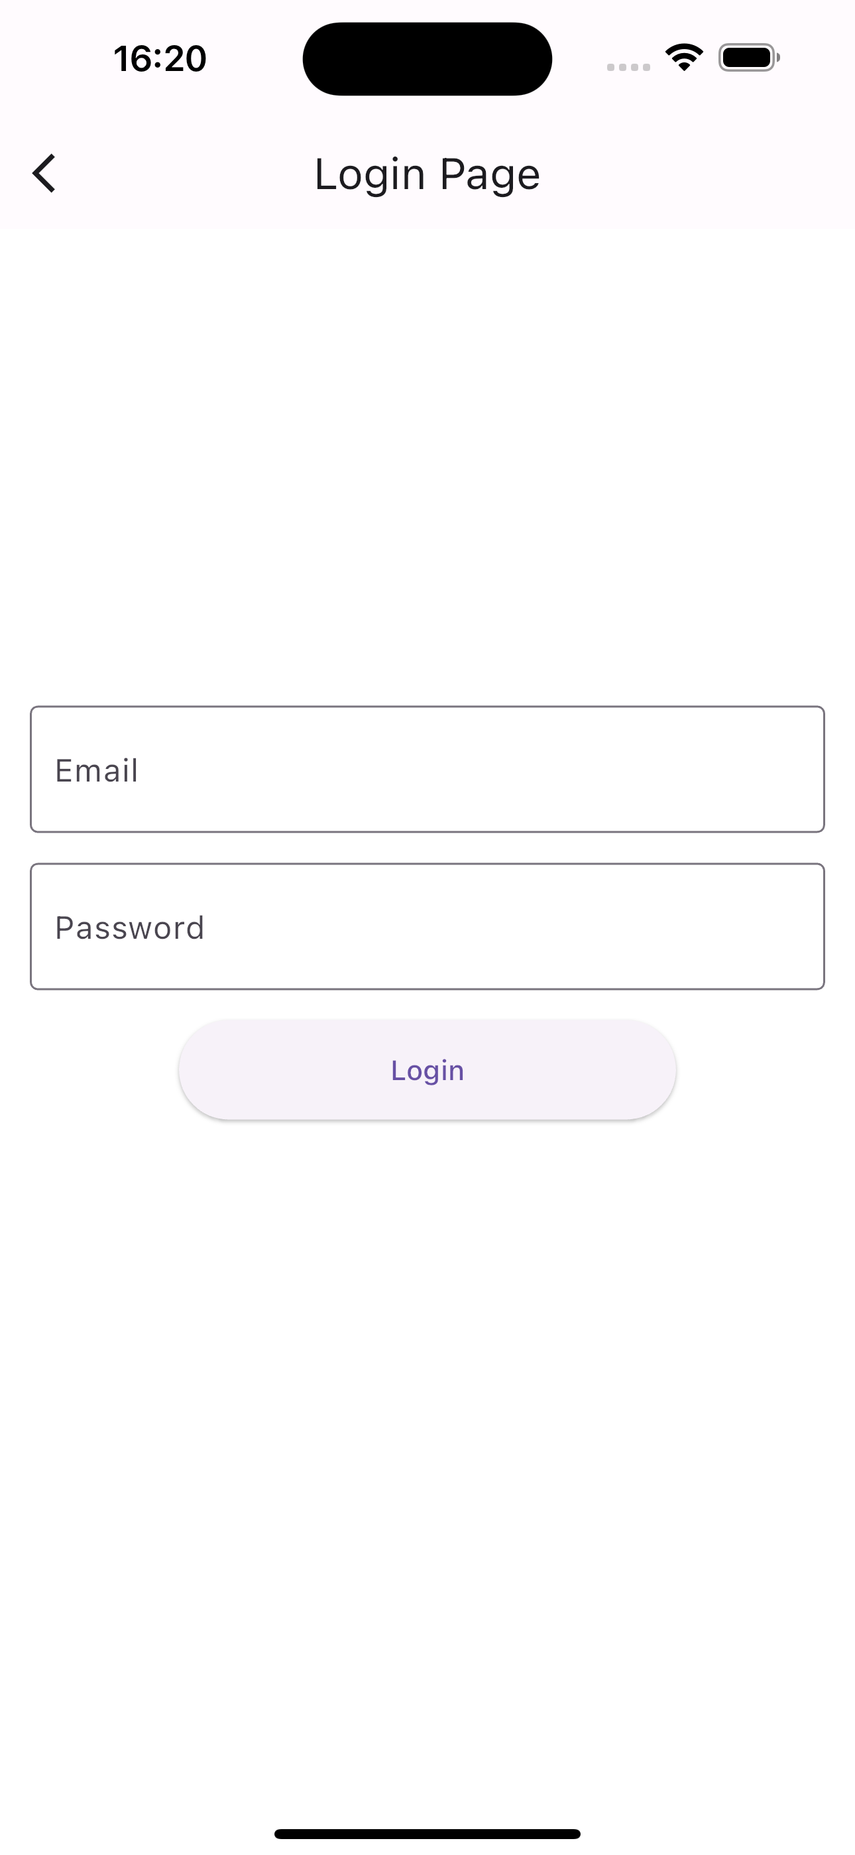
Exercise
LoginPage
Exercise 06.04 (medium)
Create a new project ‘login_flow’
Reproduce the app navigation structure on the right.
The login page consists of a form with two textboxes (one for the username and the other for the password) and a button.
When the user types “bug@expert.com” in the username textbox and “5TrNgP5Wd” in the password textbox, and taps the button, the user is redirected to the Homepage. If the credentials are wrong, a ScaffoldMessenger is showed for 2 seconds saying “Wrong credentials”.
Hint #1: you need to instantiate a TextEditingController as state variable
Hint #2: you need to use a TextField in you UI
Hint #3: then, you can access to the text value using
HomePage
TextEditingController passwordController = TextEditingController();
TextField(
obscureText: true,
controller: passwordController,
decoration: InputDecoration(
border: OutlineInputBorder(),
labelText: 'Password’,
hintText: 'Enter password’
),
),
passwordController.text

Slide 40
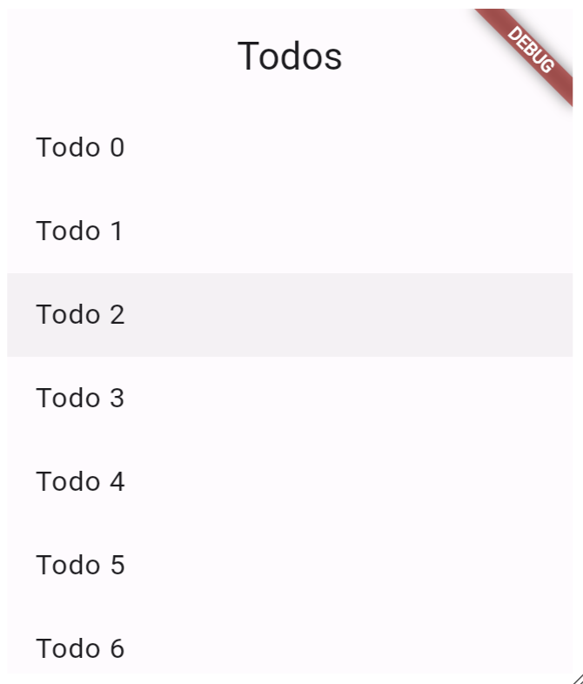
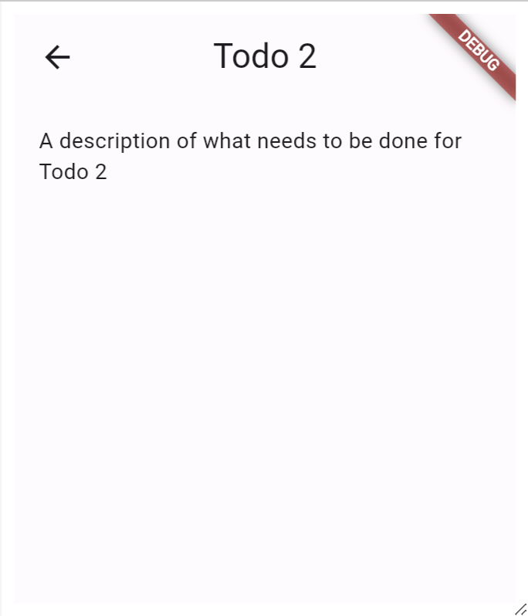
Exercise
Exercise 06.05 (medium)
Follow the cookbook https://docs.flutter.dev/cookbook/navigation/passing-data by the Flutter team to learn how to pass data to a route directly to its constructor.
(solution available from the Flutter team in the cookbook)

Slide 41
Outline
Recap
Navigator
Navigate to a new screen and back
Named routes
Passing argument to a named routes
Returning an argument from a named route
Exercise
Homework
Resources

Slide 42
Homework
Get familiar with Asynchrony and Navigator

Slide 43
Outline
Recap
Navigator
Navigate to a new screen and back
Named routes
Passing argument to a named routes
Returning an argument from a named route
Exercise
Homework
Resources

Slide 44
Resources
Code repository of today’s lesson and exercises solution
https://github.com/gcappon/bwthw/tree/master/lab_06-navigation
Async and await codelabs
https://dart.dev/codelabs/async-await
Navigation Recipes
https://docs.flutter.dev/cookbook/navigation

