Slide 1
Giacomo Cappon
Authentication

Slide 2
Outline
Recap
The flow
RESTful API in practice
Case study
Exercise
Homework
Resources

Slide 3







Recap: The IMPACT backend
HTTPS requests/responses
Lesson 9
Get token (JWT) using credentials
(If credentials are ok) Receive token
Ask for specific data using token
(If request is ok) Receive data (JSON format)
https://impact.dei.unipd.it/bwthw/
Your app
Lesson 10

Slide 4
Outline
Recap
The flow
RESTful API in practice
Case study
Exercise
Homework
Resources

Slide 5
The (JWT) authorization flow in practice
Use credentials to ask for a JWT token pair
Receive JWT token pair
Store token pair for making calls

Slide 6
“Obtaining data” flow in practice
Access token expired?
YES
NO
Refresh token expired?
Make a call to get data using access token
YES
NO
Redo authorization process
Get a new token pair using the refresh token and store it

Slide 7
The entire flow in practice
Use credentials to ask for a JWT token pair
Receive JWT token pair
Store token pair for making calls
Access token expired?
YES
NO
YES
Refresh token expired?
Make a call to get data using access token
NO
Get a new token pair using the refresh token and store it

Slide 8
Outline
Recap
The flow
RESTful API in practice
Case study
Exercise
Homework
Resources

Slide 9
RESTful API in practice
From the practical point of view, RESTful API can be used via http/https following three steps:
Step 1: Send an http/https request to the RESTful API
Step 2: Await for the response
Step 3: Process the response (usually in a JSON format)
The http/https request has the following structure:
<METHOD> <HTTP or HTTPS>://<DOMAIN>/<ENDPOINT>?<PARAMETERS>
+
<BODY> and <HEADERS>
<METHOD> and <ENDPOINT> defines the so-called route, e.g.:
GET /heartrate/today/
DELETE /user/1

Slide 10
RESTful API in practice
Beside its content a response contains an HTTP status code, i.e., a special number that tells to the frond-end if the request is successful or, otherwise, why it is not successful. Here’s the most common:
200: OK
401: UNAUTHORIZED
403: FORBIDDEN
404: NOT FOUND
500: INTERNAL SERVER ERROR
Normally, the front-end developer has to manage these codes based on the API specifics

Slide 11
Outline
Recap
The flow
RESTful API in practice
Case study
Exercise
Homework
Resources

Slide 12
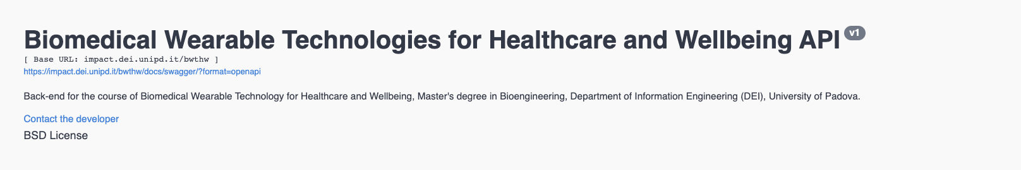
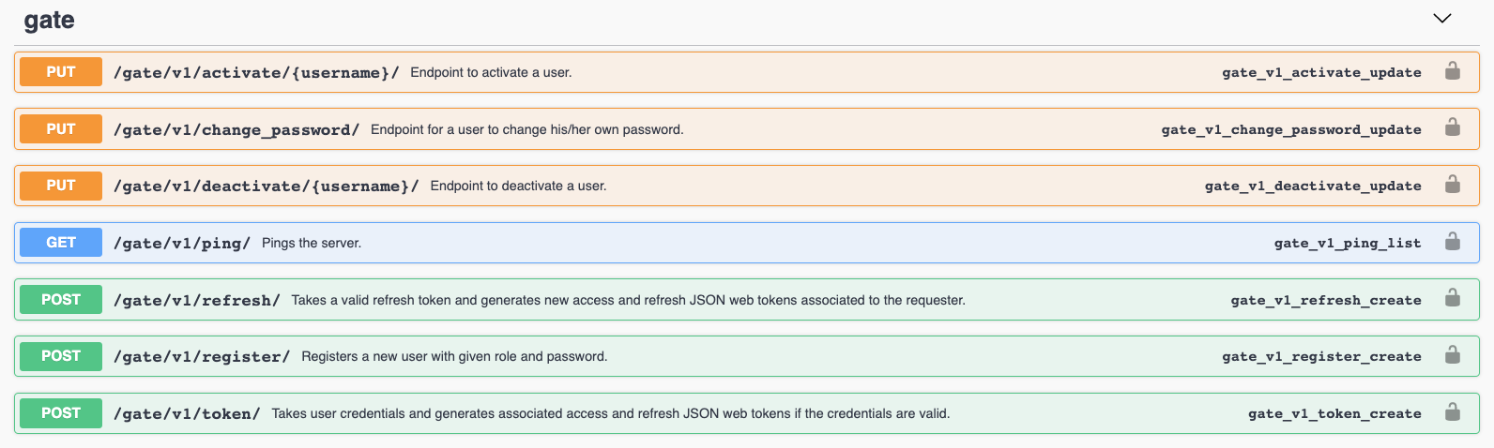
Get the authorization: The IMPACT gate

Slide 13
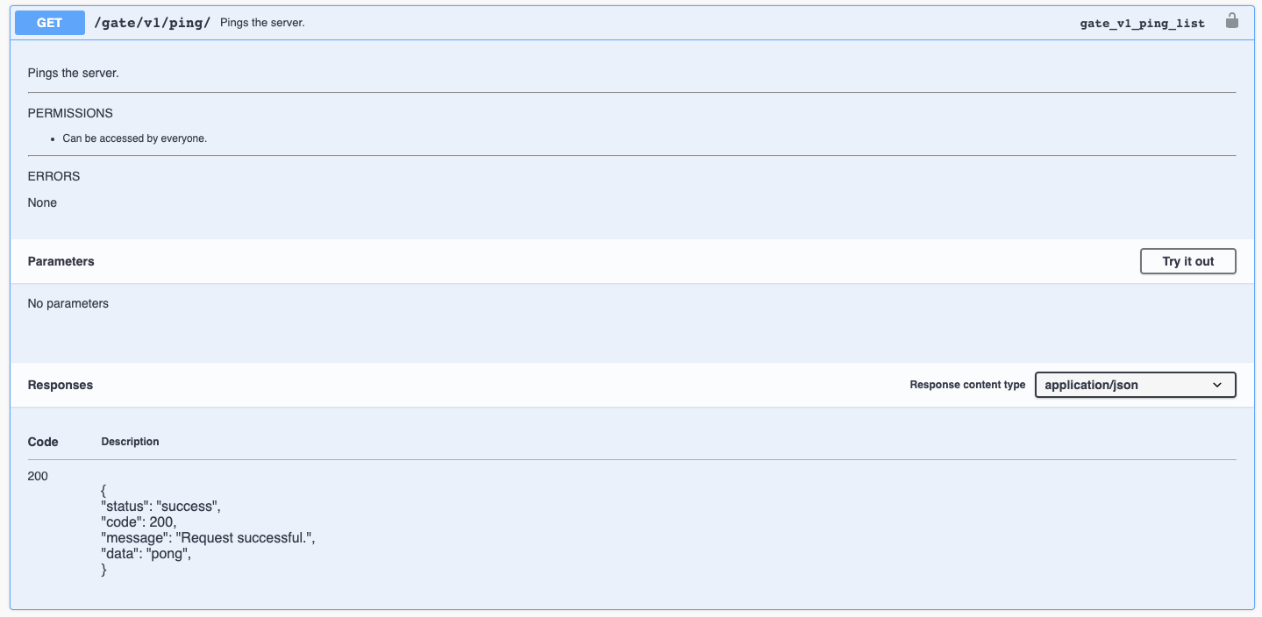
The IMPACT gate: ping

Slide 14
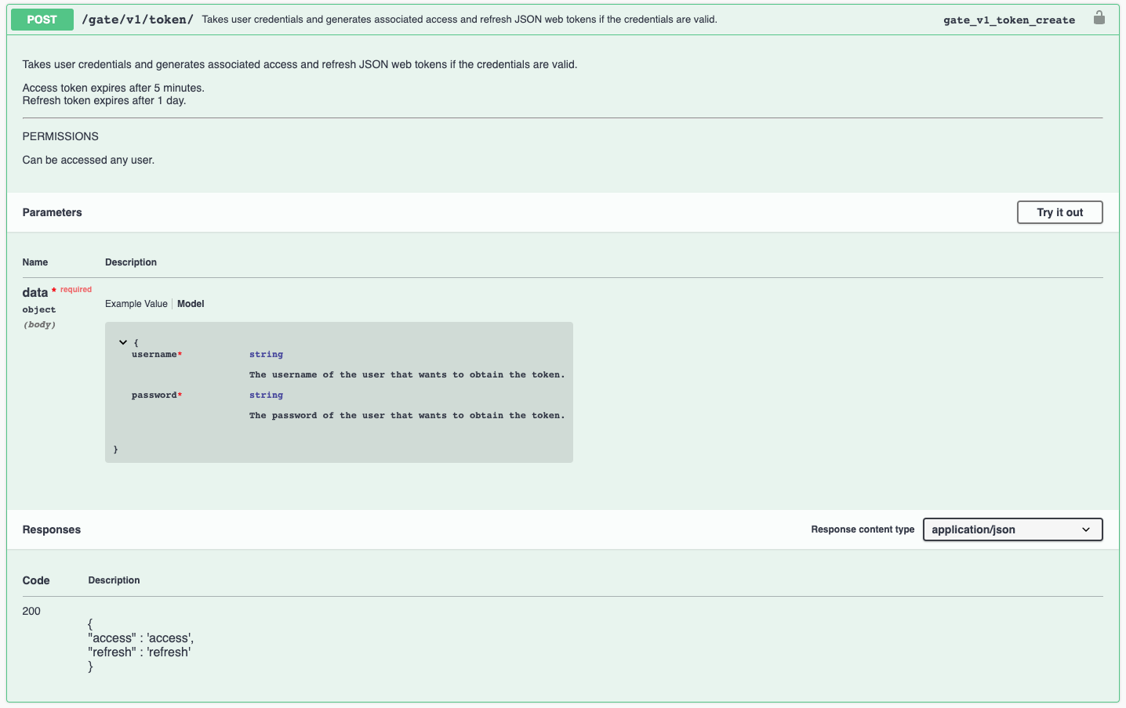
The IMPACT gate: token

Slide 15
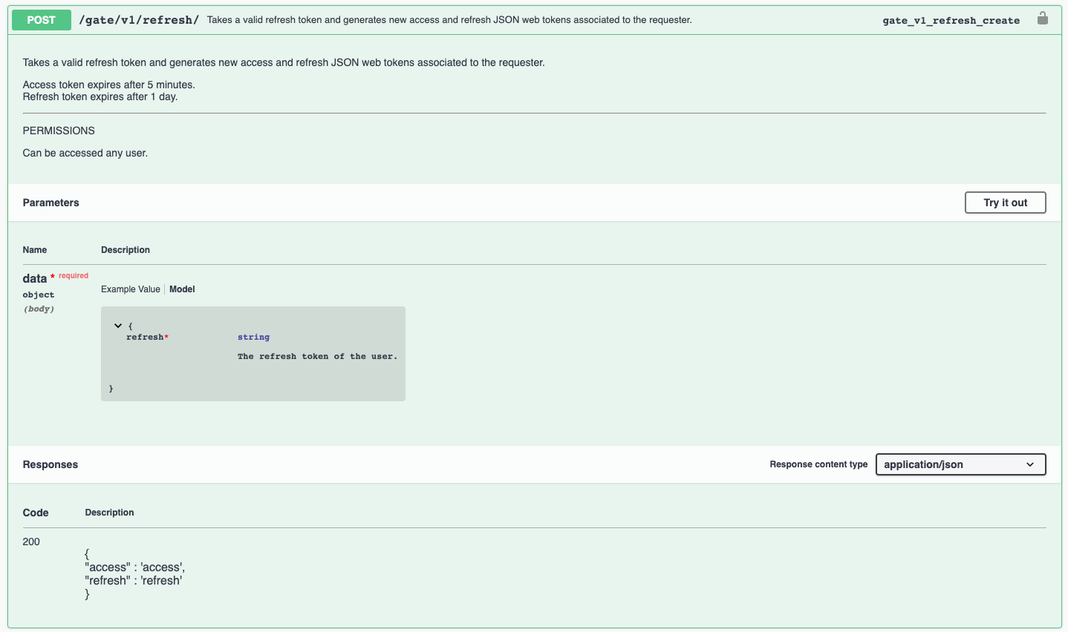
The IMPACT gate: refresh

Slide 16
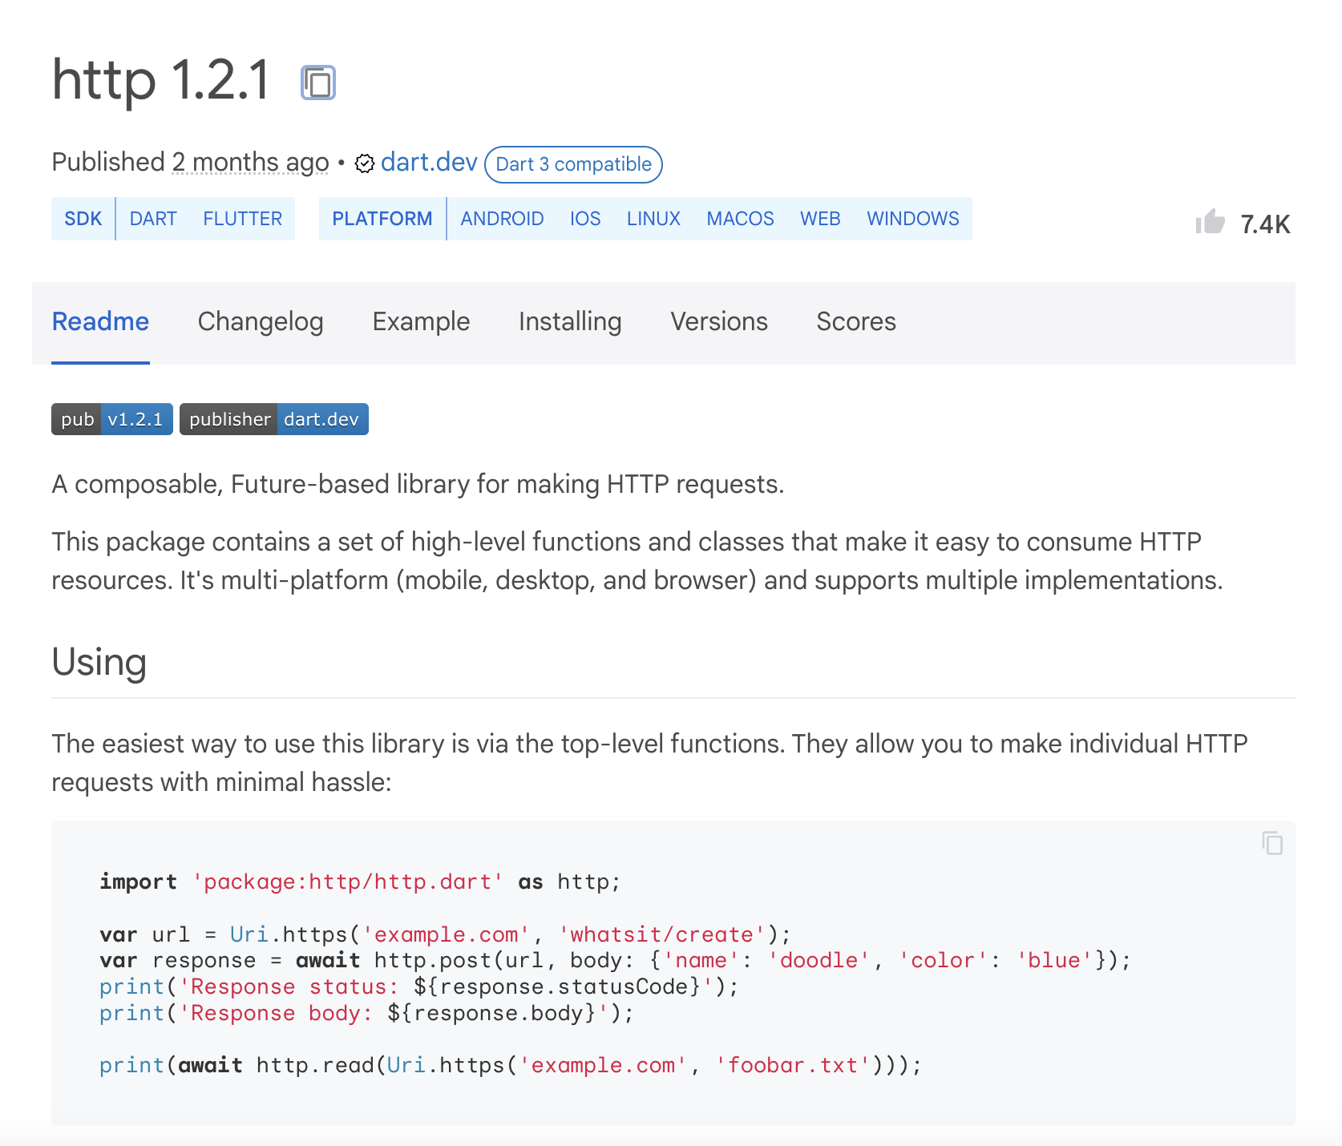
http package
To be able to make calls we will use the http package. This provides a simple web client to be used to make http calls.

Slide 17
Android-specific action
To be able to access to internet functionalities in Android you are required to provide a specific permission:
To do so, in the android>app>src>main folder open the AndroidManifest.xml file, and add the following after the <manifest …> tag:
<manifest xmlns:android...>
...
<uses-permission android:name="android.permission.INTERNET" />
<application ...
</manifest>
No need to do this in iOS.
Only if you are using your physical device

Slide 18
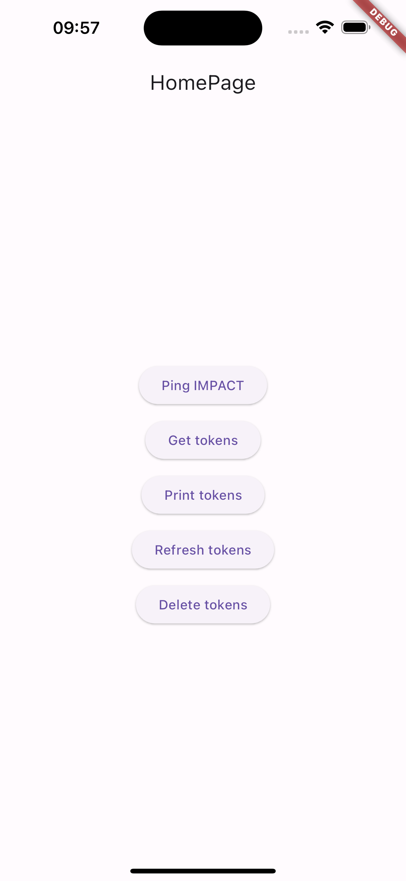
Case of study - Live
Let’s implement the operations required by the authorization flow
Use credentials to ask for a JWT token pair
Receive JWT token pair
Store token pair for making calls
Full example in lab_09-authorization/impact_authorization/

Slide 19
Outline
Recap
The flow
RESTful API in practice
Case study
Exercise
Homework
Resources

Slide 20
Exercise
Get familiar with the example
Try to integrate the authorization flow in your project

Slide 21
Outline
Recap
The flow
RESTful API in practice
Case study
Exercise
Homework
Resources

Slide 22
Homework
Get familiar with the http package

Slide 23
Outline
Recap
The flow
RESTful API in practice
Case study
Exercise
Homework
Resources

Slide 24
Resources
IMPACT documentation
https://impact.dei.unipd.it/bwthw/docs/swagger/
HTTP Status Codes
https://en.wikipedia.org/wiki/List_of_HTTP_status_codes
Fetch data from the internet. Cookbook by the Flutter community
https://docs.flutter.dev/cookbook/networking/fetch-data
Send data to the internet. Cookbook by the Flutter community
https://docs.flutter.dev/cookbook/networking/send-data

