Slide 1
Giacomo Cappon
Setup the environment

Slide 2
We need some tools in our belt
Developing mobile apps requires some tools
As programmers, we need to setup our development environment in order to be able to write code, compile it, test its behaviour, and deploy it to the final user machine (in this case, a phone).
To do so, we need to:
Use some software to write the actual code
Choose a framework and the respective programming language
Have specific libraries in place to support the phone operating system
Have some tools to be able to work as a team
This document will give an overview of the development environment we are going to use during this course and will tell what to do to prepare it.

Slide 3


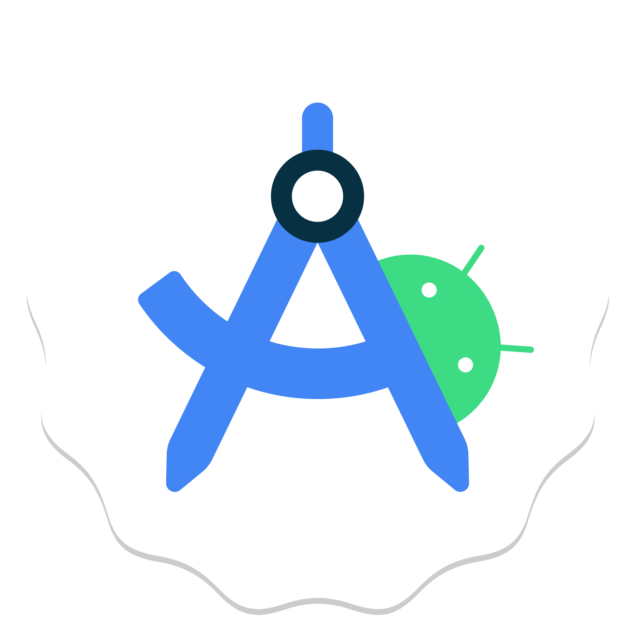

The environment: Overview
IDE
(To write code, compile, and test)
Flutter + Dart
(The framework and its programming language)
Android Studio
(For Android support)
XCode
(For iOS support)
VCS
(For version control and to enable teamwork)

Slide 4
The environment: IDE
The first component of the environment is the IDE (Integrated Development Environment).
The IDE is where we actually will write the code: it is a text editor with some flavour (high-level functionalities).
The IDE of choice in this course is Visual Studio Code (VS Code)

Slide 5
The environment: Framework and compiler
The second component of the environment is, of course, the framework (and the programming language) we are going to use to develop mobile apps.
We will use Flutter: a brand-new framework by Google based on the Dart programming language.
Why Flutter? Because it allows us to write a single code to create mobile app for either iOS or Android (but also desktop app for Windows, Mac, and Linux). This means that:
We will build one app that will look the same in both iOS and Android
We will not be constrained by the operating system (OS)
Developing time is halved

Slide 6


The environment: OS support
The third component of the environment are the OS-specific (iOS or Android) libraries to install in order to let Flutter do its magic and compile.
Both the iOS and the Android libraries will install the compiler for Flutter and a virtual phone simulator to allow you to test the mobile app without actually having a physical device.
Since Flutter is OS-agnostic, you have a choice here:
Install iOS support
Install Android support
Install both
A good way to choose the best option is: “Ok, I will have a virtual device, but at some point, I would like to deploy my app to an actual phone (my phone). What is the OS of my phone?
Note that if you have an iPhone but you do not have a Mac, you need to go for Android since XCode is not available for Windows

Slide 7
iOS or Android support?
Do you have a Mac?
Yes
No
OS of your phone?
iOS
Android
iOS support or both
Android support

Slide 8
The environment: VCS
The final component of the environment is the Version Control System (VCS)
As you will learn in the first lab lesson, the VCS is a software that allows to maintain and manage the various version of the code you are going to write, and it will be fundamental to work as a team.
In this course, we will use GIT, the most famous VCS.

Slide 9
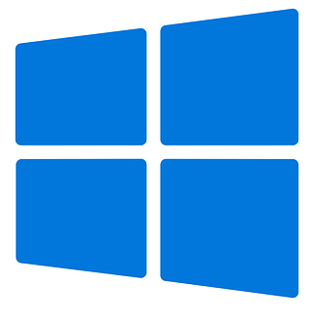
Instructions
Mac Users need to install the following:
XCode
Rosetta (if you have an Apple Silicon)
VS Code
Flutter and Cocoapods
Android Studio (if Android support is necessary)
Windows Users need to install the following:
Git
VS Code
Flutter
Android Studio
Slides 10-14
Slides 15-18

Slide 10
(Mac) 1. XCode
Open the App Store, search “XCode” and install it

Slide 11

(Mac) 2. Rosetta
When installing on an Apple Silicon Mac, install the Rosetta translation environment. Some components require the Rosetta.
Open a Terminal and run
>> sudo softwareupdate --install-rosetta --agree-to-license

Slide 12
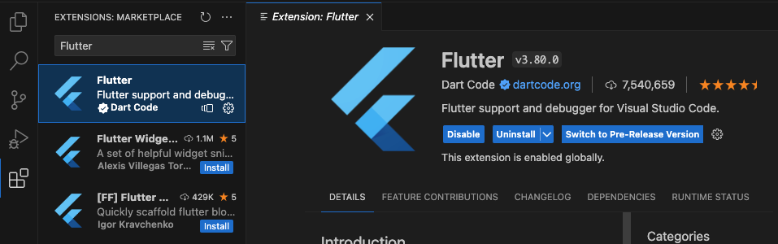
(Mac) 3. VS Code
Install VS Code
Go to > https://code.visualstudio.com/
Download and install VS Code
Add the Flutter extension for VS Code
Open VS Code
Go to the Extension tab
Type ‘Flutter’ in the search bar
Install the first entry of the search results
Flutter extension to be installed
Search bar
‘Extension’ tab

Slide 13
(Mac) 4. Flutter and Cocoapods
Go to https://docs.flutter.dev/get-started/install/macos/mobile-ios?tab=vscode#install-the-flutter-sdk
Follow the instructions from section ”Install the Flutter SDK” to the end

Slide 14
(Mac) 5. Android Studio
Go to https://developer.android.com/studio, download Android Studio and install it
Go to https://docs.flutter.dev/get-started/install/macos/mobile-android?tab=vscode#configure-android-development
Follow the instructions from section ”Configure Android development” to the end

Slide 15

(Windows) 1. Git
Simply go to https://gitforwindows.org/, download Git SCM and install it

Slide 16
(Windows) 2. VS Code
Install VS Code
Go to > https://code.visualstudio.com/
Download and install VS Code
Add the Flutter extension for VS Code
Open VS Code
Go to the Extension tab
Type ‘Flutter’ in the search bar
Install the first entry of the search results
Flutter extension to be installed
Search bar
‘Extension’ tab

Slide 17
(Windows) 3. Flutter
Go to https://docs.flutter.dev/get-started/install/windows/mobile?tab=vscode#install-the-flutter-sdk
Follow the instructions of section ”Install the Flutter SDK”

Slide 18
(Windows) 4. Android Studio
Go to https://developer.android.com/studio, download Android Studio and install it
Go to https://docs.flutter.dev/get-started/install/windows/mobile?tab=vscode#configure-android-development
Follow the instructions from section ”Configure Android development” to the end

