Slide 1
Giacomo Cappon
Project Guidelines

Slide 2
Outline
Project delivery instructions
Project presentation guidelines

Slide 3
General info
In the following, we reported the instructions on how to deliver your project. In a nutshell, you must prepare and submit a .pdf file containing
the number of your group and the name of each group participant
the link to a public GitHub repository containing a ”valid” version of the code
Since the project must be delivered through GitHub, code delivered via mail will be ignored
“Valid” code must be in the master (or main) branch and must have been committed no later than the 15th of July, and no later than 3 days before the project discussion date.

Slide 4
Example scenario
”I belong to Group 50 composed by me, Martina Vettoretti, and Luca Cossu”
“My code is located in my public repository named bwthw”

Slide 5
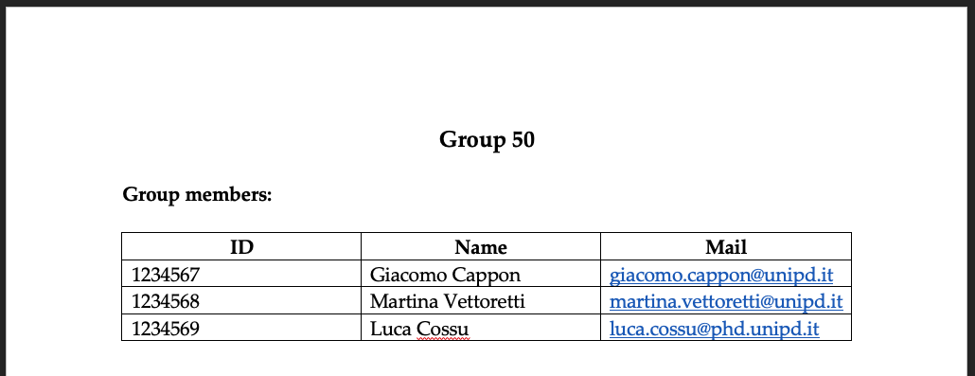
Step 1: Fill the group info
Create a .docx file
Fill the group info at the very top of the file, e.g.:

Slide 6

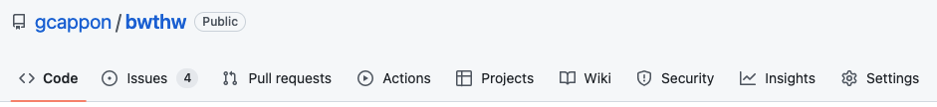
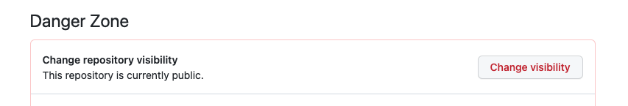
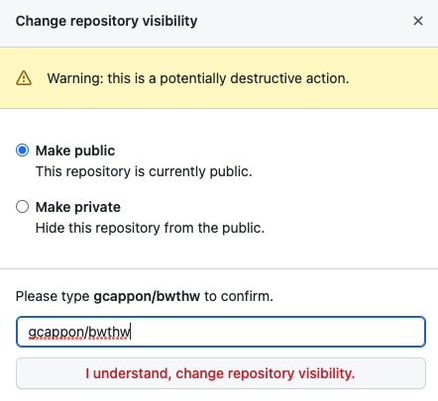
Step 2: Make your repository public
First, make sure your repository is public. This is true if, in GitHub, a “public” label is present near your repo name:
If, instead, the label says “private”, follow these steps to make it public:
Go to “Settings”
Scroll down till the “Danger Zone”
Click on “Change visibility”
Select “Make public”
Type the name of the repo to confirm
Click on the button
Notes:
We focused the laboratories on front-end development

Slide 7
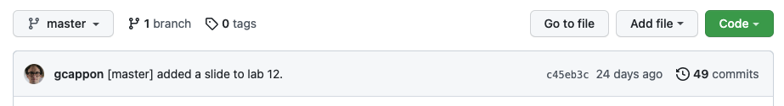
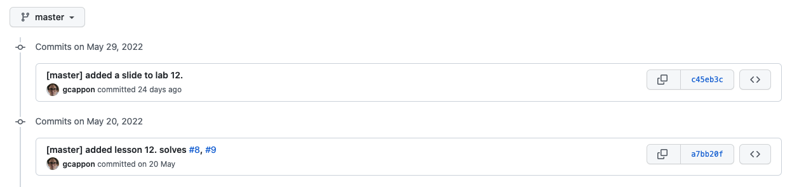
Step 3: Locate the link to a valid code version
From the home page of your GitHub repo, click on the “history” link
Click on the link of the version of the code that you want to submit
Note: be sure that your are in the master (or main) branch!

Slide 8
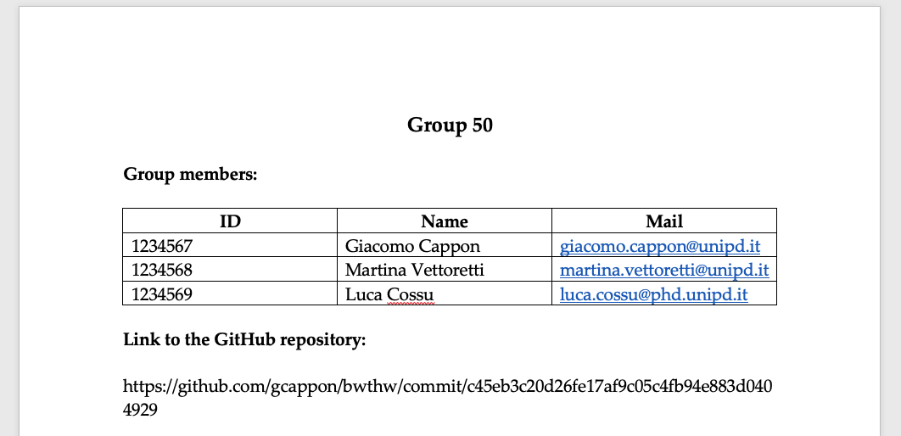
Step 4: Put the link in the .docx file
Copy and paste the link in the url bar of your browser in the .docx file below the group info, e.g.:

Slide 9


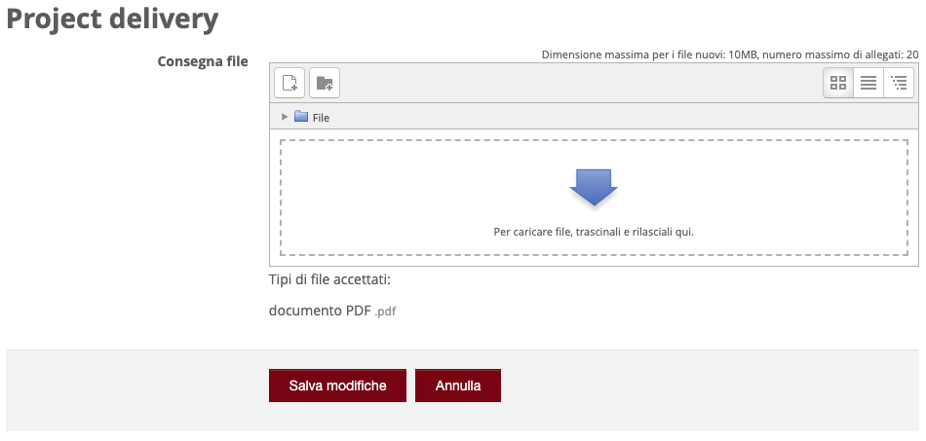
Step 5: Submit the .pdf to moodle
Export your .docx file to .pdf
Then, go to moodle. In the “Project discussion – Project delivery” section locate “Project delivery”:
Click on the delivery button:
Upload the .pdf file
Save and that’s it!

Slide 10
Outline
Project delivery instructions
Project presentation guidelines

Slide 11
Rationale
In the following we reported a brief guide that contains some hints on what to cover during your project discussion. As such, consider this document as a guide rather than something to “fill” with words and images.
You are free to use this PowerPoint template (style, colors, etc…) for preparing the presentation. Of course, you are also free to use your own template if you prefer.
The skeleton proposed here is just a simple guideline. Feel free to change it according to your needs.

Slide 12
Discussion structure – General info
You have 25 minutes max to present your project followed by ~20 min of Q&A. Discussions of more than 25 minutes will be penalized.
The presentation must include a PowerPoint presentation followed by a live demonstration of your app working. Both the presentation and the demo must fit the 25 minutes.
The discussion has to be in English.
The Q&A session will be in English.

Slide 13
Discussion structure – (Possible) skeleton
A possible skeleton for your discussion can be:
Background - What’s the ”story” behind your app? Is it for healthy people? Is it targeting any disease? …
Problem to be solved/Feature to be provided to the public - What’s the target user/use case? What kind of problem your app is trying to solve? What’s missing in the current market (if some)? …
Your solution - High overview of your app (name, catchy motto, …). What do you want to enable with your app? …
Core app functionalities
Screen map of your app
User authentication and management - How do you do it? …
Data collection – How do you do it? …
Data persistence – How do you manage data in your app (DB schema can be used here)? What’s the data flow inside your app? …
Data visualization and presentation – How do you visualize user data in your app? …
Original part - What’s the original part of your app? Have you implemented literature stuff? If yes, briefly describe it. …
Project management flavours - How did you work as a group? …
Special implementation decisions – Did you make implementative decisions that worth some space in the project discussion? …
Closing remarks and future developments – Sum up you discussion briefly. What are the possible evolution of your app in the future? …
Live demo - Show (via emulator or physical device) your app working.

Slide 14
Discussion suggestions
Be smart.
Try to motivate every choice.
Consider to split the discussion among the group participants to demonstrate that you worked as a group.
Consider to allocate around 15 minutes for the PowerPoint presentation and 10 minutes for the live demo.
Prepare the live demo. You only have 10 minutes so you must know what to ”tap”, to show, to do ,….
Be sure that your app is working when you run the demo.

