Slide 1
Giacomo Cappon
Symposium

Slide 2
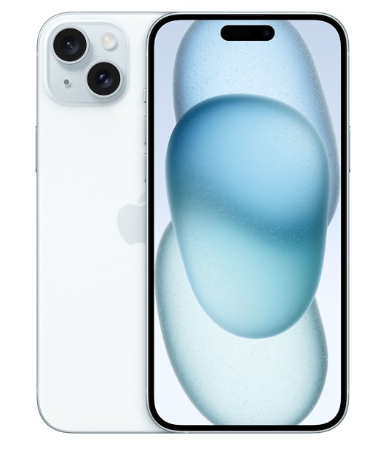
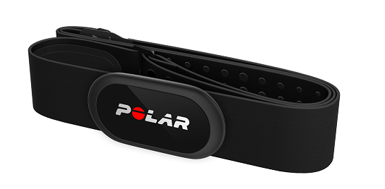
The devices
Polar H10 Heart Rate Monitor
Bluetooth and ANT+ communication
Sampling rate of 1 Hz
iPhone 15
Hosts a custom app that communicates with Polar H10
Collects and export data

Slide 3
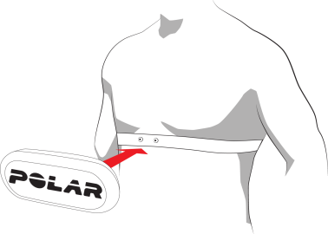
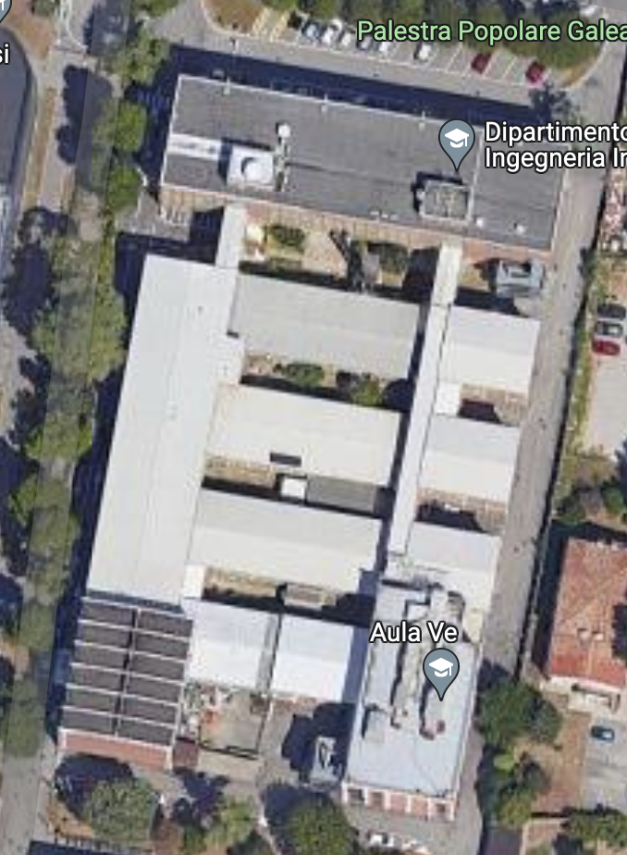
The “protocol”
5 volunteers wearing 1 x Polar H10 + 1x iPhone (need their Age and BW)
2 laps of the DEI “main” building walking as fast as possible
At the end, export data
Start/Stop

Slide 4
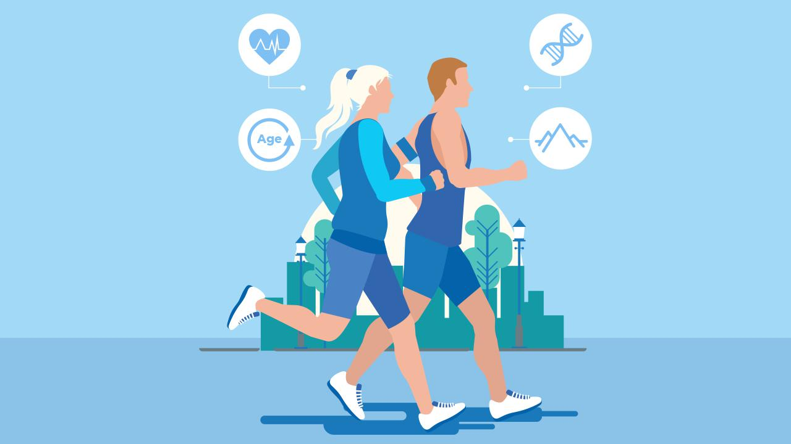
The aim
Rank the 5 subjects by cardiovascular health evaluated according to their estimated VO2_{MAX} calculated from the recorded heart rate
VO2_{MAX} is the maximum
oxygen volume a subject can
consume per min (l/min).

Slide 5
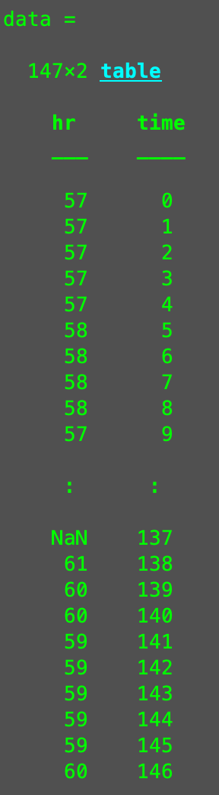
How data will look like
5 .csv files containing
time from start (s)
heart rate at given time (bpm)

