Slide 1
Quantitative Usability Evaluation

Slide 2
Usability
Usability has an international standard definition in ISO 9241-11: the extent to which a product can be used by specified users to achieve specified goals with effectiveness, efficiency, and satisfaction in a specified context of use.
It is very important to quantify your application from the usability point-of-view
Problem: ISO 9241-11 made the point that there is no specific property of an artifact that you can call usability. Rather, something “usable” is appropriate to its context, where the context includes:
Task that is being done
Background/Experience of the user who is doing it
Environment in which it is being done.

Slide 3
Contents
ISO 9241-11 breaks the measurement of usability down into three separate components that must be defined relative to the context of use:
Effectiveness (whether people can actually complete their tasks and achieve their goals)
Efficiency (the extent to which they expend resource in achieving their goals)
Satisfaction (the level of comfort they experience in achieving those goals)
Thus, a system that lets people complete their tasks, but at the expense of considerable expenditure of time and effort and which was felt to be very unsatisfactory by all concerned, could not really be said to be usable. (By the same measure, however, a system which people enjoyed using but which didn’t allow them to complete any tasks and on which they spent a lot of unproductive time could equally be argued not to be very usable.)

Slide 4
Formative tests
Formative tests. (The bulk of usability testing) They have the aim of finding and fixing usability problems
Data take the form of problem descriptions and design recommendations
Quantification can be made in terms of frequency and severity of an encountered problem, time to complete a task, completion rate of a task.

Slide 5
Summative tests
Summative tests have the aim of describing the usability of an application using metrics. Two types: Benchmark and Comparative
Benchmark Usability Tests: aim to describe how usable an application is relative to a set of benchmark goals. They provide:
Input on what to fix in an interface
Baseline for the comparison of post-design changes
Comparative Usability Tests: aim to compare usability of two or more applications or different versions of the same application
They allow to identify the best tool for the job from the point-of-view of usability

Slide 6
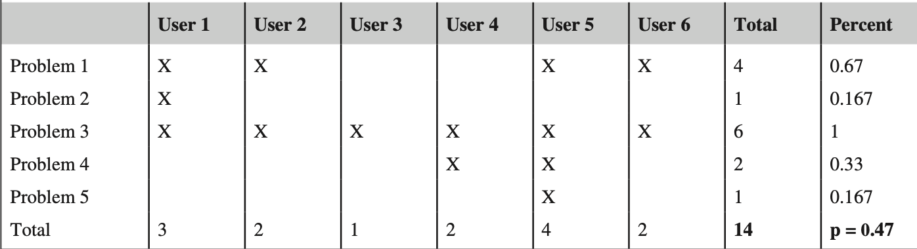
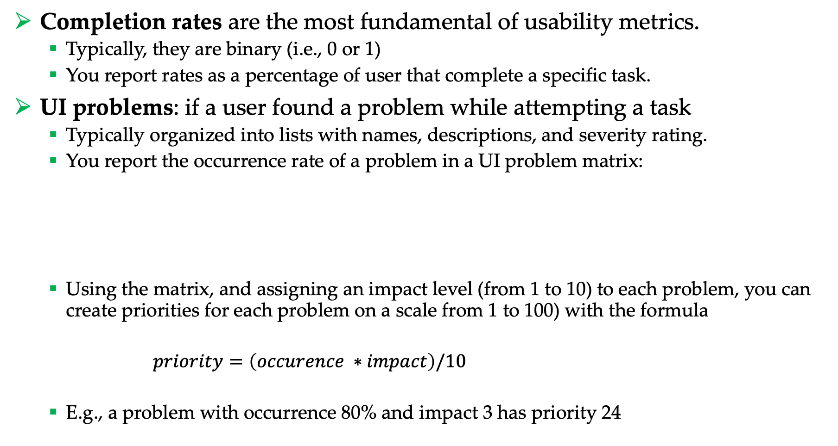
Metrics
Completion rates are the most fundamental of usability metrics.
Typically, they are binary (i.e., 0 or 1)
You report rates as a percentage of user that complete a specific task.
UI problems: if a user found a problem while attempting a task
Typically organized into lists with names, descriptions, and severity rating.
You report the occurrence rate of a problem in a UI problem matrix:
Using the matrix, and assigning an impact level (from 1 to 10) to each problem, you can create priorities for each problem on a scale from 1 to 100) with the formula
$priority=\left(occurence ∗impact\right)/10$
E.g., a problem with occurrence 80% and impact 3 has priority 24

Slide 7
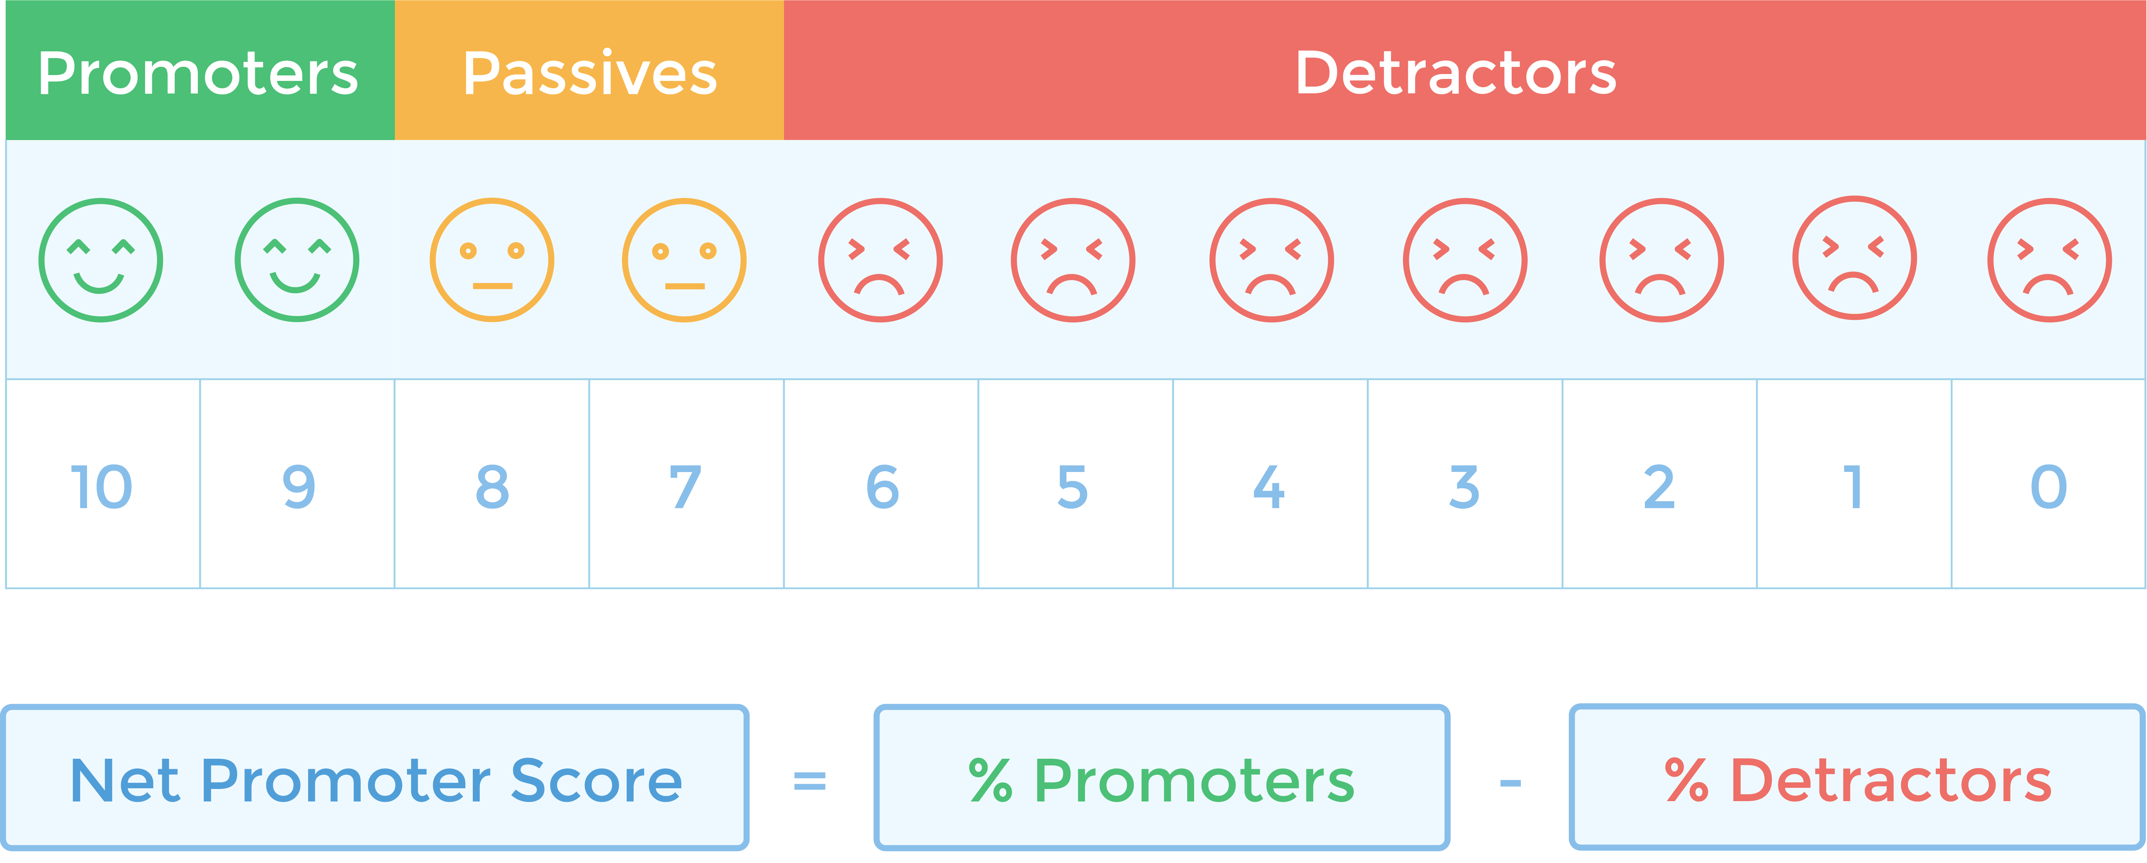
Metrics
Net promoter score (NPS): is a score based on a single question on loyalty: “How likely it is that you will recommend this product to a friend or colleague on a scale from 0 to 10?”
You are a:
Promoter if your response is 9 or 10
Passive if your response is 7 or 8
Detractor if your response is < 7
The Net promoter score is computed subtracting the percentage of promoters with the percentage of detractors
The final score goes from -100% to 100%

Slide 8
Metrics
Comments and open-ended data can be very heterogeneous and might include:
Reasons why users are promoters or detractors for an app
User insights from field studies
App complaints to calls to user service
Why a task was difficult
Requirement list: features that a user identify as necessary in your app but it is still not implemented.

Slide 9
Satisfaction ratings
Satisfaction ratings: obtained via standardized usability questionnaries.
Standardized usability questionnaires (SUQ) consists of a collection of question items each associated to an underneath score. At the end, all questions are collected together in a single satisfaction rating that provide a standardized measure.
The advantages of standardized questionnaires include:
Objectivity: independent verification of the measurement
Replicability: it is easy to replicate the studies of others
Quantification: results can be quantified via numbers and statistics
Economy: very cheap to reuse
Communication: results are very easy to communicate
Generalization: it is fundamental that the results are generalizable

Slide 10
Assessing the quality of a SEQ
Reliability: consistency of measurement
Can be measured via the Cronbach’s alpha. Can range between 0 (no reliability) and 1 (perfect reliability). Measures that can affect a person’s future (e.g., college entrance test) should have a minimum alpha of 0.9. For other research or evaluations > 0.7 is acceptable.
Validity: am I measuring what I am trying to measure?
Content validity
Criterion-related validity
Construct validity
Sensitivity: it must be sensitive to experimental manipulations
For example, responses from participants who experience difficulties working with Product A but find Product B easy to use should reflect a statistically significant difference in the overall SEQ outcome
There is no direct measurement of sensitivity.

Slide 11
Available SUQ
SUQ can be administered at the end of each task, i.e., post-task:
After-Scenario Questionnaire (ASQ) - Lewis, 1991
Expectation Ratings (ER) – Albert and Dixon, 2003
Usability Magnitude Estimation (UME) – McGee, 2004
Single Ease Question (SEQ) – Sauro, 2010
Subjective Mental Effort Question (SMEQ) – Sauro and Dumas, 2009
…or at the end of the entire study, i.e., post-study:
Questionnaire for User Interaction Satisfaction (QUIS) – Chin et al., 1988
Software Usability Measurement Inventory (SUMI) – Kirakowski and Corbett, 1993
Post-Study System Usability Questionnaire (PSSUQ) – Lewis, 1995
System Usability Scale (SUS) – Brooke, 1996
General recommendation:
Post-test: SEQ or SMEQ
Post-study: SUS

Slide 12
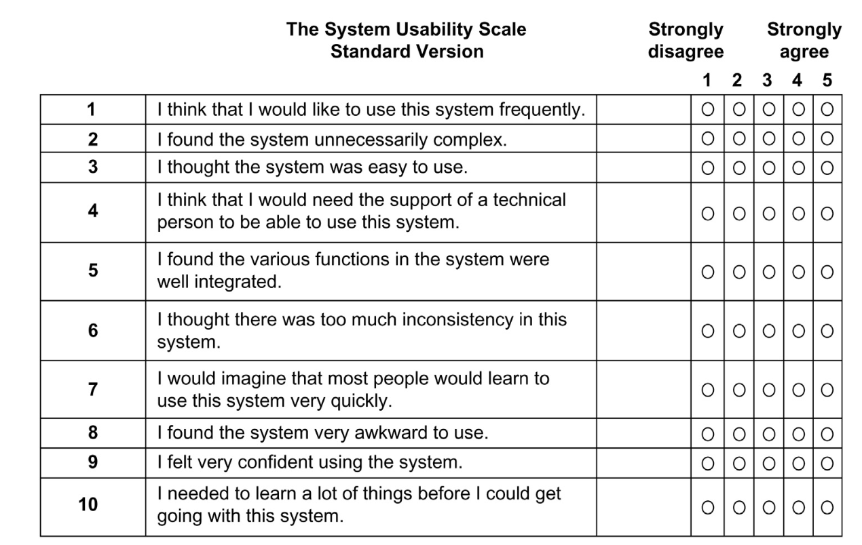
SUS

Slide 13
SUS Scoring
Each item's score contribution ranges from 0 to 4.
For items 1, 3, 5, 7, and 9 (the positively worded items) the score contribution is the scale position minus 1.
For items 2, 4, 6, 8, and 10 (the negatively worded items), the contribution is 5 minus the scale position.
You then multiply the sum of the scores by 2.5 to obtain the overall value of SUS.

Slide 14
Example
For items 1, 3, 5, 7, and 9 (the positively worded items) the score contribution is the scale position minus 1:
(3-1) + (4-1) + (4-1) + (3-1) + (5-1) = 16
For items 2, 4, 6, 8, and 10 (the negatively worded items), the contribution is 5 minus the scale position:
(5-2) + (5-2) + (5-1) + (5-3) + (5-2) = 15
You then multiply the sum of the scores by 2.5 to obtain the overall value of SUS:
(16 + 15) x 2.5 = 77.5

Slide 15
Psychometric evaluation of SUS
The ten SUS items were selected from a pool of 50 potential items, based on the responses of 20 people who used the full set of items to rate two software systems, one of which was relatively easy to use, and the other relatively difficult. The items selected for the SUS were those that provided the strongest discrimination between the systems. In the original paper by Brooke (1996), he reported strong correla- tions among the selected items (absolute values of r ranging from 0.7 to 0.9), but he did not report any measures of reliability or validity, referring to the SUS as a quick and dirty usability scale. For these reasons, he cautioned against assuming that the SUS was any more than a unidimensional measure of usability (p. 193): “SUS yields a single number representing a composite measure of the overall usabil- ity of the system being studied. Note that scores for individual items are not meaningful on their own.” Given data from only 20 participants, this caution was appropriate at that time.
An early assessment of the SUS indicated a reliability of 0.85 (Lucey, 1991). More recent esti- mates using larger samples have consistently found its reliability to be at or just over 0.90 (Bangor et al., 2008; Lewis et al., 2015a,b; Lewis and Sauro, 2009).

Slide 16
Psychometric evaluation of SUS
In an ambitious investigation of the psychometric properties of the SUS, Bangor et al. (2008) con- ducted a factor analysis of 2324 SUS questionnaires and concluded there was only one significant factor, consistent with prevailing practitioner belief and practice. The method applied by Bangor et al., however, did not exclude the possibility of additional structure. Lewis and Sauro (2009) reanalyzed the data from Bangor et al. and an independent set of SUS cases from Sauro and Lewis (2009), and concluded that the factor structures of the two datasets converged at a two-factor solution. Later in the same year, Borsci et al. (2009), using a different measurement model and an independent set of data (196 Italian cases), arrived at the same conclusion—a two-factor solution with Items 1, 2, 3, 5, 6, 7, 8, and 9 on one factor and Items 4 and 10 on the other.
Based on the content of the items, Lewis and Sauro (2009) named the 8-item subscale “Usable” and the 2-item subscale “Learnable.” Using the data from Sauro and Lewis, the subscale reliabilities (coefficient alpha) were 0.91 for Usable and 0.70 for Learnable. An analysis of variance on the data showed a significant study by scale interaction—evidence of scale sensitivity. To make the Usable and Learnable scores comparable with the Overall SUS score so they also range from 0 to 100, just multiply their summed score contributions by 3.125 for Usable and 12.5 for Learnable.

Slide 17
Where did the 3.125 and 12.5 multipliers come from?
The standard SUS raw score contributions can range from 0 to 40 (ten items with five scale steps ranging from 0 to 4). To get the multiplier needed to increase the apparent range of the summed scale to 100, divide 100 by the maximum sum of 40, which equals 2.5:
100/40 = 2.5
Because the Usable subscale has eight items, its range for summed score contributions is 0-32, so its multiplier is:
100/32 = 3.125
Following the same process, the multiplier for the Learnable subscale is:
100/8 = 12.5

Slide 18
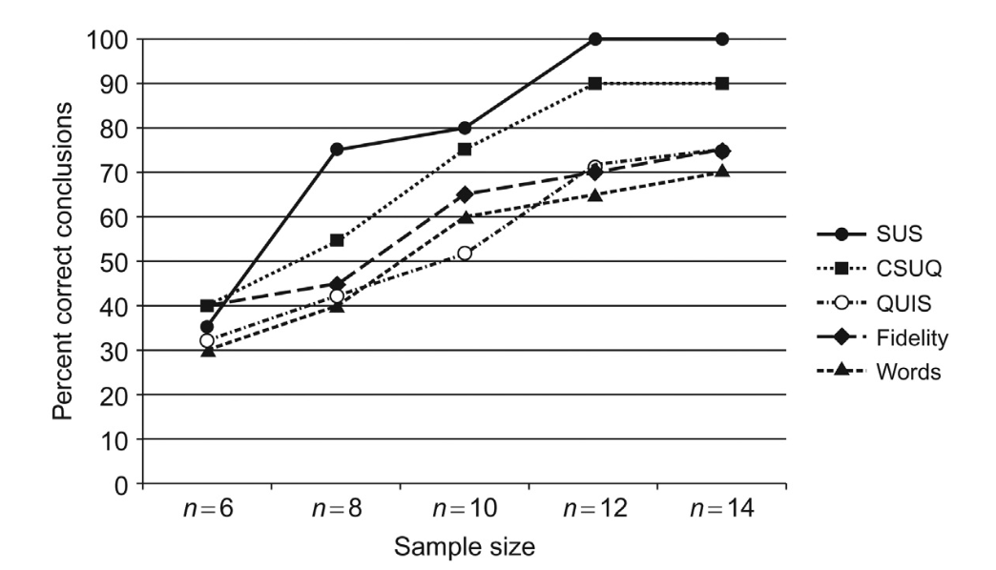
How many people do I need?
To run a usability test using SUS you do not always need a lot of people
According to a study of Tullis and Stetson, 2004 good results can be obtained with 8-12 people.
Remember: your test user pool must be representative of the final user population.
(Extreme) Example: If your app is intended for pregnant women, your pool cannot be made of men

Slide 19
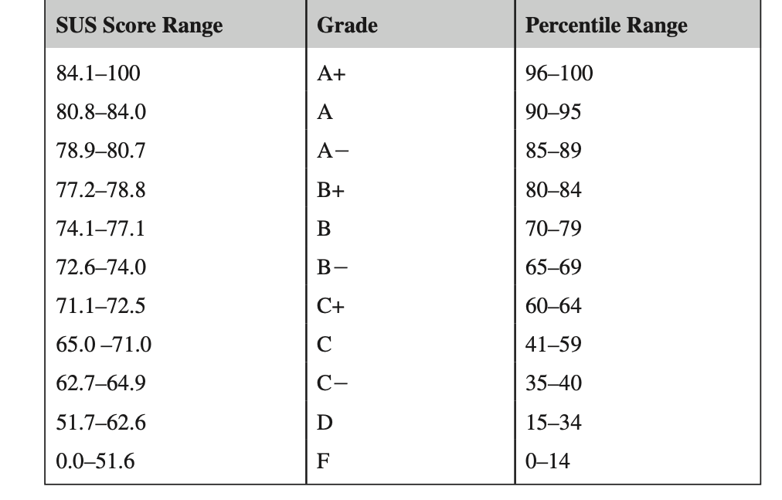
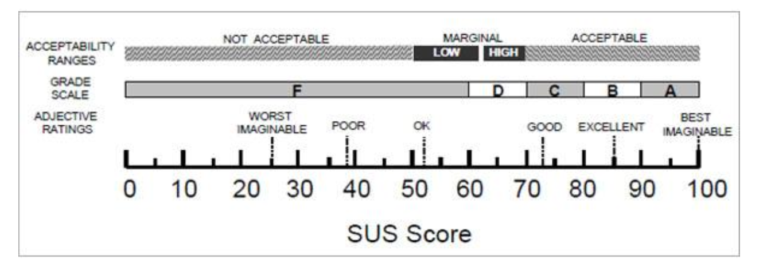
What is a good SUS?
To be “good” SUS must be > 73
Note: It has been showed that a SUS score of 82 (±5), also tend to be "Promoters.” according to NPS

Slide 20
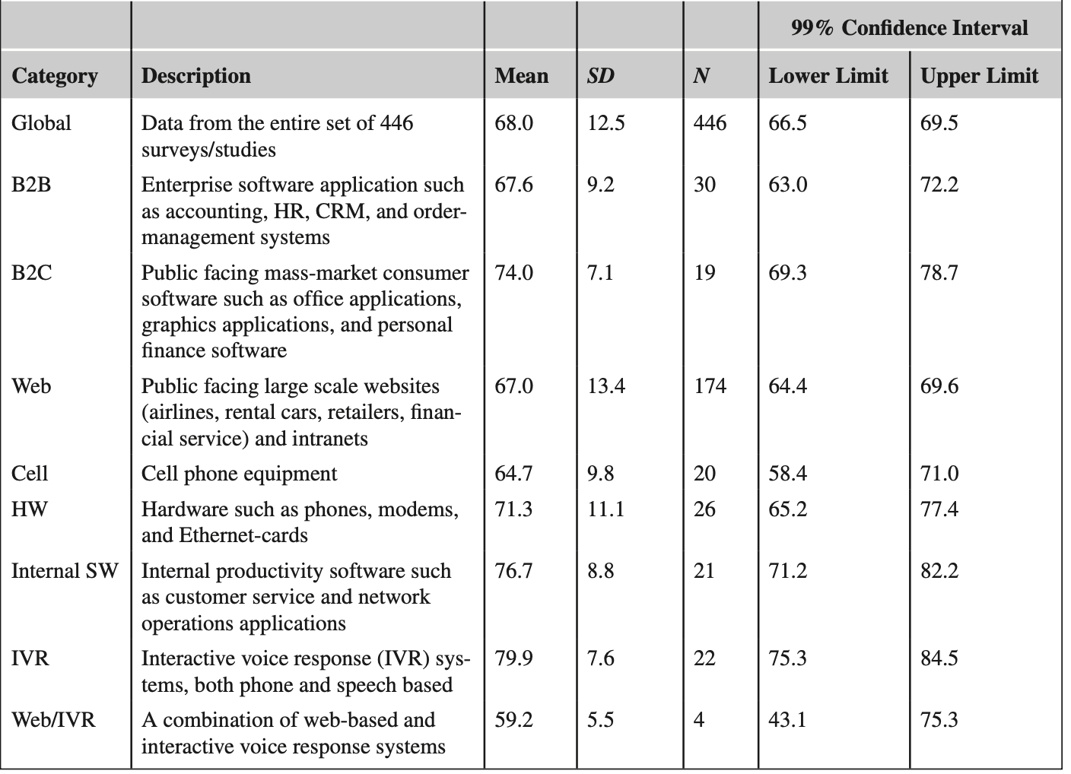
What is a good (interface specific) SUS?

Slide 21
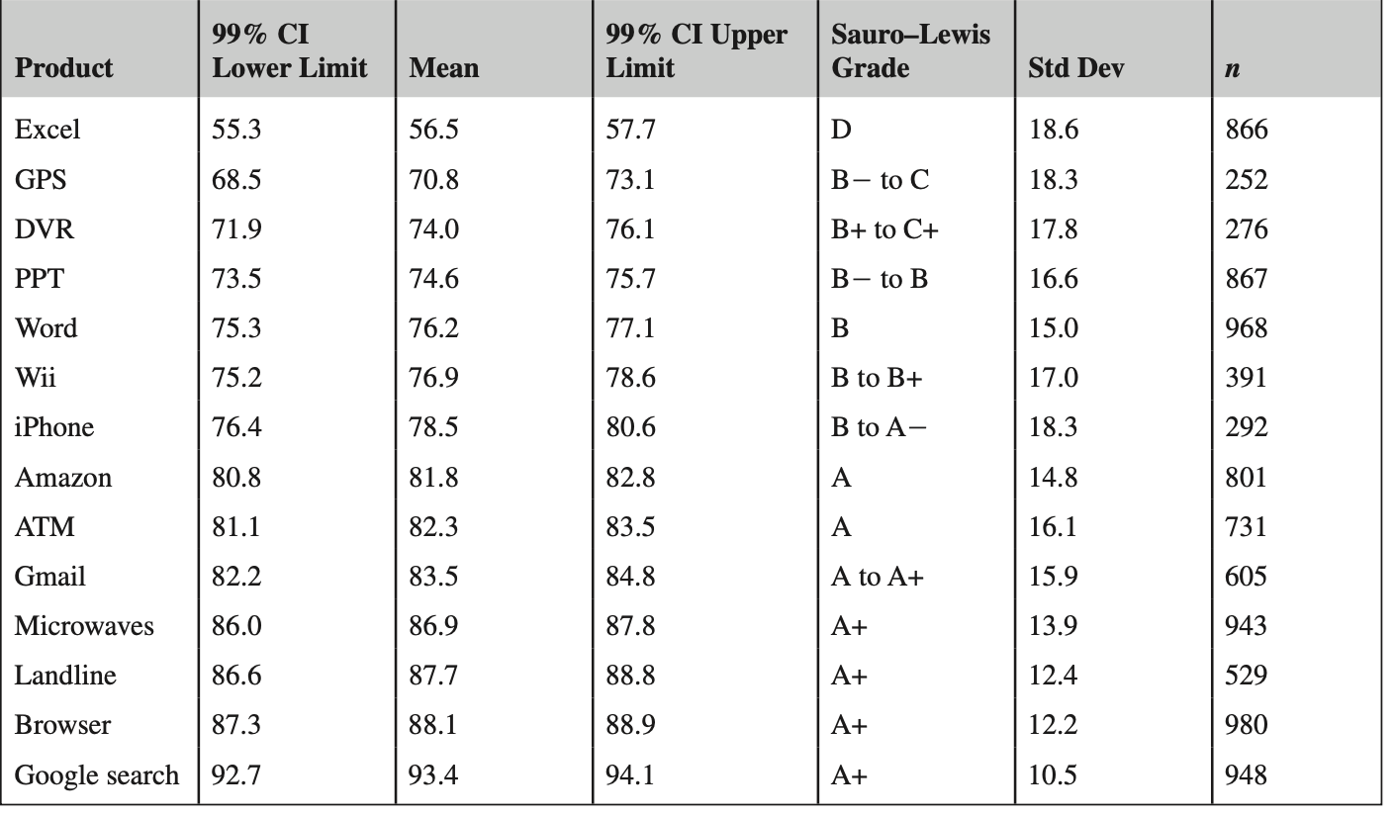
How everyday products are rated using SUS?

Slide 22
Final notes on SUS
Extensive analyses of SUS show that:
SUS is reliable. Users respond consistently to the scale items, and SUS has been shown to detect differences at smaller sample sizes than other questionnaires.
SUS is valid. That is, it measures what it purports to measure.
SUS is not diagnostic. That is, it does not tell you what makes a system usable or not.
SUS scores are not percentages, despite returning a value between 0 and 100. To understand how your product compares to others, you need to look at its percentile ranking.
SUS measures both learnability and usability.
SUS scores have a modest correlation with task performance, but it is not surprising that people’s subjective assessments may not be consistent with whether or not they were successful using a system.
Subjective assessments of usability are only one component of the overall construct of usability.

Slide 23
How precise is our estimate?
In usability testing, like most applied research settings, we almost never have access to the entire user population. Instead we have to rely on taking samples to estimate the unknown population values. If we want to know how long it will take users to complete a task or what percent will complete a task on the first attempt, we need to estimate from a sample. The sample means and sample proportions (called statistics) are estimates of the values we really want—called the population parameters.
When we don’t have access to the entire population, even our best estimate from a sample will be close but not exactly right, and the smaller the sample size, the less accurate it will be. We need a way to know how good (precise) our estimates are.
To do so, we construct a range of values that we think will have a specified chance of containing the unknown population parameter. These ranges are called confidence intervals.

Slide 24
Confidence interval (CI)
Confidence intervals are used just like margins of errors. In fact, a confidence interval is twice the margin of error. If you hear that 57% of likely voters approve of pro- posed legislation (95% margin of error ±3%) then the confidence interval is six percentage points wide, falling between 54% and 60% (57 − 3% and 57 + 3%).
A confidence interval provides both a measure of location and precision. That is, we can see that the av- erage approval rating is around 57%. We can also see that this estimate is reasonably precise. If we want to know whether the majority of voters approve the legislation we can see that it is very unlikely (less than a 2.5% chance) that fewer than half the voters approve.

Slide 25
Components of a CI
Confidence level: the ”coverage” of a confidence interval
A confidence level of 95% (the typical value) means that if you were to sample from the same population 100 times, you’d expect the interval to contain the actual mean or proportion 95 times.
Variability: If there is more variation in a population, each sample taken will fluctuate more and therefore create a wider confidence interval. The variability of the population is estimated using the standard deviation from the sample.
Sample size: Without lowering the confidence level, the sample size is the only thing a researcher can control in affecting the width of a confidence interval. The confidence interval width and sample size have an inverse square root relationship. This means if you want to cut your margin of error in half, you need to quadruple your sample size. For example, if your margin of error is ±20% at a sample size of 20 you’d need a sample size of approximately 80 to have a margin of error of ±10%.

Slide 26
Computing CI
CI are computed differently according to your population pool and the type of data
Here we will focus on computing CI for continuous data (e.g., rating scales obtained from SUS)

Slide 27

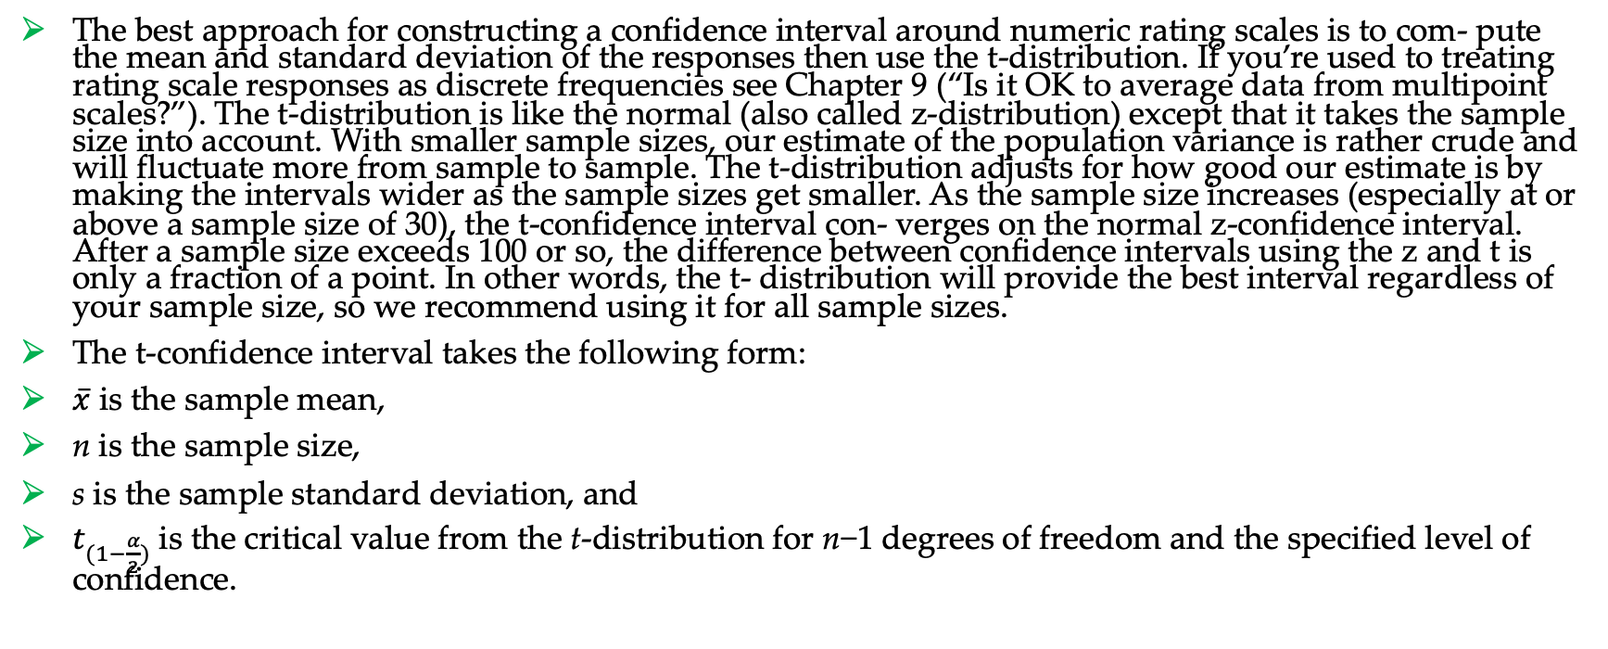
CI
The best approach for constructing a confidence interval around numeric rating scales is to com- pute the mean and standard deviation of the responses then use the t-distribution. If you’re used to treating rating scale responses as discrete frequencies see Chapter 9 (“Is it OK to average data from multipoint scales?”). The t-distribution is like the normal (also called z-distribution) except that it takes the sample size into account. With smaller sample sizes, our estimate of the population variance is rather crude and will fluctuate more from sample to sample. The t-distribution adjusts for how good our estimate is by making the intervals wider as the sample sizes get smaller. As the sample size increases (especially at or above a sample size of 30), the t-confidence interval con- verges on the normal z-confidence interval. After a sample size exceeds 100 or so, the difference between confidence intervals using the z and t is only a fraction of a point. In other words, the t- distribution will provide the best interval regardless of your sample size, so we recommend using it for all sample sizes.
The t-confidence interval takes the following form:
$\overline{x}$ is the sample mean,
n is the sample size,
s is the sample standard deviation, and
$t_{(1−\frac{α}{2})}$is the critical value from the t-distribution for n−1 degrees of freedom and the specified level of confidence.
$$\overline{x}±t_{(1−\frac{α}{2})}\frac{s}{\sqrt{n}}$$

Slide 28
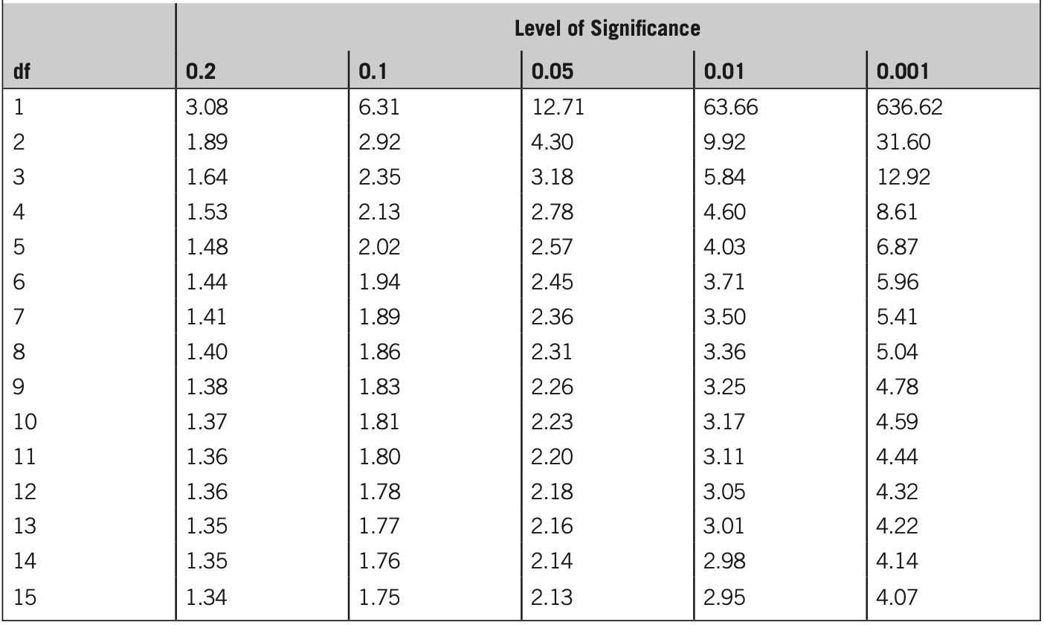
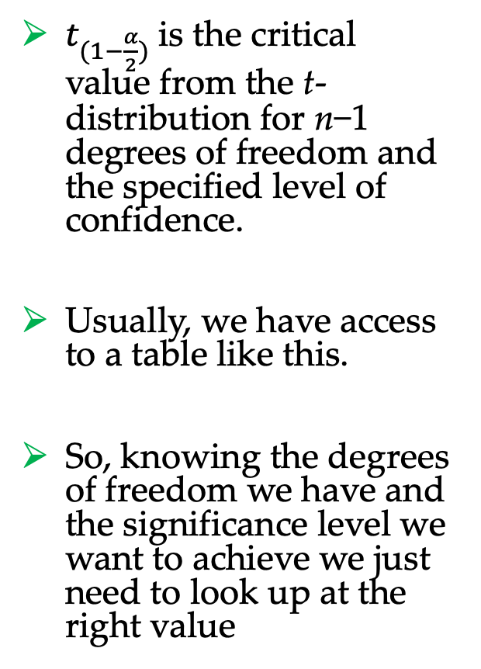
CI
$t_{(1−\frac{α}{2})}$is the critical value from the t-distribution for n−1 degrees of freedom and the specified level of confidence.
Usually, we have access to a table like this.
So, knowing the degrees of freedom we have and the significance level we want to achieve we just need to look up at the right value

Slide 29
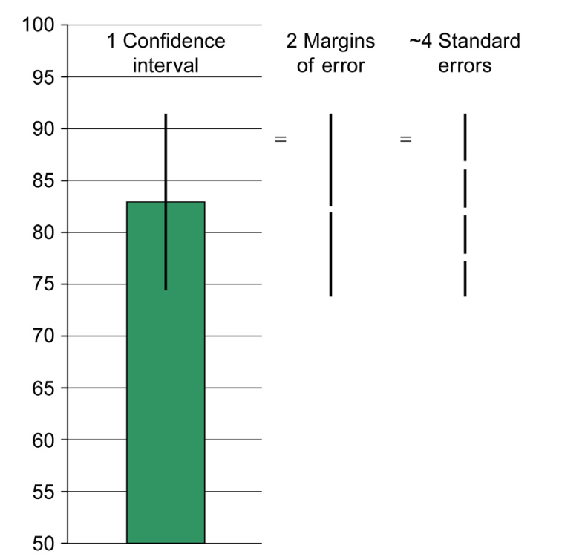
CI
The confidence interval formula can appear intimidating. A simplified way of thinking about it is to think of the confidence interval as two margins of error around the mean. The margin of error is approximately two standard errors, and the standard error is how much we expect sample means to fluctuate given the sample size (Fig. 3.2).
To construct the interval, we need the mean, standard error, sample size, and critical value from the t-distribution, using the appropriate value of t for our sample size and desired confidence level. We can obtain the mean and standard deviation from our sample data.
$$\overline{x}±t_{(1−\frac{α}{2})}\frac{s}{\sqrt{n}}$$

Slide 30

Example
For example, let’s use the following scores from the System Usability Scale (SUS), collected when users rated the usability of an app:
90, 77.5, 72.5, 95, 62.5, 57.5, 100, 95, 95, 80, 82.5, 87.5
From this data we can generate the three basic ingredients needed to generate the t-confidence interval.
Mean: 82.9
Standard deviation: 13.5
Sample size: 12
$$\overline{x}±t_{(1−\frac{α}{2})}\frac{s}{\sqrt{n}}=t_{0.95}$$

Slide 31
References
Sauro, Lewis – Quantifying the User Experience: Practical Statistics for User Research, 2nd edition – Elsevier
Brooke et al., SUS: A Retrospective, Journal of Usability Studies, vol. 8, no. 2, 2013, pp. 29-40.

