Slide 1
Elements of network security

Slide 2
Agenda
Definitions of network security and cryptography
Symmetric-key cryptography
Asymmetric-key cryptography
Digital signature algorithms and hash function
Elements of security in network communication
Authorization

Slide 3
Network security
Network security problems can be divided roughly into four areas:
Secrecy, also called confidentiality → keeping information secret to unauthorized users.
Authentication → determining whom you are talking to before revealing sensitive information.
Nonrepudiation → signatures to ensure that the user you are talking to is who it claims to be.
Integrity control → how you can be sure that a message you received was really the one sent and not something that a malicious adversary modified in transit or concocted.
All network security is based on cryptographic principles.

Slide 4
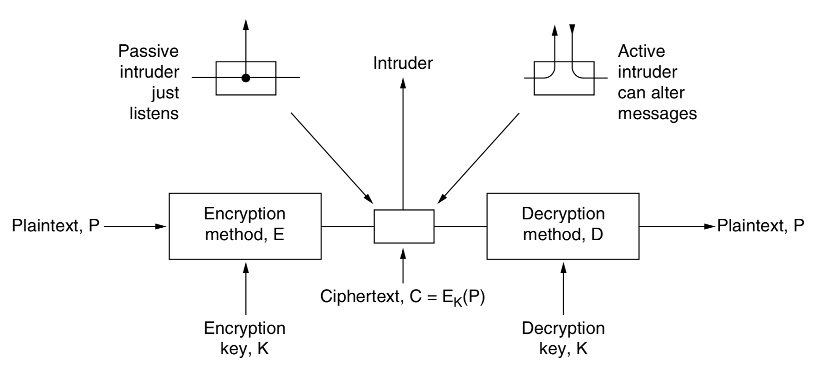
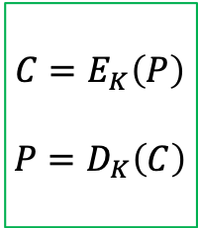
Cryptography
Cryptography: the study of secure communications techniques that allow only the sender and intended recipient of a message to view its contents.
Cipher: a transformation of the message, without regard to the linguistic structure of the message.
General encryption model (symmetric cryptography):
$$C=E_{K}\left(P\right)$$
$$P=D_{K}\left(C\right)$$

Slide 5
Cryptography
Cryptanalysis: the art of breaking ciphers
Cryptology: the art of devising ciphers
A fundamental rule of cryptography is that one must assume that the crypt- analyst knows the methods used for encryption (E) and decryption (D).
Kerckhoff’s principle (1883): All algorithms must be public; only the keys are secret.
The secrecy of a cipher stands on the secrecy of the key.
The key must be sufficiently complex not to allow an intruder to discover the key by exhaustive search!

Slide 6
Two historic ciphers: substitution ciphers
Substitution ciphers: each letter or group of letters is replaced by another letter or group of letters.
Caesar cipher: each letter is substituted with the letter k steps ahead in the alphabet, where k is the key of the cipher. Only 25 possible keys.
Monoalphabetic substitution cipher: each letter is substituted with another general alphabet letter. The key is the 26-letter string representing the alphabet permutation. Number of possible keys: 26! However, this cipher can be easily broken comparing the frequency of letters in the plain and encrypted text.
Plain text:
A | B | C | D | E | … | W | X | Y | Z
k = 3
Encrypted text:
D | E | F | G | H | … | Z | A | B | C
Plain text:
A | B | C | D | E | … | W | X | Y | Z
Encrypted text:
F | M | P | Z | G | … | S | J | L | A

Slide 7
Modern cryptography
The encryption algorithm is made so complex that, even if the cryptanalyst acquires vast amount of enciphered text, he/she will not be able to make any sense of it without the key.
There are mainly two classes of cryptography algorithms:
Symmetric-key algorithms → same key for encryption and decryption
Asymmetric-key algorithms → different key for encryption and decryption

Slide 8
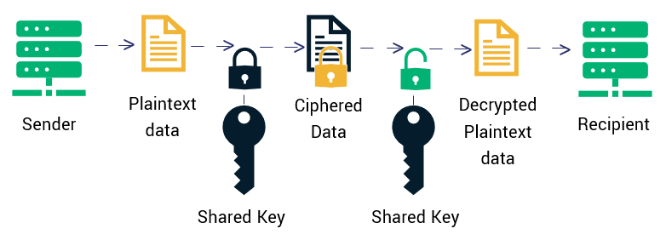
Symmetric-key algorithms
The key for encrypting the data is the same to be used for decrypting the ciphered message.
The key must be shared between the sender and the recipient, but it must be protected, because any user having the key can potentially decrypt the message.
Also called private-key cryptography algorithms.
Encryption
Decryption

Slide 9
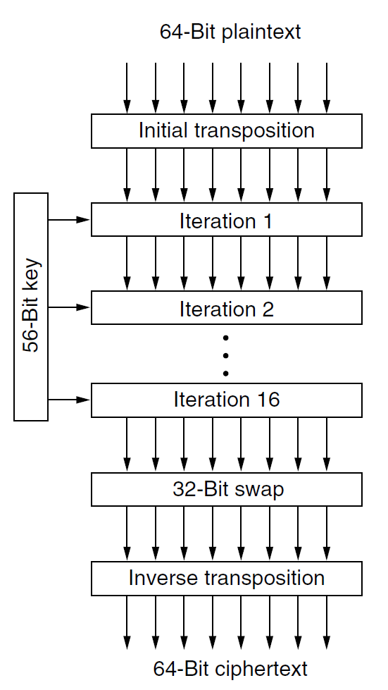
Data Encryption Standard (DES)
Introduced in the ‘70 by IBM and adopted as a security standard by the U.S. government for many years.
Encryption by groups of 64 bits.
Key K made of 56 bits.
From K, create 16 keys (K_{i}) of 48 bit using specific functions
Encryption steps:
Key-independent transposition (i.e., changing the order)
16 encryption iterations using each K_{i}
Swap of the leftmost 32 bits with the rightmost 32 bits
Inverse of the key-independent transposition
Decryption done with the same steps in reverse order.

Slide 10
Triple DES
1977: Diffie and Hellman (Stanford) designed a machine able to break DES by exhaustive search in less than a day and estimated that it could be built for 20 million $.
1979: IBM proposed Triple DES algorithm
The triple DES key is 112-bit long (K₁,K₂).
With K₁=K₂ the triple DES is equivalent to DES.
K₁
K₂
K₁
Plain data
DES encryption
DES decryption
DES encryption
Encrypted data
K₁
K₂
K₁
Encrypted data
DES decryption
DES encryption
DES decryption
Plain data

Slide 11
Advanced Encryption Standard (AES)
1997: the U.S. National Institute of Standards and Technology (NIST) invited researchers from all over the world to submit proposals for a new standard, to be called AES (Advanced Encryption Standard).
15 serious algorithms were proposed.
2000: NIST proclaimed the winner: Rijndael, by Joan Daemen and Vincent Rijmen, two young Belgian cryptographists.
2001: Rijndael became the new AES adopted by U.S. government.
Two variants of AES are generally used:
Variant with blocks of 128 bits and a key of 128 bits
Variant with blocks of 128 bits and a key of 256 bits
Still considered one of the most secure cryptography algorithms

Slide 12

Limitations of the symmetric-key algorithms
The privacy of the key is fundamental. No matter how strong a cryptosystem is, if an intruder can steal the key, the system is worthless.
The key must be shared between the sender and the recipient.
need to distribute the key and at the same time to keep it protected

Slide 13
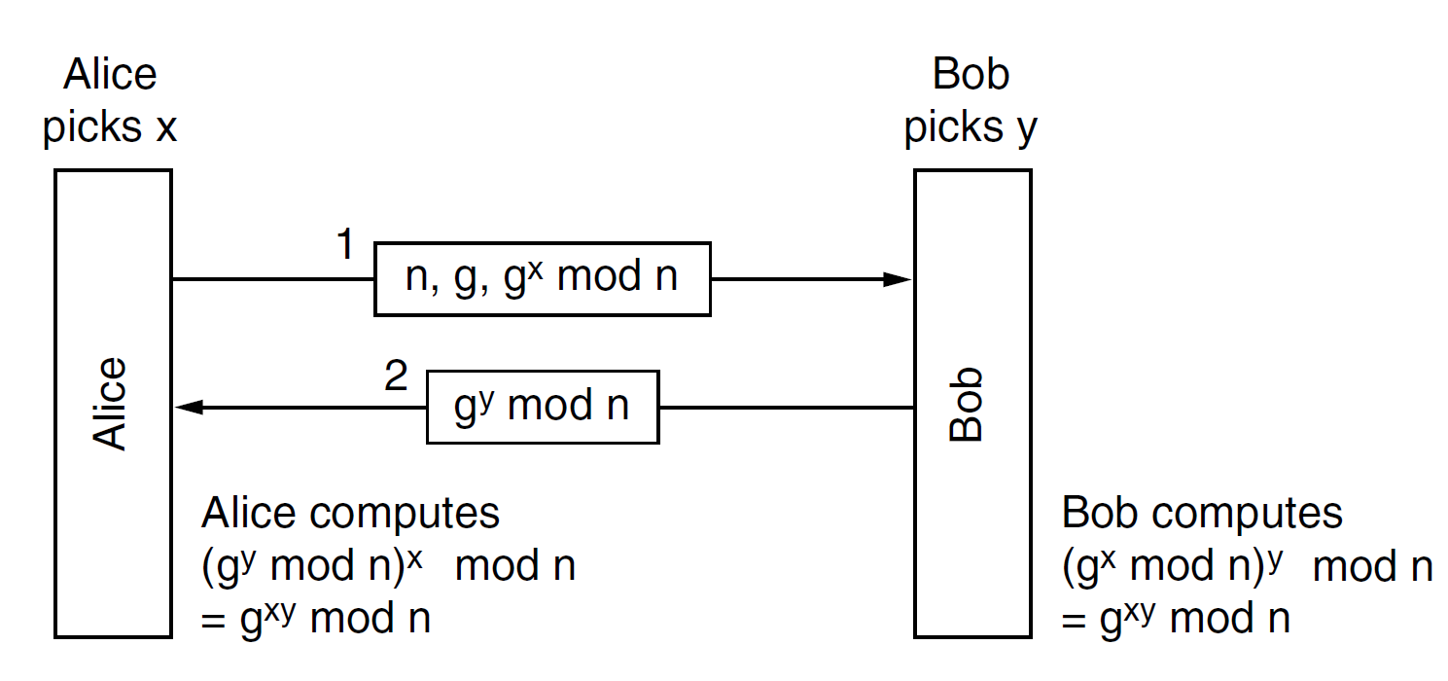
Diffie-Hellman key exchange protocol
Diffie-Hellman key exchange protocol: two users (Alice and Bob) that never met before can establish a shared secret key (Diffie and Hellman, 1976).
Alice and Bob have to agree on two large numbers, n and g, where n is a prime, (n − 1)/2 is also a prime, and certain conditions apply to g. These numbers may be public.
Now Alice picks a large (e.g., 1024-bit) number, x, and keeps it secret.
Similarly, Bob picks a large secret number, y.
By the laws of modular arithmetic:
(g^{y} mod n)^{x} mod n = (g^{x} mod n)^{y} mod n = g^{xy} mod n
g^{xy} mod n is the secret key for Alice and Bob
The strength of the approach is that from only g^{x} mod n, n, and g is very difficult to find x.

Slide 14
Example of generation of a secret key
Alice and Bob publicly agree to use n = 23 and g = 5 (which is a primitive root modulo 23).
Alice chooses a secret integer x = 4, then sends Bob A = g^{x} mod n
A = 5⁴ mod 23 = 4
Bob chooses a secret integer y = 3, then sends Alice B = g^{y} mod n
B = 5³ mod 23 = 10
Alice computes s = B^{x} mod n
s = 10⁴ mod 23 = 18
Bob computes s = A^{y} mod n
s = 4³ mod 23 = 18
Alice and Bob now share a secret key (the number 18).

Slide 15
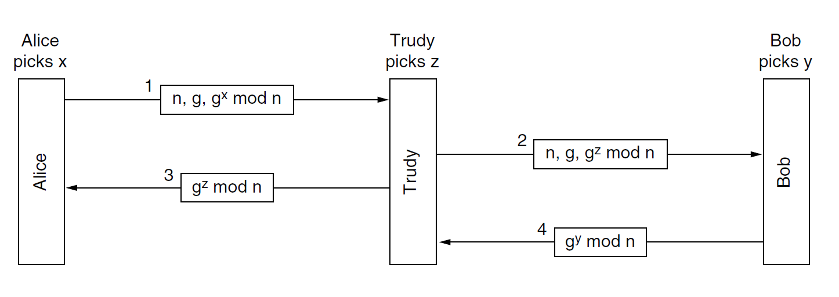
Man-in-the-middle attack
Critical aspect: this approach can be violated by a man-in-the-middle attack
1976: Diffie and Hellman (Stanford University) proposed a new kind of cryptosystem, in which the encryption and decryption keys were different
So different that the decryption key could not feasibly be derived from the encryption key.

Slide 16
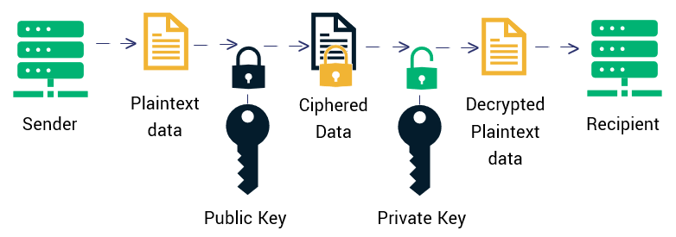
Asymmetric-key algorithms
The key for encrypting is different from the key to be used for decrypting the message.
Each recipient has a pair of twin keys, a public key and private key, such that it is extremely difficult to derive the private key from the public one.
The sender must encrypt the message using the public key of the recipient.
The recipient can decrypt the ciphered message using its own private key.
Also called public-key cryptographic algorithms.
Encryption
Decryption
The public key can be distributed also in unsafe channels.

Slide 17
RSA
1978: Rivest, Shamir and Adleman (MIT) proposed the RSA asymmetric-key algorithm.
The generation of the keys is based on some number principles by these 4 steps:
Choose two distinct large prime numbers, p and q (typically 1024 bits)
Compute N = p × q and z = (p − 1) × (q − 1).
Choose an integer number relatively prime to z and call it d.
Find an integer number e such that the rest of e × d divided by z is 1.
Public key: (N,e)
Private key: (N,d)
p and q are secret, only who generated the keys knows them.
Strength of RSA: from N it is very difficult to recover p and q
→ from the public key it is very difficult to retrieve the private key

Slide 18
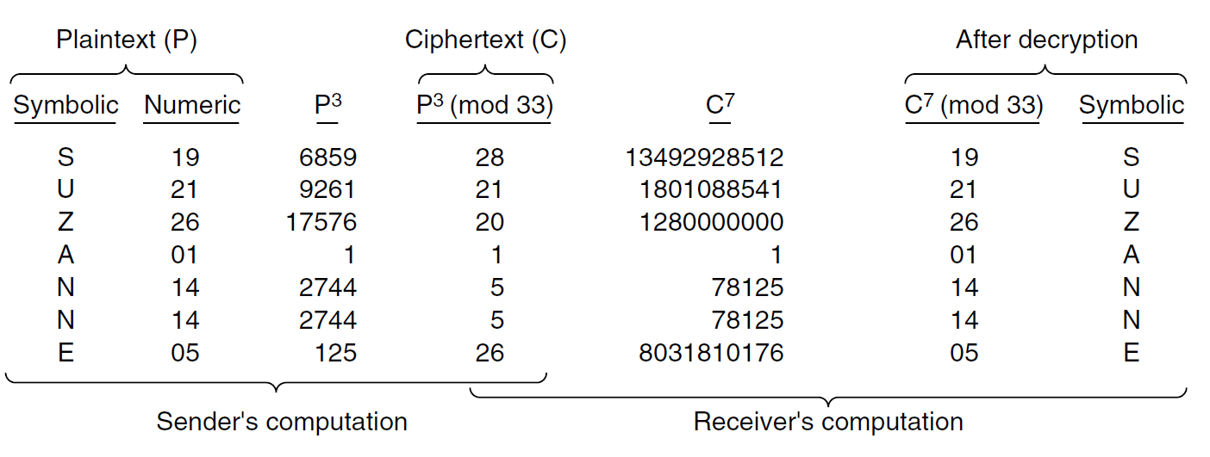
Encryption and decryption with RSA
The message is divided into blocks of k bits such that 2^{k}<N
Each k-bit number of the plain text, P, is encrypted by the operation
C = P^{e} mod N
It can be proven that C can be decrypted using d and N as:
P = C^{d} mod N
Public key: (N,e)
Private key: (N,d)
Example with public key (33,3) and private key (33,7)

Slide 19


Symmetric vs asymmetric key algorithms
Symmetric algorithms:
Their application for encryption and decryption is fast
Need to distribute the private key through a safe communication channel
A new key must be generated for each pair of communication entities
Asymmetric algorithms:
Very strong security level, no need to distribute the private key.
There is a pair of keys for each user.
It requires keys of at least 1024 bits for good security, which makes the encryption and decryption quite slow.

Slide 20
Hybrid algorithms
BONUS
Asymmetric-key and symmetric-key algorithms combined to have the advantages of both approaches.
Symmetric algorithm (fast) used to encrypt the message M with key K_{sym}.
K_{sym}, typically much shorter than M, encrypted with the asymmetric algorithm (slow).
Encrypted K_{sym,en} securely distributed even using an unsafe communication channel.
Encryption
Decryption
Alice (sender)
K_{sym}
Bob (recipient)
K_{Bob,public} K_{Bob,private}
Plain message
Symmetric encryption
Encrypted message
Symmetric decryption
Decrypted message
K_{Bob,public}
K_{Bob,private}
K_{sym}
Asymmetric encryption
Asymmetric decryption
K_{sym}
K_{sym,en}

Slide 21
Network security
Secrecy or confidentiality.
Addressed by cryptography algorithms (symmetric-key, asymmetric-key, or hybrid)
Authentication
Nonrepudiation
Integrity control
They can be achieved by digital signature

Slide 22
Digital signatures
The authenticity of documents is determined by the presence or absence of an authorized handwritten signature.
Digital signature replaces handwritten signature for digital messages.
Requirements of a digital signature:
The receiver can verify the claimed identity of the sender (authentication).
The sender cannot later repudiate the contents of the message (non-repudiation).
The receiver cannot possibly have altered the message himself (integrity).

Slide 23
Digital signature by symmetric-key cryptography
E_{K}(.): Function for symmetric encryption with key K
Each user is provided a secret key to be used in symmetric-key cryptography.
A central trusted authority knows the keys of every user and can verify the identify of all users.
Alice (sender)
Ka
Plaintext P
Central trusted authority
with secret key Kc
Ka is secret key of Alice
Kb is the secret key of Bob
Bob (recipient)
Ciphertext C
C = E_{Ka}(B, P)
Kb
C’ = E_{Kb} (A, P, E_{Kc}(A, P))
Alice’s identity
Bob’s identity
The central authority decrypts the message with Ka and thus authenticates Alice.
Needed to Bob to demonstrate he has received the message from the central authority (Alice cannot repudiate the message)

Slide 24
Limitations of the symmetric-key digital signature
A central trusted authority must be in the middle of any exchange of signed messages.
The central authority reads all the signed messages.
This problem can be solved using public-key algorithms.

Slide 25
Public-key digital signature
If Alice encrypts a message with her private key (Ka,priv) then Bob can decrypt the message with her public key (Ka,pub).
Ka,pub: Alice’s public key
Ka,priv: Alice’s private key
Alice
Bob
Encryption with key Ka,priv
Ciphered P
Decryption with key Ka,pub
Plaintext P
Plaintext P
If Bob can open the message by Ka,pub, then Bob is sure that the message was sent by Alice, because Alice is the only one having Ka,priv
→ authentication and non-repudiation are guaranteed
Secrecy is not guaranteed: anyone with Ka,pub can open the message.

Slide 26
Public-key signature with secrecy
If secrecy of the message must also be guaranteed, public-key cryptography can be applied twice, using both the keys of the sender and the receiver.
Ka,pub: Alice’s public key Kb,pub: Bob’s public key
Ka,priv: Alice’s private key Kb,priv: Bob’s private key
Alice
Bob
Encryption with Ka,priv
Encryption with Kb,pub
Ciphered P
Decryption with Kb,priv
Decryption with Ka,pub
P
P

Slide 27
Message digest
Critical aspect of public-key signature: public-key cryptography is slow.
To make digital signature faster, instead of encrypting the entire message, the signature can be applied on a message digest obtained by a hash function.
Hash function: a function h(.) that takes an arbitrarily long piece of plaintext, P, and from it computes a fixed-length bit string, called digest or fingerprint.
Properties that the hash function must have:
Given P, it is easy to compute h(P).
Given h(P), it is almost impossible to find P.
Given P, no one can find P′ such that h(P′) = h(P).
A change to the input of even 1 bit produces a very different output.
Computing h(P) is much faster than encrypting P with a public-key algorithm → digests can be used to speed up digital signature algorithms.

Slide 28
Digital signature with message digest (no secrecy)
If message secrecy is not required:
Ka,pub: Alice’s public key Kb,pub: Bob’s public key
Ka,priv: Alice’s private key Kb,priv: Bob’s private key
Alice
Bob
h(.)
h(P)
Encryption with Ka,priv
Ciphered h(P)
h(P)
P
Decryption with Ka,pub
Digest comparison
P
h(P)
h(.)
If the two digest are the same Bob can be sure that the message was sent by Alice, because otherwise the decrypted hash would differ from the one obtained by Bob.
→ Authentication and non-repudiation ensured.
Bob is also sure that the message P was not altered during transmission. Any small modification of P would result in a different digest! → Integrity ensured.

Slide 29
Digital signature with message digest (with secrecy)
If message secrecy is required:
Ka,pub: Alice’s public key Kb,pub: Bob’s public key
Ka,priv: Alice’s private key Kb,priv: Bob’s private key
Alice
Bob
h(.)
h(P)
Encryption with Ka,priv
Ciphered h(P)
h(P)
P
Decryption with Ka,pub
Digest comparison
Ciphered P
P
h(P)
Encryption with Kb,pub
Decryption with Kb,priv
h(.)
P must be encrypted, but the signature can still be done just on the digest because from the digest it impossible to recover the original message.

Slide 30
Example of hash functions
SHA-1 (Secure Hash Algorithm 1)
it generates a 160-bit message digest
SHA-1(«hello world») → 2aae6c35c94fcfb415dbe95f408b9ce91ee846ed
SHA-1(«hello word») → e0738b87e67bbfc9c5b77556665064446430e81c
MD5 (Message Digest 5)
it generates a 128-bit message digest
MD5(«hello world») → 5eb63bbbe01eeed093cb22bb8f5acdc3
MD5(«hello word») → 13574ef0d58b50fab38ec841efe39df4

Slide 31
Security in network communication
Main security techniques:
Cryptography algorithms to ensure secrecy
Digital signature to ensure authentication and non-repudiation
Hash functions to ensure integrity
Security algorithms are implemented at different layers of the TCP/IP network model.
Network layer → IPsec
Transport-Application layer → SSL/TLS

Slide 32
IPsec (IP security)
IPsec (IP security): secure network protocol suite to implement secure encrypted communication at the network layer.
IPsec includes protocols for the following services:
network-level peer authentication
data origin authentication
data integrity
data confidentiality (encryption)
negotiation of cryptographic keys to use during the session
Protection against replay attacks (where the intruder replays a conversation)
IPsec is an algorithm-independent framework that can implement multiple algorithms.
If an algorithm that is now thought to be secure may be broken in the future, the framework is still working.
Multiple granularities: it is possible to protect a single TCP connection or all traffic between a pair of hosts.

Slide 33
Algorithms in IPsec
BONUS
Packets need to be exchanged extremely rapidly so IPsec is mainly based on symmetric encryption.
Integrity algorithm:
HMAC-SHA1/SHA2
Symmetric encryption algorithms for confidentiality:
TripleDES
Different versions of AES
Key exchange algorithms:
Diffie–Hellman
ECDH (Elliptic-curve Diffie–Hellman)
Authentication algorithms:
RSA
ECDSA (Elliptic Curve Digital Signature Algorithm)
PSK (Pre-shared key)

Slide 34
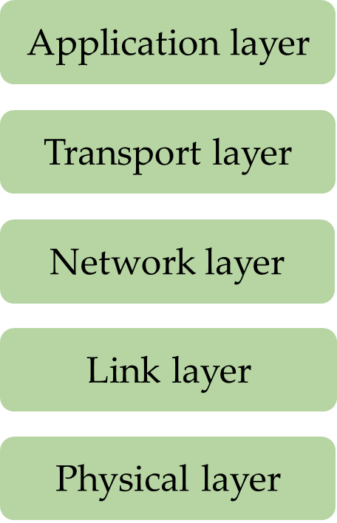
Secure socket layer (SSL) and Transport Layer Security (TLS)
Secure Socket Layer (SSL): A software for building a secure connection between two sockets, including:
Parameter negotiation between client and server.
Authentication of the server by the client.
Secret communication.
Data integrity protection.
SSL is positioned between the application layer and the transport layer
SSL consists of two subprotocols, one for establishing a secure connection and one for using it.
When HTTP is used over SSL it is called HTTPS (secure HTTP), even though it is the standard HTTP.
2015: SSL was deprecated and substituted by the Transport Layer Security (TLS).
SSL

Slide 35
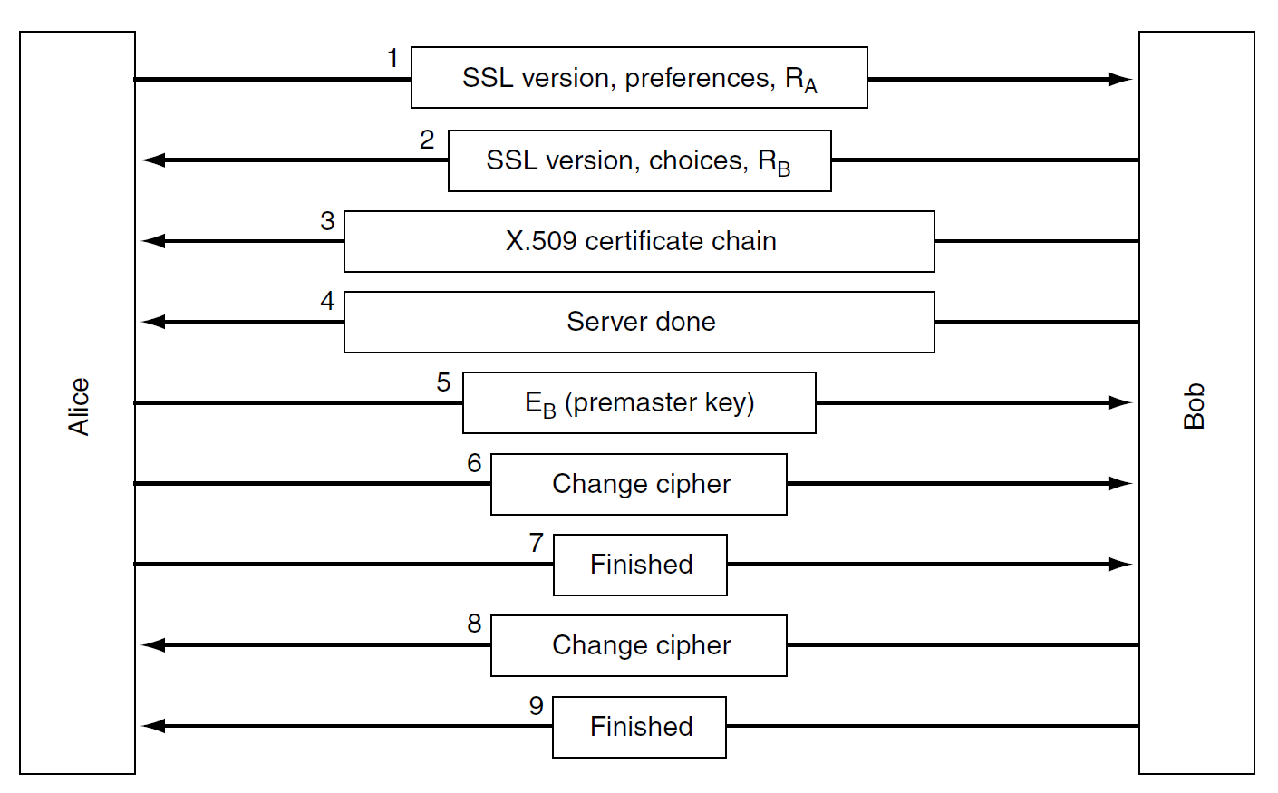
SSL connection establishment protocol
BONUS
Alice expresses preferences about cryptography and compression algorithms to use.
Bob chooses among Alice preferences.
Bob provides the certificate with his public key.
Bob communicates his part is done.
Alice sends an encrypted premaster key. With the premaster key Alice and Bob are able to calculate their session key (similarly to Diffie-Hellman).
Alice tells Bob to switch to the ciphered communication.
Alice tells Bob the setup is done.
Bob tells Alice he will switch to ciphered communication.
Bob confirms that the setup is done.
The actual session key used for encrypting data is derived from the premaster key combined with two large random numbers, R_{A} and R_{B}, in a complex way.

Slide 36
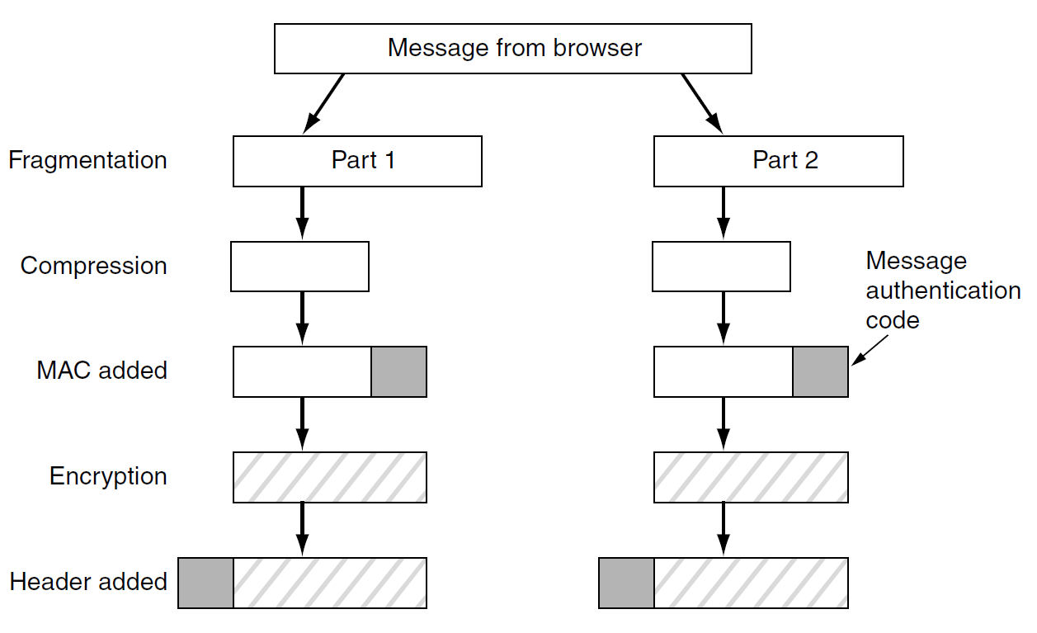
SSL data transmission protocol
BONUS
SSL supports multiple cryptographic algorithms. The strongest one uses triple DES with three separate keys for encryption and SHA-1 for message integrity.
The session key is concatenated with the compressed text and the result is hashed with the agreed-on hashing algorithm. The resulting digest is the Message Authentication Code (MAC).

Slide 37


Authorization
Authentication: the process of proving that the user is who he/she declares to be.
Authorization: the act of granting a user permission to do something.
Necessary when some resources/tasks are limited to users with special permission (access control).
It specifies what data a user is allowed to access and what the user can do with that data.
Access request
Unauthorized user
Access denied
Server
Protected endpoint
Access request
Authorized user
Access granted

Slide 38
Basic access authentication
Authorization using account credentials
Each user of the website/web application has an account with a user ID and a password (credentials).
The user logs into the website/web application providing its credentials.
The server verifies credentials and allows the user to access the resources it is authorized to access.
HTTP request header to provide credentials:
Authorization: Basic <credentials>
where <credentials> includes user ID and password.
Often authorization is performed after the server request it.

Slide 39
Basic access authentication
Unauthorized request
GET /home HTTP/1.1
Client
Server
DB of credentials
The server responds authorization is needed:
HTTP/1.1 401 Unauthorized
WWW-Authenticate: Basic realm=’’protection space’’
Ask user
Authorized request
GET /home HTTP/1.1
Authorization: Basic <credentials>
Access control program
DB of protected resources
Server’s response to authorized request
HTTP/1.1 200 OK
HTTP/1.1 403 Forbidden
or
How can we protect the transmission of credentials?

Slide 40
Digest access authentication
Its uses an hash function to protect credentials.
Client
Server
Unauthorized request
DB of credentials
DB of protected resources
Authorization is needed
+ random nonce (large number, N)
credentials, N
Access control program
credentials, N
h(·)
h(·)
h’(credentials, N)
h(credentials, N)
h(credentials, N)
Digest comparison
Server’s response to authorized request
Alternative solution: encrypted communication with the HTTPS protocol.

Slide 41
The problem of delegated authorization
A third-party app wants to access some resources of another service provider, whose access is restricted by authorization.
The authorization must be delegated to the third-party app.
Today delegated authorization is very common:
Your Strava app may synchronize your Fitbit data
→ Fitbit authorization is delegated to Strava
You may share your preferred song in Spotify on your Facebook profile
→ Facebook authorization is delegated to Spotify
How can a third-party app perform delegated authorization?

Slide 42
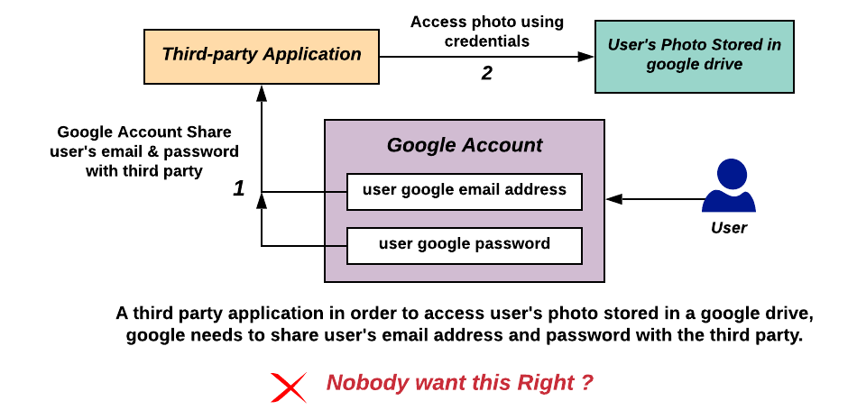
The incorrect solution: sharing login credentials

Slide 43

OAuth protocol
OAuth (Open Authorization): a protocol for delegated authorization that does not require to share credentials with the third-party app.
2007: First version (OAuth 1.0)
2012: Second version (OAuth 2.0)
Main co-author is Blaine Cook, one of the developers of Twitter.
Today OAuth is commonly used by companies such as Twitter, Amazon, Google, Facebook and Microsoft to permit the users to share information about their accounts with third-party applications or websites.
Why do we study OAuth?
If you develop an app that integrates data from third-party servers that require authorization, you may need to use OAuth to request resources.

Slide 44
OAuth roles
Resource owner: The user who authorizes a third-party application to access their data.
The application’s access to the user’s data is limited to the scope of the authorization granted (e.g., read or write access).
Client: The third-party application that wants to access the user’s account.
The client must be authorized by the user.
The authorization must be validated by an API of the authorization server.
Resource server: The server hosting the protected user data.
Authorization server: It verifies the identity of the user and issues access tokens to the third-party application.

Slide 45
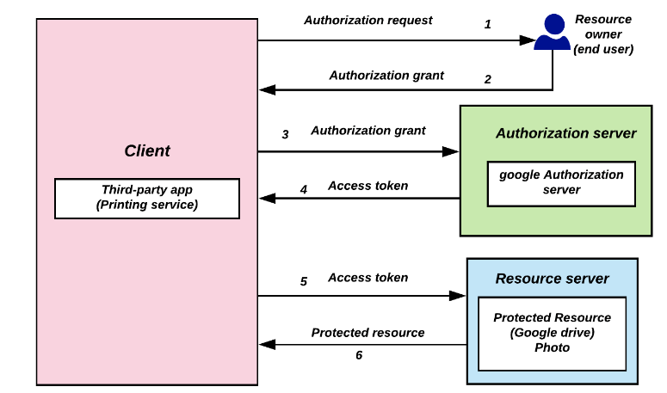
OAuth abstract model
Example: a printing service app wants to access Google drive photos

Slide 46
Application registration
The third-party app (e.g. the printing app) must be registered with the service provider (e.g. Google).
The third-party app’s developer must complete a registration form (usually in the developer page of the service’s website) providing details about the app.
Redirect URI (or Callback URL): where the service will redirect the user after they authorize (or deny) the third-party app → the part of the third-party app that handles authorization codes and access tokens.
Once the third-party app is registered, the service issues client credentials:
Client ID: a public string used by the service to identify the client.
Client secret: a private password used to authenticate the identity of the client when the app requests to access a user’s data

Slide 47

Example of delegated authentication with OAuth
Example: The app yelp.com wants to get access to a user’s Google account profile contacts.
Client
Authorization server
yelp.com
accounts.google.com
Authorization request
Authentication of the resource owner
Connect with Google
Email:
Resource owner
Client ID: abc123
Redirect URI: yelp.com/callback
Scope: profile contacts
Password:
contacts.google.com
Authorization code, client ID, client secret
Request consent from the resource owner
Access token
Contacts
Access token
yelp.com/callback
accounts.google.com
Loading
Allow Yelp to access your profile and contacts?
Back to the redirect URI with the authorization code
No
Yes

Slide 48
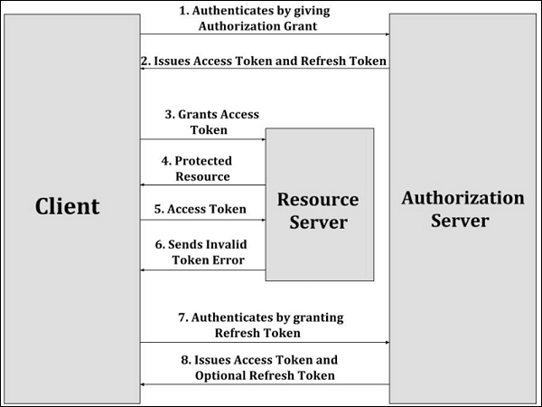
Refresh token
Access token have an expiration time.
A refresh token can be used by the client to request a new access token to the authorization server without the need to repeat the entire authorization process.

Slide 49
JSON Web token
JSON Web Token (JWT, pronounced “jot”): an Internet standard that defines a compact way for securely transmitting a token between parties as a JSON object. The token can be verified and trusted because it is digitally signed (e.g., using RSA with SHA-256).
A JWT token consists of three parts separated by dots, a header, a payload, a signature, encoded in Base64Url (a type of encoding to represent binary data).
xxxxx.yyyyy.zzzzz
Header: the type of the token and the signing algorithm
{ "alg": “RS256", "typ": "JWT" }

Slide 50
JSON Web token
{
"iss": "https://accounts.google.com",
"sub": "you@gmail.com",
"name": “John Smith"
"aud": "s6BhdRkqt3",
"exp": 1311281970,
"iat": 1311280970,
"auth_time": 1311280969
}
xxxxx.yyyyy.zzzzz
Payload: it contains claims, i.e., some statements.
Standard payload claim fields
iss | Issuer | Identifies principal that issued the JWT.
sub | Subject | Identifies the subject of the JWT.
aud | Audience | Identifies the recipients that the JWT is intended for. If the principal processing the claim does not identify itself with a value in the aud claim when this claim is present, then the JWT must be rejected.
exp | Expiration Time | Identifies the expiration time on and after which the JWT must not be accepted for processing.
nbf | Not Before | Identifies the time on which the JWT will start to be accepted for processing.
iat | Issued at | Identifies the time at which the JWT was issued.

Slide 51
JSON Web token
xxxxx.yyyyy.zzzzz
The signature is calculated by these steps:
header and payload encoded using Base64url
concatenation of the encoded header and payload with a separating character
Encryption of the obtained string through the cryptographic algorithm specified in the header.
RS256(base64UrlEncode(header) + "." + base64UrlEncode(payload), signature_key)
Signature: it contains a signature of the header and payload

Slide 52
Example of a JWT token
Header
eyJhbGciOiJSUzI1NiIsImtpZCI6IkRNa3Itd0JqRU1EYnhOY25xaVJISVhu
YUxubWI3UUpfWF9rWmJyaEtBMGMifQ
.
eyJzdWIiOiIwMHU5bzFuaWtqdk9CZzVabzBoNyIsInZlciI6MSwiaXNzIjoi
aHR0cHM6Ly9kZXYtMzQxNjA3Lm9rdGFwcmV2aWV3LmNvbS9vYXV0aDIvYXVz
OW84d3ZraG9ja3c5VEwwaDciLCJhdWQiOiJsWFNlbkx4eFBpOGtRVmpKRTVz
NCIsImlhdCI6MTUwOTA0OTg5OCwiZXhwIjoxNTA5MDUzNDk4LCJqdGkiOiJJ
RC5oa2RXSXNBSXZTbnBGYVFHTVRYUGNVSmhhMkgwS2c5Ykl3ZEVvVm1ZZHN3
IiwiYW1yIjpbImtiYSIsIm1mYSIsInB3ZCJdLCJpZHAiOiIwMG85bzFuaWpr
aWpLeGNpbjBoNyIsIm5vbmNlIjoidWpwMmFzeHlqN2UiLCJhdXRoX3RpbWUi
OjE1MDkwNDk3MTl9
.
dv4Ek8B4BDee1PcQT_4zm7kxDEY1sRIGbLoNtlodZcSzHzXU5GkKyl6sAVmdXOIPUlAIrJAhNfQWQ-
_XZLBVPjETiZE8CgNg5uqNmeXMUnYnQmvN5oWlXUZ8Gcub-GAbJ8-
NQuyBmyec1j3gmGzX3wemke8NkuI6SX2L4Wj1PyvkknBtbjfiF9ud1-
ERKbobaFbnjDFOFTzvL6g34SpMmZWy6uc_Hs--n4IC-ex-
_Ps3FcMwRggCW_-7o2FpH6rJTOGPZYrOx44n3ZwAu2dGm6axtPIsqU8b6sw7DaHpogD_hxsXgMIOzOBMbYsQEiczoGn71ZFz_1O7FiW4dH6g
Payload
Signature

Slide 53
References
Tanenbaum, Wetherall – Computer Networks – Fifth Edition
Chapter 8 – Network security

