Slide 1
Giacomo Cappon
Exam and Project Discussion Q&A

Slide 2
Outline
The theory exam
Project delivery instructions
Project presentation guidelines

Slide 3
Exam structure
Written test of 90-minute duration:
4 open questions
Notes:
The exam is in English, answers to be provided in English (English errors not penalized). Dictionary is not allowed.
At the exam, the students cannot use any course material (slides, books, articles, etc.), nor any electronic device (e.g., smartphone, notebook, etc.). Only the pen and a calculator is allowed.
The questions will focus on the course content presented during both the “theory” and the “laboratory” lessons except the material marked as
In any case, no questions will require to write Dart/Flutter code.
BONUS

Slide 4
Mark of the theory exam
Open questions:
0 to 5 points each
Total score: up to 20 points

Slide 5
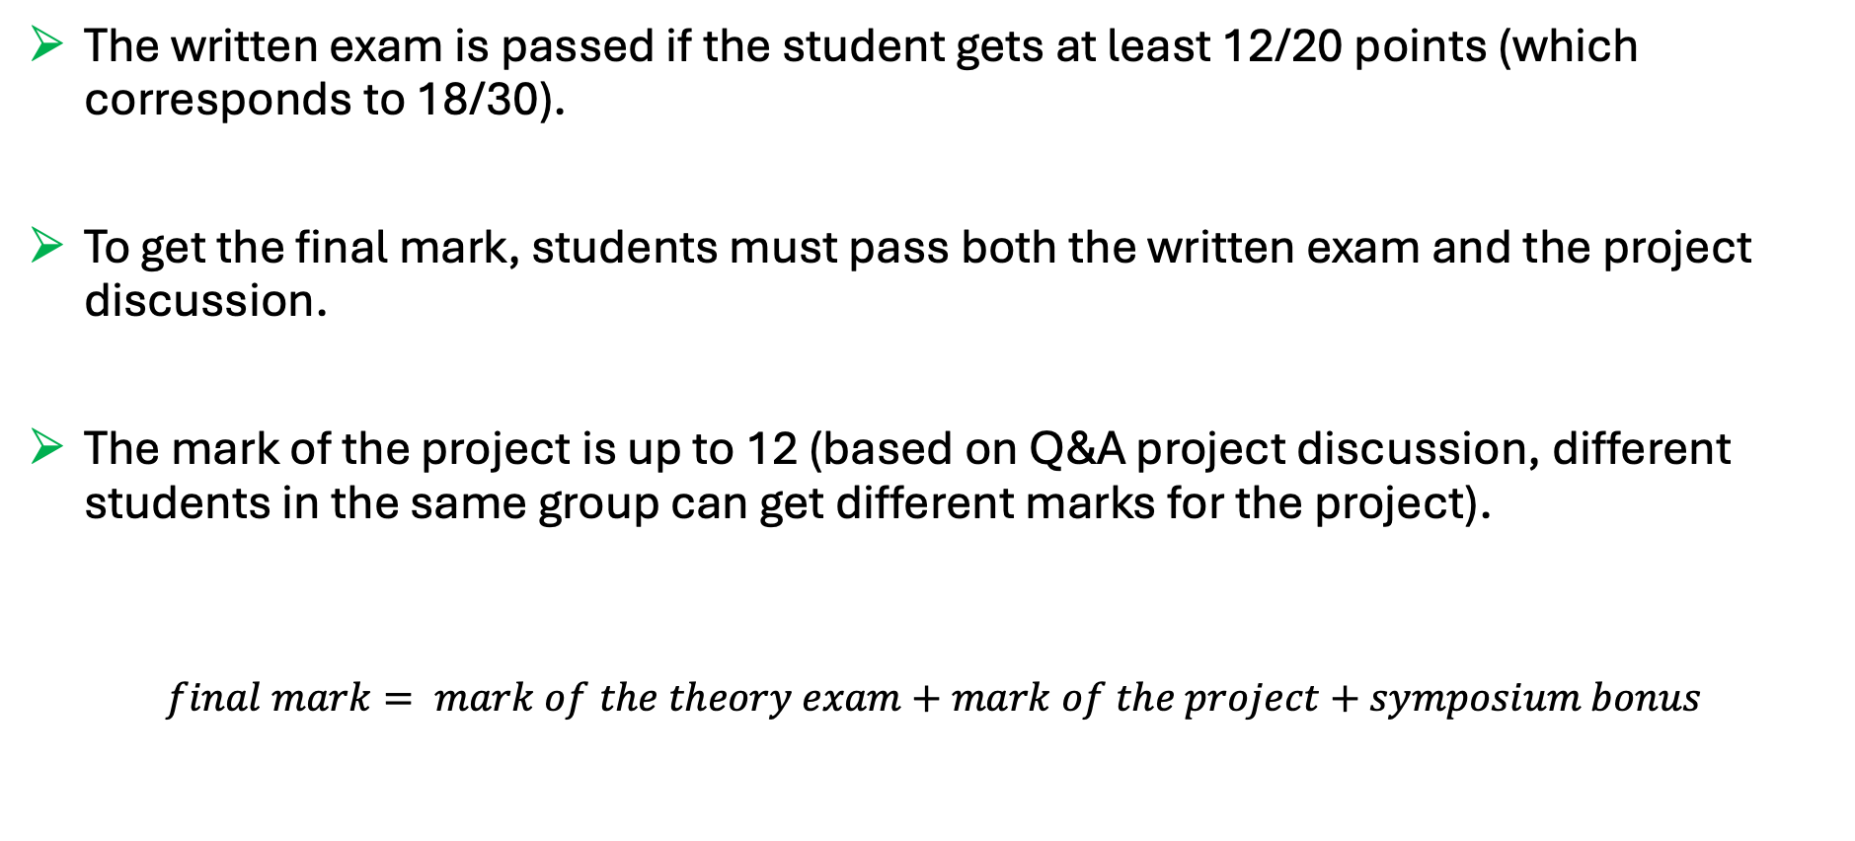
Final mark
The written exam is passed if the student gets at least 12/20 points (which corresponds to 18/30).
To get the final mark, students must pass both the written exam and the project discussion.
The mark of the project is up to 12 (based on Q&A project discussion, different students in the same group can get different marks for the project).
$$final mark= mark of the theory exam+mark of the project+symposium bonus$$

Slide 6
Examples of open questions
Q1. Explain the RSA algorithm
Q2. Explain the role of the embedded processing unit
Q3. Provide a description of the following HTTP methods: GET, HEAD, POST, PUT, DELETE.

Slide 7
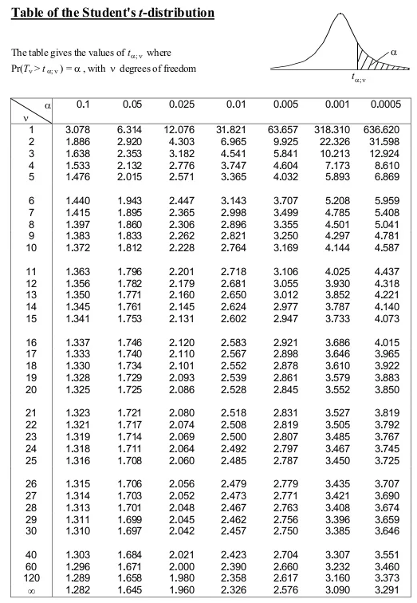
Examples of open questions
Q4. Given the results of 5 SUS questionnaires collected by 5 participants evaluating an app A:
SUS_{A} = 65, 80, 93, 78, 54
Calculate the confidence interval at 90% : 74 ± 14.25
Evaluate if an app B (evaluated by the same 5 participants) with SUS:
SUS_{B} = 90, 90, 87, 95, 91
can be said to be significantly more usable with a level of confidence >= 0.05:
t = 2.30 → NO (if it was >= 0.1, YES)

Slide 8
Outline
The theory exam
Project delivery instructions
Project presentation guidelines

Slide 9
General info
In the following, we reported the instructions on how to deliver your project. In a nutshell, you must prepare and submit a .pdf file containing
the number of your group and the name of each group participant
the link to a public GitHub repository containing a ”valid” version of the code
Since the project must be delivered through GitHub, code delivered via mail will be ignored
“Valid” code must be in the master (or main) branch and must have been committed no later than the 12/07/2026, and no later than the day before the project discussion date.

Slide 10
Example scenario
”I belong to Group 50 composed by me, Martina Vettoretti, and Luca Cossu”
“My code is located in my public repository named bwthw”

Slide 11
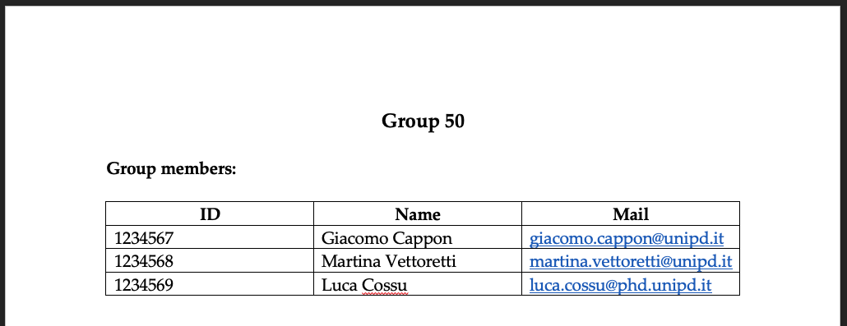
Step 1: Fill the group info
Create a .docx file
Fill the group info at the very top of the file, e.g.:

Slide 12

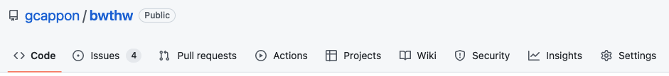
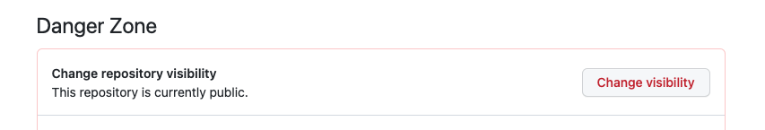
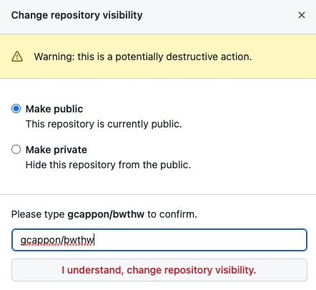
Step 2: Make your repository public
First, make sure your repository is public. This is true if, in GitHub, a “public” label is present near your repo name:
If, instead, the label says “private”, follow these steps to make it public:
Go to “Settings”
Scroll down till the “Danger Zone”
Click on “Change visibility”
Select “Make public”
Type the name of the repo to confirm
Click on the button
Notes:
We focused the laboratories on front-end development

Slide 13
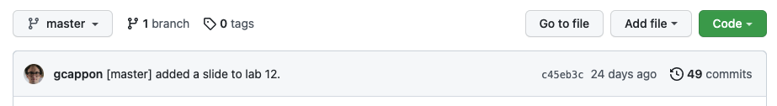
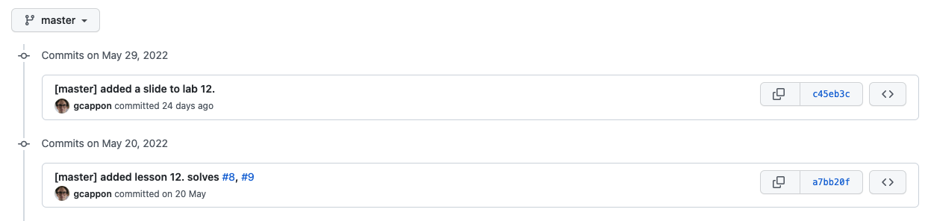
Step 3: Locate the link to a valid code version
From the home page of your GitHub repo, click on the “history” link
Click on the link of the version of the code that you want to submit
Note: be sure that your are in the master (or main) branch!

Slide 14
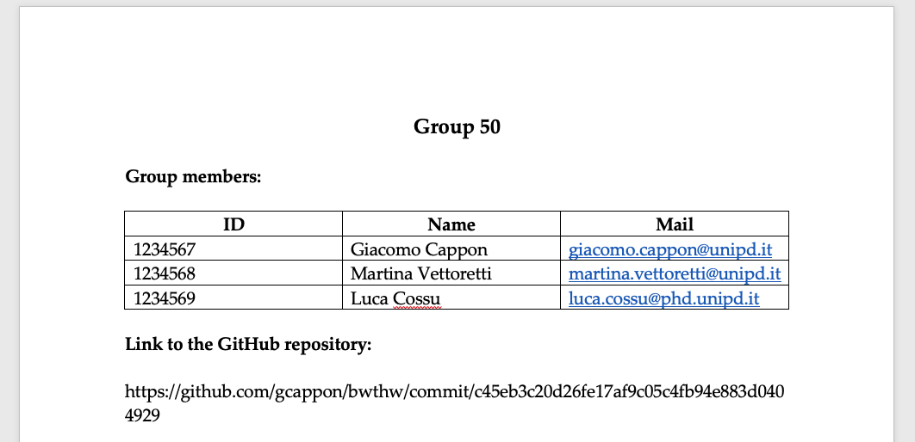
Step 4: Put the link in the .docx file
Copy and paste the link in the url bar of your browser in the .docx file below the group info, e.g.:

Slide 15


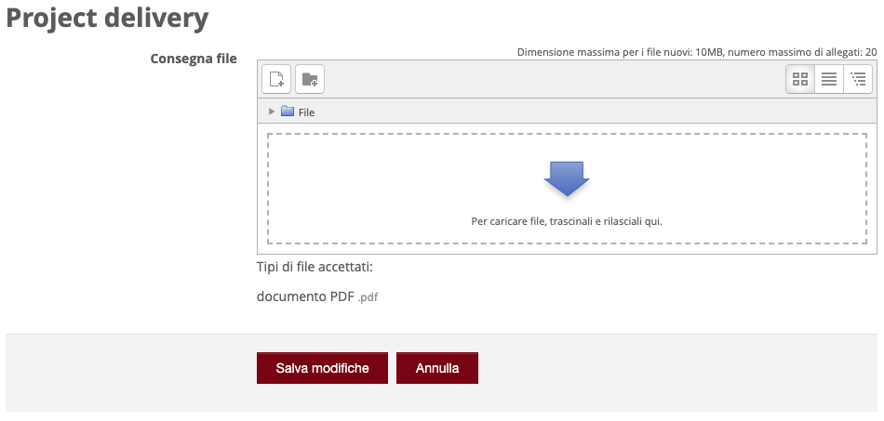
Step 5: Submit the .pdf to moodle
Export your .docx file to .pdf
Then, go to moodle. In the “Project discussion – Project delivery” section locate “Project delivery”:
Click on the delivery button:
Upload the .pdf file
Save and that’s it!

Slide 16
Outline
The theory exam
Project delivery instructions
Project presentation guidelines

Slide 17
Rationale
In the following we reported a brief guide that contains some hints on what to cover during your project discussion. As such, consider this document as a guide rather than something to “fill” with words and images.
You are free to use the template your prefer
The skeleton proposed here is just a simple guideline. Feel free to change it according to your needs.

Slide 18
Discussion structure – General info
You have 25 minutes max to present your project followed by ~20 min of Q&A. Discussions of more than 25 minutes will be penalized.
The presentation must include a PowerPoint presentation followed by a live demonstration of your app working. Both the presentation and the demo must fit the 25 minutes.
The discussion must be in English.
The Q&A session will be in English.

Slide 19
Discussion structure – (Possible) skeleton
A possible skeleton for your discussion can be:
Background/Target
Problem to be solved/Feature to be provided to the public –
Your solution
Core app functionalities
Original part
Project management flavours
Special implementation decisions
Closing remarks and future developments
Live demo - Show (via emulator or physical device) your app working.

Slide 20
Discussion suggestions
Try to motivate every choice.
Consider in advance how much time you will allocate to the PowerPoint presentation and how much time for the live demo.
Prepare the live demo. You have limited time so you must know what to ”tap”, to show, to do ,….
Be sure that your app is working when you run the demo.

