Slide 1
Giacomo Cappon
Implementing UI

Slide 2
Outline
Recap
Building layouts in Flutter
Basic examples
Exercise
Homework
Resources

Slide 3
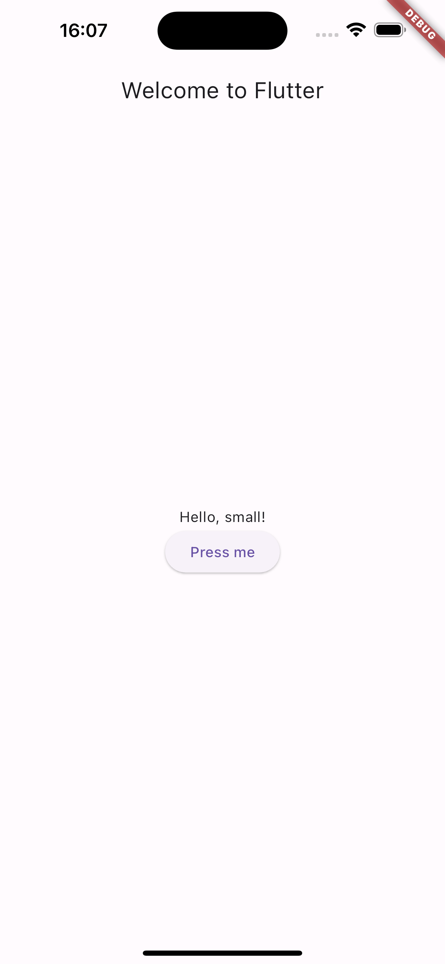
Recap: Widget tree
UIs are represented in Flutter hierarchically through a Widget tree
...
Scaffold
AppBar
Center
Text
Column
MainAxisAlignment
ElevatedButton
Text
Text

Slide 4
Outline
Recap
Building layouts in Flutter
Basic examples
Exercise
Homework
Resources

Slide 5
Building layouts in Flutter
Layouts are organized in a Widget tree
But how a widget is sized and positioned somewhere?
To answer this question, we need to fully understand this rule:
Constraints go down. Sizes go up. Parent sets position.
The set of 4 doubles: minimum and maximum height, minimum and maximum width.
The set of 2 doubles: height and width.
The set of 2 doubles: x and y.

Slide 6
Building layouts in Flutter
Constraints go down. Sizes go up. Parent sets position.
A widget gets its constraints from its parent and tells its children what are the constraints (i.e., “constraints go down”).
A widget then asks its children the sizes they want to be (i.e., “sizes go up”).
A widget positions its children (i.e., “parent sets position”).
Parent
POS.
CONSTRAINTS
SIZES
Widget
POS.
Children

Slide 7
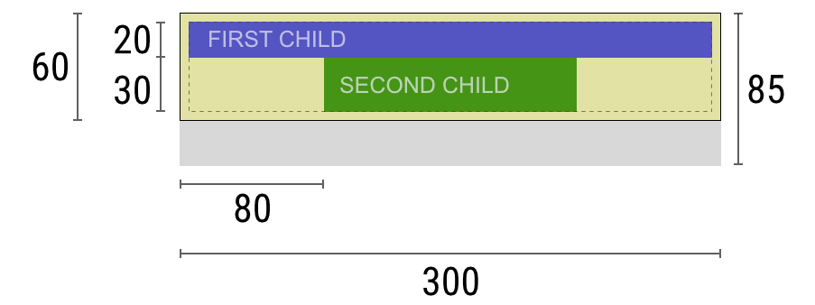
Negotiating constraints, sizes, and position
Widget: “Hey parent, what are my constraints?”
Parent: “You must be from 80 to 300 pixels wide, and 30 to 85 tall.”
Widget: “Since I want to have 5 pixels of padding, then my children can have at most 290 pixels of width and 75 pixels of height.”
Widget: “Hey first child, you must be from 0 to 290 pixels wide, and 0 to 75 tall.”
First child: “OK, then I wish to be 290 pixels wide, and 20 pixels tall.”
Widget: “Since I want to put my second child below the first one, this leaves only 55 pixels of height for my second child.”
Widget: “Hey second child, You must be from 0 to 290 wide, and 0 to 55 tall.”
Second child: “OK, I wish to be 140 pixels wide, and 30 pixels tall.”
Widget: “Very well. My first child has position x: 5 and y: 5, and my second child has x: 80 and y: 25.”
Widget: “Hey parent, I’ve decided that my size is going to be 300 pixels wide, and 60 pixels tall.”
Parent
POS.
CONSTRAINTS
SIZES
Widget
POS.
Children

Slide 8
Limitations
A widget can decide its own size only within the constraints given to it by its parent: a widget can’t have any size it wants.
A widget can’t know and doesn’t decide its own position in the screen.
It’s impossible to precisely define the size and position of any widget without taking into consideration the tree as a whole.
If a child wants a different size from its parent and the parent doesn’t have enough information to align it, then the child’s size might be ignored.
Parent
POS.
CONSTRAINTS
SIZES
Widget
POS.
Children

Slide 9
Outline
Recap
Building layouts in Flutter
Basic examples
Exercise
Homework
Resources

Slide 10
Dive into examples
In the “Understanding constraints” article by Marcelo Glasberg https://docs.flutter.dev/development/ui/layout/constraints (you will also find the link in the Resources section of this presentation) there are a lot (29) of examples explaining how all of this works.
Let’s report the most interesting ones.

Slide 11

Example 1
Widget _example1() => Container(color: Colors.red);
The screen is the parent of the Container, and it forces the Container to be exactly the same size as the screen.
So the Container fills the screen and paints it red.

Slide 12
Example 2
Widget _example2() => Container(width: 100, height: 100, color: red);
The red Container wants to be 100 × 100, but it can’t, because the screen forces it to be exactly the same size as the screen.
The Container fills the screen.

Slide 13
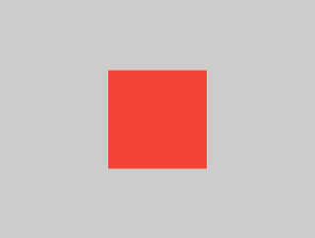
Example 3
Widget _example3() => Center(
child: Container(width: 100, height: 100, color: red),
);
The screen forces the Center to be exactly the same size as the screen, so the Center fills the screen.
The Center tells the Container that it can be any size it wants, but not bigger than the screen. Now the Container can be 100 × 100.

Slide 14
Example 6
Widget _example6() => Center(
child: Container(color: red),
)
The screen forces the Center to be exactly the same size as the screen, so the Center fills the screen.
The Center tells the Container that it can be any size it wants, but not bigger than the screen. Since the Container has no child and no fixed size, it decides it wants to be as big as possible, so it fills the whole screen.

Slide 15
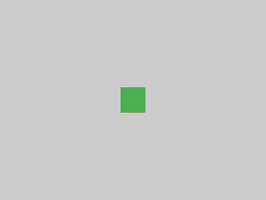
Example 7
Widget _example7() => Center(
child: Container(
color: red,
child: Container(color: green, width: 30, height: 30),
),
);
The screen forces the Center to be exactly the same size as the screen, so the Center fills the screen.
The Center tells the red Container that it can be any size it wants, but not bigger than the screen. Since the red Container has no size but has a child, it decides it wants to be the same size as its child.
The red Container tells its child that it can be any size it wants, but not bigger than the screen.
The child is a green Container that wants to be 30 × 30. Given that the red Container sizes itself to the size of its child, it is also 30 × 30. The red color isn’t visible because the green Container entirely covers the red Container.

Slide 16
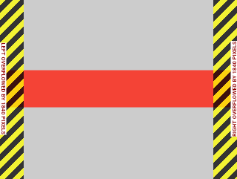
Example 14
Widget _example14() => UnconstrainedBox(
child: Container(color: red, width: 4000, height: 50),
);
The screen forces the UnconstrainedBox to be exactly the same size as the screen, and UnconstrainedBox lets its child Container be any size it wants.
Unfortunately, in this case the Container is 4000 pixels wide and is too big to fit in the UnconstrainedBox, so the UnconstrainedBox displays the much dreaded “overflow warning”.

Slide 17
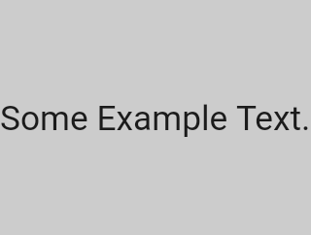
Example 18
Widget _example18() => const FittedBox(
child: Text('Some Example Text.'),
);
The screen forces the FittedBox to be exactly the same size as the screen. The Text has some natural width (also called its intrinsic width) that depends on the amount of text, its font size, and so on.
The FittedBox lets the Text be any size it wants, but after the Text tells its size to the FittedBox, the FittedBox scales the Text until it fills all of the available width.

Slide 18
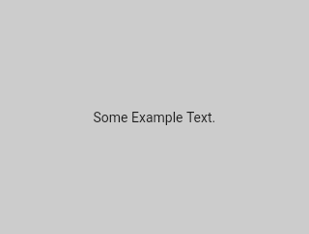
Example 19
Widget _example19() => const Center(
child: FittedBox(
child: Text('Some Example Text.'),
),
);
But what happens if you put the FittedBox inside of a Center widget? The Center lets the FittedBox be any size it wants, up to the screen size.
The FittedBox then sizes itself to the Text, and lets the Text be any size it wants. Since both FittedBox and the Text have the same size, no scaling happens.
Full example in lesson_08-implementing_ui/layout_basics/

Slide 19
Outline
Recap
Building layouts in Flutter
Basic examples
Exercise
Homework
Resources

Slide 20
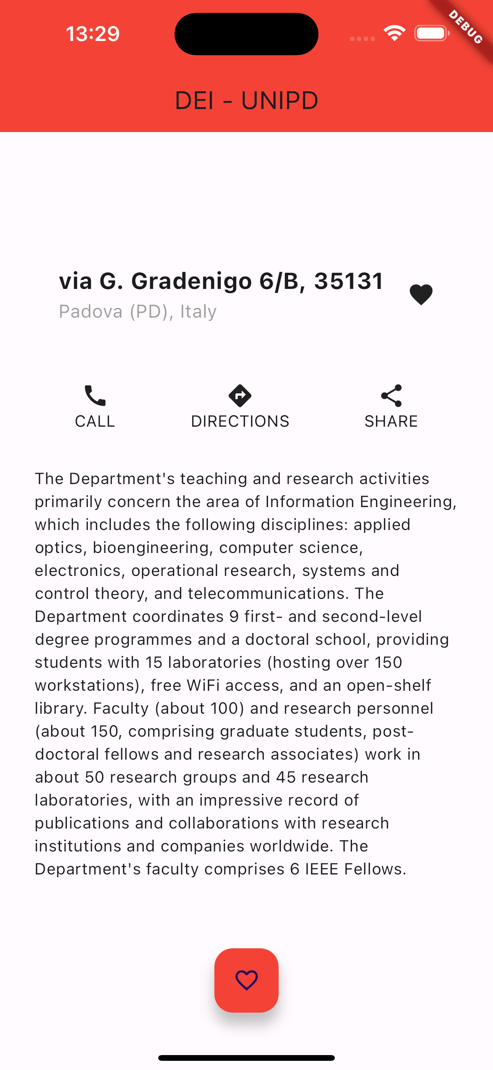
Exercise
Exercise 01
Create a new project ‘reproduce_layout’
Reproduce, as close as possible, the layout on the right.
Hint: I used the following widgets: AppBar, Text, Container, Icon, SizedBox, Column, Row, Colors, and some others…

Slide 21
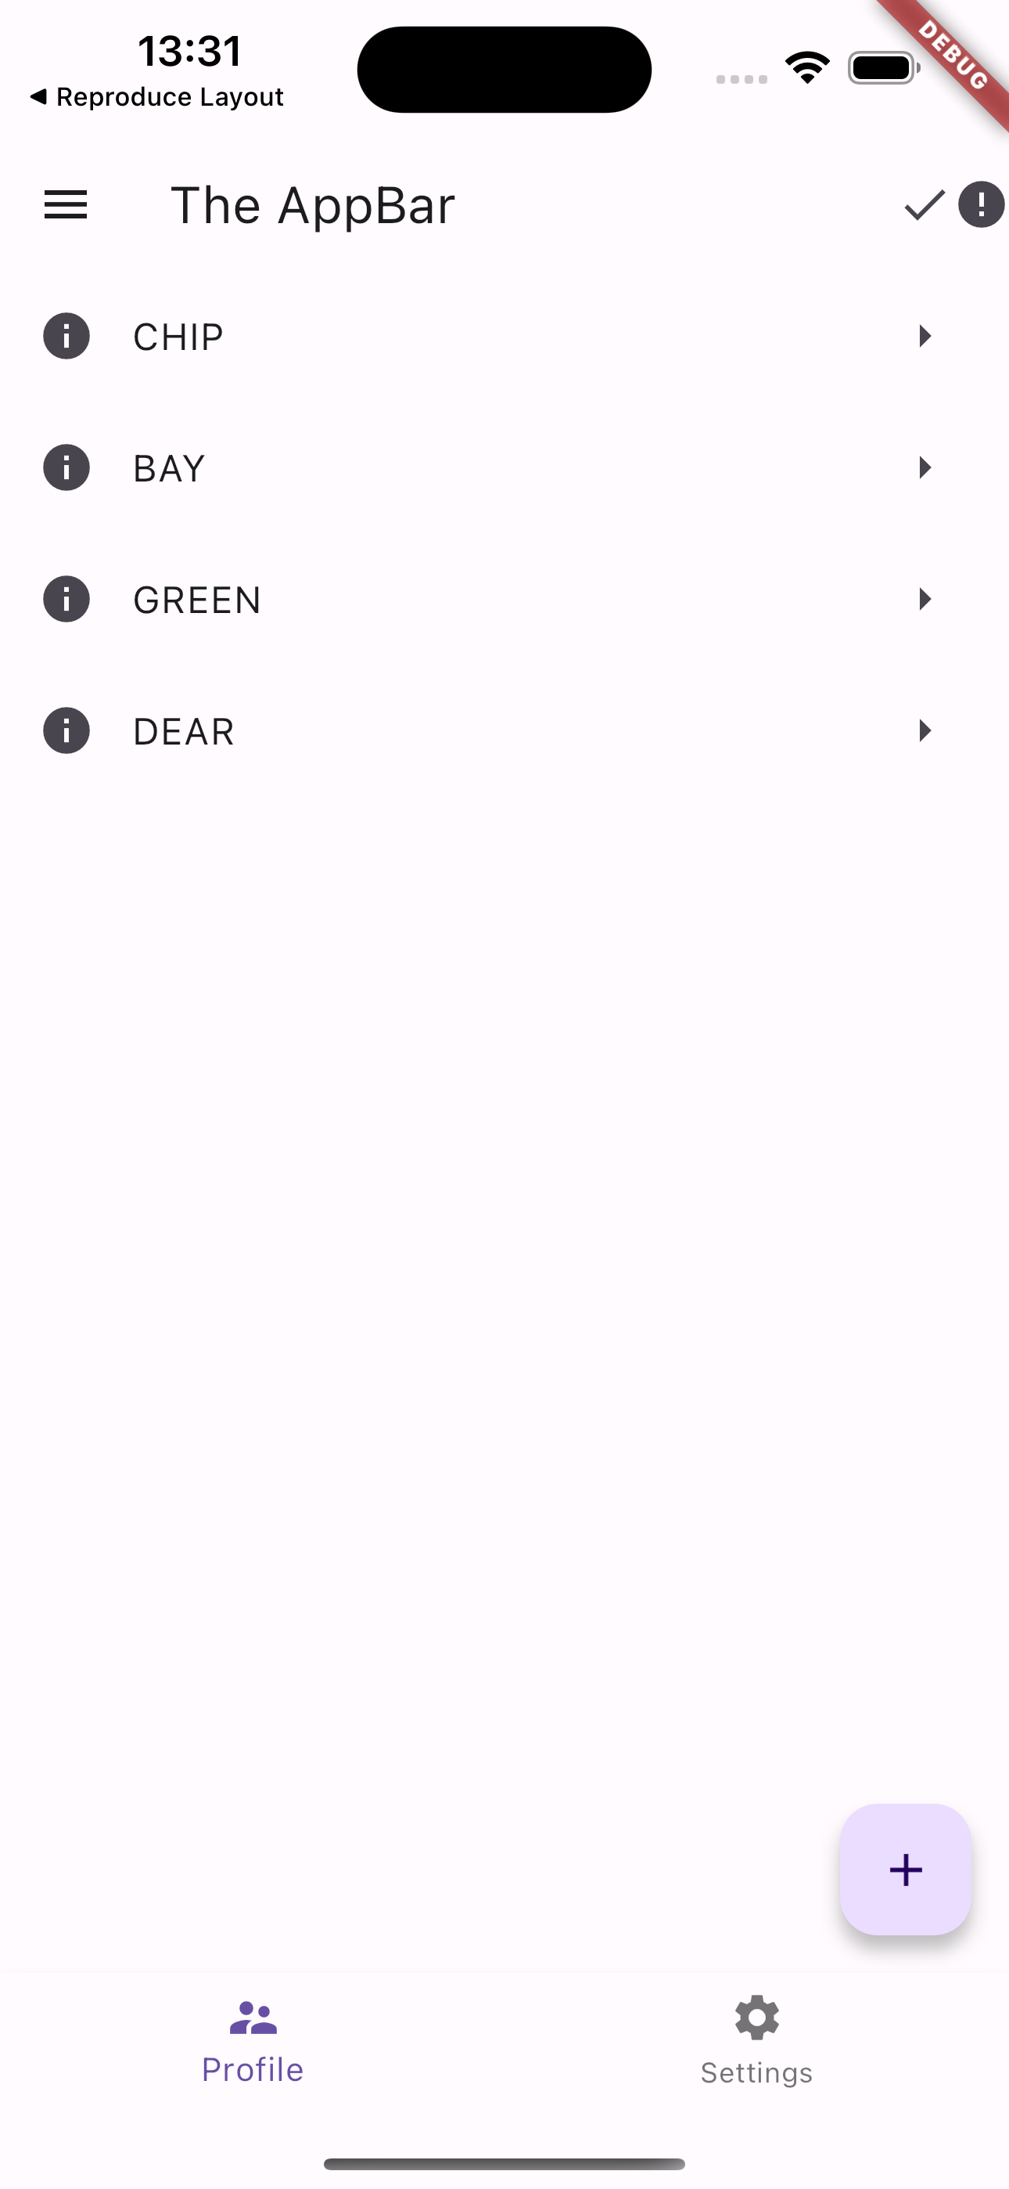
Exercise
Exercise 02
Create a new project ‘exercise_listview’
Copy the code of main.dart of ‘scaffolding’ into the main.dart of ‘exercise_view’
Modify the ListView so that the app looks like the app on the right (hint: I used Icons.info)

Slide 22

Exercise
Exercise 03
Install the english_words package into the ‘exercise_listview’ app
Starting from the code of exercise 02, modify each ListTile in order to show as title, every time you restart the app, a random word in uppercase generated using the english_words package just installed

Slide 23
Outline
Recap
Building layouts in Flutter
Basic examples
Exercise
Homework
Resources

Slide 24
Homework
Get familiar with UI constraints
Get fluent in writing simple UIs

Slide 25
Outline
Recap
Building layouts in Flutter
Basic examples
Exercise
Homework
Resources

Slide 26
Resources
Code repository of today’s lesson and exercises solution
https://github.com/gcappon/bwthw/tree/master/lesson_08-implementing_ui
Material Widgets for UI
https://docs.flutter.dev/development/ui/widgets/material
(Some) Widget for UI Catalog
https://docs.flutter.dev/development/ui/widgets
Flutter Widget list
https://docs.flutter.dev/reference/widgets
Understanding constraints
https://docs.flutter.dev/development/ui/layout/constraints
Layouts in Flutter
https://docs.flutter.dev/development/ui/layout

