Slide 1
Giacomo Cappon
State Management in Flutter

Slide 2
State
State stands for everything that is necessary to define how the app and its screen behave and look at some point in time:
Assets
Variables
Fonts
…
Conceptually can be divided in:
Ephemeral state: sometimes called local state, what can be striclty contained in a Widget
App state: sometimes called shared state, things that you want to share across many parts of the app

Slide 3
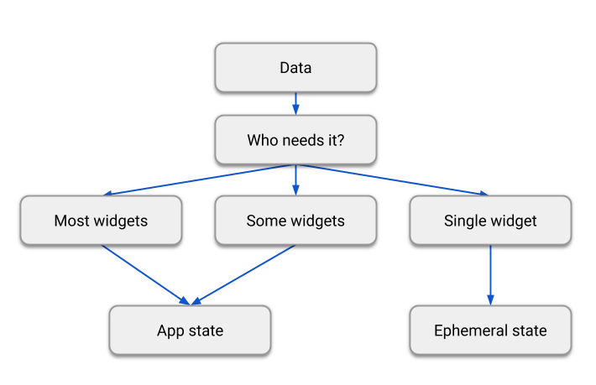
State
There is no universal rule to chose if a variable is part of the ephemeral state or the app state. A diagram that can help:

Slide 4
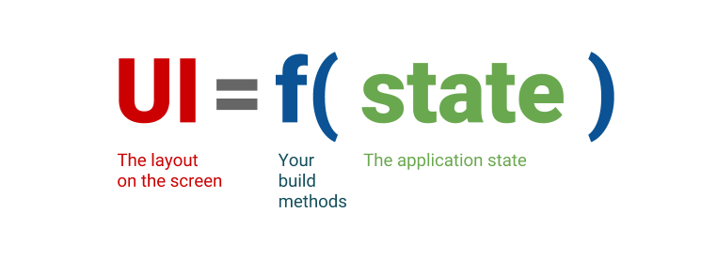
Remember: Flutter is declarative
Flutter is a declarative framework
State is changed? Build methods are called and the UI is refreshed.

Slide 5
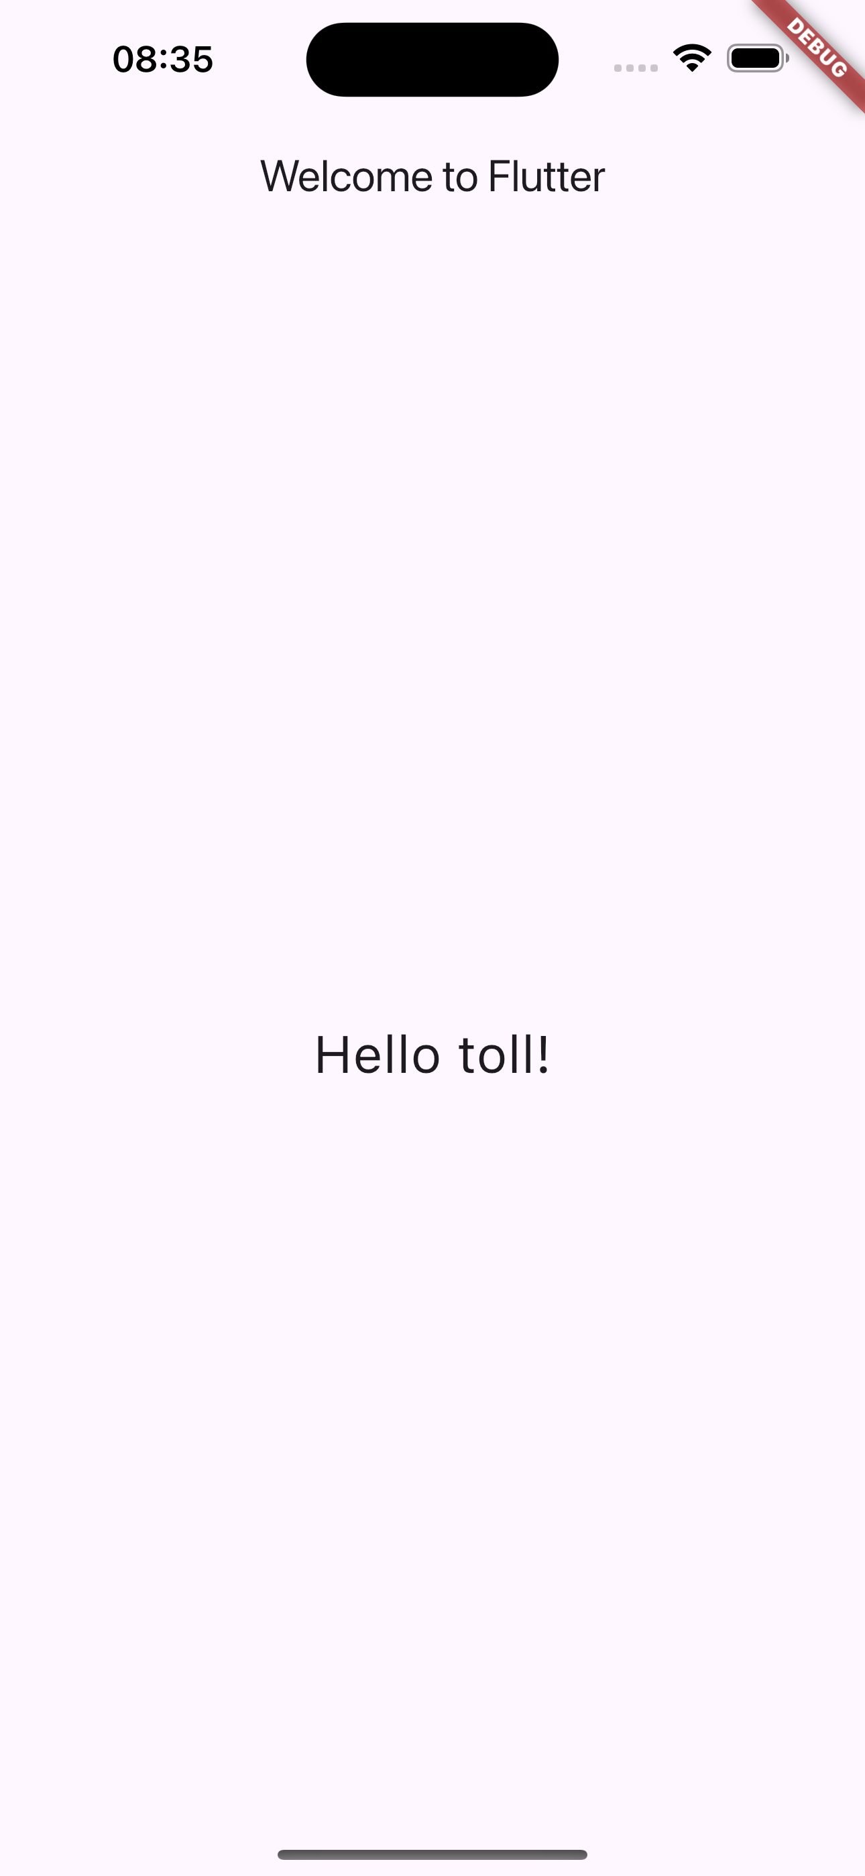
So far…
In lesson 5 we built a very simple app that, whenever you open it, a new random ”Hello” message is shown to the user.
Code available at: lesson_05-the_flutter_framework/my_custom_first_app/
Question #1: What is “state” here?
Question #2: How the state is managed? What’s the flow?

Slide 6

So far…
Let’s expand the app as follows:
Problem: how to change the UI dynamically?

Slide 7
The Widget Tree
Remember: Widgets are combined together using a tree structure
class MyApp extends StatelessWidget {
MyApp({Key? key}) : super(key: key);
@override
Widget build(BuildContext context) {
final word = WordPair.random().first;
return MaterialApp(
title: 'Welcome to Flutter',
home: Scaffold(
appBar: AppBar(title: Text('Welcome to Flutter'),),
body: Center(child: Text('Hello $word!', style: TextStyle(fontSize: 26) ,),),),
);
}//build
}//MyApp
main
MyApp
MaterialApp
Scaffold
AppBar
Center
Text
Text

Slide 8
The Widget Tree
Remember: Widgets are combined together using a tree structure
class MyApp extends StatelessWidget {
MyApp({Key? key}) : super(key: key);
@override
Widget build(BuildContext context) {
final word = WordPair.random().first;
return MaterialApp(
title: 'Welcome to Flutter',
home: Scaffold(
appBar: AppBar(title: Text('Welcome to Flutter'),),
body: Center(child: Text('Hello $word!', style: TextStyle(fontSize: 26) ,),),),
);
}//build
}//MyApp
MyApp is not just a Widget, it is a StatelessWidget

Slide 9
Stateless vs. Stateful widgets
There are two main types of Widgets:
StatelessWidgets:Widgets that always build the same way given a particular configuration and ambient state. So, they never re-build while they are displayed to the user (their lifetime).
StatefulWidgets: Widgets that can build differently several times over their lifetime.
You can think about StatelessWidget as a sort of constant and StatefulWidget as a variable.

Slide 10
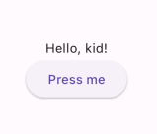
Changing the UI
Let’s start by simply changing the UI
Problems:
How to add a button
How to put it there
We know how! We can use the Column Widget
Column
Child#1
Child#2

Slide 11

Different UI, different tree
How the widget tree changed?
...
...
Scaffold
Scaffold
AppBar
Center
AppBar
Center
Text
Column
Text
Text
MainAxisAlignment
ElevatedButton
Text
Text

Slide 12
Changing the UI
Problem: how to change the UI dynamically?
In other words: how to change the app state without reloading or restarting everything
We need a StatefulWidget

Slide 13
StatefulWidget
As we mentioned before, StatefulWidget maintain state that might change during the lifetime of the widget.
Implementing a stateful widget requires at least two classes:
A StatefulWidget class that creates an instance of the Widget itself
A State class: a class that manages the state of the StatefulWidget

Slide 14
The boilerplate code of a StatefulWidget
class ClassName extends StatefulWidget{
ClassName({Key? key}) : super(key: key);
@override
_ClassNameState createState() => _ClassNameState();
}//RandomHello
class _ClassNameState extends State<ClassName>{
@override
Widget build(BuildContext buildContext){
//return some widget
}//build
}//_ClassNameState

Slide 15
Our new code
Now let’s refactor the MyApp code to be more modular
We can put all the “scaffold-related” code in a new monolithic Widget
class HomePage extends StatefulWidget {
HomePage({Key? key}) : super(key: key);
@override
State<HomePage> createState() => _HomePageState();
}
class _HomePageState extends State<HomePage> {
@override
Widget build(BuildContext context) {
final word = WordPair.random().first;
return Scaffold(
appBar: AppBar(title: Text('Welcome to Flutter'),),
body: Center(
child: Column(
mainAxisSize: MainAxisSize.min,
children: [
Text('Hello $word!', style: TextStyle(fontSize: 26)),
SizedBox(height: 16),
ElevatedButton(
child: Text('Press me'),
),
],
),
),
);
}}//HomePage

Slide 16
Our new code
And refactor MyApp like that
void main() {
runApp(MyApp());
}//main
class MyApp extends StatelessWidget {
MyApp({Key? key}) : super(key: key);
@override
Widget build(BuildContext context) {
return MaterialApp(
title: 'Welcome to Flutter',
home: HomePage(),
);
}}//MyApp

Slide 17
Same UI, different tree
The UI should look like the same as before, but we have a new widget tree
...
...
Scaffold
Scaffold
AppBar
Center
AppBar
Center
Text
Column
Text
HomePage
MainAxisAlignment
ElevatedButton
Text
Column
Text
MainAxisAlignment
ElevatedButton
Text
Text

Slide 18
void initState(){}
Let’s do some changes to HomePage to make it more stateful
class _HomePageState extends State<HomePage>{
String? _word;
@override
void initState() {
_word = WordPair.random().first;
super.initState();
}//initState
...
_word will represent the state of the Widget
initState is a special method that is called the first time the Widget is created. It is used (as its name suggest) to initialize the state of the Widget itself.

Slide 19
setState((){})
We are ready to implement the function to provide to onPressed
...
@override
Widget build(BuildContext context) {
return Scaffold(
appBar: AppBar(title: Text('Welcome to Flutter'),),
body: Center(
child: Column(
mainAxisSize: MainAxisSize.min,
children: [
Text('Hello $_word!', style: TextStyle(fontSize: 26)),
SizedBox(height: 16),
ElevatedButton(
onPressed: () {
setState(() {
_word = WordPair.random().first;
});
},
child: Text('Press me'),
),
],
),
),
);
...
setState is a special method that requires a function as input. setState notifies the Flutter framework that the state might be changed causing to delete and rebuild the widget itself.

Slide 20
We did it!
Full example in lesson_11-the_flutter_framework/my_custom_first_app_with_steroids/

Slide 21
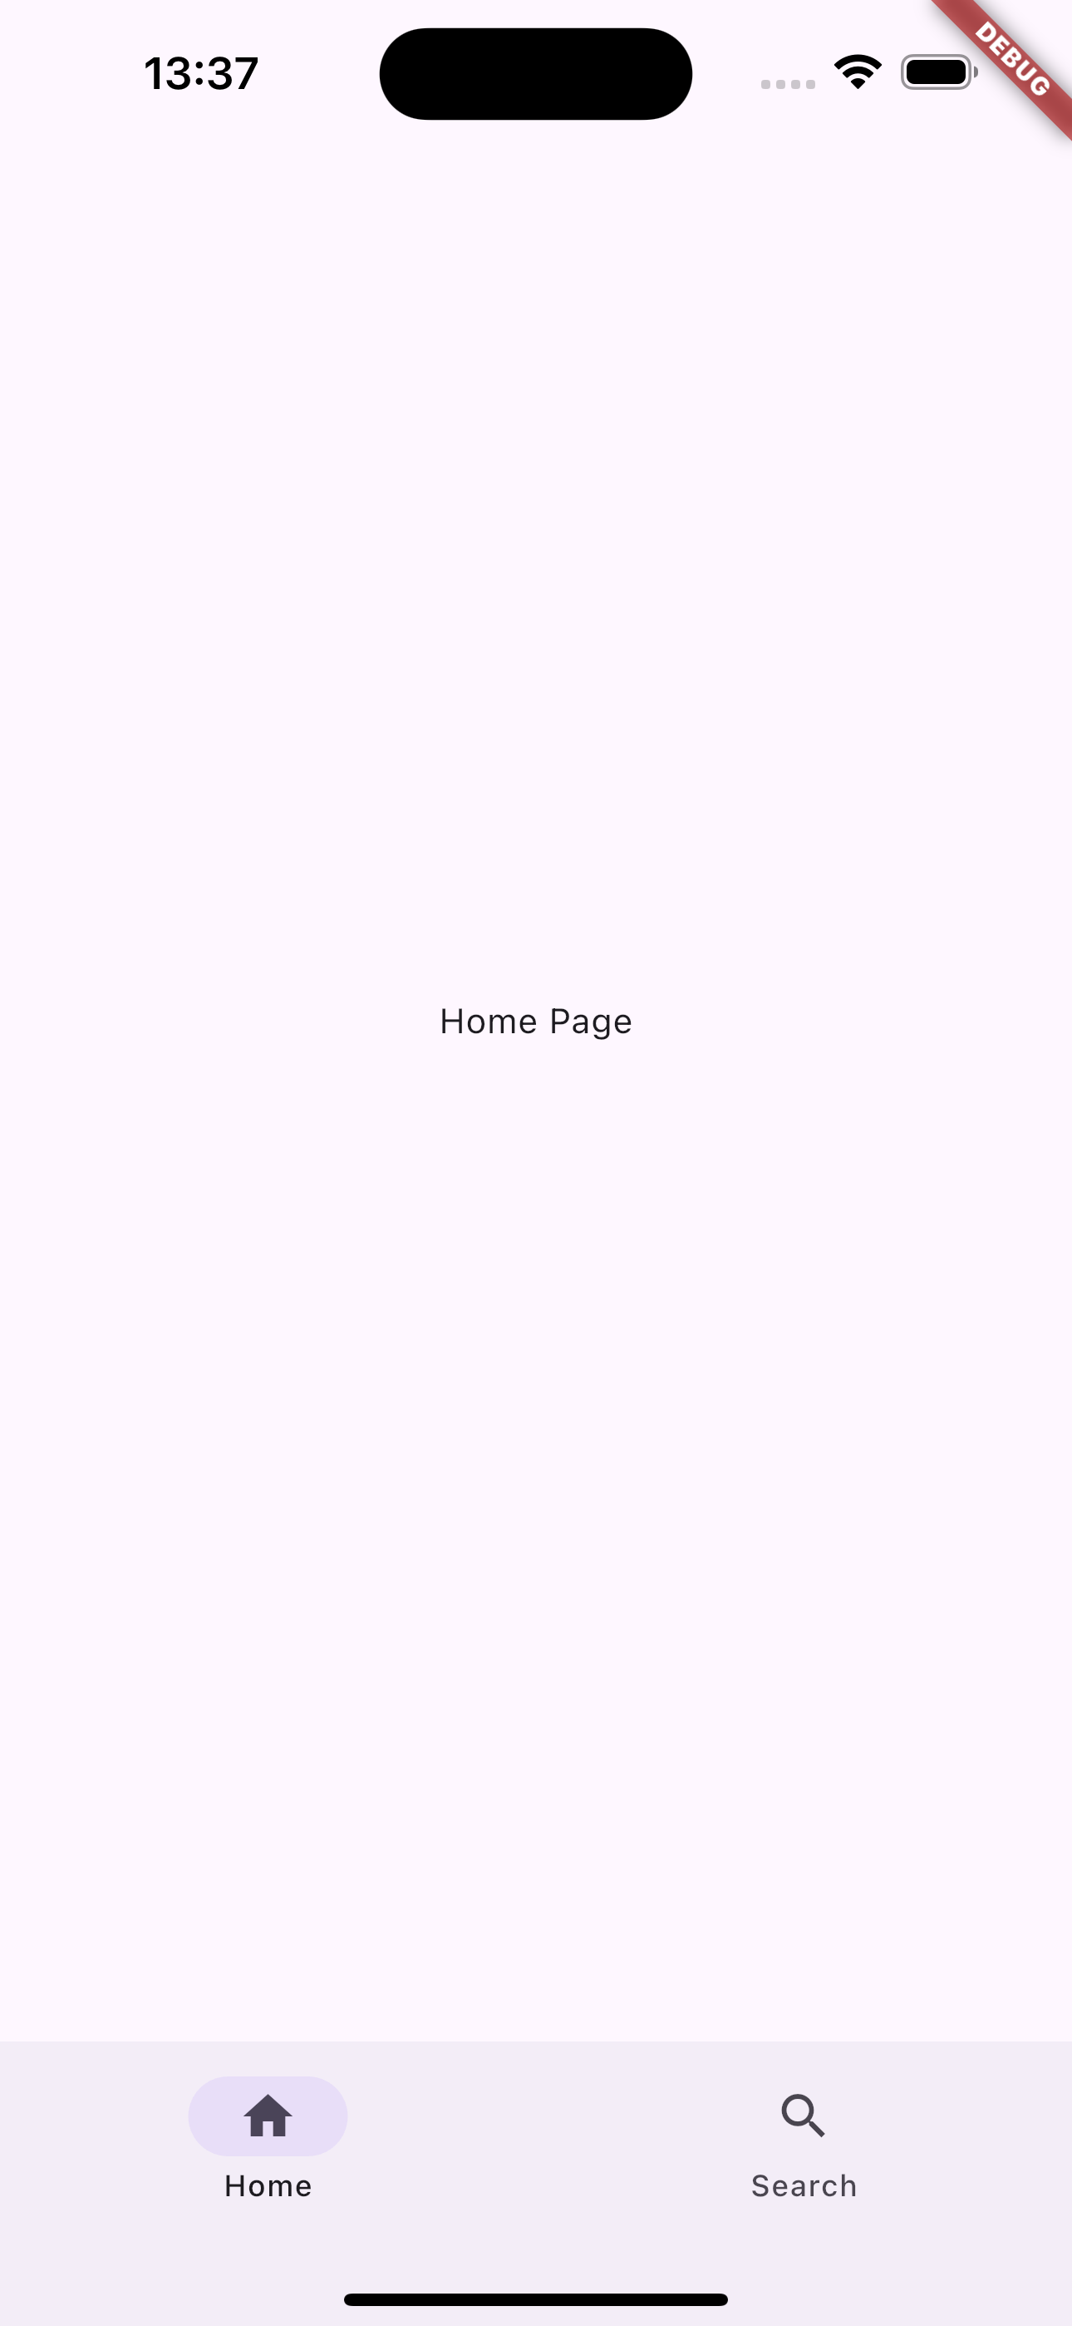
A specific use case - NavigationBar
A particular use case of setState() is the following:
...
class HomeScreen extends StatefulWidget {
const HomeScreen({super.key});
@override
State<HomeScreen> createState() => _HomeScreenState();
}
class _HomeScreenState extends State<HomeScreen> {
int selectedIndex = 0;
// List of pages
final List<Widget> pages = [
Center(child: Text("Home Page")),
Center(child: Text("Search Page")),
];
@override
Widget build(BuildContext context) {
return Scaffold(
body: pages[selectedIndex],
bottomNavigationBar: NavigationBar(
selectedIndex: selectedIndex,
// When user taps an item
onDestinationSelected: (int index) {
setState(() {
selectedIndex = index;
});
},
destinations: [
NavigationDestination(
icon: Icon(Icons.home_outlined),
selectedIcon: Icon(Icons.home),
label: "Home",
),
NavigationDestination(
icon: Icon(Icons.search_outlined),
selectedIcon: Icon(Icons.search),
label: "Search",
),
],
),
);
}
}
...
Full example in lesson_11-the_flutter_framework/navigation_bar_example/

Slide 22


The limitation of setState()
Why we cannot fully depend on setState() ?
In a typical widget tree, when two children of a parent are not in the same class as of the parent, rendering one child from another becomes impossible until you implement very messy logic.
We DO NOT want that
Parent
Rendering Child
Renderer Child

Slide 23
So, how to manage state?
There is no such a thing as a “universal way to manage state”
There are a lot of possible approaches:
Provider
Riverpod
Redux
BLoC
…
Every approach has its PROs and CONs. So?
Here, we will discuss Provider, the recommended approach by the Flutter community.

Slide 24

Provider core idea
Provider wants to provide!
The core idea is to provide the entity (one or more classes) in charge of maintaining the state down through the widget tree
Each child will be able to access to the entity and react to state changes.
State manager entity
Inject it to
Child widget tree

Slide 25
Provider classes
Provider implement a set of classes, here’s the most important:
ChangeNotifier
ChangeNotifierProvider
Consumer
MultiProvider
...

Slide 26



Provider classes: ChangeNotifier
ChangeNotifier is a class that can notify listeners of any changes in the state.
You usually extend the ChangeNotifier for models so you can send notifications when your model changes.
When something in the model changes, you call notifyListeners() and whoever is listening can use the newly changed model.
A class that extends ChangeNotifier
notifyListeners() is called
A class that listens to the other class
Do something!

Slide 27
Provider classes: ChangeNotifierProvider
ChangeNotifierProvider is a class that wraps a class that implements ChangeNotifier and provide it to its descendants.
Now the widget tree can access to it (and use it!)
Synthax: ChangeNotifierProvider( create: (context) => ClassImplementingChangeNotifier(), child: <widget_tree>, );
ClassImplementingChangeNotifier
ChangeNotifierProvider
Inject an instance to
Child widget tree

Slide 28
Provider classes: Consumer
Consumer is a widget that listens for changes in a class that implements ChangeNotifier, then rebuilds the widget tree below itself when it finds any.
Whenever notifyListeners() is called, the Consumer’s builder function is called. Synthax: return Consumer<ClassImplementingChangeNotifier>( builder: (context, widget, child) { return Text(<use widget>); }, );
ClassImplementingChangeNotifier
ChangeNotifierProvider
Inject an instance to
Child widget tree
notifyListeners() is called
Consumer
Call builder method

Slide 29
Provider classes: MultiProvider
What if you need to inject more than one provider through the widget tree? Use MultiProvider.
Synthax example:
MultiProvider(
providers: [
Provider<ChangeNotifier1>(create: (_) => ChangeNotifier1()),
Provider<ChangeNotifier2>(create: (_) => ChangeNotifier2()),
...
],
child: <widget_tree>,
);
List of providers.

Slide 30
Wrapping up: Provider (core) flow
ClassImplementingChangeNotifier
ChangeNotifierProvider
Inject an instance to
Child widget tree
notifyListeners() is called
Consumer
Call builder method

Slide 31
Resources
State management
https://docs.flutter.dev/development/data-and-backend/state-mgmt/intro
Making sense of all those Flutter Providers
https://medium.com/flutter-community/making-sense-all-of-those-flutter-providers-e842e18f45dd
List of state management approaches
https://docs.flutter.dev/development/data-and-backend/state-mgmt/options

