Slide 1
Fundamentals of computer networks and HTTP

Slide 2



Computer networks
Data collected by wearable IoT sensors are shared among different devices running over a computer network, typically the Internet.
Computer network: a collection of autonomous computers (hosts) interconnected by a single technology.
Two computers are said to be interconnected if they are able to exchange information.
Purpose of computer networks: to share resources (e.g. data and applications).

Slide 3
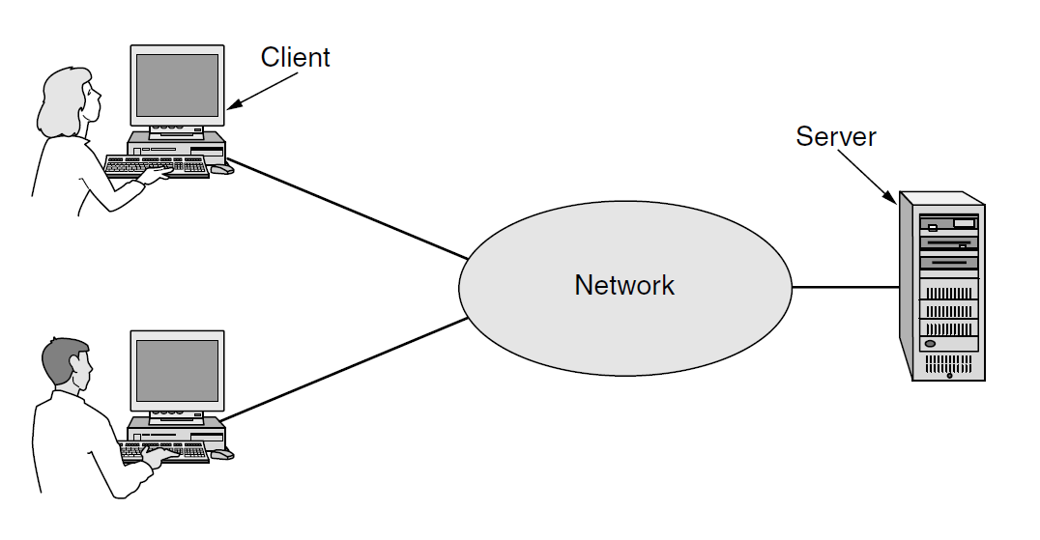
Client-server model
Client-server model: a network structure that partitions tasks between the providers of a resource or service, called servers, and service requesters, called clients.
The server is often designed to operate as a centralized system that serves many clients. The computing power, memory and storage requirements of a server must be scaled appropriately to the expected workload.

Slide 4
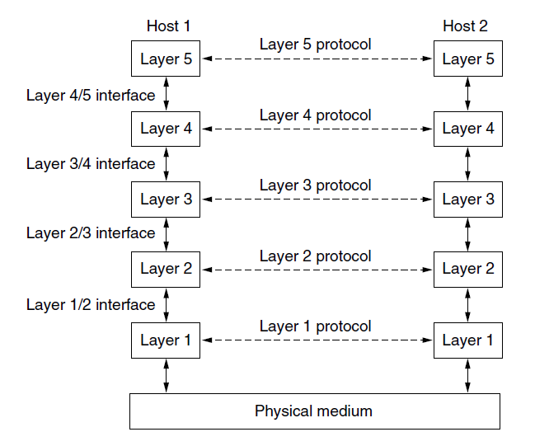
Network software: protocol hierarchies
To reduce their design complexity, most networks are organized as a stack of layers or levels, each one built upon the one below it.
The purpose of each layer is to offer certain services to the higher layers while shielding those layers from the details of how the offered services are actually implemented.

Slide 5
Network software: protocol hierarchies
Two entities of the same layer on different machines are called peers.
When two peers of layer n communicate, the rules and conventions used in this conversation constitute the layer n protocol.
Protocol: agreement between the communicating parties on how communication must work.
Layers and protocols form the network architecture.

Slide 6
Network software: protocol hierarchies
Virtual communication
Physical communication
In reality, no data are directly transferred from layer n on one machine to layer n on another machine.
Each layer passes data to the layer immediately below it, until the lowest layer is reached.
Layer 1 passes data to the physical medium through which actual communication occurs.
An interface between each pair of adjacent layers defines which primitive operations and services the lower layer makes available to the upper one.

Slide 7
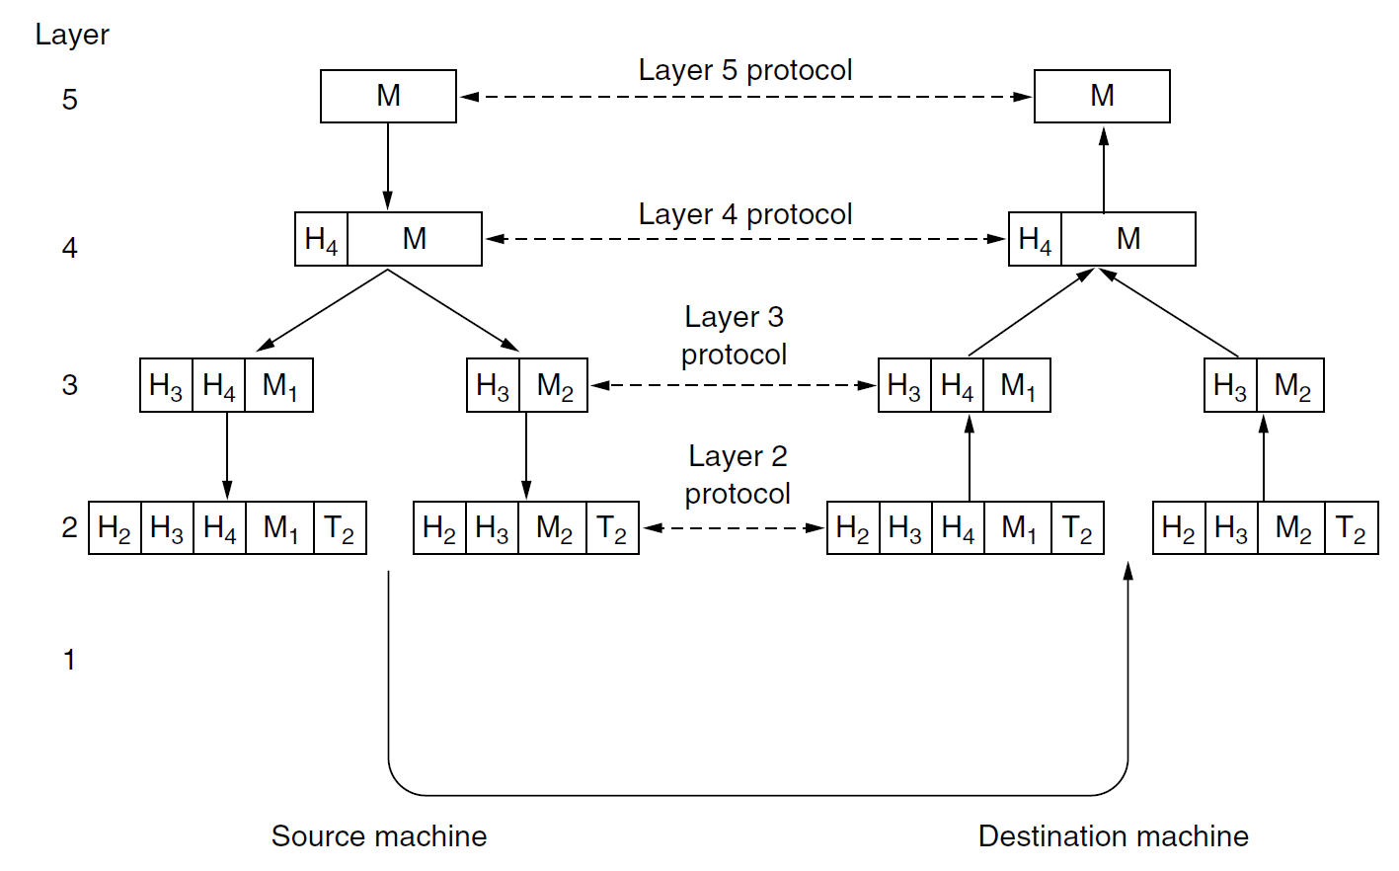
Example of network architecture
A message M is produced by an application running on layer 5 and given to layer 4 for transmission.
Layer 4 puts a header (e.g. address) in front of M to identify it and then pass it to layer 3.
Layer 3 breaks M into smaller packets (M1 and M2) and add headers to each packet which are passed to layer 2.
Layer 2 adds a header and a trailer to each packet and then pass them to layer 1 for physical transmission to the destination machine.
None of the headers for layers below n are passed up to layer n.

Slide 8
Services and primitives
Service: a set of primitives (operations) that a layer provides to the layer above.
What operations the layer is prepared to perform on behalf of its users
No information about how these operations are implemented.
It relates to an interface between two layers, with the lower layer being the service provider and the upper layer being the service user.
Examples of primitives for a simple connection-oriented service
Primitive | Meaning
LISTEN | Block waiting for an incoming connection
CONNECT | Establish a connection with a waiting peer
ACCEPT | Accept an incoming connection from a peer
RECEIVE | Block waiting for an incoming message
SEND | Send a message to the peer
DISCONNECT | Terminate a connection

Slide 9
Connection-oriented vs connectionless services
Two types of service:
Connection-oriented service: the service user first establishes a connection with the receiver, then it uses the connection to send data, and finally it releases the connection (like in a telephone communication).
In most cases the order of data bits is preserved → bits arrive in the same order they were sent.
Connectionless service: each message carries the full destination address and each one is sent independently on the subsequent messages (like in postal system).
Normally, when two messages are sent to the same destination, the first one sent will be the first one to arrive. However, it is possible that the first one sent can be delayed so that the second one arrives first.
The messages in a connectionless service are also called datagram.

Slide 10
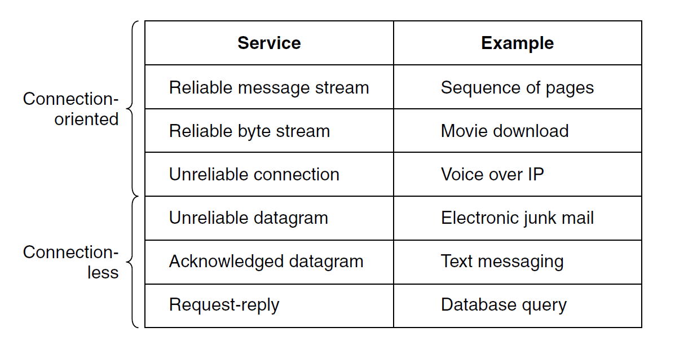
Reliable vs. unrealiable services
A reliable service never looses data: the receiver acknowledges the receipt of each message so the sender is sure that it arrived.
The acknowledgement process introduces overhead and delays, sometimes undesirable.
E.g. in a telephone communication it is less disruptive to hear a bit of noise on the line from time to time than to experience a delay waiting for acknowledgements.
An unreliable service does not return an acknowledgement to the sender

Slide 11
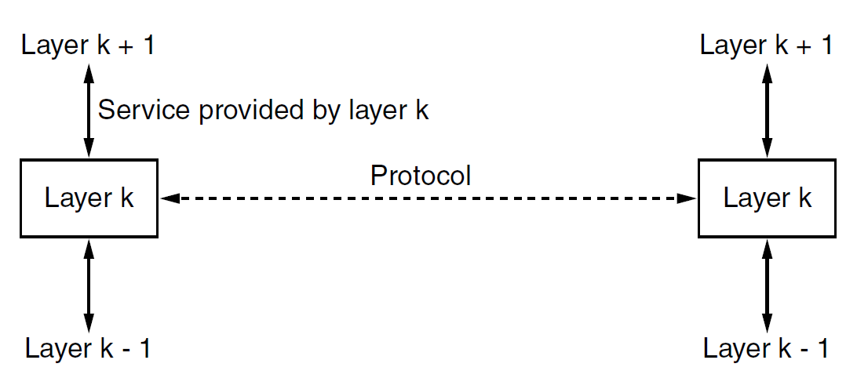
Protocol vs. service
Protocol: The set of rules governing the format and meaning of the packets, or messages that are exchanged by the peer entities within a layer.
Service: the set of primitives (operations) that a layer provides to the layer above it. They are related to the interfaces between layers.
The protocol of layer k defines the implementation details of services which layer k provides to users of layer k+1; such details are not visible to users of layer k+1.

Slide 12
The TCP/IP reference model
Application layer
Worldwide Internet: the global system of interconnected computer networks that uses the Internet protocol suite (TCP/IP) to communicate between networks and devices.
The reference model used by the worldwide Internet is called TCP/IP reference model and it was introduced by Cerf and Kahn in 1974.
Transport layer
Network layer
Link layer
Physical layer

Slide 13
The TCP/IP reference model
Application layer
It includes the protocols used by applications running on different hosts to communicate
Example: A Web browser can send requests to a Web server using the HTTP protocol, which is a protocol of the application layer
Transport layer
Network layer
Link layer
Physical layer

Slide 14
The TCP/IP reference model
It creates and maintain conversations between applications on two hosts
Two transport protocols have been defined:
Transmission control protocol (TCP): a reliable connection-oriented protocol that allows a byte stream delivery without errors.
User Datagram Protocol (UDP): an unreliable, connectionless protocol for applications in which prompt delivery is more important than accurate delivery (e.g., speech or video).
Application layer
Transport layer
Network layer
Link layer
Physical layer
TCP/UDP header
Data
SEGMENT

Slide 15
The TCP/IP reference model
Application layer
Finds the correct routing path, handles congestions and quality of service.
Packets are sent independently to the destination by a certain path.
This layer works with two protocols:
Internet protocol (IP): it defines the IP addresses, i.e,. that label (e.g., 192.0.2.1) that uniquely identifies a host connected to a computer network using the IP protocol.
Internet Control Message Protocol (ICMP): it sends error and control messages.
Transport layer
Network layer
Link layer
Physical layer
IP header
TCP/UDC header
Data
PACKET

Slide 16
The TCP/IP reference model
Source and destination MAC address (local address in a LAN)
Application layer
Error checking information
Transport layer
FRAME
Link header
IP header
TCP/UDC header
Data
Link trailer
Network layer
It moves packets between the network layer and the physical layer.
Not really a layer at all, but rather an interface between hosts and physical transmission links.
Link layer
Physical layer

Slide 17
The TCP/IP reference model
Application layer
Transport layer
Network layer
00010101110110101001100110101111010101
Link layer
It physically receives and transmit raw bits over a communication channel.
A standardized interface to the transmission medium (electrical, optical, or wireless communication).
Physical layer

Slide 18
The HyperText Transfer Protocol (HTTP)
HyperText Transfer Protocol (HTTP): the main web communication protocol for exchanging information between servers and clients.
Simple request-response protocol, proper of the application layer, running over TCP.
It specifies what messages clients may send to servers and what responses they get back in return.
Most of Web currently use HTTP/1.1 and HTTP/2.0, which share the same syntax.
1991
1996
1997
2015
2020
HTTP/0.9
HTTP/1.0
HTTP/2.0
HTTP/3.0
HTTP/1.1

Slide 19
Request structure (HTTP/1.1)
Each request consists of one or more lines of ASCII text
Case-sensitive name of the method (type of the request)
First line:
Name of the resource in the server
METHOD resource protocol
Name of the protocol version
(e.g. HTTP/1.1)
Request headers:
Additional information related to the request.
In HTTP/1.1 there must be at least one header containing the DNS name of the server.
Host: servername
Other optional headers
Empty line
Request body (payload):
Optional message body

Slide 20
HTTP methods
HTTP methods indicate the desired action to be performed for a given resource
Method | Desired action
GET | Retrieves a resource
HEAD | Retrieves a resource header
POST | Submits an entity to the specified resource (causes a change of server state)
PUT | Replaces all current representations of the target resource with the request payload.
DELETE | Deletes a resource
TRACE | Echoes the incoming request
CONNECT | Establishes a tunnel to the server identified by the target resource
OPTIONS | Describes the communication option for a resource
PATCH | Applies partial modifications to a resource

Slide 21
Examples of request headers
Host: the server’s DNS name
Authorization: needed for pages that are protected. The client might need to demonstrate it has the right to see the requested page.
Content-Type: the type of the content in the request body.

Slide 22
(Other) Examples of request headers
BONUS
User-Agent: it allows the client to inform the server about the user agent making the request, e.g., the browser implementation
Accept: it allows to tell the server what the client is willing to accept
If-Modified-Since: time and date of last page modification, it allows the client to check the validity of cached pages (the client stores recently requested contents in a cache memory, similarly to what the server does).
Cache-Control: it specify directives that must be obeyed by all caching mechanisms along the request/response chain (e.g., no-cache).
…

Slide 23
Response structure (HTTP/1.1)
A response message is sent by a server to a client as a reply to its former request message.
Three-digit integer code representing the result of the server's attempt to understand and satisfy the request.
Status line:
Optional. If the status code indicated a problem, the reason phrase might displayed the further information about the nature of the problem.
Protocol status_code reason_phrase
Response headers:
Status code | Description
1xx | Informational: the request was received and is being processed,
2xx | Successful: the request was successfully received, understood, and accepted.
3xx | Redirecting: further action needs to be taken in order to complete the request.
4xx | Client error: the request contains bad syntax or cannot be fulfilled.
5xx | Server error: The server failed to fulfill an apparently valid request.
Optional headers
Empty line
Request body (payload):
Optional message body

Slide 24
Examples of response headers
Date: date and time the message was sent
Content-Type: the type of the returned content (e.g., HTML, image, plain text, …)
Content-Length: the content length in bytes
Last-Modified: time and date the page was last changed
…

Slide 25
(Other) Examples of response headers
BONUS
Content-Language: the natural language used in the page
Expires: Time and date when the page stops being valid
ETag: tag for the content of the page (used for caching)
Location: redirect the recipient to a location other than the requested URL for completion of the request or identification of a new resource
…

Slide 26
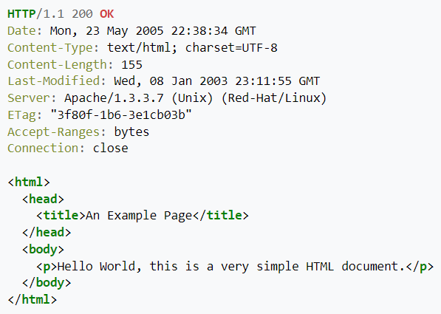
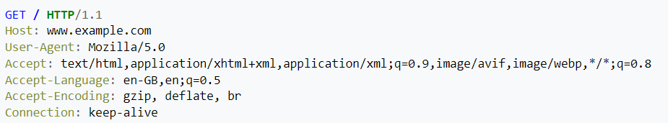
GET
GET: Retrieves a resource.
GET / HTTP/1.1
Host: www.example.com
Accept-Language: en
Response example:
Request example:

Slide 27
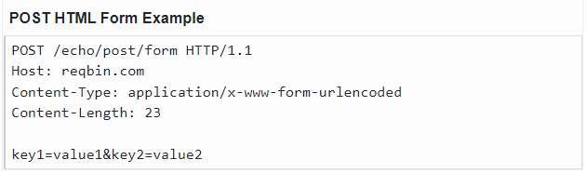
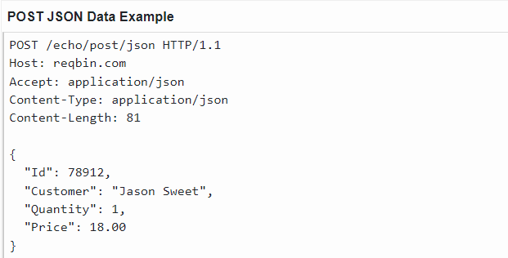
POST
POST: Submits an entity to the specified resource. Can be used for creating a resource.
If the request is accepted, then the server does something with the data that depends on the URL, and send a response page indicating the result.
POST is commonly used when forms are submitted, or when uploading files to servers, e.g., to extend a database appending some new data.

Slide 28
Other important methods
PUT: Replaces all current representations of the target resource with the request payload. Can be used for updating/modifying a resource.
DELETE: Deletes a resource.
PATCH: Applies partial modifications to a resource.
HEAD: it just asks for the message header, without the actual content. It can be used to collect information for indexing purposes, or to test a resource for validity.

Slide 29
POST vs PUT vs PATCH
Difference between POST and PUT?
POST: the client asks to the server to accept the entity enclosed in the request as a new subordinate of the resource identified by the request URL.
PUT: the client asks to the server to store the enclosed entity under the request URL. → If the request URL refers to an already existing resource, the server replaces the existing entity with the new enclosed entity. If the URL does not point to an existing resource, the server can create the resource with that URL.
Difference between PUT and PATCH?
PUT supplies a modified version of the resource to be allocated at the request URL.
PATCH supplies a set of instructions to modify the resource at the requested URL.

Slide 30
Other (less) important methods
BONUS
TRACE: it asks the server to send back the request. Useful when requests are not processed correctly to check what the server received.
CONNECT: it lets a user make a connection to a Web server through an intermediate device, such as a Web cache.
OPTIONS: it queries the server for a resource and obtain the methods and headers that can be used with that resource.

Slide 31
Properties of the HTTP methods
Safe methods: A request method is safe if a request with that method has no intended effect on the server.
GET, HEAD, OPTIONS, and TRACE are safe, since they only read data from the server.
POST, PUT, DELETE, PATCH, CONNECT are not safe, since they may modify the server state.
Idempotent methods: A request method is idempotent if multiple identical requests with that method have the same intended effect as a single such request.
PUT and DELETE, and safe methods are idempotent.
POST, PATCH and CONNECT are not necessarily idempotent. Sending an identical POST request multiple times may further modify the state of the server.
Cacheable methods: A request method is cacheable if responses to requests with that method may be stored by the client in the cache for future reuse.
Only GET, HEAD, and POST are cacheable.

Slide 32
Summary of properties of the HTTP methods
METHOD | REQUEST HAS BODY | RESPONSE HAS BODY | IS SAFE | IS IDEMPOTENT | IS CACHEABLE
GET | Optional | Yes | Yes | Yes | Yes
HEAD | Optional | No | Yes | Yes | Yes
POST | Yes | Yes | No | No | Yes
PUT | Yes | Yes | No | Yes | No
DELETE | Optional | Yes | No | Yes | No
TRACE | No | Yes | Yes | Yes | No
CONNECT | Optional | Yes | No | No | No
OPTIONS | Optional | Yes | Yes | Yes | No
PATCH | Yes | Yes | No | No | No

Slide 33
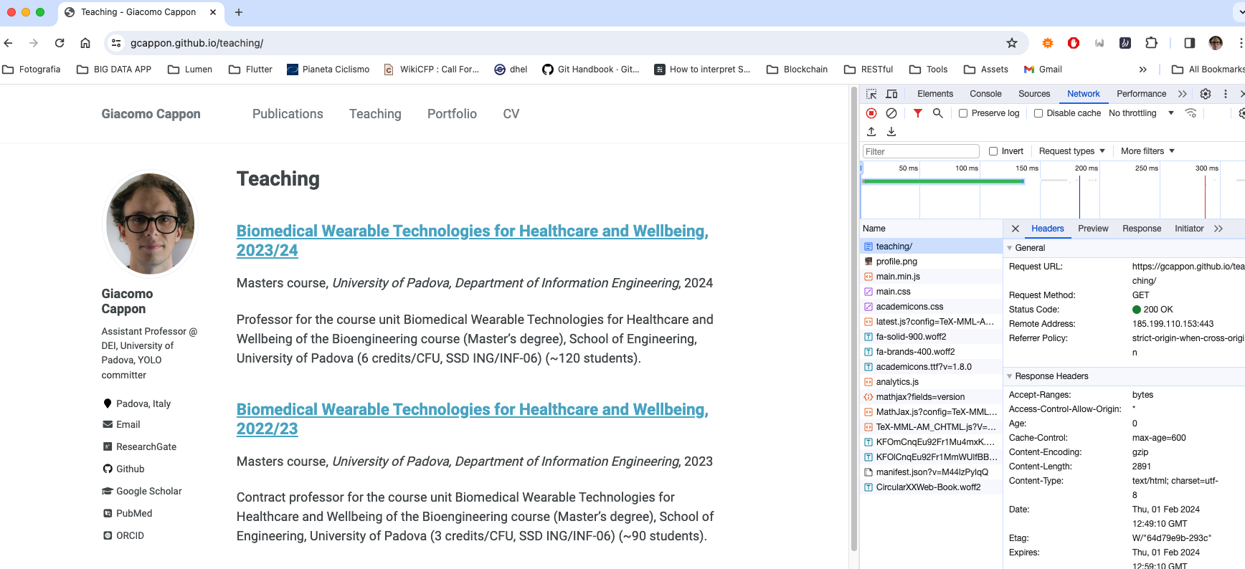
Example: inspecting the HTTP requests in Chrome
Request headers
Requested page and contents
Response headers

Slide 34
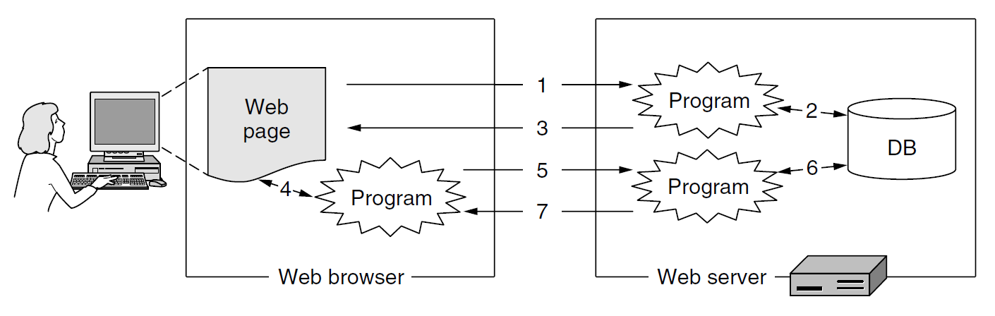
Web application
Web application: a Web page or a collection of Web pages, delivered over HTTP, which use server-side or client-side processing, i.e., programs, to provide an "application-like" experience within a Web browser.
Web applications access data that are stored in databases in the server and use Web protocols (e.g., HTTP) to exchange data with the client. They use the Web browser to display a user interface by which the user can use the app (making queries, inserting data, view retrieved data, etc.).
Advantage of Web applications: The users do not need to install separate application programs, and data can be accessed from different computers and backed up by the service operator.
Examples of Web apps: Gmail, Google Docs, Trello, online banking apps, online retail sales apps, …
To act as applications, Web pages can no longer be static, but they need to generate dynamic content.

Slide 35
Example of a Web application architecture
Client
Server
Web browser
HTTP
Server-side language interpreter
HTML interpreter
Database
Client-side language interpreter
Plugs-in
Back-end program # 1
Back-end programs # 2
…
…

Slide 36
Structured data formats
Web applications need to exchange data with the server.
HTML is not suitable for representing data because it mixes content with formatting. It is indeed concerned about the presentation of the content.
It is difficult to automatically retrieve data within an HTML file
Two popular structured data formats that facilitate the automatic structured data processing:
Extensible Markup Language (XML)
JavaScript Object Notation (JSON)

Slide 37
Extensible Markup Language (XML)
Example of XML code that define a book list
A language for specifying structured content.
Introduced in 1998.
It defines a set of rules for encoding documents in a format that is both human-readable and machine-readable.
Unlike HTML, there are no defined tags for XML. Each user can define their own tags.
Extension .xml
<?xml version="1.0" ?>
<book list>
<book>
<title> Human Behavior and the Principle of Least Effort </title>
<author> George Zipf </author>
<year> 1949 </year>
</book>
<book>
<title> The Mathematical Theory of Communication </title>
<author> Claude E. Shannon </author>
<author> Warren Weaver </author>
<year> 1949 </year>
</book>
<book>
<title> Nineteen Eighty-Four </title>
<author> George Orwell </author>
<year> 1949 </year>
</book>
</book list>

Slide 38
JavaScript Object Notation (JSON)
A format that uses human-readable text to store and transmit data objects consisting of attribute–value pairs and arrays.
Introduced in 2001.
JSON is language-independent. It was derived from JavaScript, but many modern programming languages include code to generate and parse JSON-format data.
Extension .json
JSON data types: number, string, Boolean, null (empty value)
JSON data structures
Object
Array

Slide 39
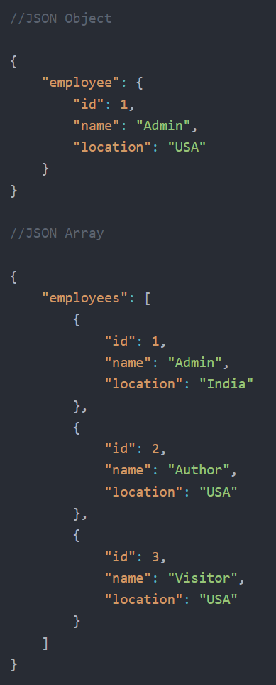
JSON data structures
JSON object: a collection of name–value pairs where the names (also called keys) are strings. The order of pairs is not relevant. The object is surrounded by curly braces.
JSON array: an ordered list of zero or more elements, each of which may be of any type. Arrays use square bracket notation with comma-separated elements.
Objects can contain array and arrays can contain objects.

Slide 40



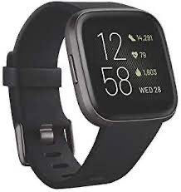
Why JSON are important here? What we need?
The Fitbit data you will need to develop your project (stored in the IMPACT server are stored in a JSON format
We need to learn how to make and ”debug” our requests!
[
{
"time": "03:10:19",
"value": 58,
"confidence": 1
},
{
"time": "03:10:24",
"value": 54,
"confidence": 3
},
{
"time": "03:10:29",
"value": 52,
"confidence": 3
}, ...
]
https://impact.dei.unipd.it/bwthw/
Your app

Slide 41

POSTMAN
We saw that using a browser we are actually visualizing the response of an HTTP request using the GET method.
What if we need to make an authenticated request? What if we need to make a POST request?
POSTMAN can help us here: https://www.postman.com
We will use it during the theory lessons to try what we learn

Slide 42
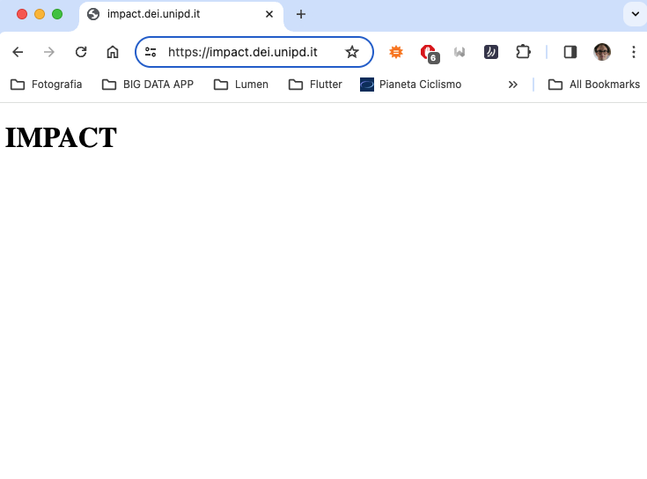
Hello IMPACT
At https://impact.dei.unipd.it/ you will obtain the following
Let’s replicate it in POSTMAN

Slide 43
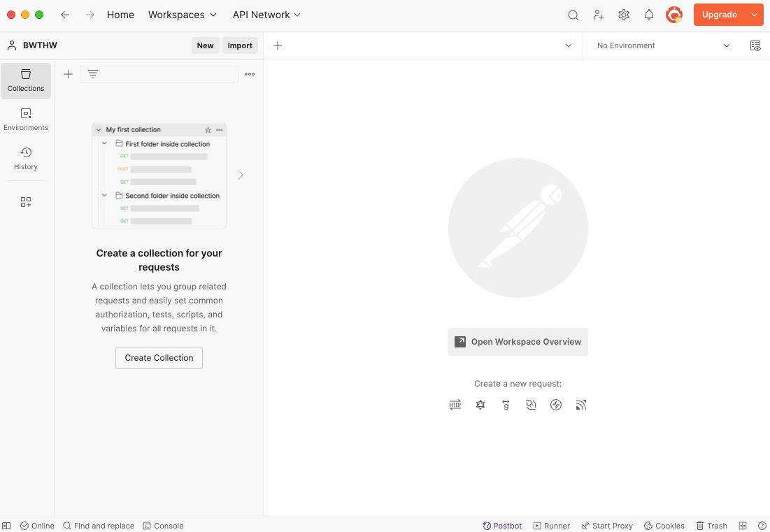
Hello IMPACT
This is the POSTMAN interface
Many things can be done (e.g., automatic debugging, writing custom scripts, etc…
We will limit to create and organize a collection of HTTP requests

Slide 44
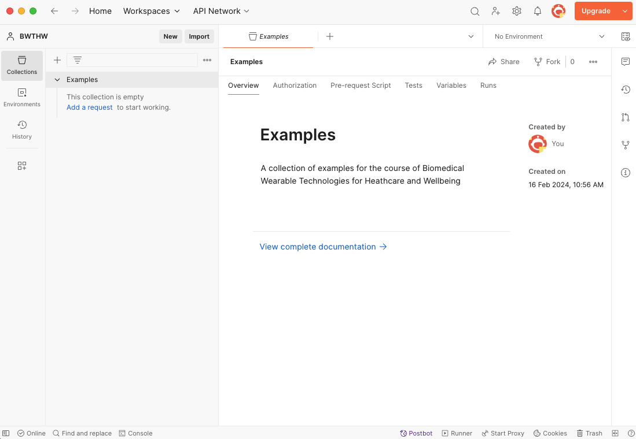
Hello IMPACT
Go to the ”Collections” tab
Press the “+” button
Create a “Blank collection”
Call it “Examples”: here we will collect all the theory lessons examples

Slide 45
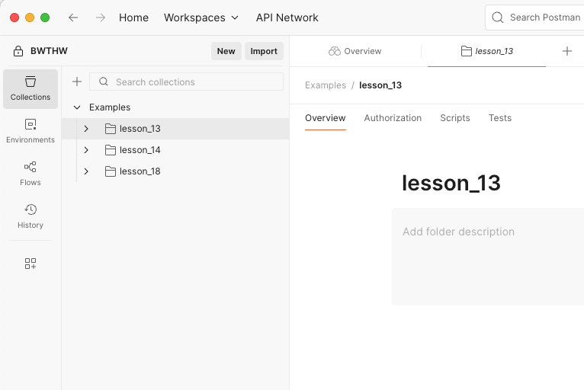
Hello IMPACT
Right click the “Examples” collection
Select “Add folder”
Call it as you want, e.g.: “lesson_13”

Slide 46
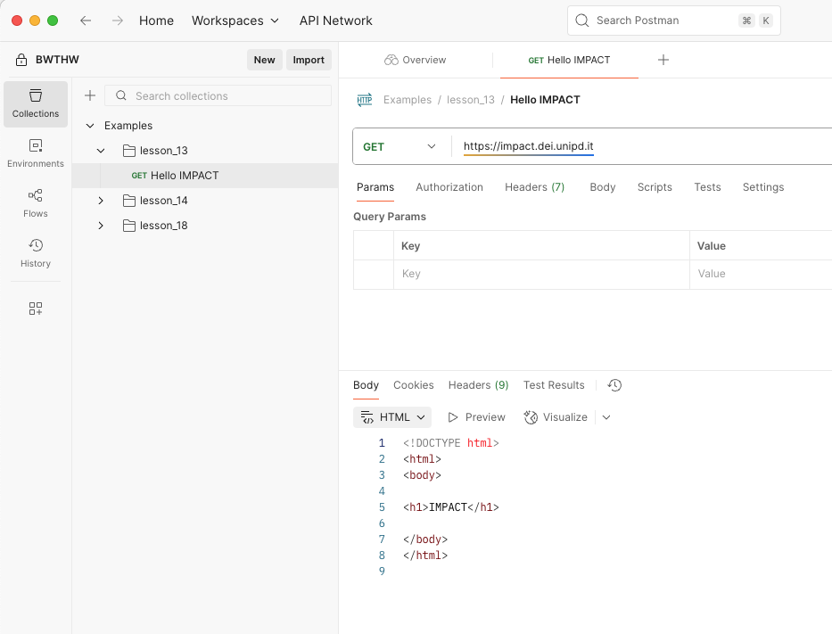
Hello IMPACT
Right click the folder and choose “Add request”
Call it as you want, e.g., “Hello IMPACT”
Choose the GET method
And write the IMPACT home URL, i.e., https://impact.dei.unipd.it/
Click “Send” and inspect the response

Slide 47
References
Tanenbaum, Wetherall – Computer Networks – Fifth Edition
Chapter 1 – Introduction
Chapter 7 – The application layer
POSTMAN: https://www.postman.com

