Slide 1
Representational State Transfer (REST) and Application Programming Interface (API)

Slide 2
Representational State Transfer (REST)
Representational state transfer (REST): a software architectural style created to guide the design and development of the World Wide Web.
REST defines a set of constraints for how the architecture of an Internet-scale distributed hypermedia system (e.g., the Web) should behave.
Introduced in 2000 by Roy Fielding (co-founder of the Apache HTTP Server project) in his doctoral dissertation (University of California, Irvine).

Slide 3

Architectural style
Architecture:
how system elements are identified and allocated
how they interact to form a system
the amount and granularity of communication needed for interaction
the interface protocols used for communication.
Architectural style: a set of architectural constraints that restricts the roles and features of architectural elements and the allowed relationships among those elements.

Slide 4
REST: goal and constraints
REST is a set of architectural constraints.
REST goal: to minimize latency and network communication, while at the same time maximizing the independence and scalability of components.
This is achieved by placing constraints on the interface between components, rather than on each component implementation.
In total, 6 architectural constraints:
Client-server architecture
Stateless communication
Cache constraint
Uniform interface between components
Layered system
Code-on-demand (optional)

Slide 5
Constraint 1: Client-server architecture
Principle of separation of concerns: a design principle for separating a computer program into distinct sections, in which each section addresses a separate concern (i.e., a different task) → modular system
The client-server (CS) architecture relies on the principle of separation of concern: separation of the user interface concerns (client) from the data storage concerns (server)
Advantages of the client-server architecture
It improves the portability of the user interface across multiple platforms
It improves scalability by simplifying the server components
It allows the client and the server components to evolve independently

Slide 6
Constraint 2: Stateless communication
Communication must be stateless in nature: the server does not store any state about the client session (i.e., the history of requests) on the server-side.
Each request from client to server must be standalone
It must contain all information necessary to understand the request
It cannot take advantage of any stored information on the server.
The session state (i.e., the history of requests) is kept entirely on the client.
If the server needs any information about previous requests to process the current request, then the client must provide this information in the current request.
Advantages:
Improved visibility: no need to look beyond the current request to determine its full nature.
Improved reliability: recovering from partial failures is easier.
Improved scalability: the server does not have to manage resource usage across requests
Tradeoff: it may decrease network performance by increasing the repetitive data sent in a series of requests

Slide 7
Constraint 3: Cache constraint
The data within a response to a request must be implicitly or explicitly labelled as cacheable or noncacheable.
If a response is cacheable, a client cache can reuse that response data for later, equivalent, requests.
Advantage:
Improved efficiency: it partially or completely eliminate some interactions.
Tradeoff:
Decrease reliability, if data within the cache differs significantly from the data that would have been obtained with a new request to the server.

Slide 8
Constraint 4: Uniform interface between components
The information is exchanged in the same way for every client-server interactions, whatever the client and the server are.
There is a common language between servers and clients that allows each part to be substituted or modified without breaking the entire system.
Advantage:
Independent evolvability of the system components: the implementation of interfaces is decoupled from the services they provide.
Tradeoff:
Decreased efficiency for some applications: the information is transferred in a standardized form rather than one which is specific to an application’s needs.

Slide 9
Constraint 5: Layered system style
The architect can inject “layers” of service between the server and the client to efficiently serve the client requests.
The layering must be transparent to the client: each component cannot “see” beyond the immediate layer with which it is interacting → the client does not know if it is talking with final data server or an intermediate server.
Advantage: by restricting knowledge of the system to a single layer, we place a bound on the overall system complexity and promote component independence.
Tradeoff: layers add overhead and latency to the processing of data, reducing user-perceived performance.
Request
Request
Request
Client
Intermediate component 1
Intermediate component 2
Data server
…
Response
Response
Response

Slide 10
Constraint 6: Code-on-demand (optional)
The client functionalities can be extended by downloading and executing code in the form of applets or scripts.
Advantage:
Clients are simplified by reducing the number of features required to be pre-implemented.
Allowing features to be downloaded after deployment improves system extensibility.
This constraint is not mandatory but optional: the architecture should support this constraint in the general case, but this may be disabled within some contexts.

Slide 11
The definition of the uniform interface
The REST uniform interface (constraint 4) is defined by putting 4 requirements on the interface between components (clients and servers):
Hypermedia as the engine of application state (HATEOAS)
Identification of resources
Manipulation of resources through representations
Self-descriptive messages

Slide 12
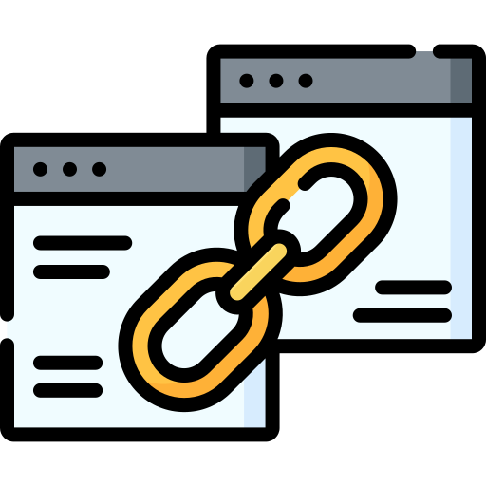
Hypermedia as the engine of application state
Web applications are based on distributed hypermedia:
When a client interacts with a Web application, the application servers provide information dynamically through hypermedia.
Hypermedia: any content that contains links to some other form of media (e.g., an image, a movie, a text) → generalization of hypertext for a general media.
When a link is selected, information is moved from the location where it is stored in the server to the location where it will be used in the client → application state transition.
A REST client needs no prior knowledge about how to interact with an application server beyond a generic understanding of hypermedia.

Slide 13

Identification of resources
Resource: any information or concept that can be named and be the target of a hypermedia (a document, an image, a collection of other resources, a temporal service, e.g., “today’s weather in Padova”...).
More precisely, the resource is the conceptual mapping to an entity or a set of entities.
The entity is the specific realization of the concept identified by the resource.
The entity to which a resource points is stored and manipulated in a specific resource representation
Each resource is identified by a label called resource identifier
Representation 1: one point for the circle center and one vector for the circle radius in SVG format
Resource: circle
Entity: a circle realization
Representation 2: coordinates of three points of the circumference in a csv file

Slide 14
Resources types
Example:
«the first version of document X»
«the revision 1.0 of document X»
«the revision 1.1 of document X»
…
«the latest version of document X»
Static resources: they always point to the same entity (with a specific representation), in this case a precise document version.
Dynamic resource: the pointed entity can change over time. At some time, the resource «the latest version of document X» will point to the same entity of «the revision 1.1 of document X».

Slide 15
Resource representations
Resource representation: a view of the current state (or realization) of the resource at the time of the request.
In a client-server interaction, the client asks to the server a resource (by the resource identifier), and the server answers by sending the corresponding resource representation.
Note: The representation sent to the client is not necessarily the same used to store the data in the server.
Resource identifier
Server
Client
Entity
Resource representation
(raw format)

Slide 16
REST self-descriptive messages
REST request message
Control data
(mandatory)
Resource identifier
(mandatory)
Representation
(optional)
Server
Client
Entity
(raw format)
REST response message
Control data
(mandatory)
Representation
(optional)
Resource metadata (optional)

Slide 17
Resource representations and REST messages
A resource representation includes:
Data (the actual representation)
Metadata (description of the representation) → typically, not displayed to the end user (e.g., data type, creation date, version number, …)
The resource representation is provided to the client within a response message that contains some additional contents:
Resource metadata (optional): additional information about the resource that exists on the server (e.g., alternate text to be displayed in the event an image representation cannot be displayed for some reason).
Control data (mandatory): it deals with the validity of the resource and its representation on the client (e.g., if data is cacheable, the expiry time, a checksum for checking integrity, …).

Slide 18
Summary of REST
An architectural style for distributed hypermedia systems
6 constraints
Client-server architecture
Stateless communication
Cache constraint
Uniform interface
Layered system
Code-on-demand (optional)
The uniform interface is realized through the definition of abstract resources
Each resource is identified by a resource identifier
The realization of a resource is an entity
A resource is manipulated by resource representations that reflect the current realization of the resource
Representations can be sent from server to client (or viceversa) encapsulating them in a self-explained message
A request message must include control data (mandatory), resource identifier (mandatory) and representation’s data and metadata (optional)
A response message must include control data (mandatory), representation’s data and metadata (optional) and resource metadata (optional)
The REST paradigm increases performance, scalability, simplicity, modifiability, visibility, portability, and reliability of the system.

Slide 19
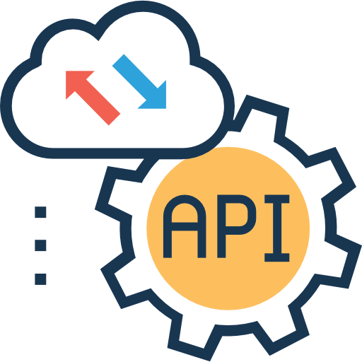
Application programming interface (API)
Two separate applications need an intermediary to talk to each other and to allow one application to access the information or functionality of the other.
Application programming interface (API): a connection or interface between computer programs, which defines how the systems can interact.
The kind of requests that can be made to a system
How to make them
The data formats that should be used
The conventions to follow
In contrast to a user interface, which connects a computer to a person, the API connects pieces of software

Slide 20
Application programming interface (API)
Why do we need API? To allow interoperability, i.e., to allow multiple systems to cooperate.
An API defines how two software systems can interact while hiding the internal details of how each system works. The API exposes only those parts that are needed for the systems to interact and keeps them consistent even if the internal details of the systems later change → Modular programming
The API is often made up of different tools or services that other applications can call.
API specification: a document or standard describing how to build or use the API tools or services.
An API may be custom-built for a particular pair of systems, or it may be a shared standard allowing interoperability among many systems.

Slide 21
Web API
Web API: an interface for clients and servers that allows them to interact through the Web.
Server-side Web API: the interface of a Web server towards the Web. It consists of one or more publicly exposed endpoints.
Endpoints: the URLs which specify where the resources that can be accessed by clients lie.
Client-side Web API: a software interface that a client uses to send requests to a server-side Web API.
It allows a client web browser or web application to extend its functionality, by exploiting resources (data, programs, more in general services) provided by Web servers.

Slide 22
Request-response Web API
Most of Web APIs are request-response APIs that rely on the HTTP protocol.
HTTP request
Client
Server
Endpoint
HTTP response
Endpoint
Endpoint
Client-side API:
The piece of software that sends requests to the server.
Server-side API:
The piece of software that receives the requests and the endpoints that provide the requested resources.

Slide 23

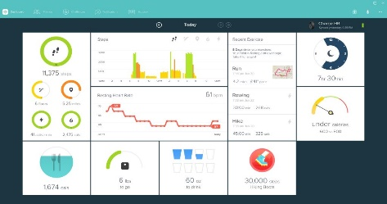

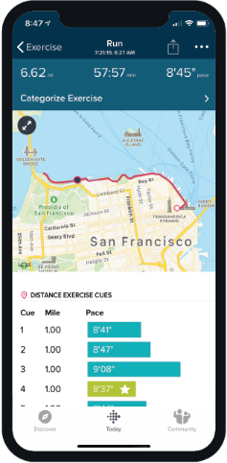
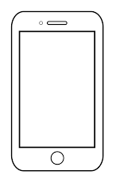
Examples of API in wearable sensors
Web application
Map database
Web API
Proprietary mobile app
Wearable device
Bluetooth API
Sensor company database
Web API
Web API
Web API
Other third-party application

Slide 24
Approaches to design request-response Web API
Web APIs are realized using protocols and/or specifications to define the semantics and syntax of the messages exchanged by client and server.
→ API architectures
Most popular request-response API architectures:
RPC: Remote Procedure Call
SOAP: Simple Object Access Protocol
REST architectural style
In this case the API is called RESTful API

Slide 25
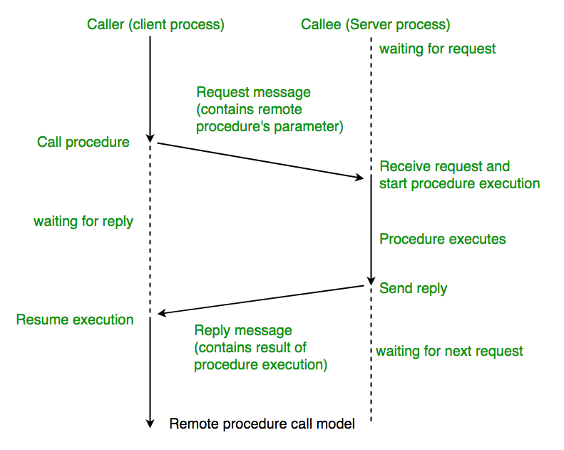
Remote Procedure Call (RPC)
The simpler and oldest web API approach
Remote Procedure Call (RPC) is a request-response protocol by which the client sends a request message to a known remote server to execute a specified procedure with supplied parameters.
RPC extends the conventional local procedure calling so that the called procedure does not need to be in the same address space as the calling procedure. The two processes may be on the same system, or on different systems with a network connecting them.
In RPC the endpoints represent actions

Slide 26
Remote Procedure Call (RPC)
Pros:
Straightforward and simple interaction: all is done with GET and POST HTTP methods
Easy to add functions: a new function can be defined and associated to a new endpoint
High performance: having the functions in the URL allows to have lightweight payloads
Cons:
Tight coupling to the underlying system: RPC messages are not standardized. Their format depends on the specific application → low reusability of the API
Use cases: to perform extremely high-performance, low-overhead internal messaging within big companies (Google, Facebook, Twitch, etc. ).

Slide 27
Example of RPC
This example illustrates an online shop system that tries to handle a transaction with RPC.
The function paymentService.prcessPayment is implemented in another system.
User must know a lot of things to use the function: i.e., how to create a Card, function parameters, the structure of a Result, etc…
Card card = Card();
card.setCardNumber("1234 5678 1234 5678");
card.setExpiryDate("11/30");
card.setCVC("123");
Result result = await paymentService.processPayment(card, 3.99, Currency.EUR);
if(results.isSuccess()){
fulfilOrder();
}

Slide 28
Simple Object Access Protocol (SOAP)
Released by Microsoft in 1998
Web API protocol with highly standardized messages written in XML
It runs over HTTP or other application layer protocol
<?xml version="1.0"?> <soap:Envelope xmlns:soap="http://www.w3.org/2003/05/soap-envelope/" soap:encodingStyle="http://www.w3.org/2003/05/soap-encoding"> <soap:Header> ... </soap:Header> <soap:Body> ... <soap:Fault> ... </soap:Fault> </soap:Body> </soap:Envelope>
It defines the XML document as a SOAP message
Application-specific information specifying how the recipient should process the message (optional)
The message body
Error messages (optional)

Slide 29
Example of SOAP messages
Example of SOAP request:
Example of SOAP response:
POST /InStock HTTP/1.1 Host: www.example.org Content-Type: application/soap+xml; charset=utf-8 Content-Length: nnn <?xml version="1.0"?> <soap:Envelope xmlns:soap="http://www.w3.org/2003/05/soap-envelope/" soap:encodingStyle="http://www.w3.org/2003/05/soap-encoding">
<soap:Body xmlns:m="http://www.example.org/stock">
<m:GetStockPrice> <m:StockName>IBM</m:StockName> </m:GetStockPrice>
</soap:Body>
</soap:Envelope>
HTTP/1.1 200 OK Content-Type: application/soap+xml; charset=utf-8 Content-Length: nnn <?xml version="1.0"?> <soap:Envelope xmlns:soap="http://www.w3.org/2003/05/soap-envelope/" soap:encodingStyle="http://www.w3.org/2003/05/soap-encoding"> <soap:Body xmlns:m="http://www.example.org/stock"> <m:GetStockPriceResponse> <m:Price>34.5</m:Price> </m:GetStockPriceResponse> </soap:Body> </soap:Envelope>

Slide 30
SOAP: pros and cons
Pros:
Web Services Security (WS-Security): an extention of SOAP that allows to use security mechanisms (e.g., signature of messages, encryption of messages, authentication)
SOAP allows to perform stateful communications, necessary for complex transactions in which multiple parties are involved (e.g., online banking and e-commerce applications)
Cons:
Only XML
Heavy messages
Specialized knowledge of the protocol rules needed

Slide 31
RESTful APIs
With the expansion of modern Web, a more simple, flexible and scalable way of defining API was needed.
RESTful APIs: APIs designed according to the REST principles, proposed in 2000 by Roy Fielding.
REST is resource-based (instead of action-based) and it only uses the HTTP methods (GET, POST, PUT, DELETE) → no specialized knowledge required
No strict protocol, only compliance with the 6 REST constraints
No constraints on the message format → JSON preferred to XML

Slide 32
RESTful APIs: pros and cons
Pros:
Easy, no specialized knowledge required
Multiple formats supported
Great flexibility and scalability
Cache-friendly
Cons:
REST messages have large payloads to transfer metadata necessary to understand the state of the application and to enable complex actions.
Chatty interactions: it generally requires multiple requests to get the needed data. Often unnecessary data are transferred.
Server
Endpoint
Company name, location, year of founding
Client
Company name and founder’s name
Endpoint
Founder’s name, place of birth, education
Results of multiple requests neeed to be processed (combined and filtered) on client side.

Slide 33

The IMPACT BWTHW RESTful API
This is the API you will use to build your project
It allows to authenticate, ping (to know if the server is alive), and to get data
Full URL: https://impact.dei.unipd.it/bwthw/

Slide 34
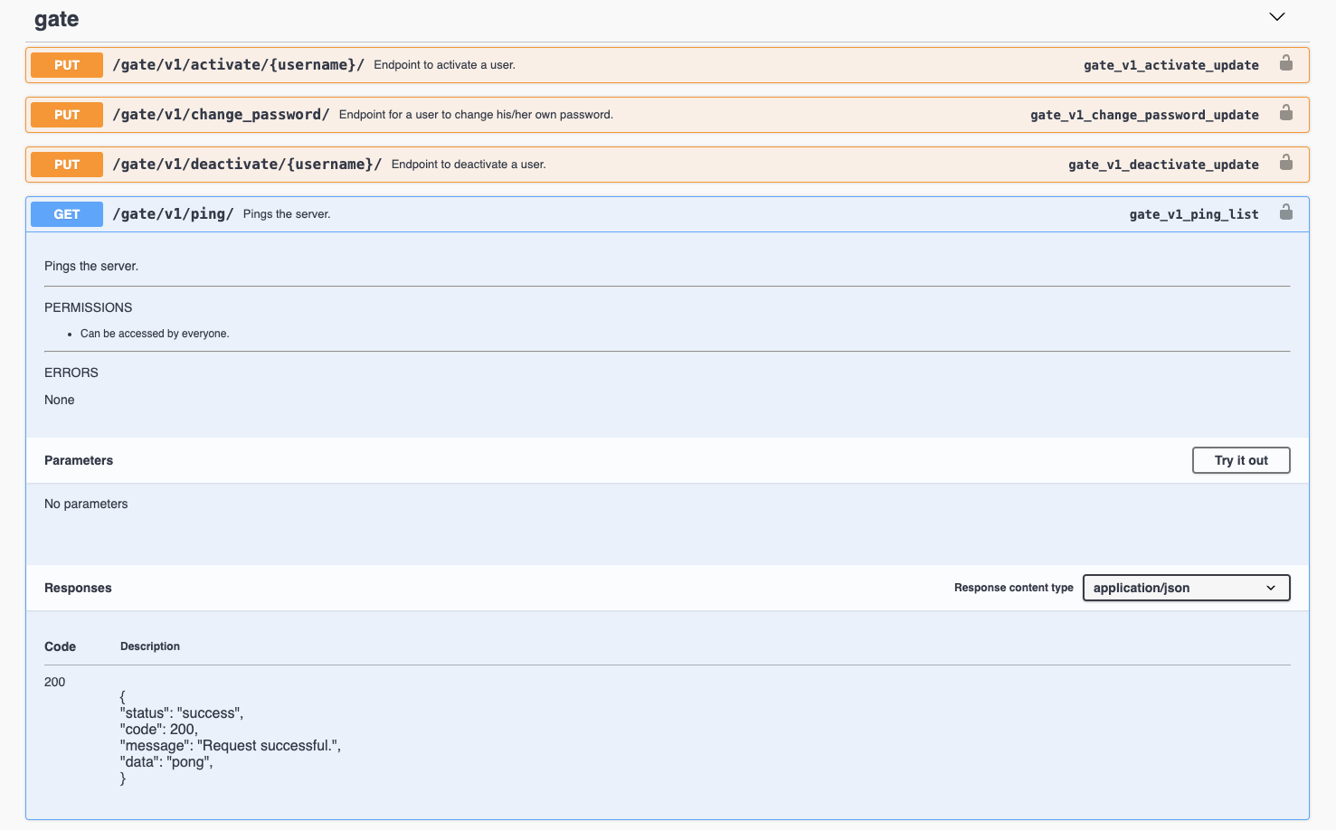
The ping endpoint
Let’s inspect the ping endpoint
Key things we can learn from the docs:
Method: GET
Full URL: https://impact.dei.unipd.it/gate/v1/ping/
It does not require parameters
It does not require to be authenticated
If successful, the response will be a JSON

Slide 35
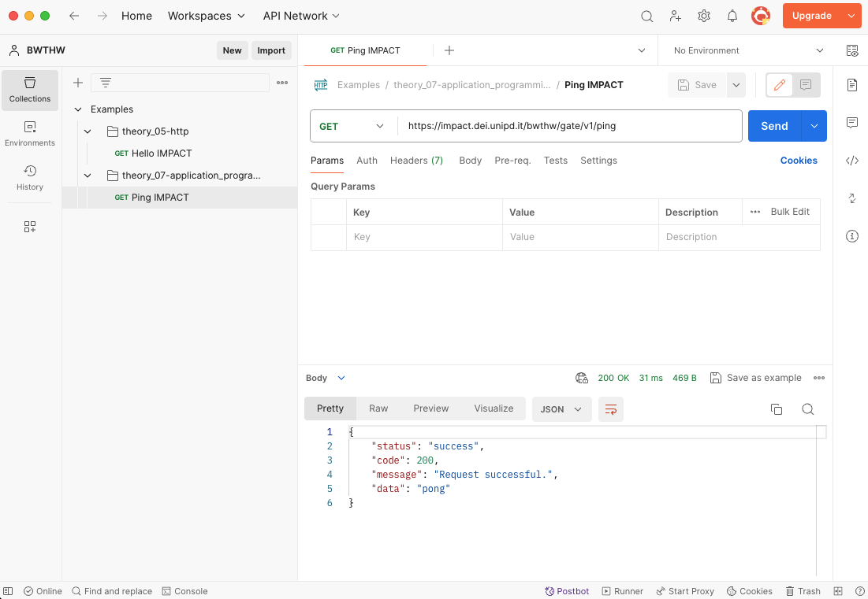
The ping endpoint
POSTMAN can be used to make a request and test it

Slide 36
Summary of types of request-response Web APIs
 | RPC | SOAP | RESTful
Organized in terms of | Local procedure calling | Enveloped message structure | Compliance with 6 architectural constraints
Format | Multiple (JSON, XML, Protobuf, …) | XML only | Multiple (JSON, XML, HTML, plain text, …)
Statefull or stateless | Both | Both | Stateless
Learning curve | Easy | Difficult | Easy
Community | Large | Small | Large
Use cases | Command and action-oriented APIs, internal high performance and massive micro-services | Payment gateways, identity management, financial applications | Public APIs, simple resource-driven app

Slide 37
Request-response API architecture
RPC, SOAP, RESTful, GraphQL are all types of request-response Web API
To get the latest information, the client always have to poll the API provider (server).
Has the train arrived?
User
8:00
API provider
No
Train station server
Has the train arrived?
8:05
No
…
8:25
Has the train arrived?
Yes!

Slide 38
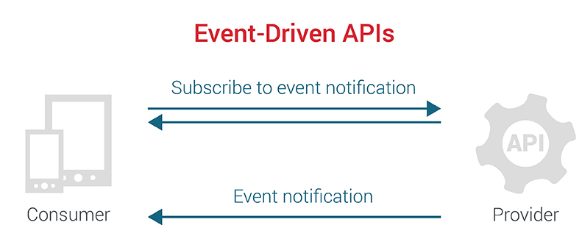
Event-driven API architecture
In event-driven APIs the API provider notifies the client when something interesting happens. Notifications do not need a request from the client.
An event-driven API must offer two capabilities to its clients
A mechanism to allow clients to subscribe to events of their interest.
Delivery of events to subscribed clients in an asynchronous manner.
User
Please notify me when the train arrives.
API provider
8:00
Train station server
8:25
The train arrived.

Slide 39
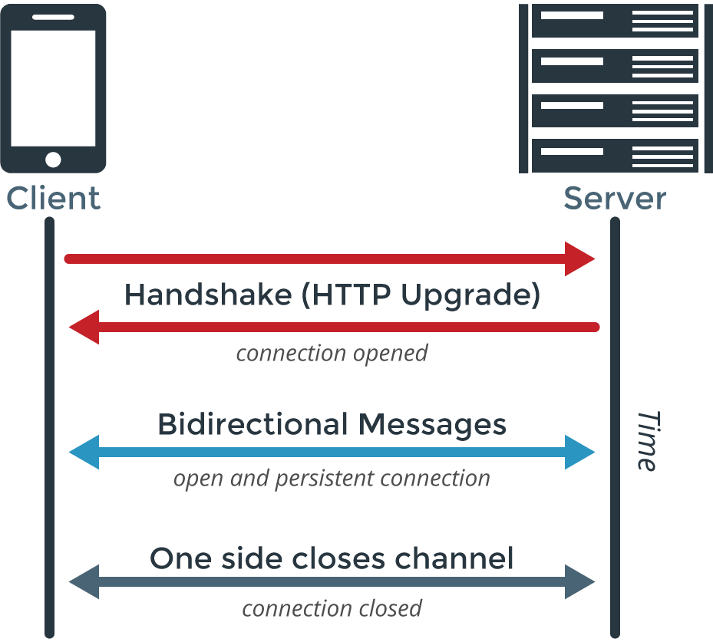
WebSocket
An example of protocol for event-driven APIs
WebSocket allows for constant, bi-directional communication between the server and client, which means both parties can communicate and exchange data as and when needed.
Suitable for realizing Web chats.

Slide 40
References
Roy T. Fielding and Richard N. Taylor, “Principles and design of the modern Web architecture”, ACM Transactions on Internet Technology, Vol. 2, No. 2, May 2002, Pages 115–150. https://www.ics.uci.edu/~taylor/documents/2002-REST-TOIT.pdf

