Slide 1
Giacomo Cappon
Implementing State Management

Slide 2
Outline
Recap on Provider and Case study
Exercises
Homework
Resources

Slide 3

Recap: Provider (core) flow
ClassImplementingChangeNotifier
ChangeNotifierProvider
Inject an instance to
Child widget tree
notifyListeners() is called
Consumer
Call builder method

Slide 4

Case of study
We will build a (too) simple e-commerce app. Users can choose, in the HomePage, products from a catalog and add them to the cart. In a different screen, CartPage, the number of items in the cart is visualized.
HomePage
CartPage
Contains
Visualizes/Clears
Catalog
Cart
User chooses a product

Slide 5
Case of study – UI widget tree
MaterialApp
HomePage
ListView
CartPage
To visualize the number of items in the Cart
To visualize the Catalog
ListTile
Text
How to manage the catalog and the cart? With two class (model).
No problems with the Catalog (Ephemeral state)…
On the other hand, Cart must be shared (App state) Where to put it?
Catalog
Cart

Slide 6
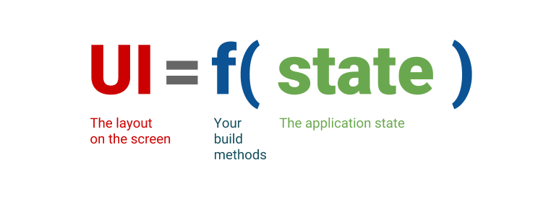
Lift the state up
The idea is “Lift the state up”
MaterialApp
Cart
Cart is injected through the tree.
Catalog
HomePage
Catalog is just a variable of HomePage.
ListView
CartPage
ListTile
Text

Slide 7
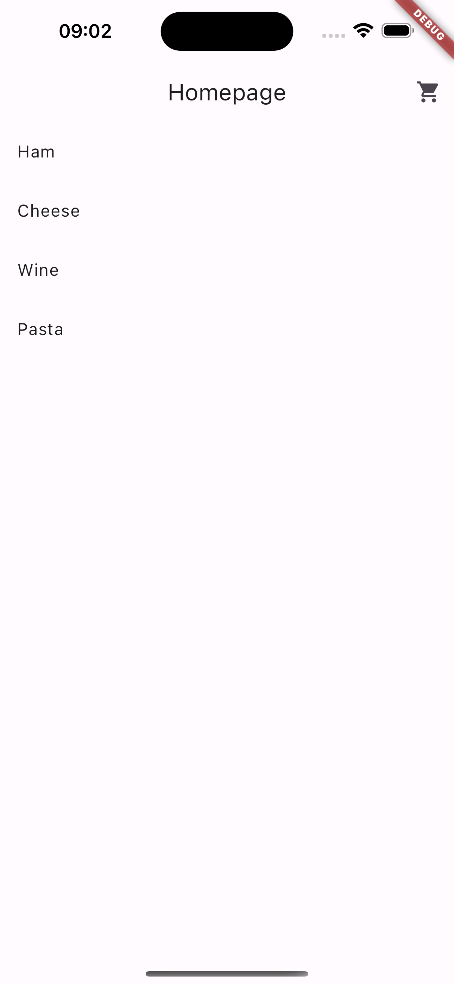
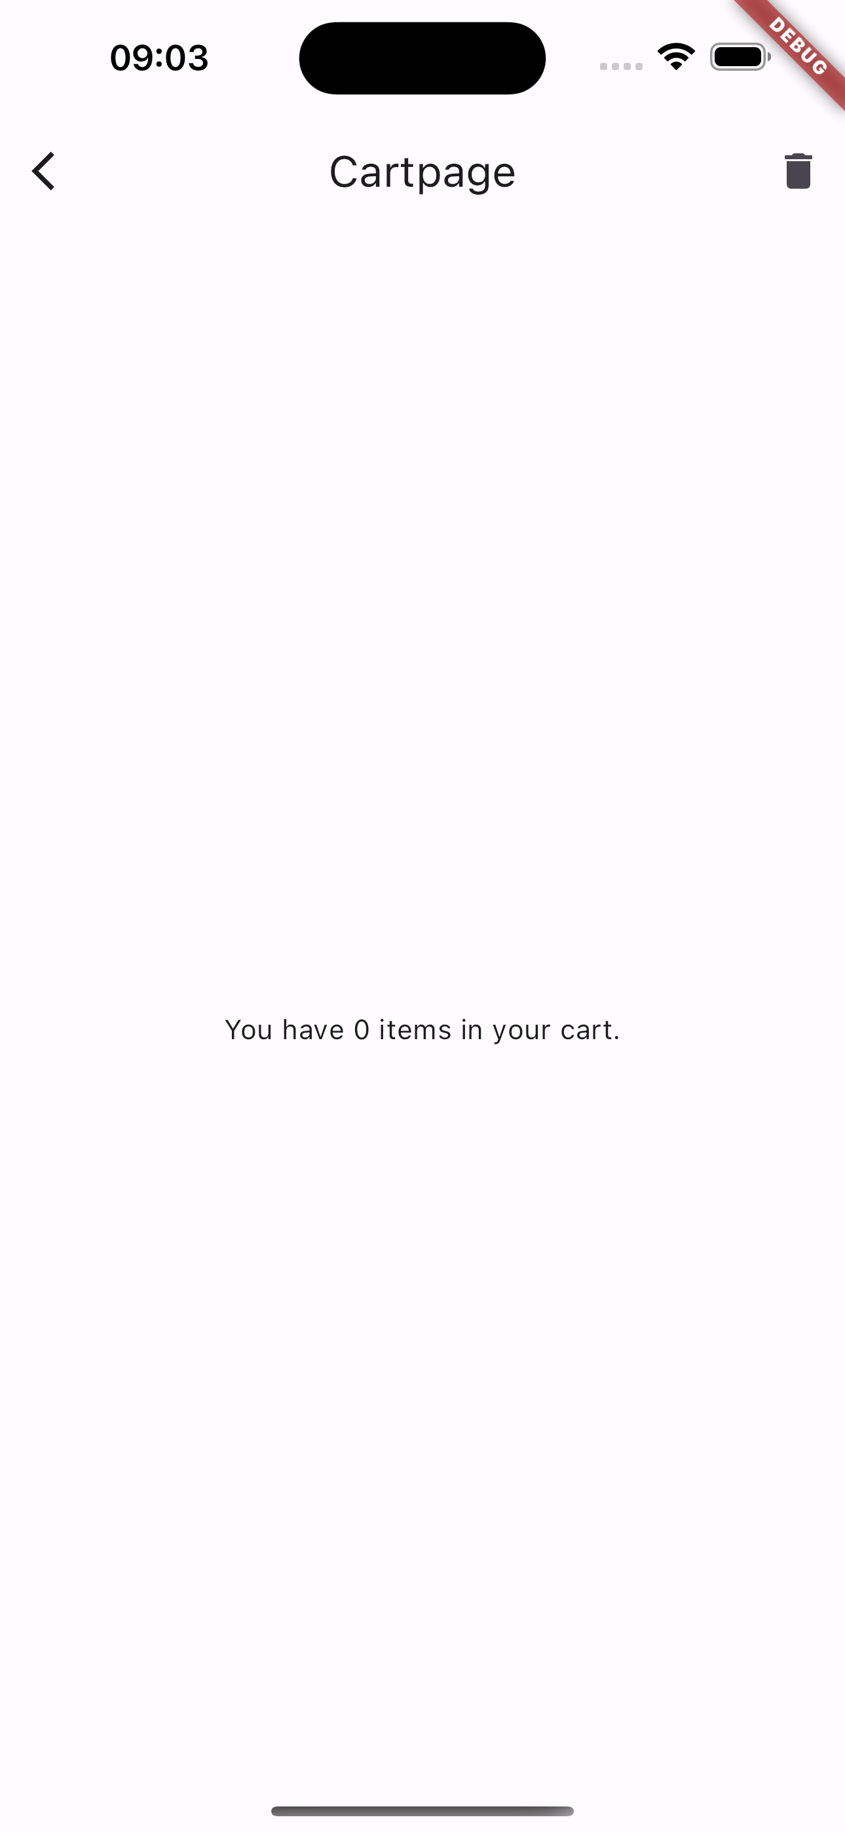
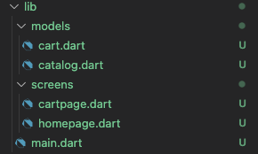
Case of study - Live
Let’s create a new project “shopper” that implements the case of study and shows how to use Provider.
Full example in lesson_12-implementing_state_management/shopper/

Slide 8
Outline
Recap on Provider and Case study
Exercises
Homework
Resources

Slide 9
Exercise
Create a new project ‘meal_manager’, an app that stores the meal intakes of a user in terms of carbohydrate content and meal timing.
The app needs to implement the following functionalities:
When a user opens (or restarts) the app, an empty list is showed;
By tapping a button, the user navigates to another page where he can add a new meal (CHO content and timing). Once he/she is done, the user taps a button and navigates back to the home page. The home page must show the updated meal list with the new meal just created;
(Bonus) The user can select a meal from the list. If he/she does that, he/she navigates to another page where he/she can edit or delete the meal entry from the list.

Slide 10
Exercise – Suggested steps
Create the UI with placeholders
Create a class that extends ChangeNotifier
”Give” that class to ChangeNotifierProvider
Implement the methods of the class created at step 2 (those that call notifyListeners())
Implement the part of the code that “calls” the methods you implemented at step 4
Integrate the Consumer where you need them

Slide 11
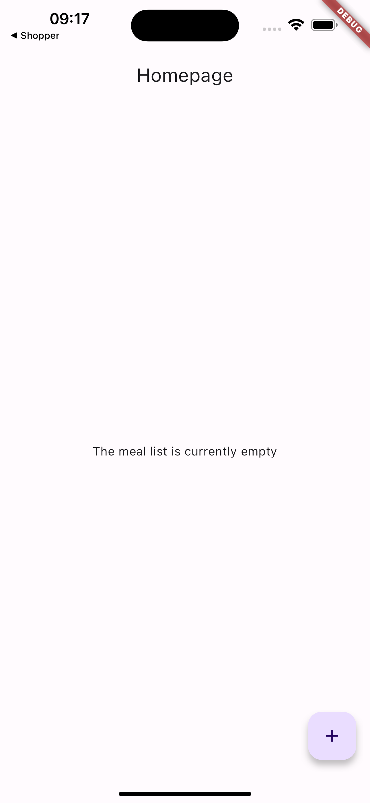
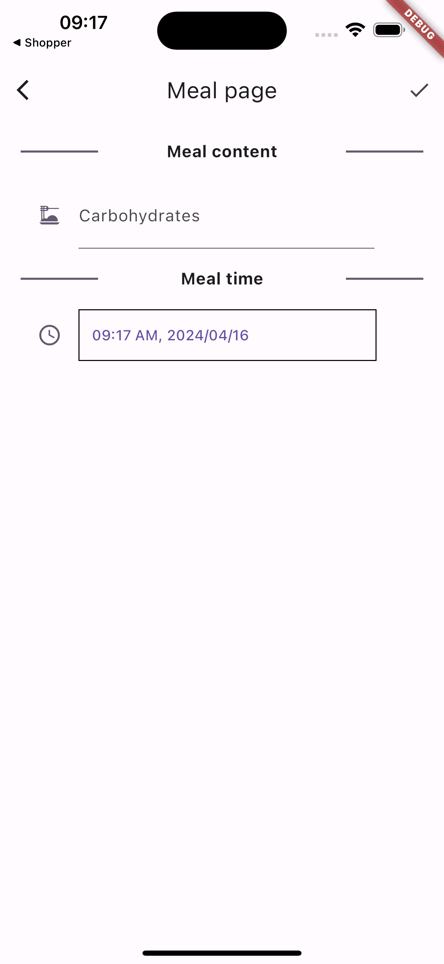
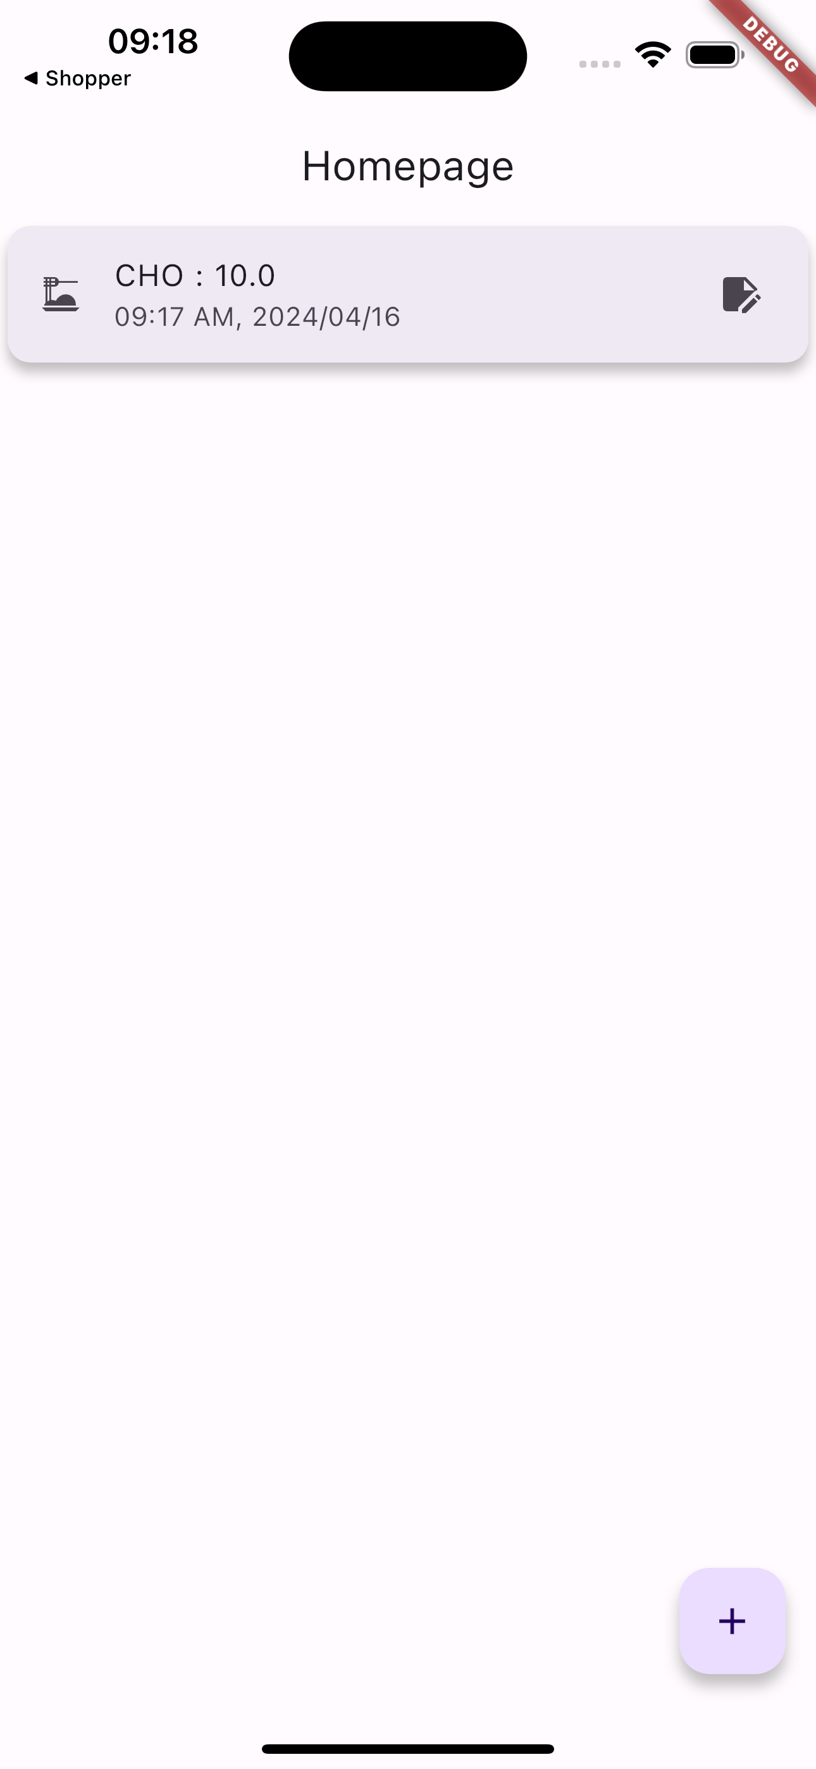
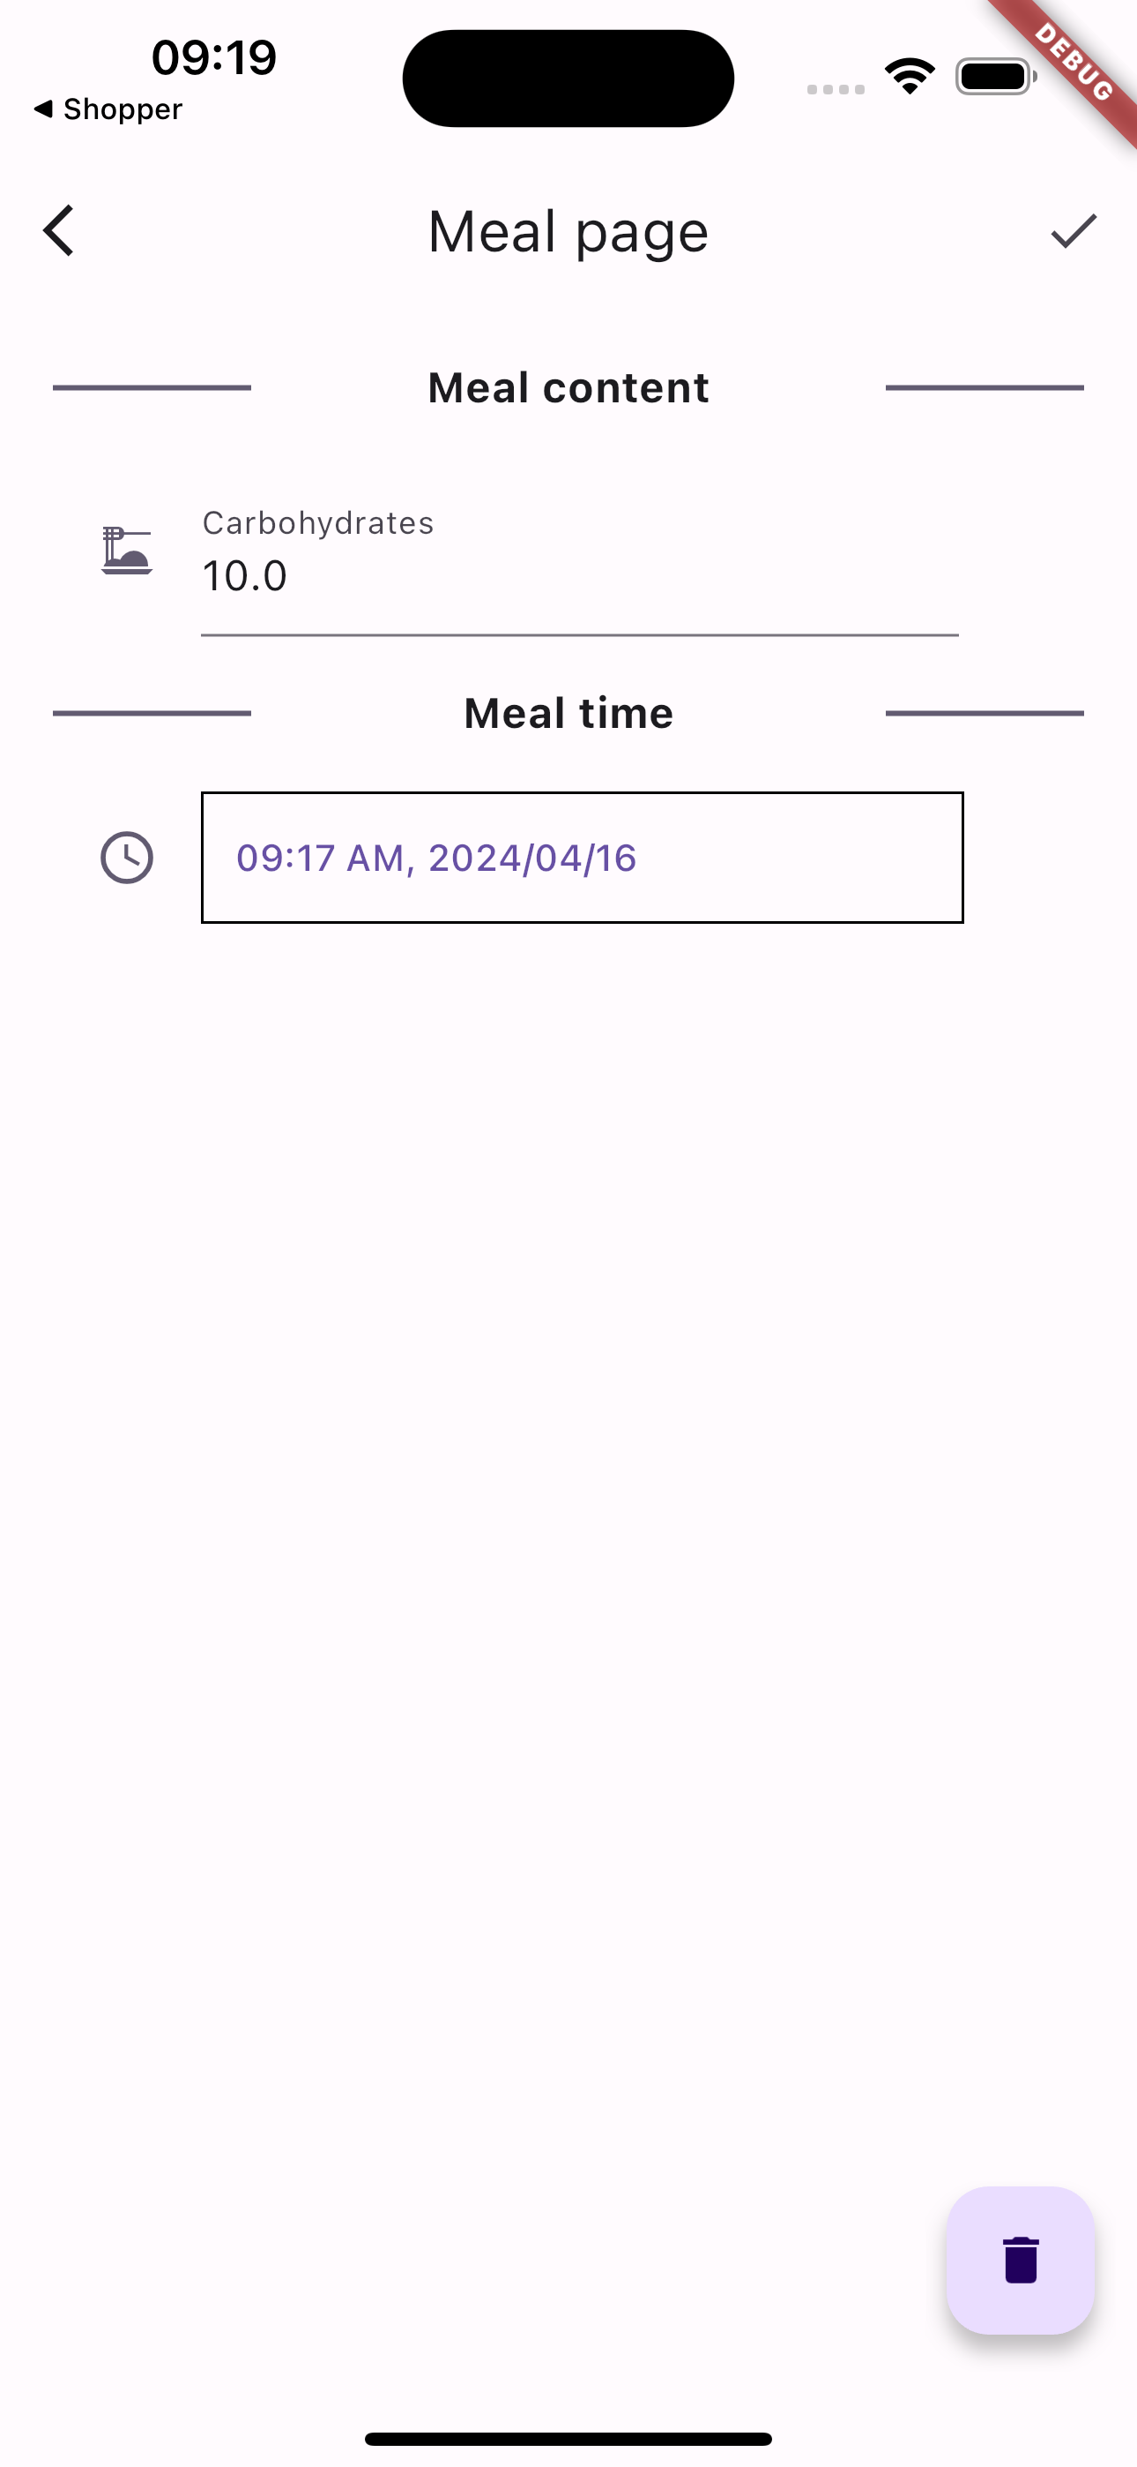
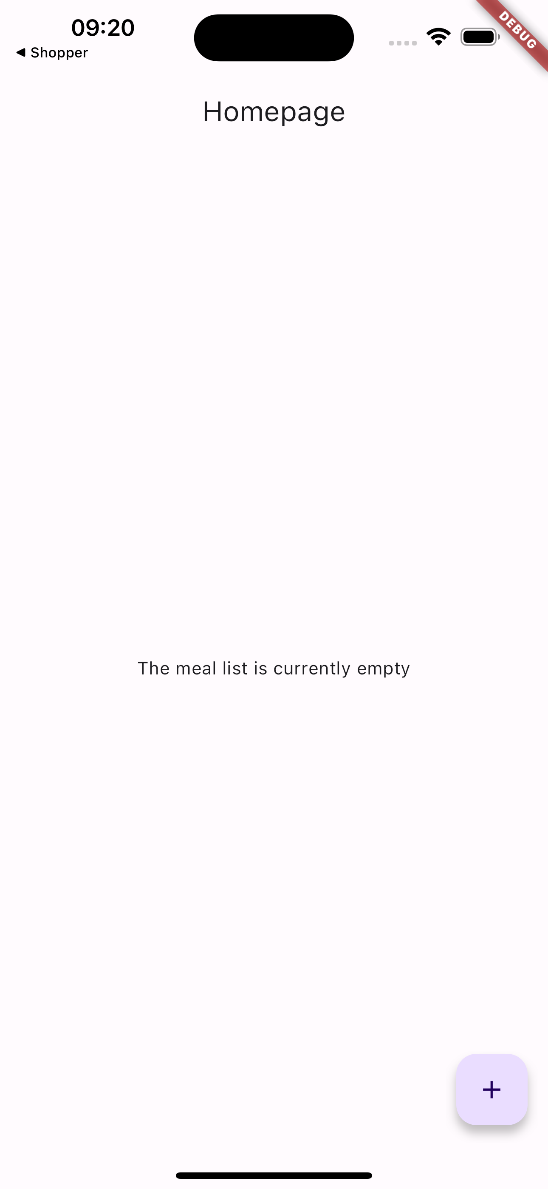
Exercise: here’s a possible idea
Homepage is initially empty
When the button is tapped the user navigates to another page where he/she can add a new meal
When the user finishes, the new meal is added to the list
When the meal is tapped, the user navigates to a new screen where he/she can edit or delete it
If the meal is edited/deleted the list is updated.

Slide 12
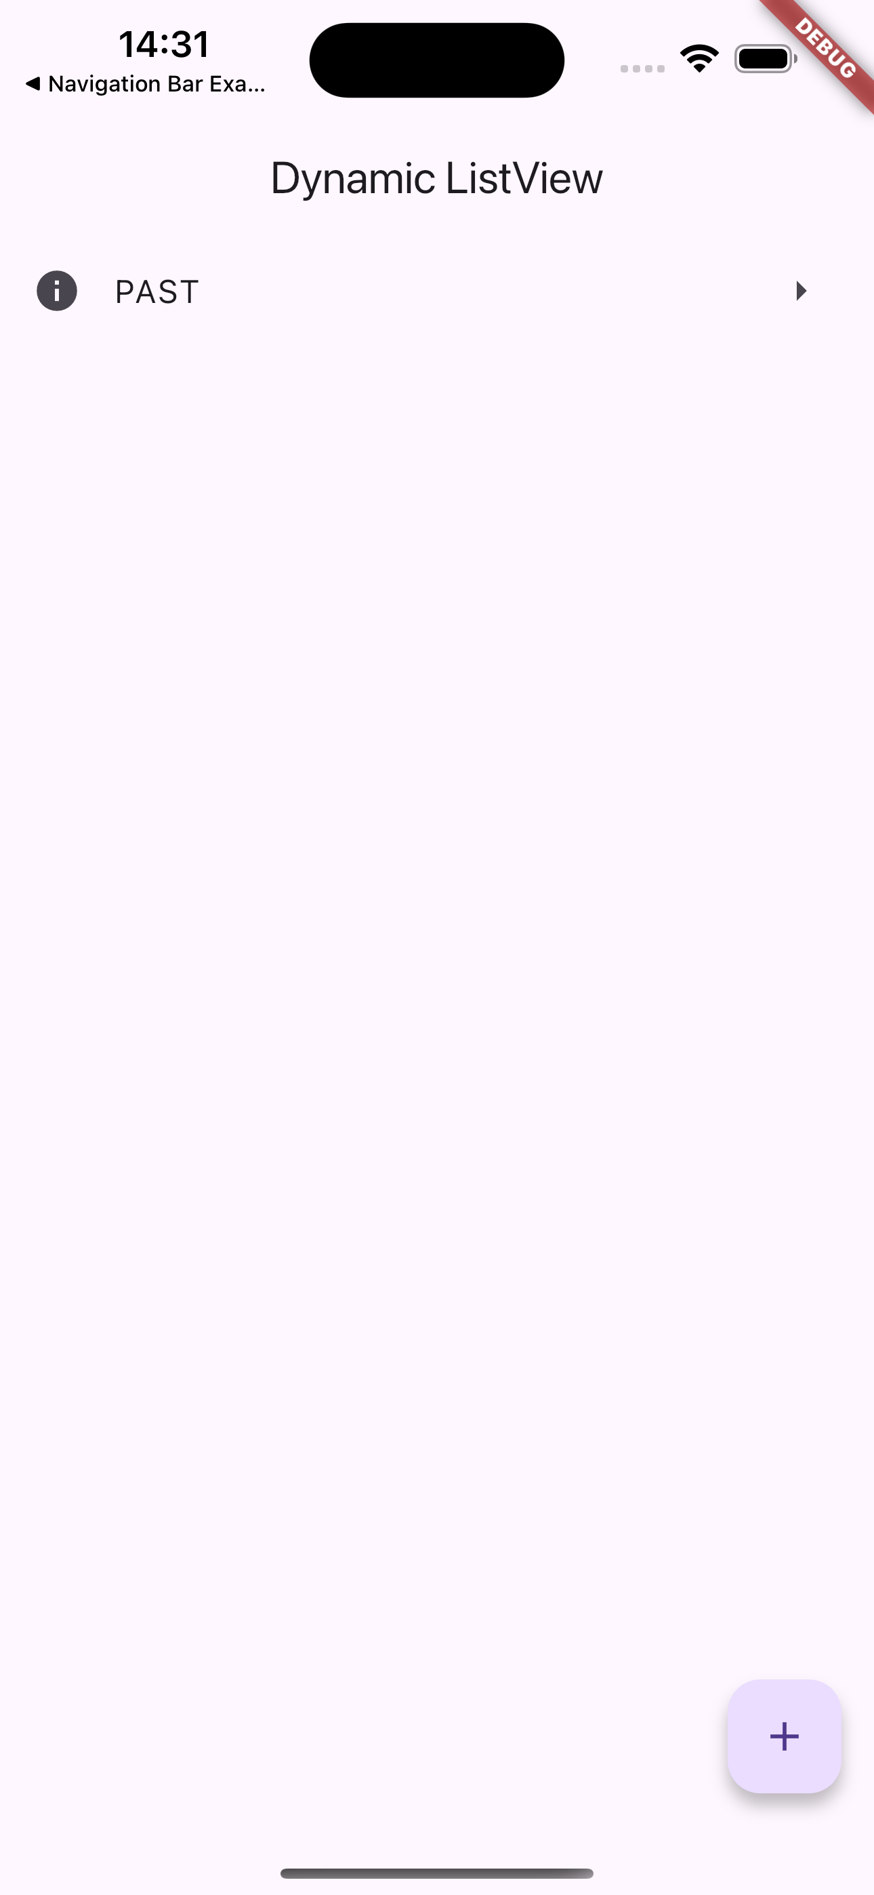
Exercise
Create a new project “dynamic_listview”
Reproduce the UI in the screenshot
The FloatingActionButton on the bottom right has the following behaviour: whenever it is pushed, a new ListTile is added to the ListView and displayed to the user.

Slide 13
Exercise
Hint: ListView has not just 1 but 4 constructurs! ListView.builder could be of help:
Note also that it is normal that when the app is reloaded or restarted, the ListView will look empty.
List<String> items = [“1”, “2”, “3”, “a”, “b”, ”c”];
ListView.builder(
itemCount: items.length,
itemBuilder: (context, index) {
return ListTile(title: Text(items[index]));
},
)

Slide 14
Outline
Recap on Provider and Case study
Exercises
Homework
Resources

Slide 15
Homework
Get familiar with Provider
Take a look to other approaches, e.g., Riverpod or BLoC. Maybe there is something that fits better your way of thinking!
Take a look at my solution. You will find some useful code.

Slide 16
Outline
Recap on Provider and Case study
Exercises
Homework
Resources

Slide 17
Resources
State management
https://docs.flutter.dev/development/data-and-backend/state-mgmt/intro
Making sense of all those Flutter Providers
https://medium.com/flutter-community/making-sense-all-of-those-flutter-providers-e842e18f45dd
List of state management approaches
https://docs.flutter.dev/development/data-and-backend/state-mgmt/options

