Slide 1
Wearables

Slide 2

Wearable devices

Slide 3
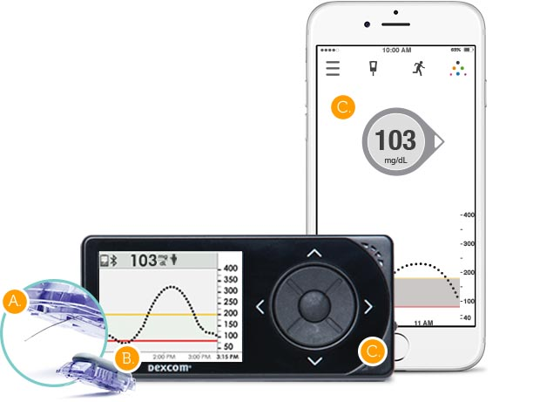
Wearable devices
A wearable device is a device that can be used for sensing physiological parameters or signals which generally include two components:
A sensor that measures the physical quantity of interest (measurand)
An embedded processing unit that does some initial processing of the measurements and either stores them in a memory or sends them to another device
Sensor
Receiver device / Gateway device (for IoT devices)
Embedded processing unit

Slide 4
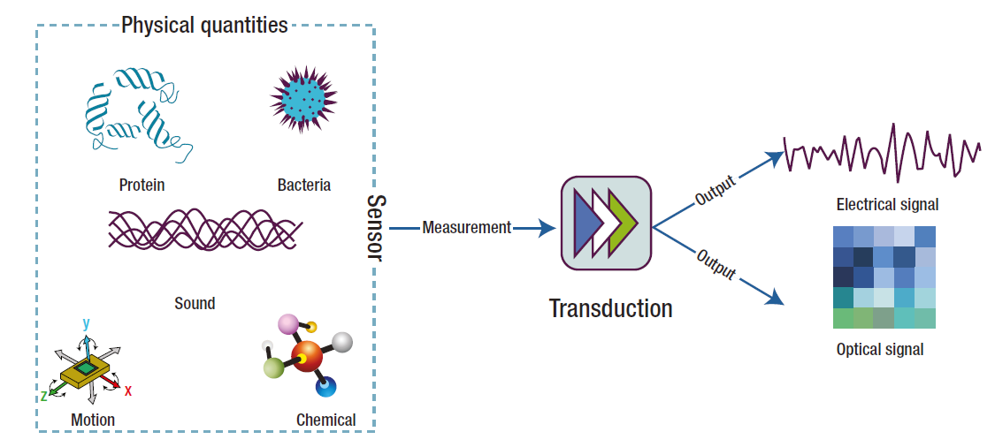
Definitions of sensor
“A sensor generally refers to a device that converts a physical measure into a signal that is read by an observer or by an instrument” (Chen et al., 2012)
Measurand

Slide 5
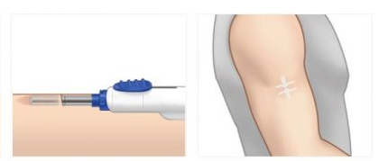
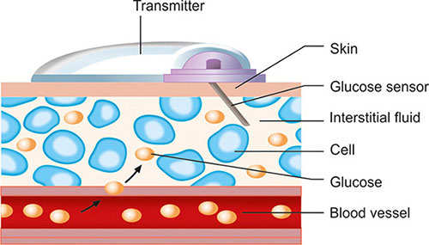
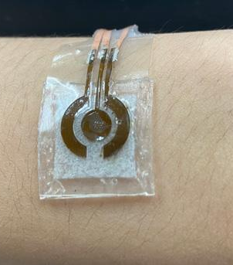
Classification of sensors based on their interaction with the measurand
Contact sensor: sensors requiring physical contact with the measurand.
Their deployment obviously perturbs the state of the subject to some degree.
Comfort and biocompatibility are important considerations
Response time determined by the speed at which the measurand is transported to the measurement site.
Poor contact can result in signal noise and the introduction of signal artifacts.
Invasive: sensors inserted into human body
Minimally-invasive: patch-type devices on the skin that monitor interstitial fluids
Non-invasive: sensors that simply have contact with the skin without effect

Slide 6
Classification of sensors based on their interaction with the measurand
Non-contact sensors: do not require direct contact with the measurand.
Minimum perturbation of the subject
Generally used in ambient sensing applications
Example: infrared thermometer
Sample based sensors: require an invasive collection of a sample of the person to be monitored by a human or automated sampling system.
The collected samples are analyzed using sensors or laboratory-based analytical instrumentation
Common approach in healthcare (e.g. monitoring cholesterol)

Slide 7
Classification of sensors based on their sensing technique
Mechanical sensors
Electrical sensors
Optical sensors
Chemical sensors

Slide 8
Mechanical sensors
Mechanical sensors detect some form of mechanical deformation of a material, in response to the measurand (input), and translate it to an electrical, optical, magnetic or thermal signal (output).
Electromechanical sensors:
Types of electromechanical sensing techniques:
Piezoresistive sensors
Capacitive sensors
Iontronic sensors
Piezoelectric sensors
Measurand
Mechanical deformation
Electrical signal

Slide 9
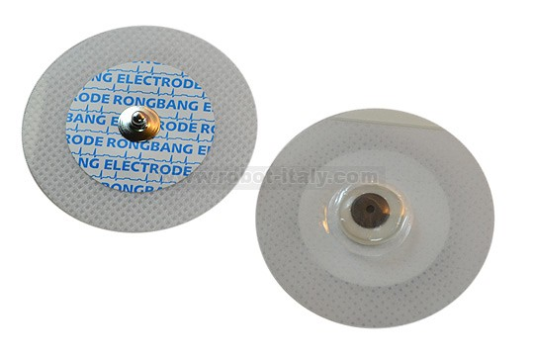
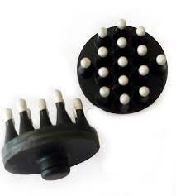
Electrical sensors
Electrical sensors: on-skin electrodes that measure a change in electrical resistance or the electrical charge of the skin.
Good electrical contact with skin is required.
Wet electrodes: solid conductive pad interfaced to the skin via an electrolyte gel that minimizes the impedance of skin by hydrating it and forming a conformal electrical contact with its textured surface.
Dry electrodes: direct contact with the skin, sensible to movement artifacts.
Skin electrodes allow to collect high-fidelity measurements of a broad range of physiologically relevant biopotentials:
electrocardiogram (ECG)
electroencephalogram (EEG)
electromyogram (EMG)
electrooculogram (EOG)
electroretinogram (ERG)
galvanic skin response (GSR), also known as skin impedance or electrodermal activity (EDA)

Slide 10
Optical sensors
Electro-optical sensors detect light and convert it to an electrical signal
Photoconductive devices convert a change of incident light into a change of resistance.
Photovoltaics (solar cells) convert an amount of incident light into an output voltage.
Photodiodes and phototransistor convert an amount of incident light into an output current.
Operating principle of wearable optical sensors: a light source introduces light into the body and based on how much the light is absorbed or reflected, measurements related to the body tissue are derived.
The wavelength of light sources can range from UV to deep infrared, depending on needed penetration depth and the absorption peak for the relevant sensing application.
Commonly used for monitoring of heart rate and blood oxygenation.

Slide 11
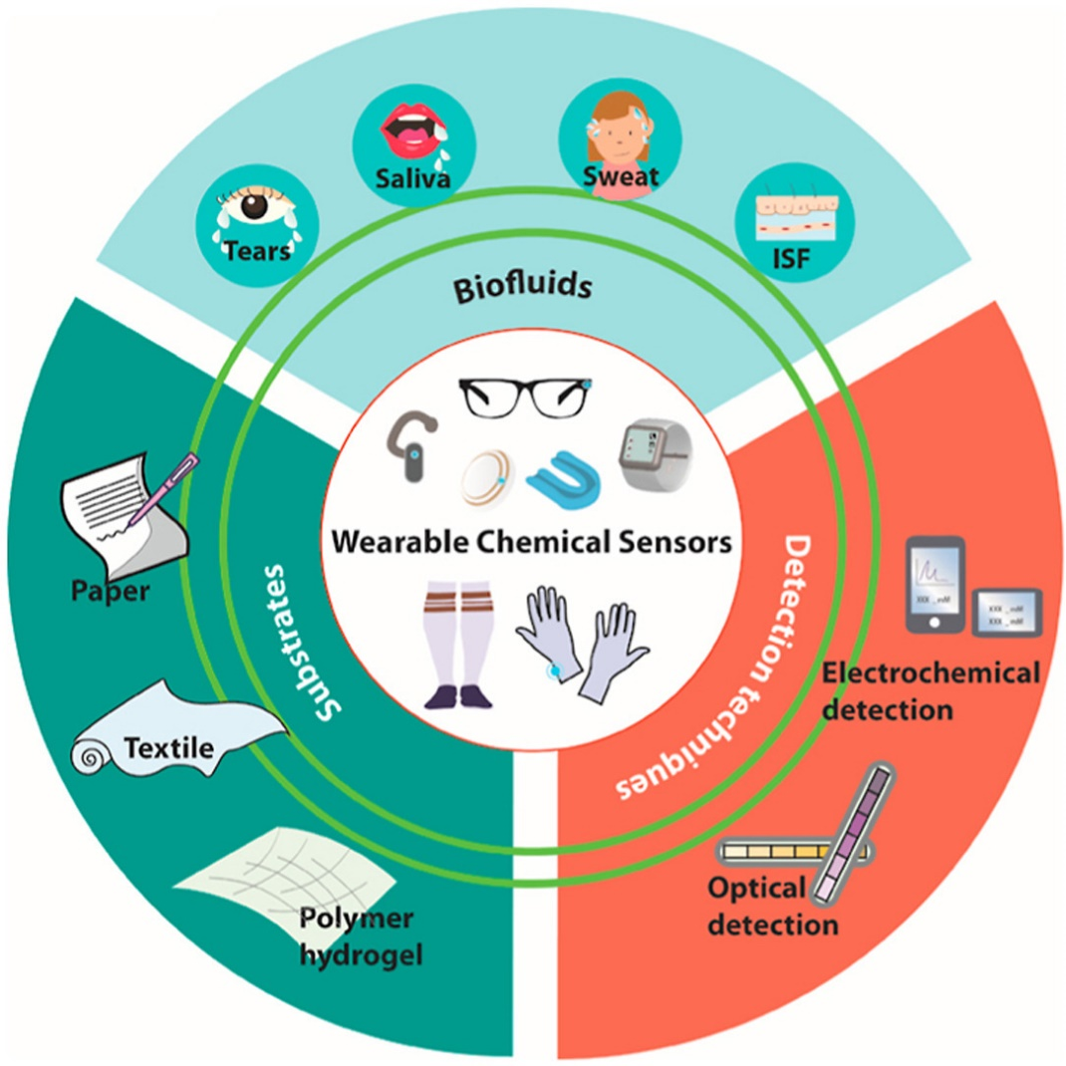
Chemical sensors
They quantify chemical markers, or analytes, in biological fluids and convert this information in an optical (optochemical sensor) or electrical signal (electrochemical sensor).
Require direct chemical interaction with the biomarker (contact sensors).
Wearable chemical sensors use non-invasive or minimally-invasive techniques to measure analytes in alternative biofluids instead of invasive blood sampling.
Biofluids secreted by the body (saliva, sweat, tears)
Interstitial fluid reached through minimally-invasive sensors or by reverse iontophoresis
When a new wearable chemical sensor is designed, the relationship between analyte concentration in the chosen biofluid and that in the traditional samples (e.g., blood) must be confirmed.

Slide 12
Sensor characteristics
To truly understand sensors, and how sensors that measure the same measurand can differ, it is necessary to understand sensor performance characteristics, which are reported in specifications (specs) or datasheet.
Systematic characteristics: those which can be exactly quantified by mathematical or graphical means;
Statistical characteristics: those which cannot be exactly quantified;
Dynamic characteristics: those characterizing the ways in which an element responds to sudden input changes.

Slide 13

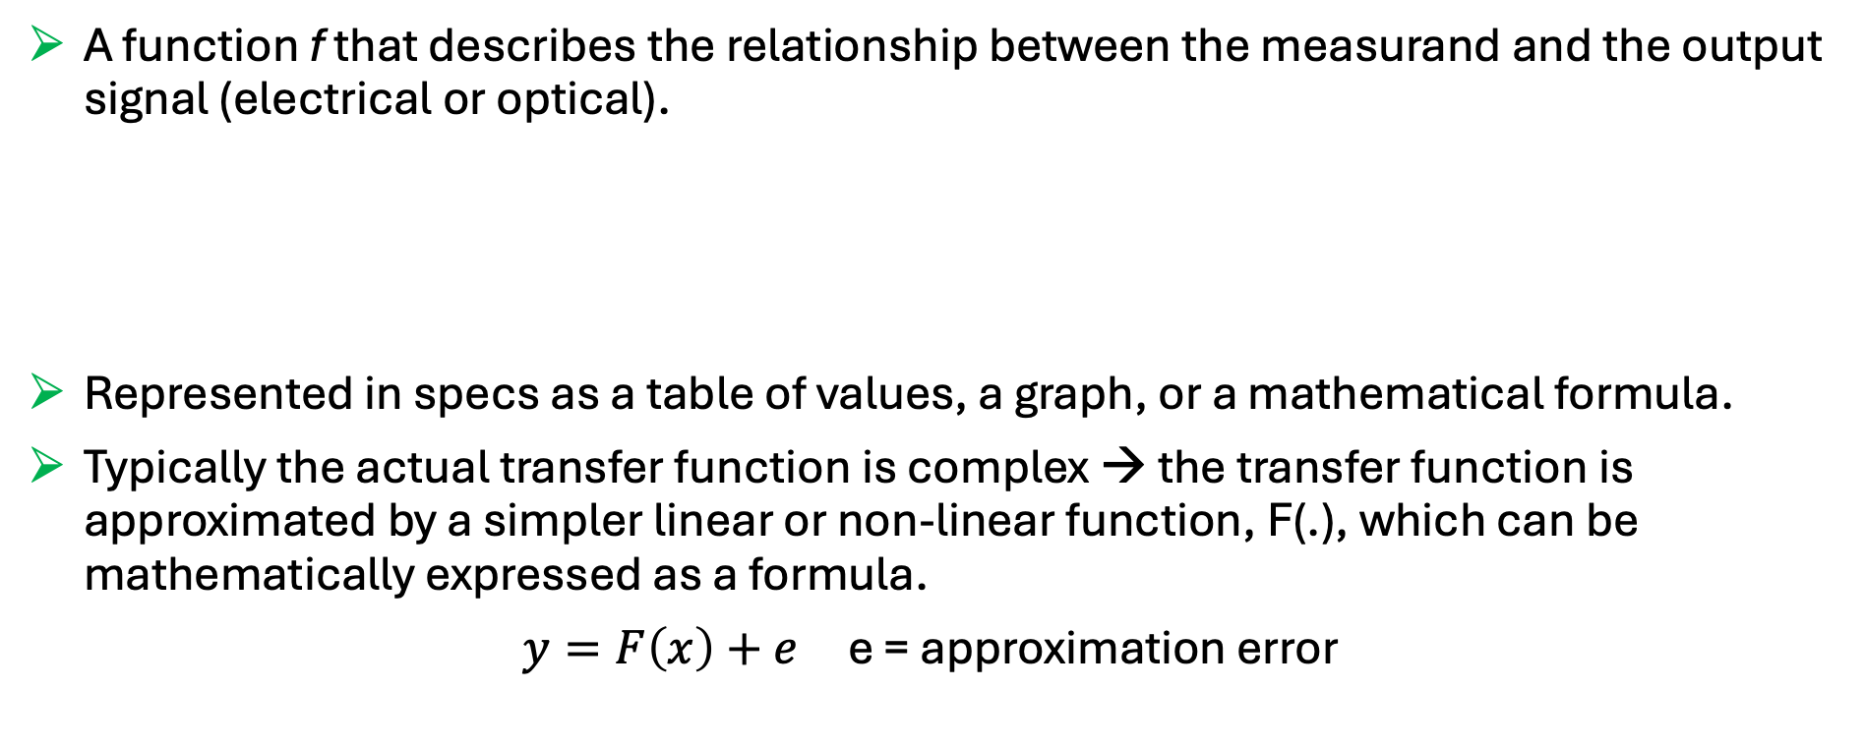
Transfer function
A function f that describes the relationship between the measurand and the output signal (electrical or optical).
Represented in specs as a table of values, a graph, or a mathematical formula.
Typically the actual transfer function is complex → the transfer function is approximated by a simpler linear or non-linear function, F(.), which can be mathematically expressed as a formula.
$y=F\left(x\right)+e$ e = approximation error
$$y=f(x)$$
Output electrical (or optical) signal
Measurand

Slide 14



Inverse transfer function
The embedded processing unit of the sensor device applies the inverse of F(.), F⁻¹(.), to convert the electrical signal generated by the sensing technique to output measurements in the same domain of the measurand.
Measurand
(e.g., glucose concentration)
Measurement (e.g., current in pA)
Glucose concentration mg/dl
Sensor
Approximated inverse transfer function
F⁻¹(y)
$$x$$
$$y$$
$$\hat{x}$$

Slide 15
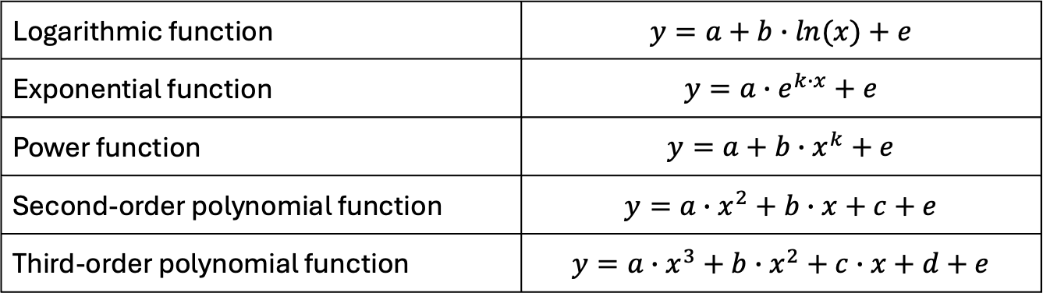

Common transfer function approximations
Linear transfer function approximation:
The offset, b, is the output value of the sensor when no measurand is applied. It is the component of the output signal which does not depend on the measurand.
The slope, a, represents the sensor sensitivity, i.e., the change in the sensor output resulting from a unit change in the input measurand.
Non-linear transfer function approximations:
$$y=a∙x+b+e$$
Logarithmic function | $$y=a+b∙ln(x)+e$$
Exponential function | $$y=a∙e^{k∙x}+e$$
Power function | $$y=a+b∙x^{k}+e$$
Second-order polynomial function | $$y=a∙x^{2}+b∙x+c+e$$
Third-order polynomial function | $$y=a∙x^{3}+b∙x^{2}+c∙x+d+e$$

Slide 16











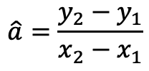
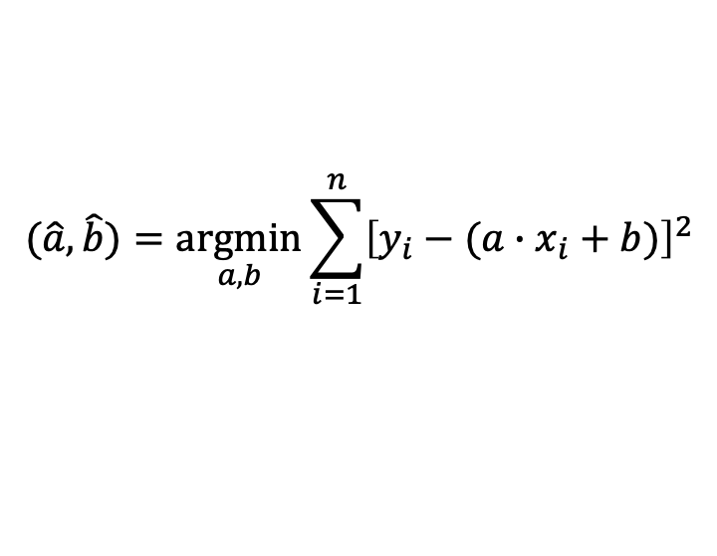
Calibration
The transfer function parameters, e.g., a and b in the linear transfer function, are in general unknown and must be estimated. This process is called calibration.
If a set of known (x,y) paired values are available, estimation of transfer function parameters can be performed by the least square approach.
For linear transfer function:
$$(\hat{a},\hat{b})=\underset{a,b}{argmin}{\sum_{i=1}^{n}{{\left[y_{i}−(a∙x_{i}+b)\right]}^{2}}}$$
Two-point calibration
Multiple-point calibration
$$y$$
$$y=\hat{a}∙x+\hat{b}$$
$$y$$
$$y=\hat{a}∙x+\hat{b}$$
$$y_{2}$$
$$\hat{a}=\frac{y_{2}−y_{1}}{x_{2}−x_{1}}$$
$$y_{1}$$
$$\hat{b}=y_{2}−\frac{y_{2}−y_{1}}{x_{2}−x_{1}}{∙x}_{2}$$
$$x_{1}$$
$$x_{2}$$
$$x$$
$$x$$

Slide 17
Embedded processing unit
The embedded processing unit is responsible for:
Performing local processing of the measurements
Storing some data in a local memory
Sending the data to another device (e.g., a display device or a gateway device for IoT systems)
Three main operations:
Denoising
Calibration
Fault detection
Sensor
Receiver device / Gateway device (for IoT devices)
Embedded processing unit

Slide 18
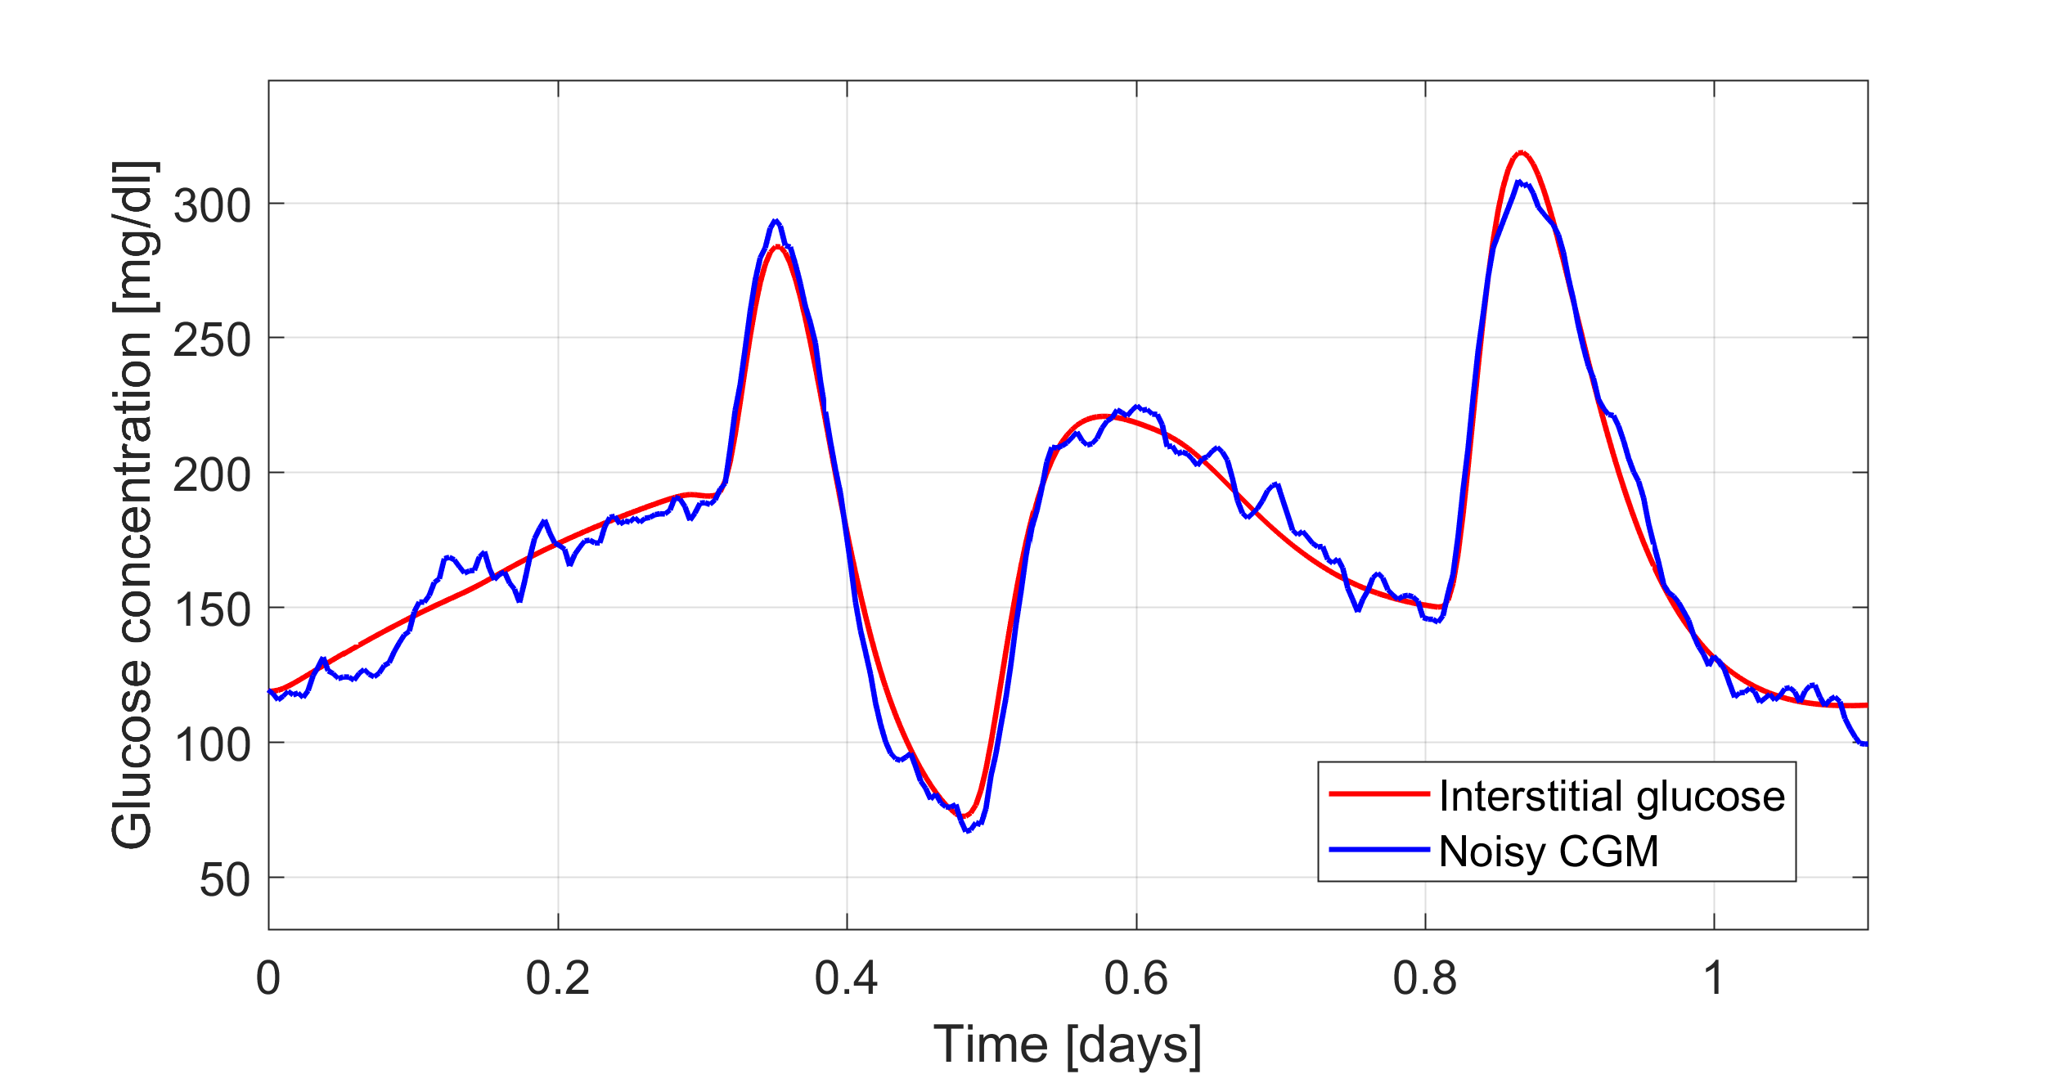
Denoising
Raw signals are often noisy: the signal of interest is corrupted by noise
Example: high-frequency noise on a CGM signal

Slide 19
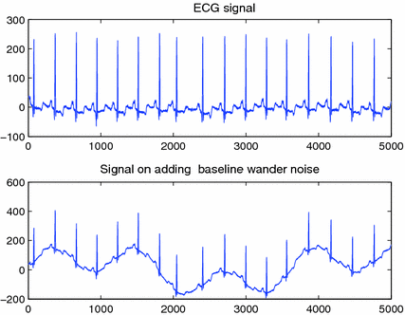
Denoising
Raw signals are often noisy: the signal of interest is corrupted by noise
Example: low-frequency noise (e.g., due to movement) on an ECG signal
Clean ECG signal
ECG signal corrupted by low-freq. noise

Slide 20
Denoising
The noise can be filtered by applying a denoising algorithm exploiting a digital filter.
Noisy signal
Clean signal
Denoising algorithm
(digital filter)
Non-causal filters: the filter output depends on past and future inputs → for offline use only
Causal filters: the filter output depends only on past and present inputs → suitable for online application

Slide 21
Fault detection
Detection of temporary sensor errors also called faults or artifacts
Example: pressure-induced signal suppression in a CGM signal
Measured signal
Artifact suppressed
Reconstructed signal
Fault detection algorithm
Signal reconstruction algorithm
(e.g. interpolation)

Slide 22
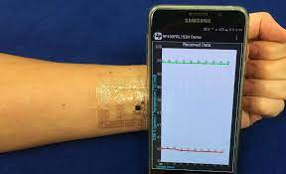
Communication systems
Wearable devices require a data transmission systems that wirelessly communicate between the sensing device and the receiver and/or gateway device (it can be the smartphone).
Bluetooth communication is the primary choice because of its simplicity, low operation cost, compatibility with new smartphone technology, and simple hardware. Drawback: it requires high power consumption.
Near field communication (NFC): a wireless communication technology that operates at a short distance (about 4 cm) and does not need the energy from the battery to transfer the data.
NFC tags can directly communicate with the smartphone equipped with the NFC modules.
Bypassing the need for batteries, NFC enables ultrathin, ultraminiaturized designs for sensors, like a temporary transfer tattoo.

Slide 23


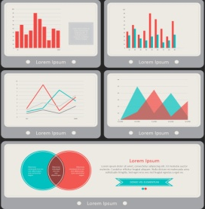

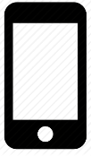

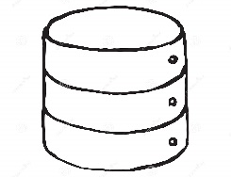

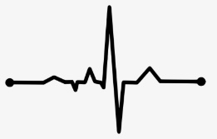
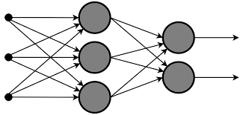
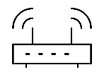
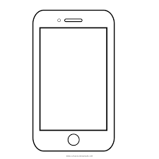
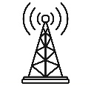
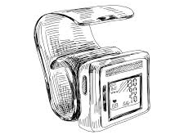
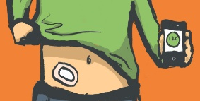

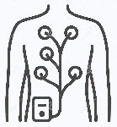
The architecture of wearable IoT systems
Alerts
Decision-support
Event log
Self-management
4. Application layer
Database
Data analyses
Signal processing
Modeling
3. Data storing and processing layer
Gateway device
WiFi,
Router
Internet
2. Network layer
GSM
Activity tracker
Sensors
ECG sensor
1. Sensing layer
Blood pressure sensor
Glucose sensor

Slide 24
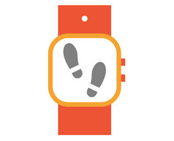

1. Sensing layer
This layer includes sensors, which are responsible for:
Collecting the data either directly from the body through contact sensors or from peripheral sensors providing indirect information of body and behaviours
Preparing the data for on-board analysis, closed-loop feedback or remote transmission for more comprehensive analysis and storing
Contact sensors
ECG sensor
Glucose sensor
Peripheral sensors
Step counter
Microphone and camera
Key components of IoT wearable sensors:
Miniaturized sensor hardware
Embedded processor with storage capabilities, power management and communication circuits
Typically, limited computing power and storage capabilities.

Slide 25

2. Network layer
Fore more comprehensive data analysis and storage, the sensor layer need to transmit the data to cloud computing servers (remotely-located computing machines).
This transmission can be mediated by a companion device that serves as a gateway, i.e., it enables the information to flow from sensors to the cloud server.
Example of gateway devices: smartphones, tablets and PCs.
The communication must be secured through:
Authentication protocols for writing, modifying and accessing the data
Security and privacy protocols for preserving the data
Sensor
Gateway device
Cloud server
Bluetooth
WiFi
GSM

Slide 26
3. Data storing and processing layer
Layer responsible for data storing and complex processing
Key components:
Database for structured data storing
Data organized based on a specific data model (relational, hierarchical, object-oriented,…)
Algorithms for data processing
Statistical analysis
Feature extraction (e.g., heart rate, calories expenditure, …)
Signal processing (e.g., filtering, artifact removal, …)
Data mining (e.g., cluster analysis, anomaly detection, sequential pattern extraction, …)
Data modeling (knowledge-based, data-driven or hybrid approaches)
Artificial intelligence (knowledge representation, machine learning, natural language processing, machine perception, automated planning, …)

Slide 27

3. Data storing and processing layer
Layer responsible for data storing and complex processing
Key components:
Database for structured data storing
Data organized based on a specific data model (relational, hierarchical, object-oriented,…)
Algorithms for data processing
Statistical analysis
Feature extraction (e.g., heart rate, calories expenditure, …)
Signal processing (e.g., filtering, artifact removal, …)
Data mining (e.g., cluster analysis, anomaly detection, sequential pattern extraction, …)
Data modeling (knowledge-based, data-driven or hybrid approaches)
Artificial intelligence (knowledge representation, machine learning, natural language processing, machine perception, automated planning, …)
Topic not covered

Slide 28
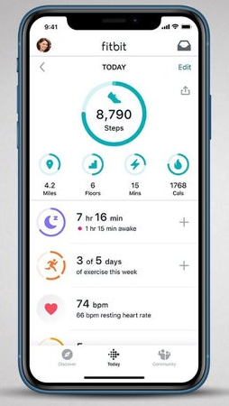
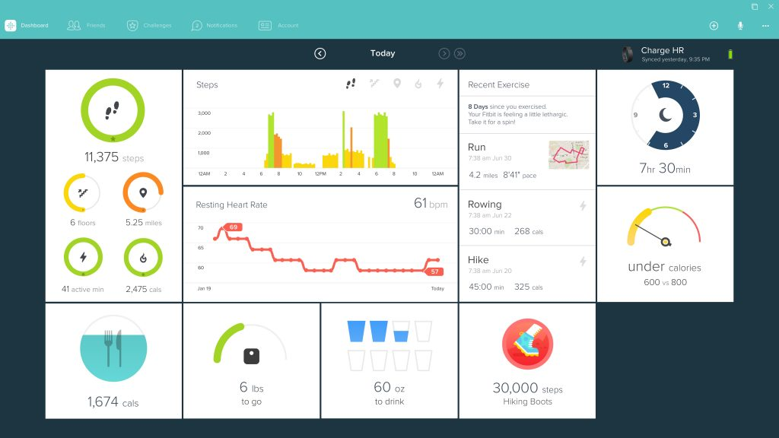

4. Application layer
Layer responsible for visualizing raw or processed data to end-users and for providing decision support to them through a software application
Possible end-users: patients, physicians, caregivers, analysts, data managers, administrators, etc.
Possible types of applications:
Mobile app
Desktop app
Web app
App installed in a mobile device (e.g. smartphone, smartwatch, tablet, etc.)
App installed in a computer. It can work offline.
App that runs on the browser.
Installation not required. Internet access required.

