Slide 1
Introduction

Slide 2
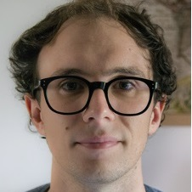
Who am I
Giacomo Cappon
Assistant Professor, Department of Information Engineering, University of Padova
PhD in Information Engineering, curriculum Bioengineering
Main research interests: signal processing; decision support systems; wearable sensors; digital health; ai for medicine
Contacts
email: giacomo.cappon@unipd.it
personal website: https://gcappon.github.io
public repos: https://github.com/gcappon

Slide 3
What is the course about?
Biomedical wearable technologies…
E-health or digital health: The use of modern Information and Communication Technologies (ICT) to efficiently deliver all kinds of healthcare services
Examples: EHR, telemedicine systems
Wearables: electronic devices worn close to and/or on the surface of the skin, which detect, analyze and transmit biomedical data, such as heart rate, activity, blood pressure, temperature, etc.
Internet-of-thing (IoT) wearables: Wearables that connect and exchange data with other devices (wearable or not) and systems over the Internet or other communication networks
E-health
Wearables
IoT wearables

Slide 4
What is the course about?
… for healthcare and wellbeing
Our society is facing some important global health challenges
Lifestyle-related illnesses driven by sedentary life, consumption of processed and fast foods, alcohol drinking and smoking
Need to change the paradigm of healthcare, from a mostly reactive system to a proactive system
Population ageing rises the demand of health services and the healthcare expenditure.
Need to decentralizing the healthcare
Covid-19 pandemic called for urgent delivery of healthcare at home
Biomedical wearable technologies are fundamental to make healthcare scalable and accessible outside the hospital setting and deliver personalized and preventive health services

Slide 5
Theory program
The theoretical part of the course will cover the following:
Wearable sensor technologies
Health design thinking
Elements of UI/UX Design
Evaluation of app usability
Fundamentals of network architectures and the HTTP communication protocol
The representational state transfer (REST) paradigm
Application programming interfaces (APIs)
Elements of network security
Authentication protocols
Regulation for health data management

Slide 6
Lab program
The laboratorial part of the course will cover the following:
The Git version control system
Dart programming language and the Flutter framework
Building mobile/web applications in Flutter
User Interface design
Navigation
State management
Basic data persistence
Networking
Integrating AI models in mobile applications
Workshop…

Slide 7
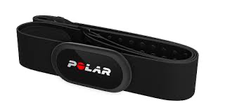
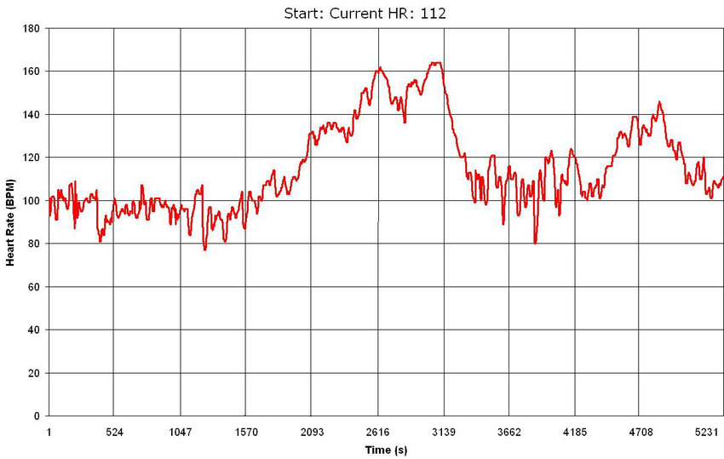
Lab program - The workshop
2-hours workshop where we will set up a fake clinical trial aimed at evaluating the cardiovascular tone in a cohort of healthy subjects using an experimental algorithm
The fastest 5 students to submit the right answer will get a +1 to the final evaluation.
1. Trial setup
2. Data collection using a wearable and an app
Together
3. Data preparation
4. Data analysis
Individually
5. Trial outcome

Slide 8


Prerequisites & End of class goals
Prerequisites
Basic:
Propension for programming, Python
Preferable:
Object-oriented programming
End of class goals
Knowing how wearable devices communicates to the end-user
Designing digital solutions to enhance healthcare and well-being
Developing a fully functioning mobile application

Slide 9
The exam
Written test: Theory exam
4 open questions
Duration: 90 min
Max vote: 20/30
Project: Development of an application that integrates and elaborates data from a smartwatch. To be done in groups of 3 students.
Duration of the discussion: 45 min (25 min presentation + 20 min Q&A)
Max vote: 12/30
Final mark: sum of the votes of the written test and the project.
Dates of the written test
First attempt: 18 Jun 2026, 14:00 (Room Me+Ne)
Second round: 07 Jul 2026, 14:00 (Room De)
Third round: 28 Aug 2026, 14:00 (Room De)
Fourth round: 01 Feb 2027, 14:00 (Room Ee)

Slide 10
Project: What’s the spirit here
The goal is learning “How to do SOMETHING ORIGINAL using wearable devices”
What I DO expect from you
To use your imagination to create that SOMETHING
To learn to build something from scratch
To use code built by others
To work together
To use Google and StackOverflow
What I DO NOT expect from you
To create the new Google
To reinvent the wheel (copying others code is fine)
To create extra complicated UI with animations and stuff

Slide 11




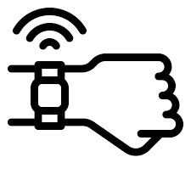
Project structure
The project consists of building an app for iOS or Android that collects user data from a wearable device through Web APIs, visualizes them, and does some tricks with them.
Core functionalities:
Correct app flow
User authentication and management
Data collection
Data visualization and presentation
Additional fuctionalities → It’s up to you! Some examples:
Run some analysis on data and provide suggestions to the user
Implement some literature algorithm
…

Slide 12
Grading
What are the grading criteria
Compliance to core functionalities
Originality of the additional feature
Quality of teamwork
How much these criteria matter?
Core functionalities: 40%
Additional app functionalities: 50%
Quality of teamwork: 10%

Slide 13

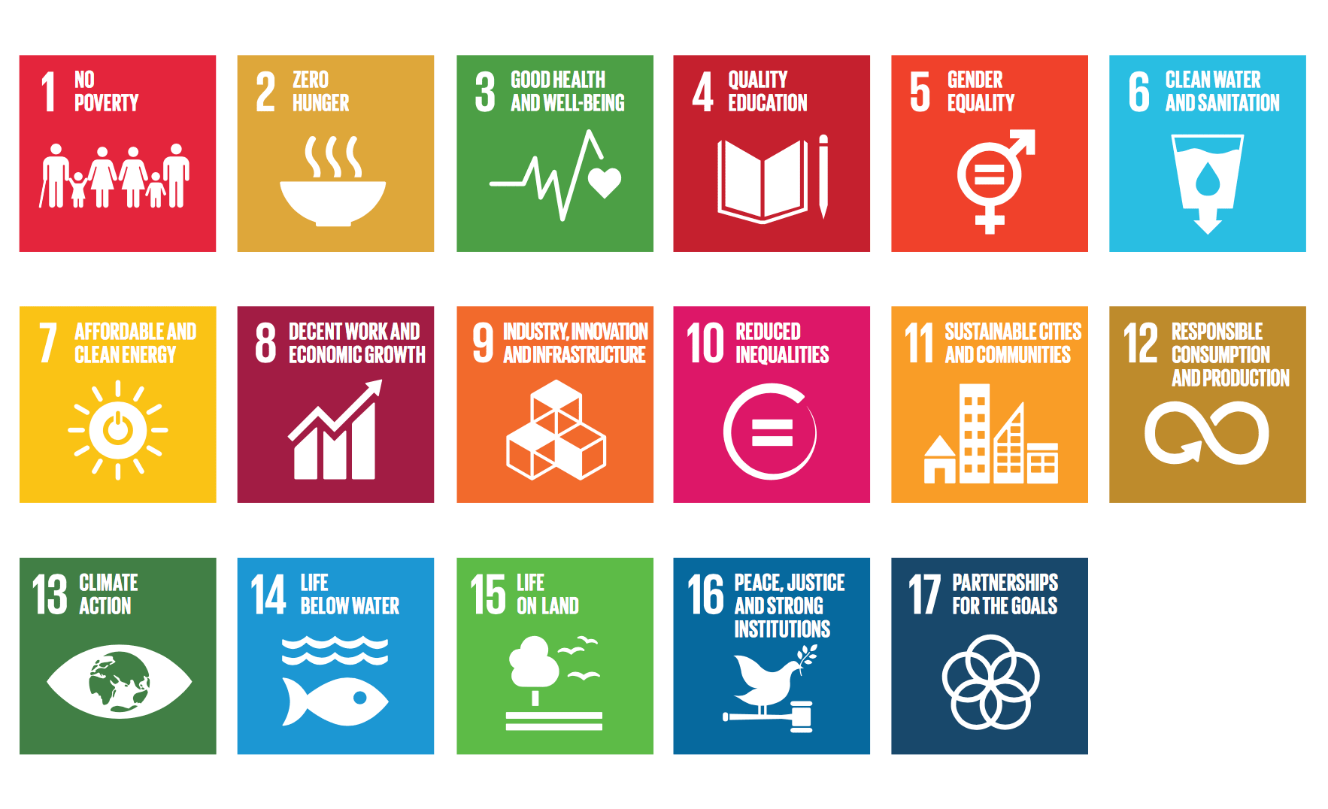
Choose your target
Your app must represent a solution for the current SDGs (Sustainable Development Goals) targets
SDG are 17 topics representing the current big challenges humanity must face and solve

Slide 14
Choose your target
These are the target you can choose from (see the elearning page for more details):
SDG 2: Target 2.2 (By 2030, end all forms of malnutrition, including achieving, by 2025, the internationally agreed targets on stunting and wasting in children under 5 years of age, and address the nutritional needs of adolescent girls, pregnant and lactating women and older persons)
SDG 2: Target 2.3 (By 2030, double the agricultural productivity and incomes of small-scale food producers, in particular women, indigenous peoples, family farmers, pastoralists and fishers, including through secure and equal access to land, other productive resources and inputs, knowledge, financial services, markets and opportunities for value addition and non-farm employment)
SDG 3: Target 3.4 (By 2030, reduce by one third premature mortality from non-communicable diseases through prevention and treatment and promote mental health and well-being)
SDG 3: Target 3.5 (Strengthen the prevention and treatment of substance abuse, including narcotic drug abuse and harmful use of alcohol)
SDG 4: Target 4.7 (By 2030, ensure that all learners acquire the knowledge and skills needed to promote sustainable development, including, among others, through education for sustainable development and sustainable lifestyles, human rights, gender equality, promotion of a culture of peace and non-violence, global citizenship and appreciation of cultural diversity and of culture’s contribution to sustainable development)
SDG 8: Target 8.9 (By 2030, devise and implement policies to promote sustainable tourism that creates jobs and promotes local culture and products)

Slide 15
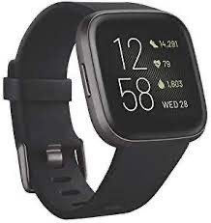
Data source
Data that you will use are collected by me using a Fitbit Versa 2
Data are available starting from 09/02 and will be collected up to 30/11
The following data “types” are included(see mor details in the Appendix):
Calories
Distance
Exercise sessions
Heart rate
Resting heart rate (Estimated)
Sleep
Steps
Your project must use at least 1 type of data

Slide 16


How to get data - The IMPACT backend
HTTP requests/responses
https://impact.dei.unipd.it/bwthw/
Your app
You will be provided with credentials (different for each group) and learn how to get data during the lab lessons

Slide 17
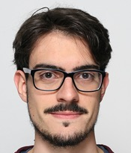
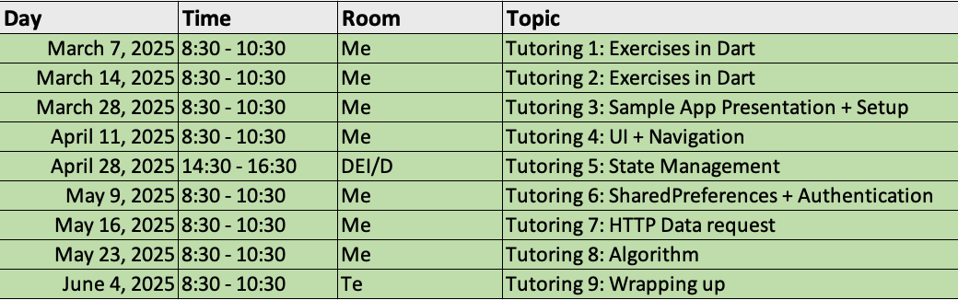
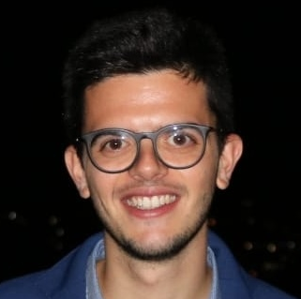
Optional tutoring activities
Need help? They are here to cover your back with answers and optional tutoring activities
Calendar of the optional tutoring activities
Luca Cossu
luca.cossu@phd.unipd.it
Alberto Gastaldello
alberto.gastaldello.2@phd.unipd.it

Slide 18




Discord server
Join the Discord server to get in touch and ask questions
Link: https://discord.gg/j76A3D27bm

Slide 19
Appendix: Data source characteristics

Slide 20
Focus on data – Calories
Calories: a list with 1 data point exactly every minute
Fields meaning:
time: timestamp (hh:mm:ss format) of the calory entry
value: the calories spent during the last 1 minute (rest + active)
[
{
"time": "00:00:00",
"value": "1.29"
},
{
"time": "00:01:00",
"value": "1.29"
},
{
"time": "00:02:00",
"value": "1.29"
},
{
"time": "00:03:00",
"value": "1.55"
},
{
"time": "00:04:00",
"value": "1.29"
},
{
"time": "00:05:00",
"value": "1.29"
},
{
"time": "00:06:00",
"value": "1.29"
},
...
]

Slide 21
Focus on data – Distance
Distance: a list with 1 data point every minute or more depending on user’s movement
Fields meaning:
time: timestamp (hh:mm:ss format) of the distance entry
value: the distance travelled between the last timestamp and now (in cm)
[
{
"time": "00:03:00",
"value": "0"
},
{
"time": "00:50:00",
"value": "0"
},
{
"time": "01:28:00",
"value": "0"
},
{
"time": "01:32:00",
"value": "1440"
},
{
"time": "01:33:00",
"value": "3110"
},
{
"time": "01:34:00",
"value": "0"
},
{
"time": "01:53:00",
"value": "0"
},
{
"time": "03:09:00",
"value": "0"
},
...
]

Slide 22
Focus on data – Steps
Steps: a list with 1 data point every minute or more depending on user’s movement
Fields meaning:
time: timestamp (hh:mm:ss format) of the step entry
value: the number of steps done between the last timestamp and now
Note: there can be days without data
[
{
"time": "00:07:00",
"value": "0"
},
{
"time": "00:10:00",
"value": "0"
},
{
"time": "01:57:00",
"value": "0"
},
{
"time": "02:29:00",
"value": "0"
},
{
"time": "02:40:00",
"value": "0"
},
{
"time": "02:57:00",
"value": "11"
},
{
"time": "02:58:00",
"value": "18"
},
{
"time": "02:59:00",
"value": "0"
}, ...
]

Slide 23
Heart rate
Heart rate: a list with 1 data point every 5 seconds.
Fields meaning:
time: timestamp (hh:mm:ss format) of the heart rate entry
value: the heart rate at the current time (in bpm)
confidence: a number from 0 to 3 defining how much the reading is reliable (this problably depends on user movement, etc. You can ignore it)
Note: there can be missing values
[
{
"time": "03:10:19",
"value": 58,
"confidence": 1
},
{
"time": "03:10:24",
"value": 54,
"confidence": 3
},
{
"time": "03:10:29",
"value": 52,
"confidence": 3
},
{
"time": "03:10:44",
"value": 52,
"confidence": 3
},
{
"time": "03:10:54",
"value": 53,
"confidence": 3
},
{
"time": "03:11:09",
"value": 54,
"confidence": 3
},
{
"time": "03:11:19",
"value": 53,
"confidence": 3
}, ...
]

Slide 24
Resting heart rate
Resting heart rate: an entry per day.
Fields meaning:
time: timestamp (hh:mm:ss format) of the resting heart rate entry (always 00:00:00)
value: the estimated resting heart rate at the current time (in bpm)
error: the estimate error (in %) (Can be ignored)
Note: there can be days without data
{
"time": "00:00:00",
"value": 51.35,
"error": 17.86
}

Slide 25
Exercise
[
{
"activityName": "Corsa",
"averageHeartRate": 143,
"calories": 727,
"distance": 8.474117,
"distanceUnit": "Kilometer",
"duration": 3.548E+6,
"activeDuration": 3.214E+6,
"steps": 8604,
"logType": "tracker",
"heartRateZones": [
{
"name": "Fuori zona",
"min": 30,
"max": 110,
"minutes": 3,
"caloriesOut": 30.146219999999971
},
{
"name": "Grassi bruciati",
"min": 110,
"max": 137,
"minutes": 8,
"caloriesOut": 97.13782
},
{
"name": "Attivita aerobica",
"min": 137,
"max": 170,
"minutes": 48,
"caloriesOut": 659.73843
},
{
"name": "Picco",
"min": 170,
"max": 220,
"minutes": 0,
"caloriesOut": 0
}
],
"speed": 9.4981754822650917,
"vo2Max": {
"vo2Max": 48.77853
},
"elevationGain": 28.042,
"time": "11:22:43"
},
Exercise: a list with 1 entry for each recorded exercise session
Fields meaning:
activityName: the type of entry (“Corsa”: Run, “Bici”: bike, “Camminata”: Walk)
averageHeartRate: the average heart rate during the session
calories: the active calories spent during the session
distance: the distance covered during the session
distanceUnit: the unit of the “distance” field
duration: the total duration of the session (in ms)
activeDuration: the total active duration of the session (in ms)
steps: the total number of steps done during the session (if “Corsa” or ”Camminata”)
logType: how this record was logged (“tracker” or “auto_detected”)
heartRateZones: a list that summarizes the number of minutes and calories spent in specific heart rate ranges (from min to max)
speed: the average speed (in km/h)
vo2max: the estimated running VO2Max (only for “Corsa” activities)
elevationGain: the elevation gained during the session
time: the starting time of the session (format hh:mm:ss)
Note: different activity types can have (slightly) different fields
Note: there can be days without data
{
"activityName": "Bici",
"averageHeartRate": 150,
"calories": 3893,
"distance": 140.143695,
"distanceUnit": "Kilometer",
"duration": 2.0901E+7,
"activeDuration": 1.756E+7,
"logType": "tracker",
"heartRateZones": [
{
"name": "Fuori zona",
"min": 30,
"max": 110,
"minutes": 28,
"caloriesOut": 214.83527999999842
},
{
"name": "Grassi bruciati",
"min": 110,
"max": 136,
"minutes": 64,
"caloriesOut": 664.55027999999993
},
{
"name": "Attivita aerobica",
"min": 136,
"max": 170,
"minutes": 232,
"caloriesOut": 3167.1500100000012
},
{
"name": "Picco",
"min": 170,
"max": 220,
"minutes": 24,
"caloriesOut": 377.76059999999995
}
],
"speed": 28.734978587699313,
"elevationGain": 663.55,
"time": "11:03:54"
},...
]

Slide 26
Sleep
Sleep: a list with 1 entry for each sleep session
Fields meaning:
dateOfSleep: day associated to the sleep entry (MM-DD format)
startTime: the starting timestamp of the sleep (MM-DD hh:mm:ss format)
endTime: the ending timestamp of the sleep (MM-DD hh:mm:ss format)
duration: the duration of the sleep session (in ms)
minutesToFallAsleep: the number of minutes spent to fall asleep
minutesAsleep: the number of minutes asleep during the sleep entry
minutesAwake: the number of minutes awake during the sleep entry
minutesAfterWakeup: the number of minutes the user spent in bed after waking up
efficiency: the estimated sleep efficiency (from 0 to 100)
logType: how the entry was logged (always “auto_detected”)
mainSleep: a boolean indicating if the entry corresponds to the main sleep session
levels: a summary of the sleeping stages (deep/wake/light/rem/restless) during the sleep session
data: the stage profile of the sleep session. Each entry contains the starting timestamp, the level, and how much it lasted.
Note: there can be days without data
[
{
"dateOfSleep": "02-14",
"startTime": "02-13 22:44:00",
"endTime": "02-14 06:36:30",
"duration": 2.832E+7,
"minutesToFallAsleep": 0,
"minutesAsleep": 429,
"minutesAwake": 43,
"minutesAfterWakeup": 3,
"timeInBed": 472,
"efficiency": 96,
"logType": "auto_detected", ”mainSleep": true,
"levels": {
"summary": {
"deep": {
"count": 5,
"minutes": 106,
"thirtyDayAvgMinutes": 86
},
"wake": {
"count": 34,
"minutes": 43,
"thirtyDayAvgMinutes": 46
},
"light": {
"count": 28,
"minutes": 235,
"thirtyDayAvgMinutes": 281
},
"rem": {
"count": 11,
"minutes": 88,
"thirtyDayAvgMinutes": 101
}
},
"data": [
{
"dateTime": "02-13 22:44:00",
"level": "wake",
"seconds": 30
},
{
"dateTime": "02-13 22:44:30",
"level": "light",
"seconds": 150
},
{
"dateTime": "02-13 22:47:00",
"level": "deep",
"seconds": 1860
}, ... },
...
]

