Slide 1
Giacomo Cappon
Git

Slide 2
Outline
Version Control Systems & GIT
Playing with GIT
The working tree
Remote repositories and best practices
Homework
Resources

Slide 3


New features means new code
When you are developing/maintaining a software, sometime new features need to be added
This translates in multiple software (AKA code) versions
v1.0
v1.1
v2.0
…
v2.6

Slide 4

Dealing with code versions: The naïve solution
How to deal with multiple code versions?
The simple (naïve) solution is to “make a folder for each code version”
Question: What are the problems here?
v1.0
v1.1
v2.0
…
v2.6

Slide 5
Problems of the “multiple folders” approach
Very error prone approach
Teams are not able to collaborate (have to manually send the code, who to blame for bug introduction? How to merge changes?)
Lot of disk space required
“Where is my code? Which is which?” situations
…

Slide 6

The gold standard: Version control systems
The gold standard to deal with this issue is to use a version control system (VCS)
VCS are softwares that allow to
track the code “history”
work together on the same code
jump between code versions
fix bugs efficiently
…
Everything (code changes, contributors, deltas,…) is stored in a dedicated repository
A repository can be stored locally or remotely (in remote repository databases) and connected to the code contributor machine
Repository

Slide 7

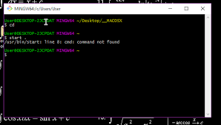
The most popular VCS is GIT. Created by Linus Torvalds in 2005, it is a free, open source, fast, and scalable solution.
We will use GIT in this course
GIT can be used via
Fancy Graphical User Interface (GUI)
Old-school terminal command line
In this course we will use the command line. Why?
GUI have limitations
GUI tools are not always available (e.g., remote servers)

Slide 8
GIT workflow
Working directory
Repository
Staging area
Working directory: where the code is.
Staging area: where you put the “new code” that you want to become the next code version.

Slide 9
GIT workflow
Working directory
(with some modifications)
Repository
Staging area
While you are working, you may decide that the code reached a state that you want to record (might be a new feature, a new release of the code, a bug fix, …)

Slide 10
GIT workflow
Working directory
(with some modifications)
Repository
Staging area
Step 1: stage that code!

Slide 11
GIT workflow
Commit
Working directory
(new version)
Repository
Staging area
Step 2: make a commit! Making a commit is like taking a snapshot of the code as it is now.

Slide 12
GIT workflow
Working directory
(new version)
Repository
Staging area
This frees the staging area and creates a new code version, which now includes .

Slide 13
Outline
Version Control Systems & GIT
Playing with GIT
The working tree
Remote repositories and best practices
Homework
Resources

Slide 14
Getting started – Our case of study
To get familiar with GIT and learn its functionalities we will start with a simple case of study consisting of several steps:
Create a new project folder with a .txt file inside
Create a new repository
Track file history
Commit file in the repository
Check the (new) repository history
Make, check, and commit modifications

Slide 15
Step 1: Create folder and file
Open the terminal
Create a directory wherever you want named “git-test” and move inside it
>> mkdir git-test && cd git-test
Open some text editor and create a file named “text.txt” containing the following text hello world
Save text.txt. Now we are ready to play with GIT.

Slide 16
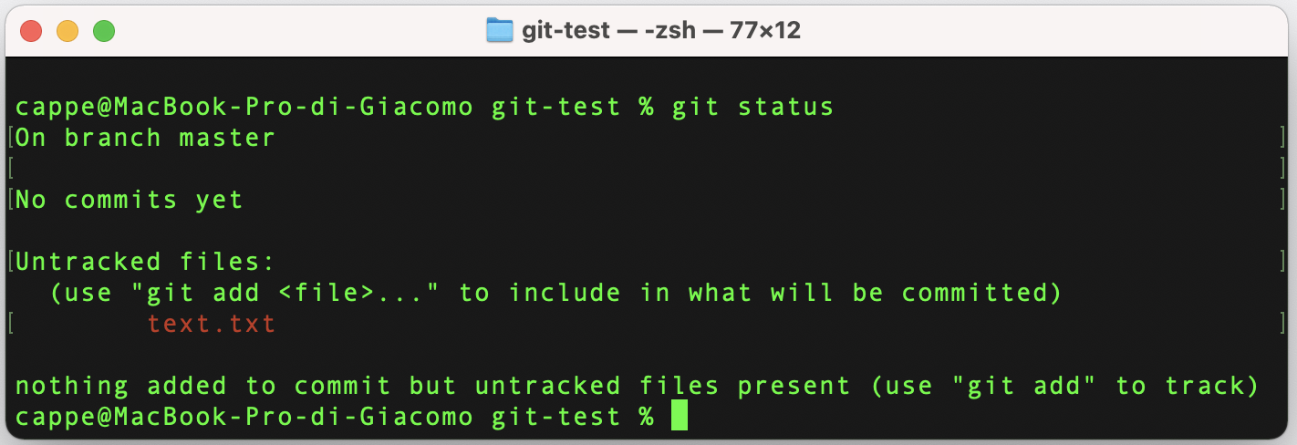
Step 2: Create a new repository
To create a repository of our project folder, simply write (be sure to be inside “git-test”: >> git init
A new hidden folder called “.git”, will be created
Now let’s check what we have done using the “git status” command

Slide 17
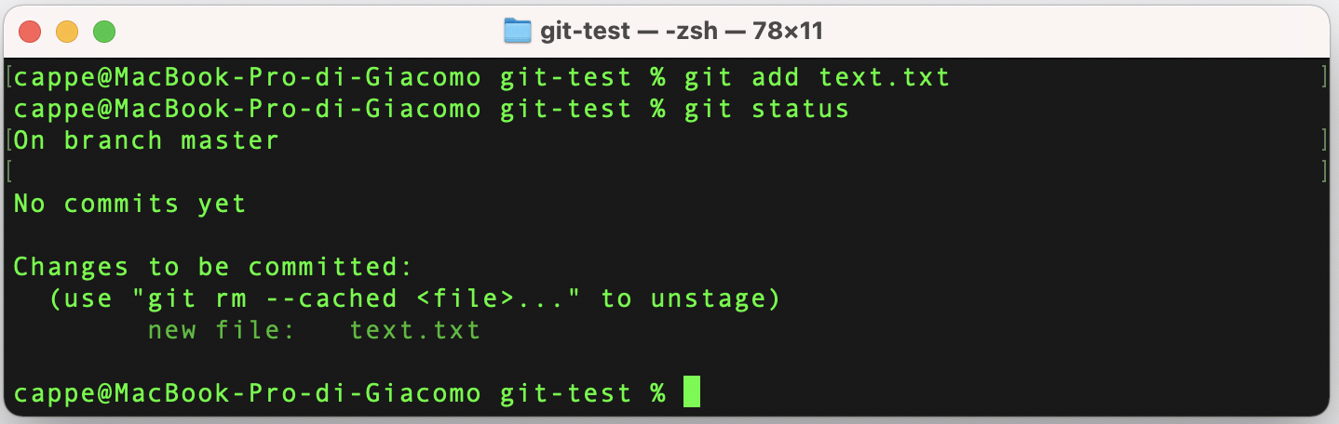
Step 3: Track the file history
To track and stage “text.txt” use the “git add” command >> git add text.txt
Alternatively, you can use ”git add *” to add all files in the project folders
Check the status of the repository

Slide 18
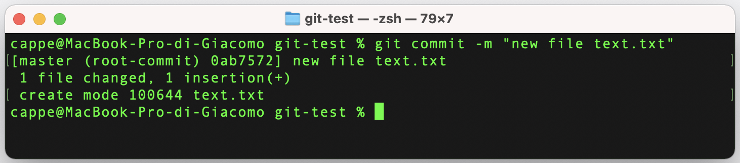
Step 4: Commit the file
To commit the file >> git commit –m “new file text.txt”
Note that we added a message! This should be meaningful.

Slide 19
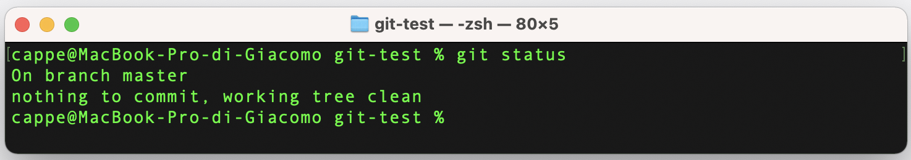
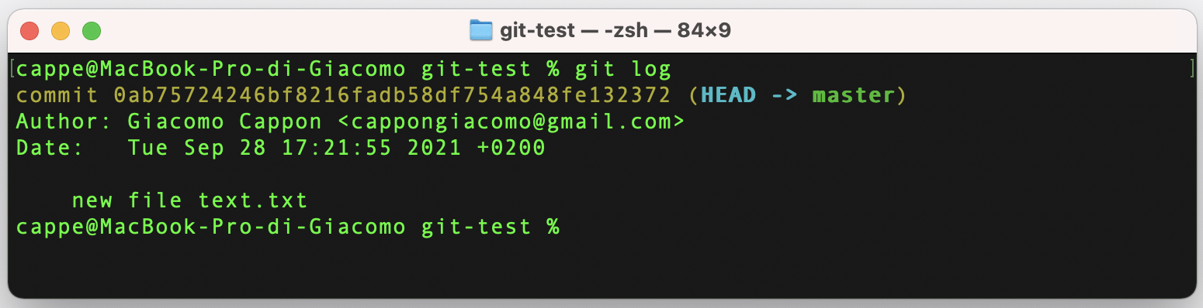
Step 5: Check the new history
Check what we have done using the “git status” command
Even more things with “git log”

Slide 20
Step 6: Make, check and commit modifications
Now let’s modify text.txt as Hello, world!
And try to do the following operations
Check the status (git status command)
Stage the modifications (git add command)
Commit the new modifications (git commit command)
I’ll give you 10 minutes to do that

Slide 21
More features: stash and reset
BONUS
A useful command is “git stash” which stores the current code changes in a stacked temporary working directory and restores the code to the previous valid status.
Try the basics (git stash push, git stash pop)
More functionalities in https://git-scm.com/docs/git-stash
Another useful command is “git reset” which clears the staging area.
Try the basics (git reset --hard)
More functionalities in https://git-scm.com/docs/git-reset

Slide 22
Outline
Version Control Systems & GIT
Playing with GIT
The working tree
Remote repositories and best practices
Homework
Resources

Slide 23
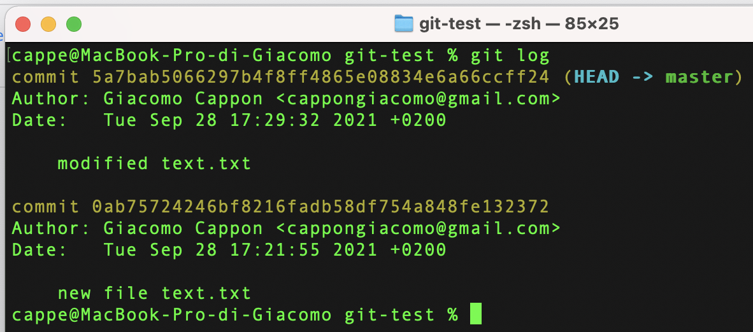
GIT core: The working tree
Let’s zoom in. What we have actually done?

Slide 24
GIT core: The working tree
The repository tracks the history thanks to a tree-based structure called working tree which memorizes the filesystem of all code versions.
The working tree has a main branch called master.
Every commit is associated to a unique hash code.
GIT moves through the working tree using the HEAD pointer.
HEAD
master
0ab757…
5a7bab…

Slide 25
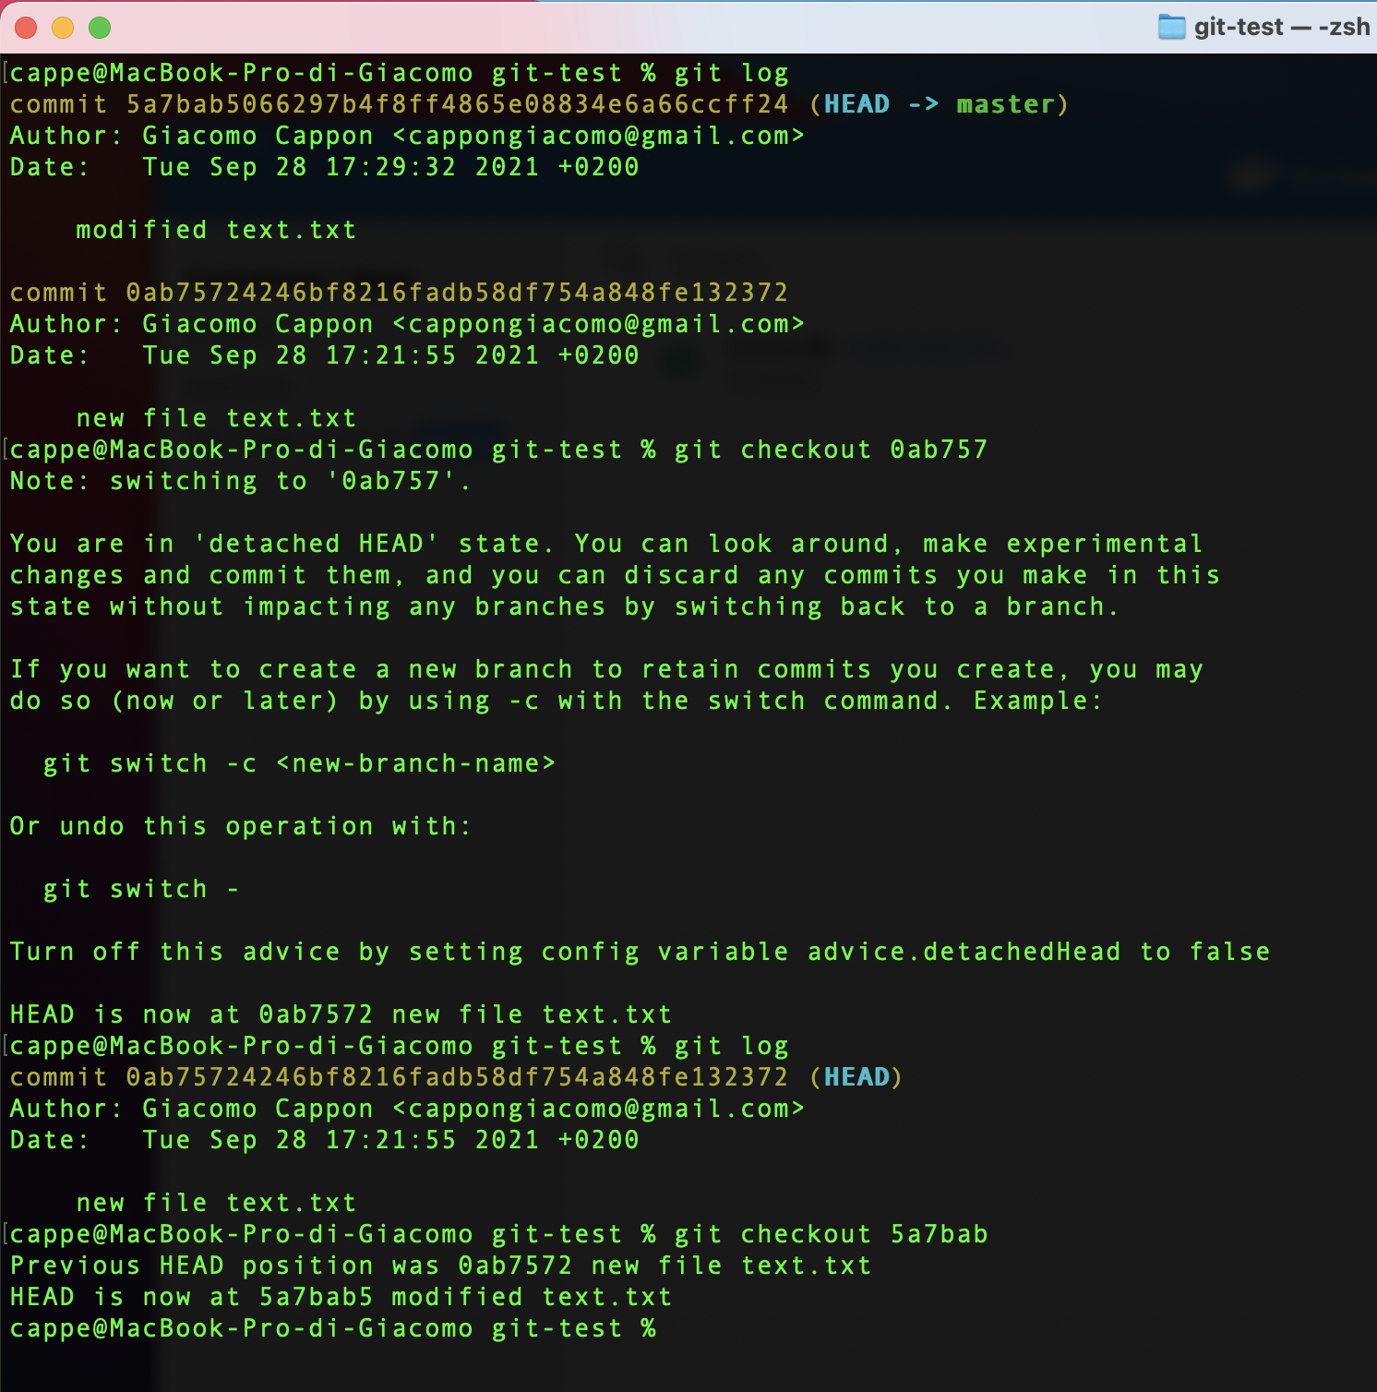
Moving through the working tree
Move through the working tree using the “git checkout” command
HEAD
master
0ab757…
5a7bab…
>> git checkout 0ab757
HEAD
master
0ab757…
5a7bab…
>> git checkout 5a7bab
HEAD
master
0ab757…
5a7bab…

Slide 26
Branching
We have a tree -> We have branches
Branching is one the greatest features of GIT and allows to create parallel branches to master and start working from there without modifying the other branches (master included).
Why this is game changer? Because now you can
Work together on parallel branches
Test functionalities in dedicated branches without affecting the main code
Fix bugs efficiently
a branch
master
another branch

Slide 27
Create new branches
To create a branch from the current commit you can use the “git branch” command >> git branch devel
Now this is our working tree:
We have a new branch called devel
devel is currently empty
HEAD points to the latest commit
If a new commit occurs this will be our working tree:
HEAD
devel
master
0ab757…
5a7bab…
HEAD
devel
New commit
master
0ab757…
5a7bab…

Slide 28
Navigate between branches
To navigate between branches, it is sufficient to use “git checkout <branch>”: >> git checkout master >> git checkout devel
IMPORTANT: if you have made some modifications, before navigating to another branch, you have to stash or commit those changes first.
HEAD
devel
master
0ab757…
5a7bab…

Slide 29
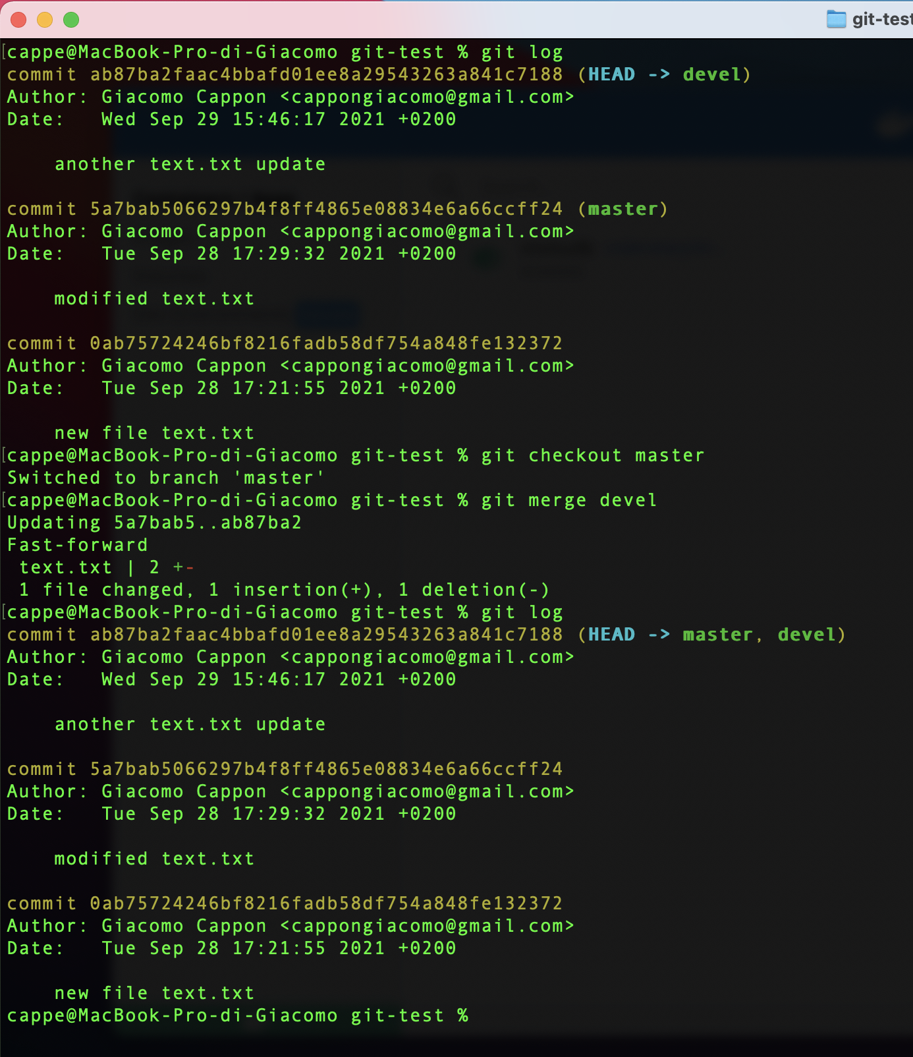
Merging branches
How to apply the changes I made in branch (e.g., devel) to another (e.g., master)?
You need to merge the first branch (devel) into the other (master) using the command “git merge <branch>” which allows to apply the <branch> history in the current one.

Slide 30
Merging branches
We have two scenarios:
Scenario 1 (like in the example):
Scenario 2 (someone altered the parent branch):
devel
master
devel
master

Slide 31
Steps to reproduce Scenario 1
BONUS
devel
Starting from the master branch do the following
In the terminal
>> git checkout devel
In the text editor
modify text.txt and save
In the terminal
>> git add *
>> git commit –m “[devel] another text.txt update”
>> git checkout master
>> git merge devel
>> git log
master
This moves us to the devel branch
This creates the update
This creates the new commit in the devel branch
This gets us back to the master branch
This applies all the new commits in the devel branch to the master branch

Slide 32
Managing scenario 2
Scenario 2 is tricky (and the most common)
It can happen that someone changed the same lines of code!
In this case you need to solve the conflicts manually. Let’s see how in a representative example
devel
master

Slide 33
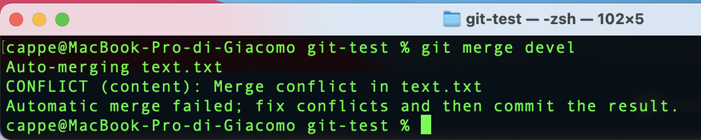
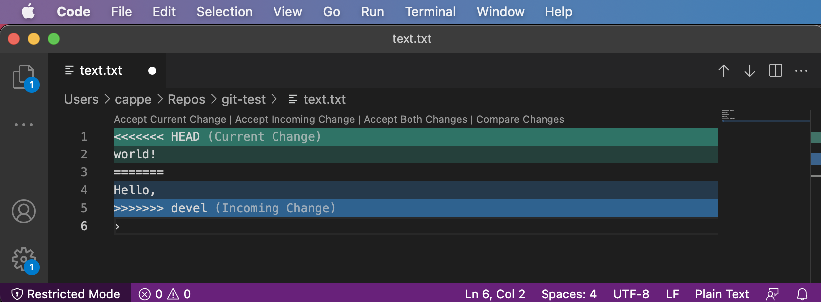
Managing scenario 2
GIT asks us to fix the conflicts and then commit once solved. So let’s do it.
Visual Studio Code (IDE of our course, see later slides) will look like this.
The software is helping us in managing the conflicts. Simply chose between “Accept current change” if you want to leave text.txt as in master or “Accept incoming change” if you want to set that line as in devel

Slide 34
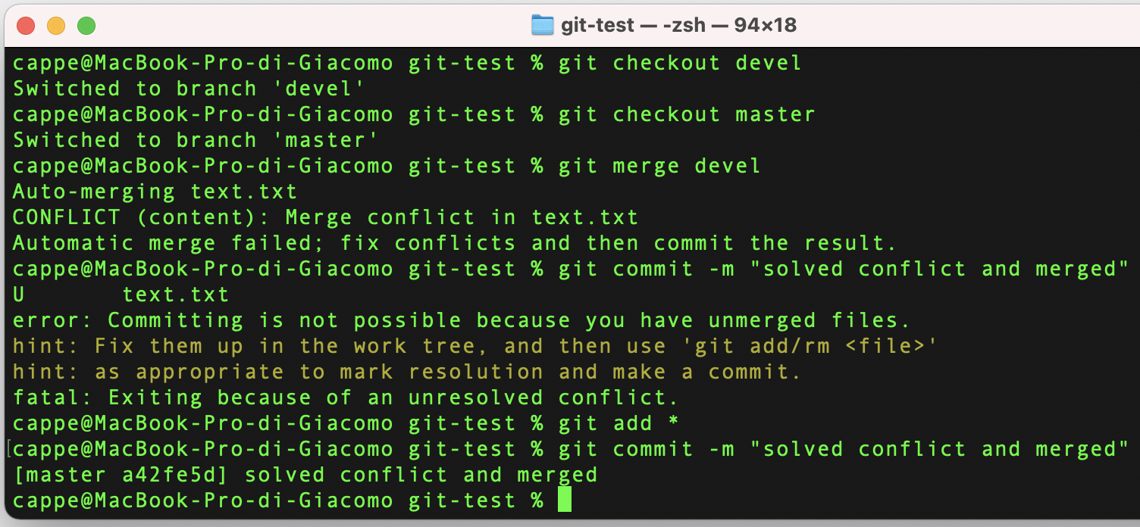
Managing scenario 2
Now that the conflict is solved, let’s commit
ERROR: remember to stage first, then commit!
And there we go.

Slide 35
Steps to reproduce Scenario 2
BONUS
devel
Starting from the master branch do the following
In the terminal
>> git checkout devel
In the text editor
modify text.txt and save
In the terminal
>> git add *
>> git commit –m “[devel] another text.txt update”
>> git checkout master
In the text editor
modify text.txt (the same line as above) and save
In the terminal
>> git add *
>> git commit –m “[master] updated text.txt”
>> git merge devel
In the text editor, solve the conflict
In the terminal
>> git add *
>> git commit –m “solved conflict and merged”
>> git log
master
This moves us to the devel branch
This creates the update
This creates the new commit in the devel branch
This gets us back to the master branch
This creates the conflict
This tries to apply all the new commits in the devel branch to the master branch but it encounters a conflict
This actually applies the changes

Slide 36
Outline
Version Control Systems & GIT
Playing with GIT
The working tree
Remote repositories and best practices
Homework
Resources

Slide 37



Remote repositories
Up to this point, we worked on a local repository. This means that collaborating is still a problem.
How to share code among collaborators? We have to go remote!
Simple procedure:
Step 1: Setup a remote (online) repository hosted by a GIT provider (e.g., GitHub, GitLab, Bitbucket,…)
Step 2: Connect your local repository to the remote repository

Slide 38

Step 1: Setup a remote repository
To setup a remote repository, start by creating an account on one of the many GIT providers available
In this course, I will refer to GitHub.

Slide 39
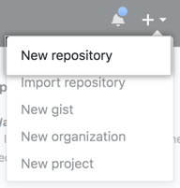
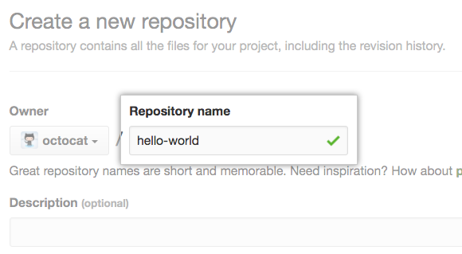
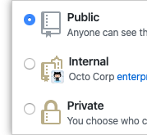

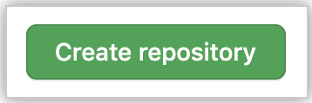
Step 1: Setup a remote repository
Once created, sign in and follow these steps
In the upper-right corner, use the + drop-down menu, and select “New repository”
Type a name for your repository (should be the same as your local one)
Choose a visibility
Uncheck the “README” box
Click “Create repository”
3
4
1
2
5

Slide 40
Step 2: Connect the local repository
Then, to link your local repository to the online follow these steps:
Open a terminal and move inside your working directory
Type >> git branch –M master >> git remote add origin https://github.com/<username>/ <remote-repo-name>.git

Slide 41
Interacting with the remote repository
Now you are ready to work
Interacting with the remote repository in quite easy
To synchronize your local changes to the remote repository (to send online the code) use the “git push” command >> git push origin <branch-name>
To sychronize the remote changes to the local repository (to download the code) use the “git pull” command >> git pull
This will ”upload” the local changes of <branch-name> to a remote branch with the same name
This will ”download” the remote changes of your current active branch

Slide 42
Best practices
Start the commit message with the branch name, for example
git commit –m “[master] a message”
Setup the working tree to something like that:
git pull before starting working on main branches (e.g., devel, master)
at least at the beginning, design one member of the team that will merge things
work on an independent branch (not shared with someone else)
other-feature
feature
devel
master

Slide 43
Many more things…
Of course GIT has many more functionalities…
Anyway, this is just a primer and learning GIT is a matter of practice
If you have any questions, doubt, etc…, do not hesitate to ask. I suggest you to make some practice to get familiar with the basics by creating a dummy repo and start working on it.
If you are curious, you can find useful extra resources in slide 47.

Slide 44
Outline
Version Control Systems & GIT
Playing with GIT
The working tree
Remote repositories and best practices
Homework
Resources

Slide 45
Homework
Next time we will start learning about Dart, the programming language we will use to develop mobile apps in this course. To do that, we need our development environment, i.e., required software and libraries to actually develop something, to be ready.
You need to prepare the development environment of your PC or MAC. To do that, follow the instruction in the file “Setup the development environment” that you can find in the course page.

Slide 46
Outline
Version Control Systems & GIT
Playing with GIT
The working tree
Remote repositories and best practices
Homework
Resources

Slide 47
Resources
Git cheatsheet
git-cheat-sheet-education.pdf in the material/ folder (gently provided by GitHub)
Git official book
https://git-scm.com/book/en/v2
Git Tutorial for Beginners: Learn Git in 1 hour
https://www.youtube.com/watch?v=8JJ101D3knE&ab_channel=ProgrammingwithMosh
Oh Shit Git
https://ohshitgit.com/

